Slide 1

中国
trend
.
杨柳
2019.10

Slide 2
关于衣食住行中的
行

Slide 3
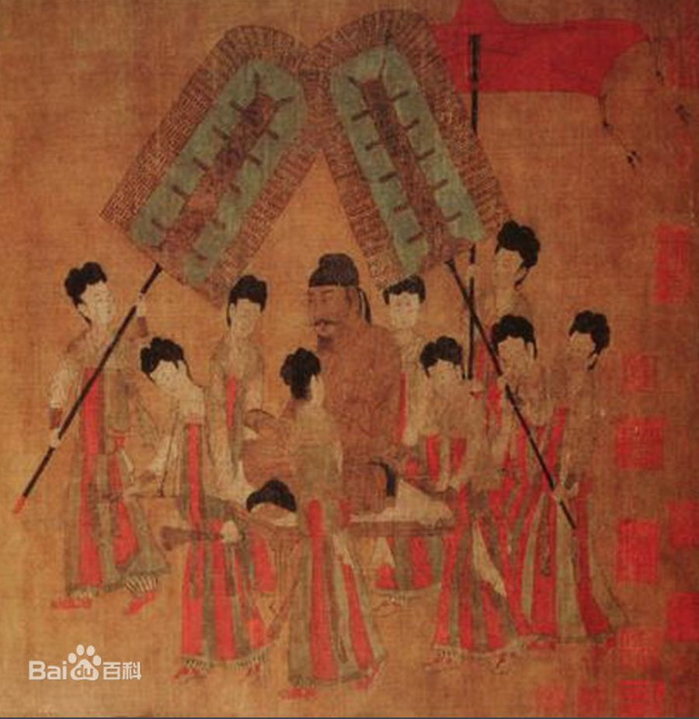
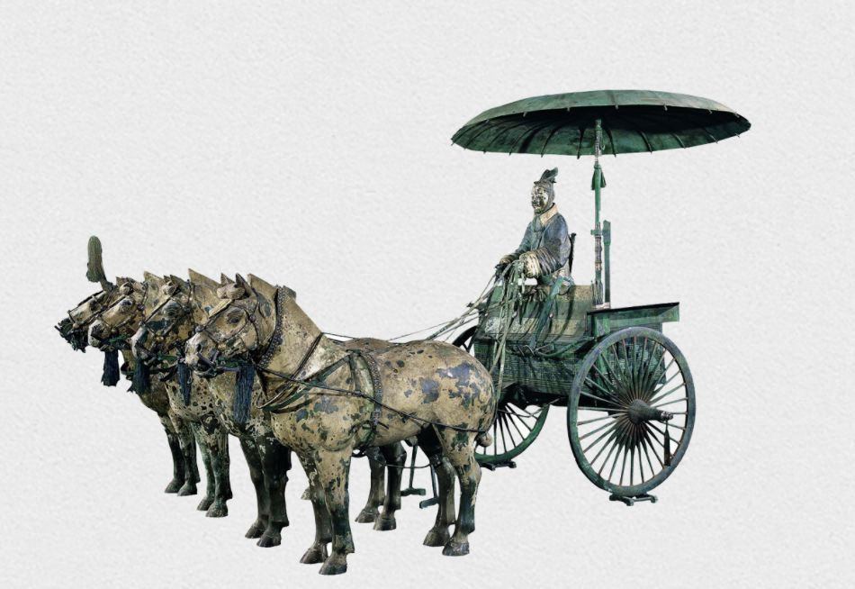
The vehicle on which the emperor rode was often called the chariot.
PART.01
古代
The carriage
马车
The vehicle on which the emperor rode was often called the chariot.
帝王所乘坐的代步工具，通常称为"辇"。

Slide 4
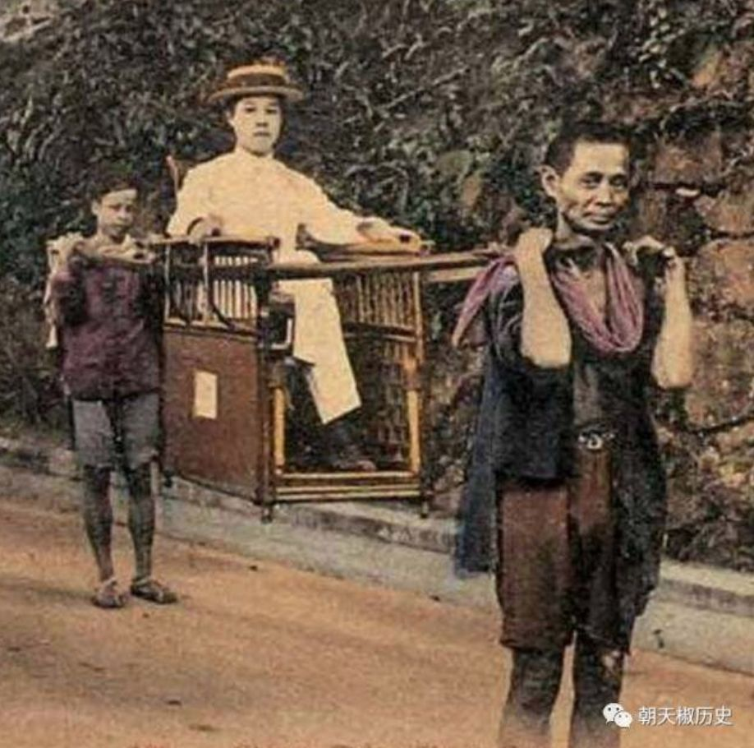
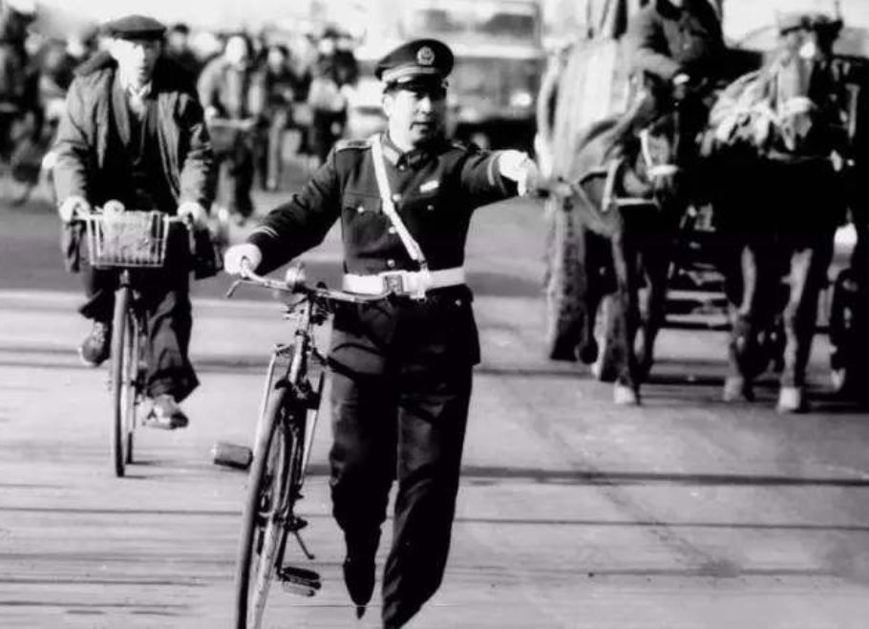
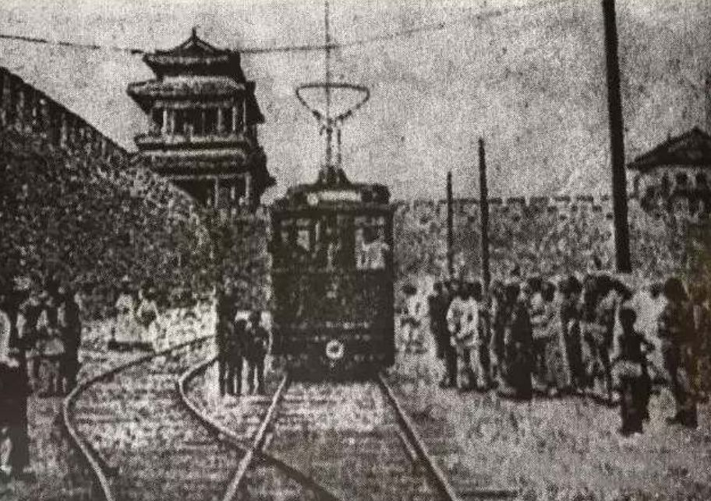
逐渐出现的汽车开始与之争抢市场
The emergence of cars began to compete with it in the market.
逐渐出现的汽车开始与之争抢市场。
Late qing dynasty and early republic of China: rickshaws (rickshaws) and animal rickshaws were relatively common.
清末民初：比较普遍的人力车（黄包车）与畜力车。
China was often called the kingdom of bicycles.
中国当年常被称为自行车王。
近代
PART.02

Slide 5
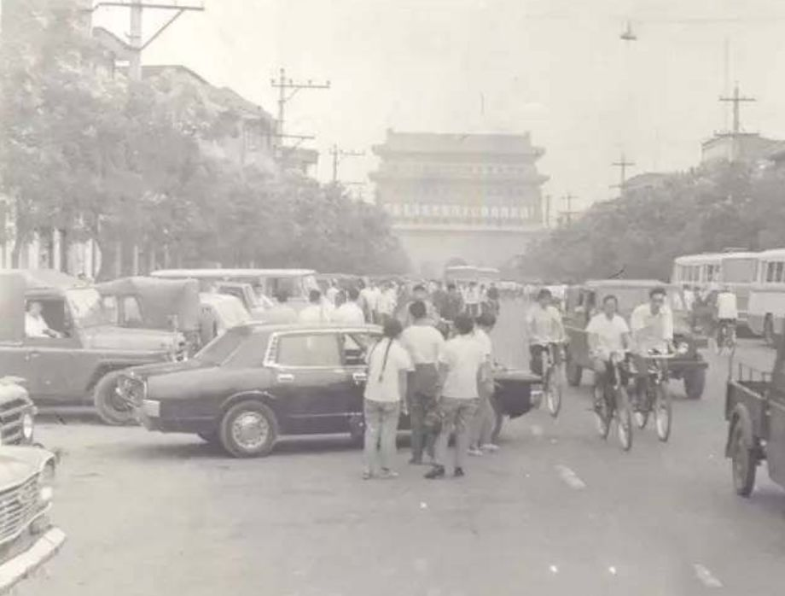
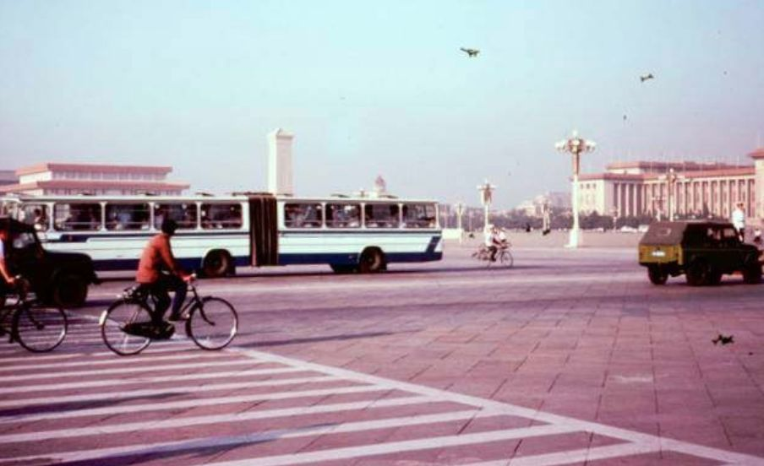
中国当年常被称为自行车王国
现代
More and more tractors, cars, modified cars, minivans and so on.
拖拉机、小轿车、改装车、面包车等越来越多。
PART.03
In the mid and late 1980s, the carrying capacity of buses was mainly to increase the length of vehicles, and articulated cars became popular.
80 年代中后期，公交车的运载能力主要是增加车辆的长度，铰接车成为了一种流行。

Slide 6
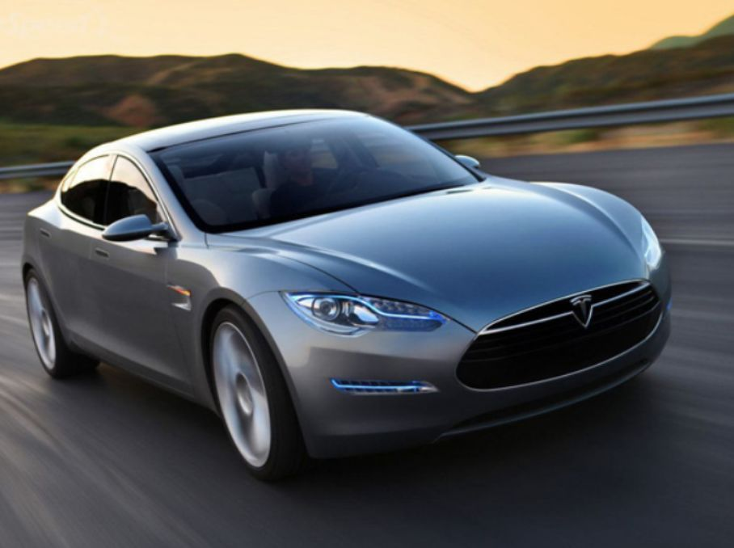
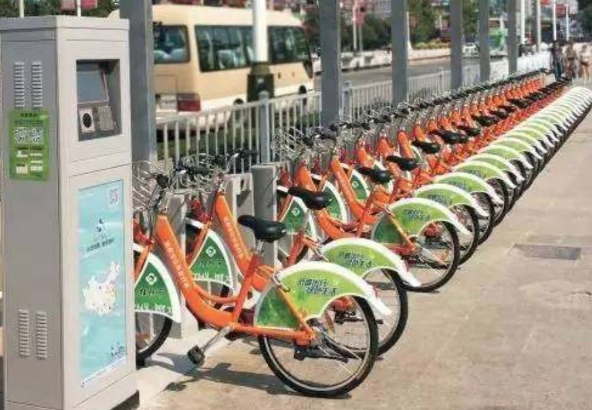
到了如今，越来越多方便快捷的交通方式走进了我们的生活。
共享单车
传统交通工具却不传统的使用方式备受欢迎 。
Sharing a bikeTraditional means of transportation, but not the traditional way of use, are popular.
PART.04
到了如今，越来越多方便快捷的交通方式走进了我们的生活。
Nowadays, more and more convenient ways of transportation come into our life.
now

Slide 7
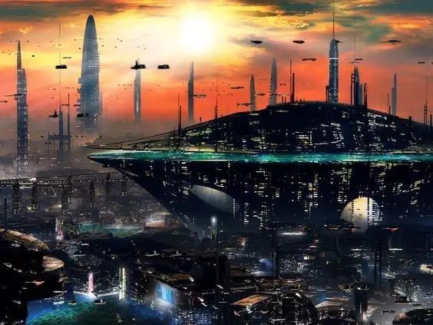
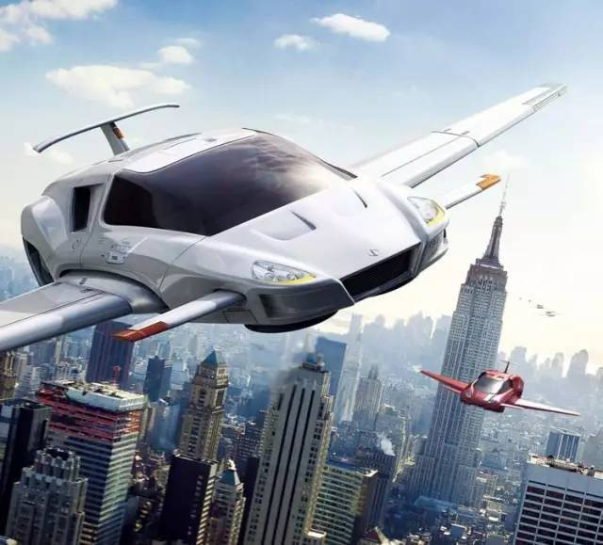
PART
05
From the horse-drawn carriage to the bicycle to the automobile.
To the present high-speed subway maglev.
And what's the future?
Whether it is a skycar or an underground train is anyone's guess.
未来
从之前的马车自行车汽车，
到现在的高铁地铁磁悬浮。
而未来会怎样？
是空中飞车还是地下列车谁也说不准。

Slide 8
感谢观看
.

