Slide 1
Similarity and clustering

Slide 2
Motivation
Problem: Query word could be ambiguous:
  Eg: Query“Star” retrieves documents about astronomy, plants, animals etc.
  Solution: Visualisation
    Clustering document responses to queries along lines of different topics.
Problem 2: Manual construction of topic hierarchies and taxonomies
  Solution:
    Preliminary clustering of large samples of web documents.
Problem 3: Speeding up similarity search
  Solution:
    Restrict the search for documents similar to a query to most representative cluster(s).

Slide 3
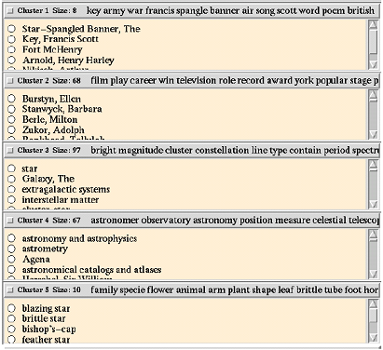
Example
Scatter/Gather, a text clustering system, can separate salient topics in the response to
keyword queries. (Image courtesy of Hearst)

Slide 4
Clustering
Task : Evolve measures of similarity to cluster a collection of documents/terms into groups within which similarity within a cluster is larger than across clusters.
Cluster Hypothesis: Given a `suitable‘ clustering of a collection, if the user is interested in document/term d/t, he is likely to be interested in other members of the cluster to which d/t belongs.
Similarity measures
  Represent documents by TFIDF vectors
  Distance between document vectors
  Cosine of angle between document vectors
Issues
  Large number of noisy dimensions
  Notion of noise is application dependent

Slide 5
Top-down clustering
k-Means: Repeat…
  Choose k arbitrary ‘centroids’
  Assign each document to nearest centroid
  Recompute centroids
Expectation maximization (EM):
  Pick k arbitrary ‘distributions’
  Repeat:
    Find probability that document d is generated from distribution f for all d and f
    Estimate distribution parameters from weighted contribution of documents

Slide 6
Choosing `k’
Mostly problem driven
Could be ‘data driven’ only when either
  Data is not sparse
  Measurement dimensions are not too noisy
Interactive
  Data analyst interprets results of structure discovery

Slide 7
Choosing ‘k’ : Approaches
Hypothesis testing:
  Null Hypothesis (H_{o}): Underlying density is a mixture of ‘k’ distributions
  Require regularity conditions on the mixture likelihood function (Smith’85)
Bayesian Estimation
  Estimate posterior distribution on k, given data and prior on k.
  Difficulty: Computational complexity of integration
  Autoclass algorithm of (Cheeseman’98) uses approximations
  (Diebolt’94) suggests sampling techniques

Slide 8
Choosing ‘k’ : Approaches
Penalised Likelihood
  To account for the fact that L_{k}(D) is a non-decreasing function of k.
  Penalise the number of parameters
  Examples : Bayesian Information Criterion (BIC), Minimum Description Length(MDL), MML.
  Assumption: Penalised criteria are asymptotically optimal (Titterington 1985)
Cross Validation Likelihood
  Find ML estimate on part of training data
  Choose k that maximises average of the M cross-validated average likelihoods on held-out data D^{test}
  Cross Validation techniques: Monte Carlo Cross Validation (MCCV), v-fold cross validation (vCV)

Slide 9
Similarity and clustering

Slide 10
Motivation
Problem: Query word could be ambiguous:
  Eg: Query“Star” retrieves documents about astronomy, plants, animals etc.
  Solution: Visualisation
    Clustering document responses to queries along lines of different topics.
Problem 2: Manual construction of topic hierarchies and taxonomies
  Solution:
    Preliminary clustering of large samples of web documents.
Problem 3: Speeding up similarity search
  Solution:
    Restrict the search for documents similar to a query to most representative cluster(s).

Slide 11
Example
Scatter/Gather, a text clustering system, can separate salient topics in the response to
keyword queries. (Image courtesy of Hearst)

Slide 12
Clustering
Task : Evolve measures of similarity to cluster a collection of documents/terms into groups within which similarity within a cluster is larger than across clusters.
Cluster Hypothesis: Given a `suitable‘ clustering of a collection, if the user is interested in document/term d/t, he is likely to be interested in other members of the cluster to which d/t belongs.
Collaborative filtering: Clustering of two/more objects which have bipartite relationship

Slide 13
Clustering (contd)
Two important paradigms:
  Bottom-up agglomerative clustering
  Top-down partitioning
Visualisation techniques: Embedding of corpus in a low-dimensional space
Characterising the entities:
  Internally : Vector space model, probabilistic models
  Externally: Measure of similarity/dissimilarity between pairs
Learning: Supplement stock algorithms with experience with data

Slide 14

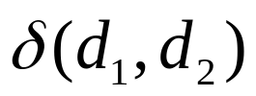
Clustering: Parameters
Similarity measure: (eg: cosine similarity)
Distance measure: (eg: eucledian distance)
Number “k” of clusters
Issues
  Large number of noisy dimensions
  Notion of noise is application dependent

Slide 15
Clustering: Formal specification
Partitioning Approaches
  Bottom-up clustering
  Top-down clustering
Geometric Embedding Approaches
  Self-organization map
  Multidimensional scaling
  Latent semantic indexing
Generative models and probabilistic approaches
  Single topic per document
  Documents correspond to mixtures of multiple topics

Slide 16






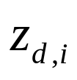


Partitioning Approaches
Partition document collection into k clusters
Choices:
  Minimize intra-cluster distance
  Maximize intra-cluster semblance
If cluster representations are available
  Minimize
  Maximize
Soft clustering
  d assigned to with `confidence’
  Find so as to minimize or maximize
Two ways to get partitions - bottom-up clustering and top-down clustering

Slide 17

Bottom-up clustering(HAC)
Initially G is a collection of singleton groups, each with one document
Repeat
  Find Γ, Δ in G with max similarity measure, s(Γ∪Δ)
  Merge group Γ with group Δ
For each Γ keep track of best Δ
Use above info to plot the hierarchical merging process (DENDOGRAM)
To get desired number of clusters: cut across any level of the dendogram

Slide 18
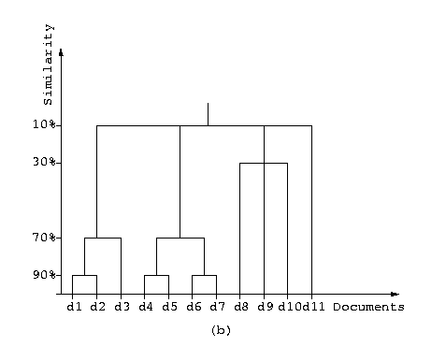
Dendogram
A dendogram presents the progressive, hierarchy-forming merging process pictorially.

Slide 19
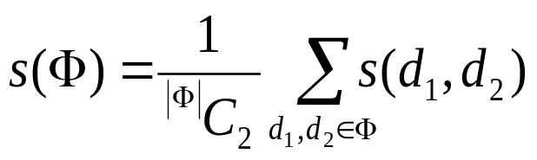

Similarity measure
Typically s(Γ∪Δ) decreases with increasing number of merges
Self-Similarity
  Average pair wise similarity between documents in Γ
  = inter-document similarity measure (say cosine of tfidf vectors)
  Other criteria: Maximium/Minimum pair wise similarity between documents in the clusters

Slide 20
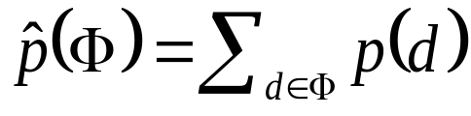
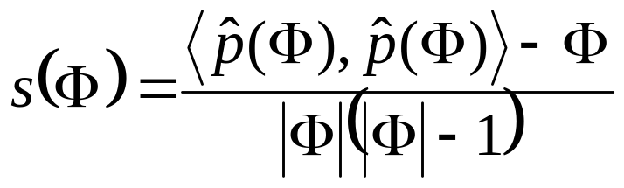
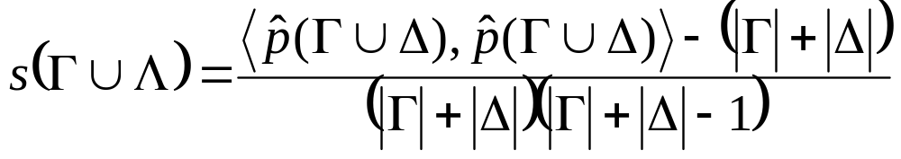
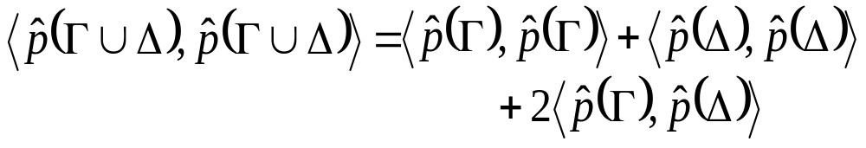
Computation
Un-normalized
group profile:
Can show:
O(n²logn) algorithm with n² space

Slide 21
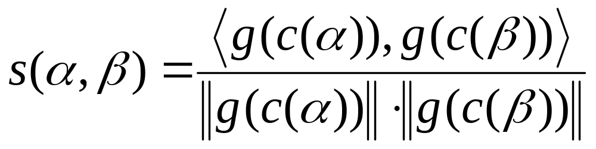
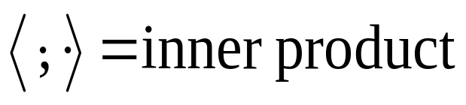
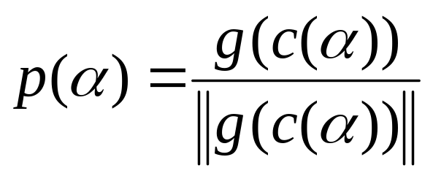
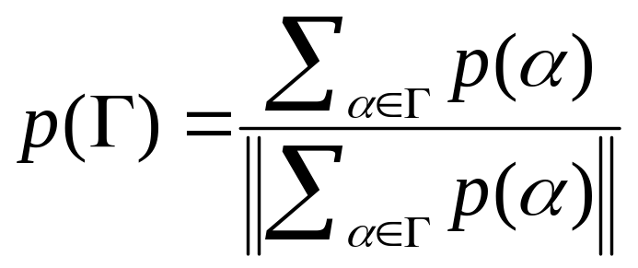
Similarity
Normalized
document profile:
Profile for
document group Γ:

Slide 22
Switch to top-down
Bottom-up
  Requires quadratic time and space
Top-down or move-to-nearest
  Internal representation for documents as well as clusters
  Partition documents into `k’ clusters
  2 variants
    “Hard” (0/1) assignment of documents to clusters
    “soft” : documents belong to clusters, with fractional scores
  Termination
    when assignment of documents to clusters ceases to change much OR
    When cluster centroids move negligibly over successive iterations

Slide 23


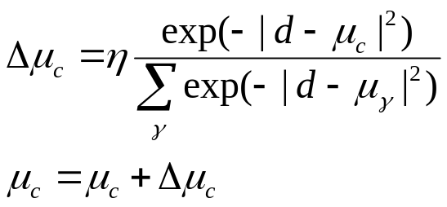
Top-down clustering
Hard k-Means: Repeat…
  Choose k arbitrary ‘centroids’
  Assign each document to nearest centroid
  Recompute centroids
Soft k-Means :
  Don’t break close ties between document assignments to clusters
  Don’t make documents contribute to a single cluster which wins narrowly
    Contribution for updating cluster centroid from document related to the current similarity between and .

Slide 24
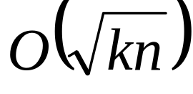
Seeding `k’ clusters
Randomly sample documents
Run bottom-up group average clustering algorithm to reduce to k groups or clusters : O(knlogn) time
Iterate assign-to-nearest O(1) times
  Move each document to nearest cluster
  Recompute cluster centroids
Total time taken is O(kn)
Non-deterministic behavior

Slide 25
Choosing `k’
Mostly problem driven
Could be ‘data driven’ only when either
  Data is not sparse
  Measurement dimensions are not too noisy
Interactive
  Data analyst interprets results of structure discovery

Slide 26
Choosing ‘k’ : Approaches
Hypothesis testing:
  Null Hypothesis (H_{o}): Underlying density is a mixture of ‘k’ distributions
  Require regularity conditions on the mixture likelihood function (Smith’85)
Bayesian Estimation
  Estimate posterior distribution on k, given data and prior on k.
  Difficulty: Computational complexity of integration
  Autoclass algorithm of (Cheeseman’98) uses approximations
  (Diebolt’94) suggests sampling techniques

Slide 27
Choosing ‘k’ : Approaches
Penalised Likelihood
  To account for the fact that L_{k}(D) is a non-decreasing function of k.
  Penalise the number of parameters
  Examples : Bayesian Information Criterion (BIC), Minimum Description Length(MDL), MML.
  Assumption: Penalised criteria are asymptotically optimal (Titterington 1985)
Cross Validation Likelihood
  Find ML estimate on part of training data
  Choose k that maximises average of the M cross-validated average likelihoods on held-out data D^{test}
  Cross Validation techniques: Monte Carlo Cross Validation (MCCV), v-fold cross validation (vCV)

Slide 28
Visualisation techniques
Goal: Embedding of corpus in a low-dimensional space
Hierarchical Agglomerative Clustering (HAC)
  lends itself easily to visualisaton
Self-Organization map (SOM)
  A close cousin of k-means
Multidimensional scaling (MDS)
  minimize the distortion of interpoint distances in the low-dimensional embedding as compared to the dissimilarity given in the input data.
Latent Semantic Indexing (LSI)
  Linear transformations to reduce number of dimensions

Slide 29



Self-Organization Map (SOM)
Like soft k-means
  Determine association between clusters and documents
  Associate a representative vector with each cluster and iteratively refine
Unlike k-means
  Embed the clusters in a low-dimensional space right from the beginning
  Large number of clusters can be initialised even if eventually many are to remain devoid of documents
Each cluster can be a slot in a square/hexagonal grid.
The grid structure defines the neighborhood N(c) for each cluster c
Also involves a proximity function between clusters and

Slide 30


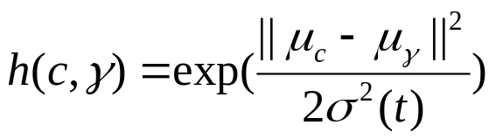




SOM : Update Rule
Like Neural network
  Data item d activates neuron (closest cluster) as well as the neighborhood neurons
  Eg Gaussian neighborhood function
  Update rule for node under the influence of d is:
  Where is the ndb width and is the learning rate parameter

Slide 31
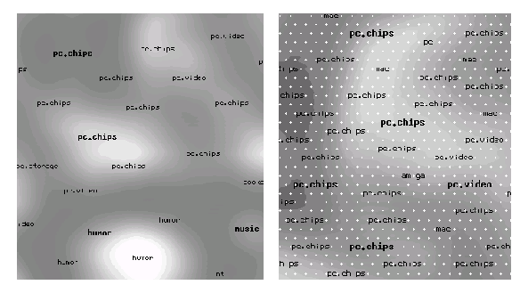
SOM : Example I
SOM computed from over a million documents taken from 80 Usenet newsgroups. Light
areas have a high density of documents.

Slide 32
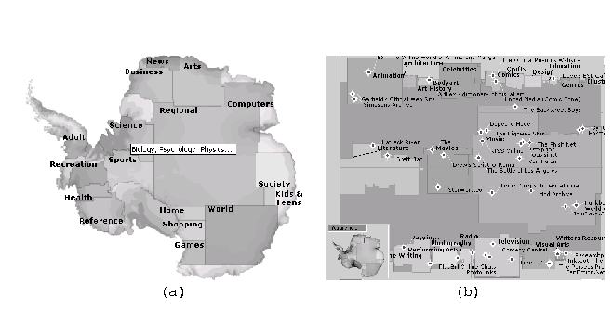
SOM: Example II
Another example of SOM at work: the sites listed in the Open Directory have beenorganized within a map of Antarctica at http://antarcti.ca/.

Slide 33
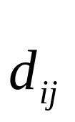

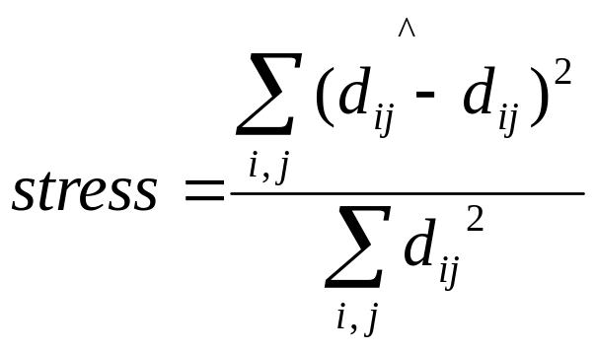
Multidimensional Scaling(MDS)
Goal
  “Distance preserving” low dimensional embedding of documents
Symmetric inter-document distances
  Given apriori or computed from internal representation
Coarse-grained user feedback
  User provides similarity between documents i and j .
  With increasing feedback, prior distances are overridden
Objective : Minimize the stress of embedding

Slide 34
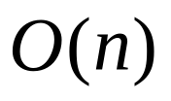
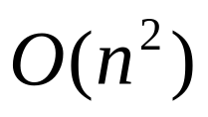
MDS: issues
Stress not easy to optimize
Iterative hill climbing
  Points (documents) assigned random coordinates by external heuristic
  Points moved by small distance in direction of locally decreasing stress
For n documents
  Each takes time to be moved
  Totally time per relaxation

Slide 35
Fast Map [Faloutsos ’95]
No internal representation of documents available
Goal
  find a projection from an ‘n’ dimensional space to a space with a smaller number `k‘’ of dimensions.
Iterative projection of documents along lines of maximum spread
Each 1D projection preserves distance information

Slide 36


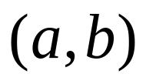
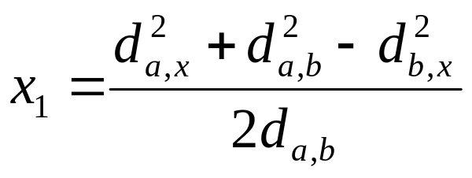
Best line
Pivots for a line: two points (a and b) that determine it
Avoid exhaustive checking by picking pivots that are far apart
First coordinates of point on “best line”

Slide 37
Iterative projection
For i = 1 to k
  Find a next (i^{th} ) “best” line
    A “best” line is one which gives maximum variance of the point-set in the direction of the line
  Project points on the line
  Project points on the “hyperspace” orthogonal to the above line

Slide 38
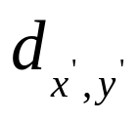
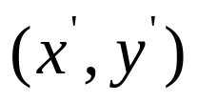
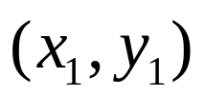
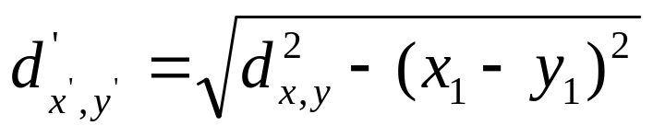
Projection
Purpose
  To correct inter-point distances between points by taking into account the components already accounted for by the first pivot line.
Project recursively upto 1-D space
Time: O(nk) time

Slide 39
Issues
Detecting noise dimensions
  Bottom-up dimension composition too slow
  Definition of noise depends on application
Running time
  Distance computation dominates
  Random projections
  Sublinear time w/o losing small clusters
Integrating semi-structured information
  Hyperlinks, tags embed similarity clues
  A link is worth a ___?___ words

Slide 40
Expectation maximization (EM):
  Pick k arbitrary ‘distributions’
  Repeat:
    Find probability that document d is generated from distribution f for all d and f
    Estimate distribution parameters from weighted contribution of documents

Slide 41
Extended similarity
Where can I fix my scooter?
A great garage to repair your 2-wheeler is at …
auto and car co-occur often
Documents having related words are related
Useful for search and clustering
Two basic approaches
  Hand-made thesaurus (WordNet)
  Co-occurrence and associations
… auto …car
… car … auto
… auto …car
… car … auto
… auto …car
… car … auto
car ≅ auto
… auto …
≅
… car …

Slide 42
Latent semantic indexing
Term
Document
k
d
Documents
A
U
D
V
car
Terms
SVD
t
auto
d
r
k-dim vector

Slide 43


Collaborative recommendation
People=record, movies=features
People and features to be clustered
  Mutual reinforcement of similarity
Need advanced models
From Clustering methods in collaborative filtering, by Ungar and Foster

Slide 44
A model for collaboration
People and movies belong to unknown classes
P_{k} = probability a random person is in class k
P_{l} = probability a random movie is in class l
P_{kl} = probability of a class-k person liking a class-l movie
Gibbs sampling: iterate
  Pick a person or movie at random and assign to a class with probability proportional to P_{k} or P_{l}
  Estimate new parameters

Slide 45
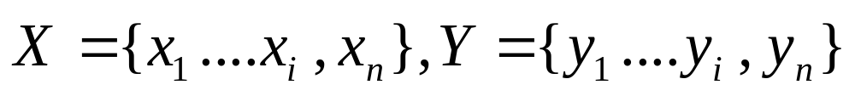
Aspect Model
Metric data vs Dyadic data vs Proximity data vs Ranked preference data.
Dyadic data : domain with two finite sets of objects
Observations : Of dyads X and Y
Unsupervised learning from dyadic data
Two sets of objects

Slide 46

Aspect Model (contd)
Two main tasks
  Probabilistic modeling:
    learning a joint or conditional probability model over
  structure discovery:
    identifying clusters and data hierarchies.

Slide 47
Aspect Model
Statistical models
  Empirical co-occurrence frequencies
    Sufficient statistics
  Data spareseness:
    Empirical frequencies either 0 or significantly corrupted by sampling noise
  Solution
    Smoothing
      Back-of method [Katz’87]
      Model interpolation with held-out data [JM’80, Jel’85]
      Similarity-based smoothing techniques [ES’92]
    Model-based statistical approach: a principled approach to deal with data sparseness

Slide 48
Aspect Model
Model-based statistical approach: a principled approach to deal with data sparseness
  Finite Mixture Models [TSM’85]
  Latent class [And’97]
  Specification of a joint probability distribution for latent and observable variables [Hoffmann’98]
Unifies
  statistical modeling
    Probabilistic modeling by marginalization
  structure detection (exploratory data analysis)
    Posterior probabilities by baye’s rule on latent space of structures

Slide 49




Aspect Model
Realisation of an underlying sequence of random variables
2 assumptions
  All co-occurrences in sample S are iid
  are independent given
P(c) are the mixture components

Slide 50
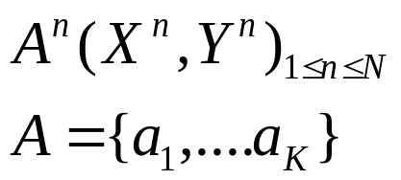
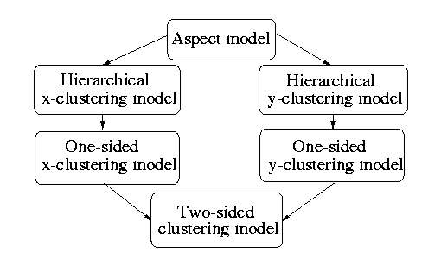
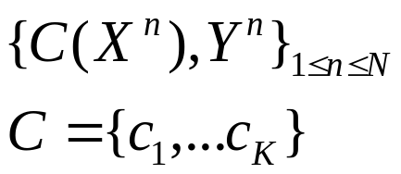
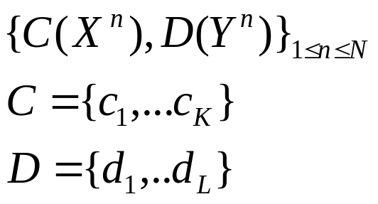
Aspect Model: Latent classes
Increasing
Degree of
Restriction
On Latent
space

Slide 51
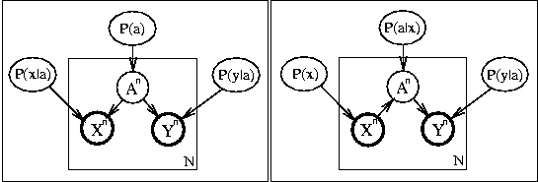
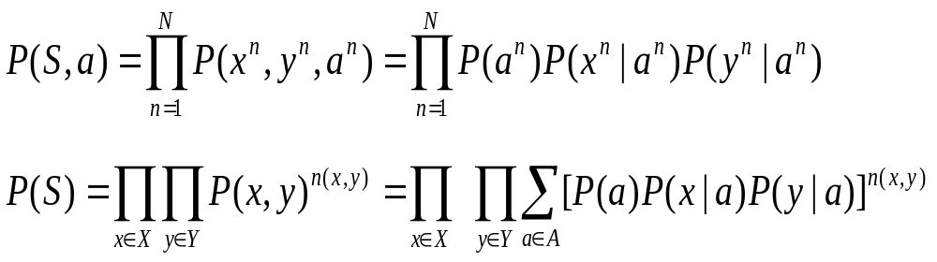
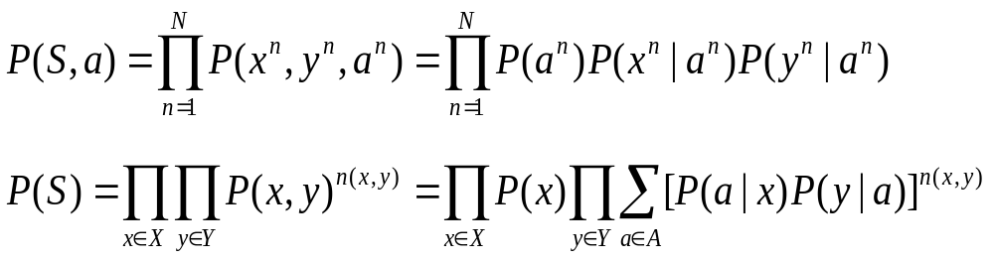
Aspect Model
Symmetric
Asymmetric

Slide 52
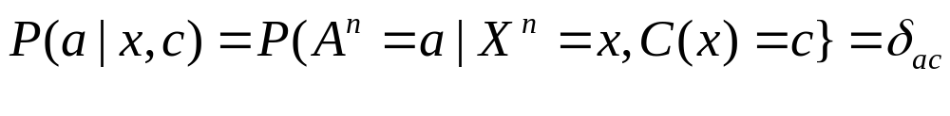
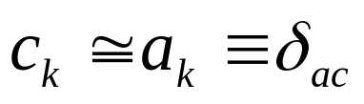
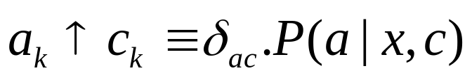
Clustering vs Aspect
Clustering model
  constrained aspect model
    For flat:
    For hierarchical
  Group structure on object spaces as against partition the observations
  Notation
    P(.) : are the parameters
    P{.}: are posteriors

Slide 53
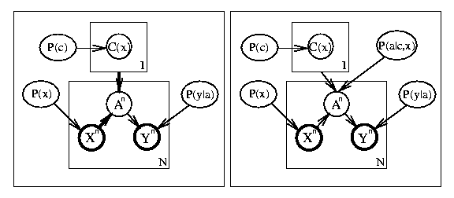
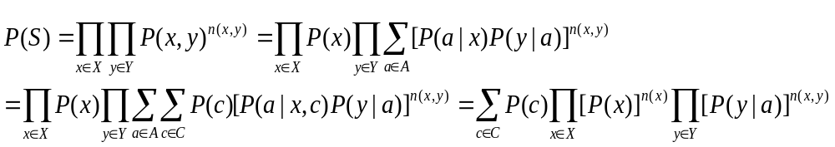
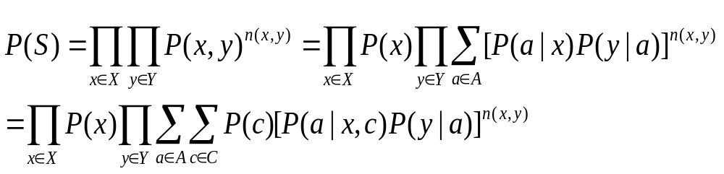
Hierarchical Clustering model
One-sided clustering
Hierarchical clustering

Slide 54
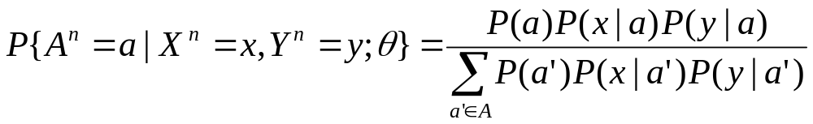
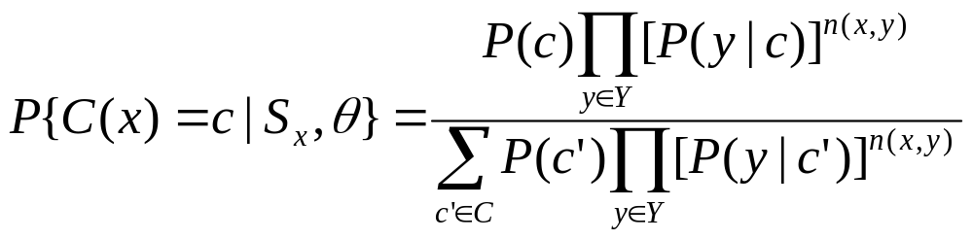
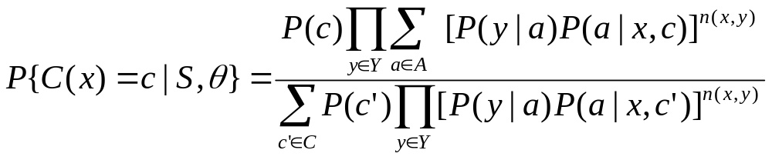
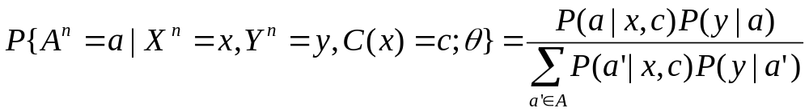
Comparison of E’s
Aspect model
One-sided aspect model
Hierarchical aspect model

Slide 55



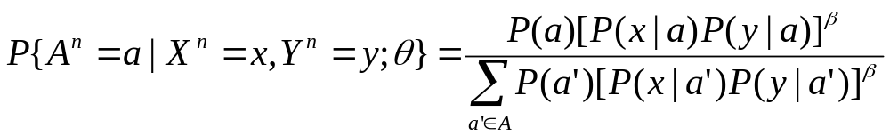
Tempered EM(TEM)
Additively (on the log scale) discount the likelihood part in Baye’s formula:
  Set and perform EM until the performance on held--out data deteriorates (early stopping).
  Decrease e.g., by setting with some rate parameter .
  As long as the performance on held-out data improves continue TEM iterations at this value of
  Stop on i.e., stop when decreasing does not yield further improvements, otherwise goto step (2)
  Perform some final iterations using both, training and heldout data.

Slide 56
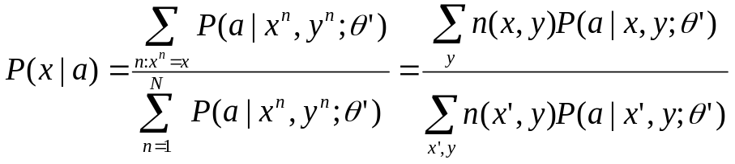
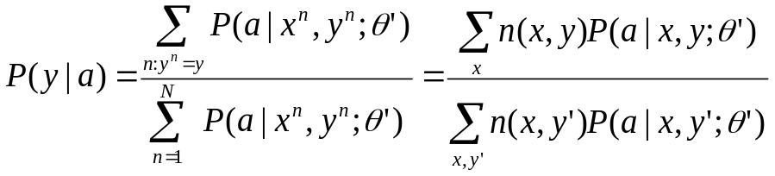
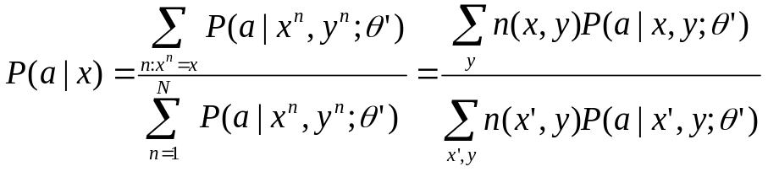



M-Steps
Aspect
Assymetric
Hierarchical x-clustering
One-sided x-clustering

Slide 57

Example Model [Hofmann and Popat CIKM 2001]
Hierarchy of document categories

Slide 58

Example Application

Slide 59


Topic Hierarchies
To overcome sparseness problem in topic hierarchies with large number of classes
Sparseness Problem: Small number of positive examples
Topic hierarchies to reduce variance in parameter estimation
  Automatically differentiate
  Make use of term distributions estimated for more general, coarser text aspects to provide better, smoothed estimates of class conditional term distributions
  Convex combination of term distributions in a Hierarchical Mixture Model
  refers to all inner nodes a above the terminal class node c.

Slide 60




Topic Hierarchies
(Hierarchical X-clustering)
X = document, Y = word

Slide 61

Document Classification Exercise
Modification of Naïve Bayes

Slide 62
Mixture vs Shrinkage
Shrinkage [McCallum Rosenfeld AAAI’98]: Interior nodes in the hierarchy represent coarser views of the data which are obtained by simple pooling scheme of term counts
Mixture : Interior nodes represent abstraction levels with their corresponding specific vocabulary
  Predefined hierarchy [Hofmann and Popat CIKM 2001]
  Creation of hierarchical model from unlabeled data [Hofmann IJCAI’99]

Slide 63
Mixture Density Networks(MDN)
[Bishop CM ’94 Mixture Density Networks]
broad and flexible class of distributions that are capable of modeling completely general continuous distributions
superimpose simple component densities with well known properties to generate or approximate more complex distributions
Two modules:
  Mixture models: Output has a distribution given as mixture of distributions
  Neural Network: Outputs determine parameters of the mixture model
.

Slide 64

MDN: Example
A conditional mixture density network with Gaussian component densities

Slide 65
MDN
Parameter Estimation :
  Using Generalized EM (GEM) algo to speed up.
Inference
  Even for a linear mixture, closed form solution not possible
  Use of Monte Carlo Simulations as a substitute

Slide 66



Document model
Vocabulary V, term w_{i}, document α represented by
is the number of times w_{i} occurs in document α
Most f’s are zeroes for a single document
Monotone component-wise damping function g such as log or square-root

