Slide 2
Traditional IR systems
Traditonal IR systems
  Worth of a document w.r.t. a query is intrinsic to the document.
  Documents
    Self-contained units
    Generally descriptive and truthful

Slide 3
Web : A shifting universe
Web
  indefinitely growing
  Non-textual content
  Invisible keywords
  Documents are not self-complete
  Most web queries 2 words long.
Most important distinguishing feature
  Hyperlinks
Mining the Web
Chakrabarti and Ramakrishnan

Slide 4
Social Network analysis
Web as a hyperlink graph
  evolves organically,
  No central coordination,
  Yet shows global and local properties
social network analysis
  well established long before the Web
  Popularity estimation for queries
  Measurements on Web and the reach of search engines
E.g.: Vannevar Bush's hypermedium: Memex
Web : An example of social network
Mining the Web
Chakrabarti and Ramakrishnan

Slide 5
Social Network
Properties related to connectivity and distances in graphs
Applications
  Epidemiology, espionage:
    Identifying a few nodes to be removed to significantly increase average path length between pairs of nodes.
  Citation analysis
    Identifying influential or central papers.
Mining the Web
Chakrabarti and Ramakrishnan

Slide 6
Hyperlink graph analysis
Hypermedia is a social network
  Telephoned, advised, co-authored, paid
Social network theory (cf. Wasserman & Faust)
  Extensive research applying graph notions
  Centrality and prestige
  Co-citation (relevance judgment)
Applications
  Web search: HITS, Google, CLEVER
  Classification and topic distillation
Mining the Web
Chakrabarti and Ramakrishnan

Slide 7
Exploiting link structure
Ranking search results
  Keyword queries not selective enough
  Use graph notions of popularity/prestige
  PageRank and HITS
Supervised and unsupervised learning
  Hyperlinks and content are strongly correlated
  Learn to approximate joint distribution
  Learn discriminants given labels
Mining the Web
Chakrabarti and Ramakrishnan

Slide 8
Popularity or prestige
Seeley, 1949
Brin and Page, 1997
Kleinberg, 1997
Mining the Web
Chakrabarti and Ramakrishnan

Slide 9
Prestige
Model
  Edge-weighted, directed graphs
Status/Prestige
  In-degree is a good first-order indicator
E.g.: Seeley’s idea of prestige for an actor
Mining the Web
Chakrabarti and Ramakrishnan

Slide 10
Notation
Document citation graph,
  Node adjacency matrix E
  E[i,j] = 1 iff document i cites document j, and zero otherwise.
  Prestige p[v] associated with every node v
Prestige vector over all nodes : p
Mining the Web
Chakrabarti and Ramakrishnan

Slide 11
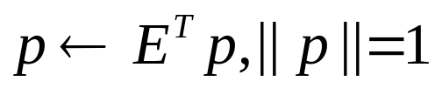
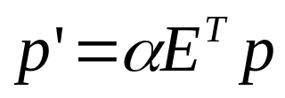
Fixpoint prestige vector
confer to all nodes v the sum total of prestige of all u which links to v
  Gives a new prestige score v’
Fixpoint for prestige vector
  iterative assignment
  Fixpoint = principal eigenvector of E^T
  Variants: attenuation factor
Mining the Web
Chakrabarti and Ramakrishnan

Slide 12
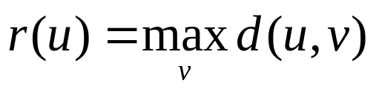
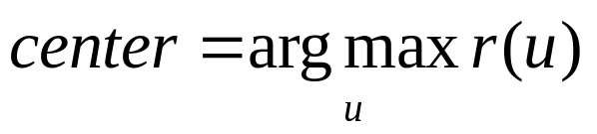
Centrality
Graph-based notions of centrality
  Distance d(u,v) : number of links between u and v0
  Radius of node u is
  Center of the graph is
Example:
  Influential papers in an area of research by looking for papers u with small r(u)
No single measure is suited for all applications
Mining the Web
Chakrabarti and Ramakrishnan

Slide 13
Co-citation
v and w are said to be co-cited by u.
  If document u cites documents v and w
E[i,j]: document citation matrix
  => E^{T}E: co-citation index matrix
  Indicator of relatedness between v and w.
Clustering
  Using above pair-wise relatedness measure in a clustering algorithm
Mining the Web
Chakrabarti and Ramakrishnan

Slide 14
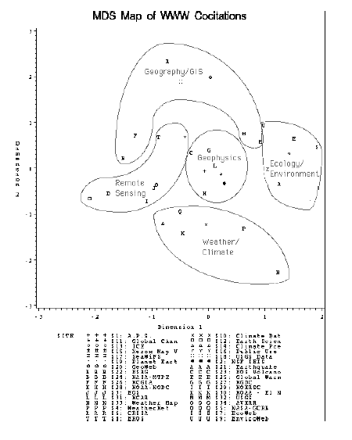
MDS Map of WWW Co-citations
Social structure of Web communities concerning Geophysics, climate, remote sensing, and ecology. The cluster labels are generated manually. [Courtesy Larson]
Mining the Web
Chakrabarti and Ramakrishnan

Slide 15
Transitions in modeling web content
(Approximations to what HTML-based hypermedia really is)
HITS and Google
B&H
Rank-and-file
Clever
Ranking of micro-pages
Mining the Web
Chakrabarti and Ramakrishnan

Slide 16
Flow of Models: HITS & Google
Each page is a node without any textual properties.
Each hyperlink is an edge connecting two nodes with possibly only a positive edge weight property.
Some preprocessing procedure outside the scope of HITS chooses what sub-graph of the Web to analyze in response to a query.
Mining the Web
Chakrabarti and Ramakrishnan

Slide 17
Flow of Models: B&H
The graph model is as in HITS, except that nodes have additional properties.
Each node is associated with a vector space representation of the text on the corresponding page.
After the initial sub-graph selection, the B&H algorithm eliminates nodes whose corresponding vectors are far from the typical vector computed from the root set.
Mining the Web
Chakrabarti and Ramakrishnan

Slide 18
Flow of Models: Rank-and-File
Replaced the hubs-and-authorities model by a simpler one
Each document is a linear sequence of tokens.
  Most are terms, some are outgoing hyperlinks.
Query terms activate nearby hyperlinks.
No iterations are involved.
Mining the Web
Chakrabarti and Ramakrishnan

Slide 19
Flow of Models: Clever
Page is modeled at two levels.
  The coarse-grained model is the same as in HITS.
  At a finer grain, a page is a linear sequence of tokens as in Rank-and-File.
Proximity between a query term on page u and an outbound link to page v is represented by increasing the weight of the edge (u,v) in the coarse-grained graph.
Mining the Web
Chakrabarti and Ramakrishnan

Slide 20
Link-based Ranking Strategies
Leverage the
  “Abundance problems” inherent in broad queries
Google’s PageRanking [Brin and Page WWW7]
  Measure of prestige with every page on web
HITS: Hyperlink Induced Topic Search [Jon Klienberg ’98]
  Use query to select a sub-graph from the Web.
  Identify “hubs” and “authorities” in the sub-graph
Mining the Web
Chakrabarti and Ramakrishnan

Slide 21
Google(PageRank): Overview
Pre-computes a rank-vector
  Provides a-priori (offline) importance estimates for all pages on Web
  Independent of search query
In-degree ≈ prestige
Not all votes are worth the same
Prestige of a page is the sum of prestige of citing pages:
p = Ep
Pre-compute query independent prestige score
Query time: prestige scores used in conjunction with query-specific IR scores
Mining the Web
Chakrabarti and Ramakrishnan

Slide 22
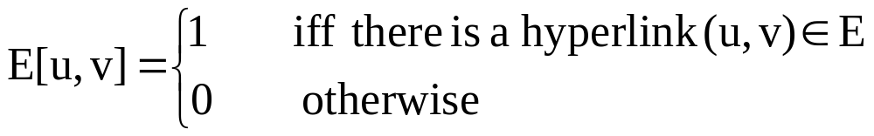
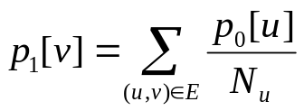
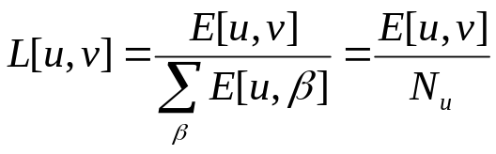
Google(PageRank)
Assumption
  the prestige of a page is proportional to the sum of the prestige scores of pages linking to it
Random surfer on strongly connected web graph
E is adjacency matrix of the Web
  No parallel edges
matrix L derived from E by normalizing all row-sums to one:
  .
Mining the Web
Chakrabarti and Ramakrishnan

Slide 23

The PageRank
After i^{th} step:
Convergence to
  stationary distribution of L.
    p -> principal eigenvector of L^{T}
    Called the PageRank
Convergence criteria
  L is irreducible
    there is a directed path from every node to every other node
  L is aperiodic
    for all u & v, there are paths with all possible number of links on them, except for a finite set of path lengths
Mining the Web
Chakrabarti and Ramakrishnan

Slide 24
The surfing model
Correspondence between “surfer model” and the notion of prestige
  Page v has high prestige if the visit rate is high
  This happens if there are many neighbors u with high visit rates leading to v
Deficiency
  Web graph is not strongly connected
    Only a fourth of the graph is !
  Web graph is not aperiodic
  Rank-sinks
    Pages without out-links
    Directed cyclic paths
Mining the Web
Chakrabarti and Ramakrishnan

Slide 25
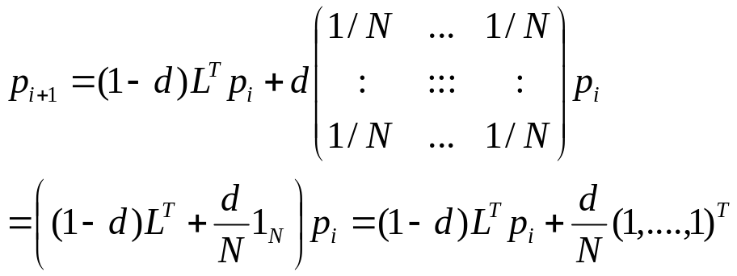
Surfing model: simple fix
Two way choice at each node
  With probability d (0.1 < d < 0.2), the surfer jumps to a random page on the Web.
  With probability 1–d the surfer decides to choose, uniformly at random, an out-neighbor
MODIFIED EQUATION 7.9
Direct solution of eigen-system not feasible.
Solution : Power iterations
Mining the Web
Chakrabarti and Ramakrishnan

Slide 26
PageRank architecture at Google
Ranking of pages more important than exact values of p_{i}
Convergence of page ranks in 52 iterations for a crawl with 322 million links.
Pre-compute and store the PageRank of each page.
  PageRank independent of any query or textual content.
Ranking scheme combines PageRank with textual match
  Unpublished
  Many empirical parameters, human effort and regression testing.
  Criticism : Ad-hoc coupling and decoupling between relevance and prestige
Mining the Web
Chakrabarti and Ramakrishnan

Slide 27
HITS: Ranking by popularity
Relies on query-time processing
  To select base set Vq of links for query q constructed by
    selecting a sub-graph R from the Web (root set) relevant to the query
    selecting any node u which neighbors any r \in R via an inbound or outbound edge (expanded set)
  To deduce hubs and authorities that exist in a sub-graph of the Web
Every page u has two distinct measures of merit, its hub score h[u] and its authority score a[u].
Recursive quantitative definitions of hub and authority scores
Mining the Web
Chakrabarti and Ramakrishnan

Slide 28
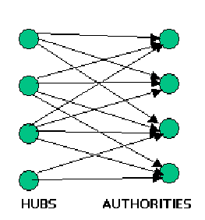
HITS: Ranking by popularity (contd.)
High prestige ⇔ good authority
High reflected prestige ⇔ good hub
Bipartite power iterations
  a = Eh
  h = E^{T}a
  h = E^{T}Eh
Mining the Web
Chakrabarti and Ramakrishnan

Slide 29
HITS: Topic Distillation Process
Send query to a text-based IR system and obtain the root-set.
Expand the root-set by radius one to obtain an expanded graph.
Run power iterations on the hub and authority scores together.
Report top-ranking authorities and hubs.
Mining the Web
Chakrabarti and Ramakrishnan

Slide 30
Higher order eigenvectors and clustering
Ambiguous or polarized queries
  expanded set will contain few almost disconnected, link communities.
  Dense bipartite sub-graphs in each community
  Highest order eigenvectors
    Reveal hubs and authorities in the largest component.
Solution
  Find the principal eigenvectors of EE^{T}
  In each step of eigenvector power iteration, orthogonalize w.r.t larger eigenvectors
Higher-order eigenvectors reveal clusters in the query graph structure.
  Bring out community clustering graphically for queries matching multiple link communities.
Mining the Web
Chakrabarti and Ramakrishnan

Slide 31

while X does not converge do
for i = 1,2….. do
for j = 1,2…… i-1 do
end for
normalize X(i) to unit L₂ norm
end for
end while
Mining the Web
Chakrabarti and Ramakrishnan

Slide 32
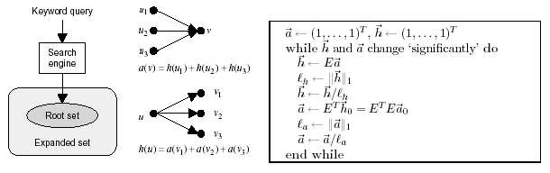
The HITS algorithm. “h” and “a”are L₁ vector norms
Mining the Web
Chakrabarti and Ramakrishnan

Slide 33
Relation between HITS, PageRank and LSI
HITS algorithm = running SVD on the hyperlink relation (source,target)
LSI algorithm = running SVD on the relation (term,document).
PageRank on root set R gives same ranking as the ranking of hubs as given by HITS
Mining the Web
Chakrabarti and Ramakrishnan

Slide 34
HITS : Applications
Clever model [http://www.almaden.ibm.com/cs/k53/clever.html]
Fine-grained ranking [Soumen WWW10]
Query Sensitive retrieving [Krishna Bharat SIGIR’98]
Mining the Web
Chakrabarti and Ramakrishnan

Slide 35
PageRank vs HITS
PageRank advantage over HITS
  Query-time cost is low
    HITS: computes an eigenvector for every query
  Less susceptible to localized link-spam
HITS advantage over PageRank
  HITS ranking is sensitive to query
  HITS has notion of hubs and authorities
Topic-sensitive PageRanking [Haveliwala WWW11]
  Attempt to make PageRanking query sensitive
Mining the Web
Chakrabarti and Ramakrishnan

Slide 36
Stochastic HITS
HITS
  Sensitive to local topology
    E.g.: Edge splitting
  Needs bipartite cores in the score reinforcement process.
    smaller component finds absolutely no representation in the principal eigenvector
Mining the Web
Chakrabarti and Ramakrishnan

Slide 37
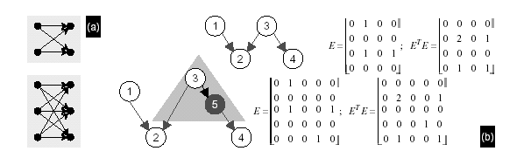
The principal eigenvector found by HITS favors larger bipartite cores.
Minor perturbations in the graph may have dramatic effects on HITS scores.
Mining the Web
Chakrabarti and Ramakrishnan

Slide 38
Stochastic HITS (SALSA)
PageRank
  Random jump ensures some positive scores for all nodes.
Proposal: SALSA (stochastic algorithm for link structure analysis)
Cast bipartite reinforcement in the random surfer framework.
Introduce authority-to-authority and hub-to-hub transitions through a random surfer specification
  At a node v, the random surfer chooses an in-link (i.e., an incoming edge (u,v)) uniformly at random and moves to u
  From u, the surfer takes a random forward link (u,w) uniformly at random.
Outcome
  SALSA authority score
    Proportional to in-degree.
    Reflects no long-range diffusion
Mining the Web
Chakrabarti and Ramakrishnan

Slide 39
HITS: Stability
HITS
  Long-range reinforcement
  Bad for stability
    Random erasure of a small fraction of nodes/edges can seriously alter the ranks of hubs and authorities.
PageRank
  More stable to such perturbations,
    Reason : random jumps
HITS as a bi-directional random walk
Mining the Web
Chakrabarti and Ramakrishnan

Slide 40
HITS as a bi-directional random walk
At time step t at node v,
  with probability d, the surfer jumps to a node in the base set uniformly at random
  with the remaining probability 1–d
    If t is odd, surfer takes a random out-link from v
    It t is even surfer goes backwards on a random in-link leading to v
HITS with random jump
  Shown by [Ng et al] to
    Have better stability in the face of small changes in the hyperlink graph
    Improve stability as d is increased.
Pending…
  Setting d based on the graph structure alone.
  Reconciling page content into graph models
Mining the Web
Chakrabarti and Ramakrishnan

Slide 41
Shortcomings of the coarse-grained graph model
No notice of
  The text on each page
  The markup structure on each page.
Human readers
  Unlike HITS or PageRank, do not pay equal attention to all the links on a page.
  Use the position of text and links to carefully judge where to click
  Do hardly random surfing.
Fall prey to
  Many artifacts of Web authorship
Mining the Web
Chakrabarti and Ramakrishnan

Slide 42
Artifacts of Web authorship
Central assumption in link-based ranking
  A hyperlink confers authority.
  Holds only if the hyperlink was created as a result of editorial judgment
  Largely the case with social networks in academic publications.
  Assumption is being increasingly violated !!!
Reasons
  Pages generated by programs/templates/relational and semi-structured databases
  Company sites with mission to increase the number of search engine hits for customers.
    Stung irrelevant words in pages
    Linking up their customers in densely connected irrelevant cliques
Mining the Web
Chakrabarti and Ramakrishnan

Slide 43
Three manifestations of authoring idioms
Nepotistic links
  Same-site links
  Two-site nepotism
    A pair of Web sites artificially endorsing each other’s authority scores
Two-site nepotism: Cases
  E.g.: In a site hosted on multiple servers
  Use of the relative URLs w.r.t. a base URL (sans mirroring)
Multi-host nepotism
  Clique attacks
Mining the Web
Chakrabarti and Ramakrishnan

Slide 44
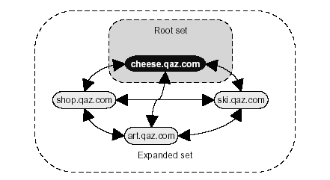
Clique attacks
Links to other sites with no semantic connection
  Sites all hosted by a common business.
Mining the Web
Chakrabarti and Ramakrishnan

Slide 45
Clique attacks
Clique Attacks
  Sites forming a densely/completely connected graph,
  URLs sharing sub-strings but mapping to different IP addresses.
HITS and PageRank can fall prey to clique attacks
  Tuning d in PageRank to reduce the effect
Mining the Web
Chakrabarti and Ramakrishnan

Slide 46
Mixed hubs
Result of decoupling the user's query from the link-based ranking strategy
Hard to distinguish from a clique attack
More frequent than clique attacks.
Problem for both HITS and PageRank,
  Neither algorithm discriminates between outlinks on a page.
  PageRank may succeed by query-time filtering of keywords
Example
  Links about Shakespeare embedded in a page about British and Irish literary figures in general
Mining the Web
Chakrabarti and Ramakrishnan

Slide 47
Topic contamination and drift
Need for expansion step in HITS
  Recall-enhancement
  E.g.: Netscape's Navigator and Communicator pages, which avoid a boring description like `browser' for their products.
Radius-one expansion step of HITS would include nodes of two types
  Inadequately represented authorities
  Unnecessary millions of hubs
Mining the Web
Chakrabarti and Ramakrishnan

Slide 48
Topic Contamination
Topic Generalization
  Boost in recall at the price of precision.
  Locality used by HITS to construct root set, works in a very short radius (max 1)
  Even at radius one, severe contamination of root if pages relevant to query are linked to a broader, densely linked topic
    Eg: Query “Movie Awards”
    Result: hub and authority vectors have large components about movies rather than movie awards.
Mining the Web
Chakrabarti and Ramakrishnan

Slide 49
Topic Drift
Popular sites raise to the top
  In PageRank (my still find workaround by relative weights)
    OR
  once they enter the expanded graph of HITS
  Example:
    pages on many topics are within a couple of links of [popular sites like Netscape and Internet Explorer
    Result: the popular sites get higher rank than the required sites
Ad-hoc fix:
  list known `stop-sites'
  Problem: notion of a `stop-site' is often context-dependent.
  Example :
    for the query “java”, http://www.java.sun.com/ is a highly desirable site.
    For a narrower query like “swing” it is too general.
Mining the Web
Chakrabarti and Ramakrishnan

Slide 50
Enhanced models and techniques
Using text and markup conjointly with hyperlink information
Modeling HTML pages at a ner level of detail,
Enhanced prestige ranking algorithms.
Mining the Web
Chakrabarti and Ramakrishnan

Slide 51
Avoiding two-party nepotism
A site, not a page, should be the unit of voting power [Bharat and Henzinger]
  If k pages on a single host link to a target page, these edges are assigned a weight of 1/k.
  E changes from a zero-one matrix to one with zeroes and positive real numbers.
  All eigenvectors are guaranteed to be real
  Volunteers judged the output to be superior to unweighted HITS. [Bharat and Henzinger]
Another unexplored approach
  model pages as getting endorsed by sites, not single pages
  compute prestige for sites as well
Mining the Web
Chakrabarti and Ramakrishnan

Slide 52

Outlier elimination
Observations
  Keyword search engine responses are largely relevant to the query
  The expanded graph gets contaminated by indiscriminate expansion of links
Content-based control of root set expansion
  Compute the term vectors of the documents in the root-set (using TFIDF)
  Compute the centroid of these vectors.
  During link-expansion, discard any page v that is too dissimilar to
How far to expand ?
  Centroid will gradually drift,
  In HITS, expansion to a radius more than one could be disastrous.
  Dealt with in next chapter
Mining the Web
Chakrabarti and Ramakrishnan

Slide 53
Exploiting anchor text
A single step for
  Initial mapping from a keyword query to a root-set
  Graph expansion
Each page in the root-set is a nested graph which is a chain of “micro-nodes”
  Micro-node is either
    A textual token OR
    An outbound hyperlink.
  Query tokens are called activated
Pages outside the root-set are not fetched, but…..
  URLs outside the root-set are rated (Rank and File algorithm)
Mining the Web
Chakrabarti and Ramakrishnan

Slide 54
Rank-and-File Algorithm
Map from URLs to integer counters,
Initialize all to zeroes
For all outbound URLs which are within a distance of k links of any activated node.
  for every activated node encountered, increment its counter by 1
End for
Sort the URLs in decreasing order of their counter values
Report the top-rated URLs.
Mining the Web
Chakrabarti and Ramakrishnan

Slide 55
Clever Project
Combine HITS and Rank-and-File
Improve the simple one-step procedure by bringing power iterations back
  Increase the weights of those hyperlinks whose source micro-nodes are `close' to query tokens.
Decay to reduce authority diffusion
  Make the activation window decay continuously on either side of a query token
  Example
    Activation level of a URL v from page u = sum of contributions from all query terms near the HREF to v on u.
Works well !
  not all multi-segment hubs will encourage systematic drift towards a fixed topic different from the query topic.
Mining the Web
Chakrabarti and Ramakrishnan

Slide 56
Exploiting document markup structure
Multi-topic pages
  Clique-attack
  Mixed hubs
Clues which help users identify relevant zones on a multi-topic page.
  The text in that zone
  Density of links (in the zone) to relevant sites known to the user.
Two approaches to DOM segmentation
  Text based:
  Text + link based : DOMTEXTHITS
Mining the Web
Chakrabarti and Ramakrishnan

Slide 57
Text based DOM segmentation
Problem
  Depending on direct syntactic matches between query terms and the text in DOM sub-trees can be unreliable.
  Example :
    Query = Japanese car maker
    http://www.honda.com/ and http://www.toyota.com/ rarely use query words; they instead use just the names of the companies
Solution
  Measure the vector-space similarity (like B&H) between the root set centroid and the text in the DOM sub-tree
    Text considered only below frontier of differentiation
  associate u with this score.
Mining the Web
Chakrabarti and Ramakrishnan

Slide 58
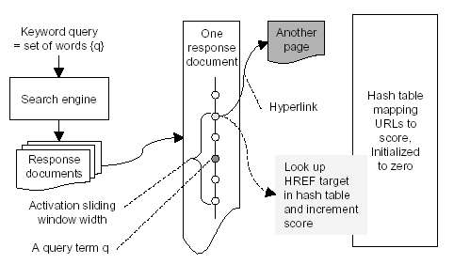
A simple ranking scheme based on evidence from words near anchors.
Mining the Web
Chakrabarti and Ramakrishnan

Slide 59
Frontier of Differentiation
Example:
Question: How to find it ?
Proposal: generative model for the text embedded in the DOM tree.
  Micro-documents:
    E.g. text between <A> and </A> or <P> and </P>
  Internal node
    Collection of micro-documents
    Represent term distribution as \Phi
Goal:
  Given a DOM sub-tree with root node u decide if it is `pure' or `mixed'
Mining the Web
Chakrabarti and Ramakrishnan

Slide 60

A general greedy algorithm for differentiation
Start at the root :
  If (a single term distribution suffices to generate the micro-documents in T_{u})
    Prune the tree at u.
  Else
    Expand the tree at u (since each child v of u has a different term distribution)
Continue expansion until no further expansion is profitable (using some cost measure)
Mining the Web
Chakrabarti and Ramakrishnan

Slide 61


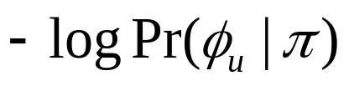

A cost measure: Minimum Description Length (MDL)
Model cost and data cost
Model cost at DOM node u :
  Number of bits needed to represent the parameters of u encoded w.r.t. some prior distribution on the parameters
Data cost at node u =
  Cost of encoding all the micro-documents in the subtree T_{u} rooted at u w.r.t. the model at u
Mining the Web
Chakrabarti and Ramakrishnan

Slide 62
Greedy DOM segmentation using MDL
Input: DOM tree of an HTML page
initialize frontier F to the DOM root node
while local improvement to code length possible do
pick from F an internal node u with children fvg
find the cost of pruning at u (model cost)
find the cost of expanding u to all v (data cost)
if expanding is better then
remove u from F
insert all v into F
end if
end while
Mining the Web
Chakrabarti and Ramakrishnan

Slide 63
Integrating segmentation into topic distillation
Asymmetry between hubs and authorities
  Reflected in hyperlinks
  Hyperlinks to a remote host almost always points to the DOM root of the target page
Goal:
  use DOM segmentation to contain the extent of authority diffusion between co-cited pages v₁, v₂…. through a multi-topic hub u.
Represent u not as a single node
  But with one node for each segmented sub-trees of u
  Disaggregate the hub score of u
Mining the Web
Chakrabarti and Ramakrishnan

Slide 64



Fine-grained topic distillation
collect G_{q} for the query q
construct the fine-grained graph from G_{q}
set all hub and authority scores to zero
for each page u in the root set do
locate the DOM root ru of u
set
end for
while scores have not stabilized do
perform the transfer
segment hubs into “micro hubs"
aggregate and redistribute hub scores
perform the transfer
normalize a
end while
Mining the Web
Chakrabarti and Ramakrishnan

Slide 65
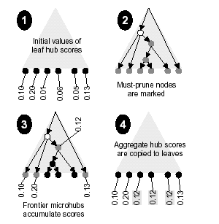
To prevent unwanted authority diffusion, we aggregate hub scores the frontier (no complete aggregation up to the DOM root) followed by propagation to the leaf nodes. Internal DOM nodes are involved only in the steps marked segment and aggregate.
Mining the Web
Chakrabarti and Ramakrishnan

Slide 66
Fine grained vs Coarse grained
Initialization
  Only the DOM tree roots of root set nodes have a non-zero authority score
Authority diffuses from root set only if
  The connecting hub regions are trusted to be relevant to the query.
Only steps that involve internal DOM nodes.
  Segment and aggregate
At the end…
  only DOM roots have positive authority scores
  only DOM leaves (HREFs) have positive hub scores
Mining the Web
Chakrabarti and Ramakrishnan

Slide 67

Text + link based DOM segmentation
Out-links to known authorities can also help segment a hub.
  if (all large leaf hub scores are concentrated in one sub-tree of a hub DOM)
    limit authority reinforcement to this sub-tree.
  end if
DOM segmentation with different \Pi and \Phi
  DOMHITS: hub-score-based segmentation
  DOMTEXTHITS: combining clues from text and hub scores
    = a joint distribution combining text and hub scores
      OR
    Pick the shallowest frontier
Mining the Web
Chakrabarti and Ramakrishnan

Slide 68
Topic Distillation: Evaluation
Unlike IR evaluation
  Largely based on an empirical and subjective notion of authority.
Mining the Web
Chakrabarti and Ramakrishnan

Slide 69
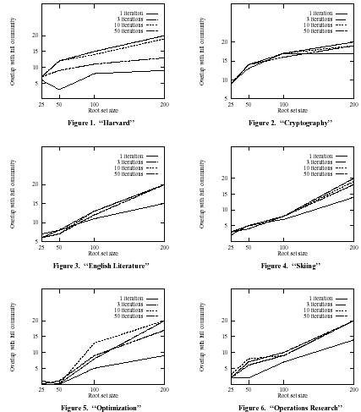
For six test topics (Harvard, cryptography, English literature, skiing, optimization and operations research)
HITS shows relative insensitivity to the root set size r and the number of iterations i. In each case the y-axis
shows the overlap between the top 10 hubs and authorities and the “ground truth” obtained by using r = 200 and i = 50.
Mining the Web
Chakrabarti and Ramakrishnan

Slide 70
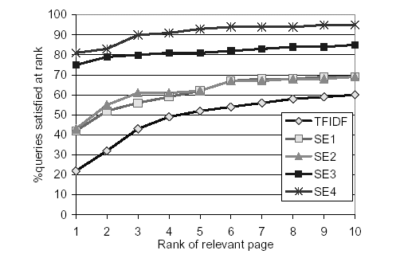
Link-based ranking beats a traditional text-based IR system by a clear margin for Web workloads.
100 queries were evaluated. The x-axis shows the smallest rank where a relevant page was found and the
y-axis shows how many out of the 100 queries were satisfied at that rank.
A standard TFIDF ranking engine is compared with four well-known Web search engines
(Raging, Lycos, Google, and Excite). Their identities have been withheld in this chart by [Singhal et al].
Mining the Web
Chakrabarti and Ramakrishnan

Slide 71
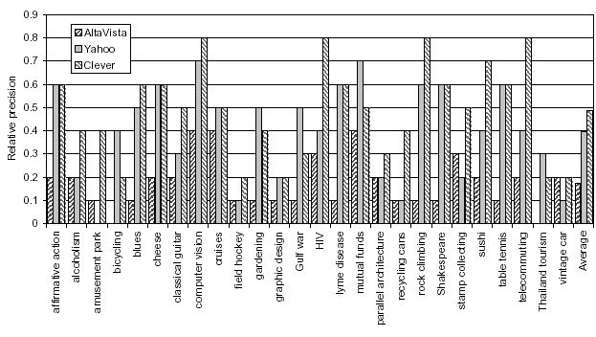
In studies conducted in 1998 over 26 queries and 37 volunteers, Clever reported better authorities than Yahoo!,
which in turn was better than Alta Vista.
Since then most search engines have incorporated some notion of link-based ranking.
Mining the Web
Chakrabarti and Ramakrishnan

Slide 72
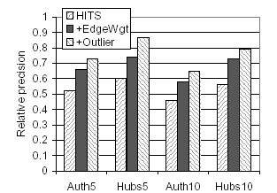
B&H improves visibly beyond the precision offered by HITS. (“Auth5” means the top five authorities
were evaluated.) Edge weighting against two-site nepotism already helps, and outlier elimination
improves the results further.
Mining the Web
Chakrabarti and Ramakrishnan

Slide 73
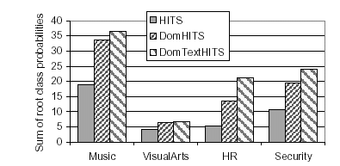
Top authorities reported by DomTextHits have the highest probability of being relevant
to the Dmoz topic whose samples were used as the root set, followed by DomHits and finally HITS.
This means that topic drift is smallest in DomTextHits.
Mining the Web
Chakrabarti and Ramakrishnan

Slide 74
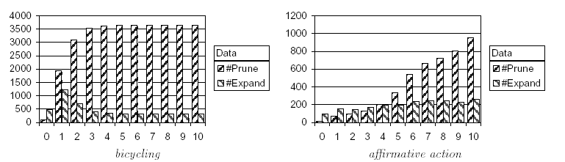
The number of nodes pruned vs. expanded may change significantly across iterations of
DomHits, but stabilizes within 10-20 iterations. For base sets where there is no danger of drift, there
is a controlled induction of new nodes into the response set owing to authority diffusion via relevant
DOM sub-trees. In contrast, for queries which led HITS/B&H to drift, DomHits continued to expand
a relatively larger number of nodes in an attempt to suppress drift.
Mining the Web
Chakrabarti and Ramakrishnan

Slide 75
Aggregate Web structure
Billions of nodes, average degree ≈ 10
Measuring regularities in Web structure
  In-degree and out-degree follows power-law distribution
    Pr(degree is k) ∝ 1/k^{x},
    where x is the power
  Property has been preserved barring small changes in aout and ain
  Easy to fit data to these power-law distributions though !!!
Links highly non-random (clustered)
  Web graph obviously not created by materializing edges independently at random.
Mining the Web
Chakrabarti and Ramakrishnan

Slide 76
Measuring the Web : Early success
Barabasi and others
model graph continually adds nodes
Preferential Attachment
  Winners take all scenario
  new node is linked to existing nodes
    Not uniformly at random
    But with higher probability to existing nodes that already have large degree
Mining the Web
Chakrabarti and Ramakrishnan

Slide 77
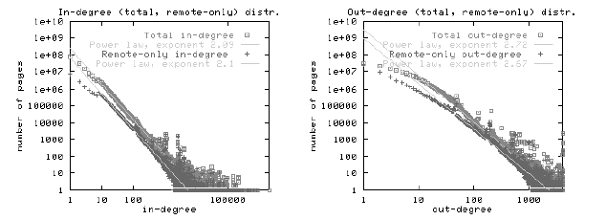
The in- and out-degree of Web nodes closely follow power-law distributions.
Mining the Web
Chakrabarti and Ramakrishnan

Slide 78
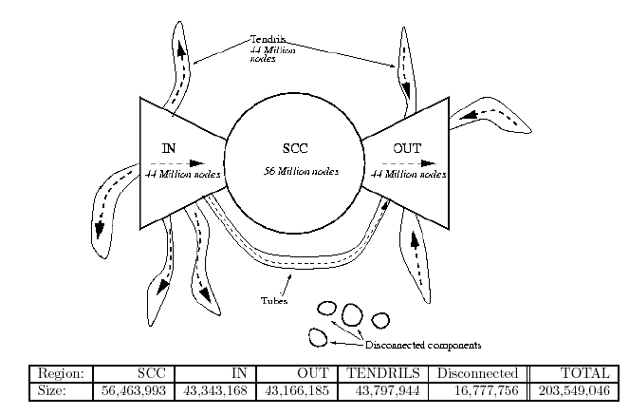
The Web is a bow-tie
Mining the Web
Chakrabarti and Ramakrishnan

Slide 79
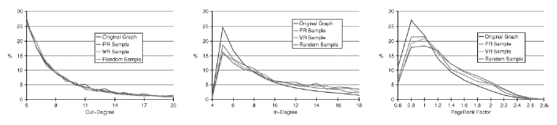
Random walks based on PageRank give sample distributions which are close to the true
distribution used to generate the graph data, in terms of outdegree, indegree, and PageRank.
Mining the Web
Chakrabarti and Ramakrishnan

Slide 80
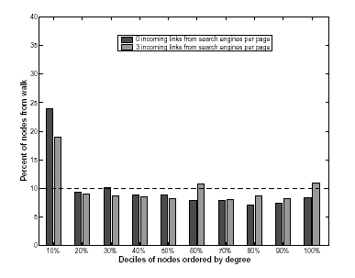
Random walks performed by WebWalker give reasonably unbiased URL samples; when sampled URLs
are bucketed along degree deciles in the complete data source, close to 10% of the sampled URLs fall
into each bucket.
Mining the Web
Chakrabarti and Ramakrishnan

Slide 81
Mean field approximation
Let node i be added at time ti
At time t_{i}, degree of node i is m
At a later time t, it is between
  m (no new nodes link to it), and
  m(1 + t − t_{i}) (if all newer
  nodes link to it)
Degree of node i follows a
complex distribution at time t > t_{i}
Model its mean, k_{i}(t), approximately
Degree
slope=m
m
slope=0
t_{i}
t
Time
Mining the Web
Chakrabarti and Ramakrishnan

