Slide 1
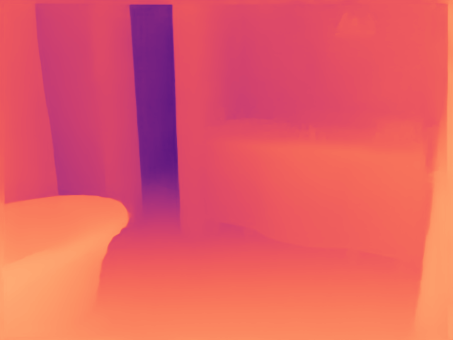
SICHUAN UNIVERSITY
Design and Implementation of a
Color-Constancy-Assisted
Monocular Depth
Estimation System
First controlled experiment
Shirsha Mitra
Student ID 2023521460130
24 October 2026
01
Notes:
My thesis investigates how color constancy can assist monocular depth estimation. This presentation reports the first implemented experiment. I ran a pretrained depth model and controlled color transformations on real RGB images with reference depth. The results are a local pilot, not a full benchmark reproduction or a new trained model. The figure shows an actual prediction saved by this experiment.
Sources
https://github.com/DepthAnything/Depth-Anything-V2/tree/main/metric_depth
https://cs.nyu.edu/~fergus/datasets/nyu_depth_v2.html
Measured source: results/summary.json, results/metrics.csv, data/nyu_pilot/manifest.json

Slide 2
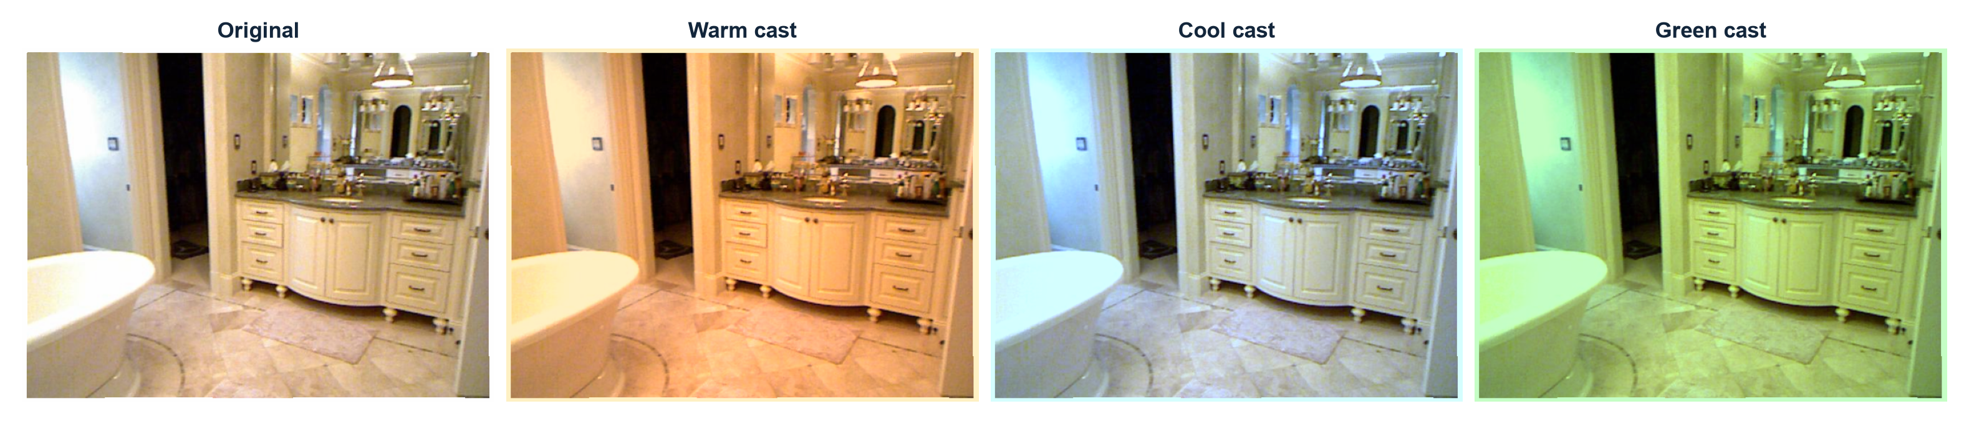
Research question
Can color correction improve depth accuracy
when illumination color changes?
The scene and reference depth stay fixed. Only the input color changes.
02
Notes:
Monocular depth estimation predicts the distance of each pixel from one RGB image. Color constancy estimates or compensates for illumination color. Here I test a concrete question: if I change the input color without changing the geometry, how does the predicted depth change? Then I test whether simple correction reduces the measured error. These are synthetic global casts of real photographs. They do not represent every real lighting or camera condition.
Sources
https://github.com/DepthAnything/Depth-Anything-V2/tree/main/metric_depth
https://cs.nyu.edu/~fergus/datasets/nyu_depth_v2.html
Measured source: results/summary.json, results/metrics.csv, data/nyu_pilot/manifest.json

Slide 3
Implemented experiment
One frozen depth model, paired image comparisons
01
02
03
04
Real RGB image
Color processing
Depth inference
Accuracy evaluation
Aligned reference depth
from NYU Depth V2
7 image conditions
4 correction choices
Depth Anything V2
Metric Hypersim Small
Same crop and mask
No scale fitting
1120 saved predictions
8 development images and 32 evaluation images
03
Notes:
The system has four stages. First, it loads aligned RGB and depth data. Second, it creates seven image conditions: the original, two warm casts, two cool casts, and two green casts. Each condition uses four processing choices, which gives 28 predictions per image. Third, the same pretrained model predicts depth for every input. Finally, the evaluator uses an identical crop, mask, and depth range. I save depth arrays, transformation metadata, runtime, and scores. No model training occurred.
Sources
https://github.com/DepthAnything/Depth-Anything-V2/tree/main/metric_depth
Measured source: results/summary.json, results/metrics.csv, data/nyu_pilot/manifest.json

Slide 4
Dataset and evaluation protocol
Setting | Pilot configuration
Data | NYU Depth V2 RGB and aligned reference depth
Evaluation subset | 32 scenes, one image each; 8 separate development scenes
Network input | 518 pixel inference setting, aspect ratio preserved
Depth evaluation | Valid reference depth 0.1-10 m, predictions clipped to this range
Image crop | Rows 45:471, columns 41:601 at 480 x 640
Aggregation | Mean of per-image scores, six casts equally weighted
Fixed methods and gains. No parameter fitting to evaluation reference depth.
04
Notes:
This is a small deterministic pilot using real NYU Depth V2 images with aligned reference depth. Each evaluation image represents a distinct scene. Development and evaluation scenes are separate. The checkpoint predicts metric depth directly. I do not fit a scale or shift to the reference depth. The checkpoint maximum depth is 20 meters, while this pilot evaluates reference pixels strictly between 0.1 and 10 meters and clips predictions to the same evaluation range. The crop is rows 45 through 470 and columns 41 through 600 using Python slice conventions at 480 by 640. Per-image metrics are averaged. These values do not reproduce the official full benchmark. RGB and depth source details and sample selection remain in data/nyu_pilot/manifest.json.
Sources
https://cs.nyu.edu/~fergus/datasets/nyu_depth_v2.html
https://github.com/DepthAnything/Depth-Anything-V2/tree/main/metric_depth
Measured source: results/summary.json, results/metrics.csv, data/nyu_pilot/manifest.json

Slide 5
Color correction baselines
All transformations operate in linear RGB
Gray-World
White-Patch
Gray-World half
Channel means
Channel maxima
Square-root gains
Estimates the illuminant
from each channel mean.
Applies inverse gains.
Estimates the illuminant
from each channel maximum.
Applies inverse gains.
Uses half the correction
strength in log-gain space.
Strength fixed at 0.5.
Every gain transform preserves mean luminance before clipping.
05
Notes:
I compare no correction with three fixed correction baselines. Gray-World assumes that the scene-average channel values provide useful information about the illuminant. White-Patch uses the channel maxima. Both compute inverse gains normalized with the geometric mean. The half-strength variant takes the square root of the Gray-World gains. It is a fixed ablation, not a novelty claim or a setting selected on evaluation ground truth. I convert sRGB to linear RGB before these operations, preserve mean luminance before clipping, clip the values, and convert back to sRGB. Clipping is recorded because it can remove information and make correction irreversible.
Sources
Measured source: results/summary.json, results/metrics.csv, data/nyu_pilot/manifest.json

Slide 6
Clean-input accuracy
32 evaluation images, without an added color cast
Processing | AbsRel | RMSE (m) | delta1 accuracy
No correction | 0.246 | 0.796 | 63.1%
Gray-World | 0.242 | 0.781 | 64.0%
White-Patch | 0.246 | 0.796 | 63.1%
Gray-World half | 0.244 | 0.789 | 63.5%
AbsRel and RMSE: lower is better
delta1: fraction of pixels within a depth ratio of 1.25, higher is better
06
Notes:
This table establishes the clean-input baseline and checks the effect of applying correction when no synthetic cast is present. The no-correction model has mean AbsRel 0.2460, RMSE 0.7961 meters and delta-one accuracy 63.09%. AbsRel is absolute depth error divided by reference depth, averaged over valid pixels. RMSE is root mean square depth error in meters. Delta-one is the fraction of valid pixels where the larger of prediction divided by reference and reference divided by prediction is below 1.25. These are means of per-image scores on this subset. They should not be compared directly with another paper unless the dataset split and all evaluation settings match.
Sources
Measured source: results/summary.json, results/metrics.csv, data/nyu_pilot/manifest.json

Slide 7
Sensitivity to color casts
No correction, mean per-image AbsRel across 32 images
Mild and strong casts use fixed channel gains with the same reference depth.
07
Notes:
This chart measures how the unchanged model responds to the synthetic color conditions. Clean is the unmodified RGB image apart from the identity transformation and common quantization path. Warm, cool, and green casts each have mild and strong channel-gain settings. The transformation preserves mean luminance before clipping, so it does not intentionally mix a brightness experiment into this first color test. Some pixels can still clip, which is one limitation of the synthetic transformation. The exact channel gains and clipping fractions are saved in the results. A change in these scores is a measured sensitivity on this subset.
Sources
Measured source: results/summary.json, results/metrics.csv, data/nyu_pilot/manifest.json

Slide 8
Correction performance across color casts
Fixed baselines, six synthetic casts, equal weight for each cast and image
Lowest among correction baselines
Gray-World
0.6%
mean error increase
against no correction
19/32 images improve
when averaging their six casts
Paired AbsRel reduction -0.0015, 95% bootstrap CI [-0.0061, 0.0025]
The interval crosses zero. This pilot does not establish an average benefit.
08
Notes:
I average the six cast conditions for each method and each image. Gray-World has the lowest corrupted-input AbsRel among the three fixed correction baselines in this pilot: 0.2409, compared with 0.2394 without correction. This corresponds to a 0.63 percent increase in average AbsRel. This is a descriptive, exploratory comparison. I did not tune a model or establish a new algorithm. I also make a paired comparison per image, keeping its six casts together. The mean reduction is -0.00150 with a 95 percent bootstrap interval from -0.00613 to 0.00254. A positive reduction means correction helped. A negative reduction means it harmed. I resample images 10,000 times. 19 images improve and 13 worsen. This interval describes the sampled images and does not establish generalization to other datasets or all real lighting.
Sources
Measured source: results/summary.json, results/metrics.csv, data/nyu_pilot/manifest.json

Slide 9
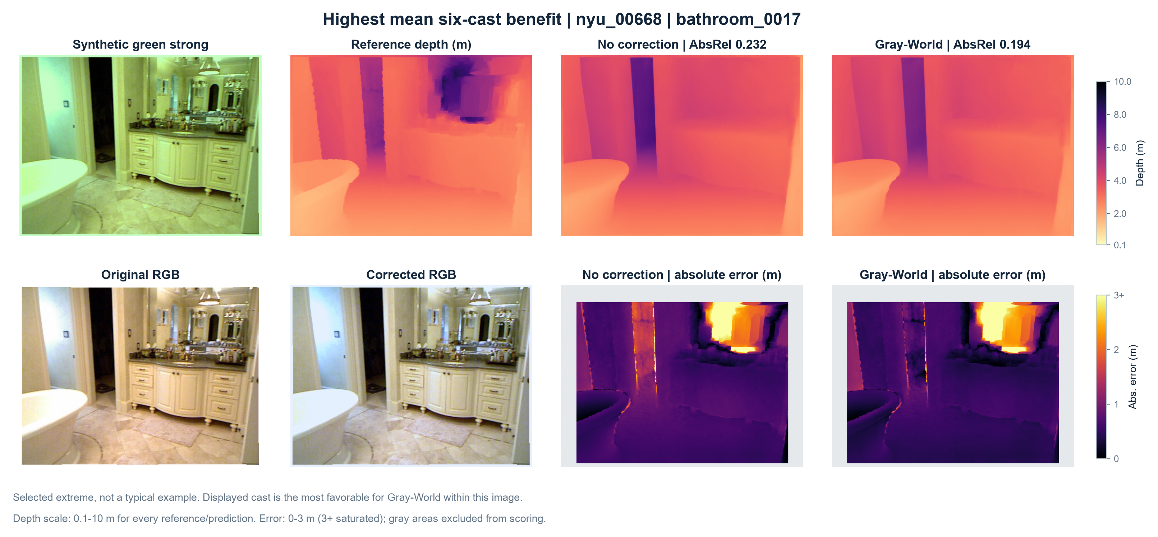
Visual comparison of saved depth predictions
The reference and predicted depth maps share the same color scale.
09
Notes:
This figure shows an actual evaluated image and the corresponding saved depth arrays. Image nyu_00668, condition green_strong. Extreme image by mean six-cast Gray-World AbsRel reduction; displayed cast is most favorable within that image. In the displayed comparison, Gray-World reduces AbsRel by 0.0373. The mean six-cast AbsRel reduction for this image is 0.0198. This is a selected extreme and does not represent the typical result. The reference depth does not change across color conditions. Compare object boundaries and relative near/far regions, and use the numerical error labels to assess accuracy. A visually smooth prediction can still have an incorrect metric scale. The preceding aggregate results provide the performance estimate.
Sources
Measured source: results/summary.json, results/metrics.csv, data/nyu_pilot/manifest.json

Slide 10
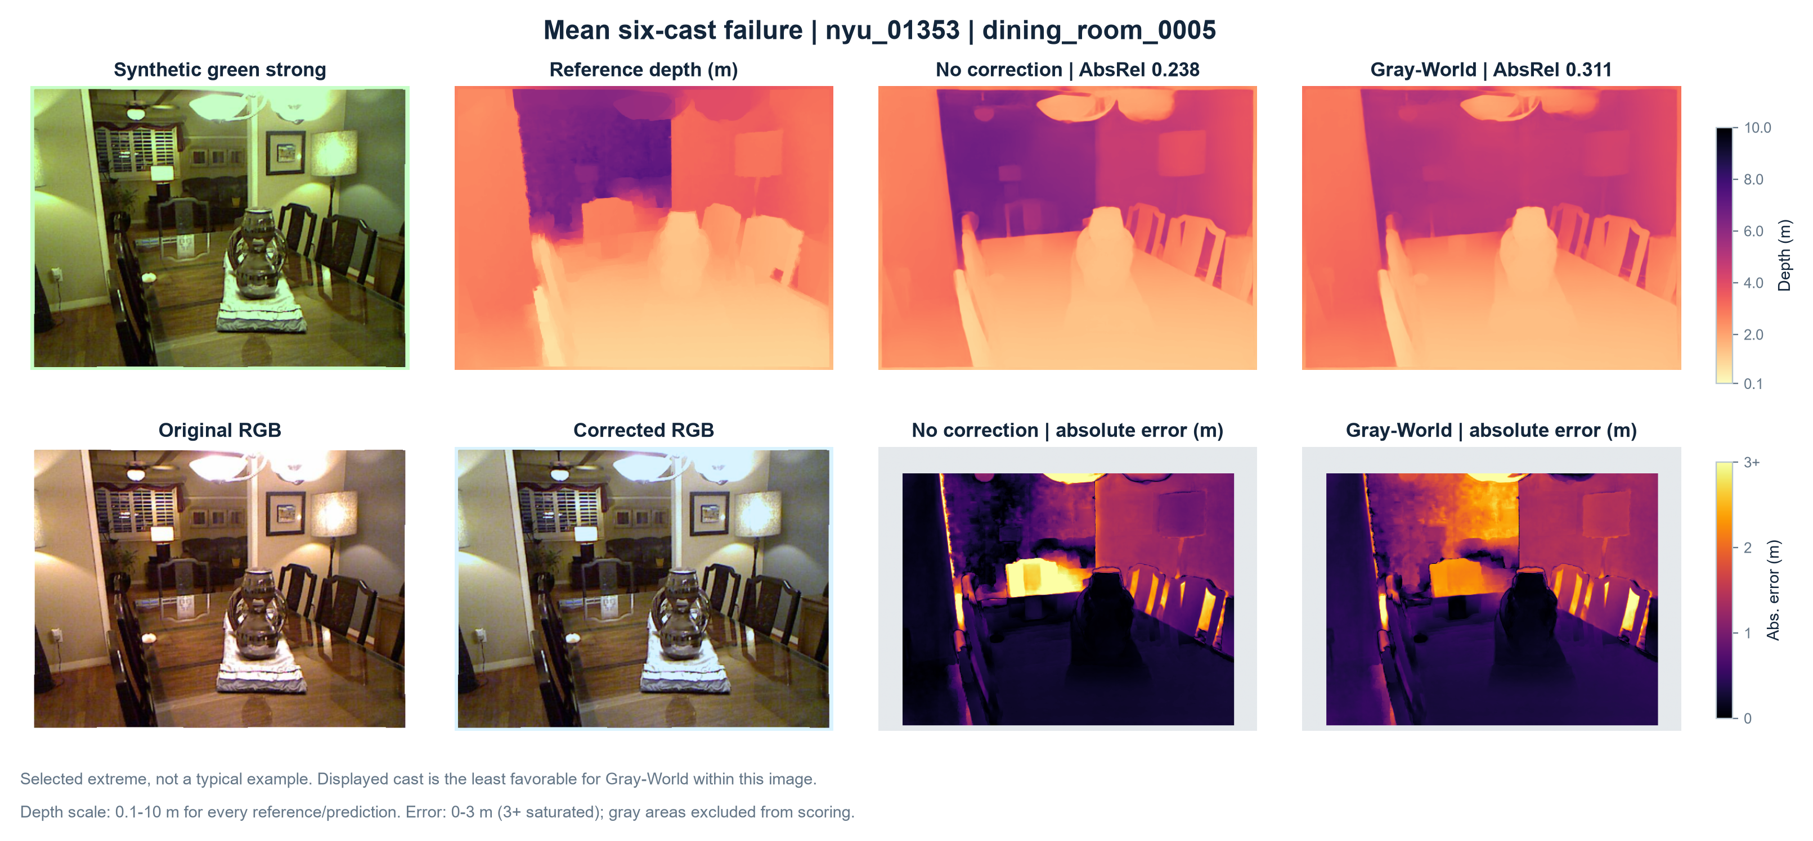
Failure analysis
A global correction can mistake scene color for illumination.
10
Notes:
I also inspect the image with the weakest average Gray-World effect across the six casts. Image nyu_01353, condition green_strong. Extreme image by mean six-cast Gray-World AbsRel reduction; displayed cast is least favorable within that image. In the displayed comparison, Gray-World increases AbsRel by 0.0730. The mean six-cast AbsRel reduction for this image is -0.0411. This is a selected extreme and does not represent the typical result. A global illuminant estimator can confuse the color of the scene with the color of the light. A scene dominated by one surface color can violate Gray-World assumptions. Channel maxima can also make White-Patch unstable. Clipping can discard color information before correction. These are possible mechanisms to investigate with further controlled tests, not a proven causal diagnosis of this single example. The clean-input comparison and per-image paired results show why applying correction to every input needs further study.
Sources
Measured source: results/summary.json, results/metrics.csv, data/nyu_pilot/manifest.json

Slide 11
Laptop execution and reproducibility
Item | Completed run
Device | Intel Core Ultra 7 255H, CPU inference
Model | Depth Anything V2 Metric Hypersim Small, 24.8M parameters
Compute setting | 8 CPU threads, input setting 518
Predictions | 1120 numerical depth arrays saved
Mean inference time | 1.13 seconds per image condition
Traceable outputs | Manifest, metrics CSV, checkpoint hash, figures and source code
The project runs in its own Python environment and opens as a VS Code workspace.
11
Notes:
The experiment ran locally using CPU inference on an Intel Core Ultra 7 255H with approximately 32 GB RAM. The run used 8 CPU threads. Mean measured inference time is 1.132 seconds per transformed input. It measures the depth inference call and excludes model loading and artifact preparation. The input-size parameter is 518. I save numerical predictions, per-image scores, an aggregate summary, source code, the data manifest, the upstream revision, and the checkpoint SHA-256. The full hash is b782898d8a3e8be1f639de33837ed85e9b4b73e40f8f5e5cd99067588d722545. The upstream model revision is a561b849ebae10a6f5ef49e26c83cbbcd36c71bf. These files support rerunning and auditing the experiment.
Sources
https://github.com/DepthAnything/Depth-Anything-V2/tree/main/metric_depth
Measured source: results/summary.json, results/metrics.csv, data/nyu_pilot/manifest.json

Slide 12
Findings and next experiments
Observed in this pilot
Next experiments
The complete paired evaluation runs locally.
Gray-World has 0.6% higher mean cast error.
Its mean clean-input error is 1.7% lower.
Expand the fixed evaluation subset and test a second depth model.
Separate clipping effects from color sensitivity.
Test real lighting changes before designing an adaptive correction rule.
Initial pretrained-model pilot. A novel method and broader validation remain future work.
12
Notes:
The current progress is a working system and a controlled first experiment. This descriptive pilot suggests what to investigate next. Compared with no correction, the lowest-error correction baseline has 0.63 percent higher average cast AbsRel, and 1.73 percent lower clean-input AbsRel. Both comparisons use the same fixed model and evaluation images. Neither result justifies a universal claim about color correction or a novel-method claim. My next steps are a larger fixed subset, another depth backbone, a separate clipping control, and images captured under real illumination changes. Only after these checks should I decide whether an adaptive correction method is justified. I would welcome the supervisor's guidance on the most useful next comparison.
Sources
https://arxiv.org/abs/2406.09414
https://github.com/DepthAnything/Depth-Anything-V2/tree/main/metric_depth
https://cs.nyu.edu/~fergus/datasets/nyu_depth_v2.html
Measured source: results/summary.json, results/metrics.csv, data/nyu_pilot/manifest.json

