Slide 1
Import and Energy Minimization of Crystallography Open Database Entries using OpenMM
Sam Kennedy
Independent Study Fall 2021 for Dr. Michael Shirts

Slide 2
Import from Crystallography Open Database (COD) – Problem Statement
Wanted to develop workflow to download and parse a subset of crystal structures from the Crystallography Open Database (COD) and perform energy minimization for various force fields
  Use OpenMM as MD package
  Used OpenFF force field (1.0.0 and 2.0.0)

Slide 3
Workflow
Using Python 3.9 Scripting
Download CIF
files from COD
Convert to
CIF to PDB
Build supercell
with PyMol
function
Build OpenFF
Molecule from
PDB and SMILES
Build OpenMM
topology from
Molecule and
supercell
OpenMM Energy
Minimization
Further
Custom Energy
Minimization
RMSD and Energy
Comparison between
Initial and final

Slide 4
Import from Crystallography Open Database (COD) - Issues
No easy way to filter organic and non-organic crystals.
Used DataWarrior copy of COD database which had organic/inorganic filtering capabilities
  Manually selected a set of ~275 COD IDs for further investigation

Slide 5
Import from Crystallography Open Database (COD) - Issues
The SMILES database did not have a string for the COD entry of interest
There is a mismatch between the SMILES string and PDB file
  Most of these errors come
  from CIF files that are missing
  atoms in their sets of coordinates
The stereochemistry is not fully
defined or other faulty
bonding information

Slide 6
Energy Minimization - Workflow
Minimization in two parts:
  Initial position minimization with built-in openMM energy minimizer
  Simultaneous minimization of position and periodic boundary box vectors
    Jacobian of atom positions taken as forces from simulation. Calculated by finite difference for box vectors.

Slide 7
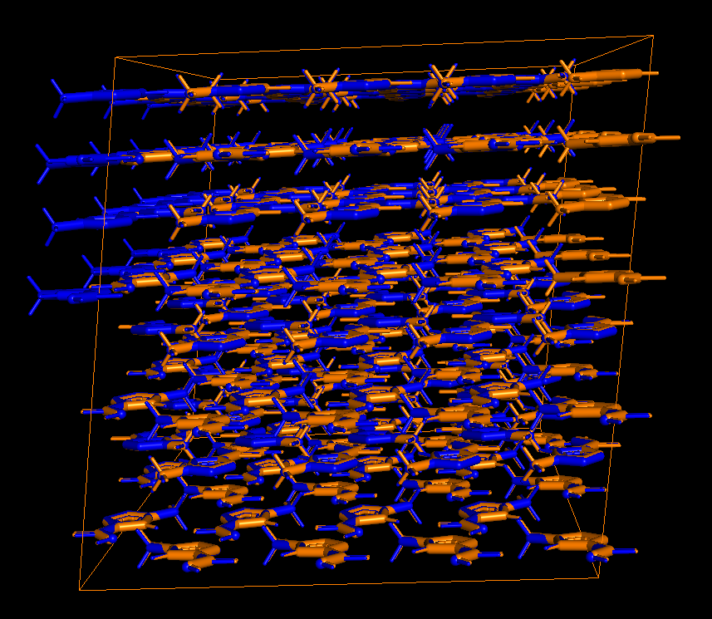
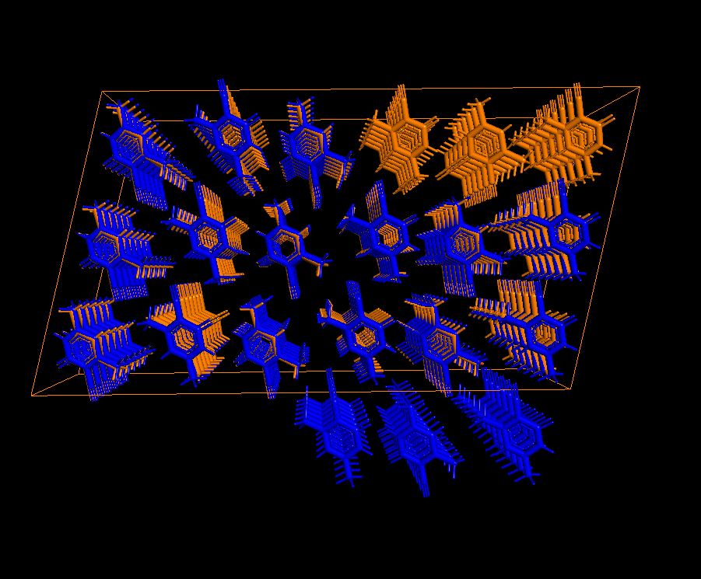
Energy Minimization - Issues
Translation of molecules across boundary
  Orange is initial supercell, blue is minimized cell
COD ID: 1519825
COD ID: 2203241

Slide 8
Energy Minimization - Issues
Energy minimization algorithm fails for many systems due to periodic cell conditions not being in a reduced format during minimizer call.
  Occasionally periodic boundary is reduced so that it is not larger than 1.8nm also causing an error.
Modified periodic boundary conditions are not output correctly into the CRYST1 entry of OpenMM generated trajectory.

Slide 9
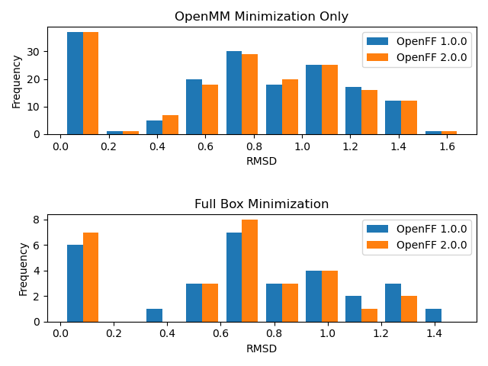
Energy Minimization – RMSD Results
No major differences between 1.0 and 2.0
Both minimization methods show high portion of large RMSD
 | Average RMSD (OpenMM Minimization Only) | Average RMSD (Box Minimization)
OpenFF 1.0.0 | 0.731 | 0.695
OpenFF 2.0.0 | 0.726 | 0.607

Slide 10
Conclusions
COD is a large database but lack robust search and filtering options
  SMILES strings are generated for a portion, but not all, of the COD
Energy minimizer needs additional optimization to avoid “reduced boundary vector” issue and to constrain molecules so they do not migrate across periodic boundary.

Slide 11
References
[1] qual5206, qual5206/OpenFFCrystalBenchmarking. 2021. Accessed: Dec. 15, 2021. [Online]. Available: https://github.com/qual5206/OpenFFCrystalBenchmarking
[2] “www.openmolecules.org.” https://openmolecules.org/datawarrior/datafiles.html (accessed Dec. 15, 2021).
[3] N. M. O’Boyle, C. Morley, and G. R. Hutchison, “Pybel: a Python wrapper for the OpenBabel cheminformatics toolkit,” Chem. Cent. J., vol. 2, no. 1, p. 5, Dec. 2008, doi: 10.1186/1752-153X-2-5.
[4] Open-Source PyMOL. Schrodinger, Inc., 2021. Accessed: Dec. 15, 2021. [Online]. Available: https://github.com/schrodinger/pymol-open-source
[5] M. Quirós, S. Gražulis, S. Girdzijauskaitė, A. Merkys, and A. Vaitkus, “Using SMILES strings for the description of chemical connectivity in the Crystallography Open Database,” J. Cheminformatics, vol. 10, no. 1, p. 23, Dec. 2018, doi: 10.1186/s13321-018-0279-6.

