Slide 2
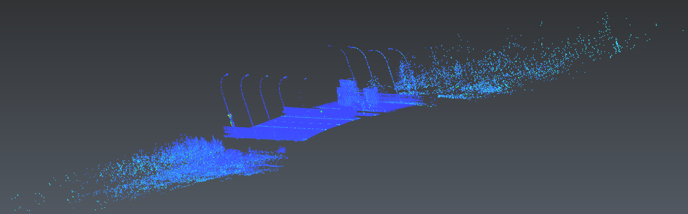
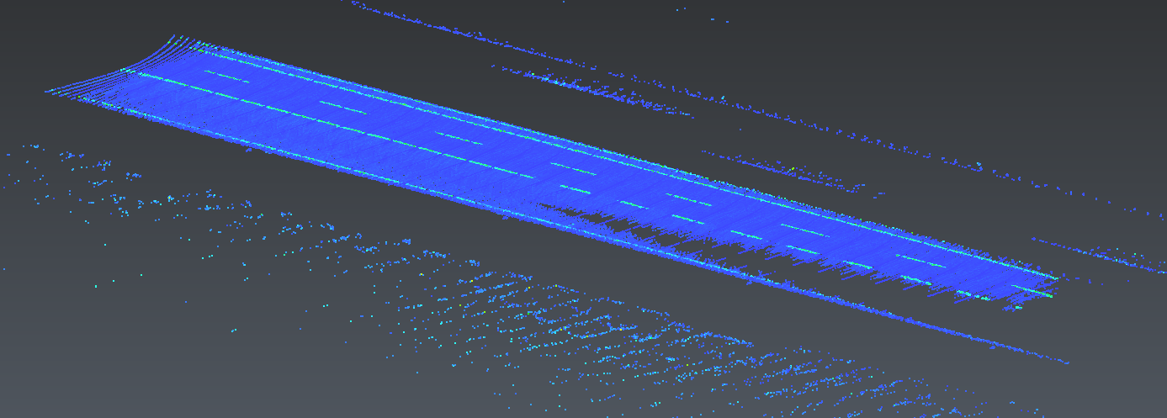
Extract point cloud of road

Slide 3
Extract point cloud of road
Method: Linear regression
Process:
(1) Extract the x, y, z coordinate data from the transformed point cloud
(2) Normalize the x, y, z dataset, then compute the cost-function:
(3) Gradient descent the cost-function and get the best weight to fit the road
(4) Set a threshold, for each point, if
Then regarded as the road. Otherwise, discarded.

