Slide 1




国外时尚卡通幻灯片模板
第一PPT模板网-WWW.1PPT.COM

Slide 2

1 Trend Alert
2 Flat Design 101
3 Flat Design, But Why?
4 Icon Design vs. Flat Design
5 How To Make A Flat Design
6 Conclusion
PPT模板下载：www.1ppt.com/moban/ 行业PPT模板：www.1ppt.com/hangye/
节日PPT模板：www.1ppt.com/jieri/ PPT素材下载：www.1ppt.com/sucai/
PPT背景图片：www.1ppt.com/beijing/ PPT图表下载：www.1ppt.com/tubiao/
优秀PPT下载：www.1ppt.com/xiazai/ PPT教程： www.1ppt.com/powerpoint/
Word教程： www.1ppt.com/word/ Excel教程：www.1ppt.com/excel/
资料下载：www.1ppt.com/ziliao/ PPT课件下载：www.1ppt.com/kejian/
范文下载：www.1ppt.com/fanwen/ 试卷下载：www.1ppt.com/shiti/
教案下载：www.1ppt.com/jiaoan/ PPT论坛：www.1ppt.cn
TABLE OF
CONTENT
© 1999 - 2014 IX Web Hosting. All rights reserved.

Slide 3

TREND
ALERT!
WEB
DESIGNS
are going FLAT! Minimalism is the new black and you got to wear it!
© 1999 - 2014 IX Web Hosting. All rights reserved.

Slide 4
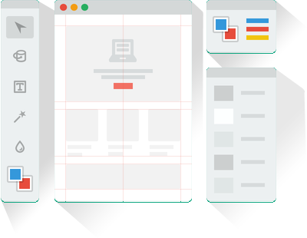
FLAT
DESIGN
101
› Flat design is a minimalistic approach to
designing that focuses primarily on
usability.
› It consists of using bright colors, spacing
and two dimensional (flat) illustrations as
elements.
› Microsoft was one of the first to apply this
design to its interface.
© 1999 - 2014 IX Web Hosting. All rights reserved.

Slide 5



..because the all out flashy websites are no longer pleasing! And people really don’t have the time to go through a content heavy page.
FLAT
DESIGN
BUT WHY?
A flat design forces you to not only minimize the colors on your website, but also the elements to keep it neat and tidy! Exactly what a user wants these days.
© 1999 - 2014 IX Web Hosting. All rights reserved.

Slide 6
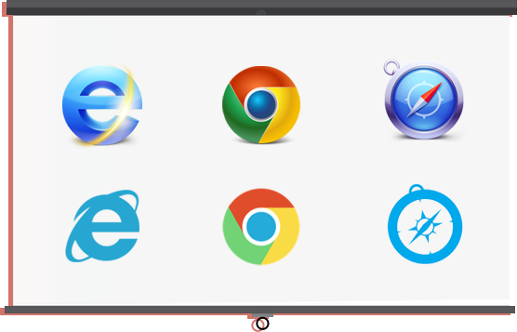


ICON
FLAT
Flat Wins
Hands Down!
© 1999 - 2014 IX Web Hosting. All rights reserved.

Slide 7

HERE’S
HOW YOU CAN GO
Fantabulously
FLAT!
© 1999 - 2014 IX Web Hosting. All rights reserved.

Slide 8

The signature element of a Flat Web Design is Bright, Bold Colors. So create a lot of Colorful Panels!
MAKE IT
BRIGHT&
BOLD
There are a lot many colors that you can play around with on Photoshop, but you can make life easier by using while creating your flat color theme.
Flat UI Colors
© 1999 - 2014 IX Web Hosting. All rights reserved.

Slide 9
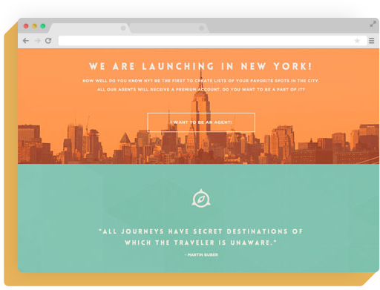

To further enhance the bold look, combine colors to make a beautiful series of background panels, like
.
TriplAgent
CREATE
MULTICOLOR
PANELS
Note
Limit your website’s color palette to a few number of colors.
© 1999 - 2014 IX Web Hosting. All rights reserved.

Slide 10
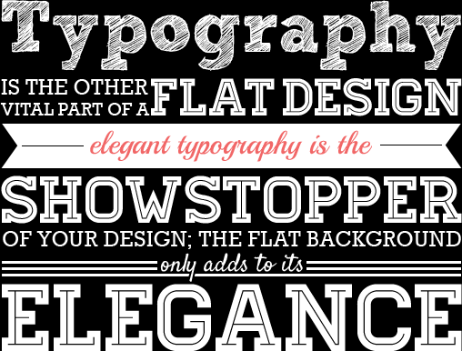
IS
THE NEW
BLACK!
Typography
© 1999 - 2014 IX Web Hosting. All rights reserved.

Slide 11
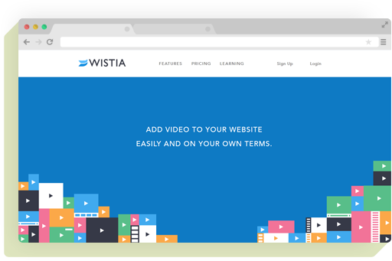
UPPERCASE
LETTERS
Use uppercase characters to demarcate navigation items and key headlines from the other elements.
has been doing this and you should too!
Wistia
© 1999 - 2014 IX Web Hosting. All rights reserved.

Slide 12
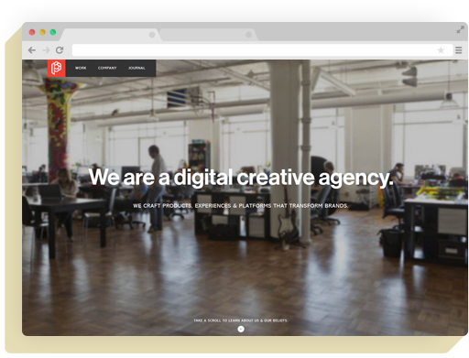
WHITE TEXT
OVER COLORED
BACKGROUNDS
Another popular technique to make your flat design stand out is to use white text over a flat background cover or a picture background.
masters this trend!
Playground Inc.
© 1999 - 2014 IX Web Hosting. All rights reserved.

Slide 13
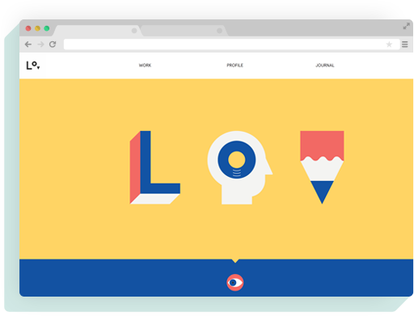
VECTORS
ARE COOL!
Vectors are constructed using geometrical shapes and distinct colors; and are best suited for artwork on flat designs. Here’s how used it.
Lorenzo Verzini
© 1999 - 2014 IX Web Hosting. All rights reserved.

Slide 14
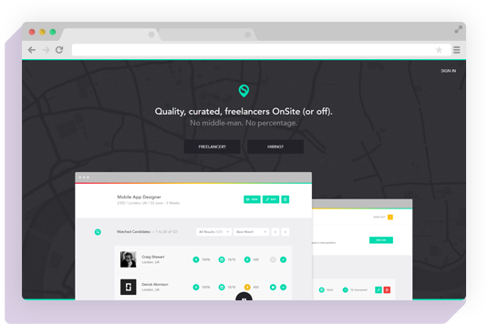
SUBTLE
BACKGROUNDS
STILL RULE!
For those of you who can’t do without heavy content, try and make visually impactful background. On this, give away the content you want to offer using contrasting colors. A very good example of this is
.
OnSite
© 1999 - 2014 IX Web Hosting. All rights reserved.

Slide 15

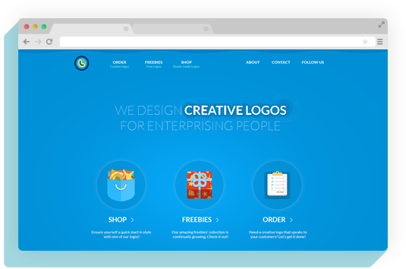
BIG IS BETTER!
Use huge page elements, and space them out well. This gives your page a ‘minimal’ look, which suits your flat design.
© 1999 - 2014 IX Web Hosting. All rights reserved.

Slide 16
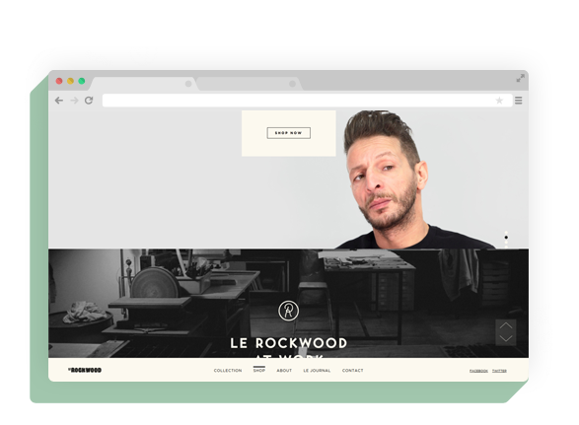
THROW
IN SOME
EFFECTS!
Create transitions and other effects using HTML5 and CSS3 to make your website look simple and yet a visual spectacle. Here’s how used it.
Le Rockwood
© 1999 - 2014 IX Web Hosting. All rights reserved.

Slide 17

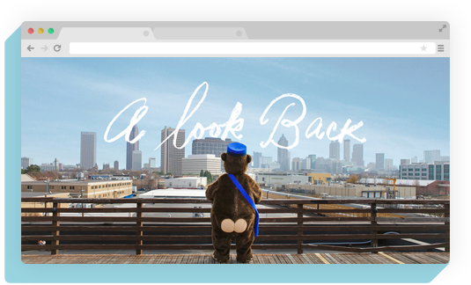
PANORAMA IS
BEAUTIFUL!
Since almost every other flat design ends up using flat colors, here’s a way to stand out: use unique panoramic photos! They serve the purpose of a centerpiece while also giving the other elements a flatter touch. gets it right!
MailChimp
© 1999 - 2014 IX Web Hosting. All rights reserved.

Slide 18

Get yourself a Flat Design UI Kit so that you don’t have to run from website to website looking for elements to use. Here are the top 5:
Flat UI Free
Flat UI Pro
EQUIP
YOURSELF!
Flat Design Toolkit
Blog/ Magazine Flat UI Kit
Vertical Infinity UI Kit
© 1999 - 2014 IX Web Hosting. All rights reserved.

Slide 19

Now that your design is in place, it’s time to ensure that it delivers quality browsing experience across all your users. The only to deliver efficiency is to sign up your website for services.
Webhosting
Depending on the resources your website requires, you can opt for any of these plans: Shared, VPS, Dedicated, Reseller and Cloud.
GET
Lastly,
HOSTED
© 1999 - 2014 IX Web Hosting. All rights reserved.

Slide 20
Because no one else in the industry can offer the following:
› Affordability
Cutting edge technology at reasonable prices.
› Scalability
Ability to flex hosting plans in sync with the
increasing needs of the website.
› Reliability
The 24/7 technical support is prompt and never
lets your website down.
› Trustworthy
Your website remains far from the risks of being
hacked as the company is certified secure by the
likes of McAfee.
WHY
Choose
IX WEB
HOSTING?
© 1999 - 2014 IX Web Hosting. All rights reserved.

Slide 21

CONCLUSION
No matter what your business offers, when it comes to websites, minimalism is the new cool.
So get rid of all the excess content and elements to make your website ready for a “Flat” overhaul!
© 1999 - 2014 IX Web Hosting. All rights reserved.

Slide 22



可以在下列情况使用
不限次数的用于您个人/公司、企业的商业演示。
拷贝模板中的内容用于其它幻灯片母版中使用。
不可以在以下情况使用
用于任何形式的在线付费下载。
收集整理我们发布的免费资源后，刻录光碟销售。
PPT模板下载：www.1ppt.com/moban/ 行业PPT模板：www.1ppt.com/hangye/
节日PPT模板：www.1ppt.com/jieri/ PPT素材下载：www.1ppt.com/sucai/
PPT背景图片：www.1ppt.com/beijing/ PPT图表下载：www.1ppt.com/tubiao/
优秀PPT下载：www.1ppt.com/xiazai/ PPT教程： www.1ppt.com/powerpoint/
Word教程： www.1ppt.com/word/ Excel教程： www.1ppt.com/excel/
资料下载： www.1ppt.com/ziliao/ PPT课件下载：www.1ppt.com/kejian/
范文下载： www.1ppt.com/fanwen/ 试卷下载： www.1ppt.com/shiti/
教案下载： www.1ppt.com/jiaoan/ PPT论坛： www.1ppt.cn

