Slide 1
Emojify : Conversion of Facial Expression Into Emojis
Submitted By:- Under Supervision of
Harshita Garg(19103046) Dr. Geeta Sikka
Kartik(19103054) Associate Professor

Slide 2
Abstract
Emotions play a vital role in every second of a person’s life. From the moment of their birth till their last breath, every emotion can be observed (for example, anger, disgust, fear, happiness, sadness, surprise and neutral) emotions.
Our project is about predicting emojis from the facial expressions which can be pre-recorded or can be taken as a live feed from the webcam and we use Convolutional Neural Networks to achieve this. We also have trained a CNN for detecting the gender

Slide 3
Dataset used
UTK dataset taken from Kaggle is used for gender detection
FER-2013 dataset is used for the emotion classification.
FER dataset contains images of people in emotions like anger, happy, sad, neutral, fearful etc.
FER contains images of various expressions
UTK dataset is a large scale dataset consisting of over 20,000 face images

Slide 4
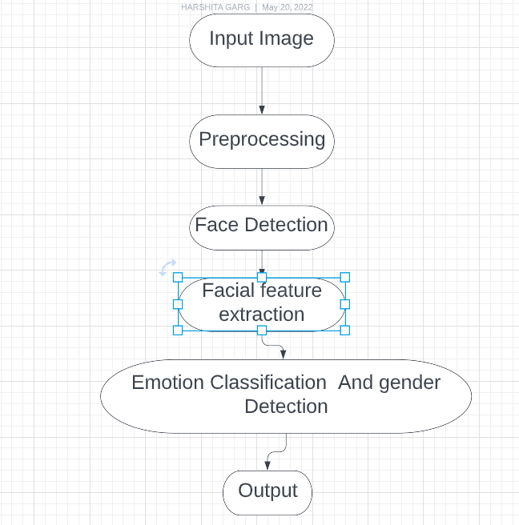
The Workflow of Project

Slide 5
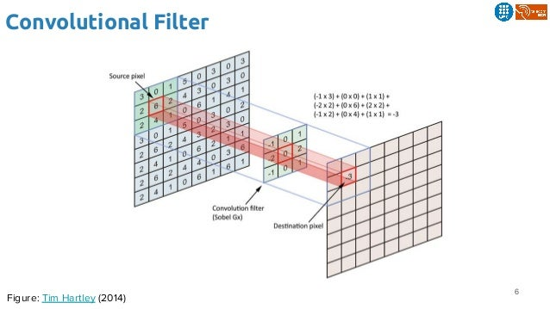
Convolutional Neural Networks
CNNs consist of multiple convolutional layers
each layer containing numerous “filters”
which perform feature extraction.
Initially these “filters” are random and by
training, the feature extraction gets
better by better.
It’s primarily used for image classification.

Slide 6
Neural Networks In Project
CNN consists of multiple convolutional layers and each layer contains numerous filters which perform feature extraction.
It’s primarily used for image classification
It primarily has 4 layers
Pooling layer
Fully Connected Layer
Activation Layer
Final Output Layer

Slide 7
Our CNN Model
First layer is a 2D convolutional layer. Kernel is of size 3 * 3. The input sphere represents the pictures which are 48 * 48 . ReLu is taken as the activation function
Again the convolutional 2d network is created with 64 neurons
Max Pooling layer has the dimensions 2 * 2
Dropout rate is 25%
Again, we have the convolutional layer, max pooling layer and a dropout
Finally, we flatten the output
Now, the dense layer , which is a hidden layer contains 1024 neurons
Then , we add a dropout of 50%
The final layer has 7 outputs .

Slide 8
CNN model for gender detection
First layer is a 2-d convolutional layer with kernel size of 3*3 . The input sphere has the pictures of 100*100. ReLu is used as activation function
2-d max pooling layer is provided
Dropout rate is 0.1
Similar configuration is followed for next 3 layers
Flattening is done and is passed to dense function which has 128 parameters.
Dropout rate is 0.2
Output is passed to the dense function which finally maps to two outputs : male or female

Slide 9
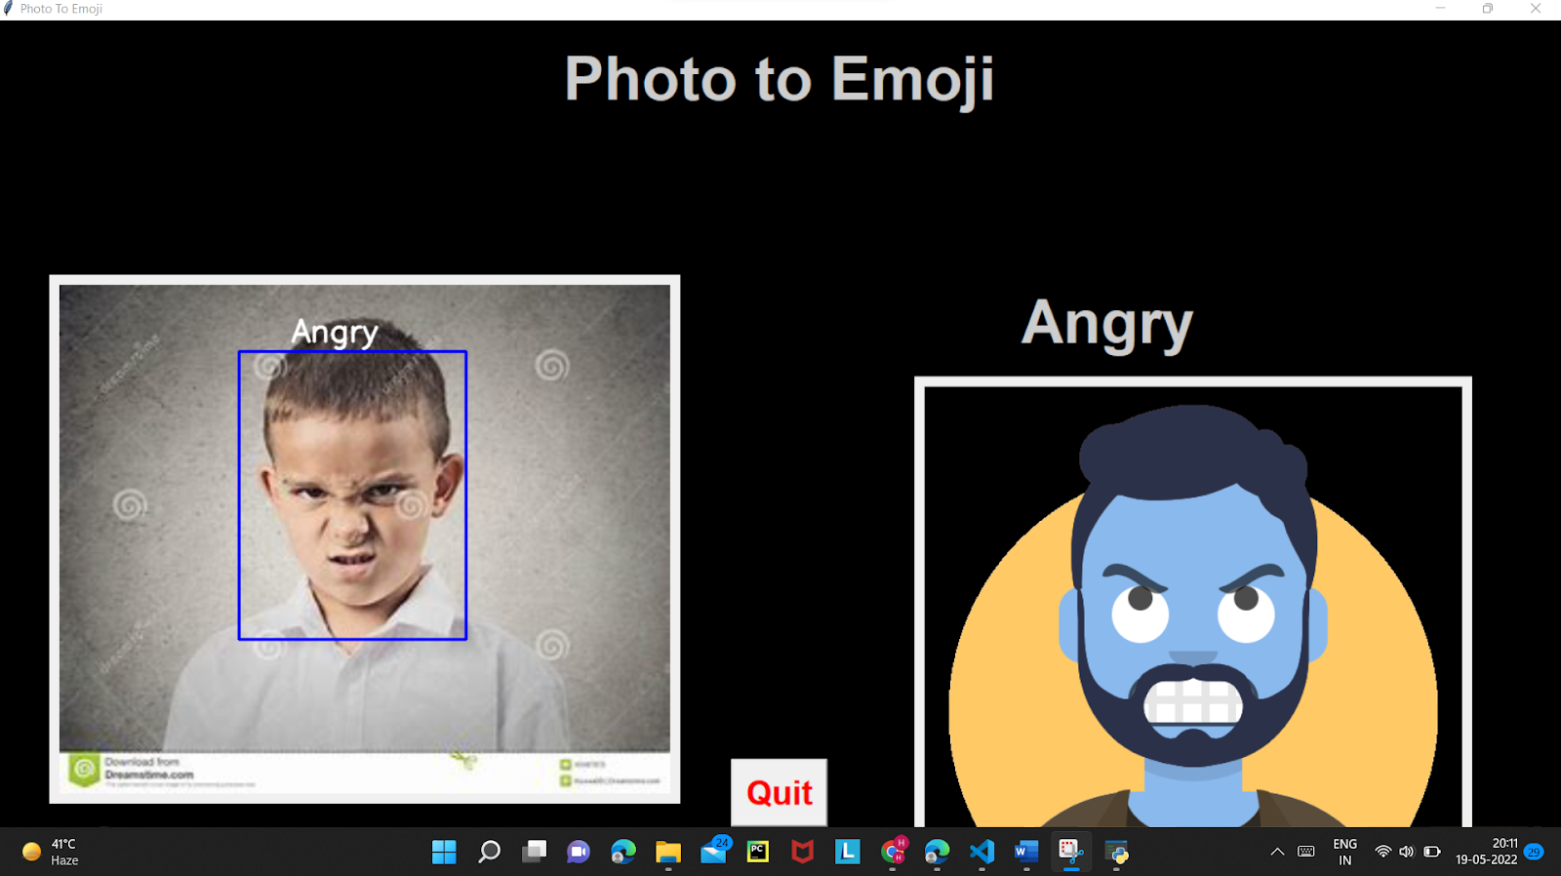
Results
Angry Emotion Recognition

Slide 10
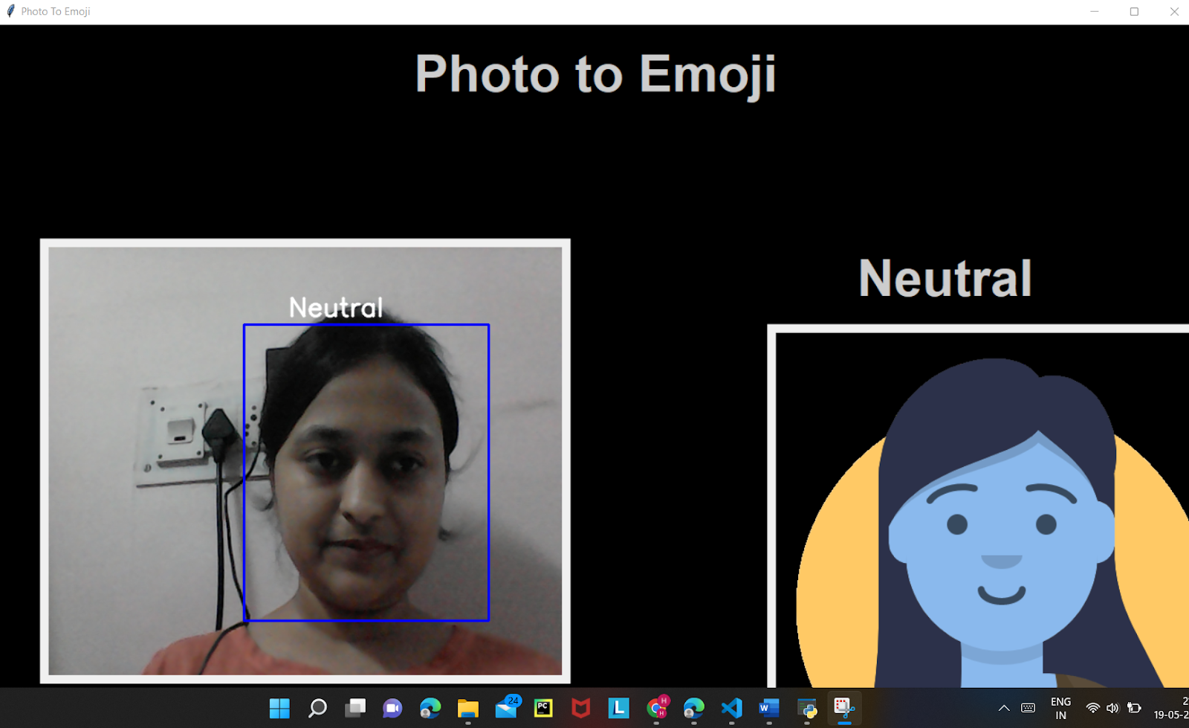
Results

Slide 11
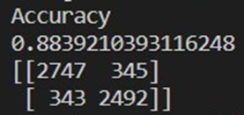
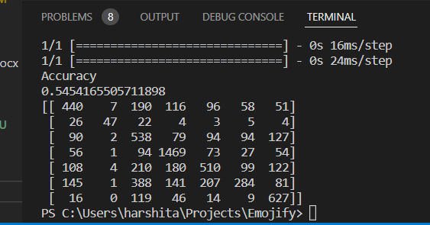
Accuracy Of Models
Accuracy and Confusion matrix of gender Model
Accuracy and Confusion matrix of Emotion Model

Slide 12
Software Requirements
Python 3.6.6
TensorFlow 1.11.0
OpenCV 3.4.3.18
NumPy 1.15.3
Keras 2.2.1
Scikit-learn 1.1.0
Matplotlib
PIL 5.3.0

Slide 13
Limitations of Our Model
The emotion model which we have has an accuracy of 54.7% and gender model has an accuracy of 88.7% which can be improved
On a real video it takes a little bit of time to predict the expression
Face should be held high and proper lighting conditions are required. So this can be improved
Sometimes Model could not able to correct the gender correctly there’s need of some improvement

Slide 14
Conclusion and Result
We have developed a Convolutional Neural Network based emotion detection model and gender detection model which works both in real time and by providing an image already stored in the device and predicts emoji corresponding to that emotion.
We hope to make more improvements like improved accuracy in future

Slide 15
Future Scope
We are Planning to achieve higher accuracy in Emotion model .
We are planning to achieve a good accuracy in complex background , dim light conditions and also when camera is held at some different angle.
We are planning to make its predictions bit faster in Real time Video

Slide 16
THANK YOU!

