Slide 1
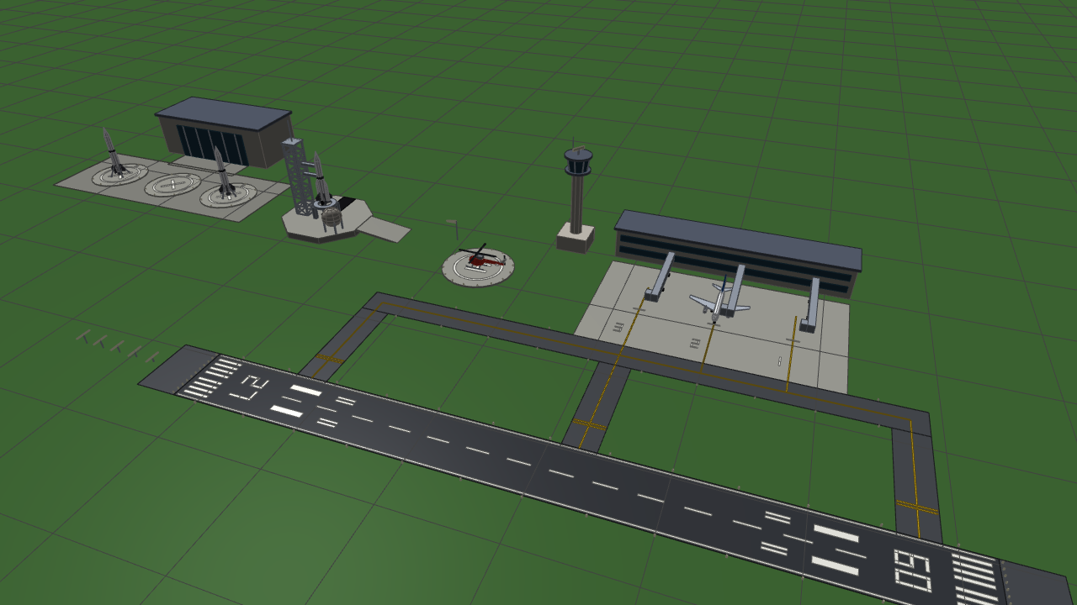
Airport ATC Simulation
in OpenGL
CSE 4102 · COMPUTER GRAPHICS PROJECT
Geometry · Transformation · Illumination · Shading
Student name: Md. Mosaddek Ali
Roll: 2107027
Course No: CSE 4102
Airplane, helicopter and a two-stage rocket in one lit, coloured airport
Notes:
Good morning. This is my CSE 4102 project: a real-time airport simulation written in C++17 and OpenGL 3.3 core, with three objects - an airliner, a helicopter and a two-stage rocket. Everything you will see is generated in code: no model files, no textures, and no maths library.

Slide 2
Outline
INTRODUCTION
1
Geometry and vertex calculation — every vertex and normal from an equation
2
Transformations — model, view and projection matrices by hand
3
Illumination model — Phong reflection with a sun the user can move
4
Shading: Gouraud vs Phong — the same equation in two pipeline stages
5
Colour, materials and depth — palettes, gloss and the depth buffer
6
Simulation and manual flight — state machines; the airliner flown by hand
7
Live demonstration — a recording of the running simulation
Notes:
The talk follows the rendering pipeline: first the vertices, then the matrices that move them, then the light and the two shading models, and finally a live recording of the simulation.

Slide 3
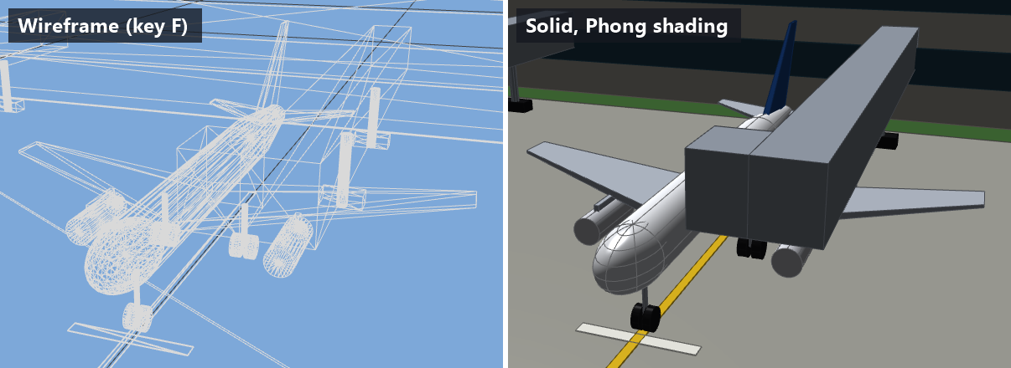
Every vertex comes from an equation
GEOMETRY AND VERTEX CALCULATION
6 generators produce 12 unit-sized meshes, uploaded to the GPU once.
Vertex layout 6 floats: position x y z and normal nx ny nz.
Flat vs smooth a cube keeps 24 vertices so its edges stay sharp; a sphere shares normals so it looks round.
Key F: the wireframe shows every triangle the generators produced
n = ( sinφ cosθ, cosφ, sinφ sinθ ), p = 0.5 n
1,900
425
triangles in the whole mesh library
vertices in one 24 × 16 UV sphere
UV sphere — the normal is the normalised position
n = normalize( cosθ, r_{bottom} − r_{top}, sinθ )
Cylinder / cone — from the cross product of the two surface tangents
Notes:
No model files are loaded. Six generator functions compute positions and normals. For the sphere the normal is simply the normalised position because it is centred on the origin. For a cylinder or cone the normal is the cross product of the two surface tangents, which leans upward by the slope of the wall. The whole scene is 1,900 triangles re-drawn with different matrices.

Slide 4
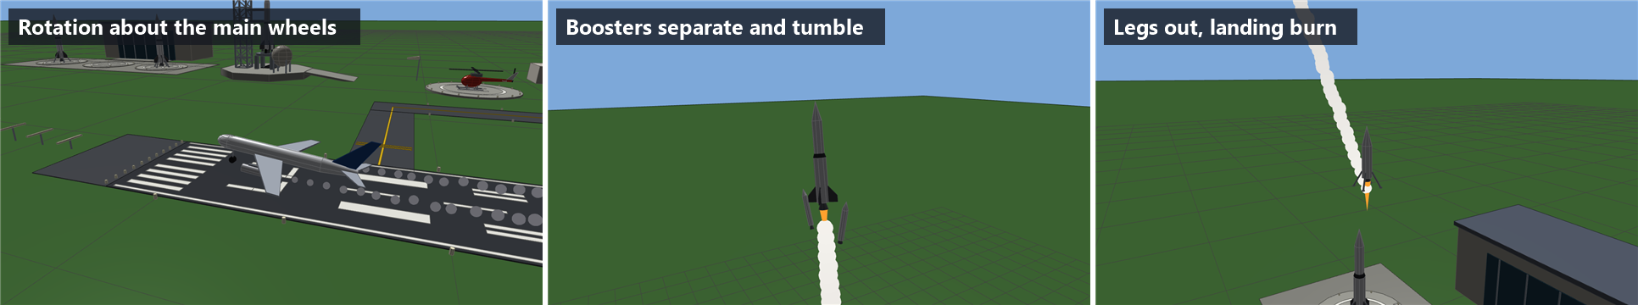
Model, view and projection — written by hand
TRANSFORMATIONS
p_{clip} = P · V · M · p_{local} n_{world} = ( M_{3×3}⁻¹ )ᵀ n_{local}
Hierarchy
Pivot rotation
Normal matrix
every part is base × its own T · R · S, read right to left
T(p) · R · T(−p) for the gear, the rotors and the rocket legs
the inverse transpose keeps normals correct under non-uniform scale
Rotation about the main wheels at lift-off · boosters separating and tumbling · the second stage with its legs deployed
Notes:
Every vertex passes through model, view and projection. The vehicles are hierarchical: the simulation gives a base matrix and each part multiplies its own local transform. Hinged parts rotate about a pivot. Normals use the inverse transpose, which matters because almost every box in this scene is a unit cube with a different scale on each axis.

Slide 5
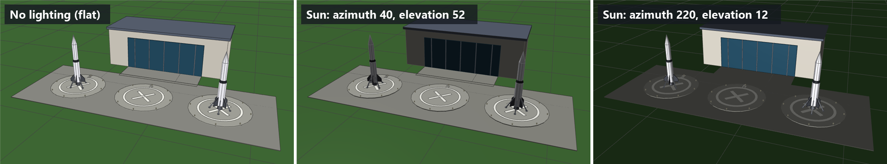
Phong reflection model, one directional sun
ILLUMINATION MODEL
I = k_{d} ( I_{a} + I_{d} max(N·L, 0) ) + I_{s} · gloss · max(R·V, 0)^{n}
Ambient 0.28
Diffuse 0.85
Specular 0.65, n = 36
bounced light: shadowed faces are dark, not black
Lambert — brighter the more a face turns to the sun
white highlight near the mirror direction R
The user moves the sun with [ ] and ; ' — at 12° the ground takes only sin 12° ≈ 0.21 of the diffuse light
Notes:
One directional light. The highlight is added as white light rather than multiplied by the material, so it also shows on a red helicopter or on dark asphalt. The sun is user controlled: as it swings round, the bright faces, the dark faces and the highlights all move with it.

Slide 6
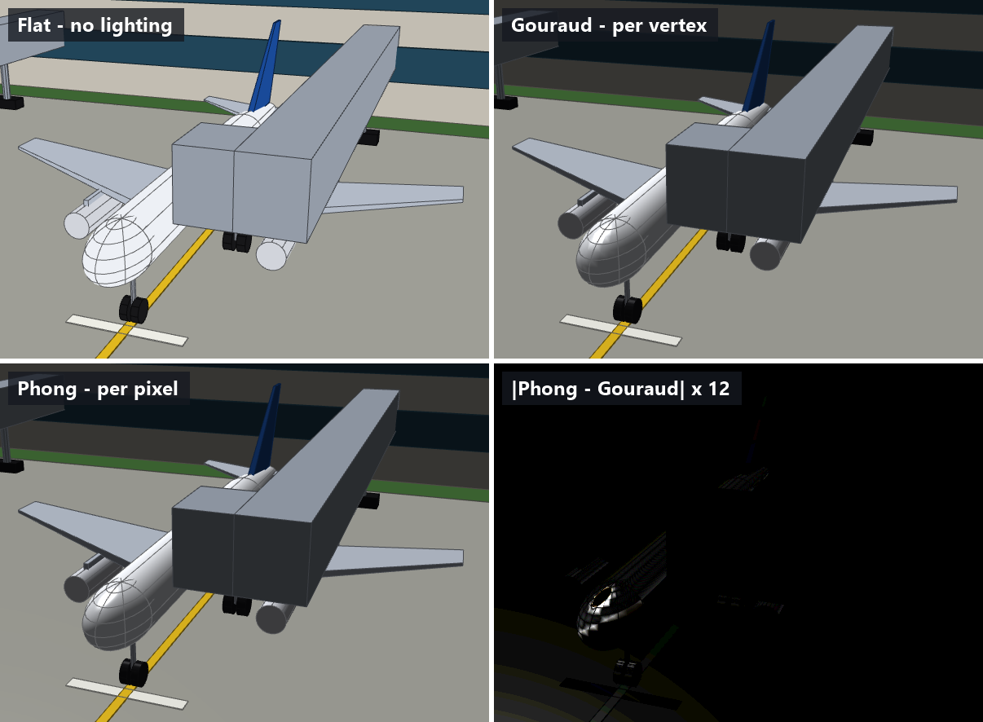
Same equation — evaluated in two different places
SHADING
N
Flat
no lighting at all
G
Gouraud
lit once per vertex, the colour interpolated
B
Phong
the normal interpolated, lit once per pixel
89.7%
of pixels change when the lighting is switched on
10.1%
change from Gouraud to Phong — up to 145 of 255 levels on a highlight
Identical frame, identical geometry, identical sun
Notes:
This is the heart of the project. Both lit modes use exactly the same lighting equation; only the place where it runs differs. They agree on the diffuse light and disagree on highlights that fall inside a triangle. The bottom right panel is the measured difference, amplified twelve times.

Slide 7
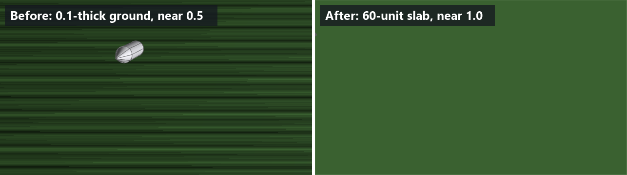
Material = colour + gloss
COLOUR, MATERIALS AND DEPTH
Grass
gloss 0.10
Asphalt
gloss 0.25
Depth precision
Δz ≈ z² / ( near · 2²⁴ )
Concrete
gloss 0.30
Glass
gloss 2.20
Airliner
gloss 2.40
Helicopter
gloss 2.20
Gloss scales the highlight: matte grass shows no glare, a polished fuselage shines. Flames and smoke are drawn unlit.
At 1,646 units up with near 0.5, Δz ≈ 0.34 — more than the 0.1-thick ground, so its two faces fought in stripes. Fixed with a 60-unit slab and near plane 1.0.
Notes:
Every surface carries a colour and a gloss factor. The depth buffer is not linear: almost all its precision sits near the camera, which caused visible z-fighting when the rocket was more than a kilometre up. Pushing the near plane out and making the ground a deep slab fixed it.

Slide 8
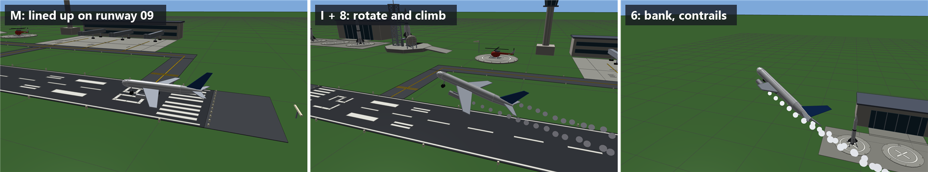
State machines, and the airliner flown by hand
SIMULATION AND MANUAL FLIGHT
Three state machines taxi, take-off, hold, approach and landing; the rocket's two separations and powered landing.
Manual flight (key M) the user takes over: thrust minus drag minus gravity sets the speed, the bank sets the turn.
I / K
throttle
8 / 5
climb / descend
4 / 6
bank
dv/dt = 7u − 0.005 v² − 9.8 sin γ
U / X
gear / brakes
Arrows and W / S stay with the camera, so the runway can be watched while landing.
Lined up · rotate and climb · bank with contrails
Notes:
The three vehicles are finite state machines. One autopilot flight takes 36 seconds from lift-off to touchdown and lands within a hundredth of a unit of the centreline. The airliner can also be flown by hand with a simple point-mass flight model, including a stall below twelve units per second.

Slide 9
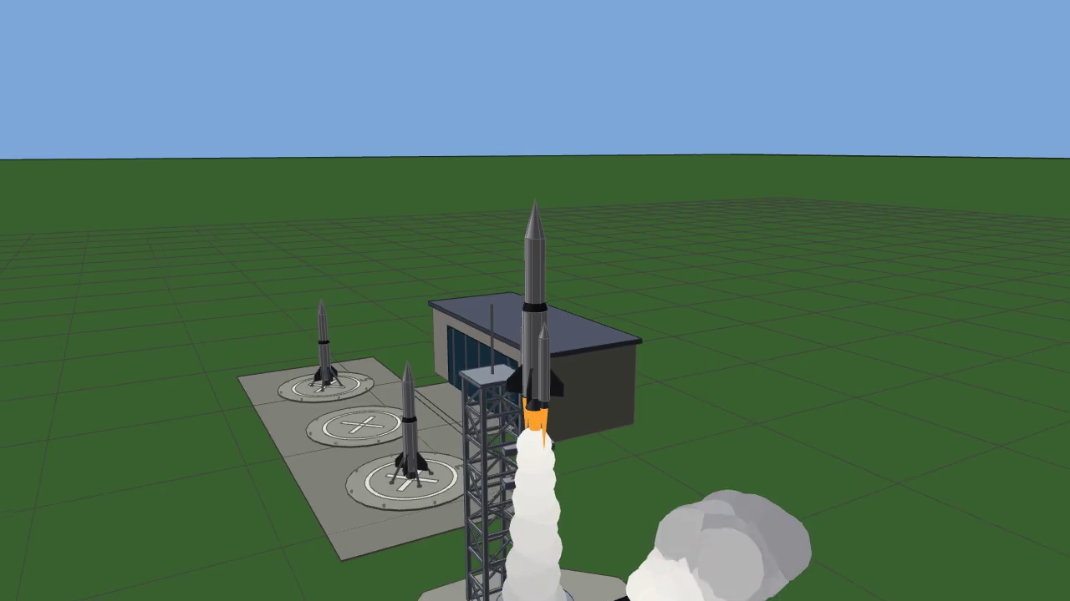
The simulation running
LIVE DEMONSTRATION
Overview · shading models · moving sun · rocket launch and separations · cockpit · manual flight (1 min 46 s)
Notes:
This recording shows, in order: the airport overview, the three shading models switching on the same frame, the sun being swung round, the rocket launch with both separations, the cockpit view, and the airliner being flown by hand. Click to play.

Slide 10
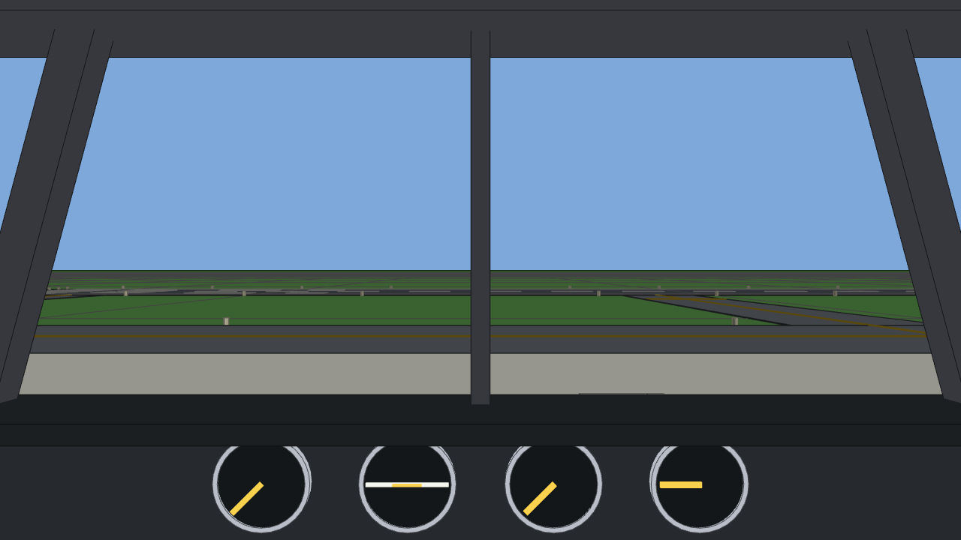
Thank you
Any questions?
Md. Mosaddek Ali
Roll: 2107027 · CSE 4102 — Computer Graphics
Notes:
Thank you. I am happy to demonstrate any part live: the shading keys N, G and B, the sun keys, or flying the airliner by hand.

