Slide 1
CS 1674: Intro to Computer Vision HW2 Background
Prof. Seong Jae Hwang University of Pittsburgh
Slides from Kristen Grauman and Adriana Kovashka

Slide 2
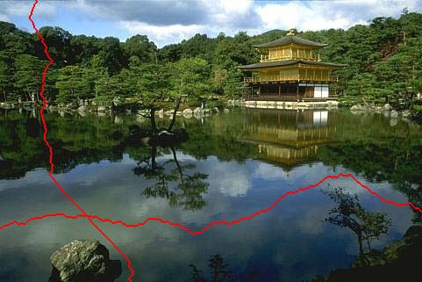
Seam carving: main idea
Resize effect:
6x10 → 5x10
[Shai & Avidan, SIGGRAPH 2007]
Notes:
The idea behind seam carving is to resize images (i.e. remove rows or columns) in such a way that “interesting” content is preserved. So if we want to remove a row, rather than removing a straight line, we will remove one pixel from each column along a “seam”, i.e. the red horizontal line. If we zoom in, a seam might look something like the image in the bottom right. Even though we are removing a non-straight seam from the image, there is only one pixel removed from each column, so each column will contain the same number of pixels. If we remove a single seam from the image on the bottom-right, which originally was a 6x10 image, we obtain a 5x10 image.

Slide 3
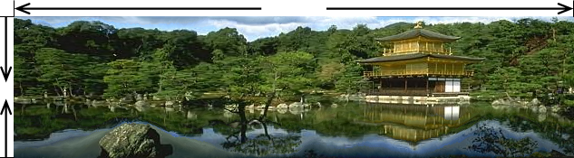

Seam carving: main idea
Content-aware resizing
Traditional resizing
[Shai & Avidan, SIGGRAPH 2007]
Notes:
In contrast to traditional resizing, content-aware resizing allows us to reduce the uninteresting content (e.g. the water which is a relatively uniform region) and to preserve interesting content with a lot of detail (like the building or trees). The results look visually more appealing than traditional resizing.

Slide 4
Seam carving: main idea
Content-aware resizing
Intuition:
Preserve the most “interesting” content
→ Prefer to remove pixels with low gradient energy
To reduce or increase size in one dimension, remove irregularly shaped (non-straight) “seams”
→ Optimal solution via dynamic programming.
Kristen Grauman, UT-Austin
Notes:
So again, we will preserve the most interesting content, and we will reduce (or can also increase, which we won’t discuss) the image in one dimension, by removing irregularly shaped (in other words non-straight) seams.
To preserve interesting content, we will remove pixels with “low-gradient energy” (to be discussed next), and to find the optimal seam which to remove, we will use dynamic programming.

Slide 5
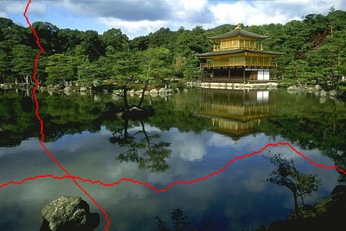
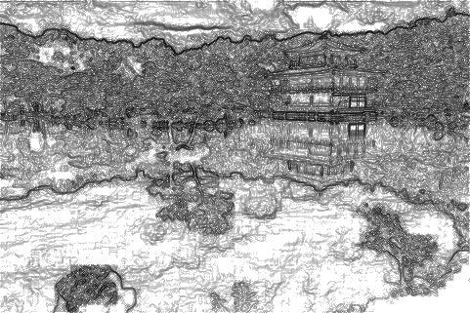
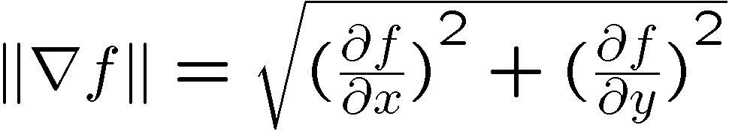
Seam carving: main idea
Want to remove seams where they won’t be very noticeable:
Measure “energy” as gradient magnitude (horizontal/vertical change)
Choose seam based on minimum total energy path across image, subject to 8-connectedness.
Kristen Grauman, UT-Austin
Notes:
We want to remove seams where they won’t be very noticeable. So we’ll measure the “energy” of an image as the image gradient magnitude, i.e. the horizontal and vertical change. The formula shows you how the energy of the image f, at each pixel (where pixel indices are not shown in the formula) is the squared sum of two derivatives. Rather than thinking of these as derivatives, think of them as the change of image intensity (which we denote by f) in the x direction and the change in the y direction. To compute this change, you can use one of the filters we discussed in class, which measures distances between pixels on the left/right, or analogously, between pixels above/below. Remember from class that horizontal gradients (i.e. dramatic change in intensity in the x direction) detect vertical edges, and vice versa.
We will choose a seam based on the minimum cumulative energy across and image, subject to 8-connectedness. By 8-connectedness we mean that a pixel has 8 neighbors, i.e. all pixels in a 3x3 window around the pixel itself.

Slide 6
Seam carving: algorithm
s₁
s₂
s₃
s₄
s₅
Let a vertical seam s consist of h positions that form an 8-connected path.
Let the cost of a seam be:
Optimal seam minimizes this cost:
Compute it efficiently with dynamic programming.
Kristen Grauman, UT-Austin
Notes:
Let a vertical seam s consist of h positions, where each pixel along the seam has 8 neighbors. It turns out we’ll only examine the 3 neighbors above or to the left of a pixel, but in order to ensure that a seam is actually connected, we’ll think of a pixel as having 8 neighbors.
So in the example on the left, we have a chain (seam) of 5 pixels.
The optimal seam we want to cut from the image is the one that has the lowest cumulative energy. The energy of a seam is the sum of the energies of the constituent pixels.
So we can compute the energy of all possible seams, and choose to cut the one that minimizes that energy across all possible seams.
We will use dynamic programming to efficiently find the seam that has the smallest energy.

Slide 7

Seam carving: algorithm
Compute the cumulative minimum energy for all possible connected seams at each entry (i,j):
Then, min value in last row of M indicates end of the minimal connected vertical seam.
Backtrack up from there, selecting min of 3 above in M.
Computing horizontal seams is analogous.
row i-1
j-1
j
j+1
row i
j
Energy matrix
(gradient magnitude)
M matrix:
cumulative min energy
(for vertical seams)
Kristen Grauman, UT-Austin
Notes:
Our first task is to find the cumulative energy of all possible connected seams. We will store one cumulative energy value for each pixel, into a matrix we call M.
The cumulative energy M(i, j) is the sum of the raw energy at pixel (i, j), and the minimum cumulative energy above that pixel.
So we’ll plot both the raw energy matrix (on the left) and the cumulative energy (on the right).
Let’s say that we are at pixel j (column j) in row i.
To find the minimum energy above, we consider pixels in row i-1, and only those pixels in that row that are neighbors to pixel j. In other words, we only consider pixels j-1, j, and j+1 in row i-1.
We start at the top, and keep computing values for M going down the image.
Then, the minimum value in the last row of M indicates the end of the optimal seam.
We can backtrack from there to find the full optimal seam, selecting the minimum of the 3 neighbors above each pixel, starting from the bottom.
Computing the optimal seam for horizontal seams is analogous, you just start from the left rather than the top and go to the right rather than to the bottom.

Slide 8
Example
First, compute cumulative energy from raw energy
Energy matrix
(gradient magnitude)
M matrix
(for vertical seams)
Kristen Grauman, UT-Austin
Notes:
Here is an example. On the left is the raw energy, which is the sum of the difference between pixels to the left/right and above/below each pixel.
For the first row of the cumulative energy, which we’ll show on the right, there is no preceding row, so we just copy the raw energy values.
For the second row, we start at the left, i.e. what corresponds to a value of 2 from the original energy matrix.
To compute M(2, 1), we take 2, and add to it the minimum value above the 2. We have to choose between 1 and 3, since M(2, 1) only has 2 neighbors above. 1 is smaller, so we add 1 to 2, and we obtain M(2, 1) = 3.
Now we need to compute the cumulative energy at the pixel that has 8 in the raw map, i.e. we have to compute M(2, 2). That’s equal to 8 plus the smallest among (1, 3, 0), i.e. the final value is 8+0 since the minimum is 0.
For M(2, 3), we compute 9 + min(3, 0), i.e. 9.
Now we move on to the third row.
Things get a little trickier because now we have to reuse the previous rows already computed for the cumulative energy map M, shown on the right, so we’ll be taking minima over the row of M that we just computed.
For M(3, 1), which in the raw energy map is 5, we compute 5 + the minimum of (3, 8), i.e. 5+3 = 8.
For M(3, 2), what do we have? Take a moment to compute it.
You should have gotten 5, which is 2 + min(3, 8, 9) = 5.
What do you get for M(3, 3)?
You should get 14.

Slide 9
Example
Now backtrack
Energy matrix
(gradient magnitude)
M matrix
(for vertical seams)
Kristen Grauman, UT-Austin
Notes:
Now we’ve computed the cumulative energy, and we need to use it to compute the optimal seam.
We’ll start at the bottom of the cumulative energy map M (on the right), and take the minimum value of that row.
That’s the value 5.
Now we need to pick the minimum from the values above the 5 in M, and we have three options: 3, 8, 9. We pick the 3.
Now we need to pick among the values above the 3, but we only have two values, 1 and 3. We pick the 1.
Now the highlighted values form our vertical seam.
Of course this is just a tiny example, usually there will be longer seams for larger images.
The next step would be to remove that seam from our toy 3x3 image, thus obtaining a 3x2 image, i.e. we removed one column, corresponding to a vertical seam.
Note that if you use a greedy approach over the original raw energy map to select the minimum seam, you’ll get a different seam. We won’t go into detail.

