Slide 1
PROJECT TITLe: AI Builder Hub – Smart Resume, Portfolio & Cover Letter Generator
CAPSTONE PROJECT
Presented By:
Gummadi Pradeep Kumar Shishira
Malla Reddy Engineering College for Women
CSE – Data Science

Slide 2
OUTLINE
Problem Statement (Should not include solution)
System Development Approach (Technology Used)
Algorithm & Deployment (Step by Step Procedure)
Result
Conclusion
Future Scope(Optional)
References

Slide 3
Problem Statement
In the current digital era, job seekers and professionals struggle to create polished resumes, portfolios, and cover letters tailored to each opportunity. Manually designing and updating these documents is time-consuming, lacks personalization, and often fails to highlight individual strengths effectively.
There is a need for an AI-powered platform that can automatically generate, customize, and manage professional assets — saving time and ensuring quality output.

Slide 4
System Approach
Technologies Used:
Frontend & Framework: Streamlit, HTML, CSS
Backend: Python
AI Model: Google Gemini API
Database: Local file storage / Firebase (optional)
Deployment: Streamlit Cloud or Localhost

Slide 5
Algorithm & Deployment
User Input Collection The system begins when the user selects a module — Resume Builder, Portfolio Builder, or Cover Letter Builder. Streamlit forms collect personal details such as name, skills, education, projects, and job preferences.
Prompt Construction The collected inputs are structured into a natural-language prompt. Example: “Create a professional resume summary for a software engineer skilled in Python, AI, and web development.”
AI Processing using Google Gemini The structured prompt is sent to Gemini API through the Python backend. Gemini performs natural-language understanding and generates context-aware, grammatically correct, and human-like content.
Output Parsing and Formatting The generated text is parsed and arranged according to predefined templates. Streamlit then formats it into visually organized sections such as Experience, Skills, Education, and Projects.
Dynamic Preview and Export Users can preview, refine, and export the generated content to PDF or DOCX. Each module launches independently in a new Streamlit tab for a seamless workflow.

Slide 6
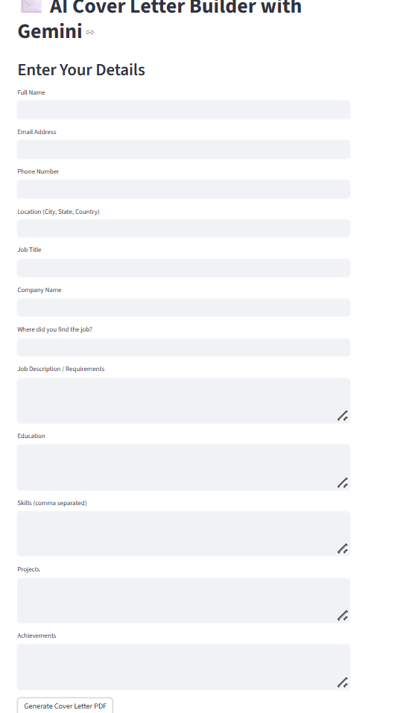
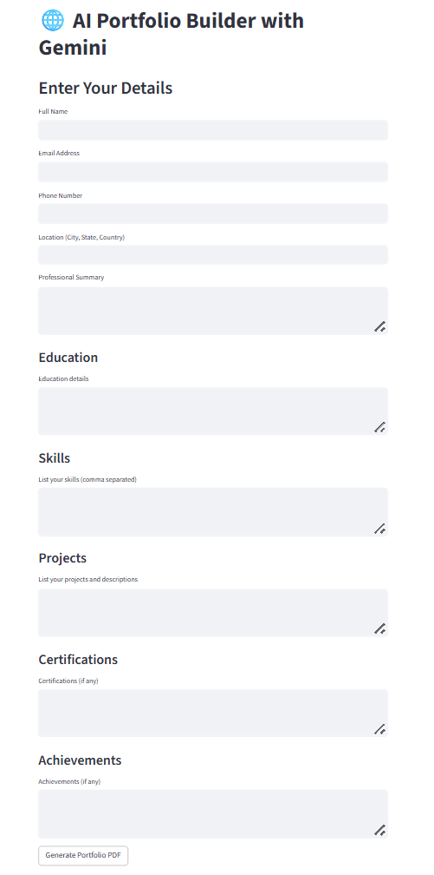
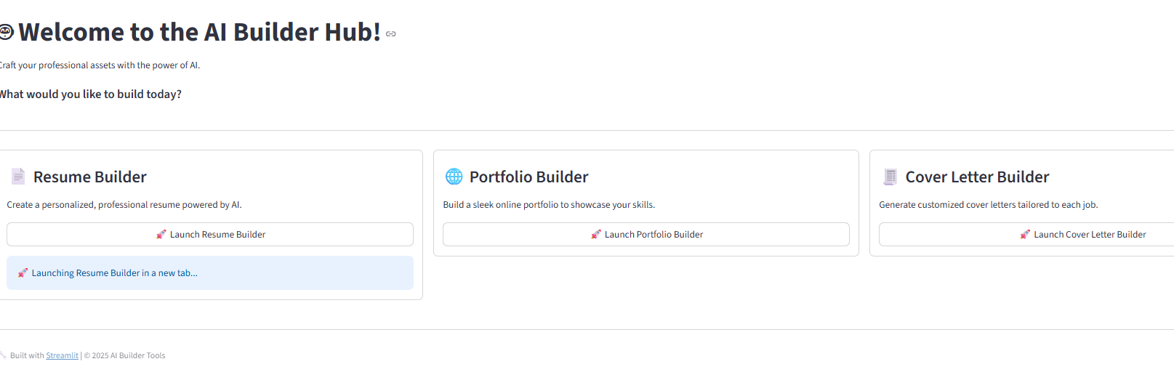
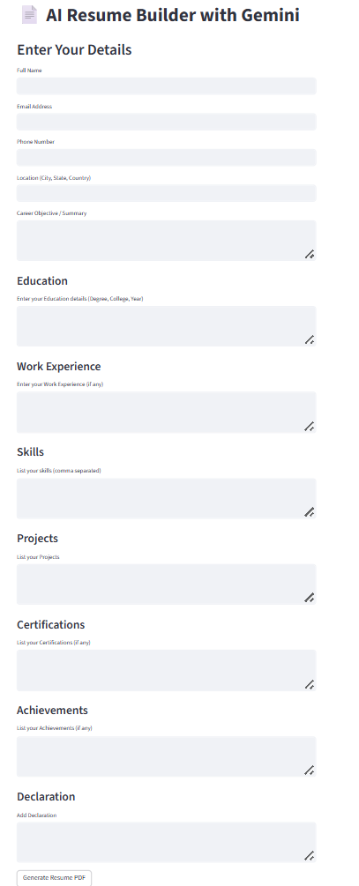
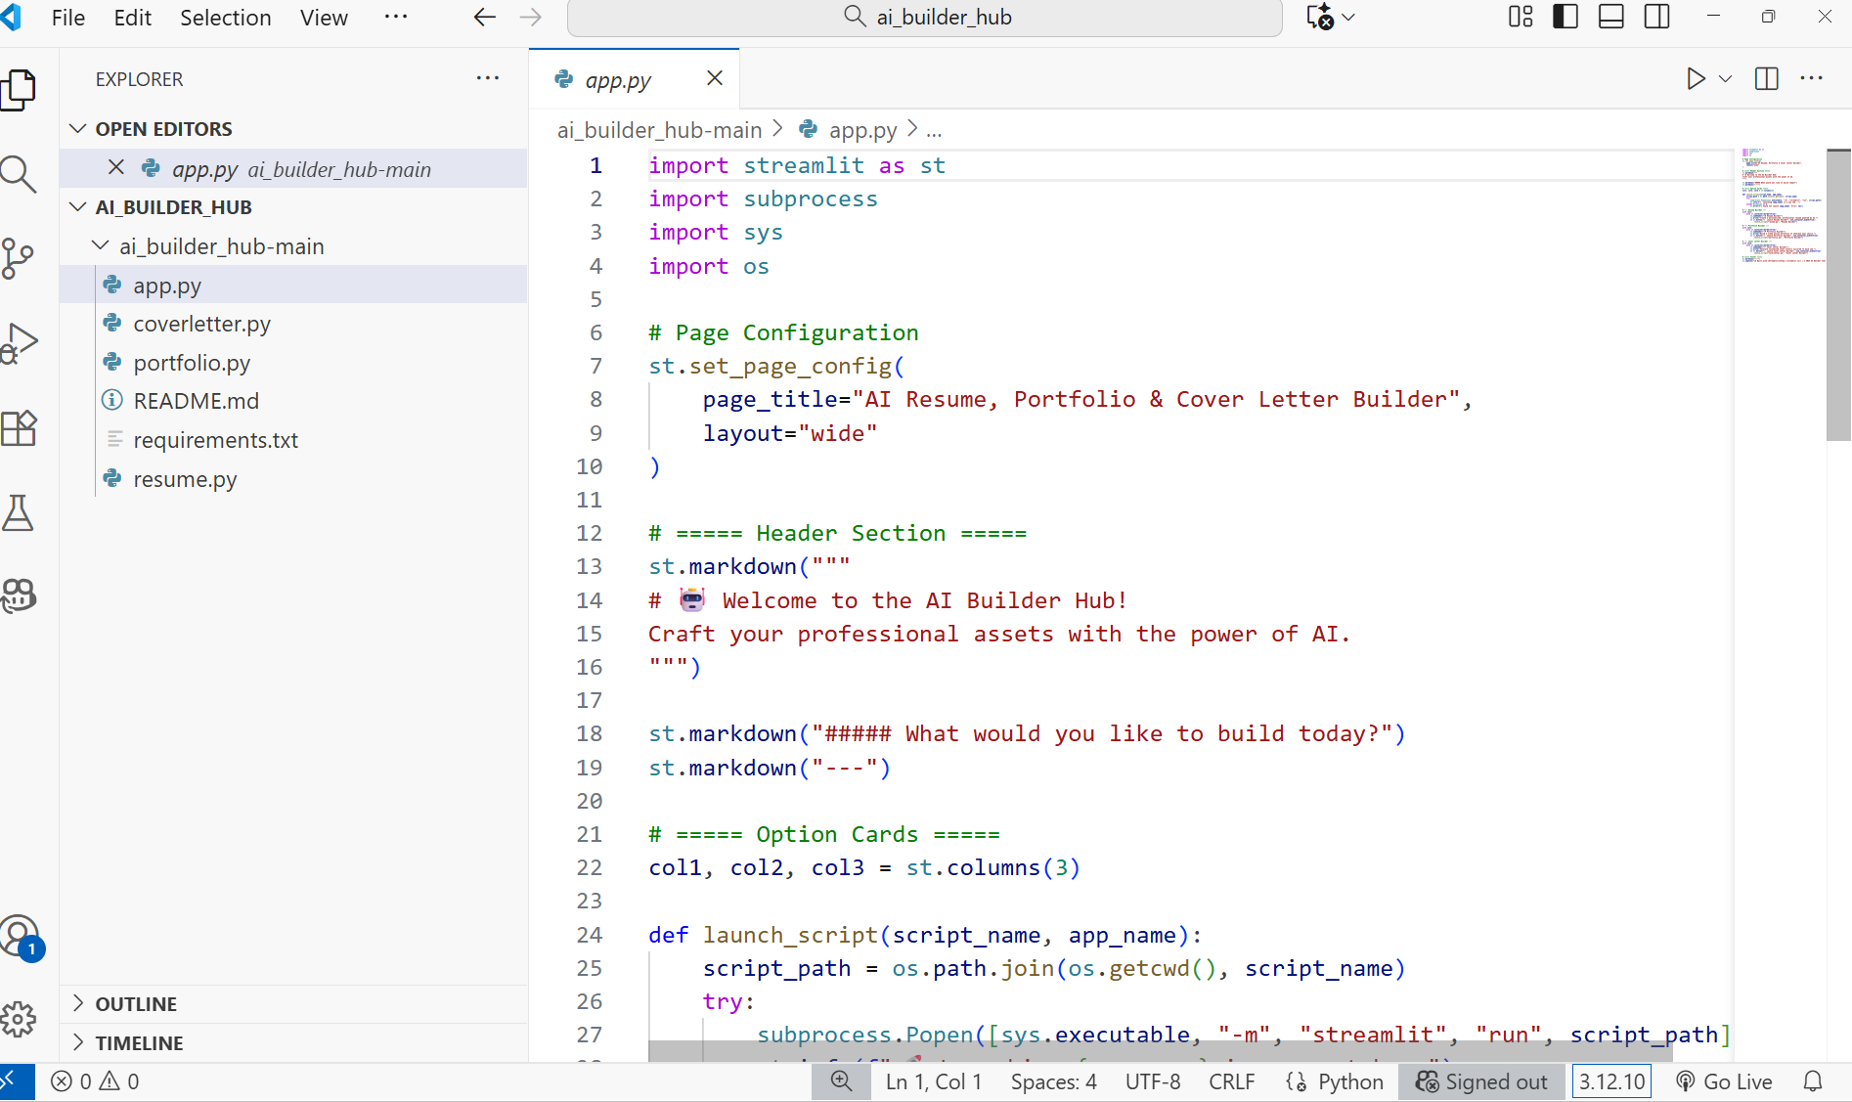
Result

Slide 7
GITHUB AND DEPLOYMNET LINK
Attach your Github Link : coding files GITHUB
https://github.com/shishira-sagar/Ai_Builder_Hub-Ai-Cloud.git
Deployment link: STREAMLIT
https://aibuilderapp-ai-cloud-na2r9radfmqwj27dh8ker4.streamlit.app/

Slide 8
Conclusion
The AI Builder Hub provides an innovative solution for automating resume, portfolio, and cover letter creation using Google Gemini AI. It enhances productivity, ensures consistency, and provides a professional edge to users seeking to improve their career documents.
This project demonstrates the real-world potential of integrating AI-driven NLP with Streamlit to build intelligent web applications.

Slide 9
Future scope(Optional)
Integration of multiple design templates and color themes.
Add login authentication and cloud data saving.
Support export options (PDF, DOCX, and HTML).
Enable direct portfolio hosting and sharing.
Include chatbot assistance for career suggestions.

Slide 10
References
Google Gemini API Documentation – https://ai.google.dev/
Streamlit Documentation – https://docs.streamlit.io/
Python Official Docs – https://www.python.org/doc/
GitHub / Stack Overflow – Community support and implementation references

Slide 11
THANK YOU

