Slide 1

SmartRide App
The Tech Team

Slide 2
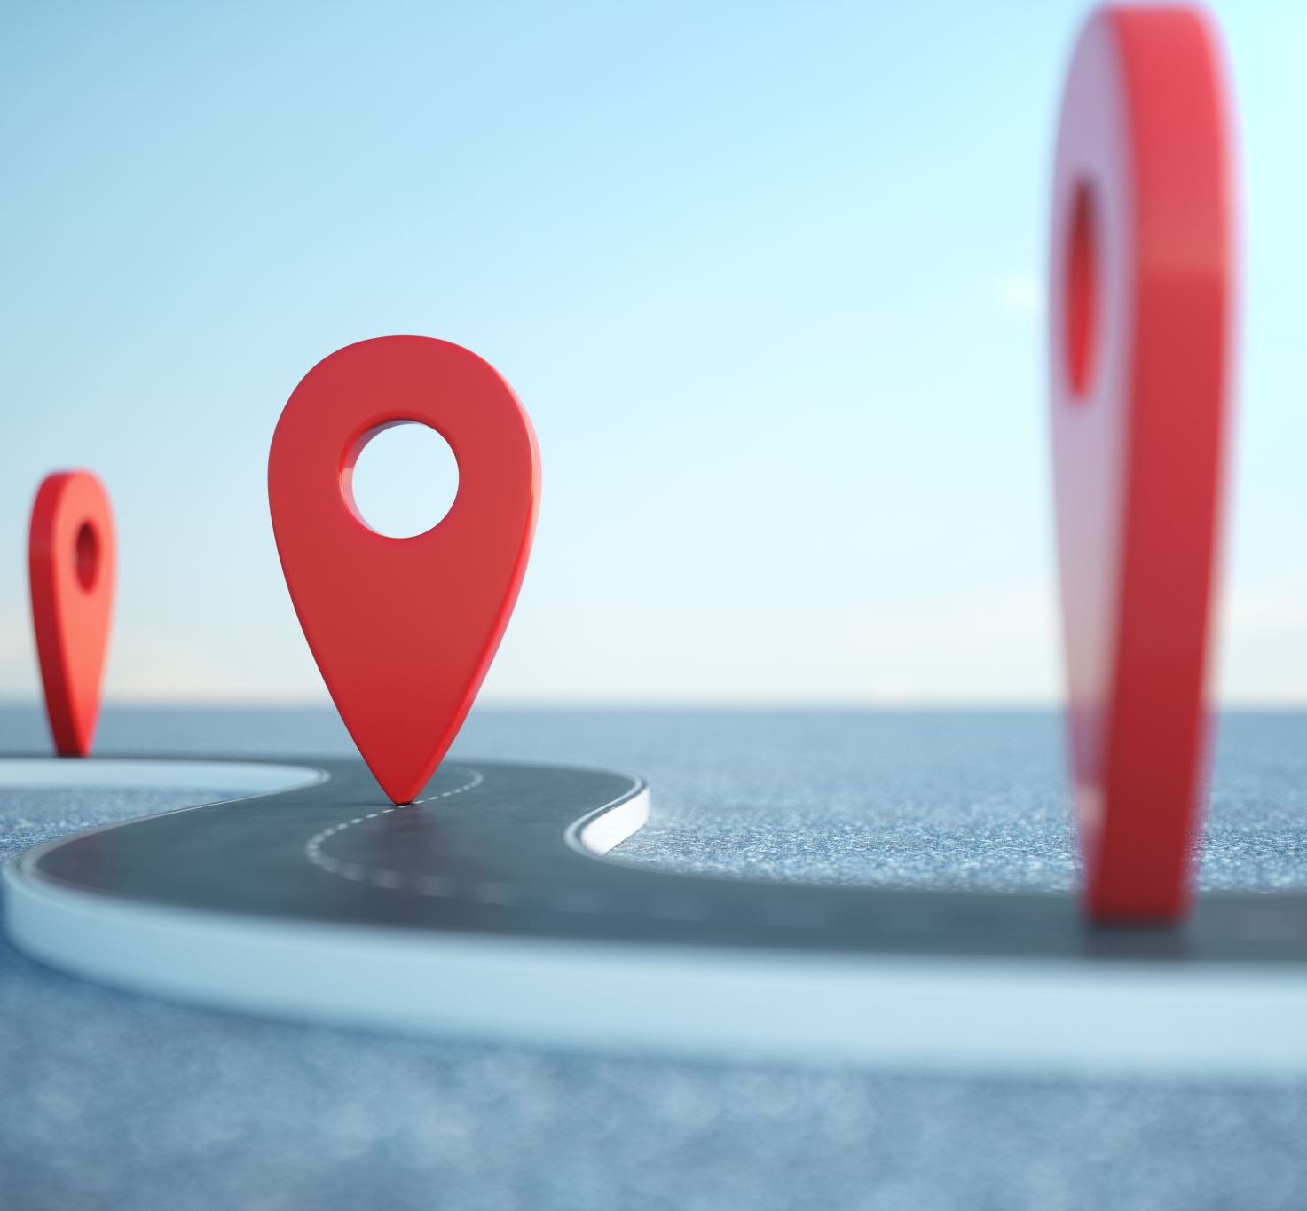
Challenges faced in Transit System:
Missing sustainable modes of transportation
Lack of real time insights
Accessibility in High Density places
Limits on promoting sustainable transit choices

Slide 3
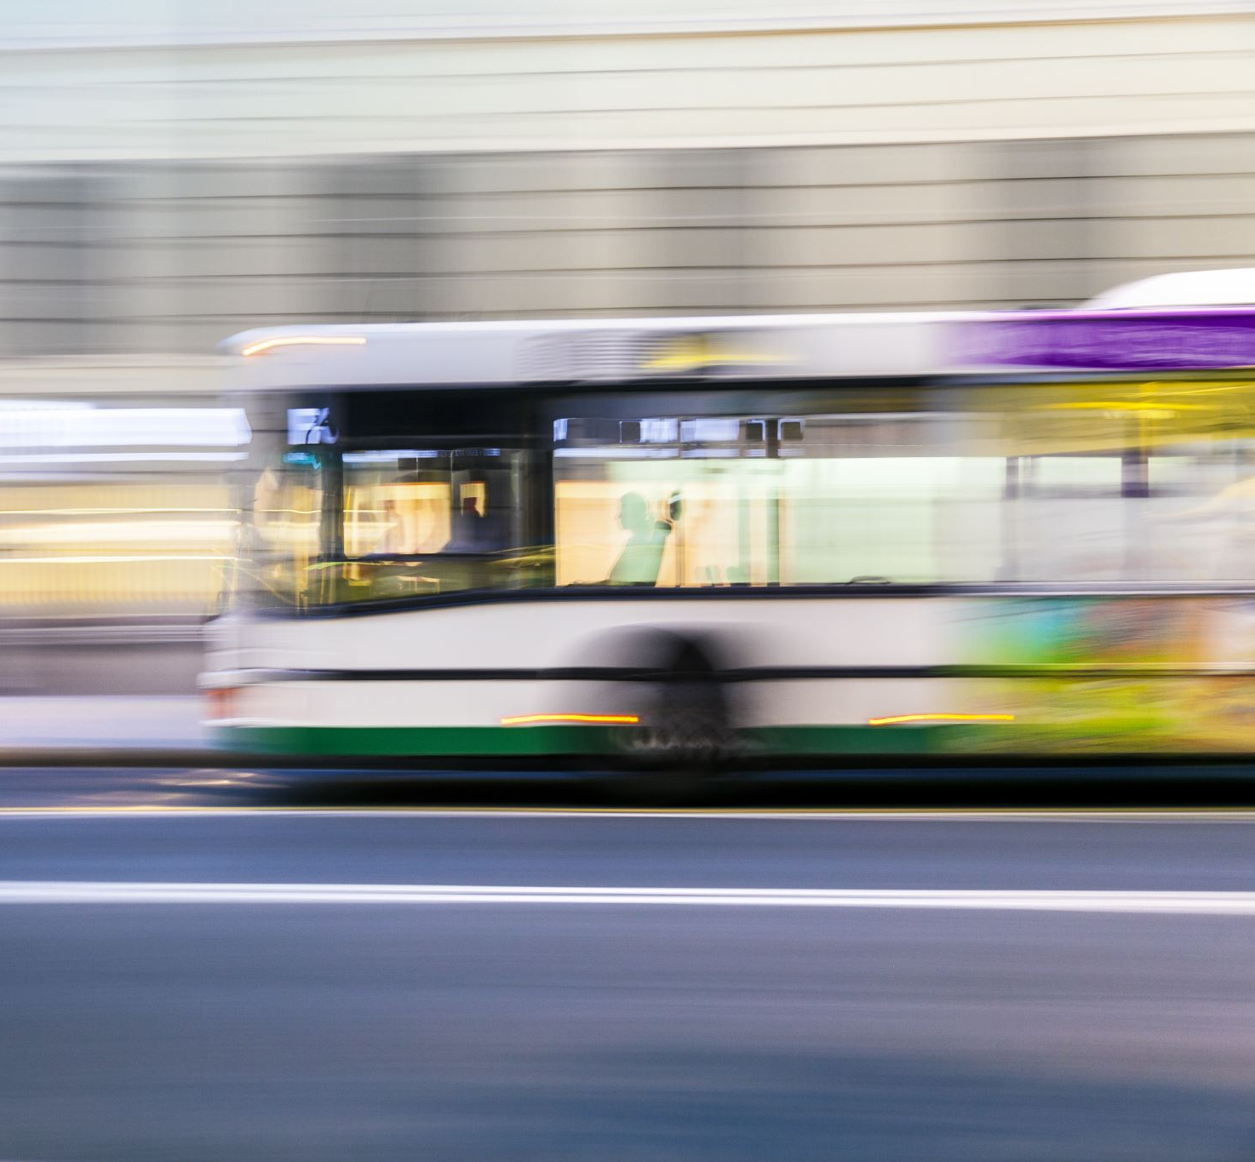
Solution
Implementing Sensor-based bus stops to collect and analyze:
Bus occupancy levels.
Air quality.
Real-time bus schedules.
Road conditions.
Peak travel hours

Slide 4
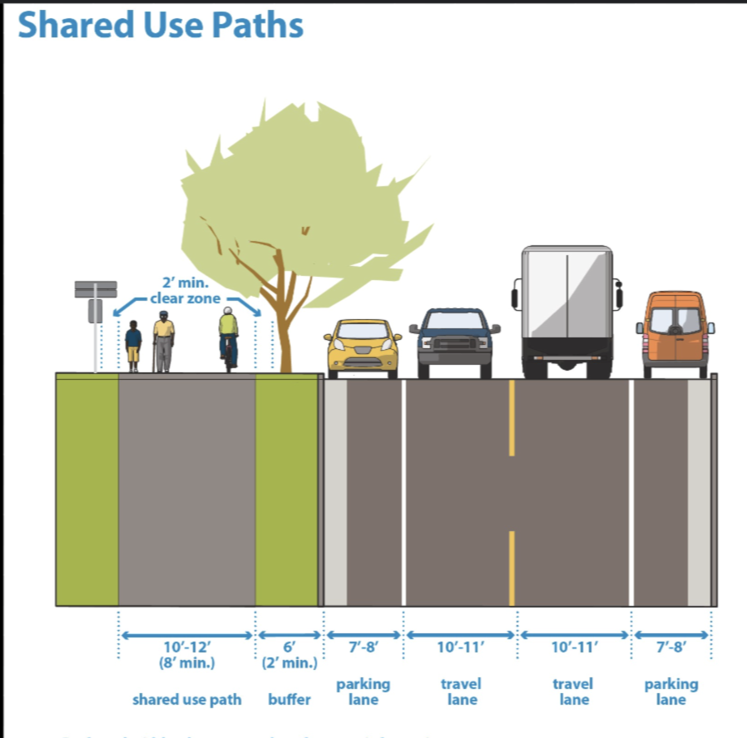
Proposing building more Multi-use pathways.
Design roads with dedicated lanes for vehicles, bikes, parking, and pedestrian paths.

Slide 5
Features and Benefits for Users
Real-time updates
Bike Booking
Time-Sensitive Notifications
Rewards and Incentives

Slide 6
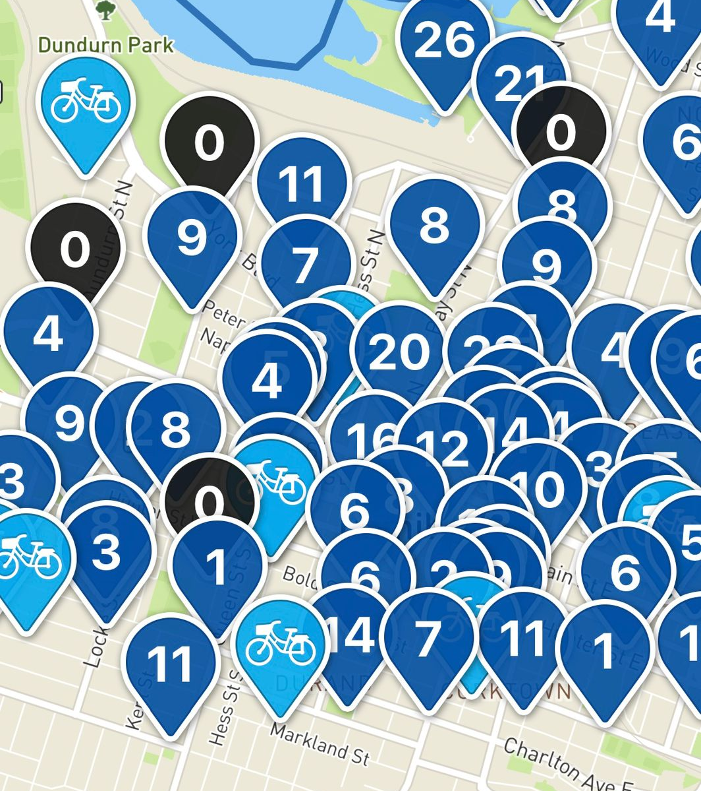
Bike Rides
Prioritize building and expanding bike lanes in :
Densely populated areas
Areas with low-air-quality
Areas with inconvenient access to buses
Areas near public terminals to offer multi-modal transportation

Slide 7
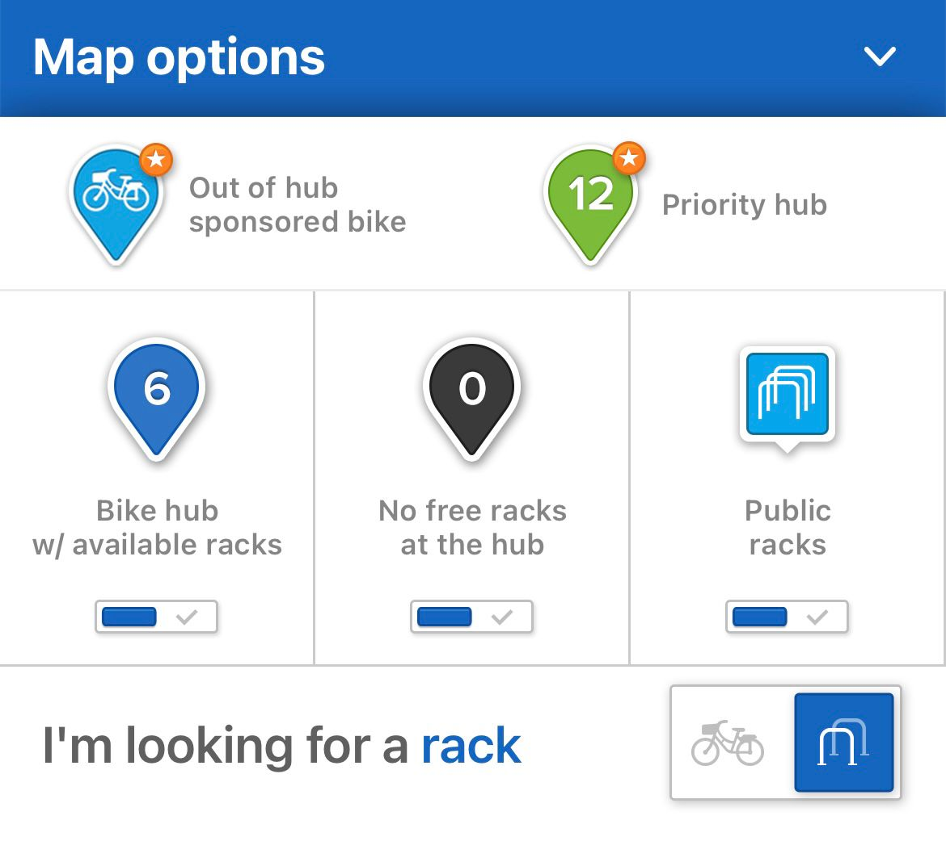
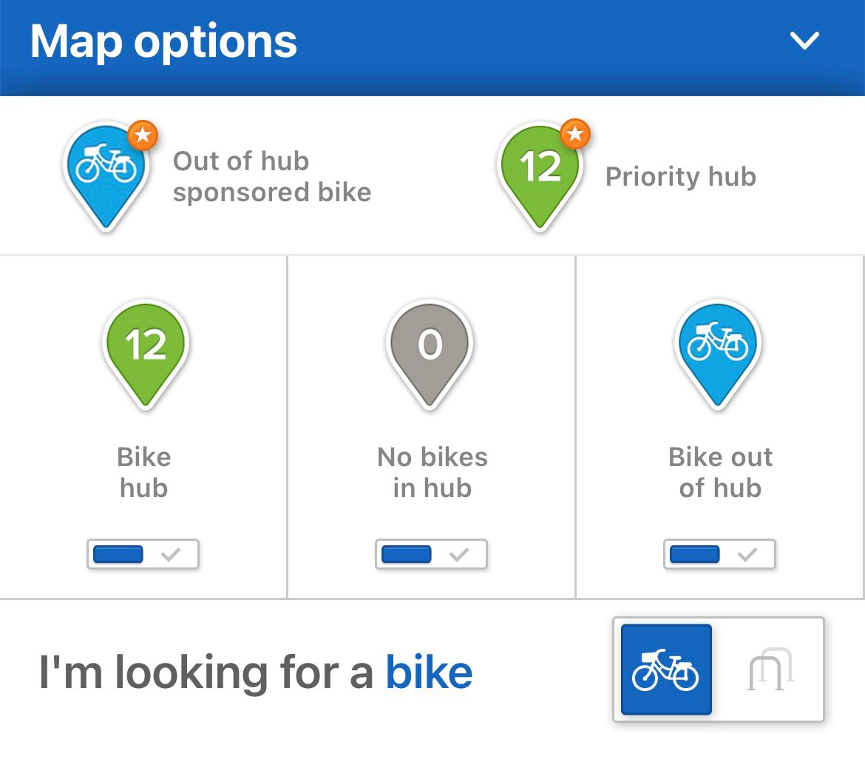
Adapting SOBI’s Success for Brampton
Hamilton partnered with McMaster University.
Objective: Improve student and resident mobility, reduce carbon footprint, and promote a healthier lifestyle.
Highest Record: 24,000 trips in a week

Slide 8
Expected Impact
Promotes Sustainability
Enhances User Experience
Encourages Healthy Travel Habits

Slide 9
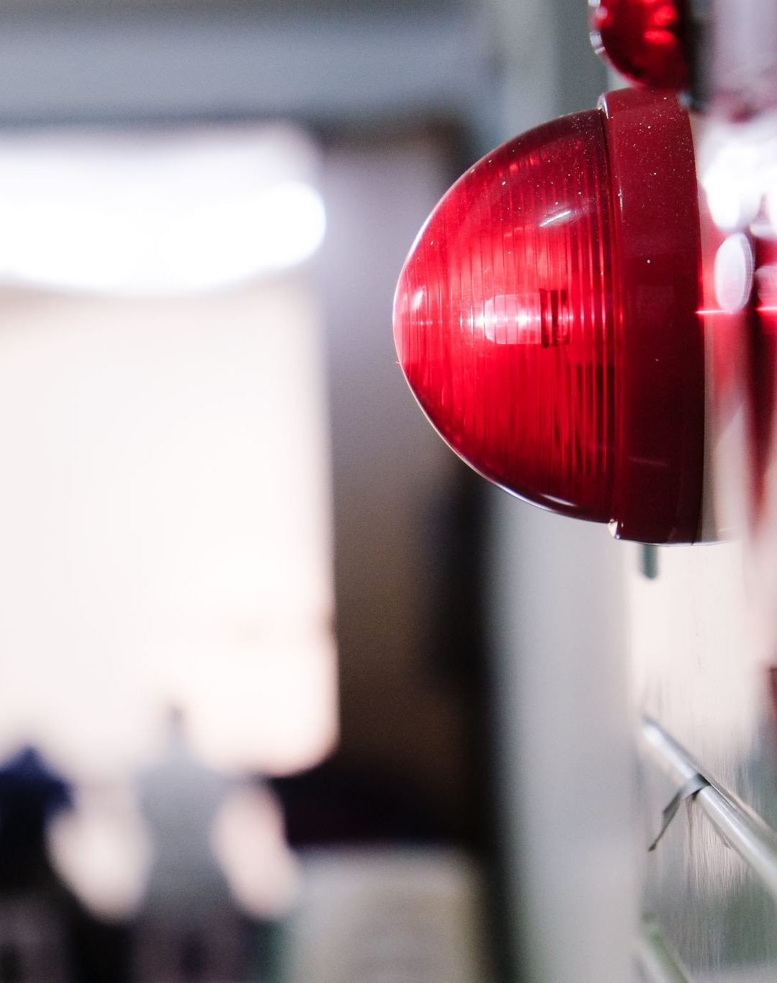
Accessibility Challenges in Crowded Buses
Challenge reaching stop button in crowded buses.
Accessibility impacted.
Discomfort for limited mobility users.

Slide 10
Implementing Smart Stop.
Implementing a “Smart Stop” feature in the app allows the passenger requests the stop, directly from the app.
Technologies:
Geofencing: Enables stop button based on proximity to destination.
Bluetooth Low Energy (BLE): Sends the stop request wirelessly to the bus’s onboard system, triggering the stop request.

Slide 11
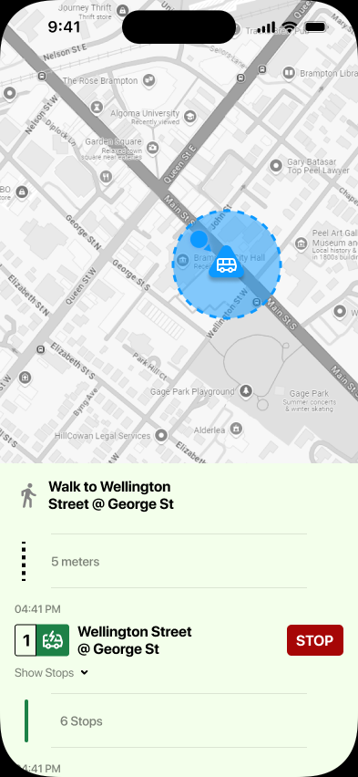
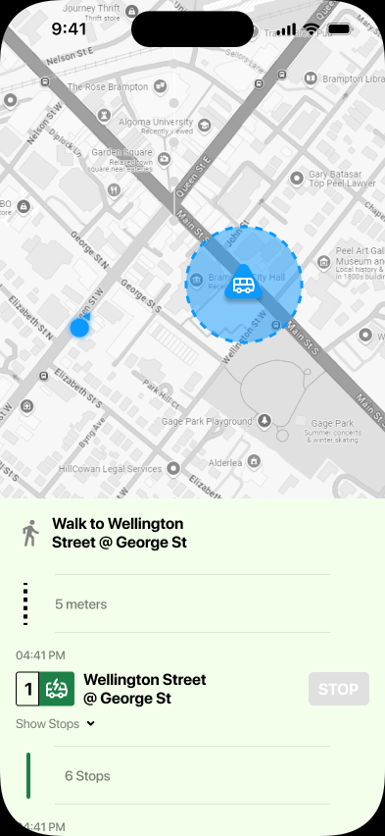
Smart Stop
User within x-meters proximity is enabled to make a stop request.
User not in the proximity cannot make a request.

Slide 12
Impact
Enhances accessibility for all passengers, especially those with limited mobility.
1
Provides a seamless, stress-free stop request experience, even in crowded conditions.
2
Improves overall passenger satisfaction by making public transit more convenient and inclusive.
3

Slide 13

Thank you

