Slide 1
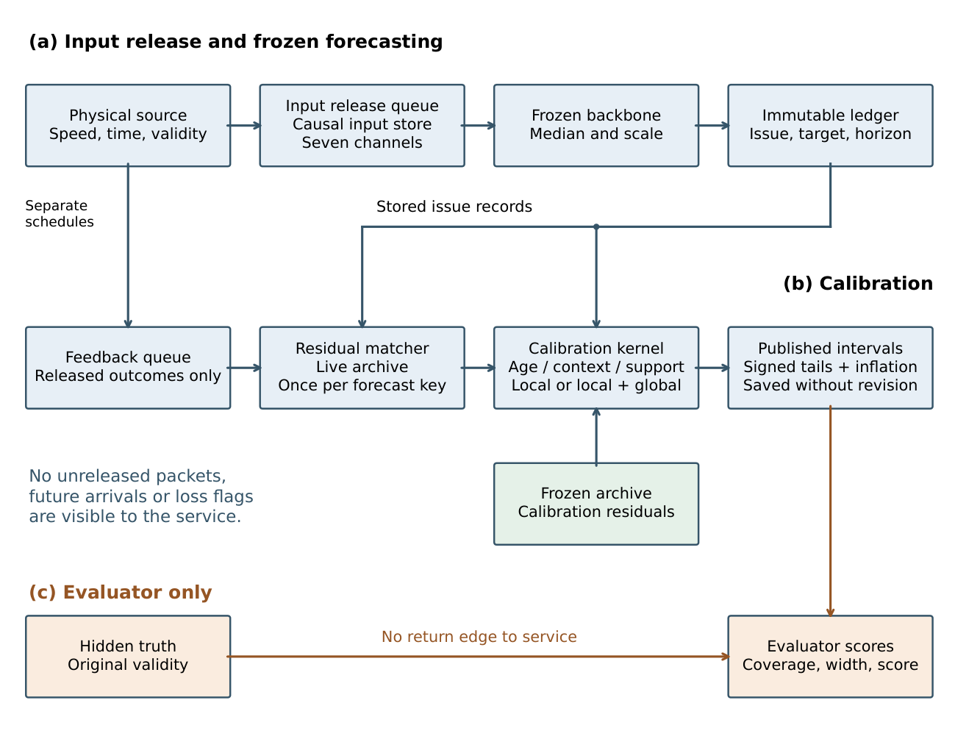
Feedback-aware calibration of traffic intervals
Input availability and outcome feedback are modelled as separate channels
Causal replay
Frozen predictors issue immutable intervals. Calibration updates use only outcomes that have actually arrived.
Signed residuals combine spatial pooling, context matching, target-age weighting and historical fallback.
Shishir Singh Chauhan and Satyabrata Roy | Manipal University Jaipur
Notes:
Source: manuscript/main.tex, sections System architecture and Mathematical modelling; figure label fig:architecture. Full article: Feedback-aware calibration of traffic prediction intervals under delayed and missing sensor reports. The diagram is the original author-generated scientific architecture, not a generated illustration.

Slide 2
Real-data calibration results
The joint rule passed in 12 of 16 backbone–condition cells
METR-LA: delayed feedback
With the Graph WaveNet adaptation, interval score improved by 0.355 m/s; coverage was 0.8985.
95% paired interval: [0.192, 0.551].
PEMS-BAY: permanent loss
On the same backbone, rolling calibration was better by 0.119 m/s.
Joint rule: both lower 95% paired bounds above zero versus rolling and adaptive conformal inference, with coverage at least 0.88.
Notes:
Sources: manuscript/main.tex, tab:backbones (all sixteen comparisons) and tab:primary (six FAR-GW cells). Eight METR-LA cells meet the joint rule; four of eight PEMS-BAY cells do. These are calibrator comparisons conditional on a forecasting backbone, not a ranking of point predictors. METR-LA delayed feedback is C3; PEMS-BAY permanent loss is C4. No source-paper benchmark scores are used.

Slide 3
Component removals have mixed effects
42 paired removal comparisons across six dataset–condition cells
A component that helps one network may harm another. The full method was not retuned from these test-set removals.
Claim boundary
No universal superiority.
No identifiable correction for outcomes missing not at random.
Removal classifications use exploratory paired 95% intervals, unadjusted for multiple comparisons.
Code and evidence: github.com/shishirbit/feedback-aware-traffic-calibration
Notes:
Sources: manuscript/main.tex, tab:ablations and fig:ablations. Across seven removals/diagnostics and six cells, 13 removal-minus-full paired score intervals are wholly positive (worse after removal), 4 are wholly negative (improve after removal) and 25 include zero. These 42 intervals are exploratory and unadjusted. No causal ranking or universal component benefit is claimed. Repository: https://github.com/shishirbit/feedback-aware-traffic-calibration

