Slide 1
Customer Case Handling Best Practices
Shishir Prakash
18th July 2024

Slide 2

Clear and Concise Communication
Structured Responses
Start with a friendly greeting. Acknowledge the customer's issue or concern.
Reassure the customer that you are there to help.
Provide clear, step-by-step instructions.
Highlight important information or warnings. Example EOL product, Know bug
Avoiding Jargon
Use layman's terms whenever possible and Adjust your language based on the customer's technical proficiency.
Explain any necessary technical terms in simple language.
Avoid overwhelming the customer with unnecessary details.
Confirming Understanding
Follow-up and ask the customer if they understand the instructions or information provided.
Ensure they have correctly understood the instructions.
Provide written summaries or resources before case closure.
Request Feedback

Slide 3
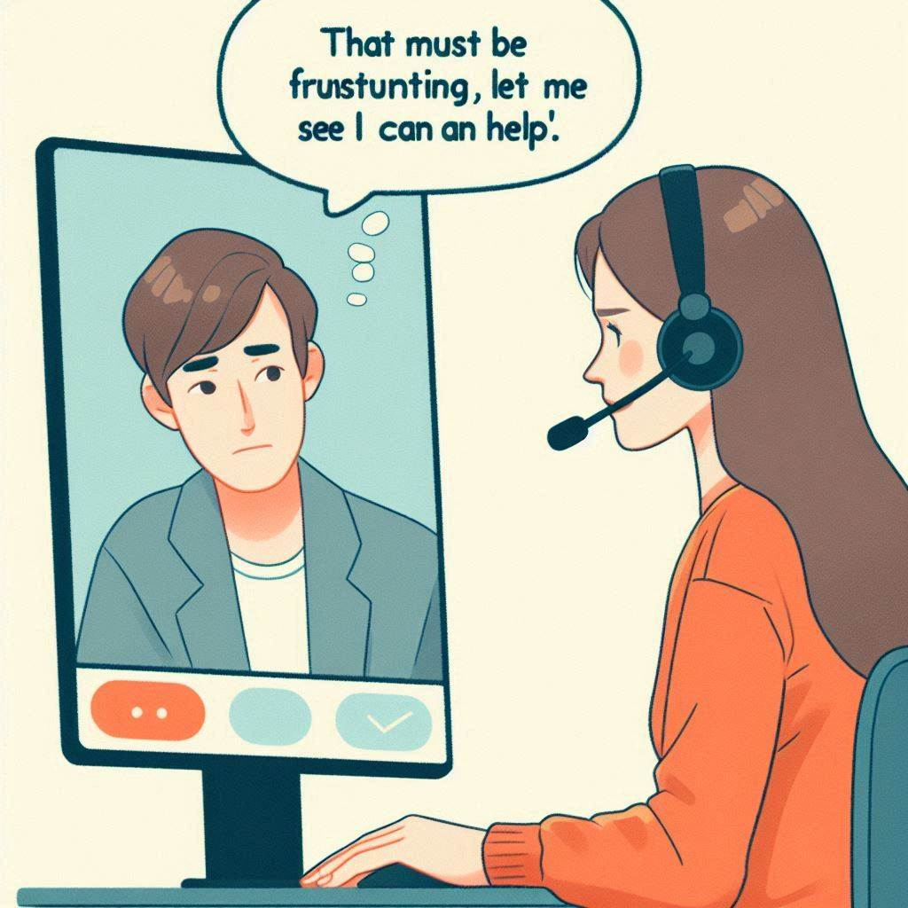
Remote Session
Active Listening
Empathy and Patience
Asking Clarifying Questions
Put Yourself in the Customer's Shoes
Understand Their Needs and Perspective
Show Genuine Concern for Their Issues

Slide 4

Handling Installation and Upgrade Issues
Guiding Customers Through Installation and Upgrades
Provide Clear, Step-by-Step Instructions and reference documents.
Be Patient and Supportive.
If Extensive Help is Needed, Softly Guide Them to Professional Services Engagement
Explain the Benefits of Professional Services in a Supportive Manner

Slide 5
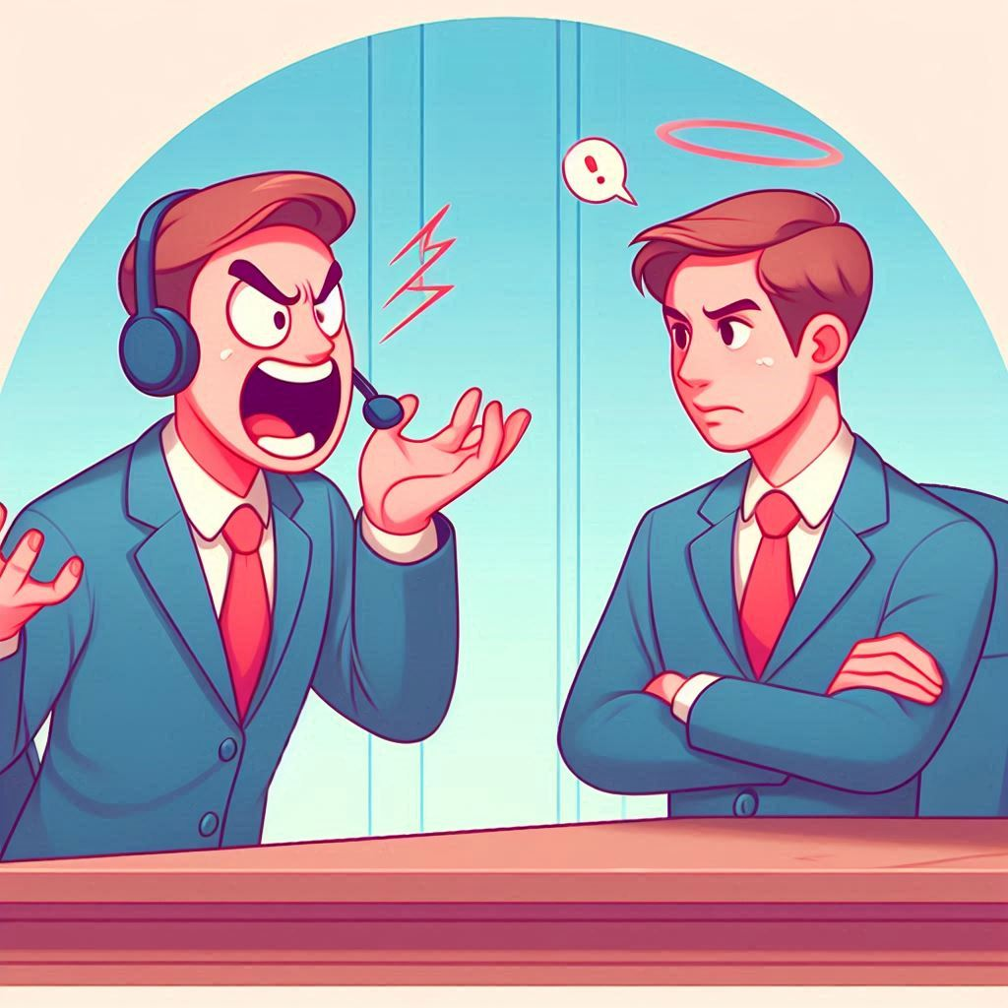
Dealing with Difficult Cases/Customers
Staying Calm and Professional
Conflict Resolution Techniques
Turning Negative Experiences into Positive Outcomes
Record Session if the things are going South

Slide 6
Thank You!

