Slide 1

What is auto-ML?
Auto-ML is the process of automating the process of applying ML to the real world problems that can be potentially automated without compromising the accuracy of our results.

Slide 2
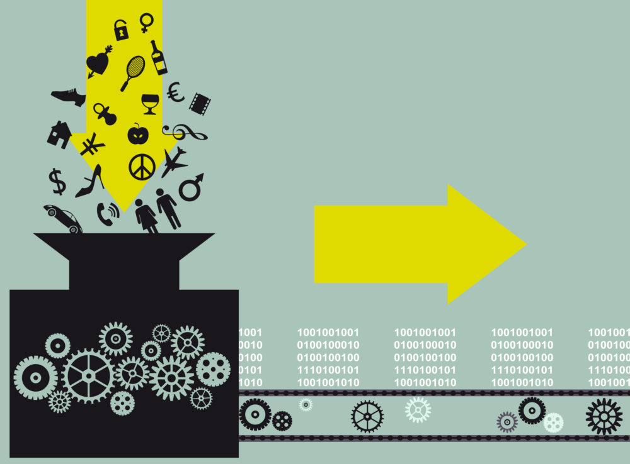
Machine Learning Pipeline

Slide 3
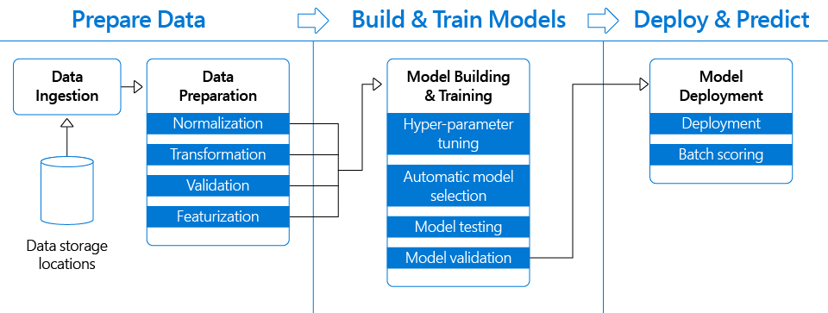
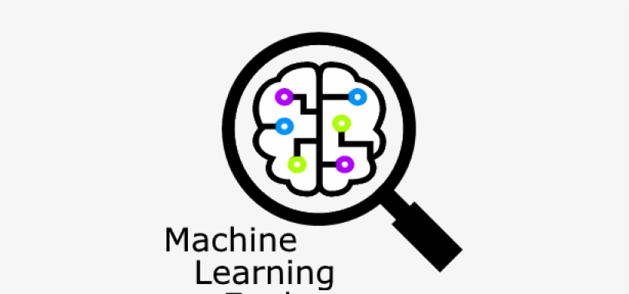
Data Preparation
Feature Engineering
Hyper-parameter Tuning
Model Selection
Model Testing
Validation

Slide 4


Data Preparation
Model Building and Training

Slide 5
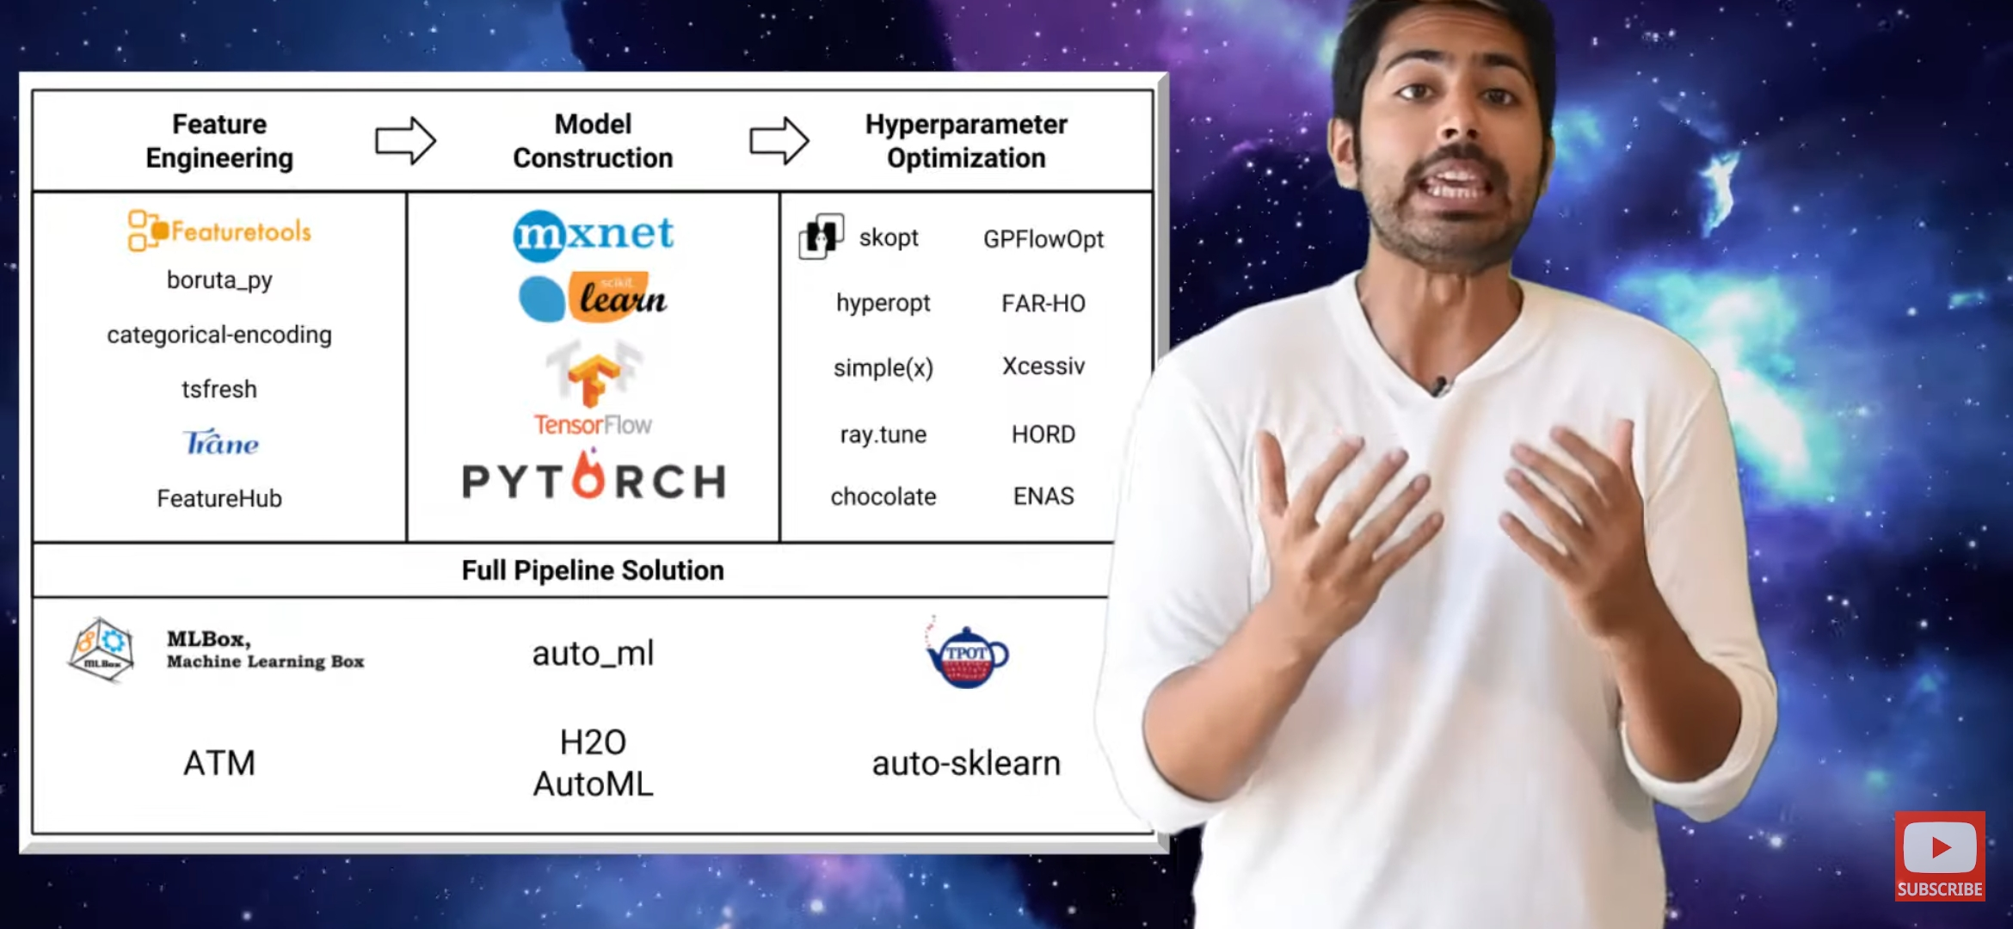
Auto-ML Frameworks

