Slide 1
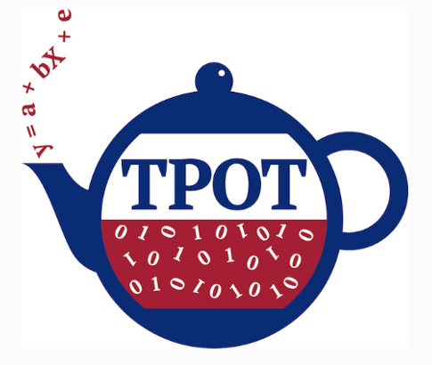
Agenda
What is TPOT?
Genetic Programming Introduction
Implementation in Python
Conclusion

Slide 2
What is TPOT?
TPOT is a python-based AutoML library that uses genetic programming algorithm to find the best performing ML pipelines, which is built on top of scikit-learn.
Automation of TPOT consists of feature selection, model selection and parameter optimization mainly except “wrangling” part(Data Cleaning/Data Cleansing) to do transformation of data, a dimension reduction or a scale change and model validation.
TPOT can eliminate the most tedious part of machine learning seemlessly and effortlessly more than ever.

Slide 3
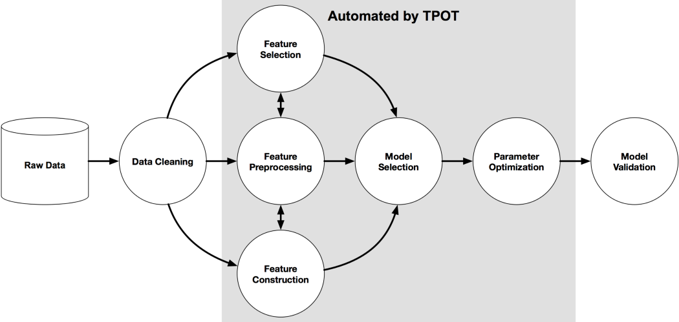

Slide 4
Genetic Programming
Genetic Programming (GP) is a type of Evolutionary Algorithm (EA), a subset of machine learning. EAs are used to discover solutions to problems humans do not know how to solve, directly. Free of human preconceptions or biases, the adaptive nature of EAs can generate solutions that are comparable to, and often better than the best human efforts. Genetic algorithms are inspired by the Darwinian process of Natural Selection, and they are used to generate solutions to optimization and search problems in computer science.
Broadly speaking, Genetic Algorithms have three properties:
Selection: You have a population of possible solutions to a given problem and a fitness function. At every iteration, you evaluate how to fit each solution with your fitness function.
Crossover: Then you select the fittest ones and perform crossover to create a new population.
Mutation: You take those children and mutate them with some random modification and repeat the process until you get the fittest or best solution.

