Slide 1
Tutorial 7: Bash
CS 104
Spring 2025
TA: Kritin Gupta

Slide 2
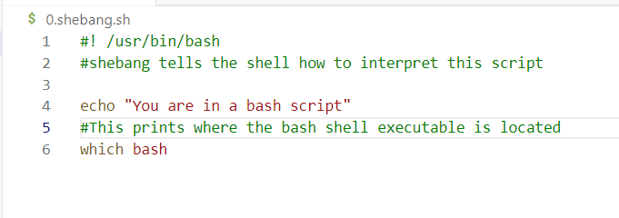
Introduction to Bash
Bash is a scripting language. You write a series of commands in a “.sh” file to automate some tasks.
The script you write runs in the shell as if you were typing commands one after the other.
It supports many programming language features of variables, loops, conditionals and functions
Note the use of shebang. If you were running a python script, you could write /usr/bin/python. Or, you could skip this entirely and run the script as
bash “script name”

Slide 3
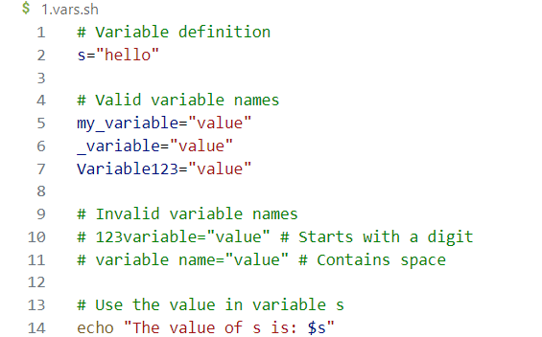
Variables in bash
Variables are strings in bash by default, though you can also have integers.
Declare/assign a variable: var=“hello”
Use a variable: ${var}
$(…) is command substitution, whereas ${…} is substituted by variable value.
Remember: No spaces around “=“

Slide 4
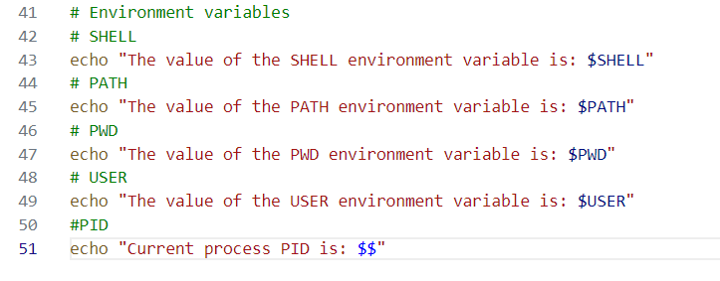
Environment Variables
These are some variables that store configurations and settings. These are some useful variables available to all processes. You can see all environment variables using env.
These can be used as normal variables

Slide 5
Arrays
Arrays in bash can be declared as arr=(val1 val2 val3)
i-th index element can be accessed as ${arr[i]}
All elements can be accessed as ${arr[*]}
Length of the array can be accessed as ${#arr[*]}
Elements can be added using += and removed using unset arr[i]
Declarative arrays (like python dictionary or C++ maps) are declared as declare –A arr
Here, the keys are strings and are accessed as ${arr[“key”]}
All keys can be accessed as ${!arr[*]}
Elements can be added by arr[“new-key”]=“new-val” and removed using unset arr[“key”]

Slide 6
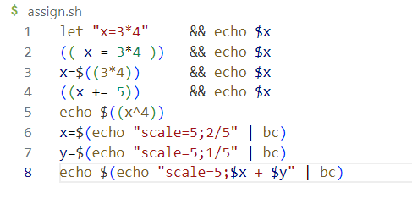
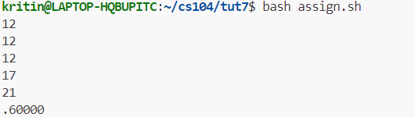
Arithmetic
Assign value to integer variables using let or ((…))
Use $((…)) for computing the value of an arithmetic expression
Bash supported arithmetic operators: Add(+), Sub(-), Mul(*), Div(/), Mod(%), Exp(**)
Bitwise Operators: And(&), Or(|), Not(~), XOR(^), Left Shift(<<), Right Shift(>>)
Assignment operators: =, {+,-,*,/,%}=
Use bc for floating point arithmetic

Slide 7
Conditionals
Syntax:
if CONDITION; then
#commands
elif CONDITION; then
#commands
else
#commands
fi
The condition can be any command or function call. If the condition exited with a return value of 0, it is evaluated as true and false otherwise.
The most common CONDITION is the test command or [[…]]
See man test for all the options you can give it.
[[…]] is preferred over […] as it is more modern and much easier to use.
This allows for arithmetic expression, string comparison and file checking

Slide 8
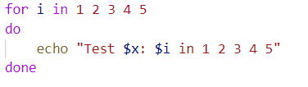
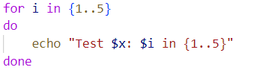
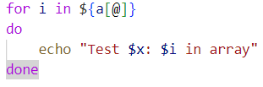

Loops
for variable in list; do
#commands
done
while CONDITION; do
#commands
done
until CONDITION; do
#commands
done
For while and until loops, CONDITION is similar to if command. While breaks when CONDITION is false and until breaks when it is true.

Slide 9
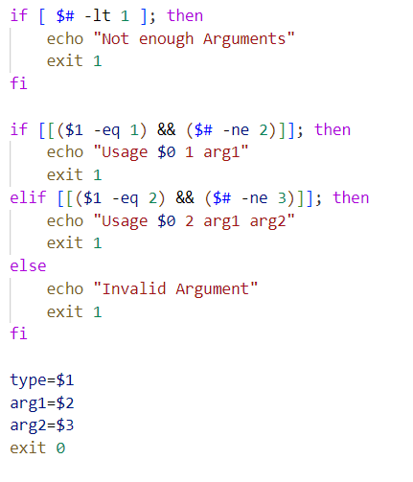
Command Line Arguments
A bash script can be given command line arguments like ./script.sh arg1 arg2 arg3
The script can read these arguments in the following variables:
$#: Number of arguments
$0: script name
$1, $2, $3…: first, second, third argument respectively
$*: all arguments as a string
$@: all arguments as an array

Slide 10
Functions
Functions can be declared as func_name(){…} and called as func_name arg1 arg2
Arguments can be accessed inside the function using $1, $2 etc.
Function can return a value using echo, and calling script can get it using command substitution
Return statement is for returning exit code only, which can be read by $?
Local variables: exist within the scope of function only. (use local keyword)
Global variables: available to all functions in script.
Exported variables: available to child scripts as well.
let x=1
export x

Slide 11
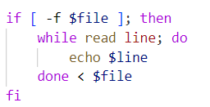
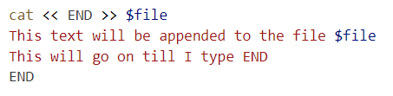
File IO
Reading:
Writing:

Slide 12
Thank You

