Slide 1
Pre-trained Language Models
Update to Dec, 2019

Slide 2
1
Prev-BERT
Overview
2
BERT
3
Post-BERT
4
Summary

Slide 3
01-Prev-BERT

Slide 4
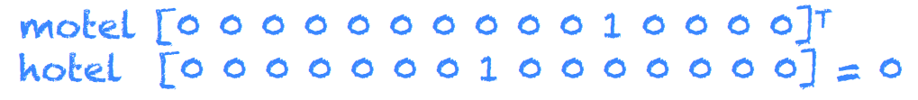
Traditional Vectorization of Words
Problems with discrete representation: one-hot
In vector space terms, this is a vector with one 1 and a lot of zeroes
No natural notion of similarity in a set of one-hot vectors
Distributional similarity based representations: word2vec
Predict between every word and its context words
Skip-grams (SG) / Continuous Bags of Words (CBOW)
[1] cs224n-2017-lecture2

Slide 5
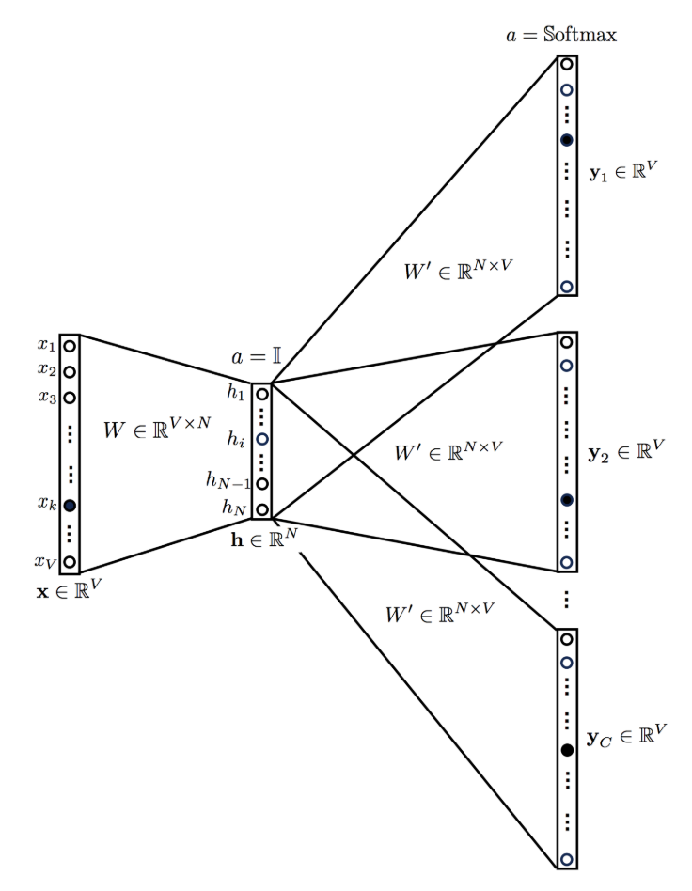
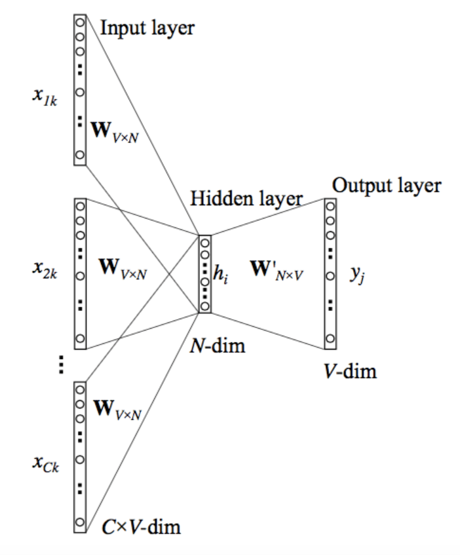
word2vec Algorithms
SG
CBOW
[1] Introduction to Word Embedding and Word2Vec
[2] Distributed Representations of Words and Phrases and their Compositionality-NIPS2013

Slide 6
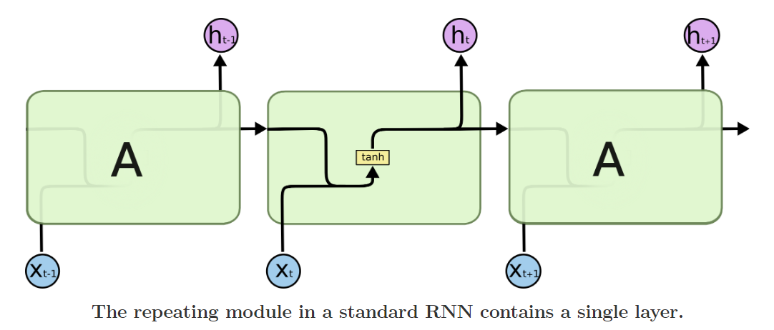

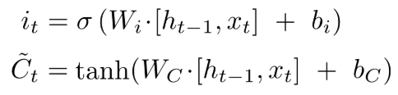
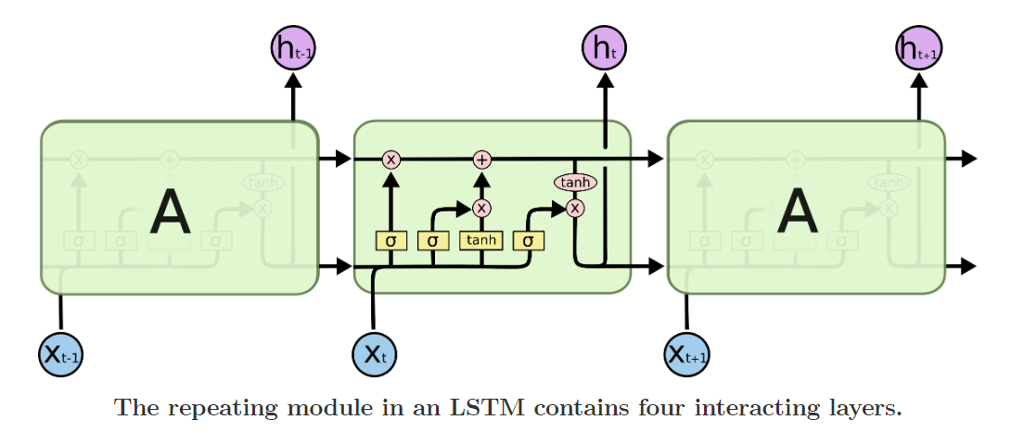

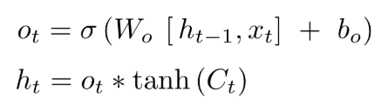
Sequence models: RNN and LSTM
LSTM:
[1] Understanding LSTM Networks
[2] 为什么相比于RNN，LSTM在梯度消失上表现更好？

Slide 7
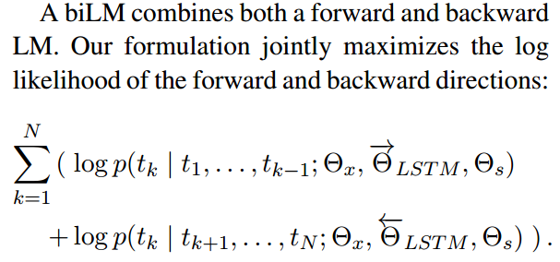
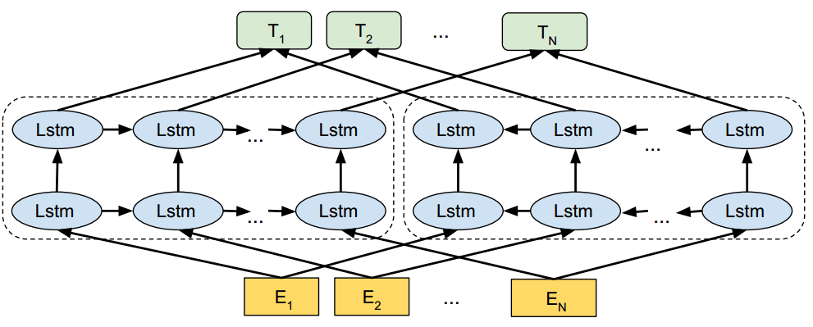
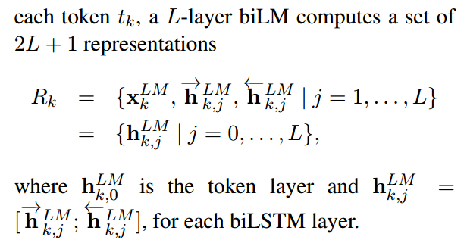
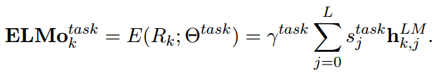
ELMo: Embeddings from Language Models
Deep contextualized word representation that models:
Complex characteristics of word use (e.g., syntax and semantics)
How these uses vary across linguistic contexts (i.e., to model polysemy)
[1] Deep contextualized word representations-arXiv2018
[2] ELMo原理解析及简单上手使用

Slide 8
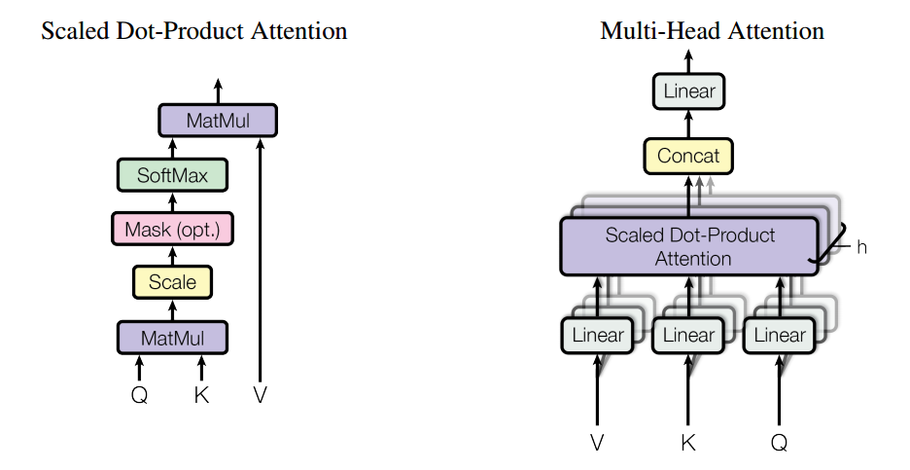
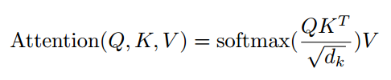
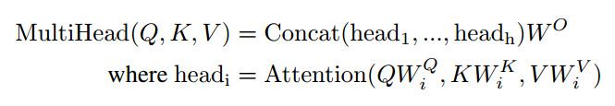
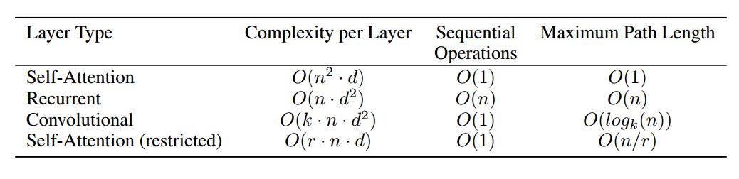
Attention Mechanism: Self-Attention
[1] Attention Is All You Need-NIPS2017
[2] 详解Transformer （Attention Is All You Need）
[3] NLP with Deep Learning | Winter 2019 | Lecture 14 – Transformers and Self-Attention

Slide 9
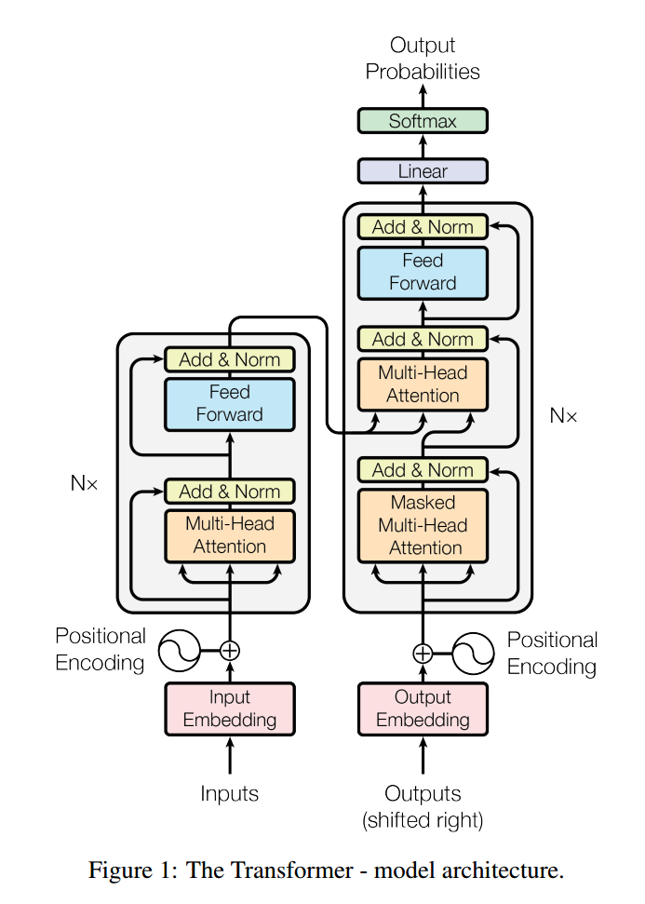
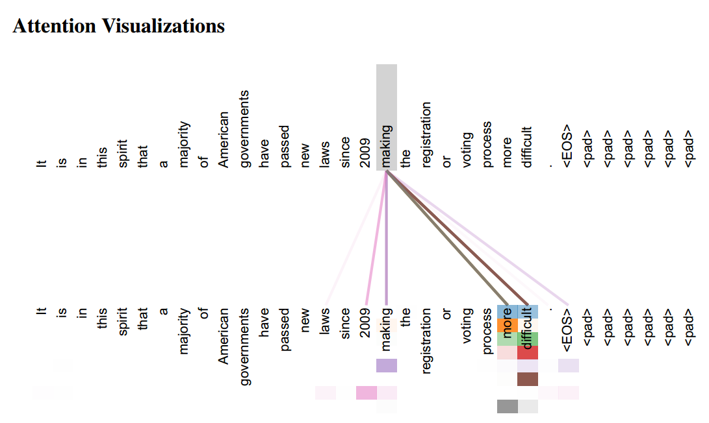
Transformer: Solely on Attention Mechanisms
[1] Attention Is All You Need-NIPS2017
[2] 详解Transformer （Attention Is All You Need）

Slide 10
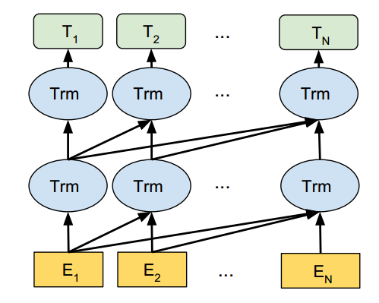
GPT: Generative Pre-Training
Training procedures:
Learning a high-capacity language model on a large corpus of text
Fine-tune to adapt the model to a discriminative task with labeled data
Main contributions:
Robust transfer performance across diverse tasks as Transformers provides a more structured memory for handling long-term dependencies in text
Minimal changes to the architecture of the pre-trained model in fine-tuning as structured text input are processed into a single contiguous sequence of tokens
[1] Improving Language Understanding by Generative Pre-Training-arXiv2018

Slide 11
02-BERT

Slide 12
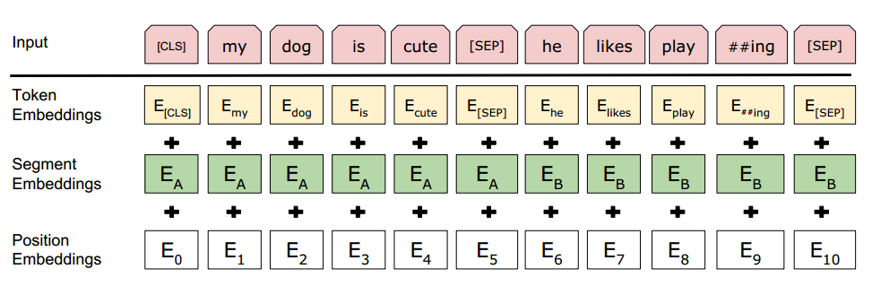
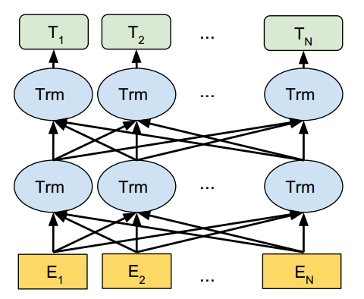
Bidirectional Encoder Representations from Transformers
[1] BERT: Pre-training of Deep Bidirectional Transformers for Language Understanding-arXiv2018

Slide 13
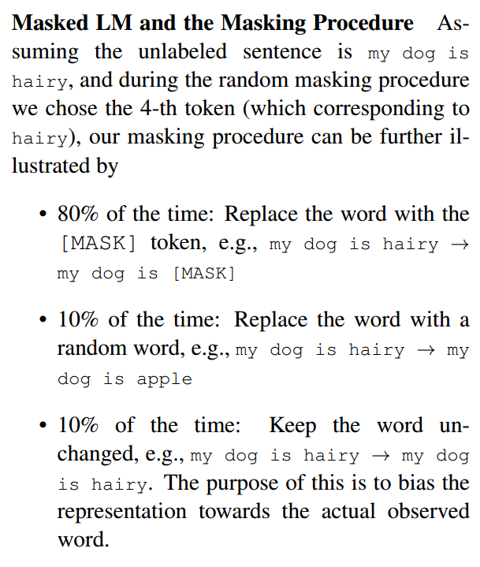
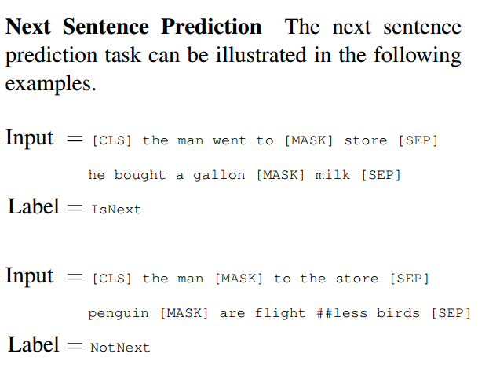
Pre-training Tasks
[1] BERT: Pre-training of Deep Bidirectional Transformers for Language Understanding-arXiv2018

Slide 14
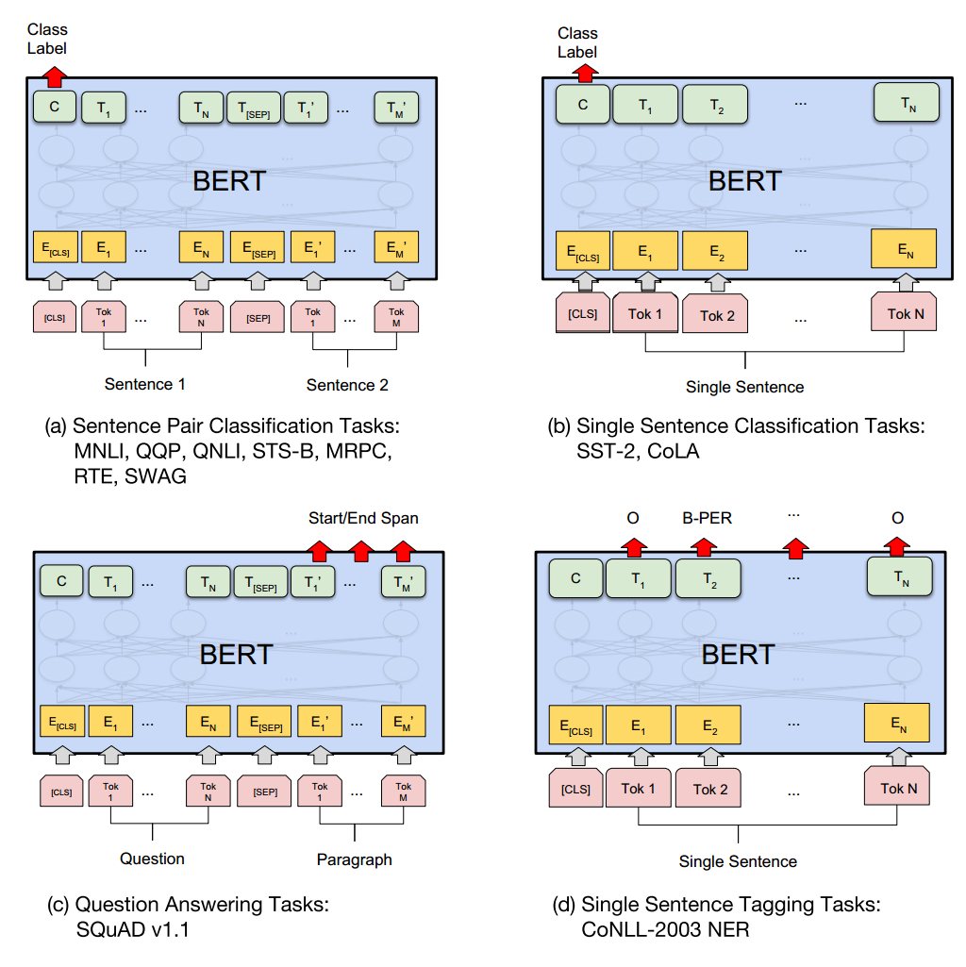
Applications with Fine-tune
[1] BERT: Pre-training of Deep Bidirectional Transformers for Language Understanding-arXiv2018

Slide 15
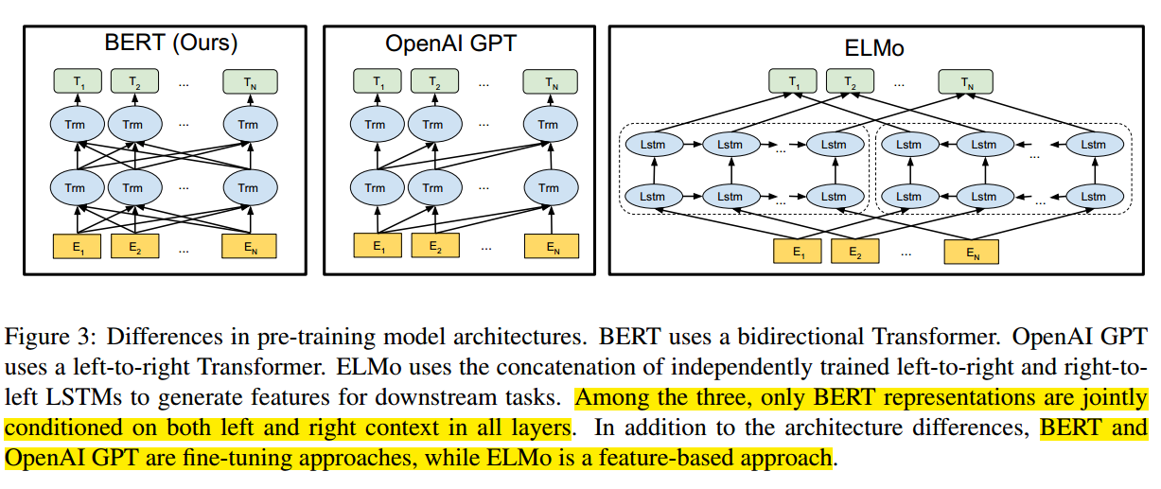
Comparison: BERT, GPT and ELMo
[1] BERT: Pre-training of Deep Bidirectional Transformers for Language Understanding-arXiv2018

Slide 16
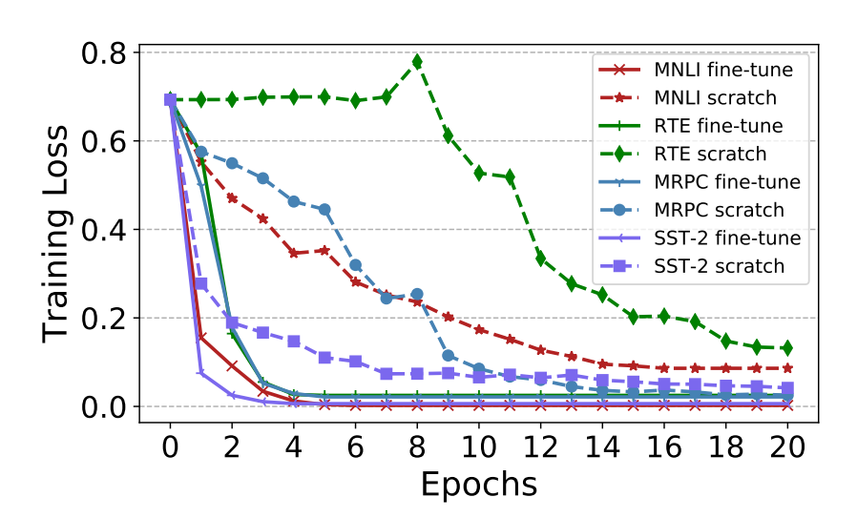
Visualize and Understand the Effectiveness
Main conclusions:
Pre-training reaches a good initial point across downstream tasks (wider optima and easier optimization)
Fine-tuning BERT tends to generalize better because of the flat and wide optima
Lower layers of BERT are more invariant during fine-tuning (close to learn more transferable representations)
[1] Visualizing and Understanding the Effectiveness of BERT-ACL2019

Slide 17
03-Post-BERT

Slide 18
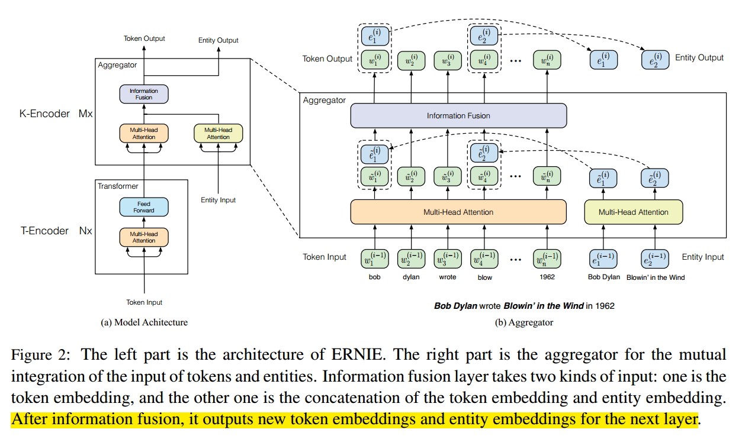
ERNIE (THU): Enhanced Language RepresentatioN with Informative Entities
[1] ERNIE: Enhanced Language Representation with Informative Entities-ACL2019

Slide 19
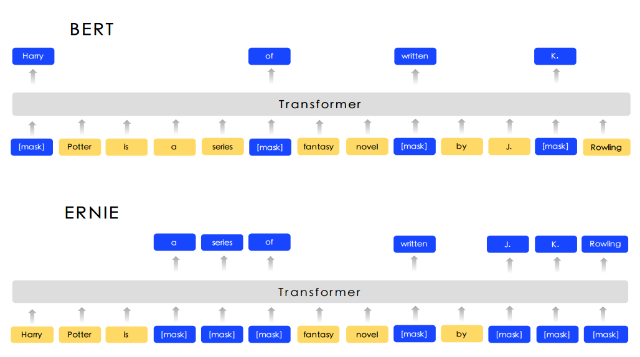
ERNIE (Baidu): Enhanced Representation through kNowledge IntEgration
Knowledge Integration
Basic-Level Masking
Phrase-Level Masking
Entity-Level Masking
[1] ERNIE: Enhanced Representation through Knowledge Integration-arXiv2019

Slide 20
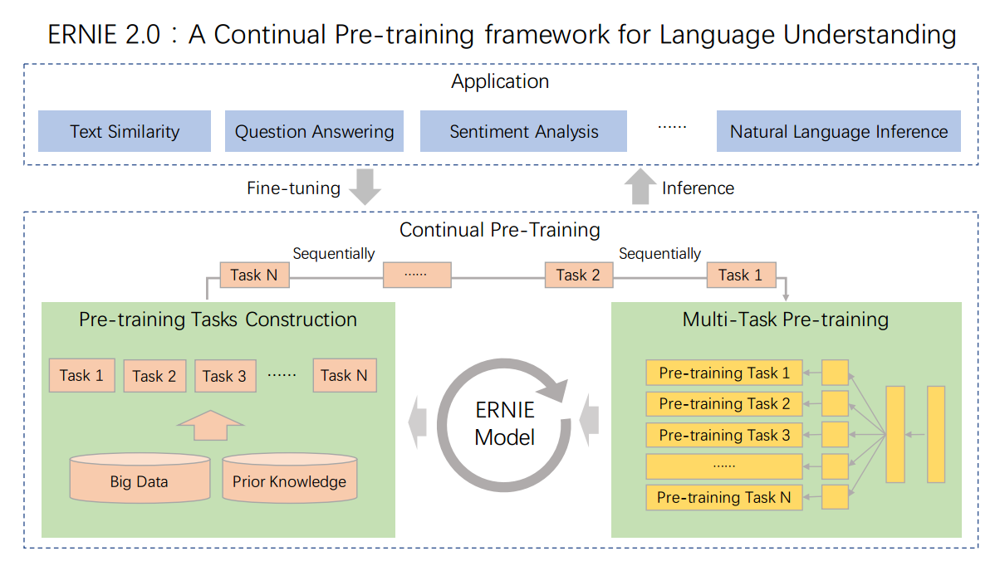
ERNIE 2.0 (Baidu): Continual Pre-training
[1] ERNIE 2.0: A CONTINUAL PRE-TRAINING FRAMEWORK FOR LANGUAGE UNDERSTANDING

Slide 21
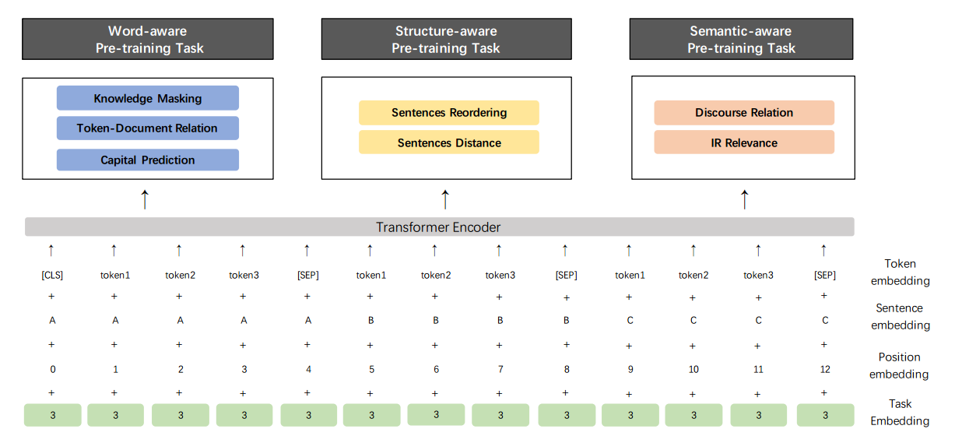
ERNIE 2.0 (Baidu): Structure
[1] ERNIE 2.0: A CONTINUAL PRE-TRAINING FRAMEWORK FOR LANGUAGE UNDERSTANDING

Slide 22
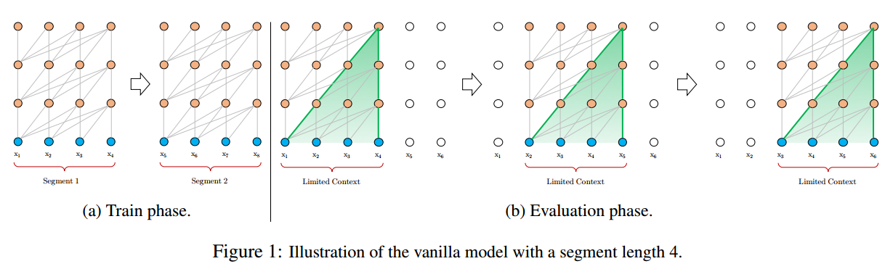
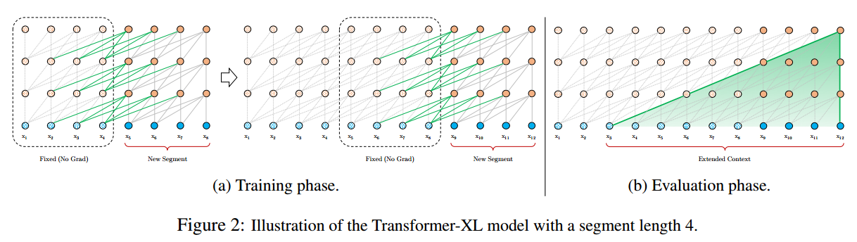
Transformer-XL
Main conclusions
Enables capturing longer-term dependency
Resolves the context fragmentation problem
[1] Transformer-XL: Attentive Language Models Beyond a Fixed-Length Context-arXiv2019
[2] transformer详解：transformer/ universal transformer/ transformer-XL
[3] Character-Level Language Modeling with Deeper Self-Attention-AAAI2019

Slide 23
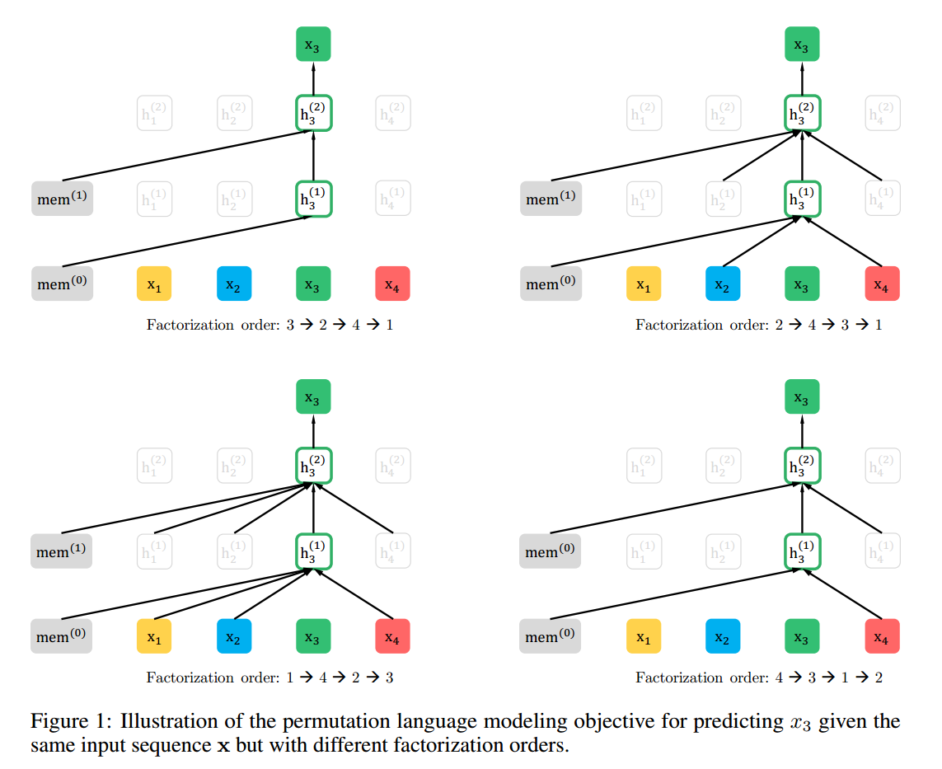
XLNet
Comparison to BERT:
Learning bidirectional contexts by maximizing the expected likelihood over all permutations of the factorization order
Overcomes the limitations of BERT as its autoregressive formulation
Integrates Transformer-XL into pre-training
[1] XLNet: Generalized Autoregressive Pretraining for Language Understanding-arXiv2019

Slide 24
04-Summary

Slide 25
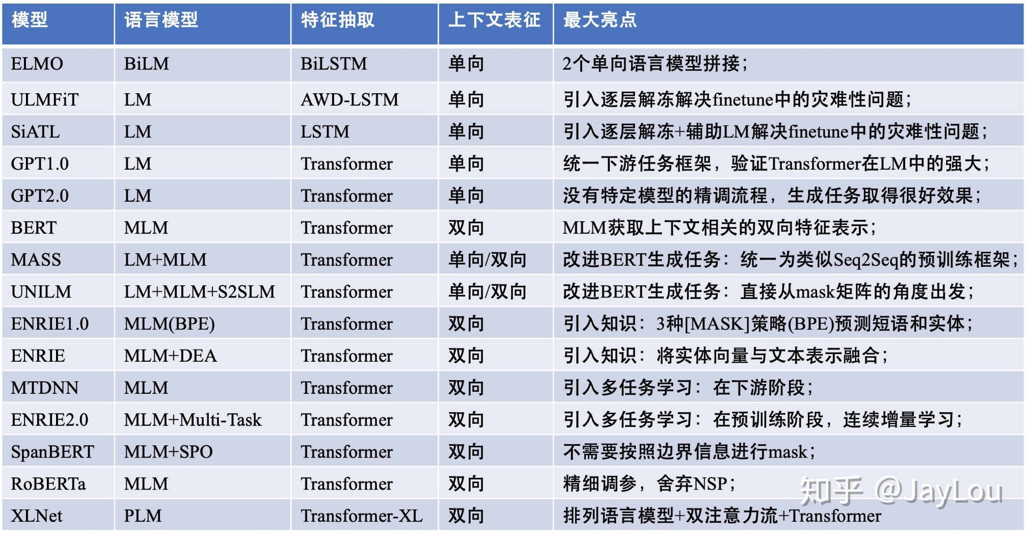
Summary Table
[1] nlp中的预训练语言模型总结(单向模型、BERT系列模型、XLNet)

Slide 26
Thanks

