Slide 1
MAKING COMMONS DYNAMIC · FIELD WORKSHOP, SYLHET · NOVEMBER 2026
Tanguar Haor: a field reflection
What three days of theory and one day in the haor changed
in what we notice, and in what we can now ask
Group presentation by seven members, Speakers 1 to 7
Field site: Joypur and the Tanguar Haor waterbody, Tahirpur, Sunamganj
Field day: 8 November 2026. Presented: 9 November 2026
A note on what this is
This is a reflection, not a survey, a diagnosis or a plan. One visit, a small number of voices, and most of what we say is attributed to the person who said it. Where we are reading rather than reporting, we say so on the slide.
Slide 1 of 17
Speaker 1 · 0:40
Notes:
SPEAKER 1 | slide 1 of 17 | target 0:40 | 92 words, about 39 s at 140 wpm
------------------------------------------------------------------------------
Good morning. This is a field reflection on Tanguar Haor, from one day in the field on 8 November and three days of workshop sessions.
It is not a survey, not an ecological diagnosis, not a policy proposal. It is a reflection on what we noticed, what we could attribute, and what we now know to ask.
We spoke with one community group at Joypur, a CNRS key informant and a boatman: a small number of voices from a place with, depending on whose count you take, seventy-seven, eighty-two or eighty-eight villages.

Slide 2
HOW WE APPROACHED THIS REFLECTION
Four moves, repeated for each question
The same discipline for all six official questions, so that evidence and interpretation stay visibly apart.
BEFORE
What we took for granted walking in. Where we have no record of a prior group assumption, we label it an analytical starting point rather than claim it was our belief.
FIELD
One concrete episode or attributed statement, with its timestamp, kept in its own context rather than flattened into a generalisation.
THEORY
One or two taught ideas, used as the workshop defined them. Not every concept is forced into every question.
SHIFT and OPEN
What became less certain once field and theory were put together, and the sharper question we can now ask. For whom, when, where, at what level.
What our evidence tags mean
OBSERVED BY US
COMMUNITY TESTIMONY
PROFESSIONAL KII
WORKSHOP LECTURE
OUR READING
OPEN QUESTION
Quotation marks appear only where a primary transcript contains those words. Bengali speech is given in the original and then lightly translated, with its timestamp. A paraphrase never appears in quotation marks, and nothing our own group said in discussion is presented as something a community member said.
Slide 2 of 17
Speaker 1 · 0:50
Notes:
SPEAKER 1 | slide 2 of 17 | target 0:50 | 107 words, about 45 s at 140 wpm
------------------------------------------------------------------------------
The same four moves for every question, because the risk in a one-day visit is that interpretation quietly turns into finding.
BEFORE is what we assumed walking in. FIELD is one episode, timestamped, in context. THEORY is one or two ideas, used as the workshop defined them. SHIFT and OPEN is what became less certain, and the better question.
The tags at the bottom appear on every slide. Teal is a community member. Ochre is the CNRS informant: testimony, not measurement. Grey is the lecture. Rust is our reading. Black is a question we cannot answer.
One rule throughout: quotation marks only for words in a transcript.

Slide 3
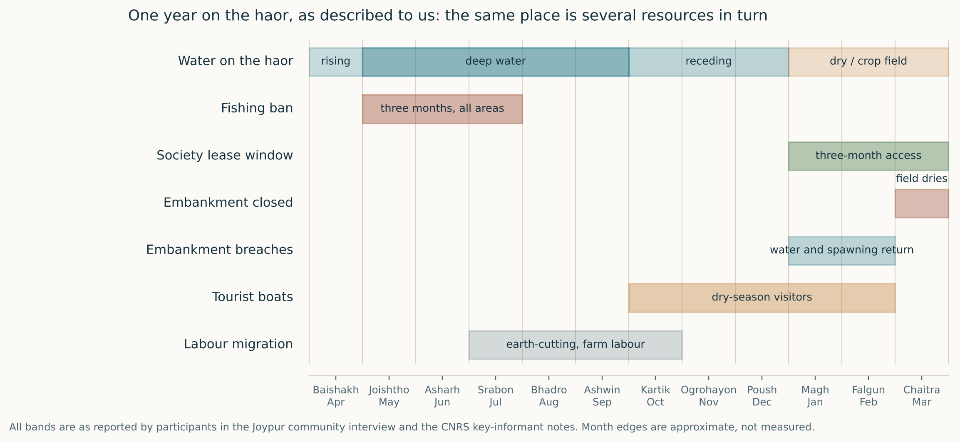
QUESTION 1 · WHAT MAKES TANGUAR HAOR AN EPHEMERAL COMMONS?
The same place is a different resource in every season
COMMUNITY TESTIMONY
PROFESSIONAL KII
Joypur interview 00:03:27, 00:12:17-00:13:52, 00:29:00, 00:50:43 · CNRS KII Part 01
Slide 3 of 17
Speaker 1 · 1:10
Notes:
SPEAKER 1 | slide 3 of 17 | target 1:10 | 171 words, about 73 s at 140 wpm
------------------------------------------------------------------------------
Start with the calendar, because everything else hangs off it.
We arrived thinking of Tanguar Haor as a place. We left thinking of it as a sequence.
Top band: for roughly five months it is deep open water. Then it recedes. Then, for four months, much of it is a crop field. Same ground, same people.
Now what sits on top. The fishing ban is three monsoon months, said to apply everywhere. The society's lease window is a different three months, in the dry season. The embankment closes in Chaitra. Tourist boats come in the dry season. Labour migration fills the gaps.
So at any moment the haor produces a different thing, for a different group, under a different rule — and the fisher, the paddy farmer and the boat operator are often the same household in different months.
Professor Nayak defines ephemeral commons as a commons whose own process of creation produces instability, cycling through creation and dissolution. Here that is literal. One caution: every band is reported, not measured.

Slide 4
QUESTION 1 · ATTRIBUTES, AND WHAT WE NOW ASK
Excludability and subtractability do not hold still either
FOUR ATTRIBUTES WE COULD ACTUALLY POINT TO
WHAT SHIFTED FOR US
Emergence and submergence. Water arrives, the fishery exists; water leaves, the field exists.
Access changes with the season, not with status. Fishing access is tied to a lease window; outside it, participants described fishing anyway.
Subtractability rises as the water falls. As depth drops, the same catch is taken from less space.
Exclusion is costly and partial. Of roughly fifty short machines, participants said two are caught.
আগে তো ইজারাদার যখন আছিল তখন তো ইজারাদার শাসন দিয়া রাখছে, মাছ মারতে পারছে না।
“when the lessee was here, the lessee kept order, people could not take fish.”
Joypur community interview, 00:27:21. Translated from Bengali; lightly translated.
We arrived expecting the ephemeral quality to be mainly hydrological. The same speaker who described the lease era as better for fish then said the present arrangement suits him. Who may take what, and who enforces it, has changed at least three times in living memory.
Open question. If the resource dissolves every year, what is the right unit of a rule: the season, the water body, or the household that moves between both?
COMMUNITY TESTIMONY
WORKSHOP LECTURE
OPEN QUESTION
Slide 4 of 17
Speaker 1 · 1:00 · hands to Speaker 2
Notes:
SPEAKER 1 | slide 4 of 17 | target 1:00 | 152 words, about 65 s at 140 wpm
------------------------------------------------------------------------------
Four attributes we could point to.
Emergence and submergence, which you have just seen. Access that changes with the season rather than with who you are. Subtractability rising as the water falls. And exclusion that is costly and partial: of about fifty short machines, one participant said two get caught, are fined, and released.
Now the shift. We went in thinking the ephemeral quality was about water. What unsettled that was this line at twenty-seven twenty-one. He describes the lease era, when the lessee kept armed guards, as the time when fish were plentiful. Less than a minute later he says the present arrangement suits them.
We are not going to resolve that contradiction. It is the finding. The institution governing this commons has itself been ephemeral — estate, lease, lease-free since 2000, society windows now. The rule dissolves and reappears as surely as the water does.
[Pause. Hand to Speaker 2.]

Slide 5
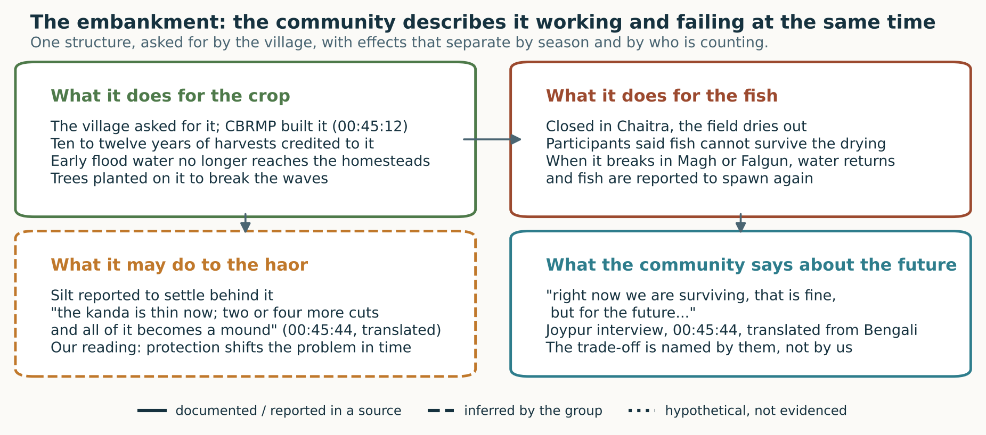
QUESTION 2 · MAIN ISSUES AND CHALLENGES
One structure, two opposite effects, both named by the same people
COMMUNITY TESTIMONY
OUR READING
Joypur interview 00:03:27, 00:04:42, 00:05:09, 00:31:26-00:32:53, 00:45:12-00:45:44
Slide 5 of 17
Speaker 2 · 1:35
Notes:
SPEAKER 2 | slide 5 of 17 | target 1:35 | 230 words, about 98 s at 140 wpm
------------------------------------------------------------------------------
The clearest thing we encountered was the embankment, and it shows why a one-day diagnosis would have been wrong.
Top left. The community asked for it; a CBRMP project built it. They credit it with ten to twelve years of harvests and with flood water no longer reaching the homesteads. Had we stopped there, we would have written a success story.
Top right, same conversation. In Chaitra the embankment is closed and the field dries. When the field dries, they said, fish cannot survive. When it breaks, in Magh or Falgun, water comes in and fish spawn again. In his own logic: if the water stays deep, then however much people fish illegally, they cannot finish the stock.
So the same structure protects the paddy and removes what the fish need. It is not one group gaining and another losing. It is often the same household, in different months.
Bottom left is our reading, dashed on the figure for that reason. Silt settling behind an embankment is a mechanism we did not measure.
Bottom right is the line that stayed with us. 'Right now we are surviving, that is fine, but for the future...' He does not finish the sentence.
Professor Nayak said on the eighth: despite best engineering, a dam breaks, and that is uncertainty. The community already holds both halves of that. Nobody had to teach them non-linearity.

Slide 6
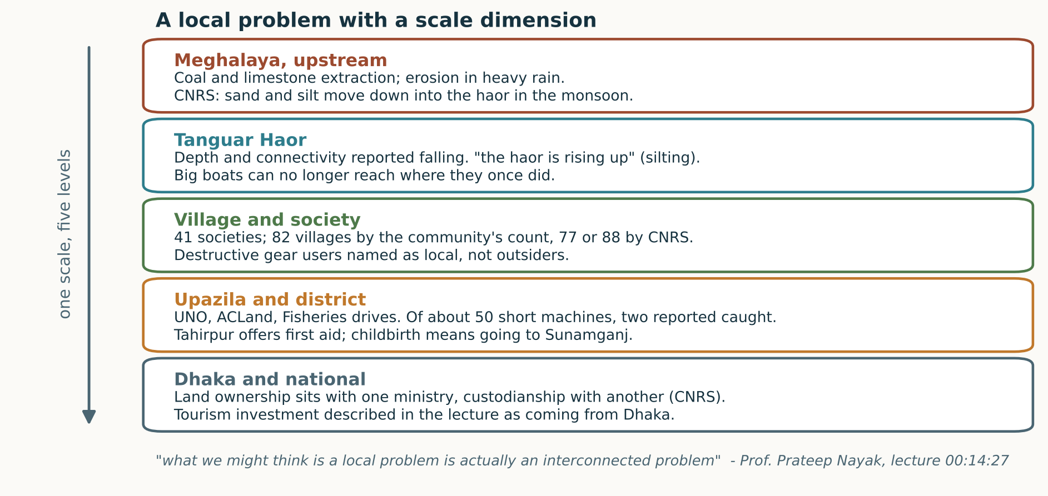
QUESTION 2 · DRIVERS, AND WHO IS SAID TO CAUSE THEM
The problem does not sit at one level, and the blame does not sit outside
A DISAGREEMENT WE ARE KEEPING
কারেন্ট জালে মাছ ধ্বংস করে না।
“the current net does not destroy fish”
Joypur, 00:11:44. The speaker has used it since birth, to eat. He named the short machine and the kona jal as the destroyers; another speaker named the china duari.
We expected outsiders. We were told the opposite.
না এইখানের মানুষ, এই টাঙ্গুয়ারেরই মানুষ।
“no, people from here, people of this very Tanguar”
Joypur, 00:49:37, asked who uses the shortgun and kona jal.
Open question. Which gear actually destroys what, and who is entitled to decide that when the people fishing disagree with each other?
COMMUNITY TESTIMONY
PROFESSIONAL KII
WORKSHOP LECTURE
Slide 6 of 17
Speaker 2 · 1:20 · hands to Speaker 3
Notes:
SPEAKER 2 | slide 6 of 17 | target 1:20 | 204 words, about 87 s at 140 wpm
------------------------------------------------------------------------------
Two points, because the figure does the work.
First, scale. The CNRS informant traces sand and silt to coal and limestone extraction in the Meghalaya hills upstream. A community speaker described the same thing from the other end: the turbid water brings mountain soil, and, in his words, the haor is rising up. Big boats can no longer reach where they once could. At the other end, land ownership sits with one ministry and custodianship with another, and tourism investment comes from Dhaka.
Professor Nayak called that mismatch governance misfit.
Second, the part that corrected us. We expected to hear that outsiders destroy the fishery. Asked directly who uses the shortgun and the fine-mesh kona jal, the answer at forty-nine thirty-seven was: people from here, people of this very Tanguar.
And they do not agree with each other about which gear is the problem. The speaker who insists the current net does not destroy fish has used it since birth, for food; he names the short machine and the kona jal instead. Another names the china duari.
We are keeping that disagreement, because resolving it would mean choosing one fisher's account over another's with nothing to decide it on.
[Pause. Hand to Speaker 3.]

Slide 7
QUESTION 3 · VULNERABILITY, TIED TO THE EPHEMERAL NATURE
Food and income: the exposure is seasonal, not general
WHAT WAS DESCRIBED TO US
WHY THIS IS AN EPHEMERAL-COMMONS VULNERABILITY
— Catch described as half a kilo or very little now, where it used to be plentiful.
— Travelling to the town market costs 200 to 250 taka and two hours, so a small catch cannot cover the fare. Buyers, called nekari, come to the village instead.
— Paddy is kept for the household through the year, not sold.
— Rice stored in empty fish-feed sacks. Our group read this as preparing for scarcity; the storage we saw, the reason we inferred.
— Dried fish sells at 250 taka locally against 300 in the market, because the trip costs 300 to 500 taka.
The income is not low in a steady way. It is concentrated into a window and then absent. A household that fishes for three months, grows paddy for three, and looks for other work for the rest is carrying the variability of the resource in its own calendar.
Professor Nayak's 6 November slides put it as a lack of access to capital assets, and as the absence of wellbeing in its material, relational and subjective dimensions. What we saw fits the material dimension. We have almost nothing on the other two.
তারা অশিক্ষিত মানুষ তারা কয় আমরা খাইয়া বাঁচি।
“they are uneducated people, they say we live by eating”
Joypur, 00:33:00, on why telling people not to fish does not work. The CNRS informant made the same point independently.
COMMUNITY TESTIMONY
OUR READING
PROFESSIONAL KII
Slide 7 of 17
Speaker 3 · 1:30
Notes:
SPEAKER 3 | slide 7 of 17 | target 1:30 | 221 words, about 94 s at 140 wpm
------------------------------------------------------------------------------
My half of question three is food and income.
What we saw is not general poverty. It is exposure with a shape.
Catch is described as half a kilo now, against plenty before. Then the market fails them twice. Going to town costs two hundred to two hundred and fifty taka and takes two hours, so a small catch cannot pay the fare. Buyers come to the village instead, called nekari, and participants said the price is not fair. For dried fish: three hundred taka a kilo in the market, three to five hundred to get there, so they sell at two fifty locally.
The paddy stays home. It is the year's eating, not a cash crop.
One honest qualification. We saw rice stored in empty fish-feed sacks. Our mentor read that as stockpiling against uncertainty, and it is persuasive. But the storage is the observation; the reason is our inference.
Why is this an ephemeral-commons vulnerability rather than just low income? Because the income is not low steadily. It is concentrated into a window, then absent. The household absorbs the variability of the resource in its own calendar.
Then this, at thirty-three minutes, on why awareness campaigns do not stop fishing. The CNRS informant made the same point independently: without food security, awareness alone will not hold a conservation rule.

Slide 8
QUESTION 3 · THE THREE-MONTH WINDOW
The thing that holds people here is the thing that exposes them
“When we asked him, you fish for three months, what do you do for the next three? We grow paddy. And the next three? We steal, we drive a rickshaw, we do this and that.”
Our own group discussion, 00:10:45. This is a team member recalling the exchange, not a verbatim community quotation. The community transcript does describe fishing without permission at 00:28:33, using the same word.
FOUR REPORTED FIGURES
3 months
of legal fishing access, by lease
What we did with that
Our group's first instinct, in the recording, was to call the three-month lease their lure, almost a weakness. Putting it next to the lecture changed that for us. The window is not a temptation. It is the only period in which the commons exists as a fishery they can legally enter, and it is three months out of twelve.
Set against the other numbers we were given, the exposure is easier to see: a three-month ban with compensation rice described as given “once, maybe two years”; electricity for about eight hours in twenty-four; the monthly family-card allowance that, in this settlement, nobody had received.
3 months
of fishing ban, reported everywhere
8 hours
of electricity in 24, at present
0
households here reported to have received
the family-card allowance
OUR READING
COMMUNITY TESTIMONY
Joypur 00:50:30, 00:54:51, 00:55:09 · group discussion 00:10:23-00:10:54
Slide 8 of 17
Speaker 3 · 1:25 · hands to Speaker 4
Notes:
SPEAKER 3 | slide 8 of 17 | target 1:25 | 209 words, about 89 s at 140 wpm
------------------------------------------------------------------------------
I want to be careful here, because the quotation on this slide is ours, not theirs.
In our own group discussion one of us recalled asking: you fish for three months, what do you do for the next three? Paddy. And the next three? We steal, we drive a rickshaw, this and that. That is a team member's recollection. It is not in the community transcript in those words. What is there, at twenty-eight thirty-three, is the same word for taking fish without permission, used by the participant about himself.
I flag it because our first instinct, on tape, was to call the three-month lease their lure. That was us being uncharitable. Three months is not a temptation; it is the entire period in which this commons exists as a fishery they can lawfully enter.
Now put the other reported numbers beside it. The ban is also three months. Compensation rice came once, maybe two years. Electricity runs about eight hours in twenty-four. And the family-card allowance, which they know from television, had reached nobody here.
So the question we should have asked, and did not, is not why they fish out of season. It is what the other nine months are made of.
[Pause. Hand to Speaker 4.]

Slide 9
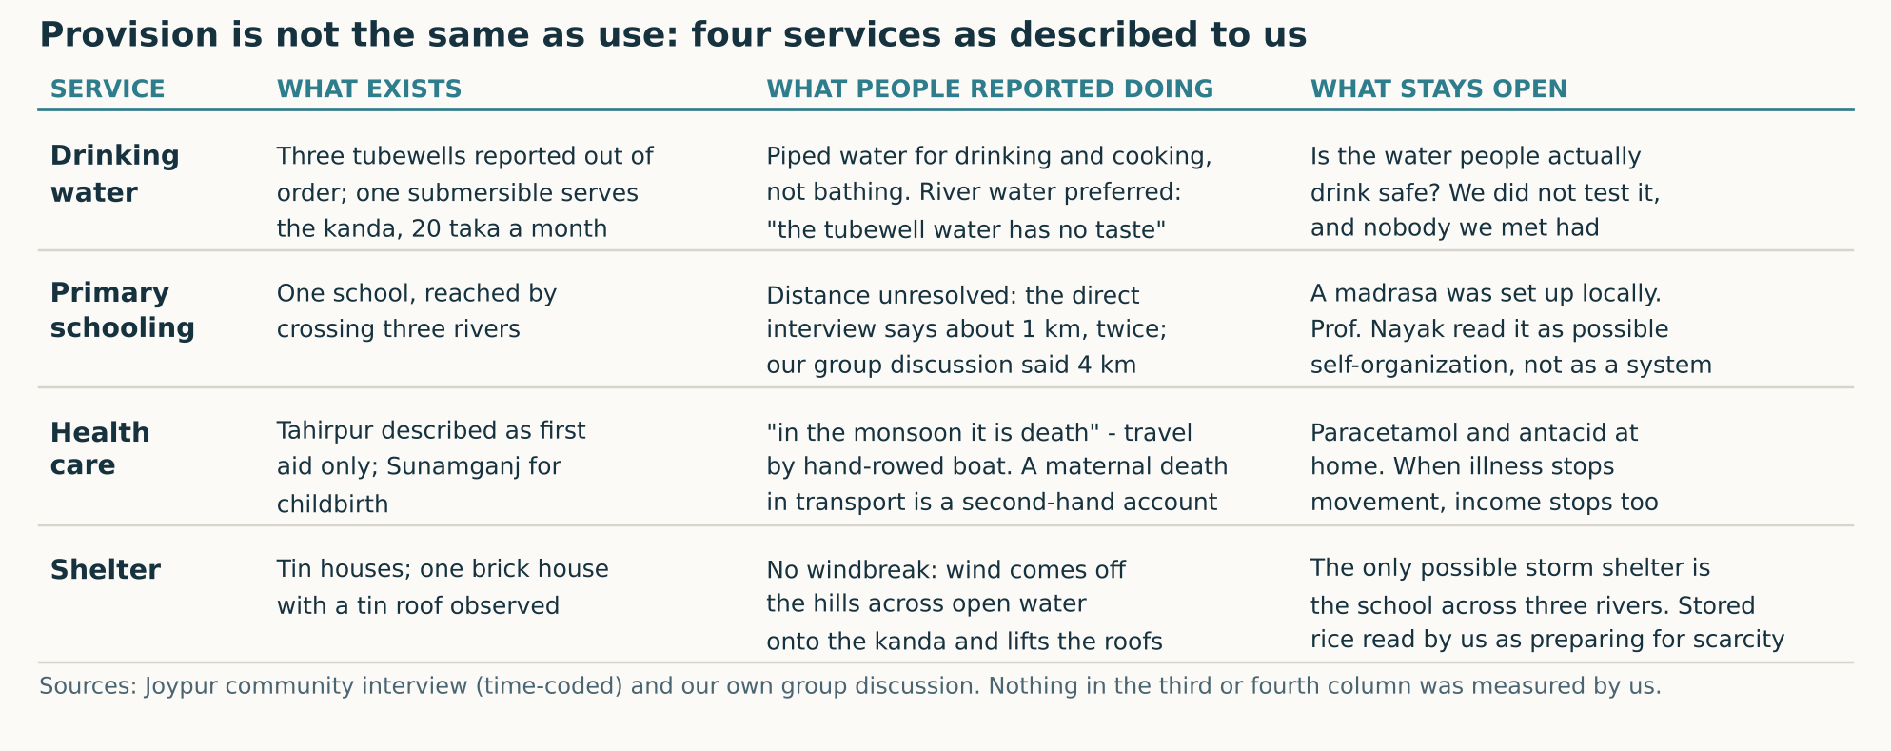
QUESTION 3 · WATER, SCHOOLING, HEALTH, SHELTER
Provision exists. Use is another question.
COMMUNITY TESTIMONY
OUR READING
WORKSHOP LECTURE
Joypur 00:16:28, 00:17:19-00:18:29, 00:38:38, 00:46:11 · group discussion 00:03:34-00:09:47
Slide 9 of 17
Speaker 4 · 1:35
Notes:
SPEAKER 4 | slide 9 of 17 | target 1:35 | 234 words, about 100 s at 140 wpm
------------------------------------------------------------------------------
My argument is one sentence: in all four of these services something has been provided, and the provision is not what determines whether people are safe.
Water. Three tubewells reported out of order. One submersible serves the kanda at twenty taka a month. Real provision. But piped water is used for drinking and cooking, not bathing, and river water is still preferred because, as they put it, the tubewell water has no taste. And we do not know whether the water people drink is safe. We did not test it; nobody we met had. Our group discussed skin irritation and menstrual hygiene when the water is turbid, but that is an association someone described, not a cause anyone established.
Health. Tahirpur is first aid; childbirth means Sunamganj. A participant said of the monsoon, in three words, that it is death. Travel is by hand-rowed boat. We were told of a maternal death in transport, but that reached us through our own discussion, so we present it as second-hand.
Shelter. Tin roofs, no windbreak, wind off the hills across open water. The only candidate storm shelter is the school across three rivers — which in a signal warning is exactly when you cannot cross.
Professor Nayak read the locally established madrasa as possible self-organization. We find that persuasive as a reading. It is not evidence that children are being educated, and we did not look.

Slide 10
QUESTION 3 · WHAT WE COULD NOT SETTLE
One number we will not quietly choose for you
FOUR MORE THINGS WE COULD NOT SETTLE
How far is the school?
The direct interview, twice. “it would be one kilometre. When we go, we have to cross three rivers” (00:16:28), and again “one kilometre away” (00:46:16).
Our own group discussion. “it is four kilometres away, they said you have to cross three rivers” (00:04:01) — while another member had just said they did not hear the distance.
What we are doing with it. Reporting both, and treating the three river crossings, which every account agrees on, as the finding. The kilometre figure is not ours to settle.
— How many villages. The community said 82; CNRS said 77, then accepted the IUCN plan's 88.
— Whether the drinking water is safe. Untested by us and, as far as we were told, by anyone here.
— Whether cultural practice has declined. Our group asserted it had, then noticed, on tape, that we never asked (00:13:04).
— Whether the maternal death and the 2022 displacement happened as relayed. Both reached us second hand through our own discussion.
OPEN QUESTION
OUR READING
Open question: when a household's account and our notes disagree, whose record becomes the data?
Slide 10 of 17
Speaker 4 · 1:30 · hands to Speaker 5
Notes:
SPEAKER 4 | slide 10 of 17 | target 1:30 | 217 words, about 93 s at 140 wpm
------------------------------------------------------------------------------
This slide exists because of a small embarrassment that turned out to be useful.
The direct interview gives the school distance as about one kilometre, and says it twice, half an hour apart. Our own group discussion, recorded the next day, says four kilometres. In the same recording another member says they had not heard the distance at all.
We are not going to pick one. We report both, and treat the three river crossings, which every version agrees on, as the finding. For a child in a storm warning, one kilometre or four matters less than three rivers between that child and the only building that could shelter them.
Four more things we could not settle. The number of villages: the community said eighty-two; the CNRS informant said seventy-seven, then accepted the IUCN plan's eighty-eight. Whether the drinking water is safe. Whether cultural practice has declined — our own recording catches us asserting it, then saying, in Bengali, but we did not actually ask this. And the maternal death and the 2022 displacement, both of which reached us second hand.
That last category is the one to hold us to. It is the easiest kind of claim to let harden into a fact between a field day and a slide deck.
[Pause. Hand to Speaker 5.]

Slide 11
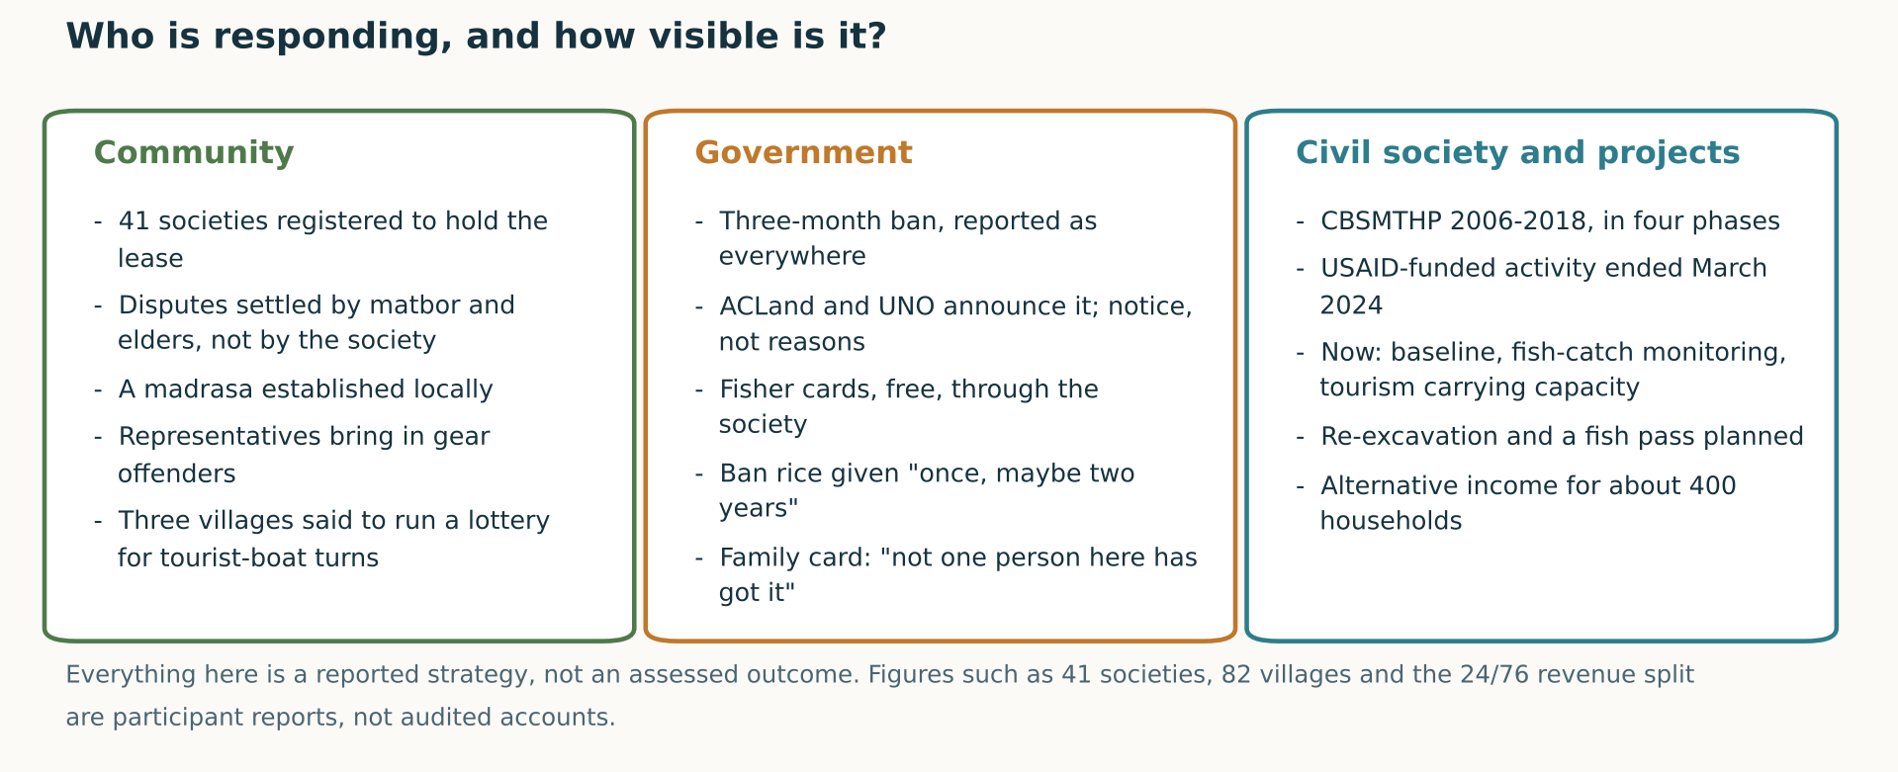
QUESTION 4 · RESPONSES ACROSS LEVELS — BRIDGE SLIDE
Custody and ownership are not in the same hands
To confirm before we present. The announced allocation gives Q1 one speaker, Q2 one, Q3 two, Q5 two and Q6 one. Question 4 has no assigned presenter. This bridge is our proposal, not an instruction from the group.
COMMUNITY TESTIMONY
PROFESSIONAL KII
OPEN QUESTION
Slide 11 of 17
Speaker 5 · 1:15 (Q4 bridge)
Notes:
SPEAKER 5 | slide 11 of 17 | target 1:15 | 176 words, about 75 s at 140 wpm
------------------------------------------------------------------------------
One housekeeping note. Our announced split covers questions one, two, three, five and six. Question four had no presenter, so I am bridging it here.
Three kinds of actor. The community is organised: forty-one societies hold the lease. But disputes are settled by the matbor and the elders, not the society. They established a madrasa. Three villages are reported to run a lottery for turns with the tourist boats, which is a rule about exclusion that nobody wrote down.
Government is present mainly as announcement. Participants described being told fishing is prohibited; they did not describe being told why a gear is harmful. One volunteered that people who do not fish at all hold fisher cards.
Civil society is present as a sequence of projects with end dates.
The thing I would point at sits underneath all three. Legal ownership of the land is with the Ministry of Land; custodianship is with Environment and Forests. Custody and ownership are not in the same hands. That is governance misfit in the structure, not anyone's failure to try.

Slide 12
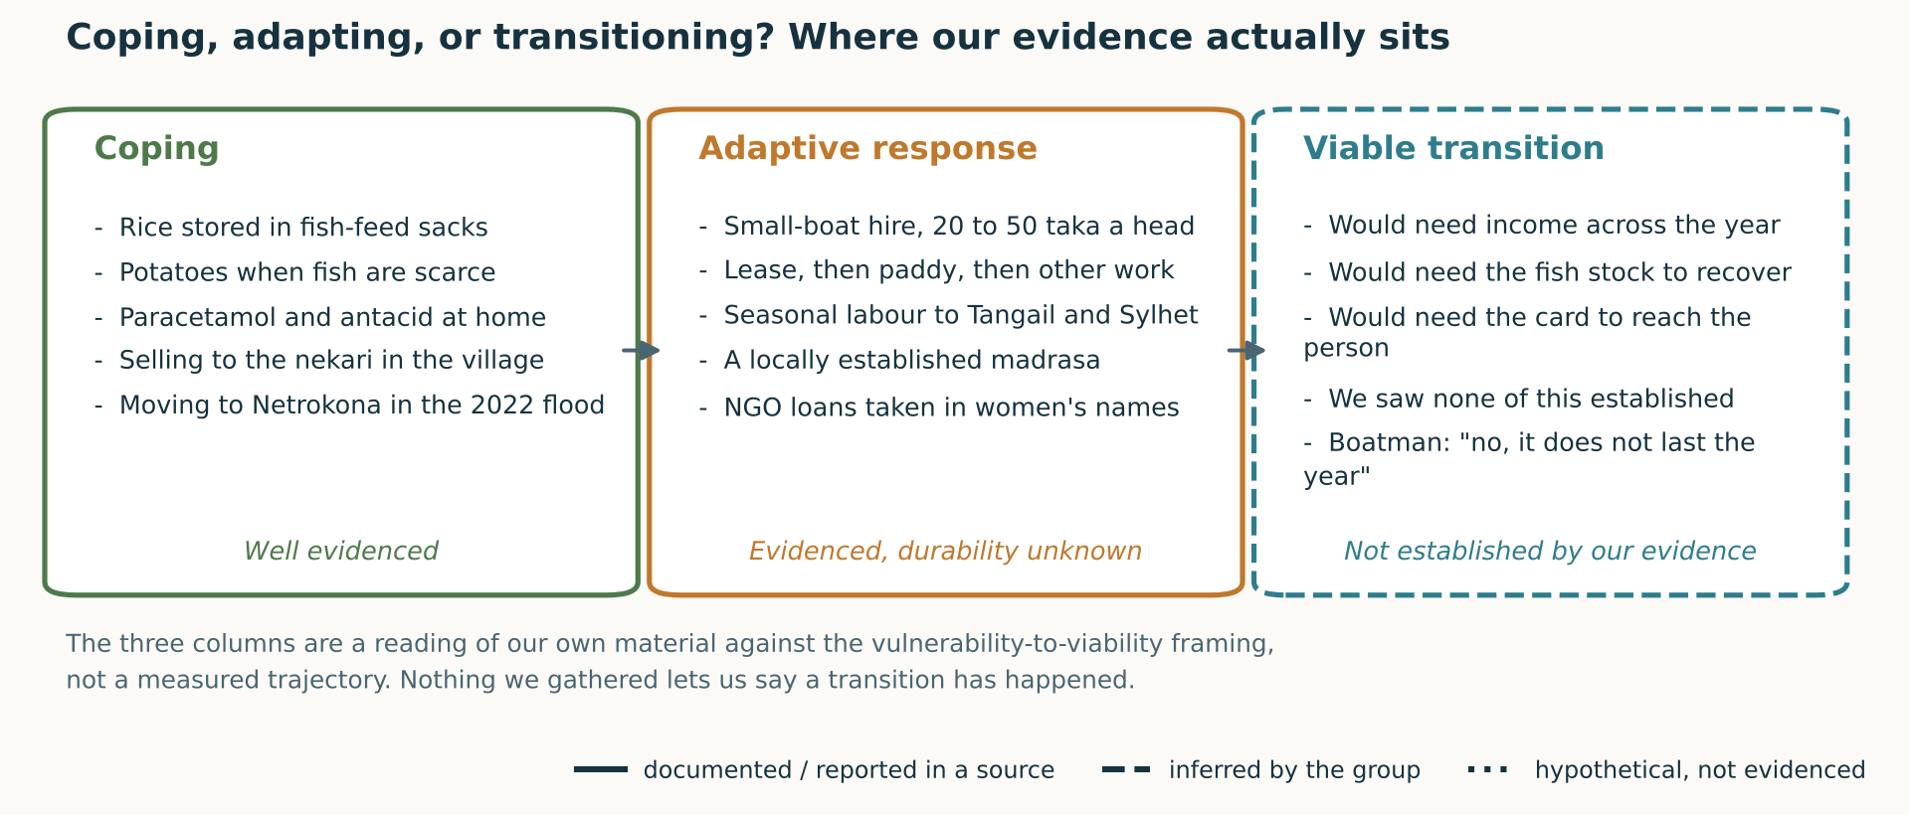
QUESTION 5 · ARE VULNERABILITY-TO-VIABILITY TRANSITIONS TAKING PLACE?
We can evidence coping. We cannot evidence a transition.
COMMUNITY TESTIMONY
OUR READING
WORKSHOP LECTURE
Joypur 00:38:06, 00:43:01, 00:58:36 · boatman notes 18:56-20:11 · CNRS KII Part 02
Slide 12 of 17
Speaker 5 · 1:35 · hands to Speaker 6
Notes:
SPEAKER 5 | slide 12 of 17 | target 1:35 | 238 words, about 102 s at 140 wpm
------------------------------------------------------------------------------
Question five asks whether vulnerability-to-viability transitions are taking place. The honest answer from one day: we can describe the first two columns and we cannot fill the third.
Coping is well evidenced. Rice in fish-feed sacks. Potatoes when fish are scarce. Paracetamol and antacid at home. Selling to the nekari because the market is unreachable. Moving to Netrokona when the water reached neck height in 2022.
Adaptive response is also evidenced, and more interesting, because some of it is new. Small-boat hire at twenty to fifty taka a head; an NGO gave boats free and people work them for hire. Lease, then paddy, then other work. Seasonal labour to Tangail and Sylhet, permanent migration to Dhaka. A locally established madrasa. NGO loans in women's names, though the men said plainly that it is they who supply the money.
The third column is where I want to be careful. Every item is a condition that would have to hold, not something we observed. Income that lasts the year. A fish stock that recovers. A card that reaches the person it names. We saw none of it established.
The boatman was asked directly whether tourism money lasts the year. He said no, and then talked about going elsewhere for work.
So tourism is a real new income stream and it is not yet a transition. Holding both at once is our answer to question five.
[Pause. Hand to Speaker 6.]

Slide 13
QUESTION 5 · THE COUNTEREXAMPLE WE WERE GIVEN
We went in with a hypothesis about tourism. It was refused.
THE EXCHANGE
WHY WE ARE SHOWING YOU THIS
Interviewer: “big boats break the bank a lot … so the houseboats harm you.”
Joypur, 00:58:09-00:58:15. Our side of the exchange.
The question contained our conclusion. He declined it, twice, and gave a reason that was about his own household's cash rather than about the haor.
The CNRS informant, from a different position, said the opposite: that tourism has grown suddenly, that houseboats put pressure on the environment, and that local people are not receiving the livelihood benefit expected of it.
Both can be true. The benefit is real, immediate and small; the cost is diffuse, slower, and borne by a system rather than a household. That is a distribution problem across scale and across time, not a disagreement about facts.
না হাউসবোট থেইকা সুবিধা তো আমরা একটা পাইতাছি … আমি তো নগদ লাভ দেখতাছি।
“no, we are getting a benefit from the houseboats … I am seeing cash profit”
Joypur, 00:58:24. Translated from Bengali; lightly translated.
He had already said, at 00:47:12, that houseboat noise does not harm fish and that the kona jal and the short machine do. His one complaint about tourists was the polythene they leave behind.
Open question. Who is positioned to feel a cost that arrives a decade later?
COMMUNITY TESTIMONY
PROFESSIONAL KII
Slide 13 of 17
Speaker 6 · 1:35
Notes:
SPEAKER 6 | slide 13 of 17 | target 1:35 | 232 words, about 99 s at 140 wpm
------------------------------------------------------------------------------
This is where the field corrected us most directly, and it belongs in a reflection more than any success story.
Near the end of the interview one of us put it to the participant that the big boats erode the bank, he has to rebuild it, and therefore the houseboats harm him. Listen to the shape of that: the question contains the conclusion.
His answer, at fifty-eight twenty-four. No, we are getting a benefit from the houseboats. I am seeing cash profit. And he gives the mechanism: a big boat ties up, ten small boats go out, each taking passengers to the watch tower at twenty or fifty taka a head.
He had refused the same framing ten minutes earlier, naming the kona jal and the short machine instead. His one complaint about tourists was the polythene.
The CNRS informant says close to the opposite: tourism grew suddenly, houseboats pressure the environment, and local people are not getting the benefit expected.
We will not adjudicate that. Both accounts can hold, because they are measured over different horizons. The benefit is immediate, in cash, in one household. The cost is diffuse, slower, borne by a system. The person best placed to describe today's cash is not the person best placed to feel a cost arriving in a decade.
That is a question about scale and about time, not a disagreement about what happened.

Slide 14
QUESTION 5 · WHAT EVIDENCE IS MISSING
What we would need before we used the word transition
THE COMPARISON WE MUST NOT MAKE
WHAT WOULD HAVE TO BE TRUE
— Income that holds through the nine months outside the lease window, for a named set of households, over more than one year.
— A fish stock measured the same way twice, far enough apart to show a direction.
— Entitlements that arrive: the card, the ban compensation, the allowance.
— A reason to expect the gear use to change, given that the users are local and expect to fish here next year.
— Someone accountable at the level where the driver sits, not only at the level where the damage shows.
141 fish species in an earlier government assessment, against 68 in CNRS fish-catch monitoring about two months before we spoke.
That is not 73 extinctions. The two counts come from different methods, different monitoring windows and different scopes. A catch-monitoring exercise records what is landed, not what exists. We are reporting both numbers and refusing the subtraction.
The same discipline applies to the turtle nobody has seen for ten years, the dolphin remembered in the local rivers, and the birds that elders describe as once darkening the sky. These are memories, offered as memories. CNRS said plainly that no accessible, continuous species-level dataset exists for this place.
PROFESSIONAL KII
OPEN QUESTION
OUR READING
Slide 14 of 17
Speaker 6 · 1:35 · hands to Speaker 7
Notes:
SPEAKER 6 | slide 14 of 17 | target 1:35 | 240 words, about 102 s at 140 wpm
------------------------------------------------------------------------------
If we are going to claim a transition, we should say what would count as evidence. First, one comparison we are refusing.
An earlier government assessment is reported to have recorded a hundred and forty-one fish species. CNRS fish-catch monitoring, two months before our conversation, found sixty-eight. It is tempting, and we have seen it done, to subtract and announce seventy-three extinctions.
We will not. The numbers come from different methods, windows and scopes. Catch monitoring records what is landed at a market, not what exists in the water. We report both and refuse the subtraction.
The same applies to the turtle one speaker has not seen in ten years while another saw one in 2022, and to the elders describing flocks of birds that looked like cloud. Those are memories offered as memories. CNRS told us no continuous species-level dataset exists for this place.
So, what would have to be true. Income holding through the nine months outside the lease window, for named households, over more than one year. A fish stock measured the same way twice, far enough apart to show direction. Entitlements that actually arrive. A reason to expect gear use to change, given that the users are local and expect to fish here again. And somebody accountable at the level where the driver sits, not only where the damage shows.
None of that is a day's work. That is the point.
[Pause. Hand to Speaker 7.]

Slide 15
QUESTION 6 · WHAT DOES THE FUTURE LOOK LIKE?
Three futures the evidence allows, and who would have to act in each
If nothing changes at the level above
Silt keeps arriving from upstream in the monsoon. Depth keeps falling. The lease window keeps producing less from the same three months.
Who would have to act: anyone with reach upstream of the haor. Nobody we met had that reach.
If the local proposal is taken up
Participants asked for two things: deepen the beel, and put katha bamboo back as sanctuary. Their stated reason was so there would be more fish to catch.
Who would have to act: the departments that re-excavate, plus whoever decides what the sanctuary is for.
If tourism keeps growing unmanaged
Immediate cash for the villages with boats. Polythene, bank erosion and, on the CNRS account, pressure without the expected local benefit.
Who would have to act: investors described as based in Dhaka, and whoever sets a carrying capacity.
A tension inside the local proposal, which we are not resolving. The sanctuary is asked for so that more can be caught. The lecture on 8 November put the same shape in front of us with the rabbit and the carrots: plenty of food will not solve the problem, and plenty of food could be a problem. We are flagging the tension because it is theirs to settle, not ours.
COMMUNITY TESTIMONY
PROFESSIONAL KII
WORKSHOP LECTURE
Joypur 00:43:50-00:44:34 · CNRS KII Parts 01 and 02 · lecture 00:05:02
Slide 15 of 17
Speaker 7 · 1:35
Notes:
SPEAKER 7 | slide 15 of 17 | target 1:35 | 221 words, about 94 s at 140 wpm
------------------------------------------------------------------------------
I want to answer question six as three conditional futures rather than a recommendation, because a recommendation from one day is exactly what we were warned against.
First, if nothing changes upstream. Silt keeps arriving, depth keeps falling, and the three-month window keeps producing less. Who would have to act? Someone with reach upstream of this haor. Nobody we met had that reach, and that is the finding, not an accusation.
Second, if the local proposal is taken up. It is theirs and it is specific: deepen the beel, and put the katha bamboo back as sanctuary. They have watched the lessees do it, with one to two crore taka of bamboo and fifty to a hundred guards.
Third, if tourism grows without management. Immediate cash for the villages with boats. Polythene, bank erosion, and on the CNRS account, pressure without the local benefit expected.
Now the tension I am not going to resolve. When they ask for a sanctuary, the stated reason is so there will be more fish to catch. But it is the rabbit and the carrots from the lecture: plenty of food will not solve the problem, and plenty of food could be a problem.
Whether a sanctuary built to increase catch functions as a sanctuary is a real question. It is theirs to settle, not ours.

Slide 16
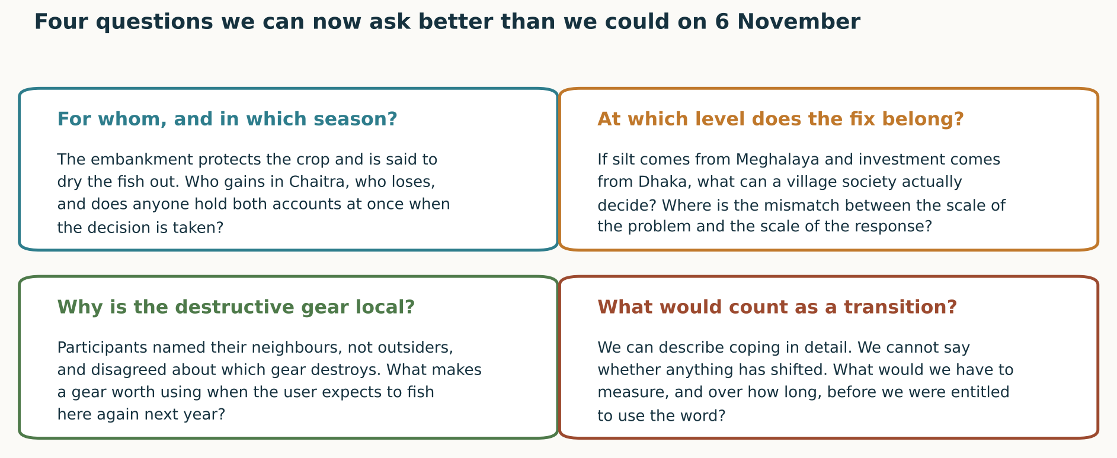
QUESTION 6 · WHAT WE CAN NOW ASK
We can now ask for whom, at which level, and over how long
OPEN QUESTION
Each question names a level, a season or a person, rather than asking for a solution.
Slide 16 of 17
Speaker 7 · 1:00
Notes:
SPEAKER 7 | slide 16 of 17 | target 1:00 | 149 words, about 63 s at 140 wpm
------------------------------------------------------------------------------
Four questions, and why each is better than what we would have asked on the sixth.
For whom, and in which season. On the sixth we would have asked whether embankments are good or bad. That has no answer. This one has to be answered twice: once for the paddy, once for the fish, possibly for the same household.
At which level does the fix belong. If the silt comes from Meghalaya and the investment from Dhaka, a village society deciding well is still deciding about the wrong thing.
Why is the destructive gear local. We arrived expecting outsiders. What makes a gear worth using when you expect to fish the same water next year?
And what would count as a transition. We can describe coping. We cannot say anything has shifted.
None of the four asks for a solution. Each names a level, a season, or a person.

Slide 17
What changed in what we notice
Not conclusions. A different set of things we can now see, and a limit we accept.
We arrived looking for a problem in Tanguar Haor.
We leave looking for the level at which the problem is produced.
“what you saw in Tanguar Haor, even if you go there for the next five years, what you will see is only one-third. Two-thirds you will never see.”
Prof. Prateep Kumar Nayak, lecture, 8 November 2026, 00:18:20. Spoken in English; transcribed, not translated.
We arrived looking for outsiders damaging a commons.
We leave looking for why a local user chooses a gear he knows is contested.
He also said that this is not a reason to walk away from the problem. It is a reason to stay engaged, to treat it as a process rather than a one-time fix, and to come back.
So we are not ending with what must be done. We are ending with a changed sense of what we are entitled to say after one day, and a list of the people we did not speak to: women in their own words, the tourist-board members, the fisheries and upazila officers, and anyone from the eighty-one other villages.
We arrived looking for whether infrastructure exists.
We leave looking for whether it is used, by whom, in which month.
We arrived looking for signs of recovery.
We leave looking for what would have to be measured before recovery could be claimed.
Thank you. We would rather be asked a hard question than a kind one.
Slide 17 of 17
Speaker 7 · 1:10 · close and questions
Notes:
SPEAKER 7 | slide 17 of 17 | target 1:10 | 173 words, about 74 s at 140 wpm
------------------------------------------------------------------------------
Four shifts, and one line to end on.
We arrived looking for a problem in Tanguar Haor. We leave looking for the level at which it is produced.
We arrived looking for outsiders damaging a commons. We leave asking why a local user chooses a gear his own neighbours dispute.
We arrived asking whether infrastructure exists. We leave asking whether it is used, by whom, in which month.
We arrived looking for signs of recovery. We leave asking what would have to be measured before recovery could be claimed.
And then this, from the eighth. What you saw in Tanguar Haor, even over five years, is only one-third. He was explicit that this is not a reason to walk away, but to stay engaged and come back.
So we close with who we did not speak to: women in their own words, the tourist-board members, the fisheries and upazila officers, and anyone at all from the other eighty-odd villages.
Thank you. We would rather be asked a hard question than a kind one.

