Slide 1

Branching strategy
By Shishu

Slide 2
Agenda
Needs Branching & Strategy
Who?
Need a strategy ?
Why?
To adopt and follow a strategy
How?

Slide 3
Who & why we need it?
Team
Collaborate & Develop
Sustainable and maintainable
Efforts are marked
Change History is logged
Issue is traceable
Development culture
Of Team
Efficiency and productivity
Visibility and quality

Slide 4
How and where to implement it?
Fork or Clone
Name of branch
Commits
Commit history
Adherence to the strategy
Improve quality and productivity
Trunk based
GitHub and GitLab Feature/ Release flow
Git flow
Notes:
-- Git Flow
Branches
- main for production
- develop for active developemnt
- feature for new exclusive feature
- release gatekeeper to production
- hotfix for urgent issues
Pros:
- Well-suited for large teams and aligning work across multiple teams.
- Effective handling of multiple product versions.
- Clear responsibilities for each branch.
- Allows for easy navigation of production versions through tags.
Cons:
- Complexity due to numerous branches, potentially leading to merge conflicts.
- Development and release frequency may be slower due to multi-step process.
- Requires team consensus and commitment to adhere to the strategy.
-- Github Flow
Branches
- main simplifies Git-Flow by eliminating release branches and have one active development branch (often main or master) that is directly deployed to production
- feature for new exclusive feature
Pros:
- Faster feedback cycles and shorter production cycles.
- Ideal for asynchronous work in smaller teams.
- Agile and easier to comprehend compared to Git-Flow.
Cons:
- Merging a feature branch implies it is production-ready, potentially introducing bugs without proper testing and a robust CI/CD process.
- Long-living branches can complicate the process.
- Challenging to scale for larger teams due to increased merge conflicts.
- Supporting multiple release versions concurrently is difficult.
-- GitLab Flow
GitLab-Flow strikes a balance between Git-Flow and GitHub-Flow. It adopts GitHub-Flow’s simplicity while introducing additional branches representing staging environments before production. The main branch still represents the production environment.
Branches
- main
- feature
- preprod
- prod
-- Trunk
Trunk Based Development promotes a single shared branch called “trunk” and eliminates long-living branches.
There are two variations based on team size: smaller teams commit directly to the trunk, while larger teams create short-lived feature branches.
Frequent integration of smaller feature slices is encouraged to ensure regular merging.

Slide 5
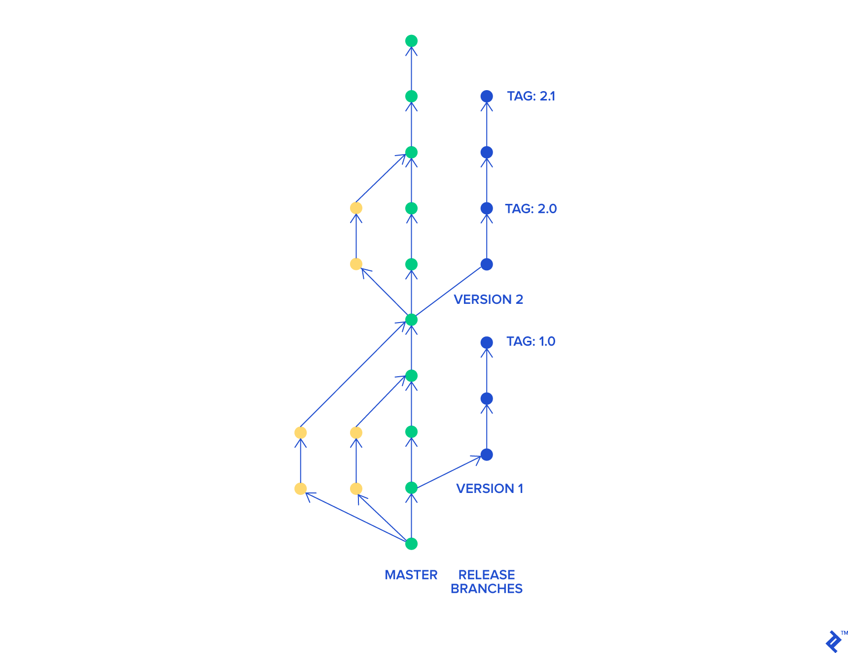
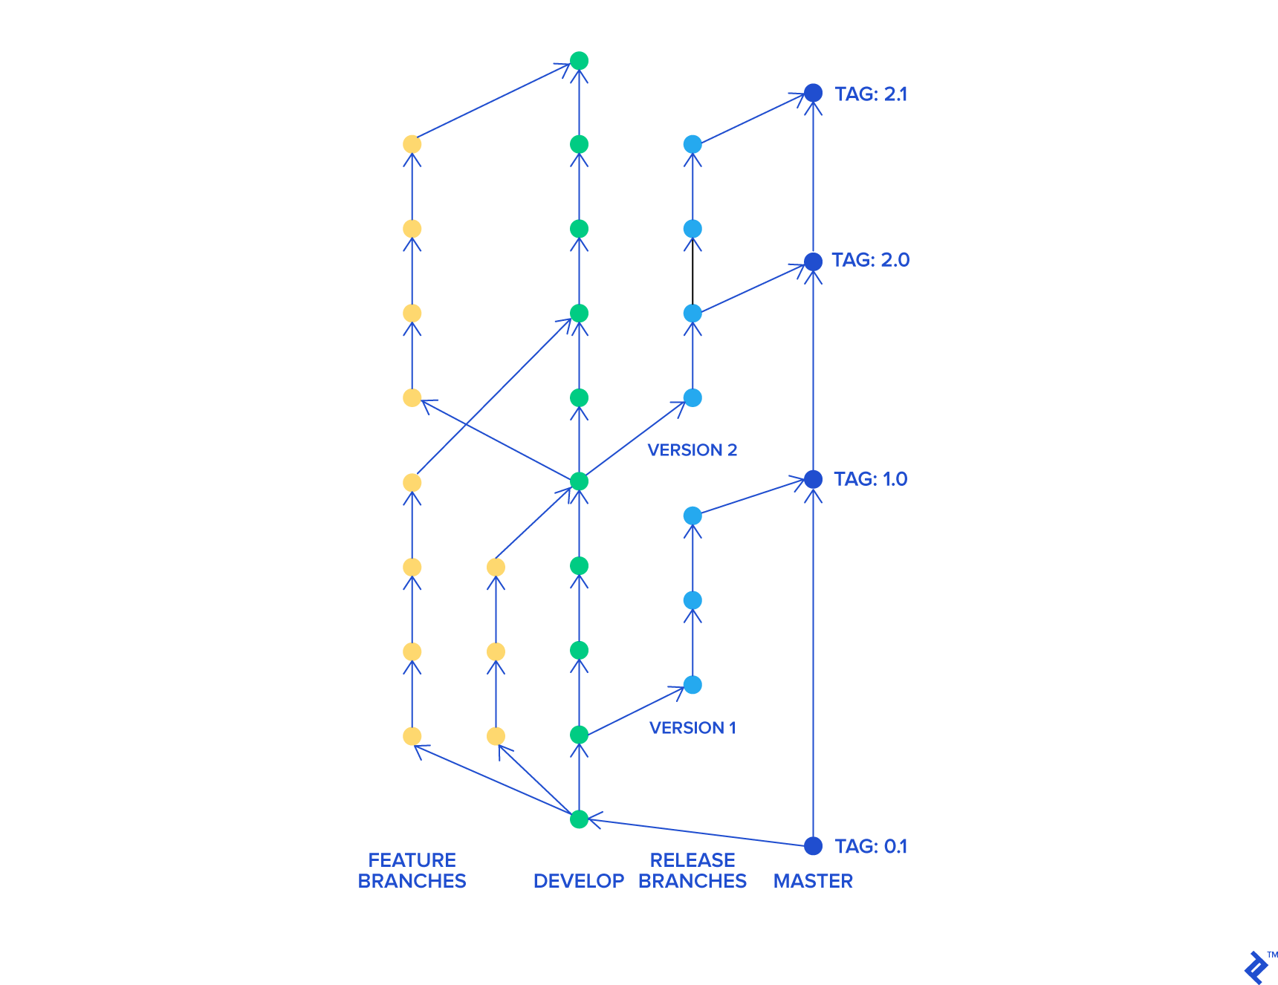
Comparison

Slide 6
Let’s decide for us
Branch name?
Commit s & History
Review and code peering?
Merging & rebasing?
Strategy?
Standardize the process (Culture)

Slide 7
Concepts
Feature / Concept | Forking | Cloning
What it is | Creates your own copy of someone else’s repo on GitHub | Creates a copy of a repo on your local machine
Where it happens? | On GitHub (cloud) | On your computer (local)
Purpose | To work independently on another project; useful for contributions | To download & work on any repo locally
Who uses it? | Contributors who don’t have repo access | Anyone who wants to work on a repo locally
Upstream
Https and ssh
Notes:
You use upstream to keep your fork up‑to‑date with the original project.
Because over time:
The original repo receives new commits: fixes, features, improvements.
Your fork becomes outdated.
Setting upstream allows you to pull changes from the original project into your fork easily.

Slide 8
Concepts
Committing with –m vs –am
Stage → Commit -> Push
Stash / Shelve
Rebase / Merge
Tools IDE integerated
Tools Git Hub Desktop
GIT MCP server
Notes:
You use upstream to keep your fork up‑to‑date with the original project.
Because over time:
The original repo receives new commits: fixes, features, improvements.
Your fork becomes outdated.
Setting upstream allows you to pull changes from the original project into your fork easily.

Slide 9

Questions?

