Slide 1

Training

Slide 2
Table of contents
What is git
What it solves
Prerequisites
Interacting with git
3 Stages in git
Common commands
Merge and rebase
Conflicts
Revert the changes
Push & pull
Some more commands
Q/A

Slide 3
What is Git
A software that interacts with code storage to maintain and manage work done by team(s) on a specific project.
A tool to help developer save, share, maintain his work at a safe place called repository.
A tool to interact with a public/intranet Drive which helps you to share and maintain your artefacts while developing a software or an application.

Slide 4
What it solves
Maintains multiple copies of your code (on different servers/machine)
Helps in team collaboration and bonding as it facilitates sharing of knowledge
Improves quality over time
Increases velocity
Division & sharing of work

Slide 5
Prerequisites
Git installed on your system
Git repository hosting service (Github/ Gitlab/Bitbucket)
Basic terminal commands

Slide 6
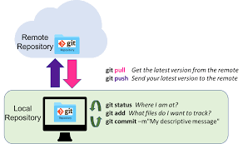
Interacting with git
Creating repo
Cloning repo
Creating a file
Stage a file
Commit a file
Push a file
Checking it on Github
Reading the changes

Slide 7
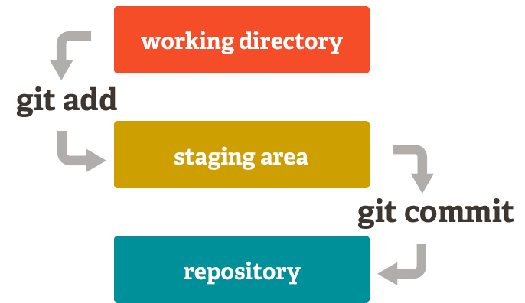
3 stages in git
Modified/Untracked
Staged
Commit

Slide 8
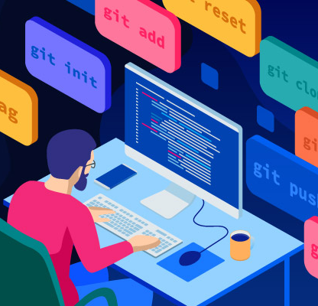
Common Commands
Branch related
Logging
Status
Tracking a file (add/commit/push)
Pull changes from repo

Slide 9
Activity-1

Slide 10
Merge/Rebase
Merge
Let's say you have created a branch for the purpose of developing a single feature. When you want to bring those changes back to master, you probably want merge (you don't care about maintaining all of the interim commits).
Rebase
A second scenario would be if you started doing some development and then another developer made an unrelated change. You probably want to pull and then rebase to base your changes from the current version from the repository.

Slide 11
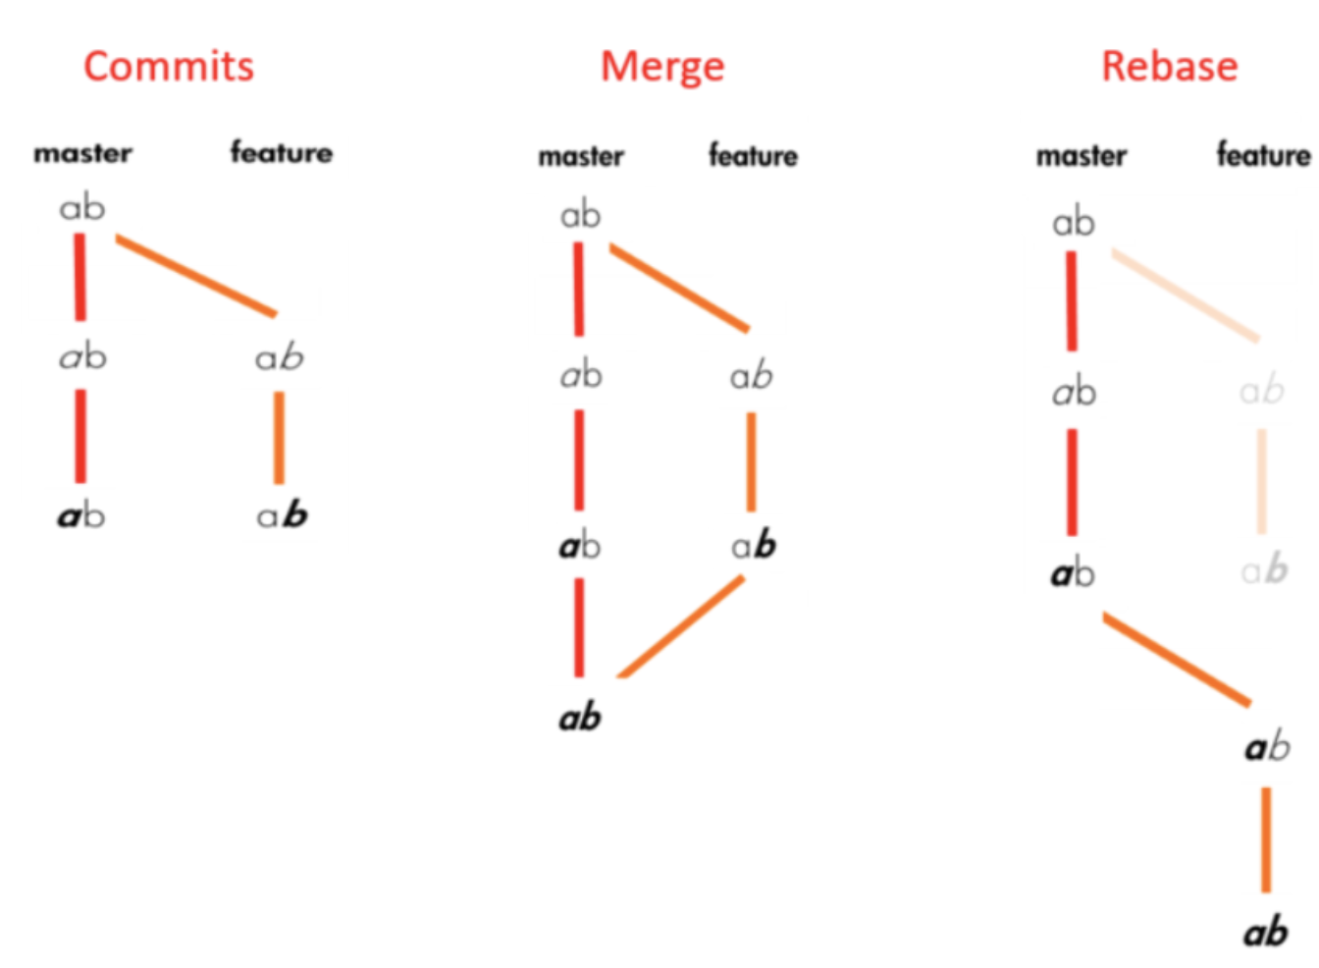
Merge/Rebase

Slide 12
Merge conflicts
It is ok getting conflicts
Always try to resolve them locally
All the parties (who worked) should be present while resolving the conflict.
Always use a text tool or IDE to resolve conflicts
Never run away from conflicts and resolve them because it is your fault which can cost you more then a simple bug.

Slide 13

Revert the changes
Reset
Best way to revert
git reset --soft <commit> revert after git commit
git reset HEAD <file> revert before commit after git add .
git checkout -- <file>. Revert before git add .
Last way to revert
git reset --hard <commit id>to reset everything to the state of that commit
git reset --hard HEAD^ to reset everything to the state of previous commit
Revert
git revert <commit hash> to revert the changes to the previous state with a commit to revert

Slide 14
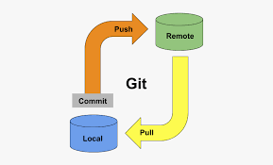
Push/Pull
Pull to be used before any push
To get all branches from remote you need to fetch
Resolve conflicts
Push the changes. Only, if you are very sure about changes
Force push (not recommended)

Slide 15
Some more
Stash
Patch
Remote
Config
Tools recommended github desktop

Slide 16

Q/A

Slide 17

Thanks!

