Slide 1

Sprocket Central Pty Ltd
Data analytics approach
[KPMG’s Lighthouse & Innovation Team][Shitab Tanzim]

Slide 2
Agenda
Introduction
Data Exploration
Model Development
Interpretation

Slide 3
Introduction
Recommend Top Customers to Target from New Customer Dataset
Problem:
Sprocket Central Pty Ltd is a long-standing KPMG client who specialises in high-quality bikes and accessible cycling accessories to riders. Their marketing team is looking to boost business by analysing their existing customer dataset to determine customer trends and behaviour. They have given us a new list of 1000 potential customers with their demographics and attributes with no prior transaction history with the organisation.
Action:
Analysis of the Transaction, Customer Demographic and Address dataset provided by Sprocket.
Find trends in sales volume by factors such as age, bike related purchase, job industry, wealth segment, car and property ownership,and state.
Calculate RFM score to recognise customer value.

Slide 4
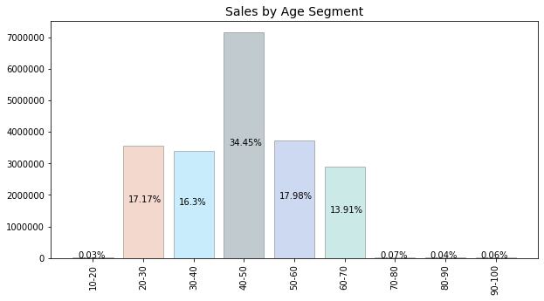
Data Exploration
Age
Insights:
Customer with age between 40 and 50 years contribute to 34.45% of the sales.
Almost same sales came from 20-30, 30-40 and 50-60 age category.
Negligible sales from customer below 20 and above 70 years of age.

Slide 5
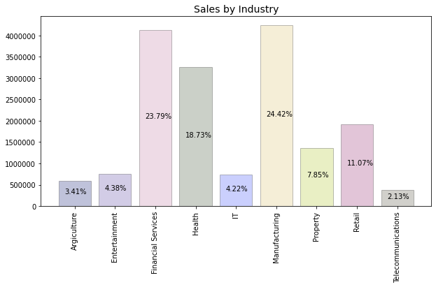
Data Exploration
Industry
Insights:
Customer from Financial Service and Manufacturing contributed most; with 23.79% and 24.42% of the sales.
Health sector follows with 18.73% of the sales.
More than 2/3rd of the sales came from these 3 industry.

Slide 6
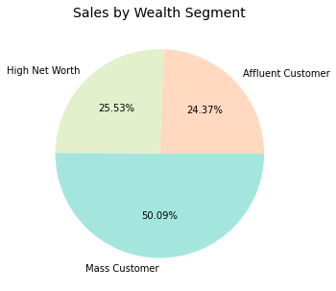
Data Exploration
Wealth Segment
Insights:
Half of the sales came from Mass Customers
High Net Worth and Affluent Customers contributed nearly equal.

Slide 7
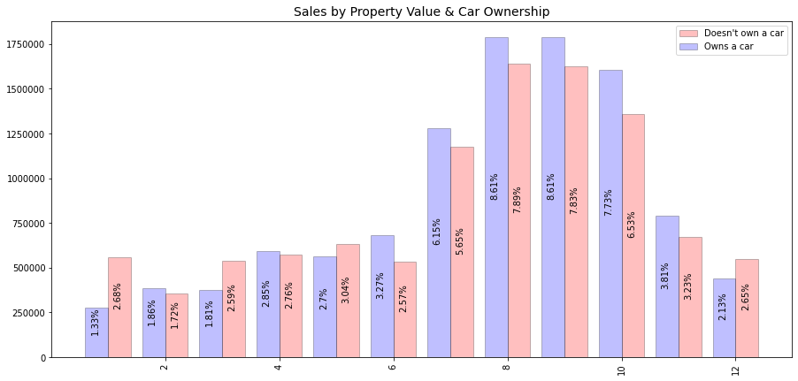
Data Exploration
Property Value and Car Ownership
Insights:
Most sales came from customer with property value between 7 and 10
Almost 60% sales came from these customers
Customer who owns a car are slightly more profitable.

Slide 8
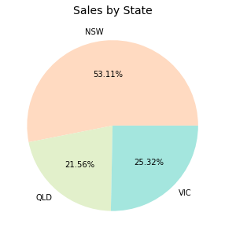
Data Exploration
State
Insights:
More than half of the sales are from New South Wales.
According to Australian Bureau of Statistics population of NSW, VIC, and QLD are 8M, 6.6M, and 5.2M. Therefore, population is not the main factor in sales per state.

Slide 9
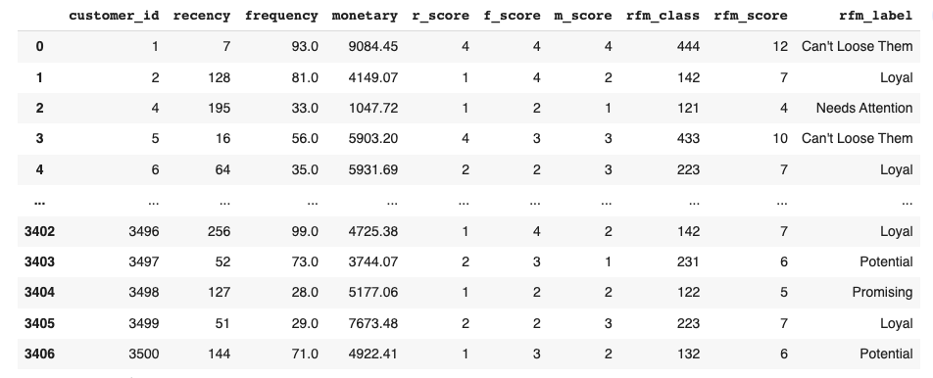
Model Development
RFM Scoring System
RFM stands for Recency, Frequency, and Monetary value, each corresponding to some key customer trait. The RFM score is a numerical score that helps you recognize all types of customers, from the best to the worst.
Predicting the RFM score of New Customers based on their demographic can give us an idea about how valuable these customers can be.

Slide 10
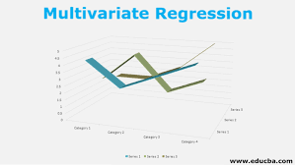
Model Development
Build RFM prediction model by Machine Learning.
- To predict the RFM score of the New Customers, we are going to build a ML Model.
- Age, gender, no. of bike related purchases, and all the other factors explored before will be used as an input variable (X).
- RFM score will be used as the output variable (Y) to perform supervised learning.

Slide 11

Interpretation
Customer to target
-After predicting the rfm score of the New Customer and sorting based on the same we can get the best customers to target.
-We can take the top 100 (or how many Sprocket wants) from the sorted table
-Moreover we can filter the best in each categories (job industry, state, etc.) to further narrow down our target customers.
- The order of predicted rfm score and the filtering of categories will give us the best results.

Slide 12
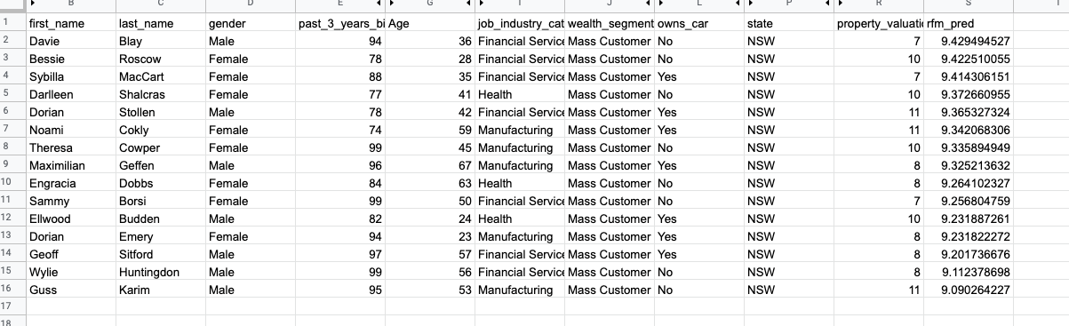
Interpretation
Customer to target
Glimpse of the top 15 customers to target:

Slide 13
Appendix

Slide 14
Appendix
RFM Score: https://www.datacamp.com/community/tutorials/introduction-customer-segmentation-python
EDA and Model Training: https://colab.research.google.com/drive/1TFOaymyi6WyVfvMy88KLPlQ8Y870juPt?usp=sharing
Catboost: https://catboost.ai/
Data Quality Assessment: https://docs.google.com/document/d/1ds-pXY8mok3ksSyu4P5i8TN6IDMyu9xx7Ne1twBkKbg/edit
Top 100 customers: https://docs.google.com/spreadsheets/d/1CJw594Ec3KFs1Im-Hwrre2gOSHkzfAfKpu_kQS5Jtgg/edit#gid=299829157

