Slide 1
Smart Irrigation System using AVR Microcontroller
(Group IV)
Submitted by: Submitted to:
Shital Kumar Singh Dr. Neha Ahuja
Dibya Krishna Kar
Nilesh Yadav
Alffrin Regi

Slide 2
Introduction:
The Smart Irrigation System is an automated solution designed to optimize water usage in agriculture by continuously monitoring soil moisture levels and controlling irrigation accordingly. It uses a soil moisture sensor to detect the condition of the soil in real time and ensures that water is supplied only when required, thereby improving efficiency and conserving resources.
Traditional irrigation methods often rely on fixed schedules or manual operation, which can lead to overwatering or underwatering of crops. This system overcomes such limitations by using an AVR microcontroller to make real-time decisions based on sensor data, resulting in better water management, reduced wastage, and improved plant growth.

Slide 3
Objective:
The main goal of this project is to develop an intelligent irrigation system that works automatically based on soil conditions. It reduces the need for manual monitoring and ensures efficient water usage.
Key Objectives:-
Automate irrigation process
Save water resources
Reduce human effort
Improve crop productivity

Slide 4
Components Used:
The system is built using basic electronic and embedded components that work together to perform sensing, processing, and actuation.
Main Components:-
ATmega32 Microcontroller
Soil Moisture Sensor
Relay Module & Water Pump

Slide 5
Working Principle:
The system continuously monitors soil moisture using a dedicated soil moisture sensor placed in the soil. This sensor detects the water content by measuring changes in electrical properties and generates an analog signal proportional to the moisture level. The analog signal is then sent to the microcontroller, where it is converted into digital form using the built-in Analog-to-Digital Converter (ADC) for accurate processing and decision-making.
The microcontroller compares the received moisture value with a predefined threshold level stored in its program. When the detected moisture level falls below this threshold, it indicates that the soil is dry. In response, the system automatically activates the relay module, which in turn switches ON the water pump to start irrigation. This process ensures that plants receive water exactly when needed.
As the pump supplies water, the soil moisture level gradually increases, and the sensor continuously updates the microcontroller with new readings. Once the moisture level reaches or exceeds the desired threshold, the microcontroller deactivates the relay, turning OFF the pump. This automatic control mechanism prevents overwatering, conserves water, and maintains optimal soil conditions for healthy plant growth.

Slide 6
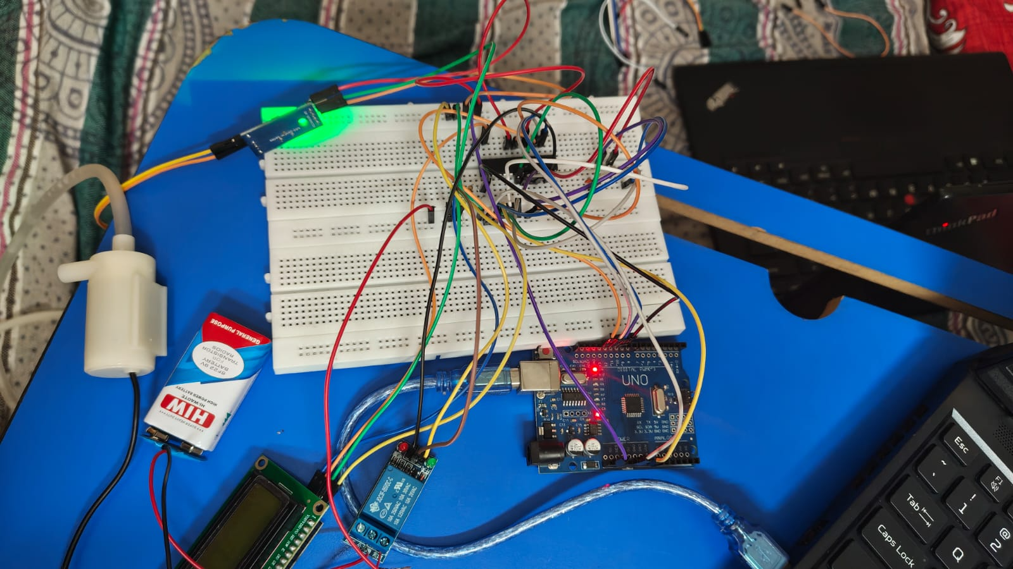
Circuit Diagram:
The circuit diagram shows the hardware connections between all components. It includes the sensor connected to the ADC pin of the microcontroller, relay driver circuit.

Slide 7
Advantages:
The Smart Irrigation System provides several benefits in agricultural applications. It ensures efficient water usage and reduces unnecessary wastage.
Key Advantages:-
Saves water through real-time monitoring
Improves plant growth
Fully automatic system
Reduces manual effort
Low cost and easy implementation
Prevents overwatering and underwatering

Slide 8
Applications:
This system can be used in various environments where irrigation is required. It is suitable for both small-scale and large-scale usage. It ensures efficient water management by supplying water only when needed, reducing wastage and improving plant health. Additionally, its automated operation makes it convenient and reliable for continuous use without manual intervention.
Agricultural fields
Home gardens
Greenhouses
Smart farming systems
Nurseries and plant cultivation centers
Parks and landscaping areas

Slide 9
Future Scope:
The system can be enhanced by integrating advanced technologies to improve functionality and efficiency.
Future Improvements:-
IoT-based remote monitoring
Mobile app control
Solar-powered system
AI-based smart irrigation

Slide 10
Conclusion:
The Smart Irrigation System demonstrates how embedded systems can be effectively used to automate agricultural processes and improve overall efficiency. By continuously monitoring soil moisture levels and controlling irrigation accordingly, it significantly reduces water wastage and ensures that plants receive the right amount of water at the right time. This helps in maintaining optimal soil conditions, leading to healthier plant growth and better crop yield.
Overall, the system is a reliable, cost-effective, and scalable solution that can be easily implemented in different agricultural environments. It supports sustainable farming practices by conserving water resources and reducing manual effort, making it an ideal approach for modern and smart agriculture systems.

