Slide 1
Expense Reimburse System
Submitted By Shital Moradiya

Slide 2
Expense Reimbursement System
Executive Summary The Expense Reimbursement System (ERS) will manage the process of reimbursing employees for expenses incurred while on company time.
All employees in the company can log in and submit requests for reimbursement and view their past tickets and pending requests.
Finance managers can log in and view all reimbursement requests and history for all employees in the company. Finance managers are authorized to approve and deny requests for expense reimbursement.
Reimbursement Statuses Reimbursement has the following statuses: Approved, Pending, and Denied
Reimbursement Types Employees must select the type of reimbursement as LODGING, TRAVEL, FOOD, or OTHER.
Technical Requirements The back-end system shall use JDB.
The middle tier shall use JSP/Servlet technology for dynamic Web application development.
Passwords shall be encrypted in Java and securely stored in the database.

Slide 3
Project Title | Expense Reimbursement System
Company Name | Revature
Development Tools | Tomcat Server
Operating System | Windows based Operating System
Programming language and Scripting language | JAVA, Servlets, JDBC, SQL, Bootstrap, Log4J Environment, HTML, CSS, JavaScript, JQuery

Slide 4
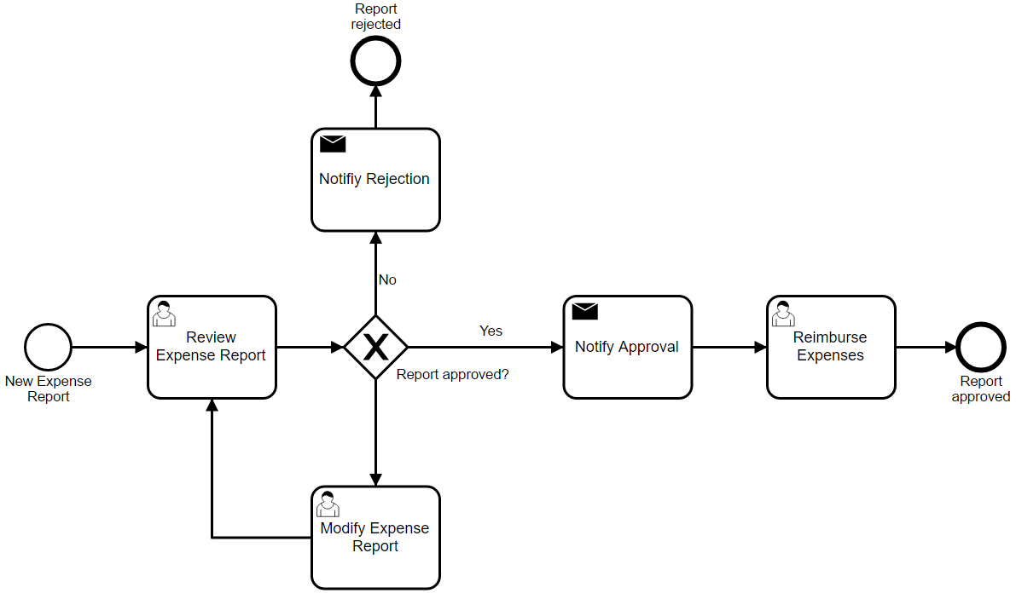

Slide 5
Database Table
-- Current reimbursement statuses: APPROVED, PENDING and DENIED
CREATE TABLE ers_reimbursement_status (
reimb_status_id NUMBER NOT NULL,
reimb_status VARCHAR2(10) NOT NULL,
CONSTRAINT reimb_status_pk PRIMARY KEY (reimb_status_id)
);
-- Current reimbursement types: LODGING, TRAVEL, FOOD or OTHER
CREATE TABLE ers_reimbursement_type (
reimb_type_id NUMBER NOT NULL,
reimb_type VARCHAR2(10) NOT NULL,
CONSTRAINT reimb_type_pk PRIMARY KEY (reimb_type_id)
);
CREATE TABLE ers_reimbursement(
reimb_id NUMBER NOT NULL,
reimb_status_id NUMBER,
reimb_date TIMESTAMP,
reimb_firstname VARCHAR2(250),
reimb_lastname VARCHAR2(250),
reimb_username NUMBER,
reimb_city VARCHAR2(250),
reimb_state VARCHAR2(250),
reimb_zip NUMBER,
reimb_amount NUMBER,
reimb_type_id NUMBER NOT NULL,
reimb_file BLOB,
CONSTRAINT ers_reimbursement_pk PRIMARY KEY(reimb_id)

Slide 6
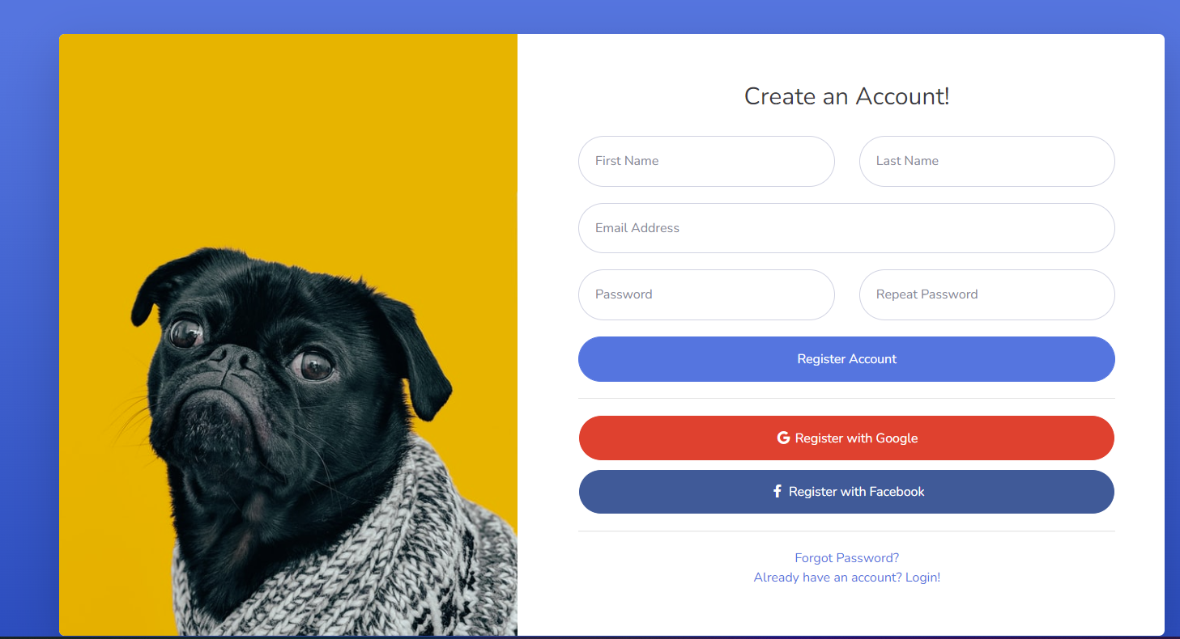

Slide 7



Slide 8
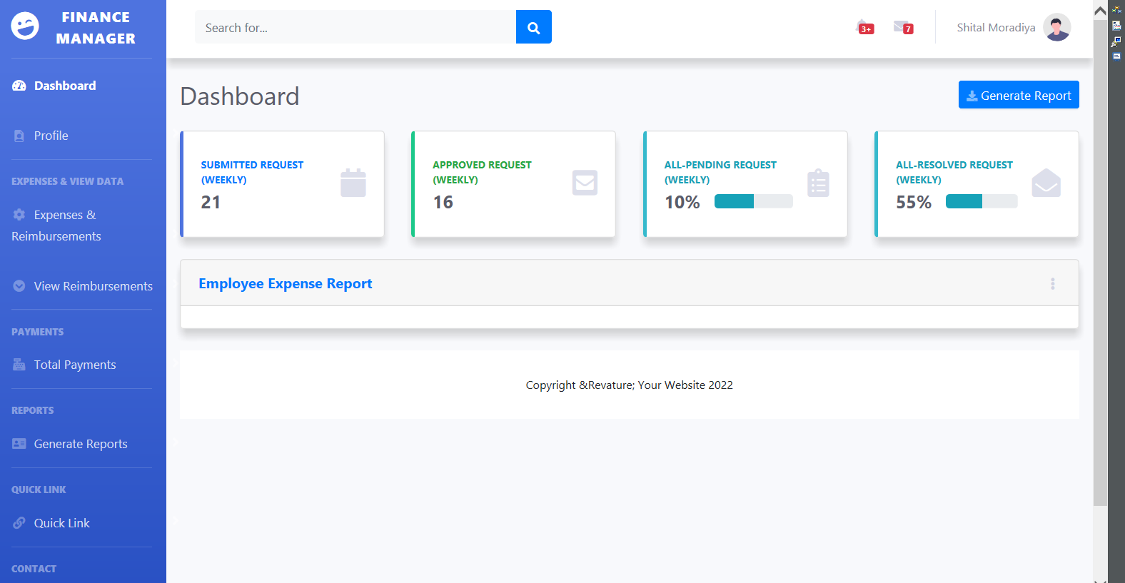
Dashboard

Slide 9
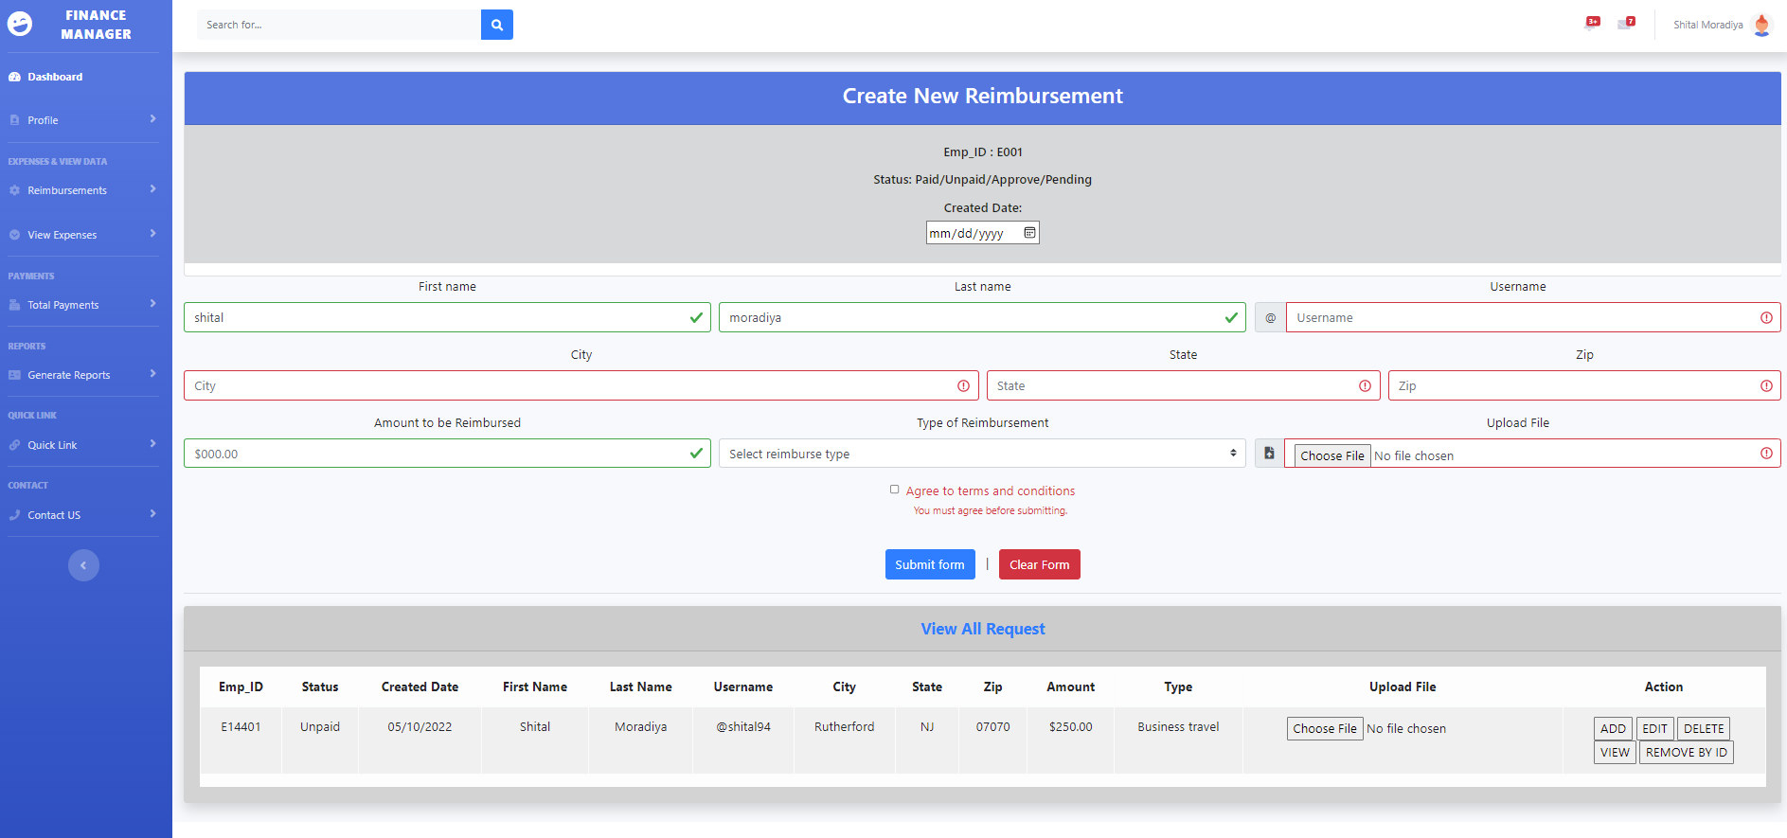
Create Reimbursement

Slide 10
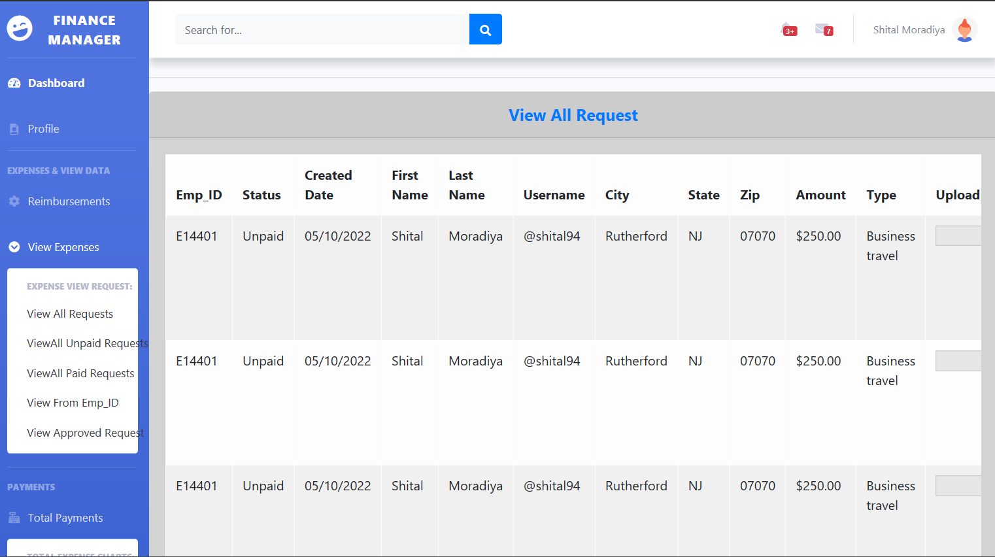
View All Requests

Slide 11
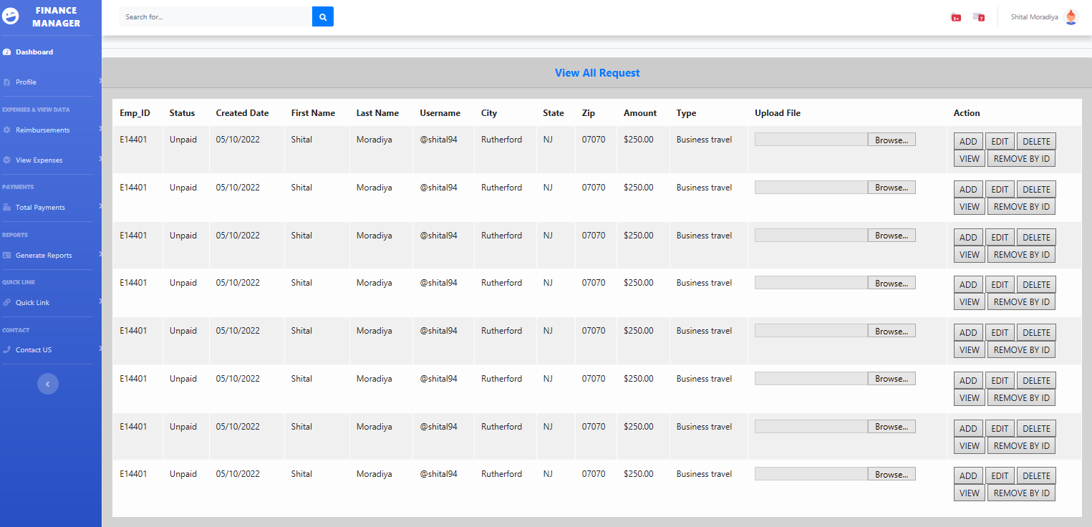
CRUD OPERATION

Slide 12
To Be Working On
In the future, when a user tries to log in with an ID and Password, those data will match with the database and then show a message and move to the dashboard.
Users can perform CRUD Operations.
Upload receipt of the reimbursement.
Manager:
View Image.
Register a new user and data is saved in the database.

Slide 13


