Slide 1
LECTURES 13-14
Data Visualization: From Grammar to Storytelling
Grammar of Graphics · Good vs misleading charts · Non-numeric data · Dashboards · Storytelling · Preparing Assignment 1
DATA209 · Advanced Exploratory Data Analysis · Dr. Shital Bhatt · Vidyashilp University

Slide 2
ROADMAP
Five ideas today
1 The Grammar of Graphics: building any chart from layers
2 Good versus misleading charts
3 Visualizing non-numeric data: categories, hierarchies, text, networks
4 Dashboard logic
5 Storytelling with data
• Also prepares you for Assignment 1
DATA209 · Advanced Exploratory Data Analysis · Dr. Shital Bhatt · Vidyashilp University
2

Slide 3
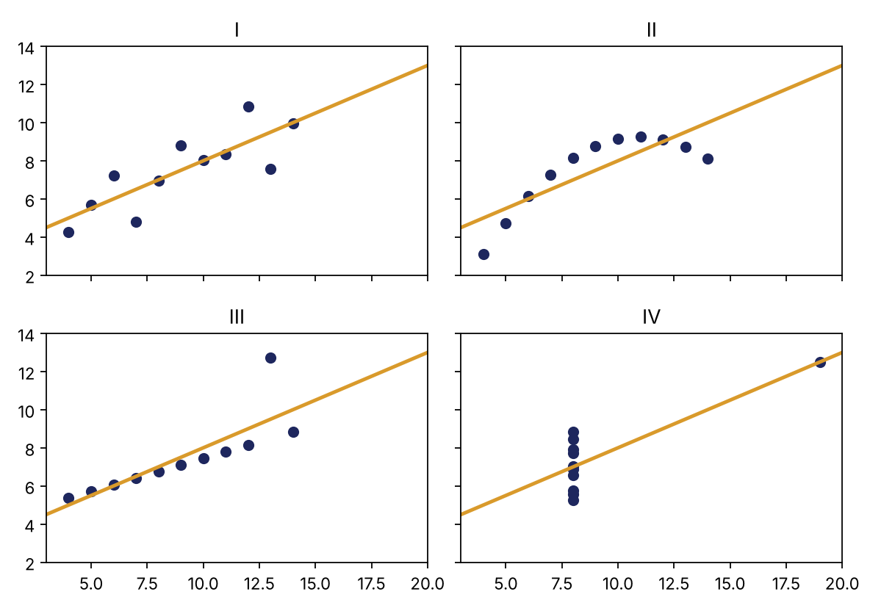
WHY VISUALIZE AT ALL?
Anscombe's quartet: same statistics, four different pictures
• Same mean, same variance
• Same correlation: r = 0.82
• Same fitted line
• Yet: a clean trend, a curve, a line with one outlier, a vertical stack with one extreme point
Summary statistics compress, and compression hides structure. Only the picture shows the difference.
DATA209 · Advanced Exploratory Data Analysis · Dr. Shital Bhatt · Vidyashilp University
3

Slide 4
GRAMMAR OF GRAPHICS
Every chart is built from layers
Data
Aesthetics
Geometry
Scales · Labels · Theme
The table you plot.
Which column controls x, y, colour, size or shape.
The shape that draws the data: points, lines, bars or boxes.
Axis ranges, titles, colours and fonts.
If you can name the layers, you can build or debug any chart.
DATA209 · Advanced Exploratory Data Analysis · Dr. Shital Bhatt · Vidyashilp University
4

Slide 5
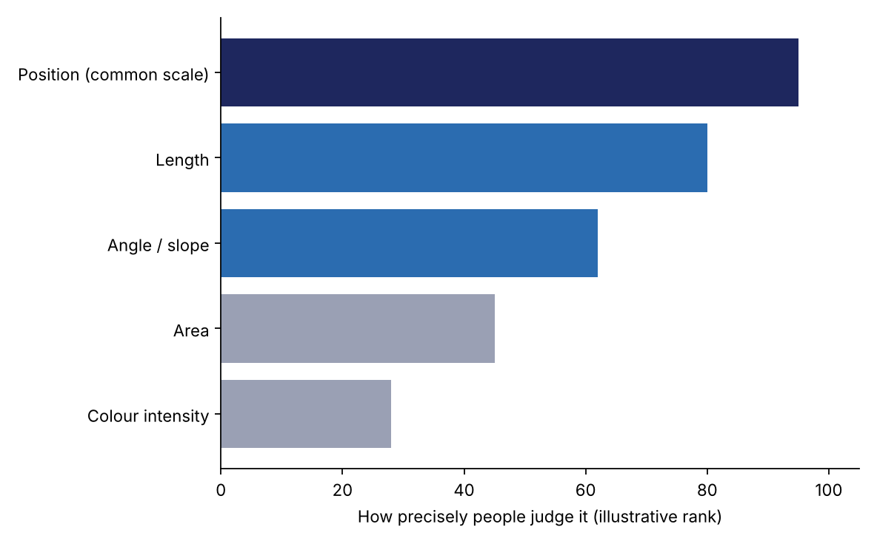
VISUAL CHANNELS
Not all channels are equally accurate
• People judge position on a common scale best, then length, then angle and slope, then area, and colour intensity least precisely.
• That is why bar charts and dot plots beat pie charts for comparing values.
• Put your most important comparison on the most accurate channel.
DATA209 · Advanced Exploratory Data Analysis · Dr. Shital Bhatt · Vidyashilp University
5

Slide 6
CHOOSING THE GEOMETRY
Pick the chart from the question you are asking
Question | Chart
How is one number distributed? | Histogram, density or box plot
How do two numbers relate? | Scatter plot
How does a number change over time? | Line chart
How do groups compare? | Bar, box or violin plot
How do two categories overlap? | Heatmap of a cross-tab
How do parts make a whole? | Stacked bar or treemap
DATA209 · Advanced Exploratory Data Analysis · Dr. Shital Bhatt · Vidyashilp University
6

Slide 7
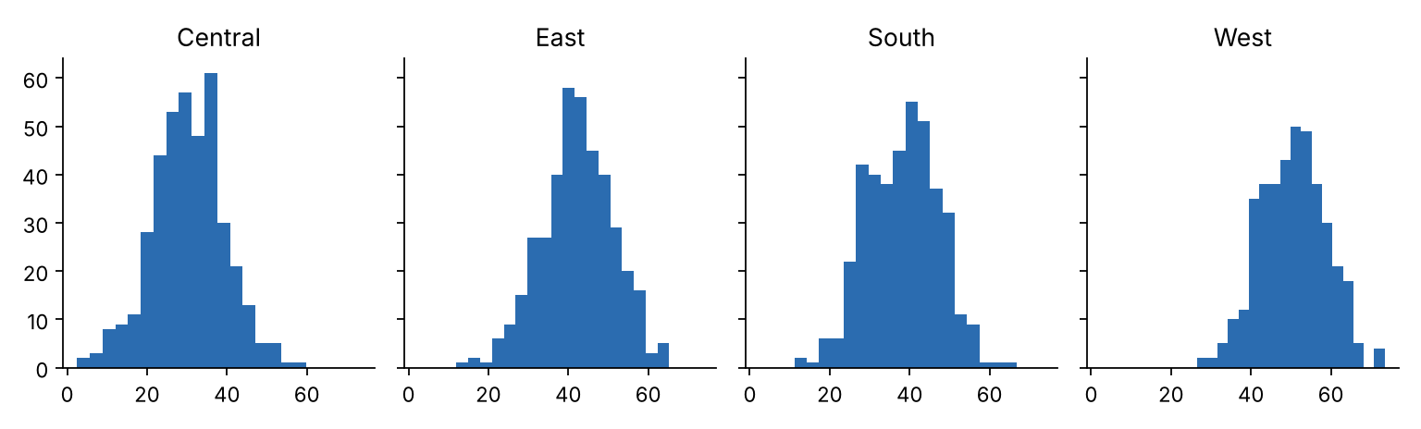
FACETS
Small multiples: one chart per group
• Facets repeat the same chart once per group in a grid.
• Every panel shares the same axes, so groups compare at a glance.
• One line of code, for example col = the grouping column in seaborn, beats piling many lines or colours onto one cluttered plot.
DATA209 · Advanced Exploratory Data Analysis · Dr. Shital Bhatt · Vidyashilp University
7

Slide 8
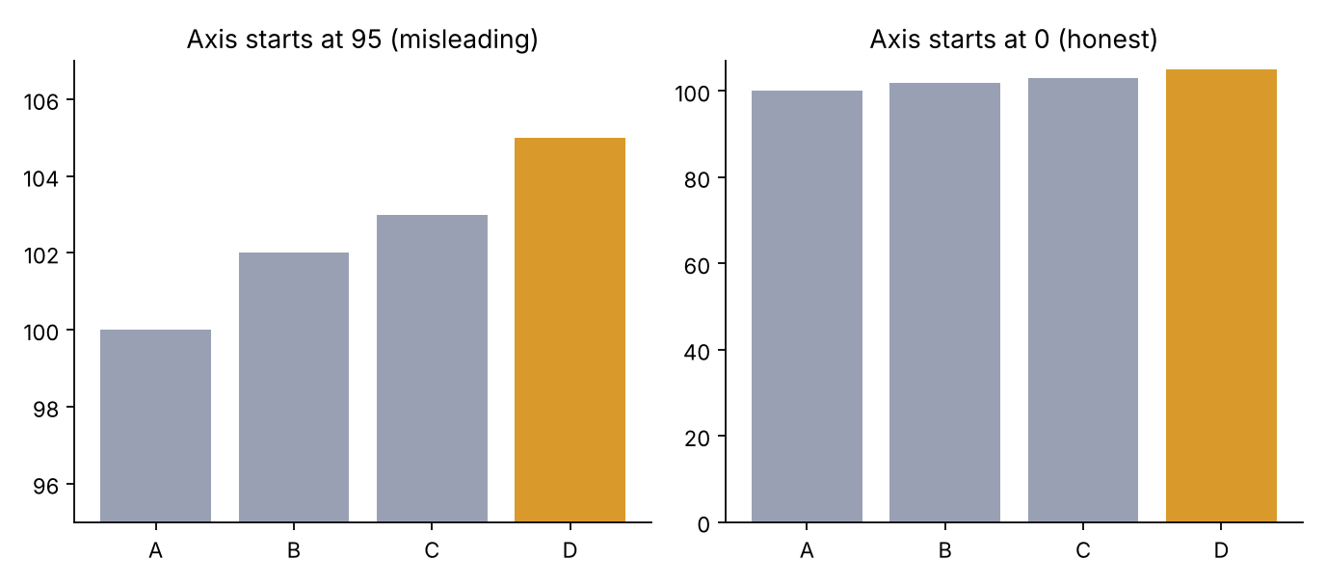
MISLEADING CHARTS 1
The truncated axis
• Both charts show exactly the same four numbers.
• Left: the axis starts at 95, so a 5% rise looks like a five-fold jump.
• Right: the axis starts at zero and shows the true, modest change.
• When bars encode a quantity, the axis must start at zero.
DATA209 · Advanced Exploratory Data Analysis · Dr. Shital Bhatt · Vidyashilp University
8

Slide 9
MISLEADING CHARTS 2
Other ways charts mislead
Dual axes
Cherry-picked range
Distorted areas
Clutter and 3-D
Missing context
Two axes can be scaled to fake any correlation.
Shows only the dates that suit the story.
Doubling a circle's radius quadruples its area.
Hide the data and bend the values.
No baseline, sample size or source leaves viewers guessing.
DATA209 · Advanced Exploratory Data Analysis · Dr. Shital Bhatt · Vidyashilp University
9

Slide 10
HONEST CHARTS
Principles of an honest chart
• Start bar charts at zero; line charts may zoom, but say so.
• Label axes with units and give an informative title.
• Use colour with purpose, and check it works for colour-blind readers.
• Remove decoration that carries no data: heavy gridlines, 3-D and shadows.
• Always show the sample size and the source.
DATA209 · Advanced Exploratory Data Analysis · Dr. Shital Bhatt · Vidyashilp University
10

Slide 11
NON-NUMERIC DATA
Mean and correlation do not apply to categories, hierarchies or text
Data | Natural chart
Categories | Sorted bar chart (sort by value, not alphabetically)
Hierarchies | Treemap: area shows share, nesting shows structure
Text | Word-frequency bar chart (better than a word cloud)
Relationships | Network diagram: nodes are items, edges are links
DATA209 · Advanced Exploratory Data Analysis · Dr. Shital Bhatt · Vidyashilp University
11

Slide 12
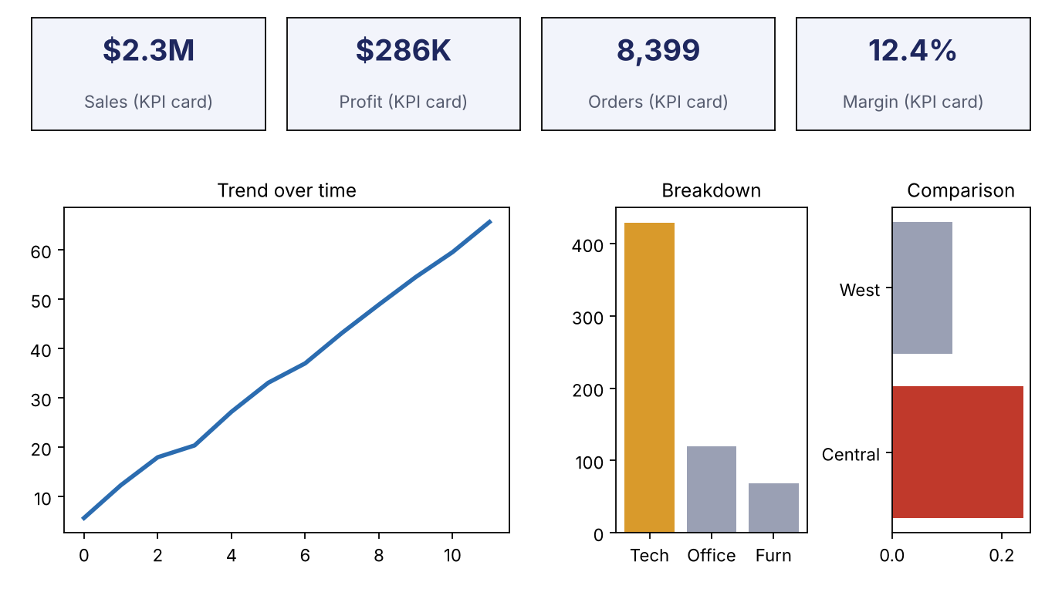
DASHBOARD LOGIC
A dashboard is several panels sharing one figure, built around a single purpose
• Start with the audience and the decision.
• Key numbers first, in a row of KPI cards.
• Then a trend, a breakdown and one comparison.
• Same colours, scales and filters across panels.
• Fewer panels, each with a clear job.
DATA209 · Advanced Exploratory Data Analysis · Dr. Shital Bhatt · Vidyashilp University
12

Slide 13
STORYTELLING
Turn a chart into a message
• Insight titles: write Central's discount stands out, not Discount by region.
• Highlight one thing: gray out the rest and colour the bar that matters.
• Annotate the key moment directly on the chart.
• Declutter: remove everything that does not support the message.
DATA209 · Advanced Exploratory Data Analysis · Dr. Shital Bhatt · Vidyashilp University
13

Slide 14
STORY STRUCTURE
Context, Conflict, Resolution
Context
Conflict
Resolution
What is the situation, and why does it matter?
What did the data reveal that is surprising or wrong?
What action do you recommend, and what will it change?
Every chart in your presentation should serve one of these three parts.
DATA209 · Advanced Exploratory Data Analysis · Dr. Shital Bhatt · Vidyashilp University
14

Slide 15
ASSIGNMENT 1
How to structure your presentation
• Problem statement: the question, the unit of observation and the target.
• Data audit: shape, types, missing values, duplicates and hidden zeros.
• Univariate and bivariate EDA with honest charts.
• Two or three hypotheses, labelled exploratory.
• A story: insight titles, one highlighted finding per slide, and a recommendation.
• Every chart needs an honest axis, labels with units and an insight title.
DATA209 · Advanced Exploratory Data Analysis · Dr. Shital Bhatt · Vidyashilp University
15

Slide 16
KEY TAKEAWAYS
What to remember
• Statistics hide structure, so always plot. Remember Anscombe's quartet.
• Every chart is data, aesthetics, geometry, scales and theme.
• Choose the geometry from the question, and use facets for groups.
• Start bar axes at zero and avoid decoration that bends the data.
• Categories, hierarchies, text and networks each have a natural chart.
• Dashboards have one purpose; stories have one message.
• Next: the lab, where you build all of these in Python.
DATA209 · Advanced Exploratory Data Analysis · Dr. Shital Bhatt · Vidyashilp University
16

