Slide 1
LECTURES 15-16
Data Quality, Integration and Validation
Four dimensions of quality · Combining sources · Duplicates · Inconsistent encoding · Validation rules
DATA209 · Advanced Exploratory Data Analysis · Dr. Shital Bhatt · Vidyashilp University

Slide 2
ROADMAP
What we learn today
• The four dimensions of data quality
• How to combine data from multiple sources
• How to detect duplicates
• How to fix inconsistent encoding
• How to write validation rules
• The lab that follows runs all of this on a real merged Airbnb file
DATA209 · Advanced Exploratory Data Analysis · Dr. Shital Bhatt · Vidyashilp University
2

Slide 3
RAW VERSUS CLEAN
Raw data was collected for another purpose
Raw data
Clean data
Duplicates, gaps and mixed spellings. Hidden sentinel values like 0, 999 or NA. Often several files with different schemas.
One row per entity. Gaps explained. One spelling. Sentinels converted to real missing values. One integrated, documented table.
The rule: audit first, fix second, and re-audit after every fix.
DATA209 · Advanced Exploratory Data Analysis · Dr. Shital Bhatt · Vidyashilp University
3

Slide 4
DATA QUALITY
Four dimensions
Accuracy
Completeness
Consistency
Validity
Is the value correct in the real world?
Is everything we need present?
Is one fact stored one way everywhere?
Does the value obey the rules?
We look at each in turn, with examples from the New York City Airbnb data.
DATA209 · Advanced Exploratory Data Analysis · Dr. Shital Bhatt · Vidyashilp University
4

Slide 5
ACCURACY
Accuracy needs a reference
• Check a value against reality, a trusted source or a peer group.
• A private room in Queens listed at $10,000 a night, against a peer median of $59.
• A good proxy: the median price of listings with the same borough and room type.
• Flag suspicious values rather than deleting them: the true value is unknown, and deleting real rows biases the data.
• Decide whether to cap, fix or remove later, once you know why.
DATA209 · Advanced Exploratory Data Analysis · Dr. Shital Bhatt · Vidyashilp University
5

Slide 6
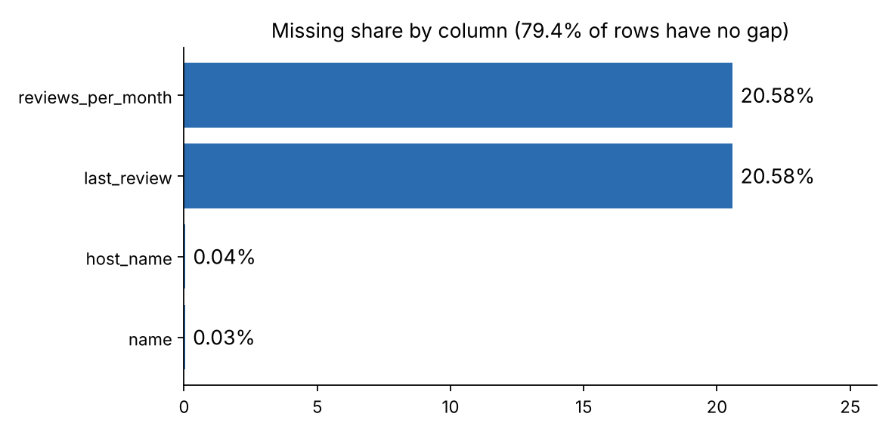
COMPLETENESS
How much is missing, and why?
• Measure the missing share per column, and the share of rows with no gap at all: only 79.4% here.
• Why? Every listing missing last_review has zero reviews, so the gap is structural, not random.
• Coverage matters too: a column can be fully filled and still never contain January or April.
DATA209 · Advanced Exploratory Data Analysis · Dr. Shital Bhatt · Vidyashilp University
6

Slide 7
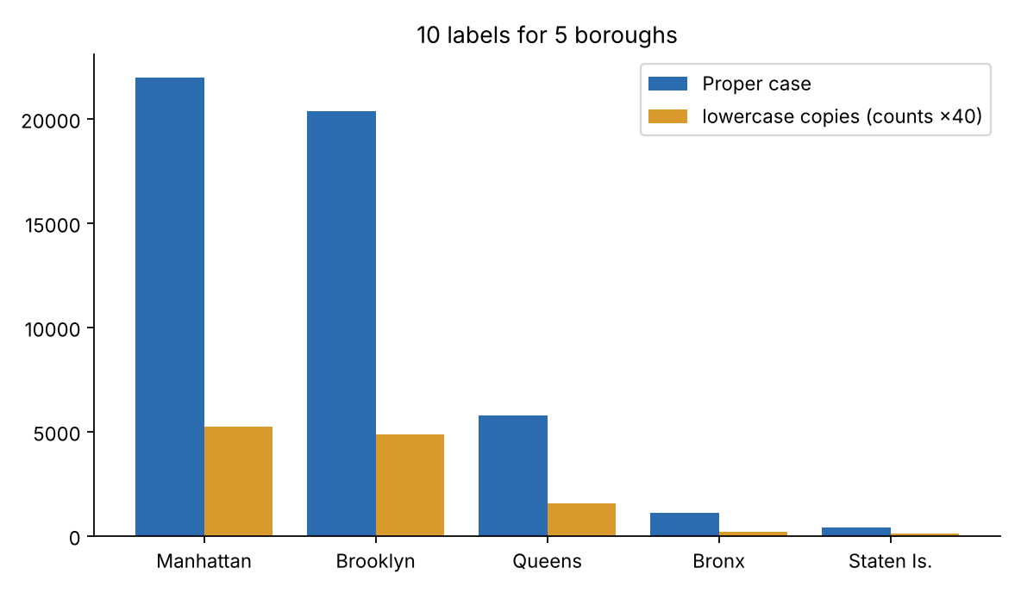
CONSISTENCY
One fact, one way
• Ten labels for five boroughs: lowercase copies sit next to the proper-case ones.
• A group by gives ten groups instead of five.
• It breaks across rows, across columns (price and price in dollars) and across sources (Manhattan versus manhattan).
• Fix: choose one standard form and apply it everywhere.
DATA209 · Advanced Exploratory Data Analysis · Dr. Shital Bhatt · Vidyashilp University
7

Slide 8
VALIDITY
Write the rules first, test every row against every rule
Rule type | Example | Result in the lab
Range | price >= 0 | 0 failures
Set | room type is one of three allowed values | 300 failures (lowercase)
Format / type | price is an integer | passes
Geographic box | latitude inside New York | 5 failures: real Staten Island listings
Uniqueness | IDs unique, no duplicate rows or columns | checked after cleaning
DATA209 · Advanced Exploratory Data Analysis · Dr. Shital Bhatt · Vidyashilp University
8

Slide 9
VALIDITY VERSUS ACCURACY
A value can pass one check and fail the other
Validity asks
Accuracy asks
Is it possible? Checked against a rule.
Is it correct? Checked against reality.
• A $10,000 room passes every validity rule and is still wrong.
• The five latitude failures are real, so rules need review too.
DATA209 · Advanced Exploratory Data Analysis · Dr. Shital Bhatt · Vidyashilp University
9

Slide 10
DATA INTEGRATION
Four steps
1 Match a key
2 Align the schema
3 Resolve conflicts
4 Re-audit
Find a shared identifier and check it is unique in each source.
Rename columns so both sources use the same names and types.
Where sources disagree, decide which one wins and why.
Check the merged table for duplicates, gaps and new conflicts.
DATA209 · Advanced Exploratory Data Analysis · Dr. Shital Bhatt · Vidyashilp University
10

Slide 11
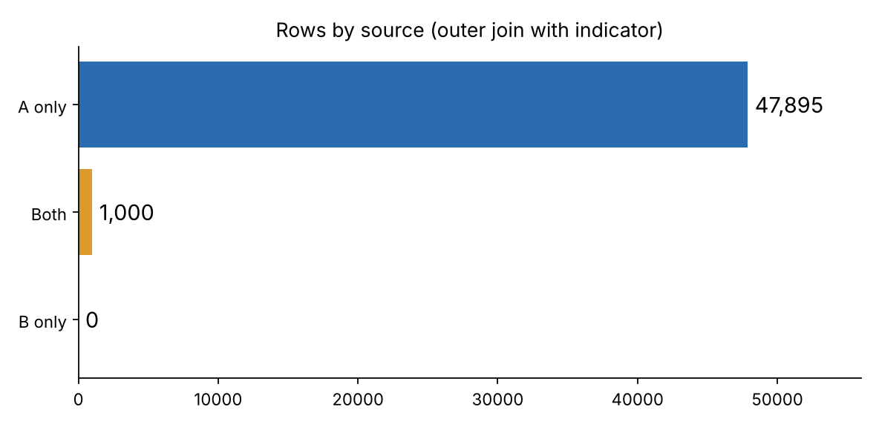
MERGING IN PRACTICE
Outer join with an indicator column
• The indicator shows whether each row is in A only, B only, or both.
• Compare matched rows field by field: 300 borough conflicts, 300 room type conflicts, 0 price conflicts.
• All were case differences only, so keep source A's spelling.
• Result: 48,895 rows with no duplicates.
DATA209 · Advanced Exploratory Data Analysis · Dr. Shital Bhatt · Vidyashilp University
11

Slide 12
DUPLICATES
Three kinds
Exact
Same key
Near-duplicates
Every column identical: 700 rows in the lab.
Same ID, other fields differ: 1,000 rows, the 700 copies plus 300 lowercase rows.
Almost the same after cleaning text, such as the same host with a similar name: 481 candidates.
Exact duplicates can be dropped automatically. Near-duplicates should be reviewed by a person.
DATA209 · Advanced Exploratory Data Analysis · Dr. Shital Bhatt · Vidyashilp University
12

Slide 13
INCONSISTENT ENCODING
Standardise, then re-audit
• Strip whitespace, fix the case, and collapse repeated spaces.
• For messy codes, use a mapping so BK, Bklyn and brooklyn all become Brooklyn.
• But standardising can create new duplicates: after title-casing, the 300 lowercase rows became exact copies of other rows.
• Order matters, so re-run the audit after every fix.
DATA209 · Advanced Exploratory Data Analysis · Dr. Shital Bhatt · Vidyashilp University
13

Slide 14
VALIDATION RULES
One reusable rule table
• Range rules: price at least zero; availability between 0 and 365.
• Type rules: price is an integer.
• Uniqueness rules: unique IDs; no duplicate rows or columns.
• Set rules: room type and borough in the allowed sets.
• Write the rules once and re-run them on every new load.
• In the lab, all twelve rules pass after cleaning.
DATA209 · Advanced Exploratory Data Analysis · Dr. Shital Bhatt · Vidyashilp University
14

Slide 15
WORKFLOW
Audit, diagnose, fix, validate
Audit
Diagnose
Fix
Validate
Shape, types, missing values and duplicates.
Test accuracy, completeness, consistency and validity.
Integrate sources, deduplicate and standardise.
Re-run the rules, re-audit and document what you did.
Document the steps so that someone else can trust and repeat them.
DATA209 · Advanced Exploratory Data Analysis · Dr. Shital Bhatt · Vidyashilp University
15

Slide 16
KEY TAKEAWAYS
What to remember
• Data quality has four dimensions: accuracy, completeness, consistency and validity.
• Validity is checked against rules, accuracy against reality.
• Completeness includes why data is missing and which categories never appear.
• Integrate sources on a key, align schemas, resolve conflicts, then re-audit.
• Standardising can create new duplicates, so re-audit after every fix.
• Document the rules and re-run them on every load.
• Next: the lab.
DATA209 · Advanced Exploratory Data Analysis · Dr. Shital Bhatt · Vidyashilp University
16

