Slide 1
DATA209 · ASSIGNMENT 1 · MODEL ANSWER
Voice of the Customer
An exploratory analysis of 28,332 Amazon product reviews — what customers write, when, and which reviews matter.
DATASET
DOMAIN
VISUALS
MARKS
28,332 × 24
E-commerce retail
12 + dashboard
25
BTech Hons. (Data Science), Semester III · Vidyashilp University
Notes:
Open by stating the business question, not the dataset.

Slide 2
Which reviews should a retailer actually pay attention to?
Reviews carry a rating, a written justification, a timestamp and product metadata. Before any of it can be modelled it has to be understood. That is the work of this report.
DATA209 · Module 2 — Assignment 1 — case study
2

Slide 3
FRAMING
How data science is used in e-commerce retail
01
Recommendation
02
Voice of customer
Item-to-item collaborative filtering — the Amazon engine published by Linden et al., 2003.
Turning free-text reviews into product signals with NLP.
03
Demand forecasting
04
Fake-review detection
Units per SKU per week from time-series models.
Anomaly and graph methods over reviewer behaviour.
DATA209 · Module 2 — Assignment 1 — case study
3

Slide 4
WRITTEN BEFORE LOOKING AT THE DATA
Six research questions
Q1 — How are ratings distributed?
Q2 — Do some categories earn better ratings?
Q3 — Do longer reviews accompany lower ratings?
Q4 — Does volume or rating drift over time?
Q5 — Does 'would recommend' add anything beyond the star rating?
Q6 — Do reviews fall into describable groups?
Sanity checks, stated in advance
Mean rating 4.0–4.8
Recommend rate rises with stars
Review counts highly unequal
Questions first, then analysis — so the work is directed rather than opportunistic.
DATA209 · Module 2 — Assignment 1 — case study
4

Slide 5
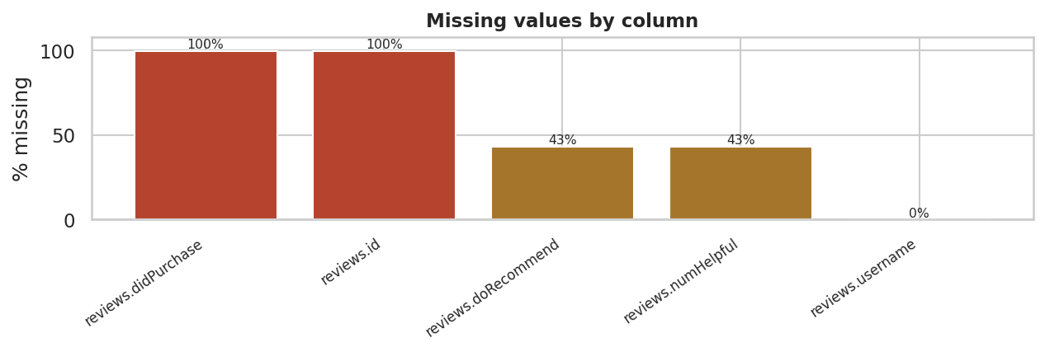
DATA QUALITY
Two columns are effectively empty
Percentage of missing values per column. Two columns are effectively empty and two more are missing for roughly 43% of reviews, which restricts what those fields can be used to claim.
DATA209 · Module 2 — Assignment 1 — case study
5

Slide 6
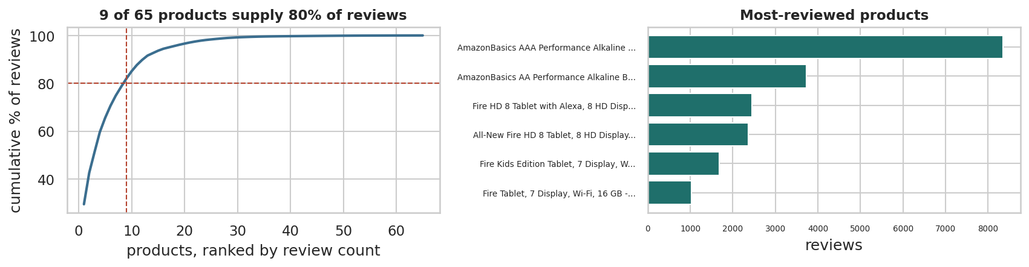
DATA QUALITY
A handful of products dominate
Cumulative share of reviews by product, ranked. A small number of products account for most reviews, so any dataset-wide average is dominated by a handful of items.
DATA209 · Module 2 — Assignment 1 — case study
6

Slide 7
DATA QUALITY
Three problems that changed what we can claim
Problem | Scale | Action
reviews.didPurchase empty | 99.97% missing | Dropped — verified-purchase analysis impossible
doRecommend / numHelpful | ~43% missing | Analysed on the observed subset only
Duplicate reviews | 57 rows | Dropped on user + text + product
Volume concentrated in one month | one month dominates | Reported — time trends unreliable
About 2% of rows removed in total, each step logged with its justification.
DATA209 · Module 2 — Assignment 1 — case study
7

Slide 8
PART 3
Summary statistics, and which to trust
n mean median mode range variance std_dev IQR skew
variable
rating (1-5) 28221 4.520 5.000 5.000 4.000 0.870 0.930 1.000 -2.350
review length (chars) 28221 136.410 87.000 50.000 8,350.000 38,711.040 196.750 107.000 15.250
review length (words) 28221 25.740 17.000 2.000 1,538.000 1,333.940 36.520 21.000 14.700
helpful votes 16071 0.470 0.000 0.000 621.000 62.810 7.930 0.000 50.690
Rating is left-skewed (mean 4.52, median 5); length is right-skewed with skew 15. Report median and IQR for both.
DATA209 · Module 2 — Assignment 1 — case study
8

Slide 9
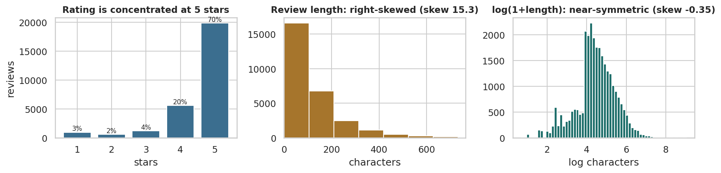
PART 3
The shape of the two headline variables
Rating distribution and review-length distribution. Ratings are heavily concentrated at 5 stars (left); review length is strongly right-skewed with a long tail of very long reviews (centre), which a log transform largely corrects (right).
DATA209 · Module 2 — Assignment 1 — case study
9

Slide 10
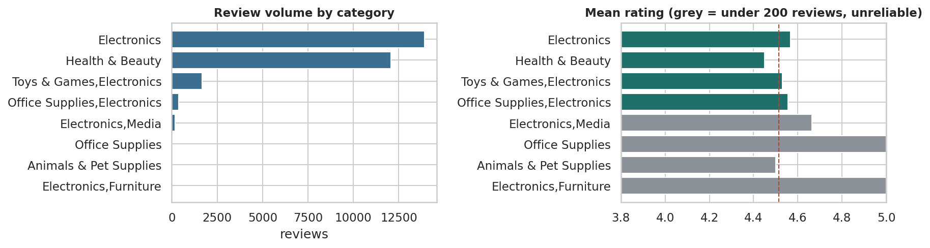
PART 5
Categorical: volume and rating by category
Review volume and average rating by product category. Volume is extremely concentrated in two categories (left); average rating varies by roughly half a star across categories (right), and the categories with fewest reviews have the least reliable averages.
DATA209 · Module 2 — Assignment 1 — case study
10

Slide 11
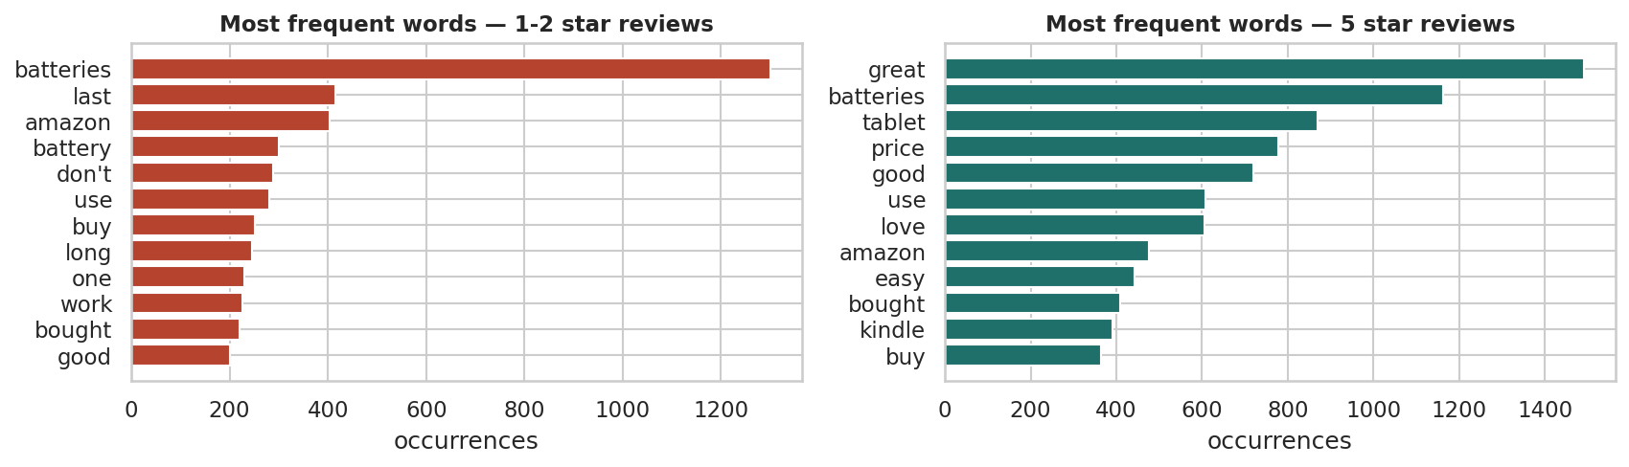
PART 5
Text: what separates 1-star from 5-star
Most frequent words in 1-2 star versus 5 star reviews, after stop-word removal. Negative reviews are dominated by product-failure and returns vocabulary; positive reviews by price and gifting vocabulary.
DATA209 · Module 2 — Assignment 1 — case study
11

Slide 12
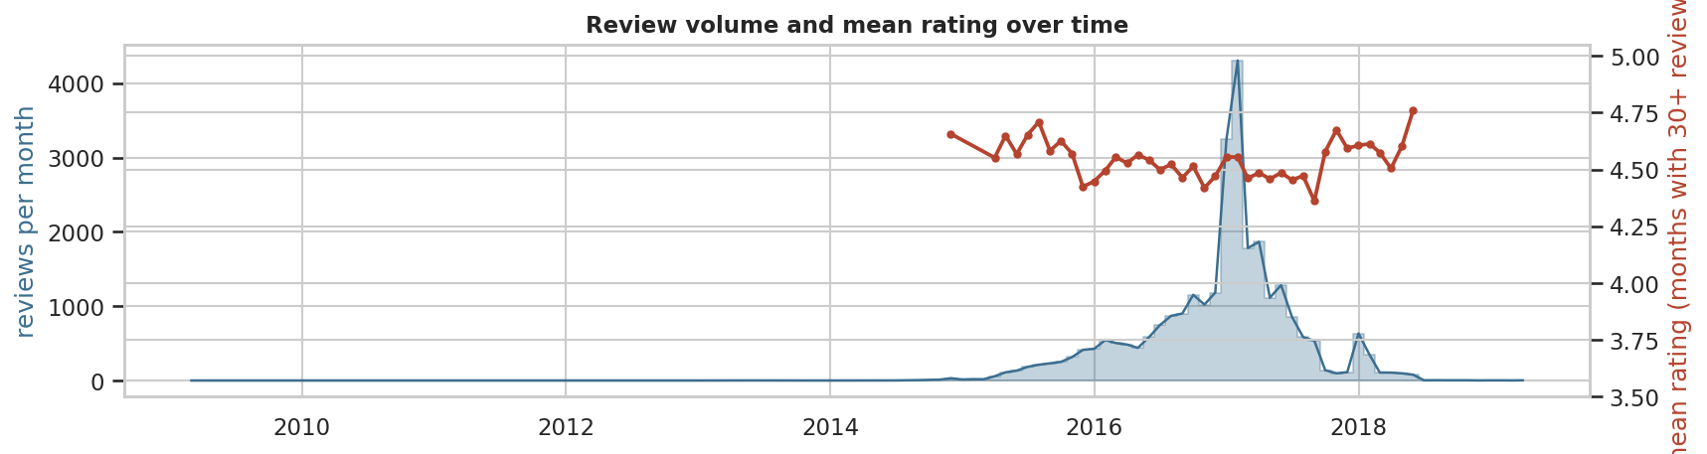
PART 5
Time series: volume and rating by month
Monthly review volume and monthly mean rating. Volume is dominated by a single collection spike; mean rating is broadly stable, so the spike reflects how the data was gathered rather than a change in customer sentiment.
DATA209 · Module 2 — Assignment 1 — case study
12

Slide 13
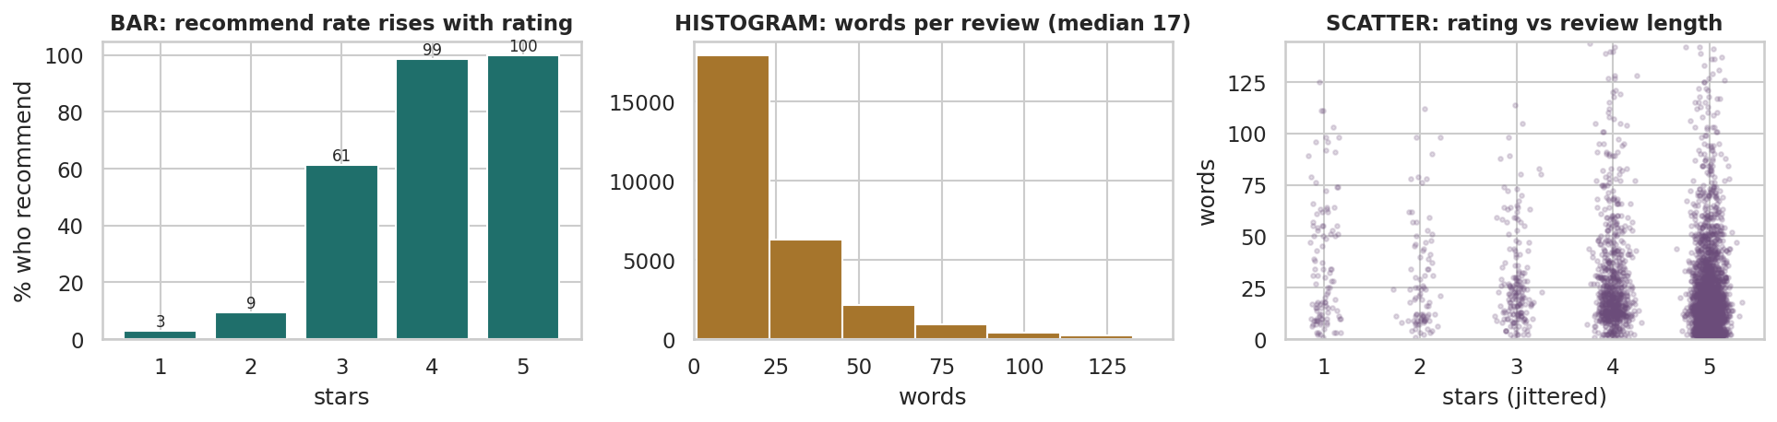
PART 6
Bar, histogram and scatter — each answers a different question
Bar chart, histogram and scatterplot on the same dataset. The bar chart compares categories, the histogram shows the shape of one variable, and the scatterplot tests a relationship between two — here showing that long reviews are not concentrated at low ratings.
DATA209 · Module 2 — Assignment 1 — case study
13

Slide 14
A rank correlation of −0.06 said 'no relationship'. It was wrong.
Splitting by rating shows median review length falling at every step: 26 words at 1 star down to 15 at 5. Dissatisfied customers write about 1.7× as much as satisfied ones.
DATA209 · Module 2 — Assignment 1 — case study
14

Slide 15
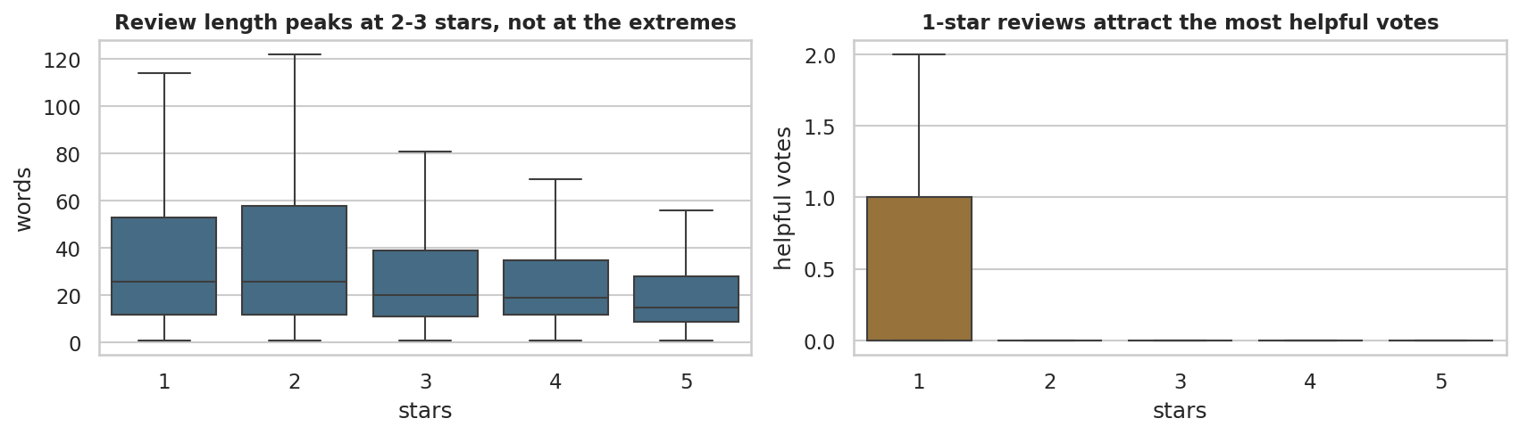
THE KEY FINDING
Length falls, and helpfulness rises, as rating drops
Review length and helpful votes by star rating. Median length falls steadily as the rating rises — dissatisfied customers write substantially more — and 1-star reviews attract by far the most helpful votes.
DATA209 · Module 2 — Assignment 1 — case study
15

Slide 16
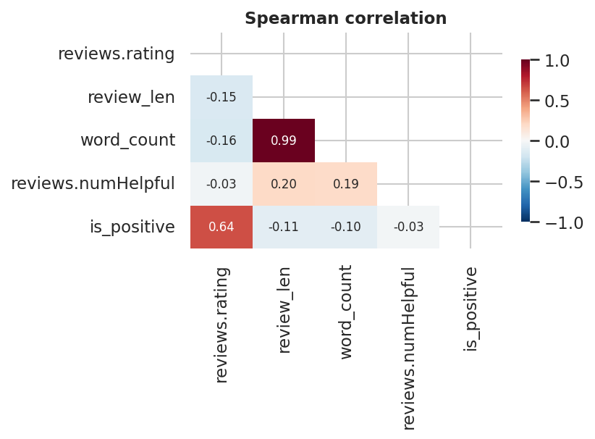
PART 6
Correlation heatmap — and a redundant pair
Spearman correlation between the numeric and ordinal variables. All associations are weak; the strongest is between the two length measures, which are near-duplicates of each other by construction.
DATA209 · Module 2 — Assignment 1 — case study
16

Slide 17
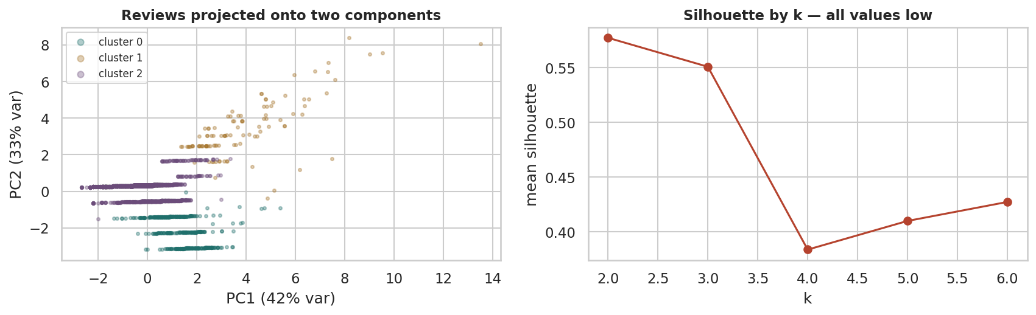
PART 7
Three groups, once the skewed features are transformed
K-means clusters of reviews projected onto the first two principal components, with the silhouette score for each candidate k. Three well-separated groups emerge — critical detail, engaged middle, and brief praise — once the heavily skewed helpful-vote and length features are log-transformed.
DATA209 · Module 2 — Assignment 1 — case study
17

Slide 18
PART 7
Naming the groups
88%
Brief praise
10%
Critical detail
2%
Engaged middle
Mean rating 4.78, median 16 words, almost no helpful votes. The silent satisfied majority.
Mean rating 2.08, median 23 words. The richest written product feedback.
Mean rating 4.46, median 48 words, ~11 helpful votes each. The reviews others actually read.
DATA209 · Module 2 — Assignment 1 — case study
18

Slide 19
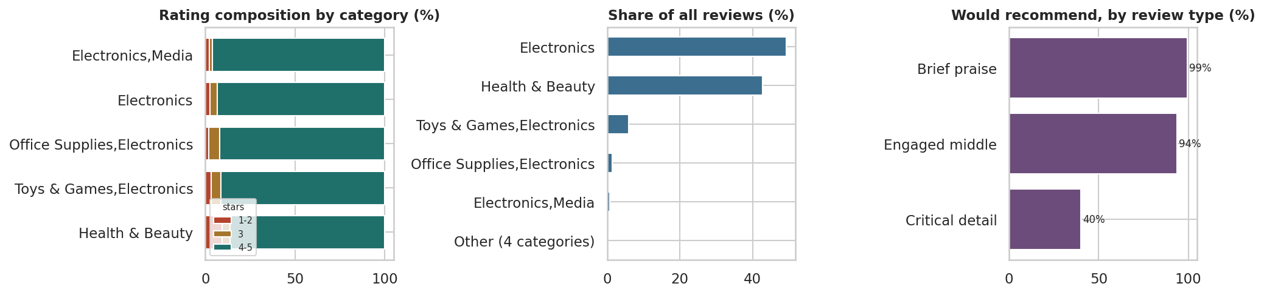
PART 7
Visualising non-numeric data
Three ways to show non-numeric data: a stacked bar of rating composition by category, a mosaic-style view of category share, and recommendation rate by cluster. None of these variables is numeric, yet all three comparisons are quantitative.
DATA209 · Module 2 — Assignment 1 — case study
19

Slide 20
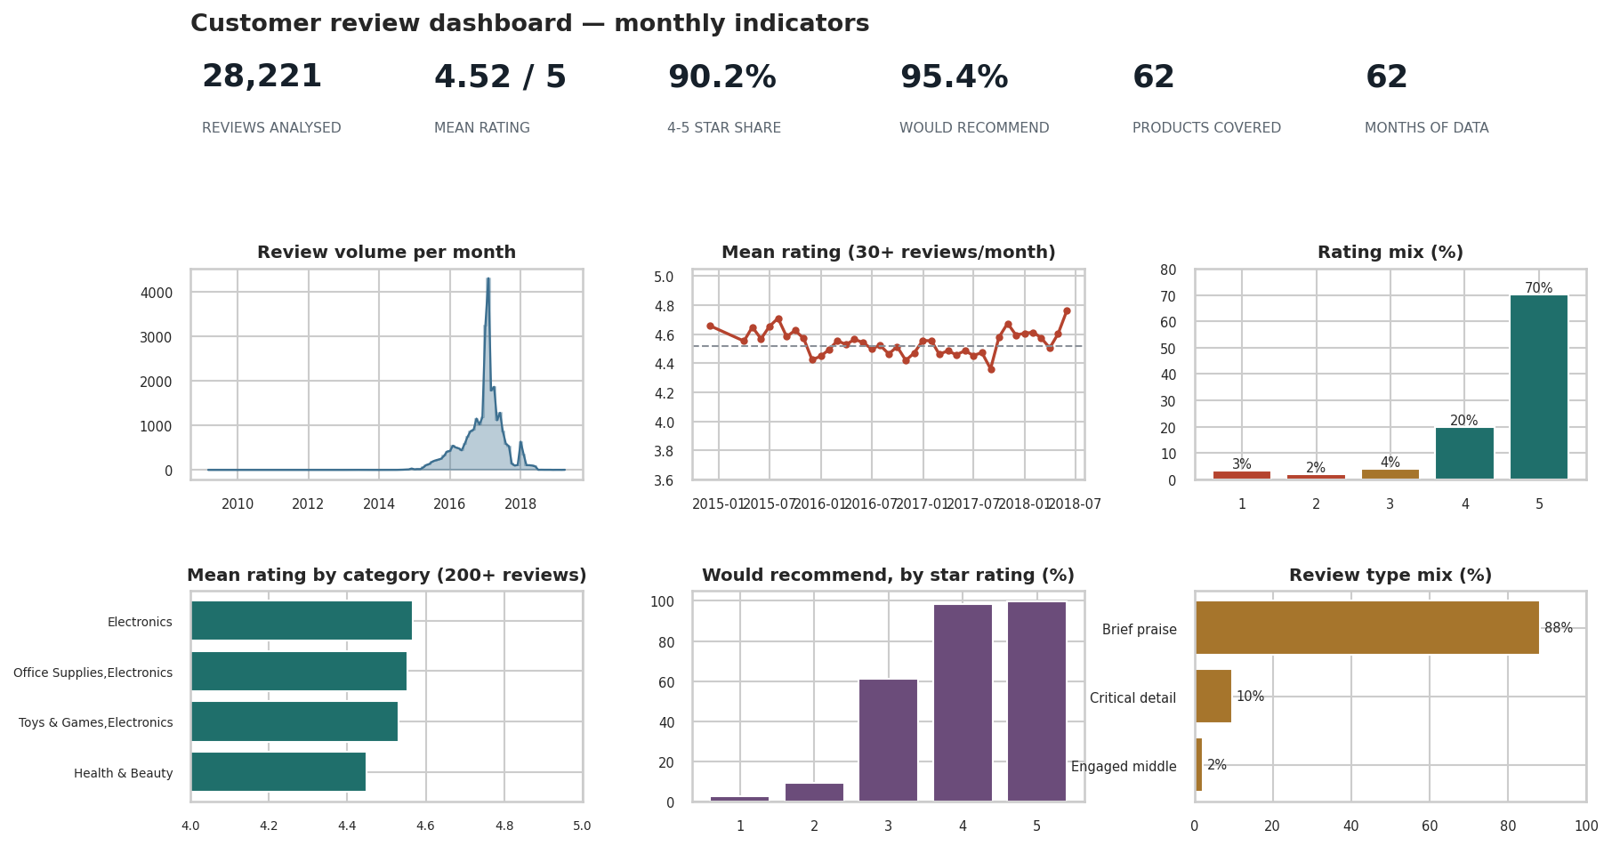
PART 8
The CEO dashboard — six monthly indicators
Summary dashboard: the six indicators a CEO would review monthly — review volume, mean rating trend, rating mix, category performance, recommendation rate and review type mix. Designed to be regenerated each month from the same code.
DATA209 · Module 2 — Assignment 1 — case study
20

Slide 21
PART 9
Answers, with honest confidence
Question | Answer | Confidence
Q1 Ratings | Left-skewed; 86% are 4–5 stars | High
Q2 Categories | Real but small — about half a star across categories | Medium
Q3 Length | Confirmed: falls at every rating step, 26 → 15 words | High
Q4 Time | Volume dominated by one collection spike | Low — sampling not uniform
Q5 Recommend | Tracks rating closely; adds little, 43% missing | Medium
Q6 Groups | Three describable groups, silhouette 0.55 | Medium
DATA209 · Module 2 — Assignment 1 — case study
21

Slide 22
PART 9
What surprised us
01
A weak coefficient hid a large effect
02
Negative reviews are the most read
86% of reviews sit at 4–5 stars, so the whole-sample rho was swamped. Always plot the pair.
1-star reviews attract by far the most helpful votes. Readers seek warnings.
03
Transform before you cluster
04
Recommend flag adds nothing
Raw helpful-vote counts (skew 67) made k-means spend a cluster on six viral reviews.
Monotone in rating and 43% missing — a dashboard could drop it.
DATA209 · Module 2 — Assignment 1 — case study
22

Slide 23
What this dataset cannot support
You should now be able to:
Causal claims — price and product mix are unobserved
Trend claims — collection is not uniform in time
Population claims — reviewers who chose to write, 65 products, one retailer
Verified-purchase claims — the field exists but is empty
Next: add price and units sold; topic-model the 1–2 star reviews
Next: obtain reviewer IDs to test whether a few prolific reviewers drive the averages

