Slide 1
DATA209 · ASSIGNMENT 2 · MODEL ANSWER
From Two Raw Extracts
to One Analytical Dataset
Integrating, cleaning and preprocessing 62,992 product reviews collected by two different processes at two different times.
RAW ROWS
ANALYTICAL ROWS
SOURCES
MARKS
62,992
57,079
2 · schemas differ
25
BTech Hons. (Data Science), Semester III · Vidyashilp University

Slide 2
Can two review extracts be combined into one dataset an analyst is willing to stand behind?
Source A: 34,660 rows × 21 columns. Source B: 28,332 × 24. They share 18 columns, overlap on 15 products, and neither is authoritative.
DATA209 · Module 3 — Assignment 2 — case study
2

Slide 3
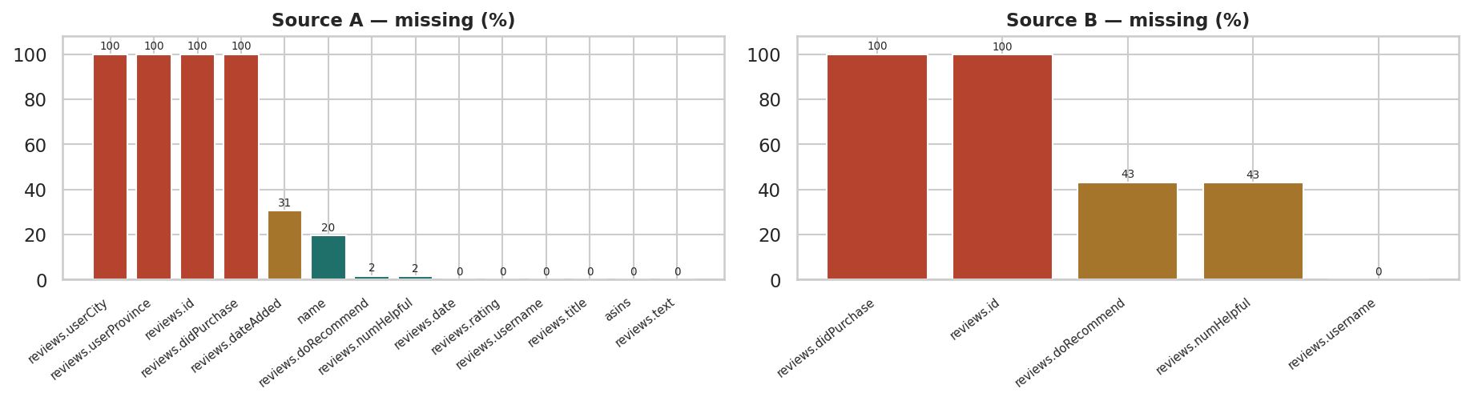
Q1 · RAW DATA
Neither source is complete
Missing values per column in the two raw extracts. Source A has three columns that are entirely empty and loses a fifth of its product names; Source B is more complete but is missing the recommendation flag and helpful-vote count for roughly 43% of reviews. No column is complete in both sources.
DATA209 · Module 3 — Assignment 2 — case study
3

Slide 4
Q1 · CONSEQUENCES OF ANALYSING RAW
Five things that would have gone wrong
01
Vacuous columns
02
Silent exclusion
Three columns in A and one in B are 100% empty — any claim built on them is empty too.
'name' missing for a fifth of Source A, so per-product summaries would drop them without warning.
03
Unsortable dates
04
Double counting
Dates arrive as strings — sorting is lexicographic and resampling impossible.
Nothing prevents the same review being counted twice across the two extracts.
DATA209 · Module 3 — Assignment 2 — case study
4

Slide 5
The product key was malformed — and it would have defeated any join.
Source B stores asins as a comma-separated list in one cell ('B018SZT3BK,B01AHB9CN2'); Source A stores a single id. Compared as strings they never match, even for the same product.
DATA209 · Module 3 — Assignment 2 — case study
5

Slide 6
Q2 · INTEGRATION
Chasing a discrepancy to its cause
# overlap measured two ways disagreed - so we investigated
ab = pd.merge(src_a[keys], src_b[keys],
on=["reviews.username","reviews.text"],
how="inner", suffixes=("_A","_B"))
print(len(ab)) # 14,053 row-pairs
print(ab[keys2].drop_duplicates().shape[0]) # 7,255 distinct
# the join is many-to-many, so row counts inflate.
# then: why do the asins differ?
def key_set(v):
return {x.strip() for x in str(v).split(",") if x.strip()}
ab["overlap"] = [bool(key_set(x) & key_set(y))
for x,y in zip(ab.asins_A, ab.asins_B)]
OUTPUT
row-pairs from join : 14,053
distinct user+text : 7,255
exact string match : 3,560
asins differ : 10,493
A: 'B01AHB9CN2'
B: 'B018SZT3BK,B01AHB9CN2'
after normalising the key:
share a product id: 6,017
genuinely different: 8,036
Always check distinct keys, not row counts — a many-to-many join inflates both.
DATA209 · Module 3 — Assignment 2 — case study
6

Slide 7
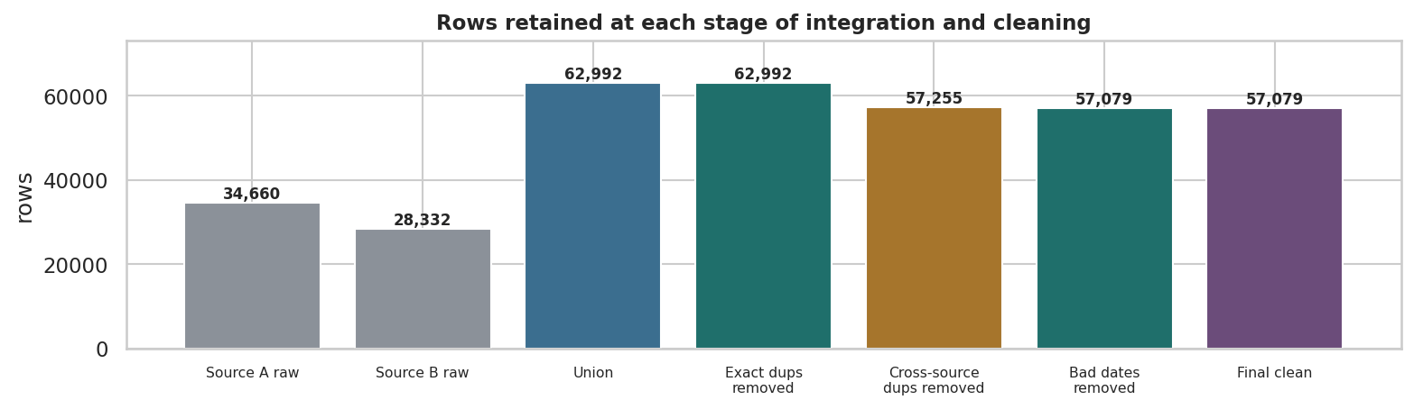
Q3 · CLEANING
Where the rows went
Row count at each stage of the cleaning pipeline. Removing reviews duplicated across the two extracts is by far the largest single reduction, which is exactly the cost of integrating sources that were never designed to be combined.
DATA209 · Module 3 — Assignment 2 — case study
7

Slide 8
Q3 · CLEANING LOG
Every decision, recorded
Step | Action | Rows lost | Why
1 | Removed exact duplicates | 0 | Identical across all carried columns
2 | Removed cross-source duplicates | 5,737 | Same user + text + normalised product key
3 | Trimmed whitespace, case-folded brand | 0 | 8 spellings of a handful of real brands
4 | Parsed dates, dropped unusable | 176 | Needed for resampling
5 | Enforced rating domain [1,5] | 0 | Values off-scale cannot be genuine
90.6% of the union survived. Integration cost more rows than cleaning did.
DATA209 · Module 3 — Assignment 2 — case study
8

Slide 9
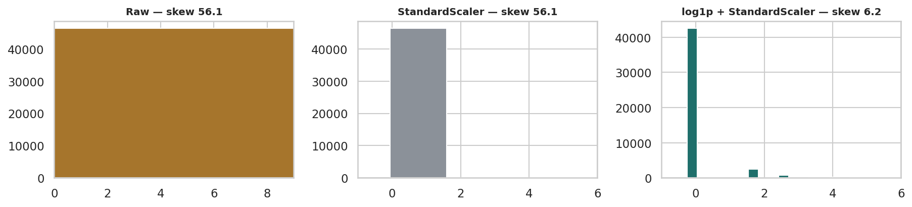
Q4 · NUMERIC
Scaling relocates; only transforming reshapes
Helpful-vote counts raw, after standardisation, and after a log transform followed by standardisation. Scaling alone relocates the distribution without reshaping it; only the log transform addresses the extreme skew.
DATA209 · Module 3 — Assignment 2 — case study
9

Slide 10
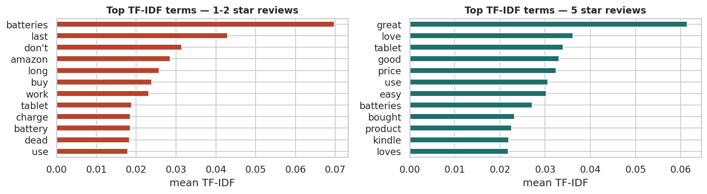
Q5 · TEXT
TF-IDF separates what raw counts cannot
Highest mean TF-IDF terms for negative and positive reviews. TF-IDF suppresses words common to all reviews and promotes the terms that actually distinguish the two groups, which raw frequency counts fail to do.
DATA209 · Module 3 — Assignment 2 — case study
10

Slide 11
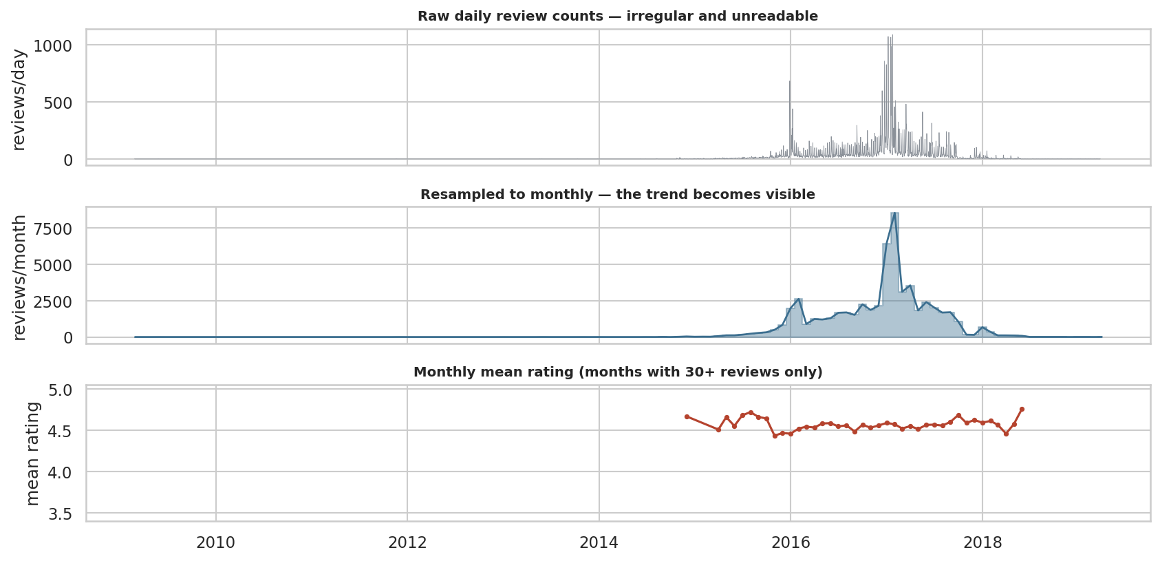
Q6 · TIME SERIES
Resampling makes an unusable series readable
The same data as raw daily events, resampled to monthly frequency, and with the daily rating series forward-filled. Resampling turns an unusable spiky series into a readable trend; forward filling makes the gaps explicit rather than invisible.
DATA209 · Module 3 — Assignment 2 — case study
11

Slide 12
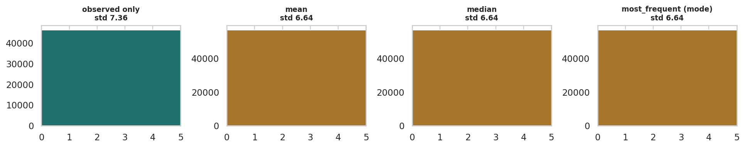
Q7 · MISSING VALUES
What each imputation strategy costs
Distribution of helpful votes after mean, median and KNN imputation compared with the observed values. Mean and median imputation create a spike at a single value and shrink the variance; KNN preserves the shape far better because it uses the other columns rather than one constant.
DATA209 · Module 3 — Assignment 2 — case study
12

Slide 13
Q7 · MECHANISM
Missingness was explained by provenance
Helpful votes present for 98.6% of Source A rows, 56.9% of Source B
The missingness indicator correlates with source, an OBSERVED variable
That is MAR — missing at random given source — not MCAR
So imputation is defensible, but imputed values inherit the character of the source that did record them
Mean and median fills shrink the standard deviation; KNN stays closest to the observed spread
Applied
mean
median
mode
KNN (k=5)
Every constant fill makes the dataset look more precise than the evidence supports.
DATA209 · Module 3 — Assignment 2 — case study
13

Slide 14
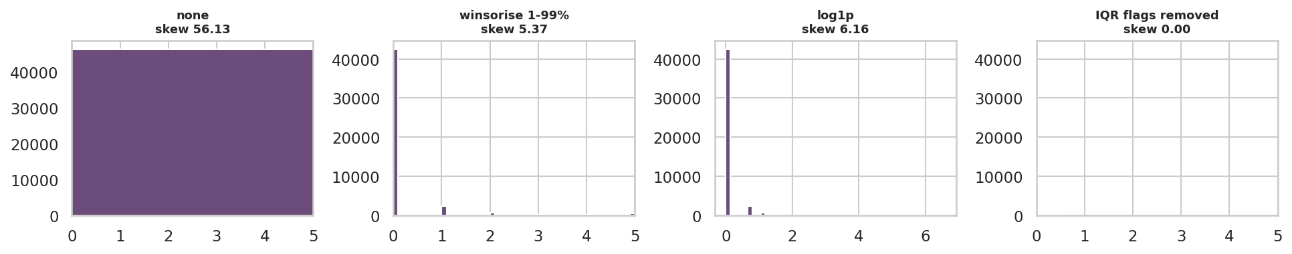
Q8 · OUTLIERS
Four treatments compared
Helpful votes under four treatments: untouched, winsorised at the 1st and 99th percentiles, log-transformed, and with IQR-flagged rows removed. The log transform reduces skew from 67 to under 5 while keeping every row, which is why it is preferred to deletion here.
DATA209 · Module 3 — Assignment 2 — case study
14

Slide 15
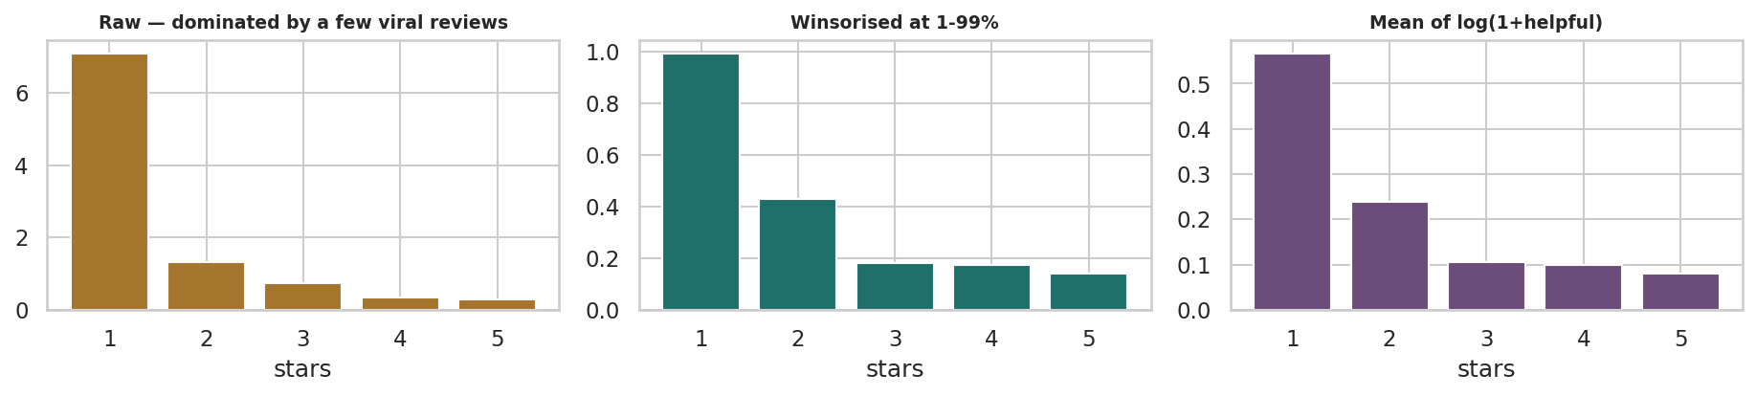
Q8 · ROBUSTNESS
Does the outlier policy change the conclusion?
Mean helpful votes by star rating under three outlier policies. Keeping the extreme values makes 1-star reviews look far more helpful than any other band; winsorising or log-transforming shows the same ranking with far less volatility. The finding survives all three, which is what makes it trustworthy.
DATA209 · Module 3 — Assignment 2 — case study
15

Slide 16
Q8 · DECISION PER VARIABLE
Treat, cap, transform or keep
Variable | Decision | Reason
helpful | Log transform | Skew 56 is intrinsic; deleting would discard the most-read reviews
review_len | Winsorise 99th | Extreme tail plausible but adds noise
words | Winsorise 99th | Same reasoning
rating | Keep | Bounded [1,5] by construction — nothing can be an outlier
DATA209 · Module 3 — Assignment 2 — case study
16

Slide 17
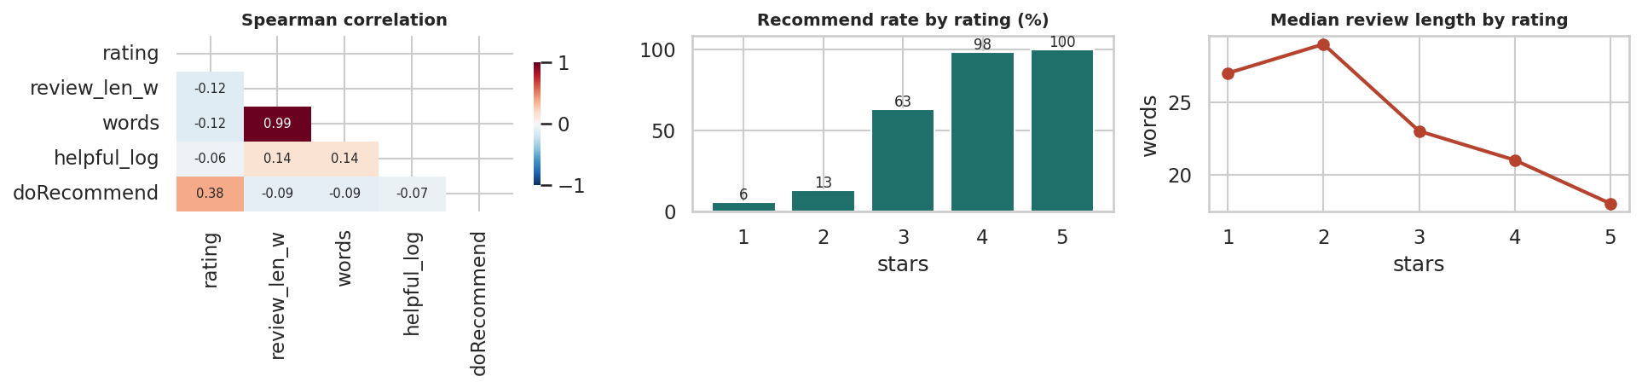
Q9 · BEST PRACTICE
The relationships that survived cleaning
Correlation structure and the two relationships that survive cleaning: recommendation rate rises monotonically with rating, and review length falls as rating rises. Both hold on the merged, deduplicated dataset.
DATA209 · Module 3 — Assignment 2 — case study
17

Slide 18
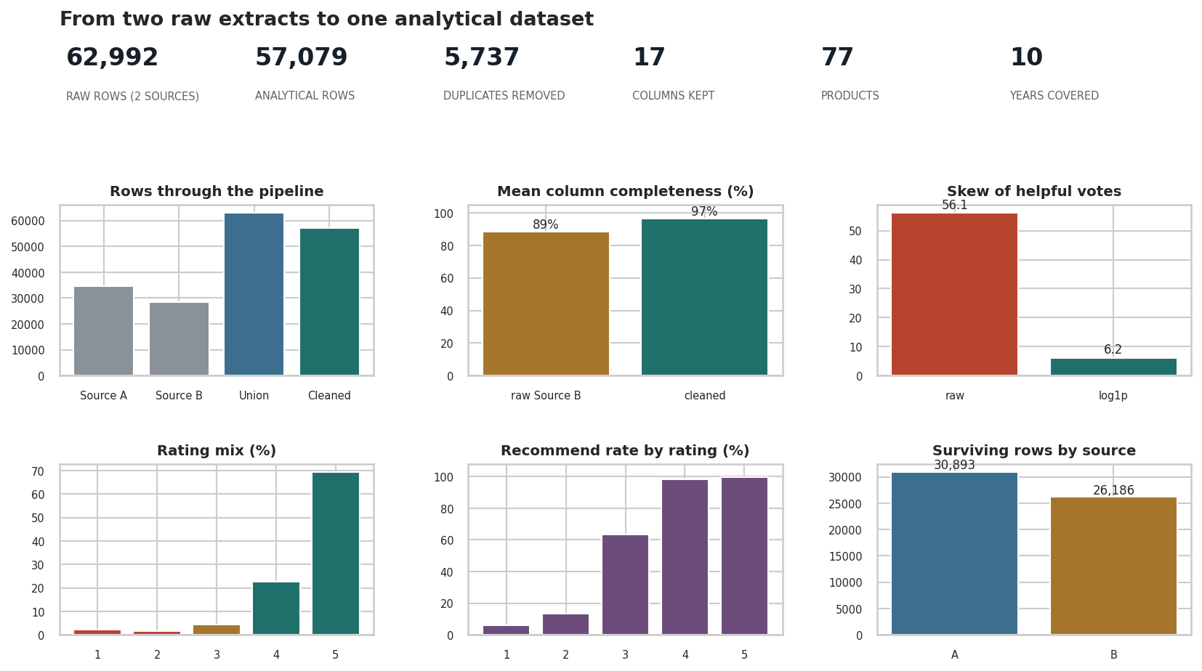
CONCLUSION
Before and after — what EDA bought
Summary dashboard contrasting the raw union with the cleaned dataset: rows retained, completeness recovered, duplicate removal, skew reduction from transformation, and the relationships that survived. This is the one-page answer to 'what did EDA do for this dataset?'
DATA209 · Module 3 — Assignment 2 — case study
18

Slide 19
FINDINGS
Five things this work established
01
Integration cost more than cleaning
02
A malformed key nearly defeated the join
03
Missingness tracked provenance
Removing reviews present in both extracts was the largest single reduction. Two sources are not twice the data.
Comma-separated product ids in one source only. Found by chasing a discrepancy between two counts.
MAR given source — which makes imputation defensible but source-dependent.
04
Scaling ≠ transforming
05
The headline finding is robust
06
Completeness improved 88.6% → 96.6%
Every scaler left skew 56 untouched; log1p cut it to 6.2.
Lower ratings attract more helpful votes under raw, winsorised and log policies alike.
And 90.6% of rows were retained — cleaning without gutting the dataset.
DATA209 · Module 3 — Assignment 2 — case study
19

Slide 20
What the cleaned dataset still cannot support
You should now be able to:
Time trends — collection was not uniform; one month dominates volume
Authority — neither source is master, so precedence was applied, not truth established
Verified-purchase analysis — the field is empty in both extracts
Population claims — reviewers who chose to write, on a narrow product set
H1: 1-2 star reviews are longer because they explain a specific failure
H4: apparent monthly movement reflects collection timing, not sentiment

