Slide 1
LECTURE L13-14 · MODULE 2 · CO2
Visual storytelling
Week 7 · Core Advanced EDA — with worked examples on the Online Shoppers dataset (12,330 sessions × 18 columns).
WEEK
SLIDES
LABORATORY
EXAMPLES
7
Deck pages 30–36
P13-14 (Assignment 1)
4 worked, all executed
DATA209 Advanced Exploratory Data Analysis · BTech Hons. (Data Science), Semester III · Vidyashilp University
Notes:
Lecture L13-14. Every code result on these slides was produced by running the code, not typed by hand.

Slide 2
WHAT THIS LECTURE COVERS
Topics
Grammar of graphics
Good vs. misleading plots
Visualising non-numeric data
Dashboard logic and storytelling with data
You will also get
Worked code on real data
Key terms and common errors
Free readings
Self-check questions
Laboratory session P13-14 (Assignment 1) puts these into practice.
DATA209 · Module 2 — L13-14 Visual storytelling
2

Slide 3
Grammar of graphics: one dataset, layered choices
A plot is data + aesthetics + geometry + scale. Changing only the geometry, with the same data and mapping, answers a different question.
DATA209 · Module 2 — L13-14 Visual storytelling
3
Notes:
Example 1 of 4. Walk through the reasoning before showing the code.

Slide 4
EXAMPLE 1
Grammar of graphics: one dataset, layered choices
fig, ax = plt.subplots(1, 3, figsize=(11.4, 2.5))
sns.scatterplot(data=df.sample(2000, random_state=RANDOM_STAT…
x="ProductRelated", y="ExitRates", hue=TARGET…
ax[0].set_title("geometry = point")
sns.boxplot(data=df, x=TARGET, y="ExitRates", ax=ax[1], showf…
ax[1].set_title("geometry = box")
sns.kdeplot(data=df, x="ExitRates", hue=TARGET, fill=True, co…
ax[2].set_title("geometry = density")
plt.tight_layout()
print("Same variables, three geometries, three different ques…
OUTPUT
Same variables, three geometries, three different q…
Output is the real result of running this code on the course dataset.
DATA209 · Module 2 — L13-14 Visual storytelling
4

Slide 5
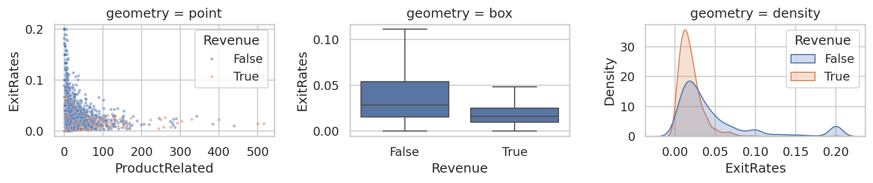
EXAMPLE 1 · FIGURE
Grammar of graphics: one dataset, layered choices
Produced by the code on the previous slide.
DATA209 · Module 2 — L13-14 Visual storytelling
5

Slide 6
The truncated axis — the commonest way a plot lies
A bar chart that does not start at zero exaggerates small differences. Both panels below are drawn from identical numbers.
DATA209 · Module 2 — L13-14 Visual storytelling
6
Notes:
Example 2 of 4. Walk through the reasoning before showing the code.

Slide 7
EXAMPLE 2
The truncated axis — the commonest way a plot lies
rate = df.groupby("VisitorType")[TARGET].mean() * 100
fig, ax = plt.subplots(1, 2, figsize=(9, 2.7))
rate.plot(kind="bar", ax=ax[0], color="#B5432E")
ax[0].set_ylim(rate.min() - 0.4, rate.max() + 0.4)
ax[0].set_title("Truncated axis — looks dramatic"); ax[0].set…
rate.plot(kind="bar", ax=ax[1], color="#1F6F6B")
ax[1].set_ylim(0, 100); ax[1].set_title("Zero baseline — hone…
plt.tight_layout()
print(rate.round(2).to_string())
print("\nAsk of your own plots: could a reader reach the oppo…
OUTPUT
VisitorType
New_Visitor 24.910
Other 18.820
Returning_Visitor 13.930
Ask of your own plots: could a reader reach the opp…
Output is the real result of running this code on the course dataset.
DATA209 · Module 2 — L13-14 Visual storytelling
7

Slide 8
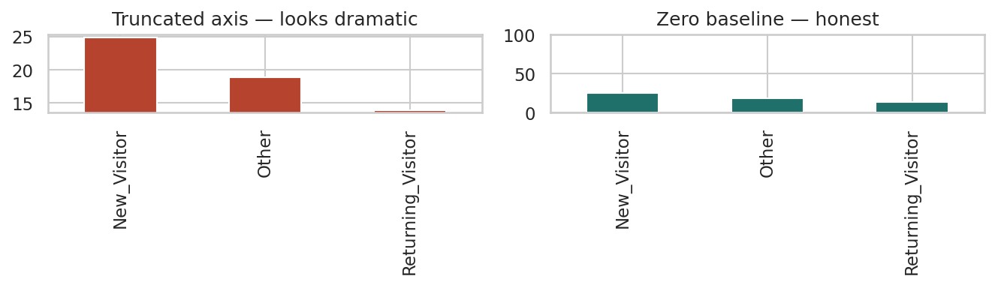
EXAMPLE 2 · FIGURE
The truncated axis — the commonest way a plot lies
Produced by the code on the previous slide.
DATA209 · Module 2 — L13-14 Visual storytelling
8

Slide 9
Visualising non-numeric data with high cardinality
Plotting 20 categories produces an unreadable chart. Show the top levels and aggregate the rest into an explicitly labelled 'Other'.
DATA209 · Module 2 — L13-14 Visual storytelling
9
Notes:
Example 3 of 4. Walk through the reasoning before showing the code.

Slide 10
EXAMPLE 3
Visualising non-numeric data with high cardinality
vc = df["TrafficType"].astype(str).value_counts(normalize=Tru…
top = vc.head(6)
other = pd.Series({"Other (%d levels)" % (len(vc) - 6): vc.il…
shown = pd.concat([top, other])
print(shown.round(2).to_string())
fig, ax = plt.subplots(figsize=(6.4, 2.6))
shown.plot(kind="barh", ax=ax, color="#1F6F6B")
ax.set_xlabel("% of sessions"); ax.set_title("TrafficType — t…
plt.tight_layout()
OUTPUT
2 31.740
1 19.880
3 16.640
4 8.670
13 5.990
10 3.650
Other (14 levels) 13.440
Output is the real result of running this code on the course dataset.
DATA209 · Module 2 — L13-14 Visual storytelling
10

Slide 11
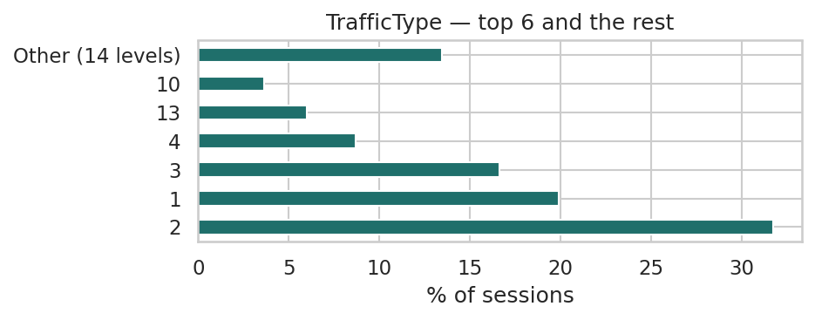
EXAMPLE 3 · FIGURE
Visualising non-numeric data with high cardinality
Produced by the code on the previous slide.
DATA209 · Module 2 — L13-14 Visual storytelling
11

Slide 12
Assignment 1 preparation — a finding-first figure
Marks come from interpretation, not decoration. Title the chart with the finding and annotate the evidence directly on it.
DATA209 · Module 2 — L13-14 Visual storytelling
12
Notes:
Example 4 of 4. Walk through the reasoning before showing the code.

Slide 13
EXAMPLE 4
Assignment 1 preparation — a finding-first figure
med = df.groupby(TARGET)["PageValues"].median()
fig, ax = plt.subplots(figsize=(6.6, 2.8))
sns.boxplot(data=df, x=TARGET, y="PageValues", ax=ax, showfli…
ax.set_title("Sessions reaching a valued page convert far mor…
ax.set_xlabel("session ended in a purchase"); ax.set_ylabel("…
ax.annotate(f"median {med[True]:.1f}", xy=(1, med[True]), xyt…
arrowprops=dict(arrowstyle="->", lw=.8), fontsize…
ax.annotate(f"median {med[False]:.1f}", xy=(0, med[False]), x…
arrowprops=dict(arrowstyle="->", lw=.8), fontsize…
plt.tight_layout()
print("Checklist: technique 30% | interpretation 35% | reprod…
OUTPUT
Checklist: technique 30% | interpretation 35% | rep…
Output is the real result of running this code on the course dataset.
DATA209 · Module 2 — L13-14 Visual storytelling
13

Slide 14
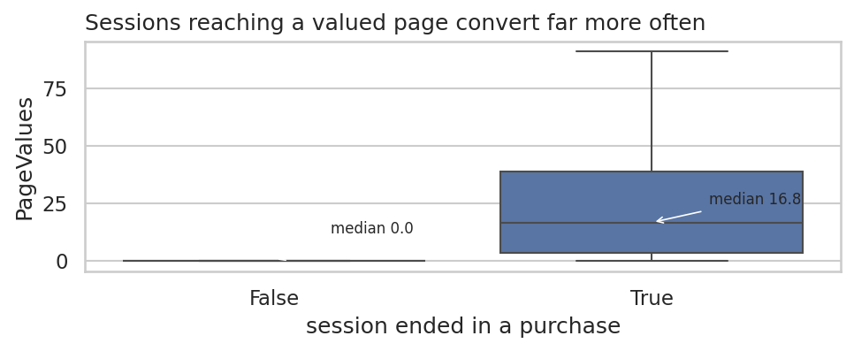
EXAMPLE 4 · FIGURE
Assignment 1 preparation — a finding-first figure
Produced by the code on the previous slide.
DATA209 · Module 2 — L13-14 Visual storytelling
14

Slide 15
MARKING AND PRACTICE
Common errors to avoid
01
Truncating a bar chart's y-axis
02
Using a pie chart to compare more than thr
Truncating a bar chart's y-axis
Using a pie chart to compare more than three categories
03
Leaving a legend to do work that direct an
04
Publishing a figure with no sentence stati
Leaving a legend to do work that direct annotation would do better
Publishing a figure with no sentence stating what it shows
DATA209 · Module 2 — L13-14 Visual storytelling
15

Slide 16
VOCABULARY
Key terms from this lecture
Grammar of graphics
Aesthetic mapping
Geometry
Facet
Small multiples
Truncated axis
Perceptually uniform colour map
Data-ink ratio
You should be able to define each of these without notes.
DATA209 · Module 2 — L13-14 Visual storytelling
16

Slide 17
WHERE TO READ MORE
Readings for L13-14
Free online
Links
In the course
Wilke — Fundamentals of Data Visualization
CMU 36-315 — Statistical Graphics and Visualization
seaborn tutorial
https://clauswilke.com/dataviz/
https://cmu-36315.netlify.app/
https://seaborn.pydata.org/tutorial.html
Slides: DATA209_Module_2_Core_Advanced_EDA.pptx, pages 30–36
Laboratory: P13-14 (Assignment 1)
Lecture notes PDF and Word document
Complete notes booklet
DATA209 · Module 2 — L13-14 Visual storytelling
17

Slide 18
L13-14 — test yourself
You should now be able to:
Name the six layers of the grammar of graphics.
When is a truncated y-axis defensible?
You have two categorical variables with six levels each. Which plot, and why?
Rewrite 'Figure 3: PageValues by Revenue' as a title that states the finding.

