Slide 1
LECTURE L27-28 · MODULE 4 · CO4
Dimensionality reduction
Week 14 · Feature Engineering & Structure — with worked examples on the Online Shoppers dataset (12,330 sessions × 18 columns).
WEEK
SLIDES
LABORATORY
EXAMPLES
14
Deck pages 21–28
P27-28
4 worked, all executed
DATA209 Advanced Exploratory Data Analysis · BTech Hons. (Data Science), Semester III · Vidyashilp University
Notes:
Lecture L27-28. Every code result on these slides was produced by running the code, not typed by hand.

Slide 2
WHAT THIS LECTURE COVERS
Topics
PCA — interpretation focused
LDA — the classification view
t-SNE and UMAP for visualisation only
Interpreting components; multicollinearity
You will also get
Worked code on real data
Key terms and common errors
Free readings
Self-check questions
Laboratory session P27-28 puts these into practice.
DATA209 · Module 4 — L27-28 Dimensionality reduction
2

Slide 3
PCA: standardise first, then read the variance
PCA maximises variance, so without standardising, the column with the largest range takes the first component by itself. The scree profile is the finding.
DATA209 · Module 4 — L27-28 Dimensionality reduction
3
Notes:
Example 1 of 4. Walk through the reasoning before showing the code.

Slide 4
EXAMPLE 1
PCA: standardise first, then read the variance
from sklearn.preprocessing import StandardScaler
from sklearn.decomposition import PCA
cols = ["Administrative","Administrative_Duration","Informati…
"ProductRelated","ProductRelated_Duration","BounceRat…
Xs = StandardScaler().fit_transform(df[cols])
pca = PCA(random_state=RANDOM_STATE).fit(Xs)
evr = pca.explained_variance_ratio_ * 100
print(pd.DataFrame({"component": [f"PC{i+1}" for i in range(l…
"eigenvalue": pca.explained_variance_,
"variance_%": evr, "cumulative_%": evr.cu…
.set_index("component").round(2).to_string())
for tgt in (80, 90, 95):
print(f"components for {tgt}% of variance: {int(np.argmax…
print("eigenvalue > 1 (Kaiser):", int((pca.explained_variance…
OUTPUT
eigenvalue variance_% cumulative_%
component
PC1 3.390 37.650 37.650
PC2 1.670 18.530 56.180
PC3 1.030 11.400 67.580
PC4 1.000 11.150 78.730
PC5 0.940 10.440 89.170
PC6 0.420 4.690 93.860
PC7 0.350 3.910 97.770
PC8 0.120 1.370 99.130
PC9 0.080 0.870 100.000
components for 80% of variance: 5
components for 90% of variance: 6
components for 95% of variance: 7
eigenvalue > 1 (Kaiser): 4
Output is the real result of running this code on the course dataset.
DATA209 · Module 4 — L27-28 Dimensionality reduction
4

Slide 5
Interpreting components through their loadings
A component you cannot name should not appear in a report. The loadings say which original variables define each axis, and the signs say what it contrasts.
DATA209 · Module 4 — L27-28 Dimensionality reduction
5
Notes:
Example 2 of 4. Walk through the reasoning before showing the code.

Slide 6
EXAMPLE 2
Interpreting components through their loadings
from sklearn.preprocessing import StandardScaler
from sklearn.decomposition import PCA
cols = ["Administrative","Administrative_Duration","Informati…
"ProductRelated","ProductRelated_Duration","BounceRat…
Xs = StandardScaler().fit_transform(df[cols])
pca = PCA(random_state=RANDOM_STATE).fit(Xs)
load = pd.DataFrame(pca.components_[:3].T, columns=["PC1","PC…
print(load.round(3).to_string())
print("\ndominant variables per component")
for pc in load.columns:
top = load[pc].abs().sort_values(ascending=False).head(3)…
print(f" {pc}: " + ", ".join(f"{n} ({load.loc[n, pc]:+.2…
fig, ax = plt.subplots(figsize=(5.8, 3.0))
sns.heatmap(load, annot=True, fmt=".2f", center=0, cmap="PuOr…
annot_kws={"size": 7}, cbar_kws={"shrink": .8}, a…
plt.tight_layout()
OUTPUT
PC1 PC2 PC3
Administrative 0.383 0.053 -0.138
Administrative_Duration 0.330 0.109 -0.189
Informational 0.349 0.281 -0.368
Informational_Duration 0.297 0.304 -0.416
ProductRelated 0.414 0.140 0.520
ProductRelated_Duration 0.416 0.183 0.481
BounceRates -0.278 0.618 0.026
ExitRates -0.324 0.587 0.023
PageValues 0.093 -0.184 -0.365
dominant variables per component
PC1: ProductRelated_Duration (+0.42), ProductRela…
PC2: BounceRates (+0.62), ExitRates (+0.59), Info…
PC3: ProductRelated (+0.52), ProductRelated_Durat…
Output is the real result of running this code on the course dataset.
DATA209 · Module 4 — L27-28 Dimensionality reduction
6

Slide 7
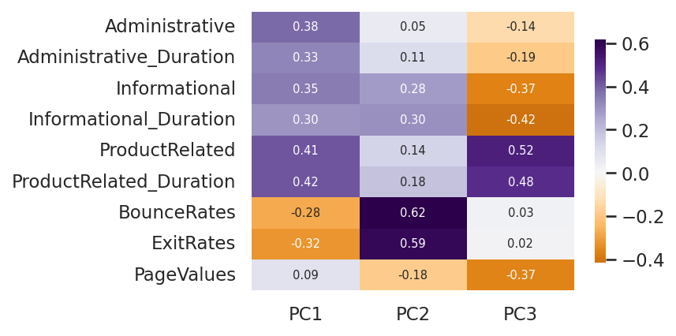
EXAMPLE 2 · FIGURE
Interpreting components through their loadings
Produced by the code on the previous slide.
DATA209 · Module 4 — L27-28 Dimensionality reduction
7

Slide 8
PCA removes multicollinearity by construction
Components are orthogonal, so VIF falls to 1. That is the benefit; the cost is that you no longer know which original measurement was redundant.
DATA209 · Module 4 — L27-28 Dimensionality reduction
8
Notes:
Example 3 of 4. Walk through the reasoning before showing the code.

Slide 9
EXAMPLE 3
PCA removes multicollinearity by construction
from sklearn.preprocessing import StandardScaler
from sklearn.decomposition import PCA
def vif(mat, names):
c = np.corrcoef(mat, rowvar=False)
return pd.Series(np.diag(np.linalg.pinv(c)), index=names,…
cols = ["Administrative","Administrative_Duration","Informati…
"ProductRelated","ProductRelated_Duration","BounceRat…
Xs = StandardScaler().fit_transform(df[cols])
before = vif(Xs, cols)
P = PCA(n_components=4, random_state=RANDOM_STATE).fit_transf…
after = vif(P, [f"PC{i+1}" for i in range(4)])
print("VIF before PCA\n" + before.round(2).sort_values(ascend…
print("\nVIF after PCA (4 components)\n" + after.round(4).to_…
print("\nIf the deliverable is 'which measurements should we …
print("use VIF and feature selection instead — PCA cannot ans…
OUTPUT
VIF before PCA
ExitRates 6.900
BounceRates 6.330
ProductRelated 4.380
ProductRelated_Duration 4.320
Administrative 1.940
Informational 1.830
Administrative_Duration 1.690
Informational_Duration 1.680
PageValues 1.040
VIF after PCA (4 components)
PC1 1.000
PC2 1.000
PC3 1.000
PC4 1.000
If the deliverable is 'which measurements should we…
use VIF and feature selection instead — PCA cannot …
Output is the real result of running this code on the course dataset.
DATA209 · Module 4 — L27-28 Dimensionality reduction
9

Slide 10
LDA is supervised; t-SNE is for looking only
LDA maximises class separation and is capped at k-1 components. t-SNE preserves local neighbourhoods for visualisation and must never be used as model input.
DATA209 · Module 4 — L27-28 Dimensionality reduction
10
Notes:
Example 4 of 4. Walk through the reasoning before showing the code.

Slide 11
EXAMPLE 4
LDA is supervised; t-SNE is for looking only
from sklearn.preprocessing import StandardScaler
from sklearn.discriminant_analysis import LinearDiscriminantA…
cols = ["ProductRelated","ProductRelated_Duration","BounceRat…
y = df[TARGET].astype(int)
Xs = StandardScaler().fit_transform(df[cols])
lda = LinearDiscriminantAnalysis().fit(Xs, y)
print("classes:", lda.classes_, "-> max components = k-1 =", …
print("explained variance ratio:", np.round(lda.explained_var…
print("\ncoefficients (which variables separate the classes)")
print(pd.Series(lda.coef_.ravel(), index=cols).sort_values(ke…
.round(3).to_string())
print("\nt-SNE/UMAP caution: cluster sizes and between-cluste…
print("and the layout changes with the seed and the perplexit…
OUTPUT
classes: [0 1] -> max components = k-1 = 1
explained variance ratio: [1.]
coefficients (which variables separate the classes)
PageValues 1.766
ExitRates -0.658
BounceRates 0.320
ProductRelated_Duration 0.213
ProductRelated 0.191
t-SNE/UMAP caution: cluster sizes and between-clust…
and the layout changes with the seed and the perple…
Output is the real result of running this code on the course dataset.
DATA209 · Module 4 — L27-28 Dimensionality reduction
11

Slide 12
MARKING AND PRACTICE
Common errors to avoid
01
Running PCA on unstandardised features
02
Applying PCA to one-hot encoded categorica
Running PCA on unstandardised features
Applying PCA to one-hot encoded categorical columns
03
Reading cluster sizes or distances off a t
04
Fitting PCA on the full dataset before cro
Reading cluster sizes or distances off a t-SNE plot
Fitting PCA on the full dataset before cross-validation
DATA209 · Module 4 — L27-28 Dimensionality reduction
12

Slide 13
VOCABULARY
Key terms from this lecture
Principal component analysis
Eigenvector
Eigenvalue
Explained variance ratio
Scree plot
Loading
Kaiser rule
LDA
t-SNE
UMAP
You should be able to define each of these without notes.
DATA209 · Module 4 — L27-28 Dimensionality reduction
13

Slide 14
WHERE TO READ MORE
Readings for L27-28
Free online
Links
In the course
scikit-learn — decomposition and PCA
Stanford CS229 — lecture notes
James et al. — Introduction to Statistical Learning, Ch. 12
https://scikit-learn.org/stable/modules/decomposition.html
https://cs229.stanford.edu/
https://www.statlearning.com/
Slides: DATA209_Module_4_Feature_Engineering_and_Structure.pptx, pages 21–28
Laboratory: P27-28
Lecture notes PDF and Word document
Complete notes booklet
DATA209 · Module 4 — L27-28 Dimensionality reduction
14

Slide 15
L27-28 — test yourself
You should now be able to:
Why must features be standardised before PCA?
PC1 explains 12% of variance. What does that tell you about the data?
Why is t-SNE unsuitable as a preprocessing step for a classifier?
How do you turn a loading vector into something a domain expert can use?

