Slide 1
LECTURE L9-10 · MODULE 2 · CO2
Bivariate relationships
Week 5 · Core Advanced EDA — with worked examples on the Online Shoppers dataset (12,330 sessions × 18 columns).
WEEK
SLIDES
LABORATORY
EXAMPLES
5
Deck pages 11–20
P9-10
4 worked, all executed
DATA209 Advanced Exploratory Data Analysis · BTech Hons. (Data Science), Semester III · Vidyashilp University
Notes:
Lecture L9-10. Every code result on these slides was produced by running the code, not typed by hand.

Slide 2
WHAT THIS LECTURE COVERS
Topics
Correlation and covariance
Scatterplots and what they hide
Relationships between categorical variables
You will also get
Worked code on real data
Key terms and common errors
Free readings
Self-check questions
Laboratory session P9-10 puts these into practice.
DATA209 · Module 2 — L9-10 Bivariate relationships
2

Slide 3
Covariance carries units; correlation does not
Covariance changes when you change units, which makes its magnitude uninterpretable. Correlation is covariance standardised, and that is why it is the one you report.
DATA209 · Module 2 — L9-10 Bivariate relationships
3
Notes:
Example 1 of 4. Walk through the reasoning before showing the code.

Slide 4
EXAMPLE 1
Covariance carries units; correlation does not
a, b = df["ProductRelated"], df["ProductRelated_Duration"]
print(f"covariance (as recorded) : {np.cov(a, b)[0,1]:,.…
print(f"covariance (duration in hours): {np.cov(a, b/3600)[0,…
print(f"correlation (as recorded) : {a.corr(b):.4f}")
print(f"correlation (duration in hours): {a.corr(b/3600):.4f}…
print("\nThe covariance moved by a factor of 3,600. The relat…
OUTPUT
covariance (as recorded) : 73,274.7
covariance (duration in hours): 20.4
correlation (as recorded) : 0.8609
correlation (duration in hours): 0.8609
The covariance moved by a factor of 3,600. The rela…
Output is the real result of running this code on the course dataset.
DATA209 · Module 2 — L9-10 Bivariate relationships
4

Slide 5
Pearson vs. Spearman — a cheap non-linearity test
Pearson measures straight-line association; Spearman works on ranks. A large gap between them says the relationship is real but not linear.
DATA209 · Module 2 — L9-10 Bivariate relationships
5
Notes:
Example 2 of 4. Walk through the reasoning before showing the code.

Slide 6
EXAMPLE 2
Pearson vs. Spearman — a cheap non-linearity test
d = df[num + [TARGET]].copy(); d[TARGET] = d[TARGET].astype(i…
cmp = pd.DataFrame({"pearson": d.corr()[TARGET].drop(TARGET),
"spearman": d.corr(method="spearman")[TAR…
cmp["gap"] = (cmp["spearman"] - cmp["pearson"]).abs()
print(cmp.reindex(cmp["gap"].sort_values(ascending=False).ind…
print("\nLargest gaps = monotonic but non-linear. Those are t…
OUTPUT
pearson spearman gap
PageValues 0.493 0.626 0.134
Administrative_Duration 0.094 0.164 0.070
ProductRelated_Duration 0.152 0.217 0.064
ExitRates -0.207 -0.254 0.047
Informational_Duration 0.070 0.112 0.042
ProductRelated 0.159 0.199 0.040
Administrative 0.139 0.168 0.029
Informational 0.095 0.114 0.019
OperatingSystems -0.015 -0.027 0.013
Browser 0.024 0.016 0.008
SpecialDay -0.082 -0.087 0.005
TrafficType -0.005 -0.001 0.004
Region -0.012 -0.015 0.003
BounceRates -0.151 -0.149 0.002
Largest gaps = monotonic but non-linear. Those are …
Output is the real result of running this code on the course dataset.
DATA209 · Module 2 — L9-10 Bivariate relationships
6

Slide 7
The correlation matrix, and what to plot next
Rank the pairs, then plot the top few. Plotting every pair blindly wastes time and hides the finding among the noise.
DATA209 · Module 2 — L9-10 Bivariate relationships
7
Notes:
Example 3 of 4. Walk through the reasoning before showing the code.

Slide 8
EXAMPLE 3
The correlation matrix, and what to plot next
corr = df[num].corr()
pairs = (corr.where(np.triu(np.ones(corr.shape), k=1).astype(…
.stack().rename("r").reset_index())
pairs.columns = ["var_1", "var_2", "r"]
print("most correlated predictor pairs")
print(pairs.reindex(pairs["r"].abs().sort_values(ascending=Fa…
.head(5).round(3).to_string(index=False))
fig, ax = plt.subplots(figsize=(6.2, 4.4))
sns.heatmap(corr, mask=np.triu(np.ones_like(corr, dtype=bool)…
center=0, vmin=-1, vmax=1, annot=True, fmt=".2f",
annot_kws={"size": 6}, cbar_kws={"shrink": .7}, a…
plt.tight_layout()
OUTPUT
most correlated predictor pairs
var_1 var_2 r
BounceRates ExitRates 0.913
ProductRelated ProductRelated_Duration 0.861
Informational Informational_Duration 0.619
Administrative Administrative_Duration 0.602
Administrative ProductRelated 0.431
Output is the real result of running this code on the course dataset.
DATA209 · Module 2 — L9-10 Bivariate relationships
8

Slide 9
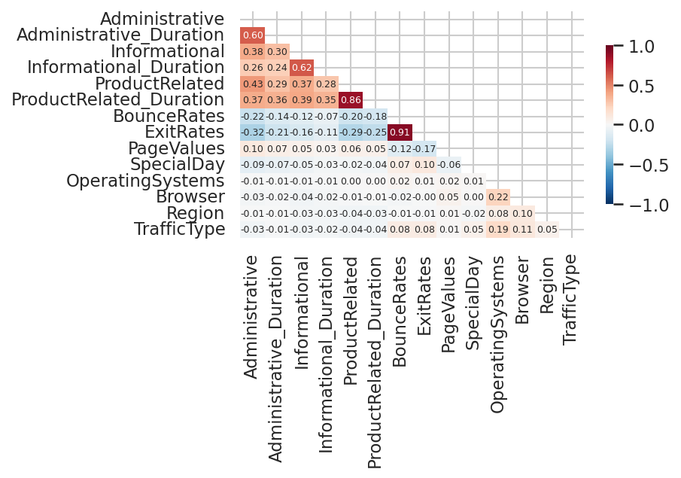
EXAMPLE 3 · FIGURE
The correlation matrix, and what to plot next
Produced by the code on the previous slide.
DATA209 · Module 2 — L9-10 Bivariate relationships
9

Slide 10
Categorical relationships: percentages, not counts
Raw counts compare groups of different sizes and mislead. Row percentages answer the question; chi-square says whether an association exists and Cramer's V how strong.
DATA209 · Module 2 — L9-10 Bivariate relationships
10
Notes:
Example 4 of 4. Walk through the reasoning before showing the code.

Slide 11
EXAMPLE 4
Categorical relationships: percentages, not counts
from scipy.stats import chi2_contingency
tab = pd.crosstab(df["VisitorType"], df[TARGET])
pct = pd.crosstab(df["VisitorType"], df[TARGET], normalize="i…
print("counts\n" + tab.to_string())
print("\nrow percentages\n" + pct.round(2).to_string())
for c in ["VisitorType", "Weekend", "Month"]:
t = pd.crosstab(df[c], df[TARGET])
chi2, p, _, _ = chi2_contingency(t)
v = np.sqrt(chi2 / (t.values.sum() * (min(t.shape) - 1)))
print(f"{c:14} chi2={chi2:9.1f} p={p:.3g} Cramers V={v:…
print("\nWith 12,330 rows nearly everything is 'significant'.…
OUTPUT
counts
Revenue False True
VisitorType
New_Visitor 1272 422
Other 69 16
Returning_Visitor 9081 1470
row percentages
Revenue False True
VisitorType
New_Visitor 75.090 24.910
Other 81.180 18.820
Returning_Visitor 86.070 13.930
VisitorType chi2= 135.3 p=4.27e-30 Cramers …
Weekend chi2= 10.4 p=0.00127 Cramers V…
Month chi2= 384.9 p=2.24e-77 Cramers …
With 12,330 rows nearly everything is 'significant'…
Output is the real result of running this code on the course dataset.
DATA209 · Module 2 — L9-10 Bivariate relationships
11

Slide 12
MARKING AND PRACTICE
Common errors to avoid
01
Running Pearson correlation on a nominal o
02
Reporting a correlation without plotting t
Running Pearson correlation on a nominal or ordinal column
Reporting a correlation without plotting the pair
03
Comparing raw counts across groups of very
04
Treating a small p-value on 12
Comparing raw counts across groups of very different sizes
Treating a small p-value on 12,000 rows as evidence of a large effect
DATA209 · Module 2 — L9-10 Bivariate relationships
12

Slide 13
VOCABULARY
Key terms from this lecture
Covariance
Pearson correlation
Spearman correlation
Kendall tau
Cramér's V
Heteroscedasticity
Cross-tabulation
Chi-square test
Effect size
Confounder
You should be able to define each of these without notes.
DATA209 · Module 2 — L9-10 Bivariate relationships
13

Slide 14
WHERE TO READ MORE
Readings for L9-10
Free online
Links
In the course
scikit-learn — clustering and metrics
seaborn — relational and categorical plots
James et al. — Introduction to Statistical Learning
https://scikit-learn.org/stable/modules/clustering.html
https://seaborn.pydata.org/tutorial.html
https://www.statlearning.com/
Slides: DATA209_Module_2_Core_Advanced_EDA.pptx, pages 11–20
Laboratory: P9-10
Lecture notes PDF and Word document
Complete notes booklet
DATA209 · Module 2 — L9-10 Bivariate relationships
14

Slide 15
L9-10 — test yourself
You should now be able to:
Pearson r = 0.15 and Spearman ρ = 0.61 for the same pair. What does that tell you?
Why is covariance rarely reported directly?
Two categories show conversion rates of 50% and 10%. What must you also report?
Rewrite 'sales correlate with advertising' as a falsifiable hypothesis.

