Slide 1
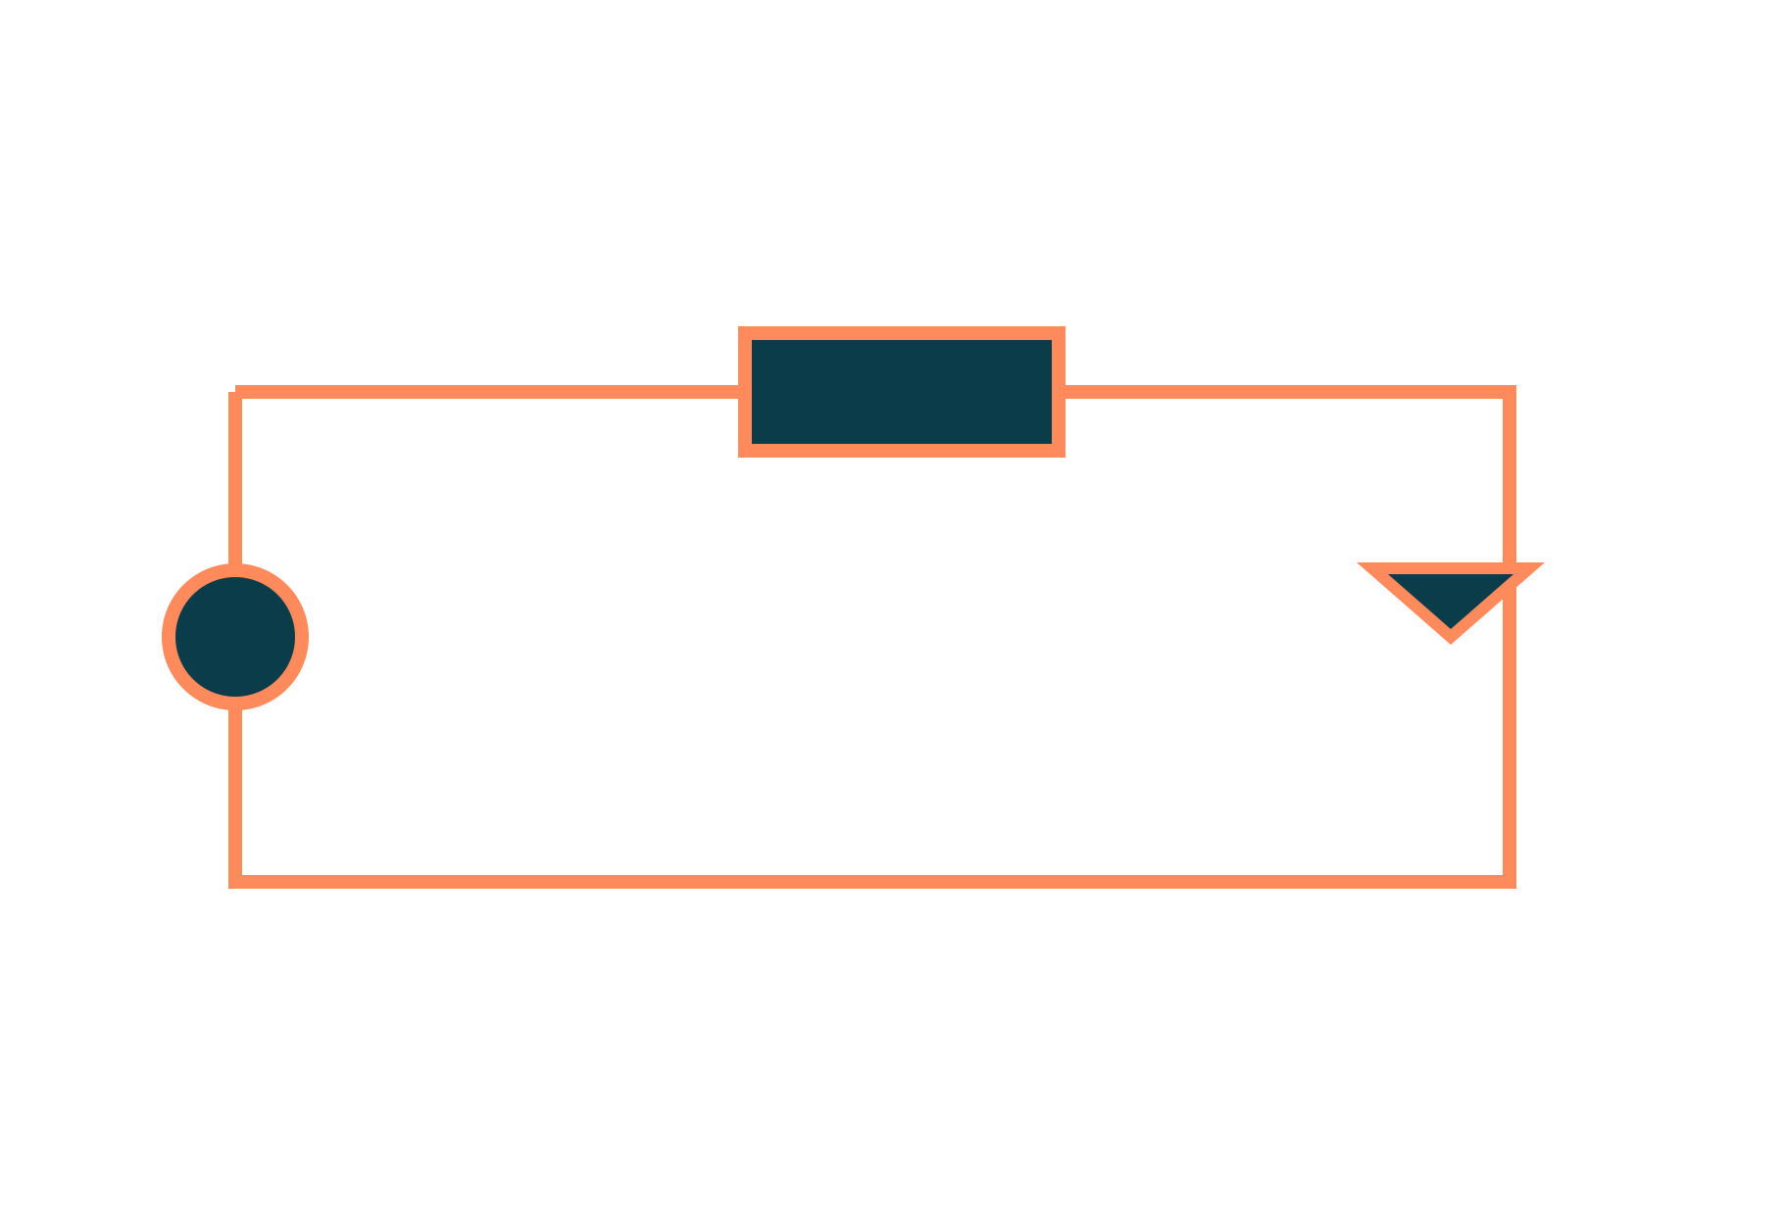
DC Circuit Analysis, Power and Energy
Basic Electrical and Electronics Engineering
Unit 1: Circuit Fundamentals
Topic: Basic nodal and mesh analysis with independent DC sources; power and energy
Prof. Mitesh Astik
Notes:
Welcome everyone. Today's topic is Basic nodal and mesh analysis with independent DC sources; power and energy. It belongs to Unit 1: Circuit Fundamentals. By the end of this session you will be able to use it in numerical problems. Keep your notebooks ready because we will solve two examples.

Slide 2

Learning Outcomes
Apply KCL and KVL to DC networks.
Solve circuits by nodal analysis.
Solve circuits by mesh analysis.
Calculate power and energy in resistive loads.
Linked to CO1
Analyse DC and AC electrical circuits to determine circuit parameters.
Notes:
Read the outcomes aloud. They map to CO1 of the syllabus. Tell students that these are examinable and that the two solved examples follow the same pattern. Ask them to tick off each outcome at the end of the lecture.

Slide 3
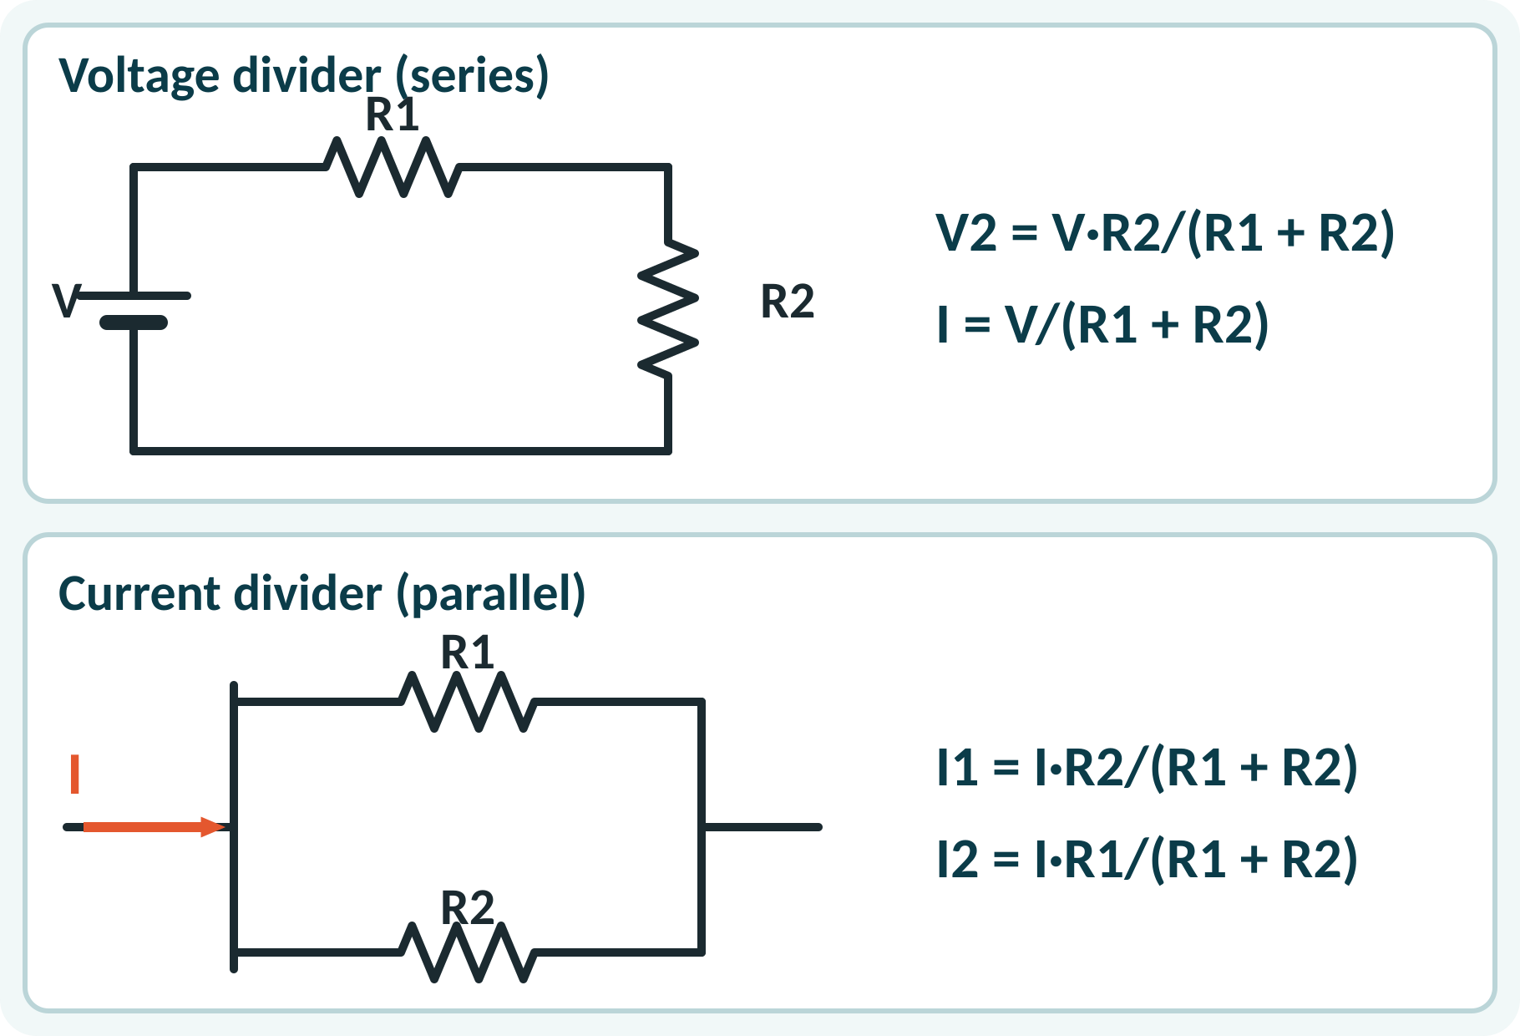
Recap: What You Already Know
Ohm's law: V = I·R.
Series: same current, voltages add.
Parallel: same voltage, currents add.
Equivalent resistance simplifies a network.
Series: Req = R1 + R2; parallel: Req = R1R2/(R1 + R2)
V volt, I ampere, R ohm
Notes:
Recall that in a series circuit the same current flows through every resistor and the voltages add. In a parallel circuit every resistor has the same voltage and the currents add. These two ideas let us reduce simple networks, but they are not enough for circuits with several sources. For those we need Kirchhoff's laws.

Slide 4
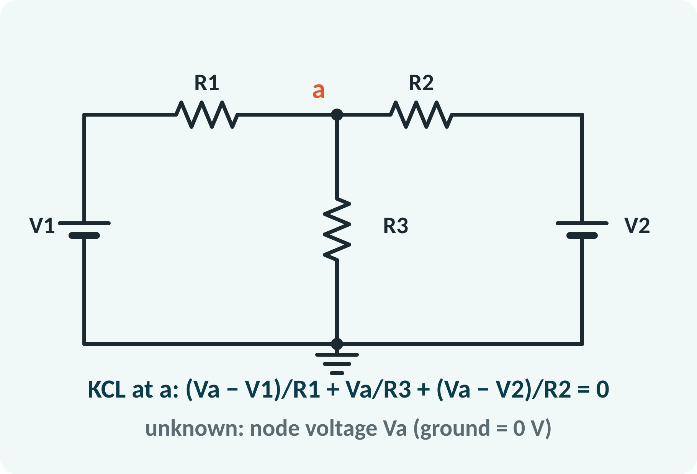
Motivation: Circuits with Many Sources
Battery banks, solar panels and chargers share loads.
Series–parallel reduction fails with two sources.
Systematic methods always work.
Same method used by circuit simulators.
Systematic methods: nodal (KCL) and mesh (KVL)
Notes:
A solar panel and a battery connected to the same load, or two generators feeding a common bus, cannot be reduced by simple series and parallel rules. We need a systematic method that works for any network. Nodal and mesh analysis are exactly that, and they are the basis of every circuit simulator, including those used in your lab.

Slide 5
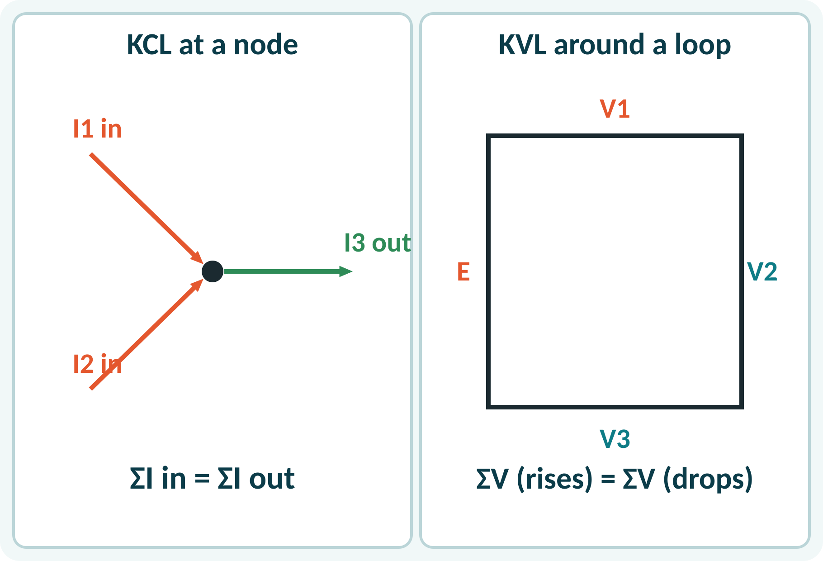
Kirchhoff's Laws
KCL: current into a node equals current out.
KVL: sum of voltage rises = sum of drops in a loop.
KCL is conservation of charge.
KVL is conservation of energy.
Mark current directions first.
KCL: ΣI(in) = ΣI(out); KVL: ΣV = 0 around any closed loop
Notes:
Kirchhoff's current law says that the net current at a node is zero because charge cannot accumulate. His voltage law says that the algebraic sum of voltages around a closed loop is zero, which is conservation of energy. Fix a direction for each current at the start and keep the signs consistent: a drop occurs when you move along the current through a resistor.

Slide 6
Nodal Analysis
Choose a reference node (ground = 0 V).
Label the other node voltages.
Write KCL at each non-reference node.
Express branch currents with Ohm's law.
Solve the equations for node voltages.
(Va − V1)/R1 + Va/R3 + (Va − V2)/R2 = 0
Number of equations = nodes − 1
Notes:
In nodal analysis the unknowns are node voltages measured from a reference node. At each non-reference node we write that the sum of currents leaving through the resistors is zero. A branch current leaving a node is the node voltage minus the neighbour voltage divided by the resistance. For our network only one equation is needed, since there is just one non-reference node.

Slide 7
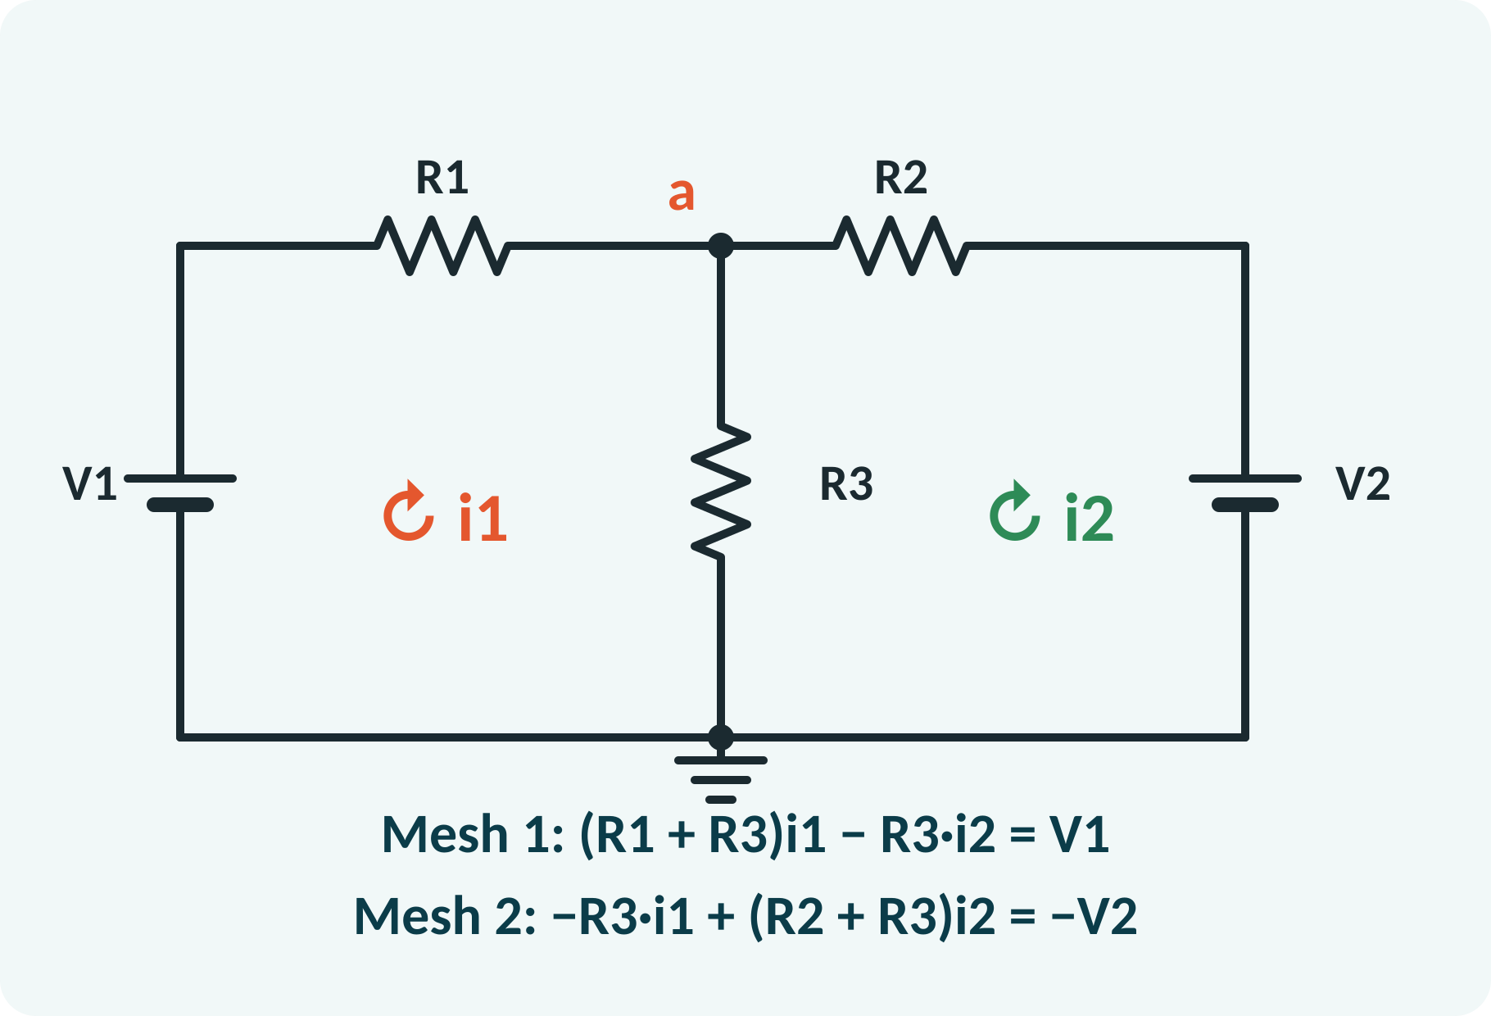
Mesh Analysis
Draw a clockwise mesh current in each loop.
Write KVL around each mesh.
Shared resistor carries the difference of currents.
Solve the equations for mesh currents.
Branch currents follow from the mesh currents.
(R1 + R3)i1 − R3·i2 = V1; −R3·i1 + (R2 + R3)i2 = −V2
Number of equations = number of meshes
Notes:
In mesh analysis the unknowns are circulating currents in the independent loops. For each mesh the sum of resistance times current drops equals the source voltage. The resistor common to two meshes carries the difference of the two mesh currents, which gives the cross term with a minus sign. Solve the pair of simultaneous equations by substitution or determinants.

Slide 8
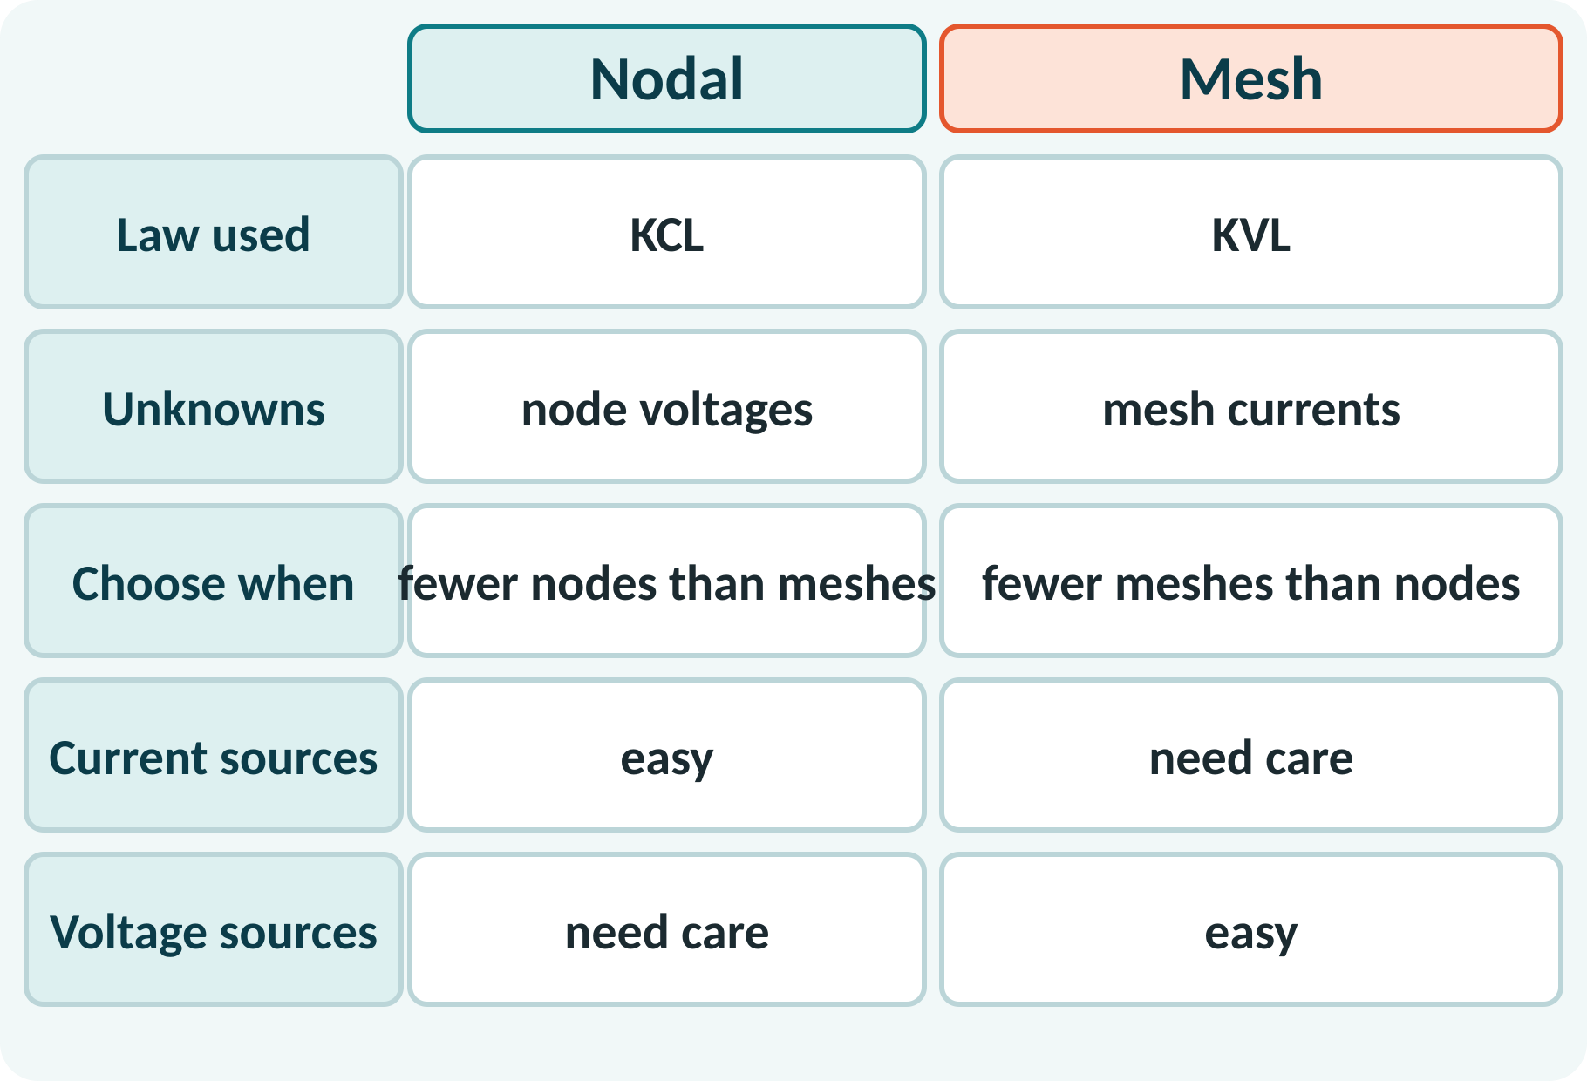
Choosing the Method
Count nodes and meshes first.
Fewer equations means less work.
Nodal suits current sources.
Mesh suits voltage sources.
Both give the same answer.
Equations: nodal n − 1; mesh b − n + 1 (b branches, n nodes)
Notes:
The two methods are equivalent and give identical results, so choose the one needing fewer equations. If there are fewer nodes than meshes, use nodal analysis. If voltage sources dominate, mesh analysis is usually simpler. Take care when the network contains the other kind of source, since this adds an extra constraint.

Slide 9
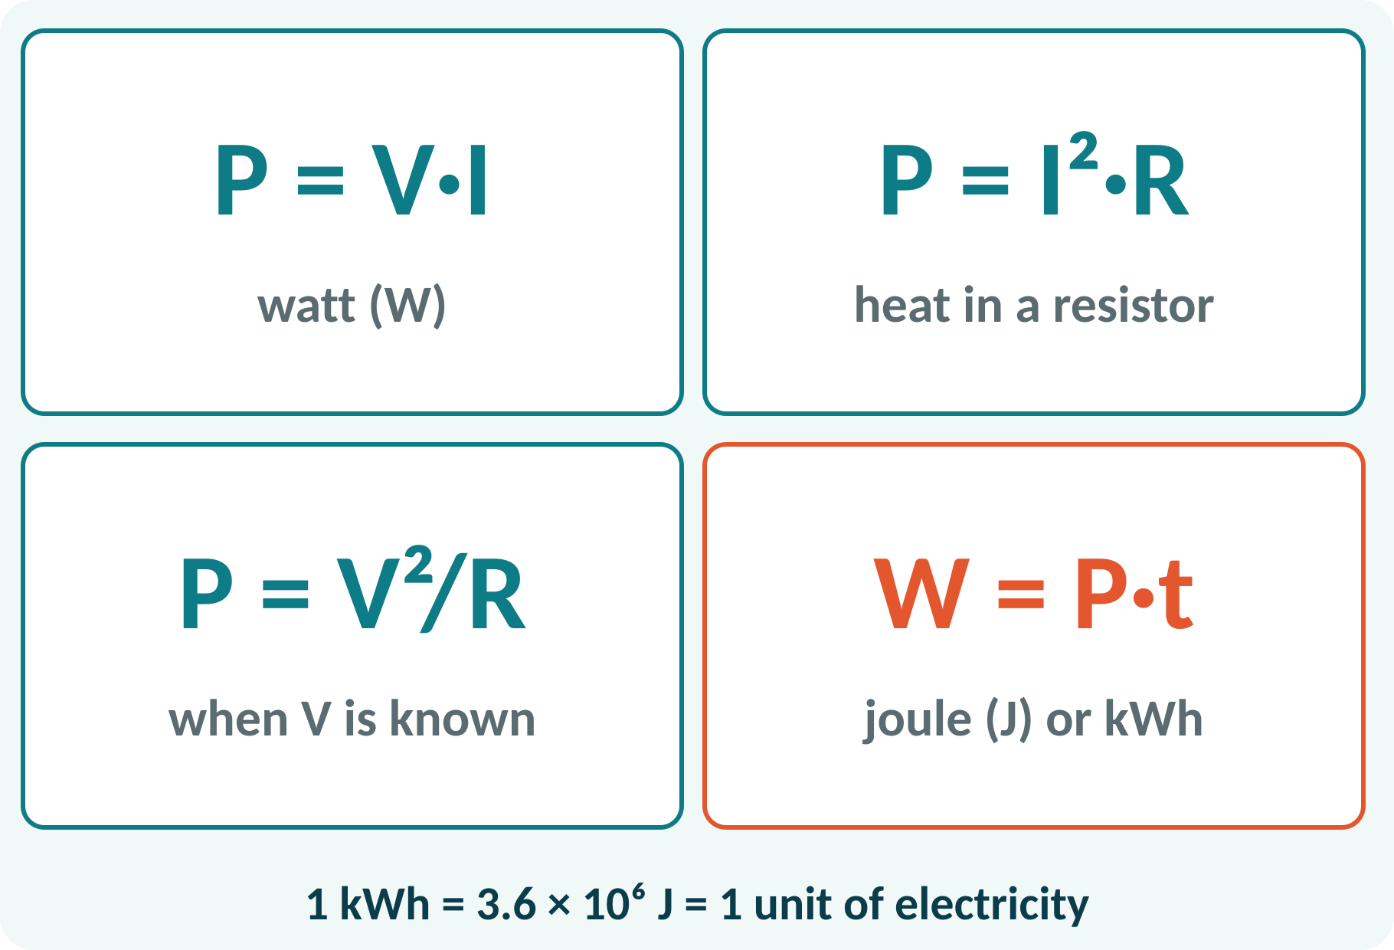
Power and Energy
Power: rate of energy conversion.
Resistor power turns into heat.
Energy = power × time.
Utility unit: kWh (one unit).
P = VI = I²R = V²/R (W); W = P·t (J, or kWh)
1 kWh = 3.6 × 10⁶ J
Notes:
Power in watts is the product of voltage and current. Using Ohm's law it can be written as I squared R or V squared over R, whichever quantities are known. Energy is power multiplied by time, in joules when the time is in seconds and in kilowatt hours for billing. The electricity meter at home counts kilowatt hours, also called units.

Slide 10
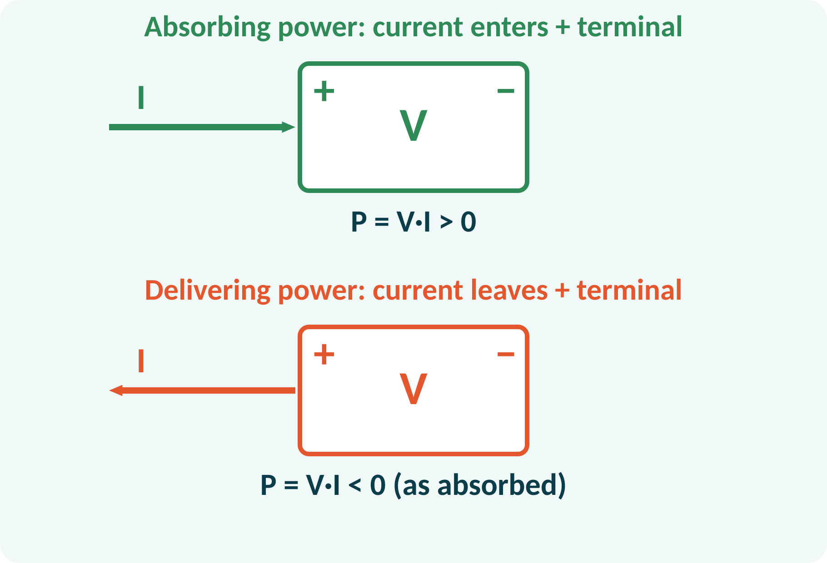
Sign Convention for Power
Current into the + terminal: element absorbs.
Current out of the + terminal: element delivers.
Resistors always absorb.
Total power delivered = total power absorbed.
Conservation: ΣP(delivered) = ΣP(absorbed)
Notes:
To decide whether an element supplies or consumes power, look at the direction of current relative to the polarity. If the current enters the positive terminal, the element absorbs power. A battery that is charging absorbs power, while the same battery discharging delivers power. Check your answer by verifying that delivered and absorbed powers are equal.

Slide 11
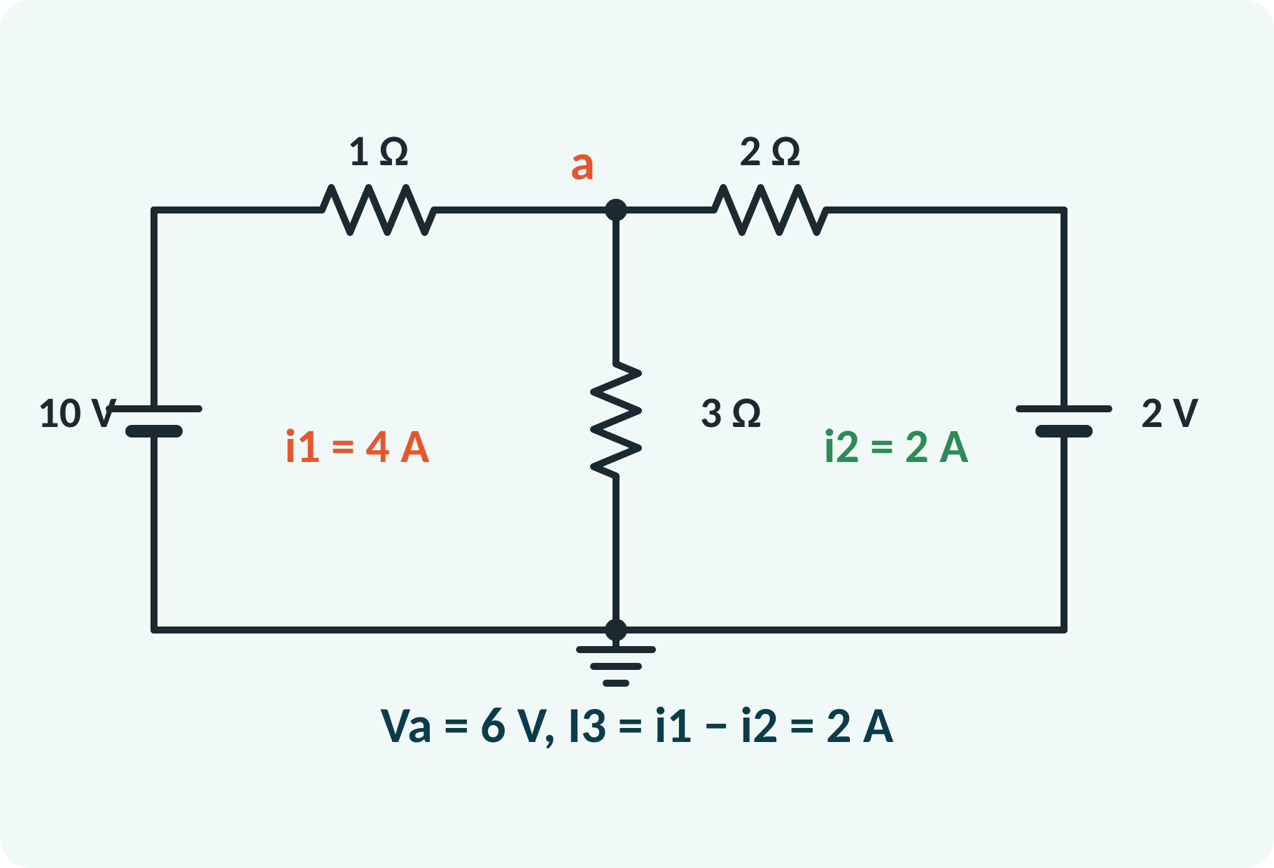
Solved Example 1: Nodal and Mesh
V1 = 10 V, V2 = 2 V, R1 = 1 Ω, R2 = 2 Ω, R3 = 3 Ω (as drawn). Find Va, branch currents, power in each resistor.
1. Nodal: (Va − 10)/1 + Va/3 + (Va − 2)/2 = 0 → 11Va/6 = 11 → Va = 6 V.
2. I1 = (10 − 6)/1 = 4 A; I2 = (6 − 2)/2 = 2 A; I3 = 6/3 = 2 A.
3. Mesh check: 4i1 − 3i2 = 10 and −3i1 + 5i2 = −2 → i1 = 4 A, i2 = 2 A.
4. P(R1) = 16 W, P(R2) = 8 W, P(R3) = 12 W: total 36 W.
Answer: Va = 6 V; currents 4 A, 2 A, 2 A; V1 delivers 40 W, V2 absorbs 4 W, resistors dissipate 36 W
Notes:
Use nodal analysis first: multiply the equation by six to clear fractions and solve for Va, which is 6 volts. The branch currents follow from Ohm's law. Then solve the mesh equations as an independent check, and they give 4 and 2 amperes, which agree. Finally verify power balance: V1 supplies 40 watts, V2 absorbs 4 watts, and the resistors dissipate 36 watts.

Slide 12
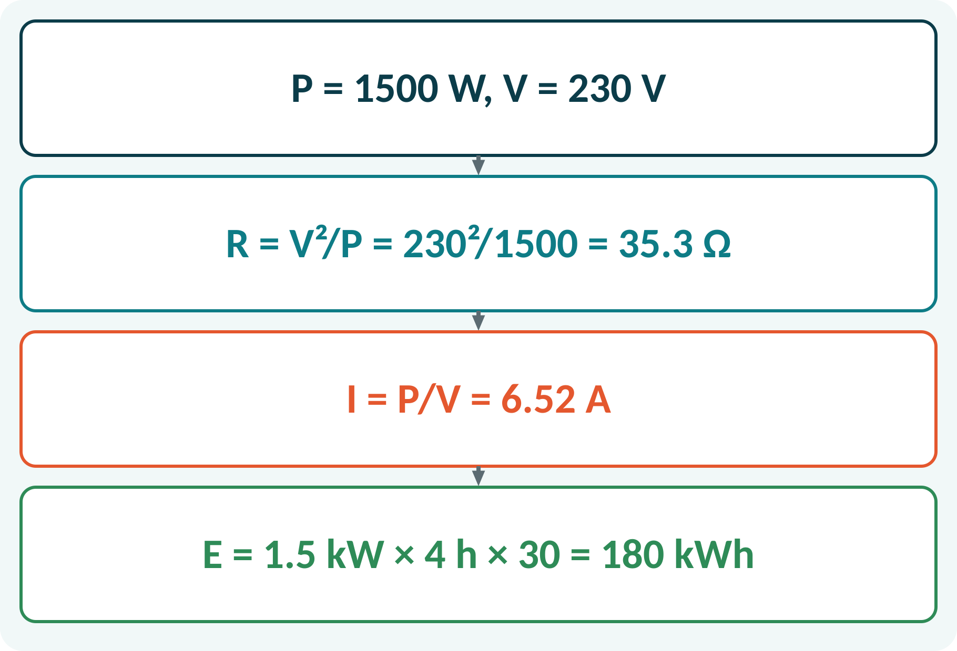
Solved Example 2: Heater Energy
A heater is rated 1.5 kW, 230 V. Find R and I. If used 4 h per day for 30 days, find the energy and the bill at ₹6 per unit.
1. R = V²/P = 230²/1500 = 35.3 Ω.
2. I = P/V = 1500/230 = 6.52 A.
3. Energy per day = 1.5 kW × 4 h = 6 kWh.
4. For 30 days: 180 kWh.
5. Bill = 180 × ₹6 = ₹1080.
Answer: R = 35.3 Ω, I = 6.52 A, E = 180 kWh, bill = ₹1080
Notes:
From the rating plate we can find the hot resistance using V squared over P, and the current using P over V. Energy in kilowatt hours is power in kilowatts times hours of use. Multiplying by the tariff gives the bill. This kind of question links circuit theory to everyday electricity use, and is common in the examination.

Slide 13
Common Mistakes and Exam Tips
✕
Common mistakes
✓
Exam tips
Wrong sign for a source or current direction.
Forgetting the shared-resistor term in mesh analysis.
Writing too many or too few equations.
Using P = V·I with V in mV and I in A.
Mixing kW and W in energy calculations.
Mark polarity and current directions first.
Check power balance at the end.
Count nodes (n − 1) or meshes before solving.
Convert all units to SI.
Notes:
These are the points where marks are lost most often in DC circuit analysis. Give one quick example for each mistake. Remind students that writing the formula, substitution and the unit earns method marks even if the arithmetic slips. Encourage them to check the answer for reasonableness.

Slide 14
Summary
KCL: ΣI in = ΣI out; KVL: ΣV = 0 in a loop.
Nodal: unknowns are node voltages; n − 1 equations.
Mesh: unknowns are mesh currents; one equation per mesh.
P = VI = I²R = V²/R; W = P·t.
Delivered power = absorbed power.
Choose the method with fewer equations; verify by power balance
Notes:
Recap in one minute. Say each point and ask the class to recall the formula for it. If they remember these ideas, most numerical problems on DC circuit analysis are within reach. Next lecture: sinusoidal voltage, RMS and phasors. Revise the two solved examples tonight.

Slide 15
Quick Quiz
Q1. Number of nodal equations for a circuit with 5 nodes:
(a) 3 (b) 4 (c) 5 (d) 6
Ans: (b)
Q2. Power in a 10 Ω resistor carrying 2 A:
(a) 20 W (b) 40 W (c) 5 W (d) 80 W
Ans: (b)
Q3. KVL expresses conservation of:
(a) charge (b) energy (c) mass (d) momentum
Ans: (b)
Q4. A 2 kW heater used for 3 hours consumes:
(a) 2 kWh (b) 3 kWh (c) 6 kWh (d) 6 kW
Ans: (c)
Q5. Current entering the + terminal means the element:
(a) delivers power (b) absorbs power (c) is open (d) is a short
Ans: (b)
Notes:
Give about one minute per question and take a show of hands. Discuss why the wrong options are tempting, especially the one that uses a wrong formula. Use the quiz as a quick check on DC circuit analysis before leaving.

Slide 16
References
1
Hughes Edward, Electrical Technology
10th Ed., Pearson Education, 2010 (Units 1, 2 textbook)
2
H. Cotton, Electrical Technology
7th Ed., CBS Publishers, 2005 (reference)
Next lecture: sinusoidal voltage, RMS and phasors (already prepared): BEEE_U1b
Notes:
Point students to the textbooks listed in the syllabus for DC circuit analysis. Ask them to solve at least three textbook problems on this topic before the next class. Thank the class and preview the next lecture.

