Slide 1
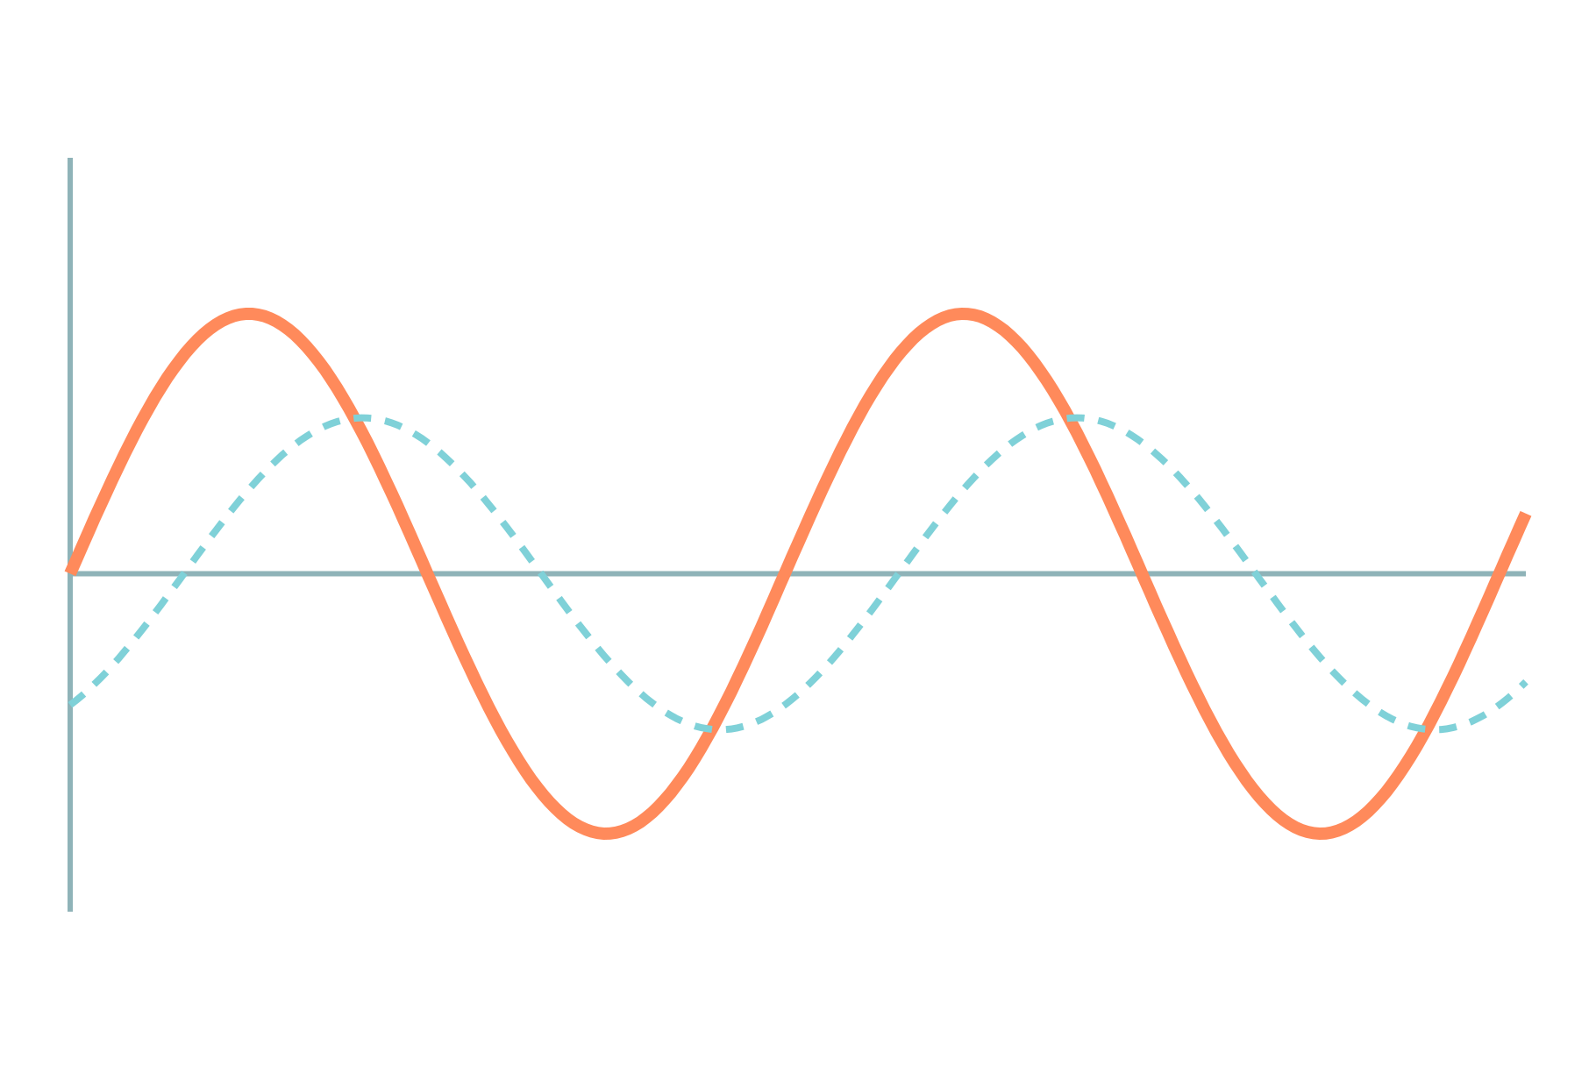
R, L, C Series Circuits and Power
Basic Electrical and Electronics Engineering
Unit 1: Circuit Fundamentals
Topic: R, L, C, RL, RC, RLC series circuits; real, reactive, apparent power; power factor
Prof. Mitesh Astik
Notes:
Welcome everyone. Today's topic is R, L, C, RL, RC, RLC series circuits; real, reactive, apparent power; power factor. It belongs to Unit 1: Circuit Fundamentals. By the end of this session you will be able to use it in numerical problems. Keep your notebooks ready because we will solve two examples.

Slide 2

Learning Outcomes
Find current and phase angle in series R, L, C circuits.
Draw impedance triangles and phasor diagrams.
Calculate P, Q, S and power factor.
Explain why power factor matters.
Linked to CO1
Analyse DC and AC electrical circuits to determine circuit parameters.
Notes:
Read the outcomes aloud. They map to CO1 of the syllabus. Tell students that these are examinable and that the two solved examples follow the same pattern. Ask them to tick off each outcome at the end of the lecture.

Slide 3
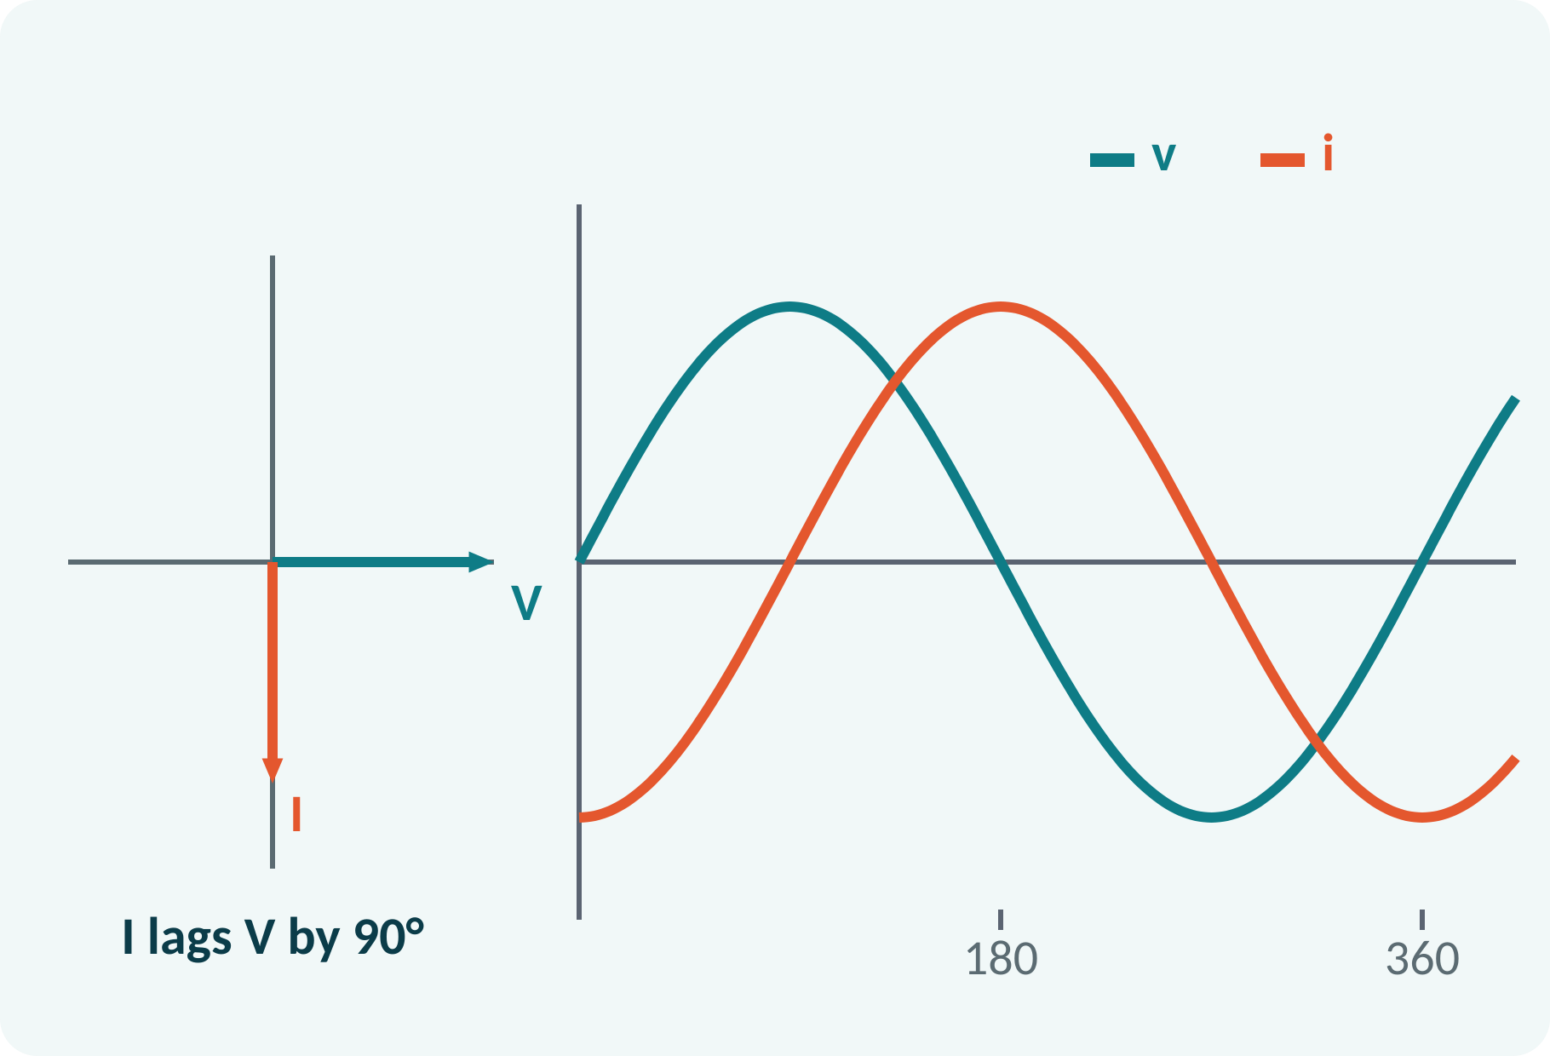
Recap: What You Already Know
Phasor V = V∠φ with RMS magnitude.
j rotates a phasor by +90°.
Add phasors in rectangular form.
ω = 2πf; 50 Hz mains.
V = Vm/√2; j = √−1 = 1∠90°
Phasor: RMS length and phase angle
Notes:
In the previous lecture we represented sinusoids as phasors. The symbol j rotates a phasor by ninety degrees, which is what makes inductors and capacitors easy to handle. Today we apply that idea to series circuits, where the same current flows through every element.

Slide 4
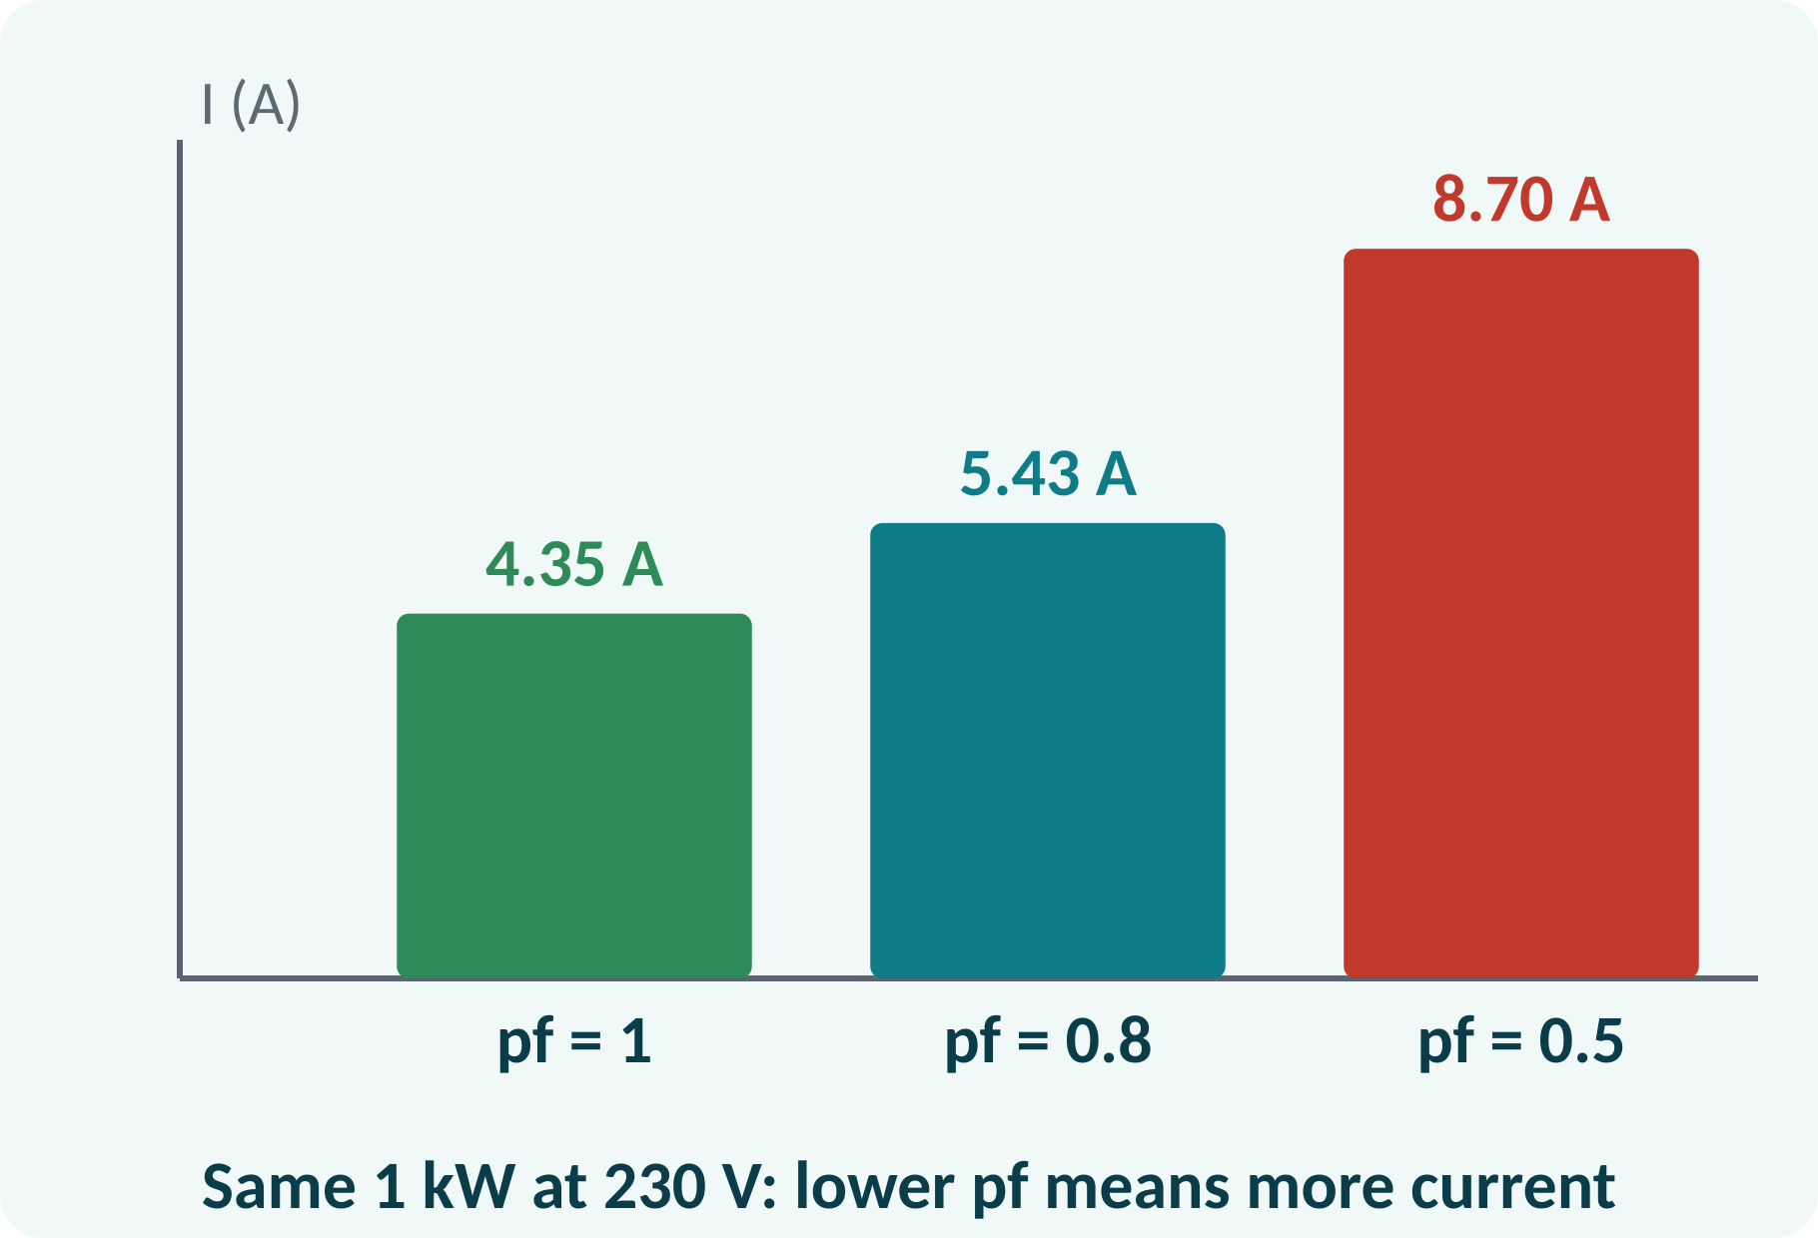
Motivation: Why Power Factor?
Motors and tube lights are inductive loads.
Reactive current heats lines but does no work.
Utilities penalise low power factor.
Capacitors in the panel correct it.
For the same real power, lower pf means more current and bigger losses
Notes:
A factory with many induction motors draws more current than needed for its useful power. That extra current is reactive current. It increases cable loss and may force the supply company to install bigger equipment, so low power factor attracts a penalty on the electricity bill. To understand why, we need the phase relationships of R, L and C.

Slide 5
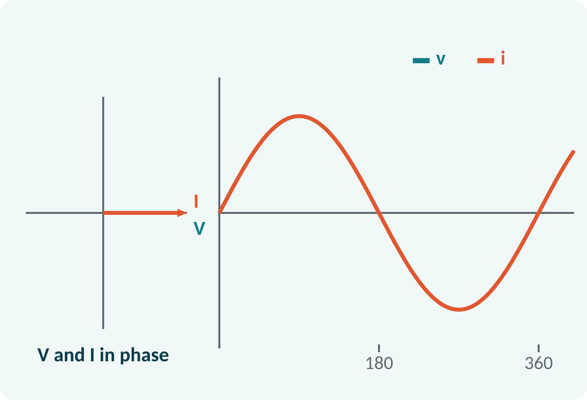
Pure Resistor
v = Vm sin ωt gives i = (Vm/R) sin ωt.
Voltage and current are in phase.
Impedance equals R, independent of frequency.
Average power P = VI = I²R.
V = I·R, φ = 0°, P = V·I = I²R
Notes:
For a resistor the instantaneous current is simply the voltage divided by R. They rise and fall together, so the phase angle is zero. The power is always positive and is dissipated as heat. A resistor is the only one of the three elements that consumes real power on average.

Slide 6
Pure Inductor
v = L·di/dt, so current lags voltage.
Current lags by 90°.
Inductive reactance XL = ωL = 2πfL.
Average power is zero; energy is stored and returned.
XL = 2πfL (Ω); I = V/XL; φ = −90°
L henry, f hertz
Notes:
The voltage across an inductor is L times the rate of change of current. When the current is increasing fastest the voltage is highest, so the current peak comes a quarter cycle later: the current lags by ninety degrees. Reactance grows with frequency, so an inductor passes low frequencies easily. It stores energy in the magnetic field and returns it, so the average power is zero.

Slide 7
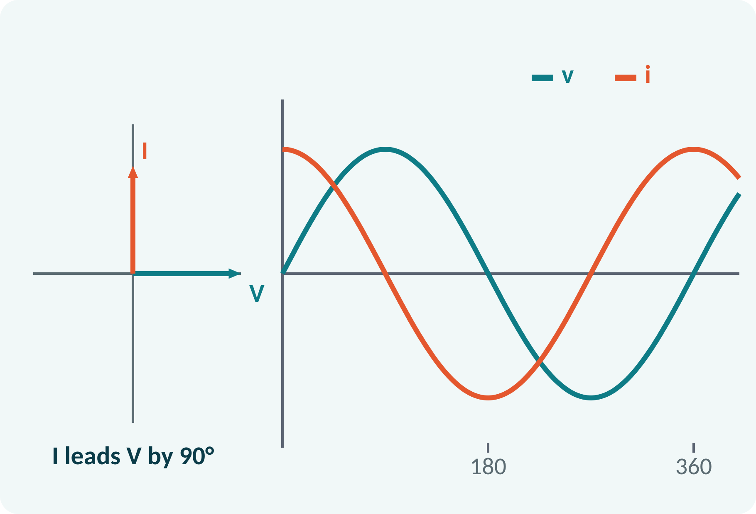
Pure Capacitor
i = C·dv/dt, so current leads voltage.
Current leads by 90°.
Capacitive reactance XC = 1/(2πfC).
Average power is zero.
XC = 1/(2πfC) (Ω); I = V/XC; φ = +90°
C farad, f hertz
Notes:
For a capacitor the current is proportional to the rate of change of voltage, so the current peaks a quarter cycle before the voltage. Capacitive reactance falls as frequency rises, the opposite of the inductor. Like an inductor, an ideal capacitor stores and returns energy, so no real power is consumed. A useful memory aid is CIVIL: in a capacitor I leads V, in an inductor V leads I.

Slide 8
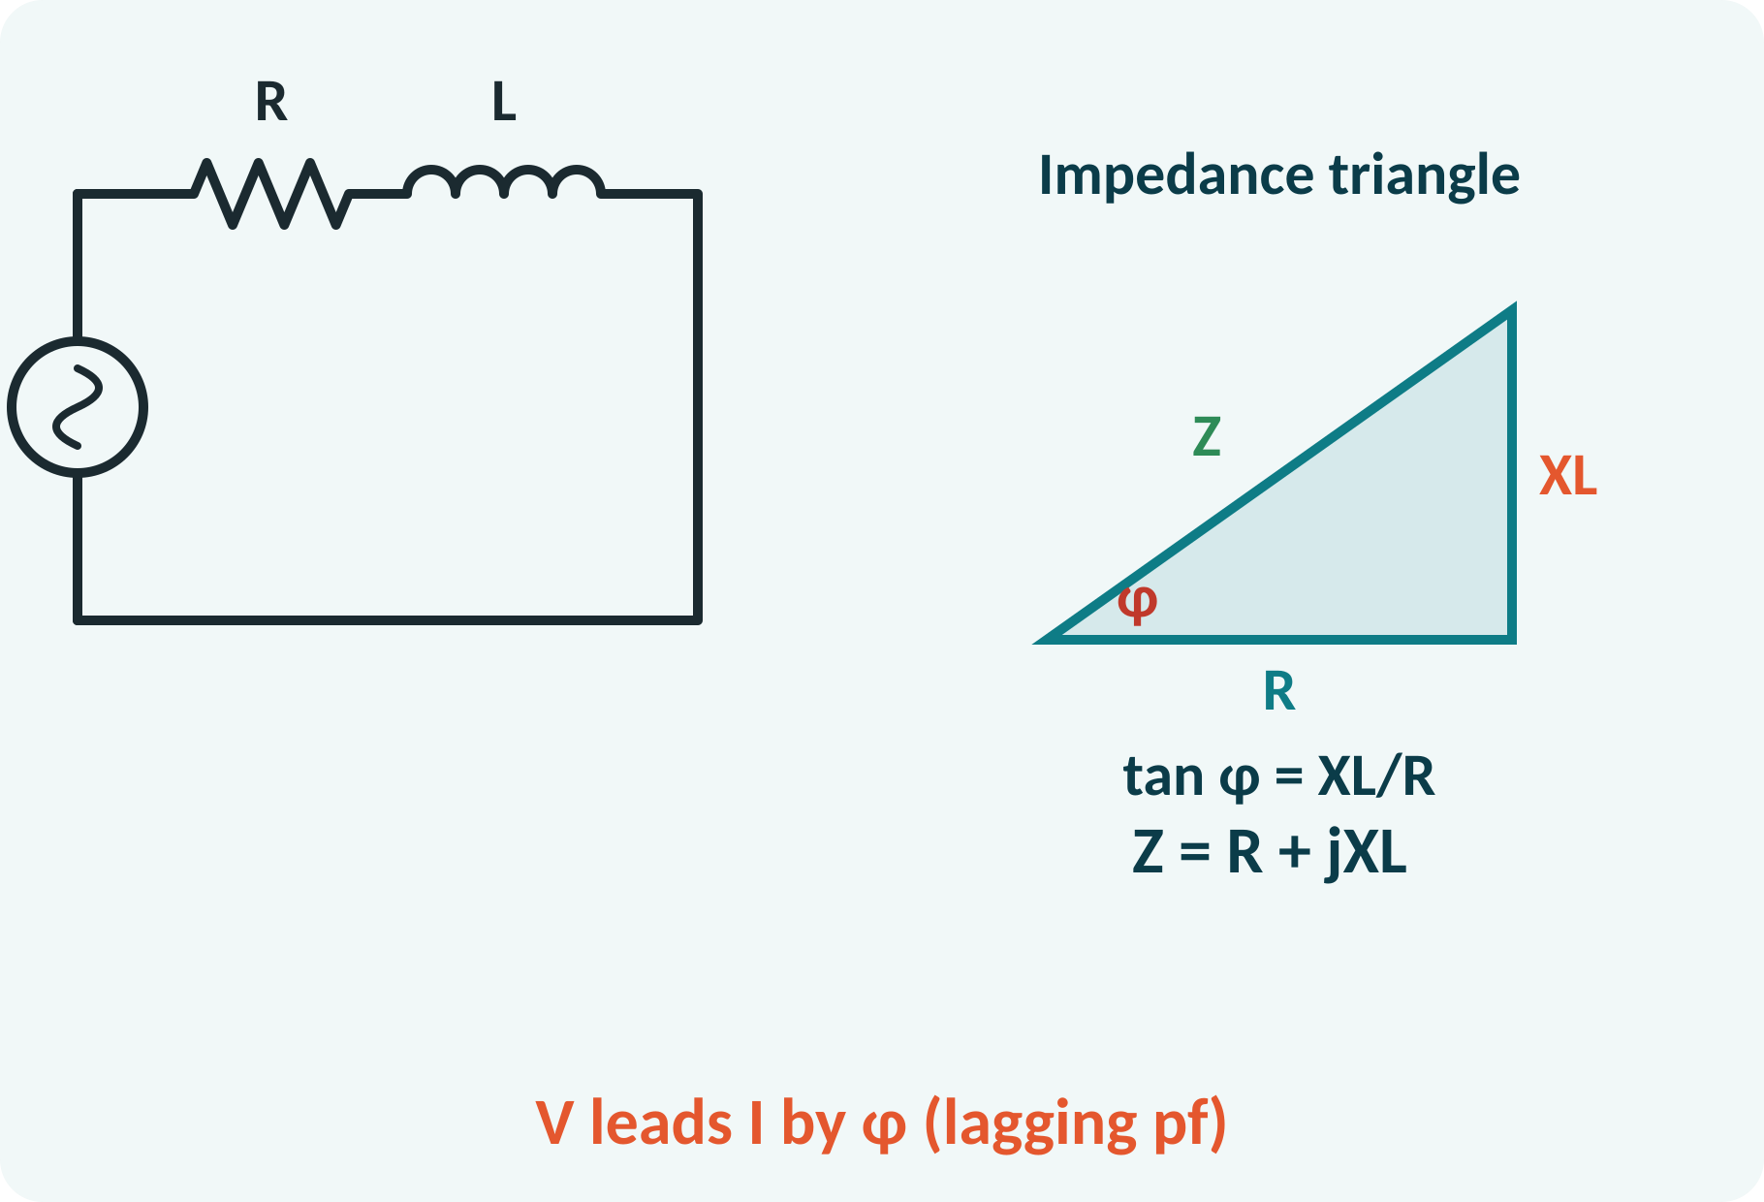
Series RL Circuit
Same current flows through R and L.
VR in phase with I; VL leads I by 90°.
Impedance Z = R + jXL.
Current lags the supply voltage by φ.
|Z| = √(R² + XL²); φ = tan⁻¹(XL/R); I = V/|Z|
V² = VR² + VL²
Notes:
Take the current as the reference phasor. The resistor voltage is in phase with it and the inductor voltage leads it by ninety degrees, so the supply voltage is their phasor sum. Dividing by the current gives the impedance triangle with R on the base and X L as the height. The phase angle is the arctangent of X L over R, and the current lags the supply.

Slide 9
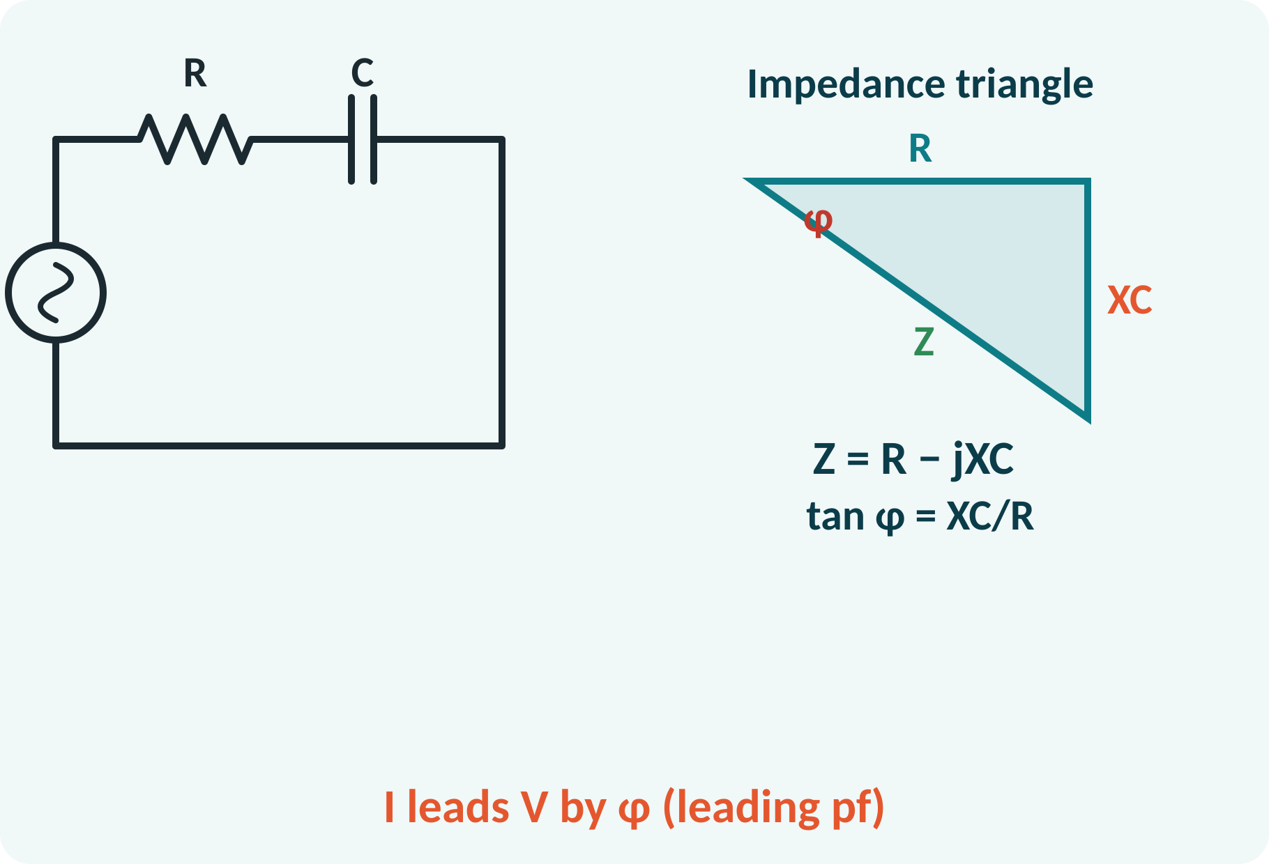
Series RC Circuit
VR in phase with I; VC lags I by 90°.
Impedance Z = R − jXC.
Current leads the supply voltage by φ.
Used in lag compensators and filters.
|Z| = √(R² + XC²); φ = tan⁻¹(XC/R); I = V/|Z|
Notes:
The capacitor voltage lags the current by ninety degrees, so the reactance is drawn downward in the impedance triangle. The total current leads the supply voltage by the angle phi. Series RC networks are common in filters and timing circuits. You will see the same RC network again when we meet the 555 timer.

Slide 10
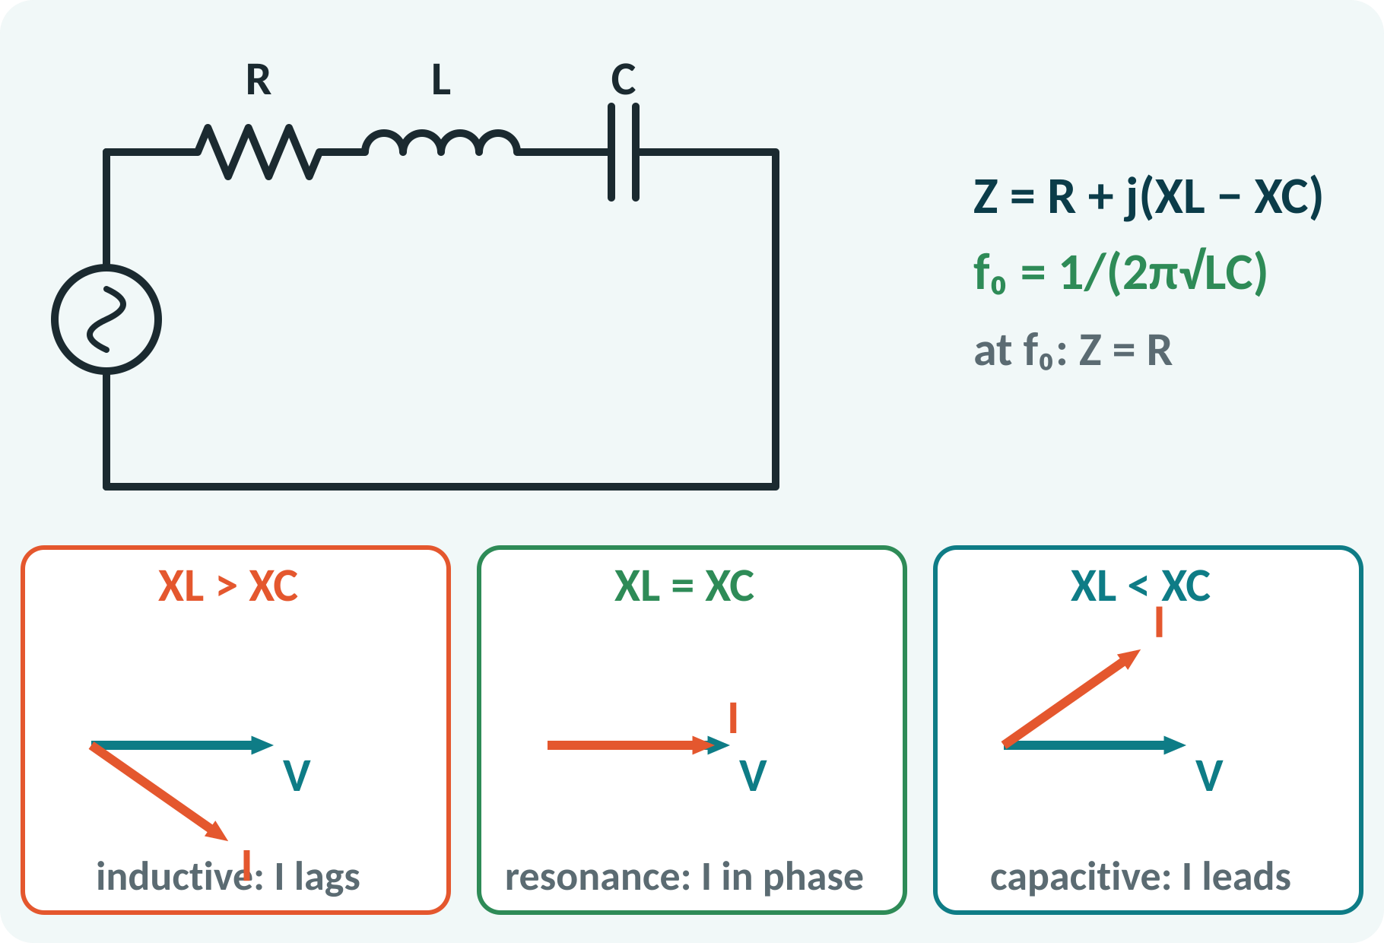
Series RLC Circuit
Z = R + j(XL − XC).
XL > XC: inductive, current lags.
XL < XC: capacitive, current leads.
XL = XC: resonance, Z = R, I maximum.
|Z| = √[R² + (XL − XC)²]; φ = tan⁻¹[(XL − XC)/R]; f₀ = 1/(2π√LC)
Notes:
In the RLC circuit the inductor and capacitor voltages are opposite in direction, so their reactances subtract. If the inductive reactance is larger the circuit behaves like an RL circuit, otherwise like an RC circuit. When the two are equal the reactive parts cancel, the impedance is just R and the current is maximum. That is series resonance at f naught equal to one over two pi root L C.

Slide 11
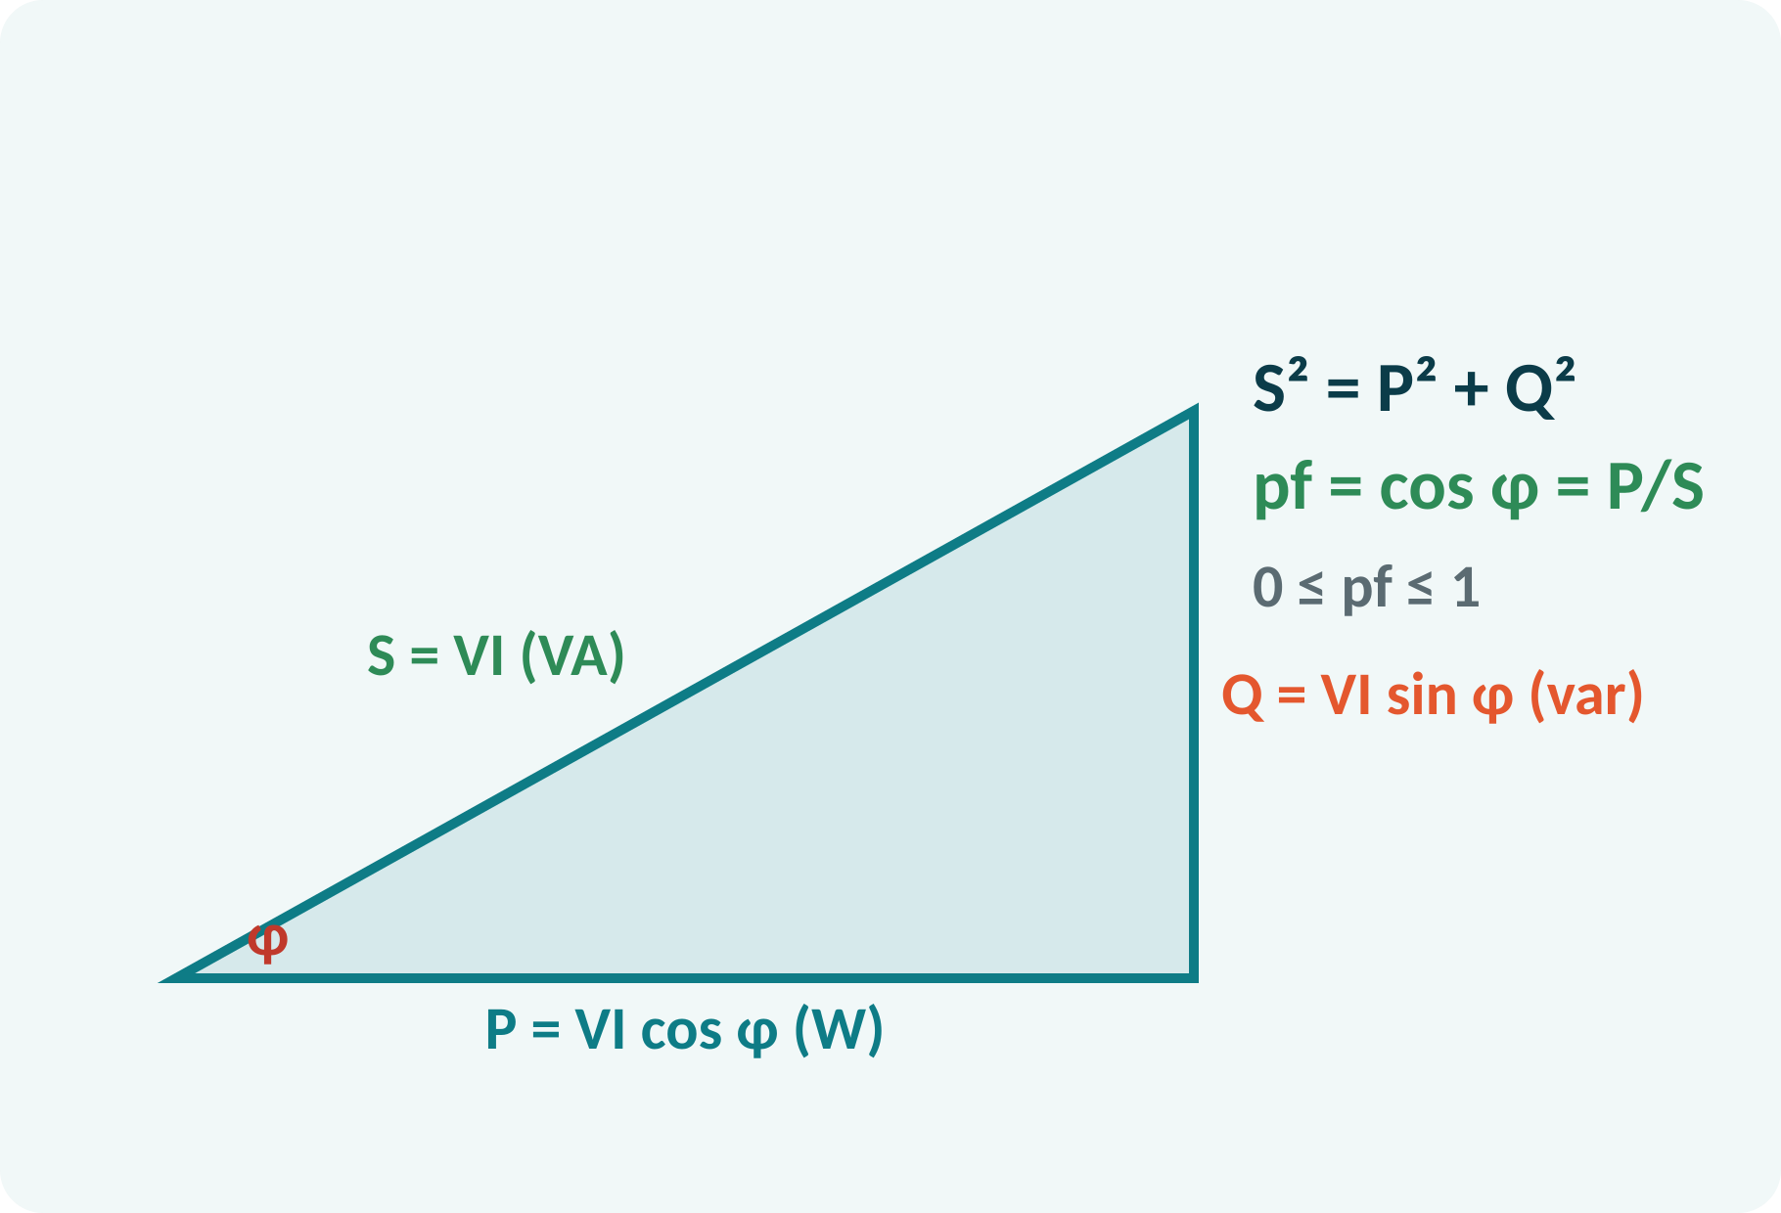
Real, Reactive and Apparent Power
Real power P is dissipated in R.
Reactive power Q is exchanged with L and C.
Apparent power S = V·I is the rating of equipment.
Power triangle: P, Q, S.
P = VI cos φ = I²R (W); Q = VI sin φ = I²X (var); S = VI (VA)
S² = P² + Q²
Notes:
Multiplying the impedance triangle by the square of the current gives the power triangle. The base is the real power in watts that does useful work. The vertical side is the reactive power in var that merely oscillates between the source and the field. The hypotenuse is the apparent power in volt-amperes, which determines the size of the cables and transformers.

Slide 12
Power Factor
pf = cos φ = P/S.
Lagging for RL loads, leading for RC loads.
Low pf: more current for the same P.
Correction: add a capacitor in parallel.
Utility tariffs reward pf near 1.
pf = cos φ = R/|Z|; I = P/(V·pf)
Notes:
Power factor is the cosine of the phase angle, or the ratio of real to apparent power. For the same real power the current is inversely proportional to the power factor, so half the power factor doubles the current and quadruples the I squared R loss in the lines. A capacitor connected across the inductive load supplies the reactive power locally, which raises the power factor.

Slide 13
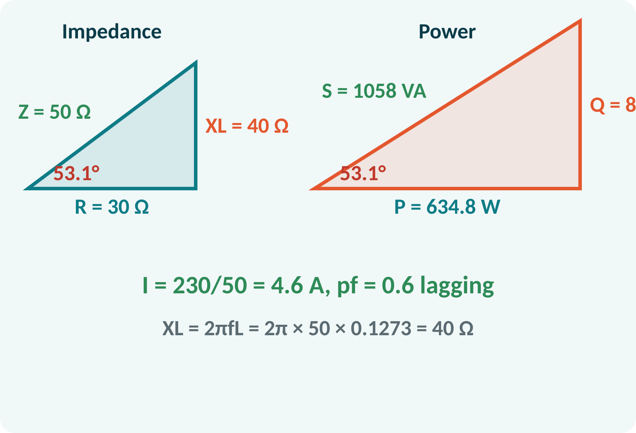
Solved Example 1: Series RL
R = 30 Ω in series with L = 0.1273 H on 230 V, 50 Hz. Find Z, I, φ, pf, P, Q, S.
1. XL = 2π·50·0.1273 = 40 Ω.
2. Z = 30 + j40 → |Z| = 50 Ω.
3. I = 230/50 = 4.6 A; φ = tan⁻¹(40/30) = 53.1°.
4. pf = cos 53.1° = 0.6 lagging.
5. P = I²R = 634.8 W; Q = I²XL = 846.4 var.
6. S = VI = 1058 VA.
Answer: I = 4.6 A lagging by 53.1°, pf = 0.6, P = 635 W, Q = 846 var, S = 1058 VA
Notes:
Compute the reactance first and then the impedance magnitude using the three-four-five triangle with a multiplier of ten. The current is the supply voltage over the impedance. Power factor is R over Z, 0.6. Compute P, Q and S, and verify that S squared equals P squared plus Q squared: about 1058 squared against 635 squared plus 846 squared.

Slide 14
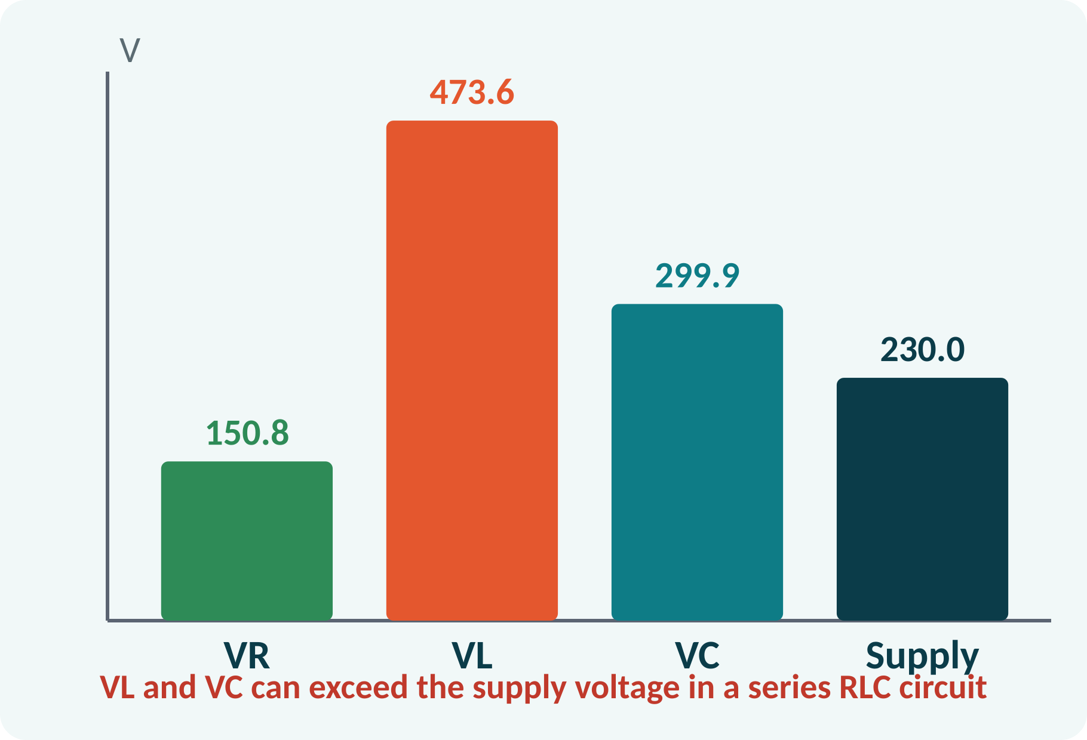
Solved Example 2: Series RLC
R = 20 Ω, L = 0.2 H, C = 80 µF on 230 V, 50 Hz. Find I, voltages, pf, P and f₀.
1. XL = 2π·50·0.2 = 62.83 Ω; XC = 1/(2π·50·80×10⁻⁶) = 39.79 Ω.
2. Z = 20 + j23.04 → |Z| = 30.5 Ω; I = 7.54 A.
3. φ = tan⁻¹(23.04/20) = 49.0°, pf = 0.656 lagging.
4. VR = 150.8 V, VL = 473.6 V, VC = 299.9 V.
5. P = I²R = 1137 W.
6. f₀ = 1/(2π√LC) = 39.8 Hz.
Answer: I = 7.54 A, pf = 0.656 lag, P = 1137 W, f₀ = 39.8 Hz
Notes:
Because the inductive reactance exceeds the capacitive reactance, the circuit is inductive and the current lags. Notice that VL and VC are both larger than the supply voltage, since they are almost opposite in phase and cancel in the sum. The real power is only dissipated in the resistor. Resonance would occur at 39.8 hertz, below the supply frequency.

Slide 15
Common Mistakes and Exam Tips
✕
Common mistakes
✓
Exam tips
Adding VR, VL and VC arithmetically.
Using XC = 2πfC.
Taking pf = sin φ.
Forgetting lead or lag with pf.
Mixing peak and RMS values.
Draw the phasor diagram first.
ELI the ICE man: V leads I in an inductor.
pf = cos φ = R/|Z|.
Check S² = P² + Q².
Notes:
These are the points where marks are lost most often in series AC circuits. Give one quick example for each mistake. Remind students that writing the formula, substitution and the unit earns method marks even if the arithmetic slips. Encourage them to check the answer for reasonableness.

Slide 16
Summary
XL = 2πfL (I lags); XC = 1/(2πfC) (I leads).
Z = R + j(XL − XC); I = V/|Z|.
P = VI cos φ; Q = VI sin φ; S = VI.
pf = cos φ = R/|Z|.
Resonance when XL = XC: f₀ = 1/(2π√LC).
φ = tan⁻¹(X/R); pf = cos φ; S² = P² + Q²
Notes:
Recap in one minute. Say each point and ask the class to recall the formula for it. If they remember these ideas, most numerical problems on AC series circuits are within reach. Next lecture: transformers. Revise the two solved examples tonight.

Slide 17
Quick Quiz
Q1. In a pure inductor, current:
(a) leads V by 90° (b) lags V by 90° (c) is in phase (d) leads by 45°
Ans: (b)
Q2. XC at 50 Hz for C = 100 µF is about:
(a) 3.18 Ω (b) 31.8 Ω (c) 318 Ω (d) 0.03 Ω
Ans: (b)
Q3. R = 6 Ω, XL = 8 Ω: |Z| =
(a) 14 Ω (b) 10 Ω (c) 2 Ω (d) 48 Ω
Ans: (b)
Q4. Power factor of the same circuit:
(a) 0.6 (b) 0.8 (c) 1.0 (d) 0.75
Ans: (a)
Q5. At series resonance:
(a) Z is maximum (b) Z = R (c) I is minimum (d) φ = 90°
Ans: (b)
Notes:
Give about one minute per question and take a show of hands. Discuss why the wrong options are tempting, especially the one that uses a wrong formula. Use the quiz as a quick check on series AC circuits before leaving.

Slide 18
References
1
Hughes Edward, Electrical Technology
10th Ed., Pearson Education, 2010 (Units 1, 2 textbook)
2
H. Cotton, Electrical Technology
7th Ed., CBS Publishers, 2005 (reference)
Next lecture: Unit 2: single-phase transformers
Notes:
Point students to the textbooks listed in the syllabus for series AC circuits. Ask them to solve at least three textbook problems on this topic before the next class. Thank the class and preview the next lecture.

