Slide 1
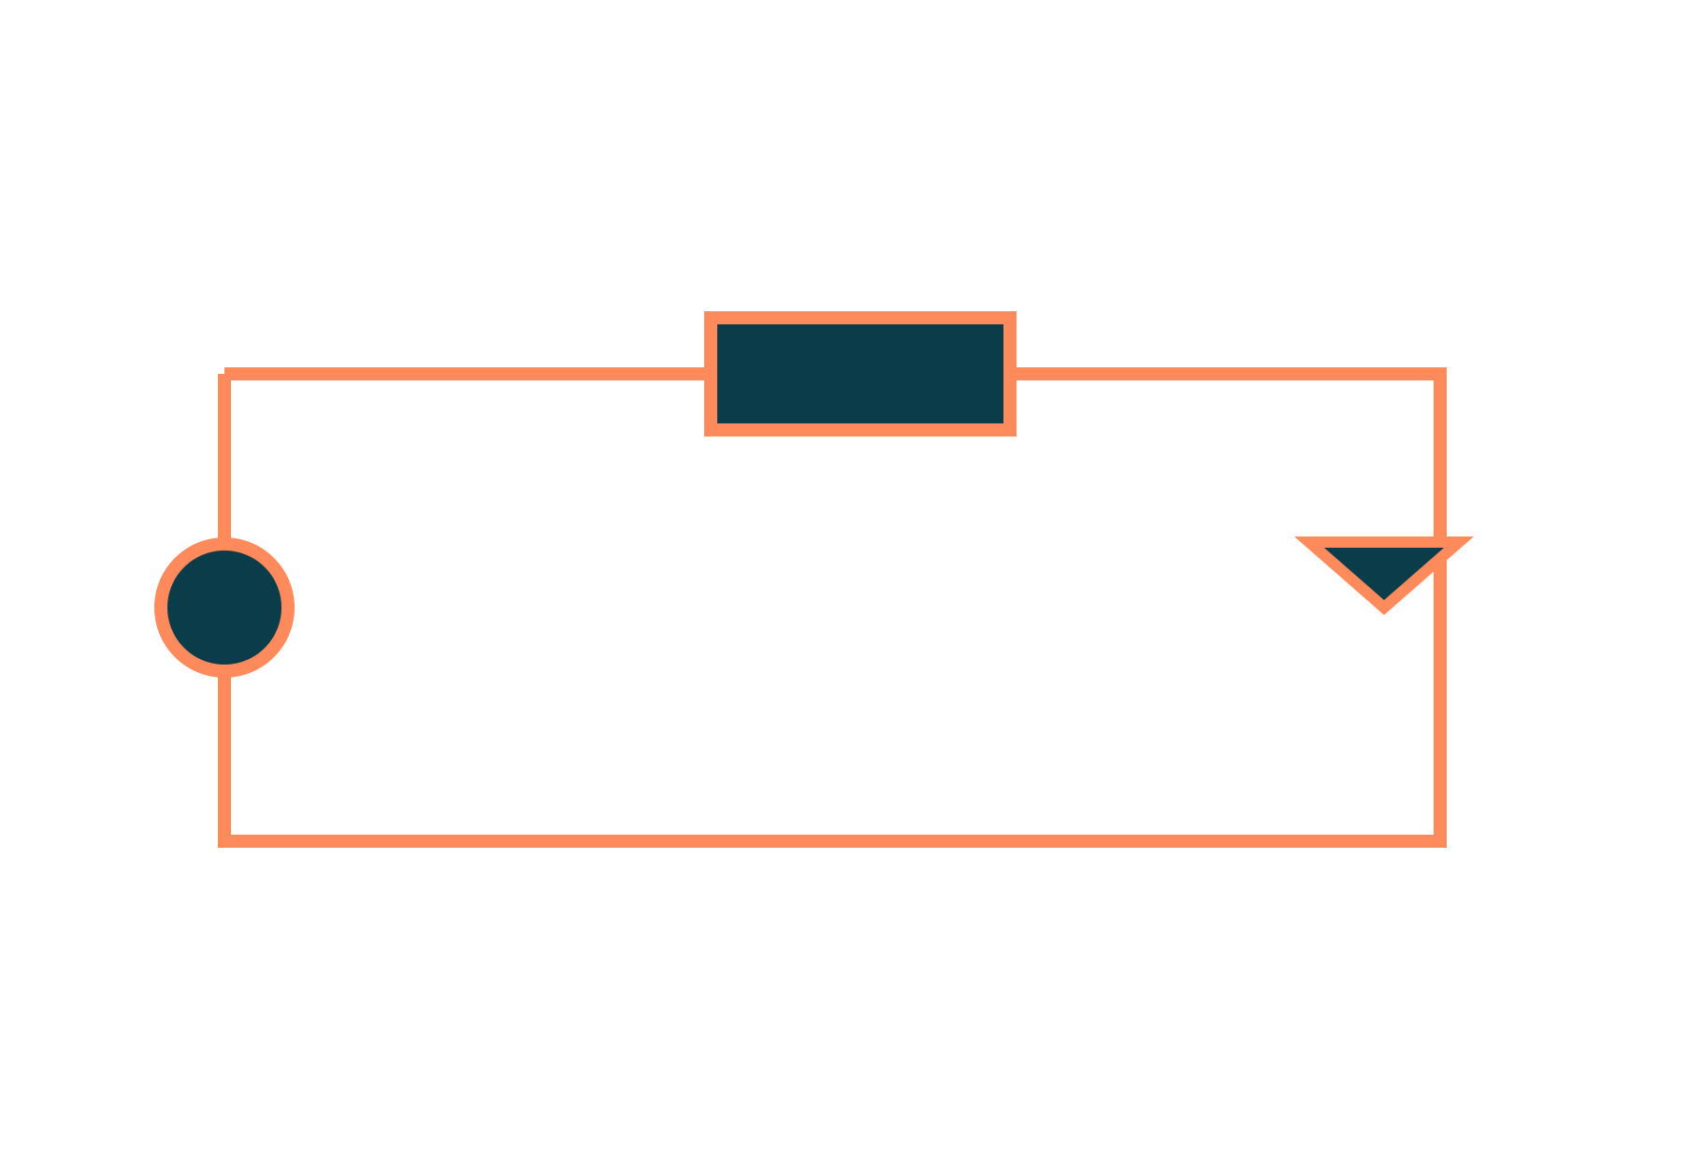
Single-Phase Transformer
Basic Electrical and Electronics Engineering
Unit 2: Transformers and Electrical Machines
Topic: Necessity, principle, types, construction, EMF equation, losses and efficiency
Prof. Mitesh Astik
Notes:
Welcome everyone. Today's topic is Necessity, principle, types, construction, EMF equation, losses and efficiency. It belongs to Unit 2: Transformers and Electrical Machines. By the end of this session you will be able to use it in numerical problems. Keep your notebooks ready because we will solve two examples.

Slide 2

Learning Outcomes
Explain why transformers are needed.
Describe principle, construction and types.
Use the EMF equation and turns ratio.
Calculate losses and efficiency.
Linked to CO2
Describe the construction and operating principle of transformers.
Notes:
Read the outcomes aloud. They map to CO2 of the syllabus. Tell students that these are examinable and that the two solved examples follow the same pattern. Ask them to tick off each outcome at the end of the lecture.

Slide 3
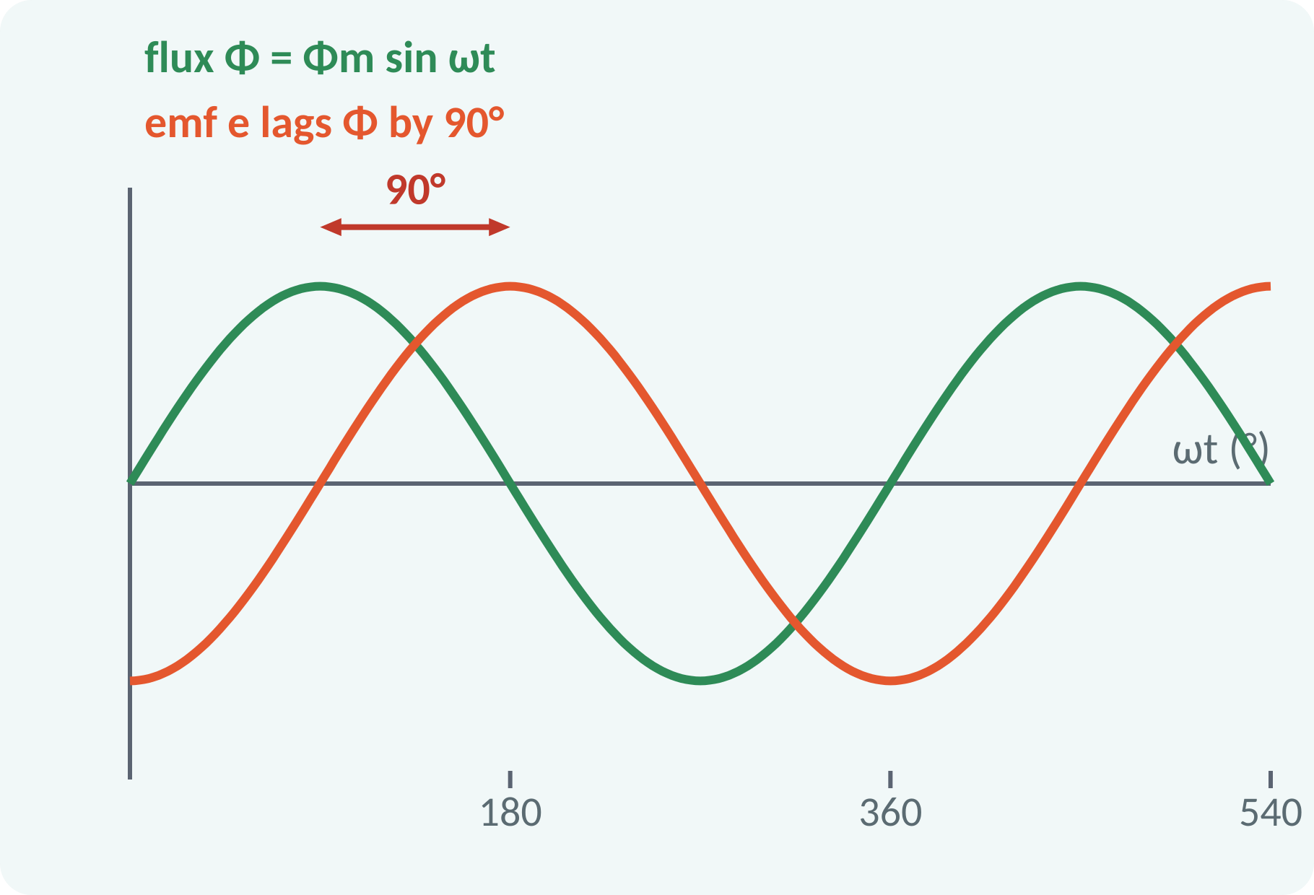
Recap: What You Already Know
Faraday: e = −N·dΦ/dt.
Changing flux induces EMF in a coil.
Sinusoidal flux gives sinusoidal EMF.
Mutual induction: flux linking two coils.
e = −N·dΦ/dt; RMS = peak/√2
Notes:
Faraday's law says that the EMF induced in a coil equals the number of turns times the rate of change of flux. For a sinusoidal flux the EMF is sinusoidal and lags the flux by ninety degrees. If two coils share the same changing flux, an EMF appears in each one. That is mutual induction, and it is the principle of the transformer.

Slide 4
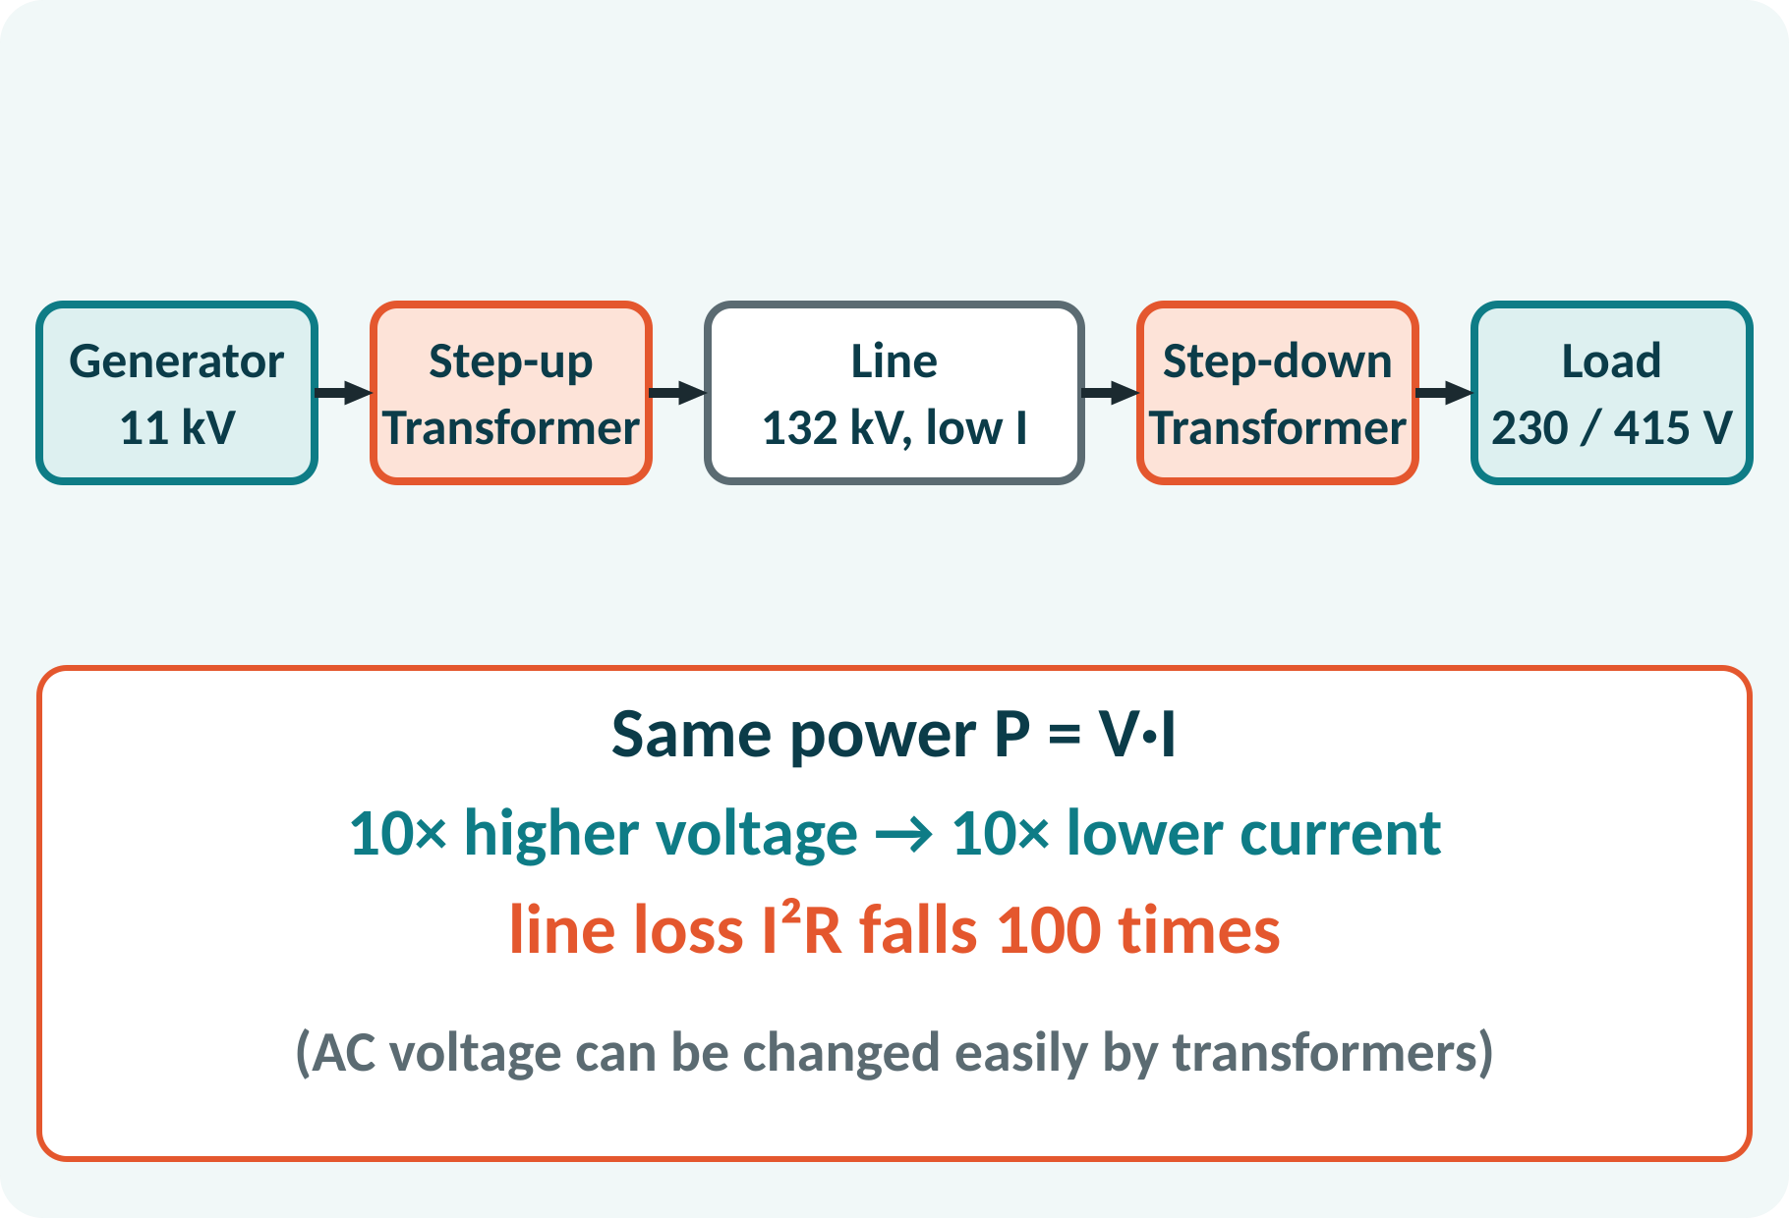
Motivation: The Phone Charger to the Power Grid
Charger: 230 V AC → 5 V.
Generators produce about 11 kV.
Transmission at 132 kV and above.
Distribution at 11 kV, then 415/230 V.
Transformers connect all the voltage levels of the grid
Notes:
Every power chain has several transformers: a step-up near the generator, step-down transformers near the load, and a tiny one inside the phone charger. They allow each part of the system to work at the most suitable voltage. Without transformers, long-distance AC transmission would be impractical.

Slide 5
Necessity of Transformers
Power P = V·I stays the same.
Higher voltage means lower current.
Line loss is I²R: it falls sharply.
Smaller conductors, higher efficiency.
Safe voltage at the consumer end.
Ploss = I²R = (P/V)²R → 10× voltage gives 1/100 loss
Notes:
For a given power the current is inversely proportional to the voltage. Since the loss in the line is I squared R, raising the voltage ten times reduces the loss to one hundredth. This is why transmission uses very high voltage. At the consumer end the voltage must be reduced again to a safe level. Only a transformer can do this efficiently for AC.

Slide 6
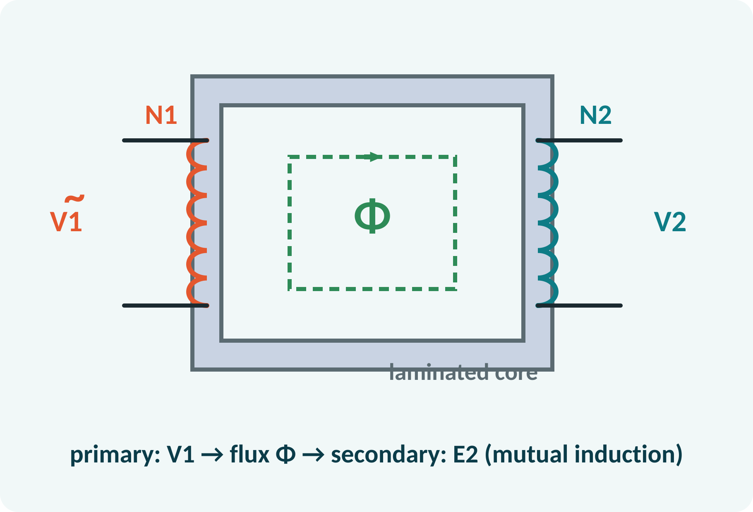
Principle of Operation
Primary winding connected to AC supply.
Alternating flux Φ forms in the core.
Flux links the secondary winding.
Mutual induction produces EMF E2.
Frequency stays the same; no moving parts.
E1 = −N1·dΦ/dt, E2 = −N2·dΦ/dt → E2/E1 = N2/N1
Notes:
The primary winding carries an alternating current that sets up an alternating flux in the iron core. Almost all the flux passes through the secondary winding and induces an EMF there by mutual induction. Because the same flux links both windings, the ratio of the induced voltages equals the ratio of the numbers of turns. The frequency is unchanged and there are no moving parts.

Slide 7
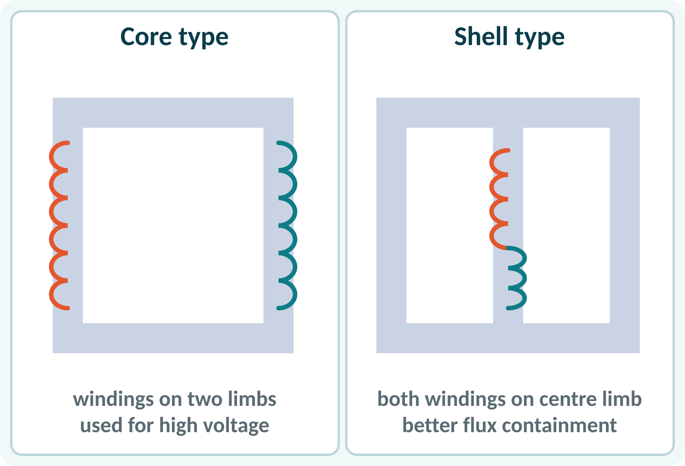
Types and Construction
Core type: windings surround the core limbs.
Shell type: core surrounds the windings.
Core of thin silicon-steel laminations.
Windings: insulated copper or aluminium.
Oil or air cooling.
Laminations (0.3–0.5 mm) cut eddy-current loss; silicon steel cuts hysteresis loss
Notes:
In the core-type transformer the windings are placed on two limbs of a rectangular core. In the shell type both windings are on the central limb of a three-limbed core, which gives a better magnetic path. The core is built from thin insulated laminations of silicon steel to reduce losses. Large transformers are immersed in oil for insulation and cooling.

Slide 8
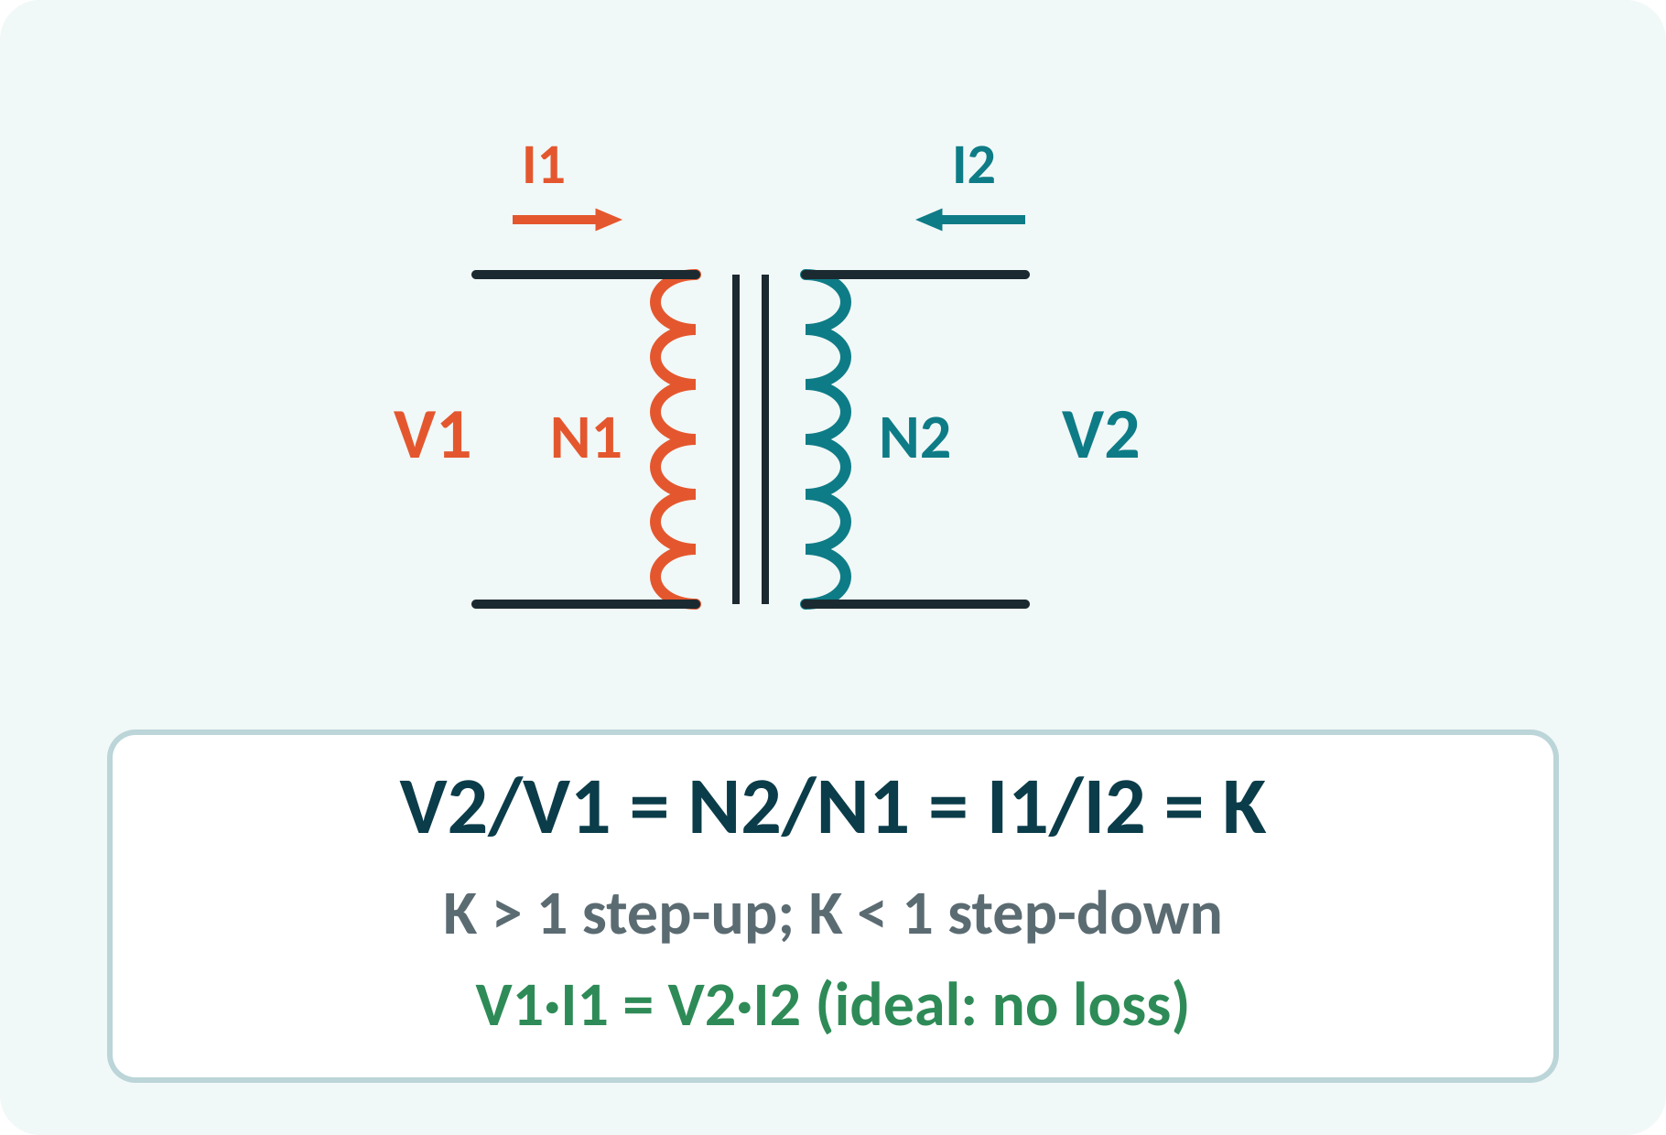
Ideal Transformer and Turns Ratio
No winding resistance, no leakage.
Core has zero loss and infinite permeability.
Voltage ratio equals turns ratio.
Current ratio is the inverse.
Input power equals output power.
V2/V1 = N2/N1 = I1/I2 = K; V1I1 = V2I2
K transformation ratio
Notes:
Start with the ideal transformer to understand the relations. The voltage ratio equals the turns ratio K. Since an ideal transformer has no loss, input volt-amperes equal output volt-amperes, so the current ratio is the inverse of the turns ratio. If K is greater than one the transformer steps the voltage up, otherwise it steps it down.

Slide 9
EMF Equation
Flux Φ = Φm sin ωt in the core.
Induced EMF = N·dΦ/dt, peak ωNΦm.
RMS value = peak/√2.
Substitute ω = 2πf.
Φm = Bm × A.
E = 4.44·f·N·Φm = 4.44·f·N·Bm·A (V)
f Hz, N turns, Φm Wb, Bm T, A m²
Notes:
The flux varies sinusoidally with peak value Φm. Differentiating gives an EMF of peak omega N Φm. Dividing by root two for the RMS value and putting omega equal to two pi f gives 4.44 f N Φm. The same expression holds for both primary and secondary windings, each with its own N. This equation is used to calculate the turns or flux for a given voltage.

Slide 10
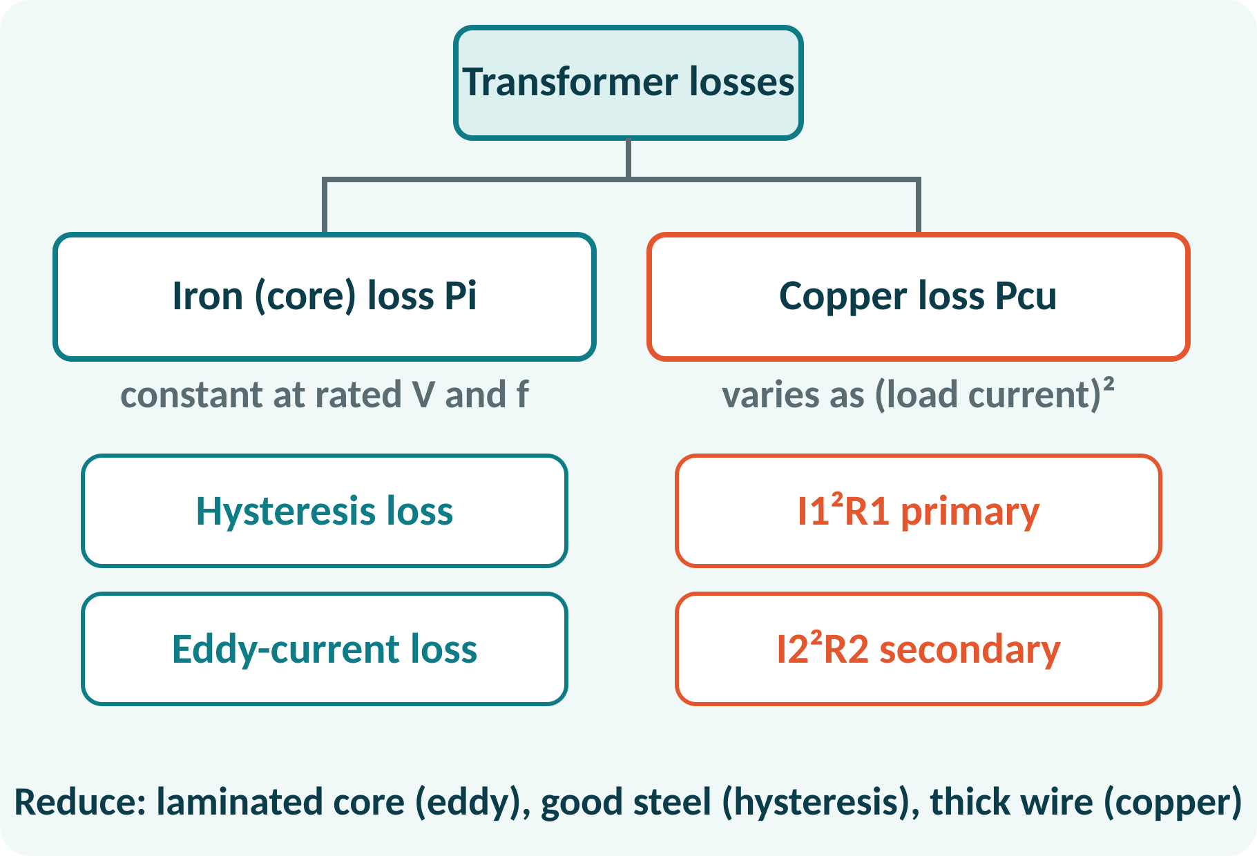
Losses in a Transformer
Iron loss: hysteresis plus eddy current.
Constant at rated voltage and frequency.
Copper loss: I²R in the windings.
Varies as the square of the load current.
No rotating parts: no friction loss.
Total loss = Pi + x²·Pcu,fl (x = load fraction)
Notes:
A transformer has two types of loss. The iron loss in the core depends on voltage and frequency, not on the load, so it is constant. The copper loss in the windings depends on the current and varies as the square of the load. These two determine the efficiency. Because there are no moving parts, a transformer is very efficient, typically above 95 per cent.

Slide 11
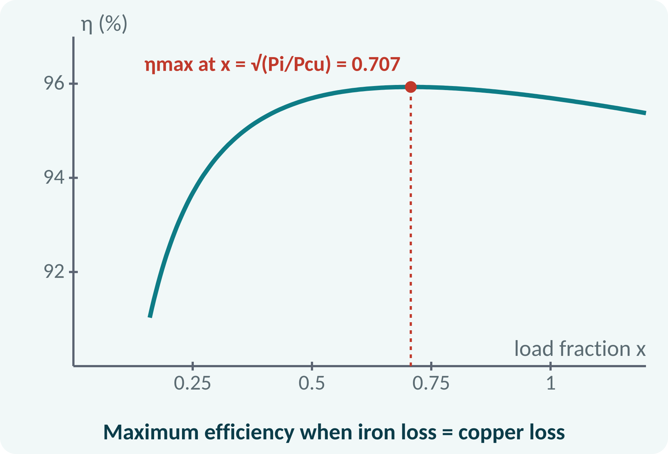
Efficiency
Efficiency = output power / input power.
Output = x·S·cos φ.
Maximum efficiency: iron loss = copper loss.
Load fraction at ηmax: x = √(Pi/Pcu,fl).
Power transformers: designed for ηmax near full load.
η = x·S·cos φ / (x·S·cos φ + Pi + x²·Pcu,fl); ηmax at x = √(Pi/Pcu,fl)
Notes:
Efficiency is the ratio of output to input power, and the input equals the output plus the losses. As the load increases, the output rises faster than the losses at first, then the copper loss takes over. The maximum occurs when the variable copper loss equals the constant iron loss. Distribution transformers that are lightly loaded most of the day are designed with a low iron loss.

Slide 12
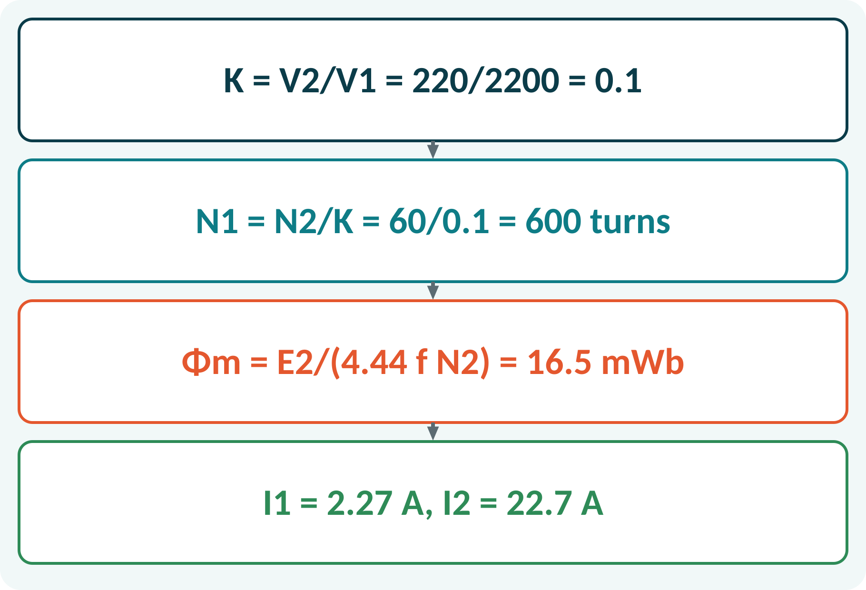
Solved Example 1: Turns and Flux
A 5 kVA, 2200/220 V, 50 Hz transformer has 60 secondary turns. Find N1, Φm, I1 and I2.
1. K = 220/2200 = 0.1.
2. N1 = N2/K = 600 turns.
3. Φm = E2/(4.44·f·N2) = 220/(4.44 × 50 × 60) = 16.5 mWb.
4. I1 = 5000/2200 = 2.27 A.
5. I2 = 5000/220 = 22.7 A.
Answer: N1 = 600, Φm = 16.5 mWb, I1 = 2.27 A, I2 = 22.7 A
Notes:
The turns ratio is the voltage ratio, so the primary has ten times more turns. The flux follows from the EMF equation applied to the secondary. Rated currents are the kVA rating divided by the respective voltages. Check that the currents are in the inverse ratio of the voltages: 22.7 over 2.27 is ten.

Slide 13
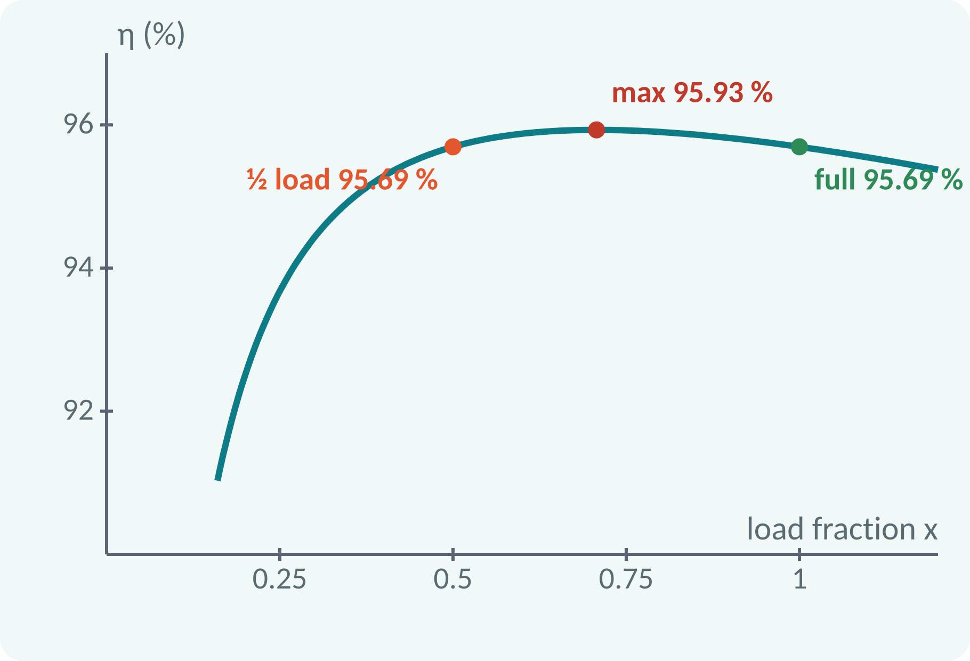
Solved Example 2: Efficiency
A 25 kVA transformer has iron loss 300 W and full-load copper loss 600 W. For pf 0.8 find η at full load, half load and maximum.
1. Full load: output 20 kW; losses 0.9 kW; η = 20/20.9 = 95.69 %.
2. Half load: output 10 kW; Pcu = 150 W; η = 10/10.45 = 95.69 %.
3. x for ηmax = √(300/600) = 0.707.
4. At x = 0.707: output 14.14 kW, losses 0.6 kW, η = 95.93 %.
Answer: 95.69 % (full), 95.69 % (half), ηmax = 95.93 % at 70.7 % load
Notes:
Efficiency is calculated from output over output plus losses. At full load the copper loss is its rated value, at half load it falls to one quarter. For the maximum efficiency we find the load fraction at which the copper loss equals the iron loss, which is the square root of the loss ratio. Notice that the efficiency curve is very flat near the maximum.

Slide 14
Common Mistakes and Exam Tips
✕
Common mistakes
✓
Exam tips
Using the primary turns for E2 in 4.44fNΦm.
Mixing kVA with kW.
Taking copper loss as constant.
Forgetting x² in the copper loss at partial load.
Applying a DC supply to a transformer.
Use E = 4.44 f N Φm with the right N.
Output power = kVA × pf.
Iron loss: fixed; copper loss: x²·Pcu.
Check that V·I is the same on both sides.
Notes:
These are the points where marks are lost most often in transformers. Give one quick example for each mistake. Remind students that writing the formula, substitution and the unit earns method marks even if the arithmetic slips. Encourage them to check the answer for reasonableness.

Slide 15
Summary
Transformers change AC voltage with the same frequency.
Principle: mutual induction in a laminated core.
V2/V1 = N2/N1 = I1/I2.
E = 4.44·f·N·Φm.
ηmax when iron loss = copper loss.
E = 4.44 f N Φm; η = output/(output + Pi + x²Pcu)
Notes:
Recap in one minute. Say each point and ask the class to recall the formula for it. If they remember these ideas, most numerical problems on transformers are within reach. Next lecture: DC motor: principle, back EMF, torque and speed control. Revise the two solved examples tonight.

Slide 16
Quick Quiz
Q1. A transformer works on:
(a) self induction (b) mutual induction (c) static friction (d) DC supply
Ans: (b)
Q2. N1 = 500, N2 = 100, V1 = 230 V gives V2 =
(a) 46 V (b) 1150 V (c) 23 V (d) 100 V
Ans: (a)
Q3. Eddy-current loss is reduced by:
(a) thick core (b) laminations (c) air gap (d) more turns
Ans: (b)
Q4. Maximum efficiency occurs when:
(a) Pi = Pcu (b) Pi = 0 (c) Pcu = 0 (d) no load
Ans: (a)
Q5. Core loss is:
(a) load dependent (b) constant (c) zero (d) ∝ I²
Ans: (b)
Notes:
Give about one minute per question and take a show of hands. Discuss why the wrong options are tempting, especially the one that uses a wrong formula. Use the quiz as a quick check on transformers before leaving.

Slide 17
References
1
Hughes Edward, Electrical Technology
10th Ed., Pearson Education, 2010 (Units 1, 2 textbook)
2
H. Cotton, Electrical Technology
7th Ed., CBS Publishers, 2005 (reference)
Next lecture: DC motor
Notes:
Point students to the textbooks listed in the syllabus for transformers. Ask them to solve at least three textbook problems on this topic before the next class. Thank the class and preview the next lecture.

