Slide 1
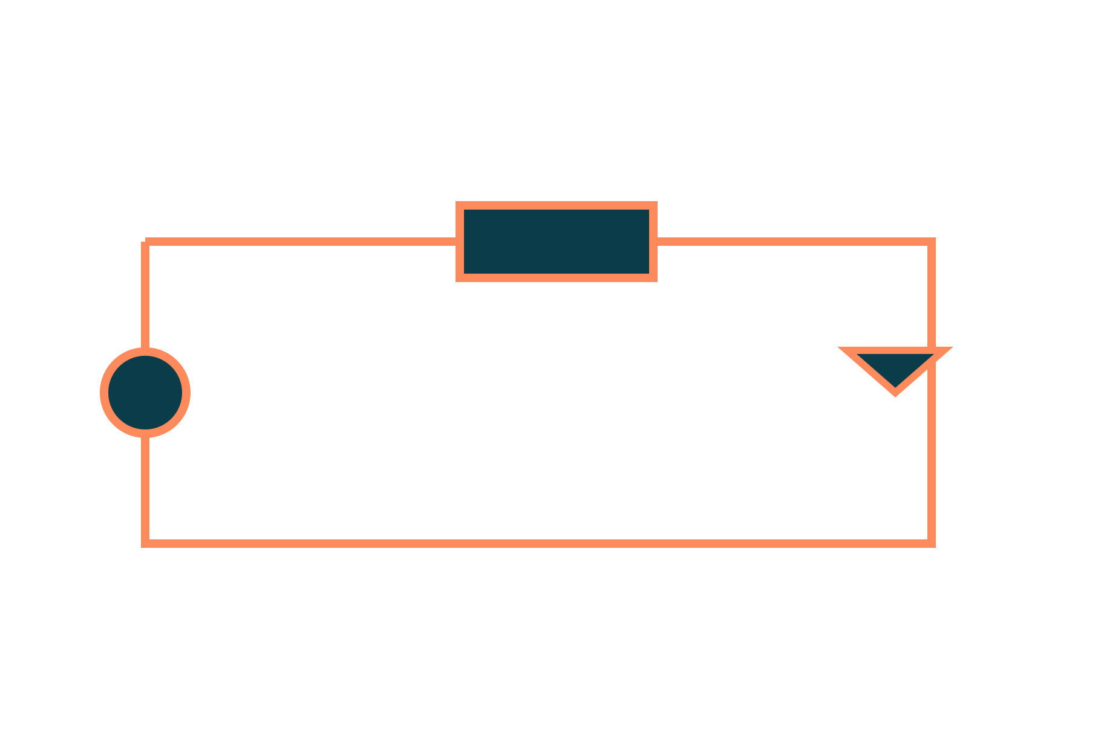
DC Motor
Basic Electrical and Electronics Engineering
Unit 2: Transformers and Electrical Machines
Topic: Principle, back EMF, torque equation, characteristics and speed control of DC shunt motor
Prof. Mitesh Astik
Notes:
Welcome everyone. Today's topic is Principle, back EMF, torque equation, characteristics and speed control of DC shunt motor. It belongs to Unit 2: Transformers and Electrical Machines. By the end of this session you will be able to use it in numerical problems. Keep your notebooks ready because we will solve two examples.

Slide 2

Learning Outcomes
Explain the principle and parts of a DC motor.
State the significance of back EMF.
Use the torque equation and characteristics.
Control the speed of a shunt motor.
Linked to CO2
Describe construction and operating principle of DC motors.
Notes:
Read the outcomes aloud. They map to CO2 of the syllabus. Tell students that these are examinable and that the two solved examples follow the same pattern. Ask them to tick off each outcome at the end of the lecture.

Slide 3
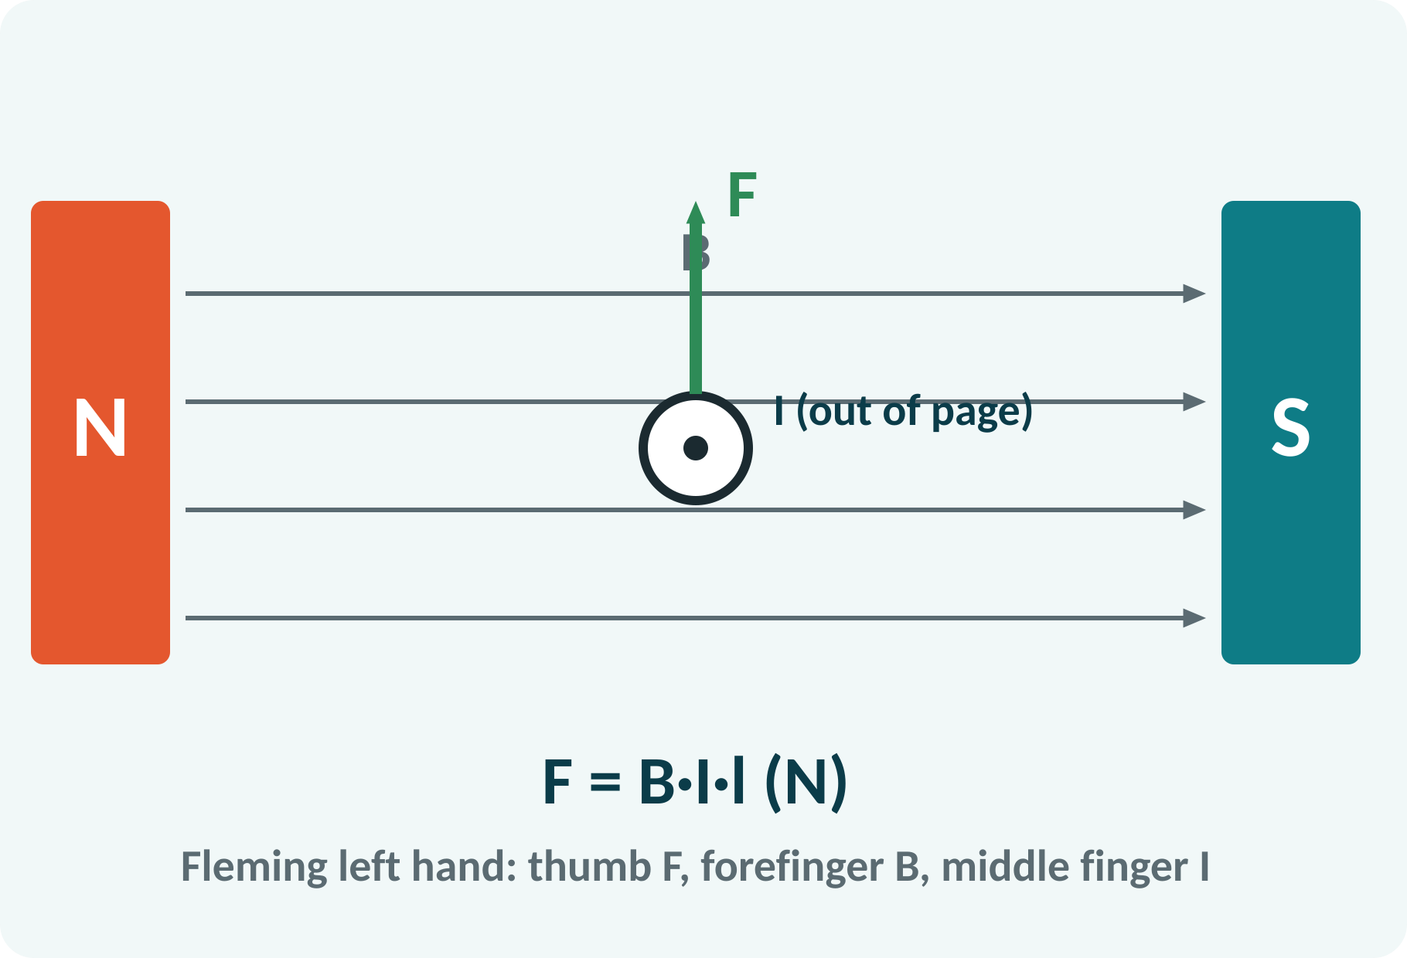
Recap: What You Already Know
Magnetic field B around a magnet.
Force on a current-carrying conductor.
Fleming's left-hand rule gives direction.
Faraday: moving conductor in a field induces EMF.
F = B·I·l (N); e = B·l·v (V)
B tesla, I ampere, l metre
Notes:
A conductor carrying current in a magnetic field experiences a force. Its direction is given by Fleming's left-hand rule, with the thumb for force, the forefinger for field and the middle finger for current. The same conductor, when moving in a field, also has an EMF induced in it. Both facts are used in the motor.

Slide 4
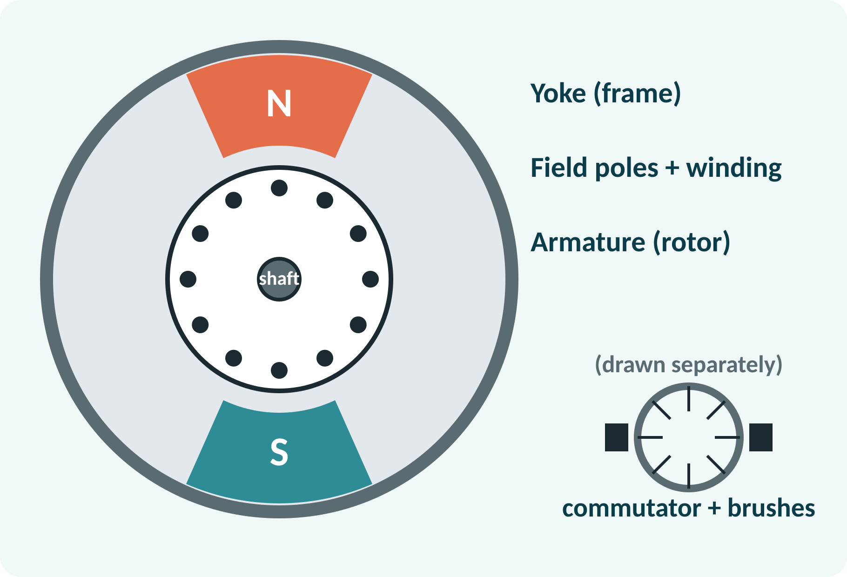
Motivation: Where DC Motors Are Used
Electric vehicles and trains.
Cranes, lifts, rolling mills.
Fans, toys, robotics, wipers.
Easy and wide speed control.
DC motor: converts electrical power into mechanical power
Notes:
DC motors are used wherever precise and wide-range speed control is needed, such as in electric traction, cranes and rolling mills. Small permanent-magnet DC motors drive toys, wipers and robots. Today we study the shunt type, in which the field winding is connected in parallel with the armature.

Slide 5
Construction of a DC Motor
Yoke: outer frame; carries flux.
Field poles with field winding.
Armature: laminated core with slots.
Commutator: copper segments on the shaft.
Brushes: carbon, supply current to armature.
Main parts: stator (yoke + poles), rotor (armature + commutator), brushes
Notes:
The stator consists of the yoke and the field poles carrying the field winding. The rotor is the armature, a laminated cylinder with slots that hold the armature conductors. The commutator is a ring of copper segments connected to the armature coils and the carbon brushes press against it. The commutator reverses the current in each coil as it passes the neutral axis, so that the torque stays in one direction.

Slide 6
Principle of Operation
Armature conductors carry current in the field.
Each conductor feels a force F = B·I·l.
Forces on the two sides form a couple.
The couple rotates the armature.
Commutator keeps the torque unidirectional.
F = B·I·l; Torque T = F × r (N·m)
Notes:
When the supply is connected, current flows in the armature conductors which lie in the field of the main poles. Each conductor experiences a force, and the forces on the two sides of a coil produce a turning moment. As the coil turns, the commutator reverses the current so the force on each side stays in the same direction. The result is continuous rotation.

Slide 7
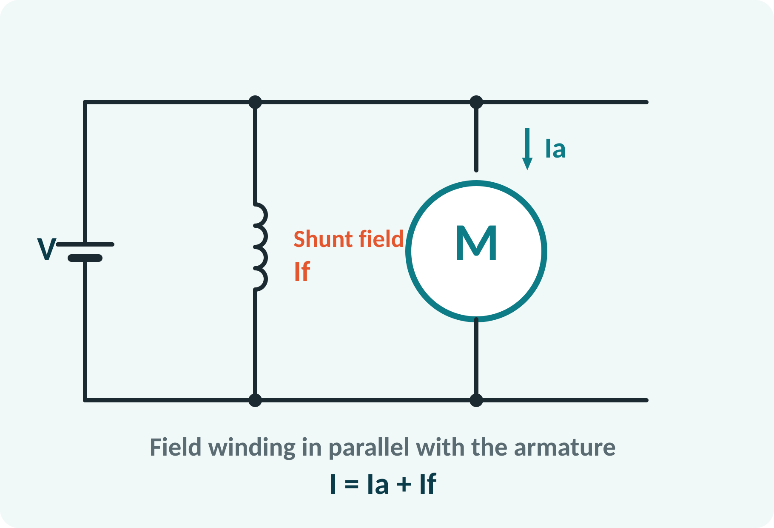
DC Shunt Motor Circuit
Field winding connected across the supply.
Field current If is nearly constant.
Flux Φ is therefore constant.
Armature draws Ia from the supply.
Line current I = Ia + If.
I = Ia + If; If = V/Rsh
Notes:
In a shunt motor the field winding has many turns of thin wire and is connected in parallel with the armature across the supply voltage. The field current is small and stays practically constant, so the flux is constant. The armature current changes with the load. The line current is the sum of the two.

Slide 8
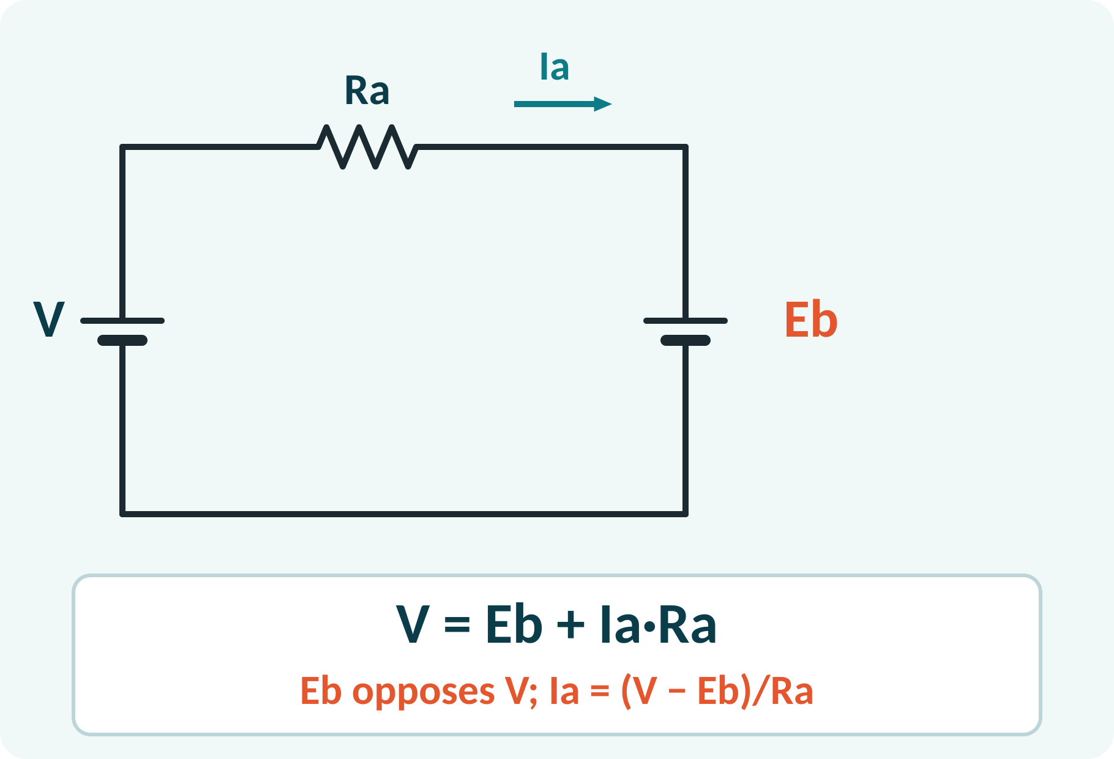
Back EMF and Its Significance
Rotating conductors cut the field: EMF induced.
This EMF opposes the supply: back EMF Eb.
Ia = (V − Eb)/Ra.
At start Eb = 0: very large current.
Eb adjusts the current to the load: self-regulation.
Eb = V − Ia·Ra = (P·Φ·Z·N)/(60·A); Pm = Eb·Ia
N speed rpm, Z conductors, P poles, A parallel paths
Notes:
The armature is a conductor moving in a magnetic field, so an EMF is induced in it which opposes the supply voltage, hence the name back EMF. The net voltage across the armature resistance is V minus Eb, so it controls the current. At standstill the back EMF is zero and the current can be very large, so a starter resistance is needed. When load increases, the speed falls slightly, Eb falls and more current flows: this is the self-regulating property.

Slide 9
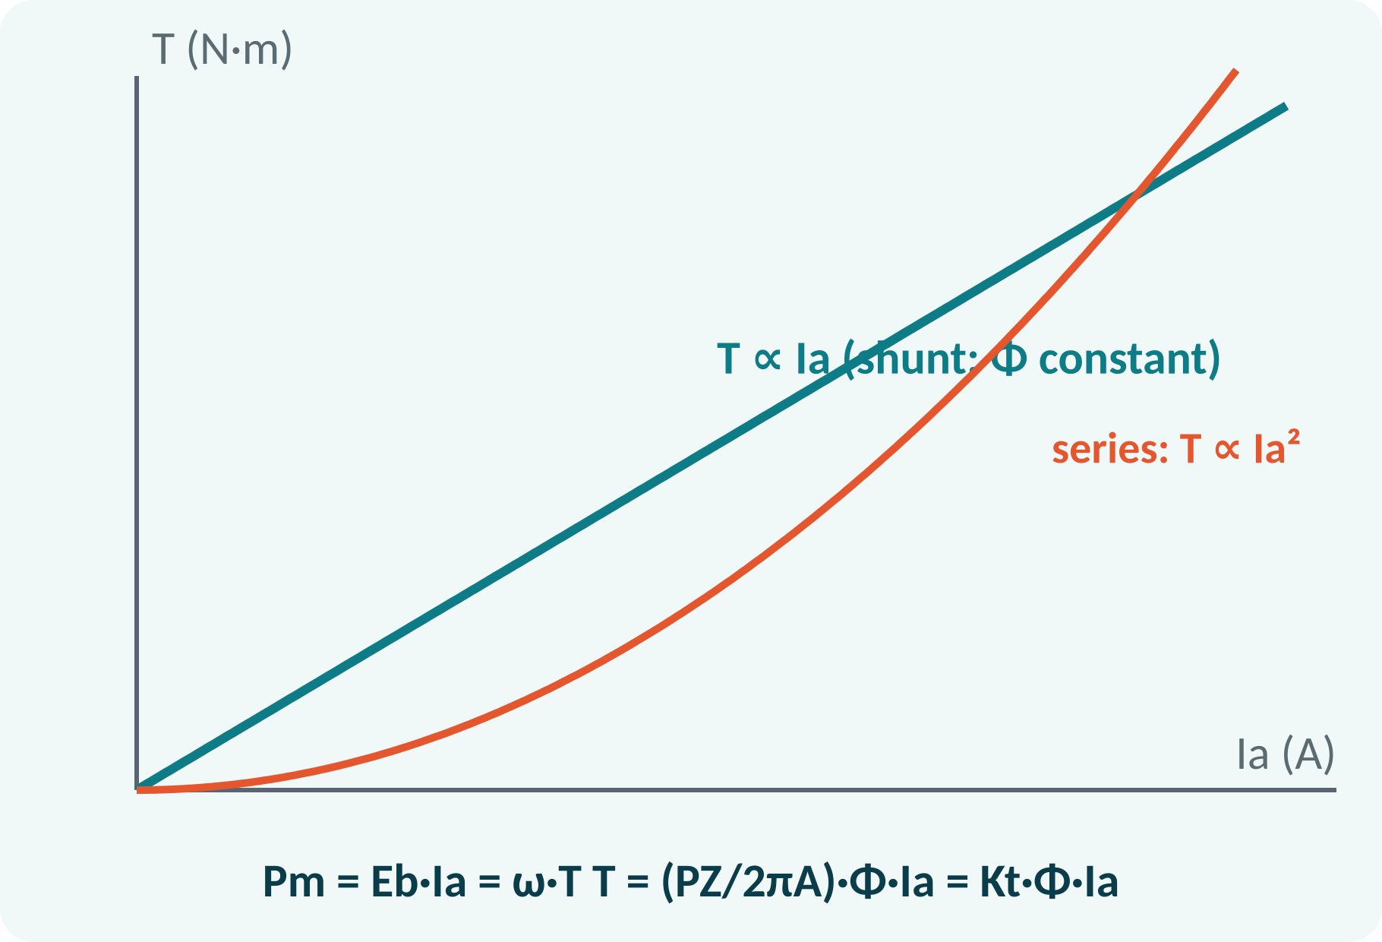
Torque Equation
Torque comes from flux × armature current.
Shunt motor: Φ constant, T ∝ Ia.
Series motor: Φ ∝ Ia, T ∝ Ia².
Mechanical power = Eb·Ia = ω·T.
T = (P·Z/2πA)·Φ·Ia = Kt·Φ·Ia (N·m); Pm = Eb·Ia = 2πN·T/60
Φ weber, Ia ampere
Notes:
The torque developed depends on the flux per pole and on the armature current. For the shunt motor the flux is constant, so the torque is proportional to the armature current. The electrical power converted into mechanical power is the back EMF times the armature current, which also equals torque times angular speed. Use this to find torque from power and speed.

Slide 10
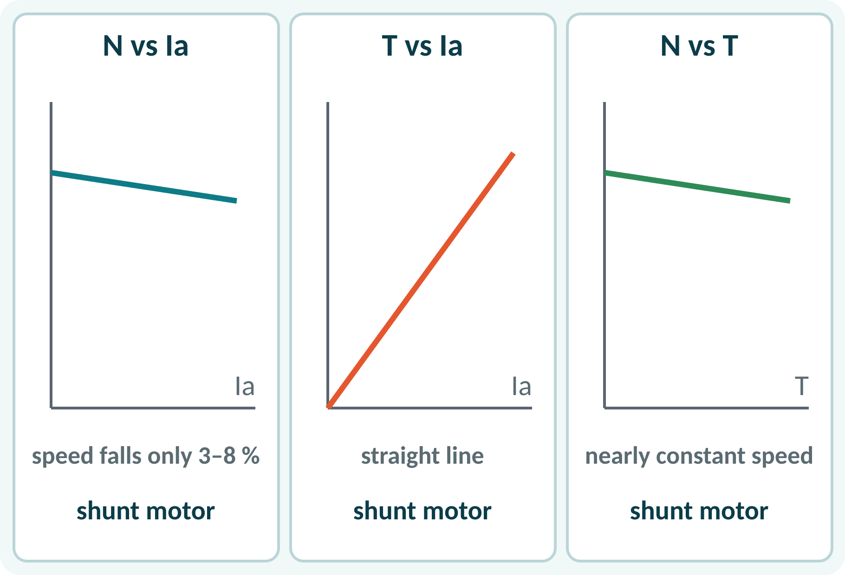
Characteristics of a Shunt Motor
Speed falls only slightly with load.
Torque rises linearly with armature current.
Practically constant-speed motor.
Never run without field: speed runs away.
N ∝ Eb/Φ; T ∝ Ia (Φ constant)
Notes:
Because the flux is constant and the armature resistance drop is small, the speed of a shunt motor falls only a few per cent from no load to full load. The torque is proportional to the armature current. This near-constant speed makes it suitable for lathes, fans, and pumps. If the field circuit opens, the flux nearly vanishes and the speed can rise dangerously.

Slide 11
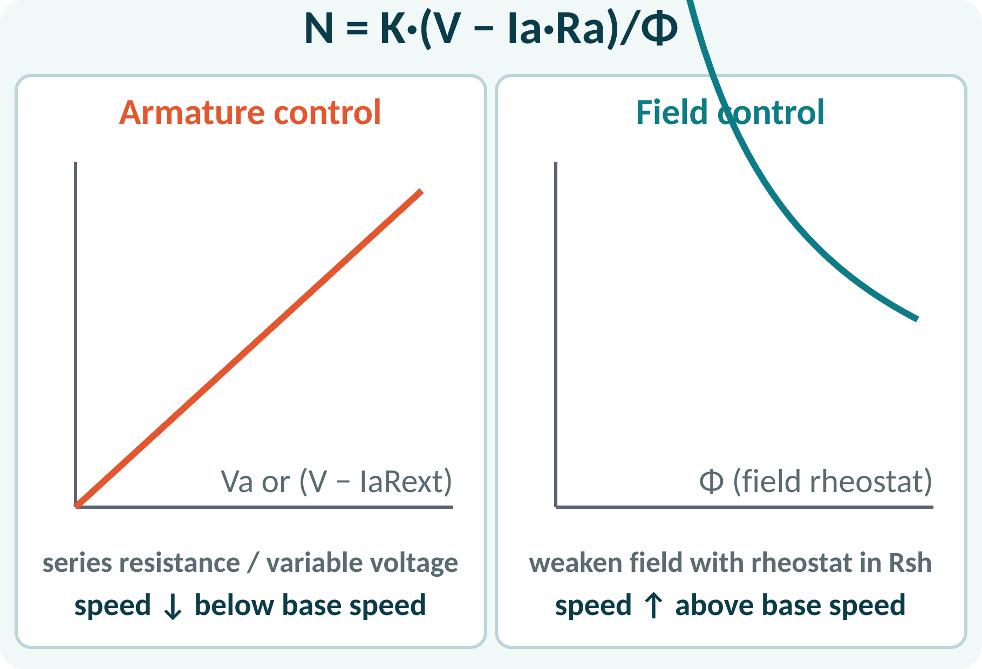
Speed Control of a Shunt Motor
Speed N ∝ (V − IaRa)/Φ.
Armature control: vary voltage or add series R.
Field control: weaken Φ with a field rheostat.
Armature control gives speeds below base.
Field control gives speeds above base.
N = K (V − Ia·Ra)/Φ; N2/N1 = (Eb2/Eb1)·(Φ1/Φ2)
K machine constant
Notes:
From the back EMF equation, speed is proportional to the armature voltage drop divided by flux. We can change the voltage applied to the armature, usually with a series resistance, which lowers the speed below the base value. Or we can weaken the field with a rheostat in series with the field winding, which raises the speed above the base value. Field control is more efficient, since the field current is small.

Slide 12
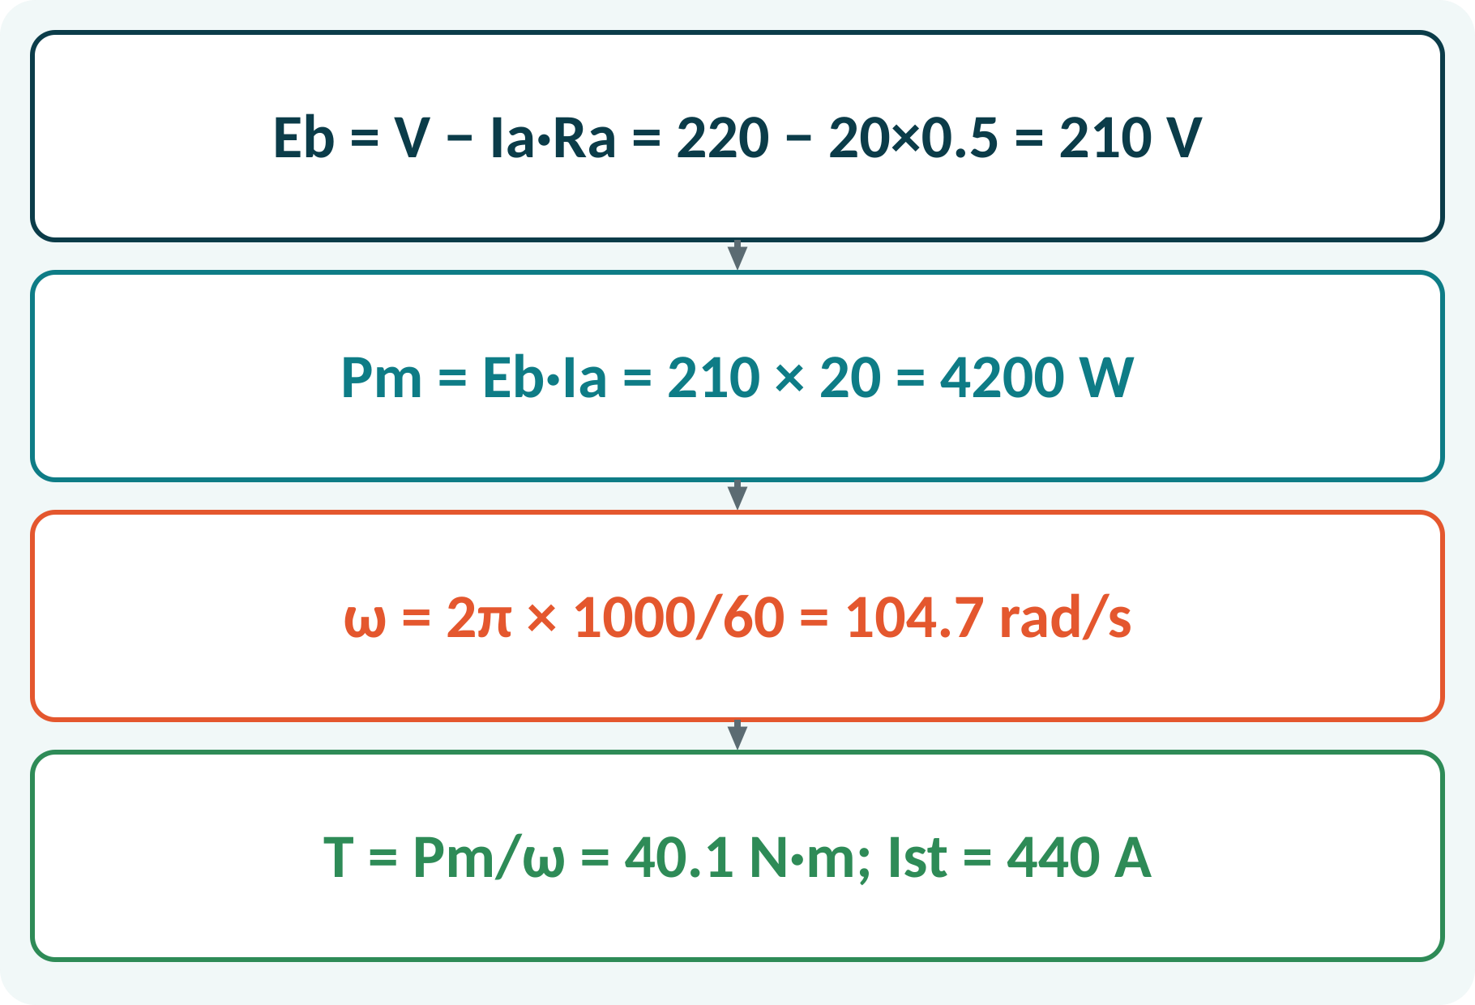
Solved Example 1: Torque and Starting
A 220 V shunt motor, Ra = 0.5 Ω, runs at 1000 rpm taking Ia = 20 A. Find Eb, Pm, T and starting current without starter.
1. Eb = 220 − 20 × 0.5 = 210 V.
2. Pm = Eb·Ia = 4200 W.
3. ω = 2π × 1000/60 = 104.7 rad/s.
4. T = 4200/104.7 = 40.1 N·m.
5. Starting current = V/Ra = 220/0.5 = 440 A (22 × rated).
Answer: Eb = 210 V, Pm = 4.2 kW, T = 40.1 N·m, Ist = 440 A without a starter
Notes:
Subtract the armature resistance drop from the supply to get the back EMF. The electrical power converted to mechanical power is Eb times Ia, and dividing by the angular speed gives the torque. Finally note that at standstill the back EMF is zero, so the current would be 440 amperes, twenty-two times the rated value. That is why a starter is essential.

Slide 13
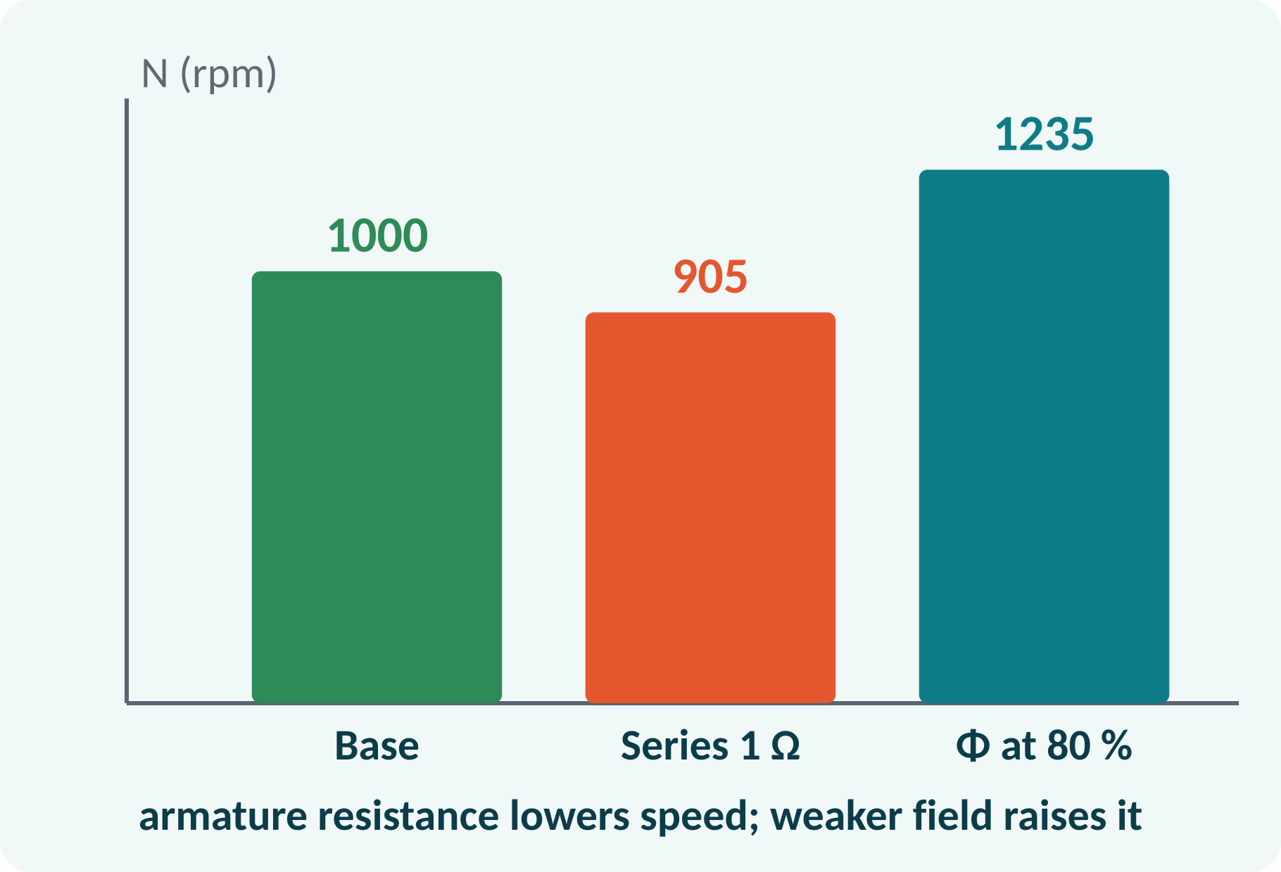
Solved Example 2: Speed Control
For the same motor with constant load torque, find the speed (a) with a 1 Ω resistance added in series with the armature, (b) with the field weakened to 80 %.
(a) Ia = 20 A: Eb = 220 − 20 × 1.5 = 190 V; N = 1000 × 190/210 = 905 rpm.
(b) T ∝ Φ·Ia: Ia = 20/0.8 = 25 A; Eb = 220 − 25 × 0.5 = 207.5 V.
N = 1000 × (207.5/210) × (1/0.8) = 1235 rpm.
Answer: (a) 905 rpm, (b) 1235 rpm
Notes:
In the first case the load torque and flux are unchanged, so the armature current stays at 20 amperes, but the extra resistor lowers the back EMF and therefore the speed. In the second case a weaker field needs a higher armature current to give the same torque. Then use the ratio of back EMFs and the inverse ratio of fluxes. Field weakening raises speed above the base value.

Slide 14
Common Mistakes and Exam Tips
✕
Common mistakes
✓
Exam tips
Using V instead of Eb in P = Eb·Ia.
Forgetting that Eb = 0 at start.
Saying T ∝ Ia for a series motor.
Opening the shunt field of a running motor.
Mixing rpm with rad/s in T = P/ω.
Compute Eb = V − IaRa first.
Convert N to ω = 2πN/60.
Use ratios for speed-change problems.
Remember: field control raises speed.
Notes:
These are the points where marks are lost most often in DC motors. Give one quick example for each mistake. Remind students that writing the formula, substitution and the unit earns method marks even if the arithmetic slips. Encourage them to check the answer for reasonableness.

Slide 15
Summary
Motor action: force on a current-carrying conductor in a field.
Back EMF: Eb = V − Ia·Ra opposes the supply.
T = Kt·Φ·Ia; Pm = Eb·Ia.
Shunt motor: nearly constant speed.
Speed control: armature voltage (below), field flux (above).
N ∝ (V − IaRa)/Φ; T ∝ Φ·Ia
Notes:
Recap in one minute. Say each point and ask the class to recall the formula for it. If they remember these ideas, most numerical problems on DC motors are within reach. Next lecture: three-phase induction motor. Revise the two solved examples tonight.

Slide 16
Quick Quiz
Q1. At the instant of starting, back EMF is:
(a) maximum (b) zero (c) equal to V (d) half of V
Ans: (b)
Q2. Torque of a shunt motor is proportional to:
(a) Ia² (b) Ia (c) 1/Ia (d) N
Ans: (b)
Q3. Field control gives speeds:
(a) below base (b) above base (c) zero (d) negative
Ans: (b)
Q4. V = 200 V, Ia = 10 A, Ra = 1 Ω gives Eb =
(a) 210 V (b) 190 V (c) 200 V (d) 10 V
Ans: (b)
Q5. The commutator in a motor:
(a) cools the machine (b) keeps torque unidirectional (c) increases flux (d) is a brake
Ans: (b)
Notes:
Give about one minute per question and take a show of hands. Discuss why the wrong options are tempting, especially the one that uses a wrong formula. Use the quiz as a quick check on DC motors before leaving.

Slide 17
References
1
Hughes Edward, Electrical Technology
10th Ed., Pearson Education, 2010 (Units 1, 2 textbook)
2
H. Cotton, Electrical Technology
7th Ed., CBS Publishers, 2005 (reference)
Next lecture: three-phase induction motor
Notes:
Point students to the textbooks listed in the syllabus for DC motors. Ask them to solve at least three textbook problems on this topic before the next class. Thank the class and preview the next lecture.

