Slide 1
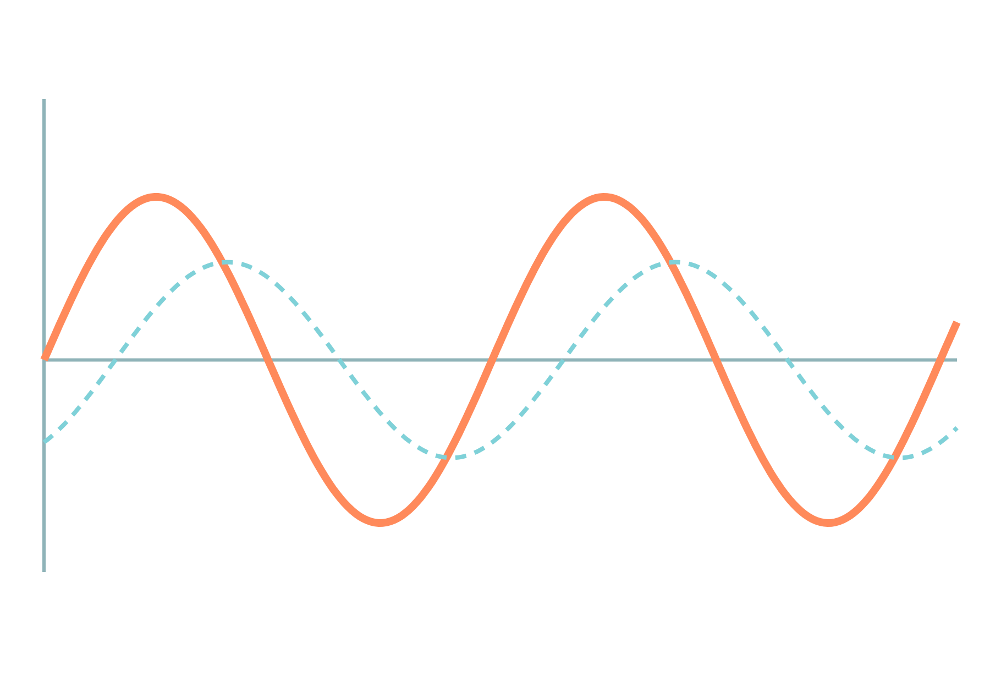
Three-Phase Induction Motor
Basic Electrical and Electronics Engineering
Unit 2: Transformers and Electrical Machines
Topic: Rotating magnetic field, principle, construction, squirrel-cage and wound-rotor types
Prof. Mitesh Astik
Notes:
Welcome everyone. Today's topic is Rotating magnetic field, principle, construction, squirrel-cage and wound-rotor types. It belongs to Unit 2: Transformers and Electrical Machines. By the end of this session you will be able to use it in numerical problems. Keep your notebooks ready because we will solve two examples.

Slide 2

Learning Outcomes
Explain the rotating magnetic field.
Describe the working principle and slip.
Name the parts of an induction motor.
Compare squirrel-cage and wound-rotor types.
Linked to CO2
Describe construction and operating principle of induction motors.
Notes:
Read the outcomes aloud. They map to CO2 of the syllabus. Tell students that these are examinable and that the two solved examples follow the same pattern. Ask them to tick off each outcome at the end of the lecture.

Slide 3
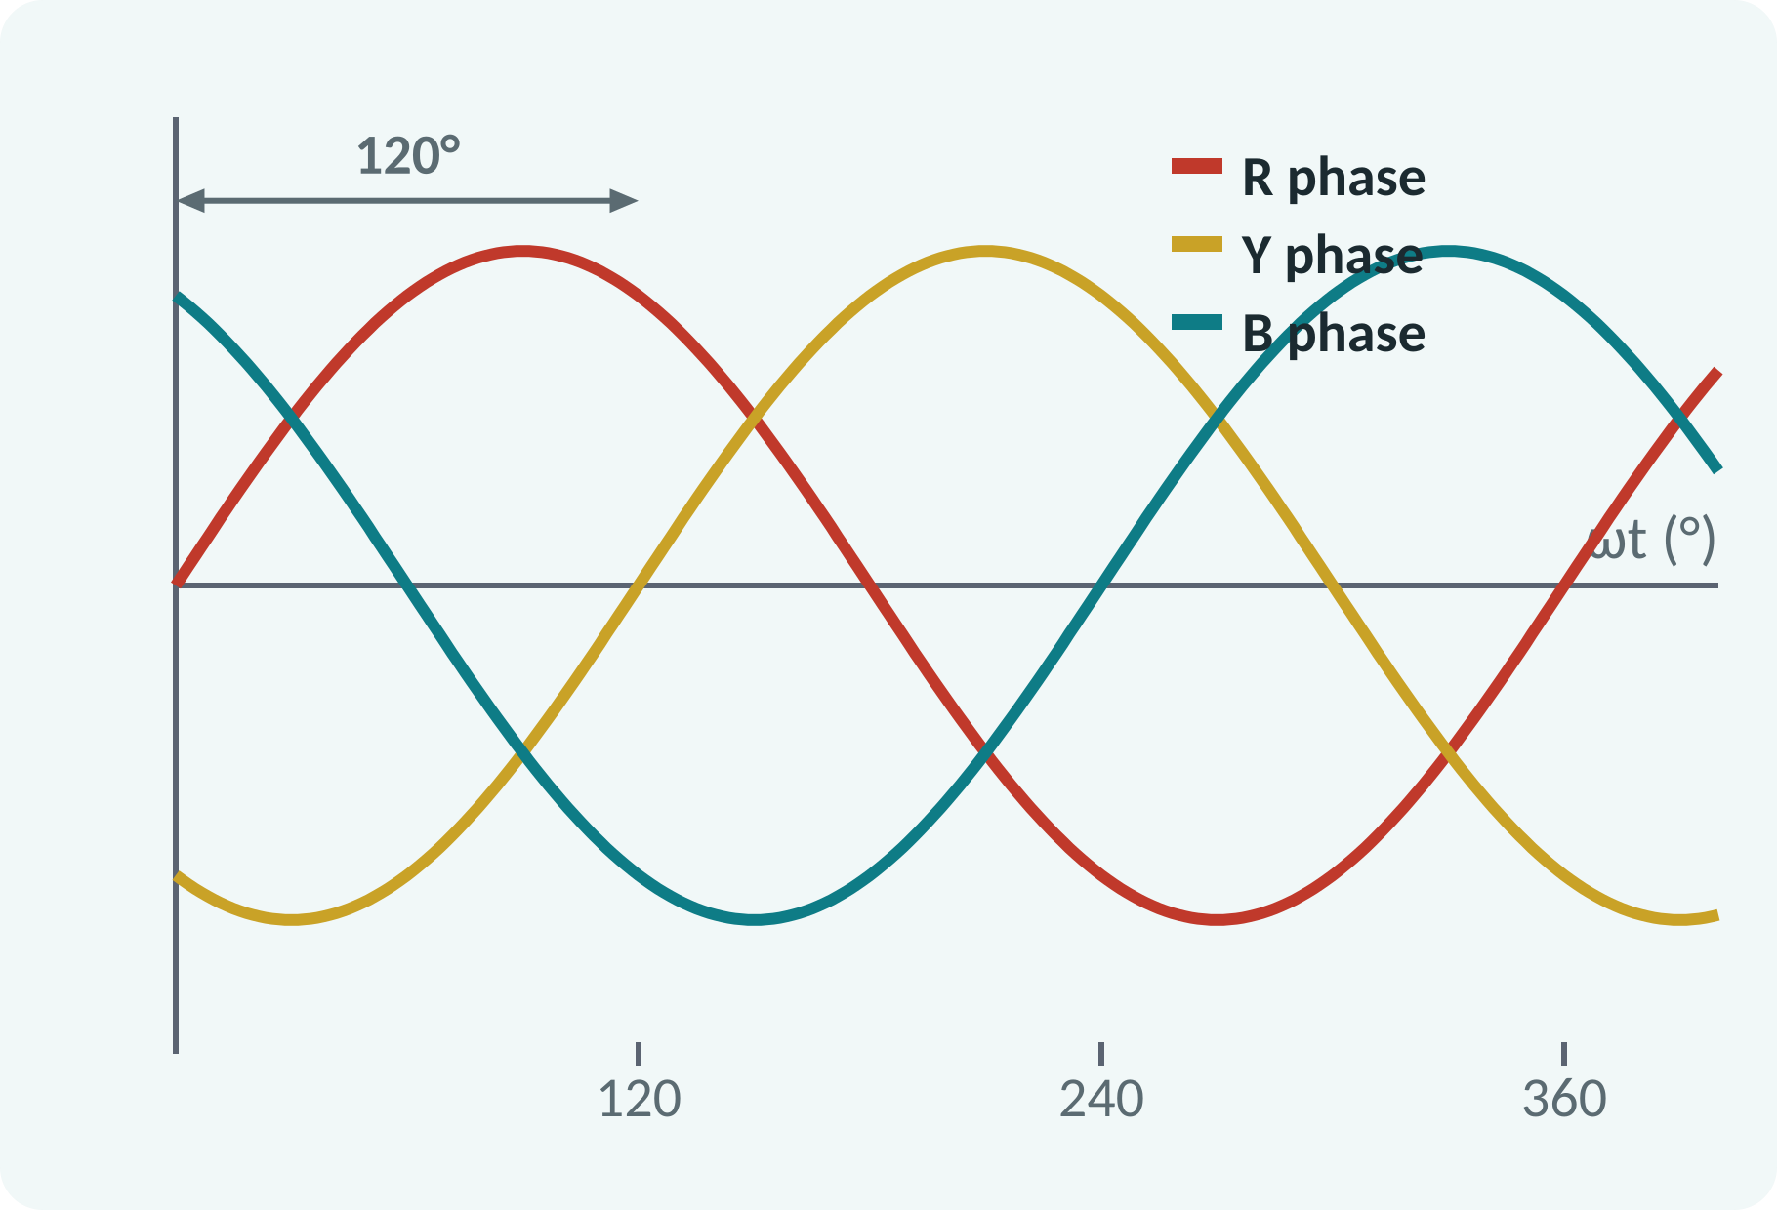
Recap: What You Already Know
Three-phase supply: three voltages 120° apart.
Faraday: moving field induces EMF.
Lenz: induced current opposes the cause.
Force on a current-carrying conductor.
VL = √3·Vph (star); phase sequence R–Y–B
Notes:
The three-phase supply has three voltages of equal magnitude displaced by one hundred twenty degrees. Faraday's law tells us that a moving magnetic field induces an EMF in a conductor, and Lenz's law says that the resulting current opposes the cause. Together with the force on a current-carrying conductor, these are all we need to understand the induction motor.

Slide 4
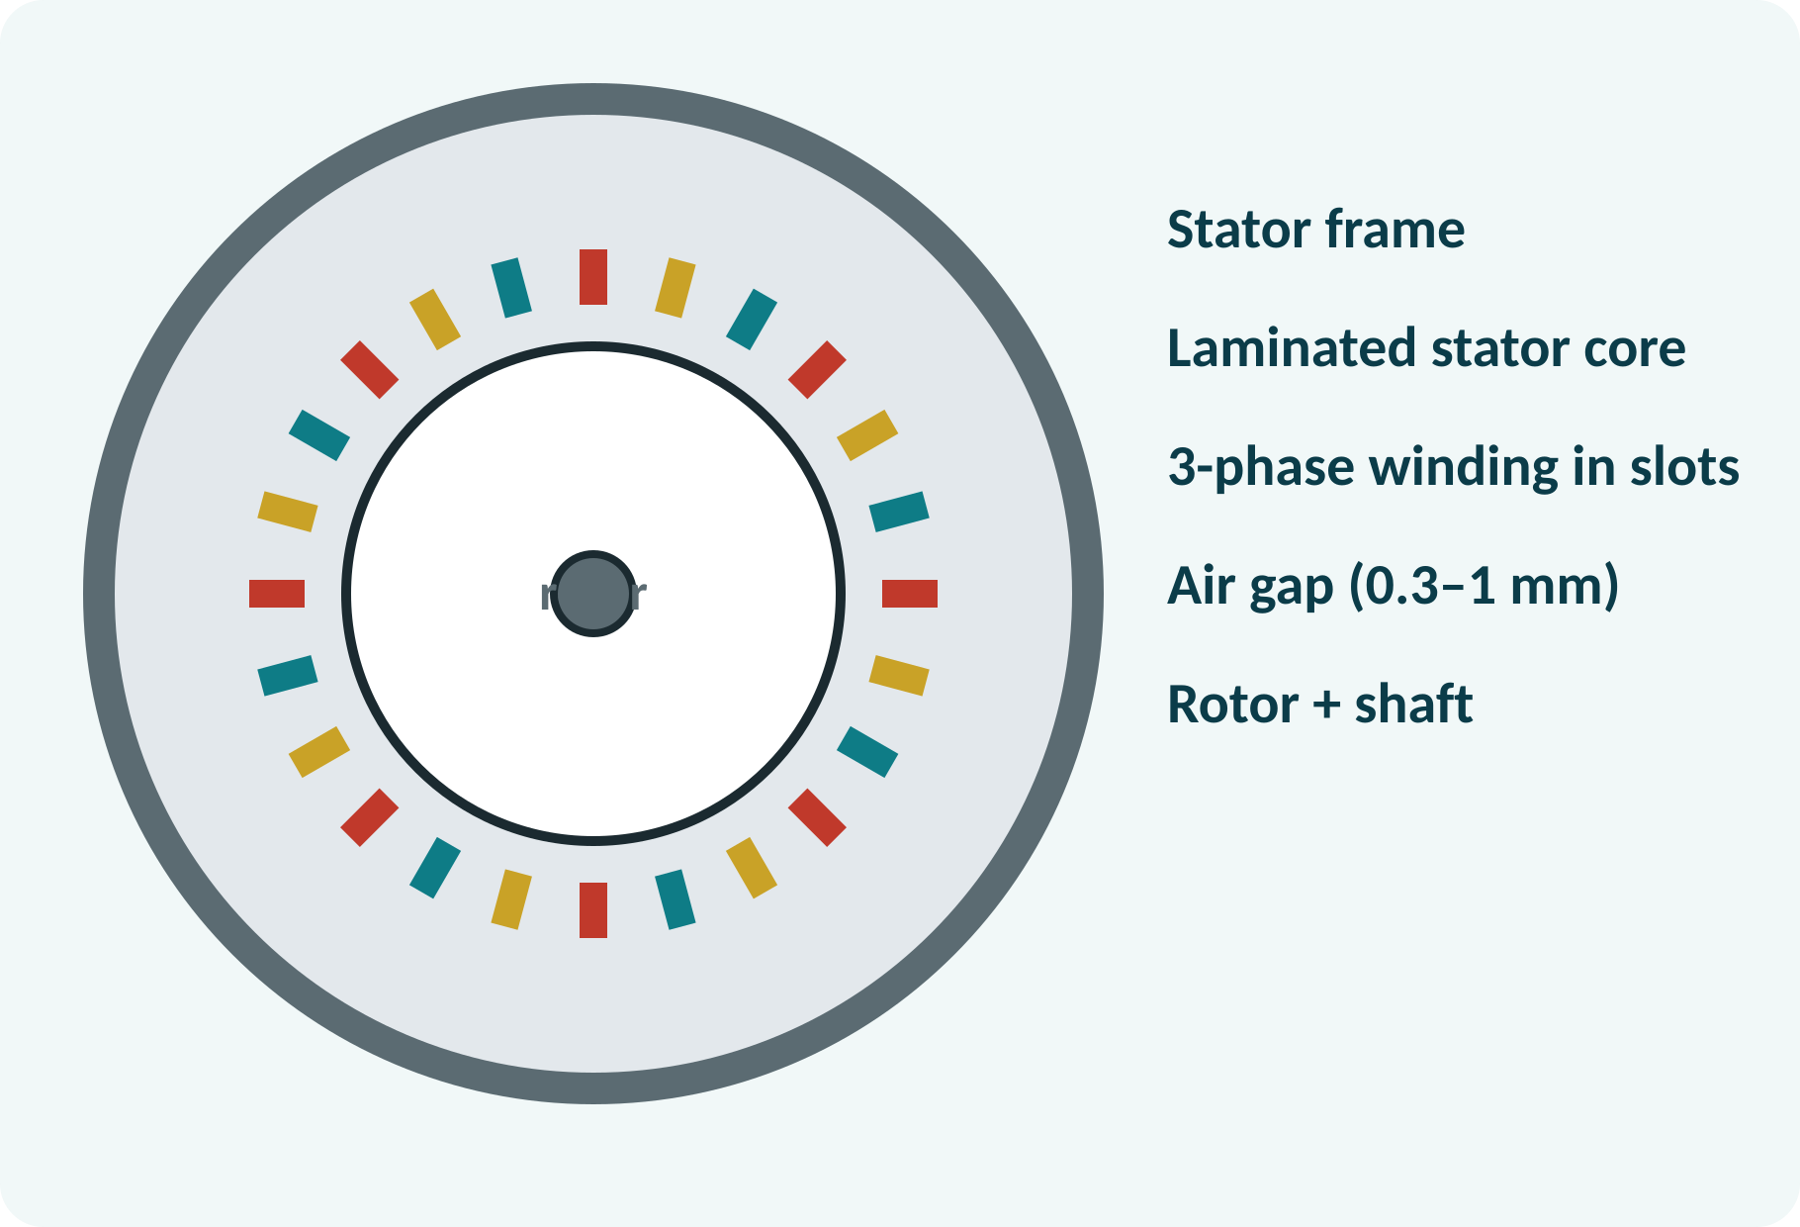
Motivation: The Industrial Workhorse
Over 70 % of industrial motors.
Pumps, fans, compressors, conveyors.
Rugged, cheap, little maintenance.
Runs directly from the three-phase mains.
Three-phase induction motor: no commutator, no brushes (squirrel cage)
Notes:
Look around a factory and almost every motor is a three-phase induction motor. It has no commutator and, in the squirrel cage form, no brushes or slip rings, so it is rugged and needs little maintenance. It connects directly to the supply and starts by itself. To see why, we need to understand the rotating field.

Slide 5
Three-Phase Supply and Stator Winding
Three coils placed 120° apart in the stator.
Each coil carries one phase current.
Currents are 120° apart in time.
The three fluxes combine in space.
φR = Φm sin ωt; φY = Φm sin(ωt − 120°); φB = Φm sin(ωt − 240°)
Notes:
The stator carries three identical windings placed one hundred twenty degrees apart in space. Each is connected to one phase, so their currents are one hundred twenty degrees apart in time. Each coil produces a pulsating flux along its own axis. The combination of the three pulsating fluxes is a flux of constant magnitude that rotates in space.

Slide 6
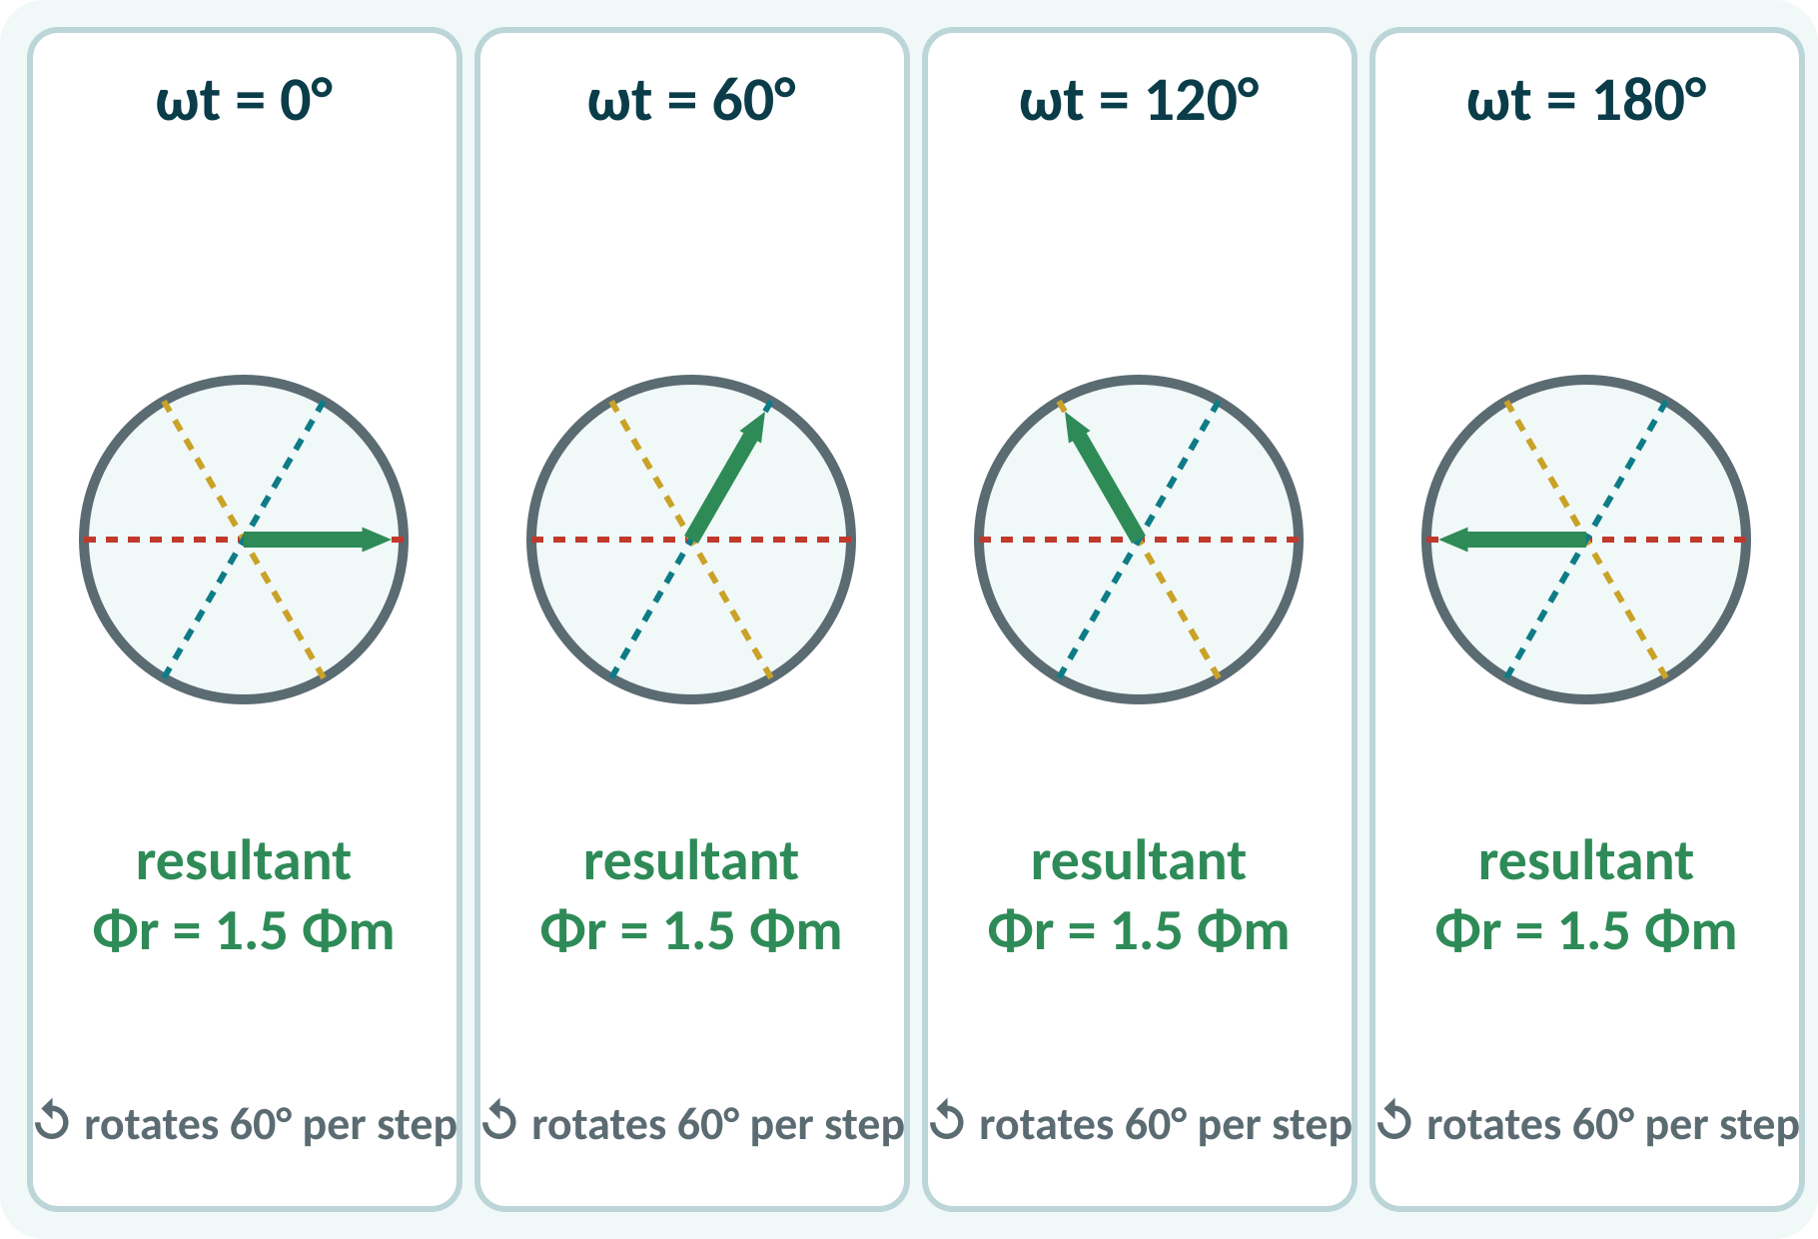
Rotating Magnetic Field
Add the three fluxes at each instant.
Resultant has constant magnitude 1.5Φm.
Its direction advances 60° every 60° of ωt.
It rotates once per supply cycle (2 poles).
Reverse two phases to reverse direction.
Φr = 1.5·Φm; speed = synchronous speed Ns
Notes:
Take four instants a sixty degrees apart. At each one, add the three flux phasors along the coil axes. The resultant has the same length, one and a half times the peak flux of one phase, but its direction has turned by sixty degrees. So a magnetic field of constant size rotates around the stator. Swapping any two supply leads reverses the direction of rotation.

Slide 7
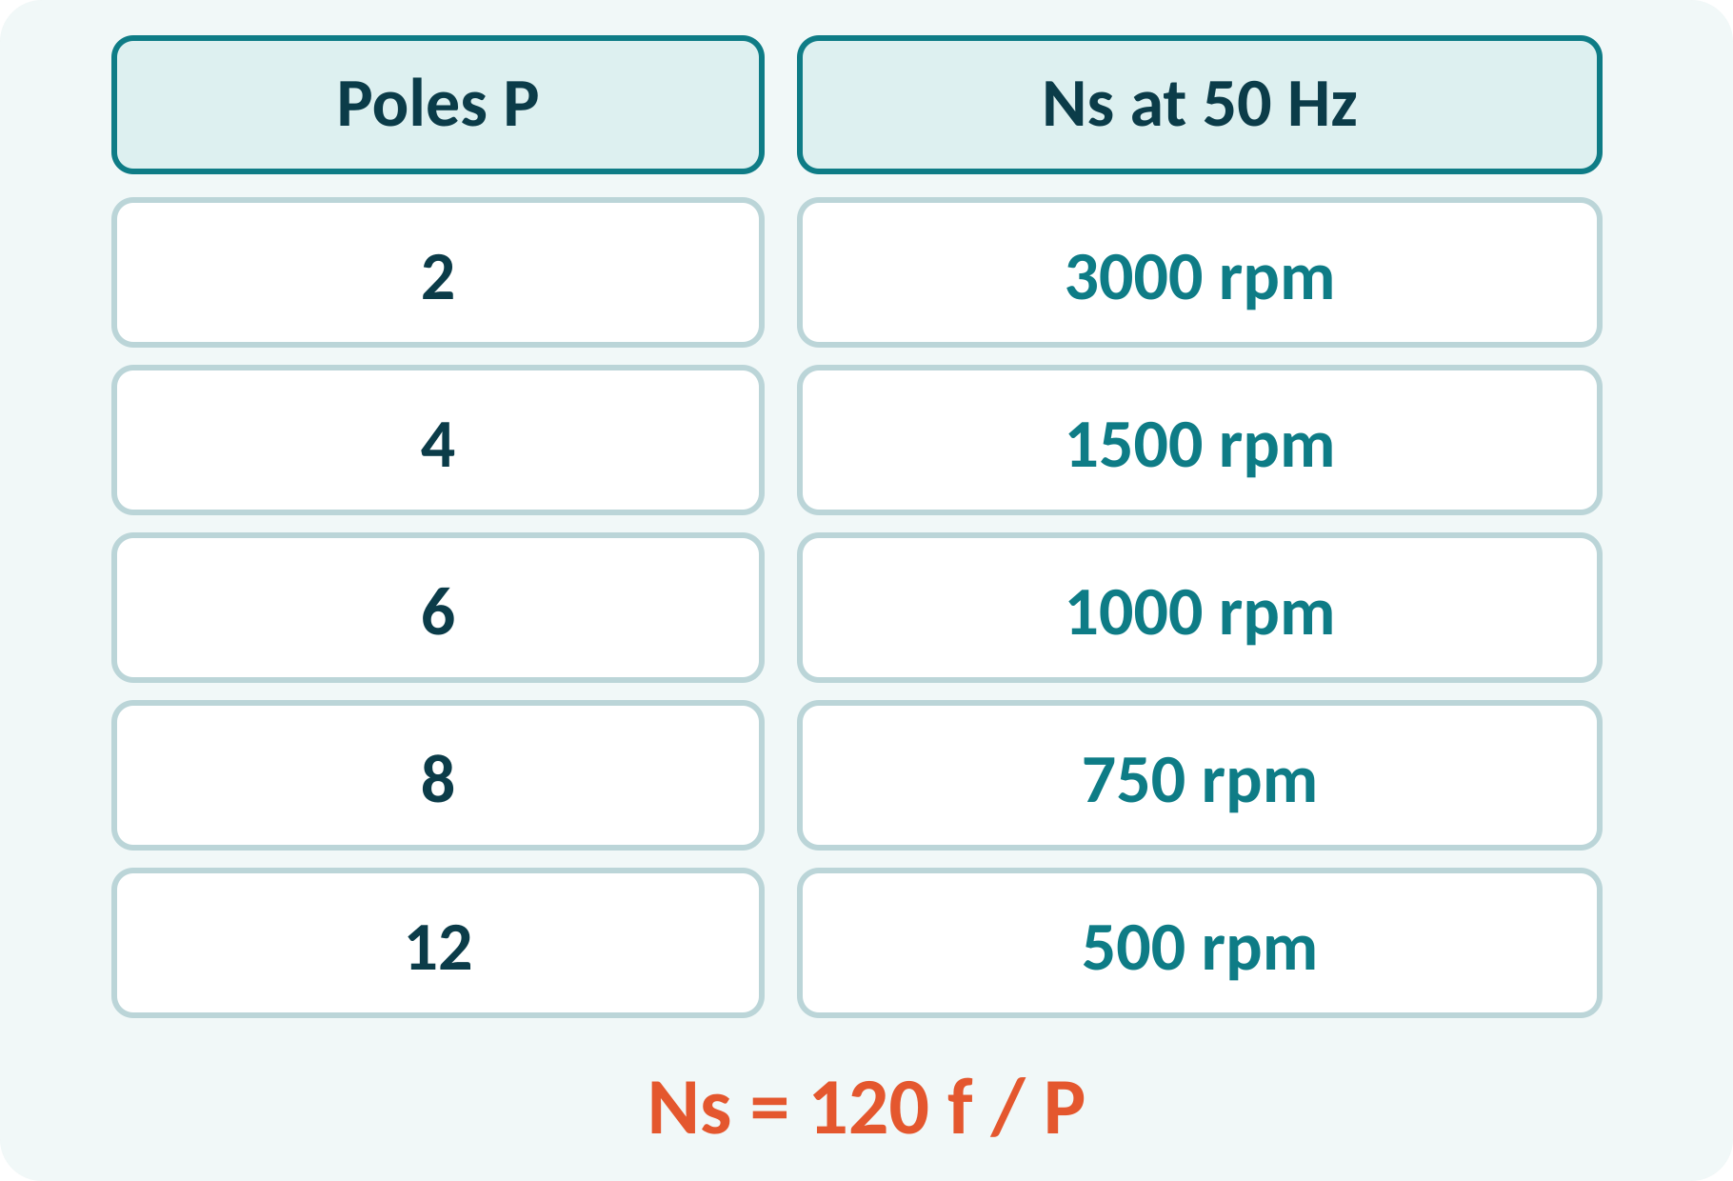
Synchronous Speed
Speed of the rotating field is Ns.
Depends on supply frequency and poles.
More poles: lower speed.
50 Hz, 4 poles: 1500 rpm.
Ns = 120·f / P (rpm)
f Hz, P number of poles
Notes:
The field completes one revolution for each pair of poles per supply cycle. So the synchronous speed is 120 times the frequency divided by the number of poles. A two-pole stator on 50 hertz gives 3000 rpm and a four-pole stator gives 1500 rpm. The motor can never run faster than the field if it is to produce torque.

Slide 8
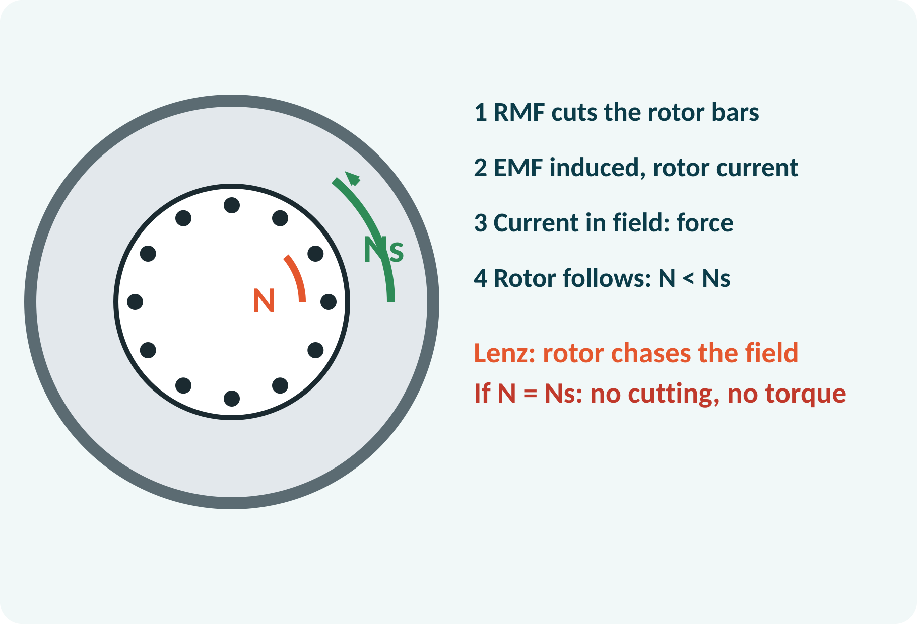
Principle of Operation
Rotating field cuts the rotor conductors.
EMF is induced (Faraday).
Rotor circuit is closed: current flows.
Current in the field gives force: torque.
Rotor follows the field (Lenz) but lags it.
Torque exists only if relative speed (Ns − N) ≠ 0
Notes:
The rotating field sweeps past the stationary rotor conductors, so EMFs are induced in them. Because the rotor circuit is closed, currents flow. These currents interact with the field and produce a torque in the direction of the field's rotation, as Lenz's law requires. The rotor accelerates but can never reach synchronous speed, because then there would be no relative motion and no induced EMF.

Slide 9
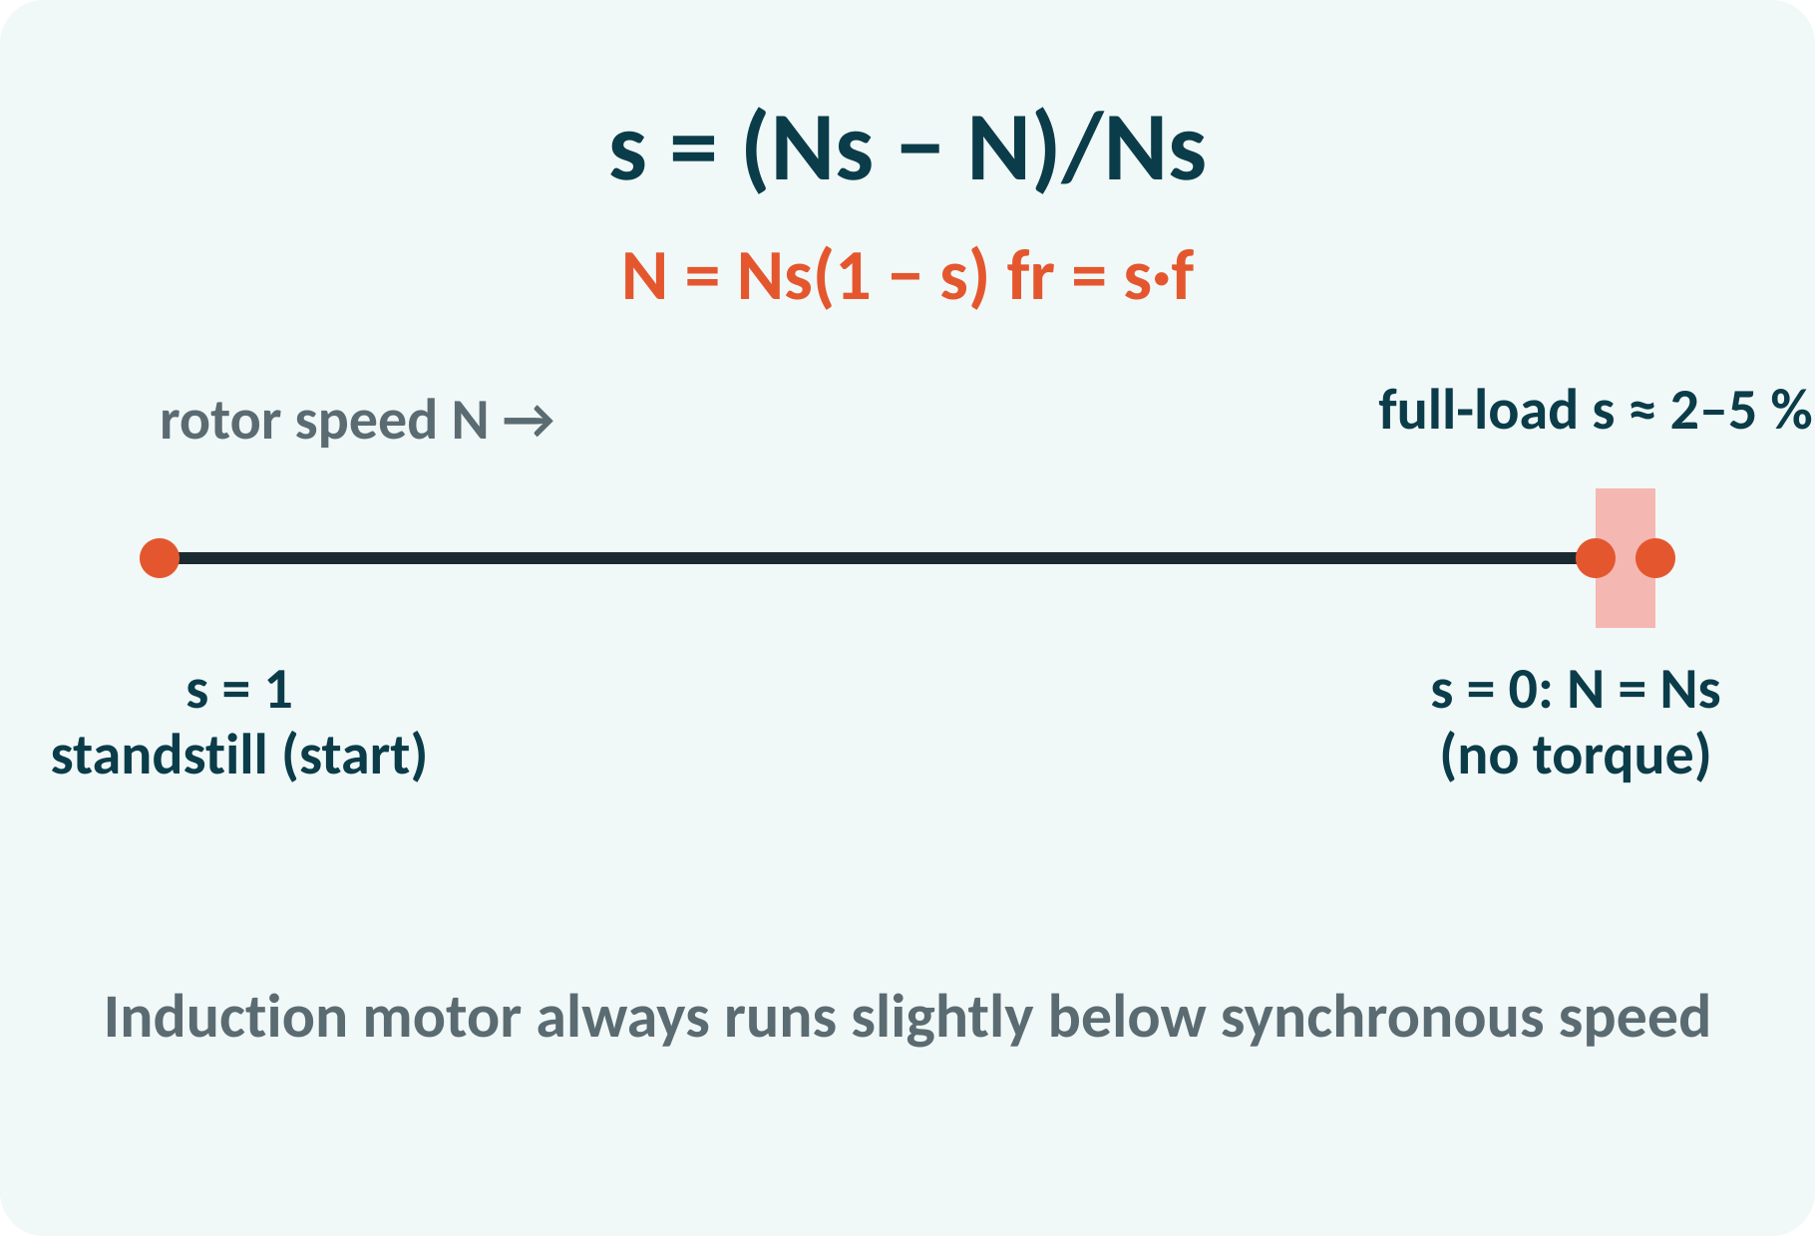
Slip
Slip measures how far N lags Ns.
Full-load slip is 2–5 %.
At start N = 0, so s = 1.
Rotor frequency is f·s: small at full speed.
s = (Ns − N)/Ns; N = Ns(1 − s); fr = s·f
Notes:
Slip is the fractional difference between the field speed and the rotor speed. At standstill the slip is one, and at synchronous speed it is zero. At full load it is typically two to five per cent. The rotor currents have frequency s times f, which is only a few hertz at normal speed. That is why a rotor core can have small losses.

Slide 10
Constructional Features: Stator
Frame: cast iron or steel, with cooling fins.
Stator core: laminated silicon steel.
Slots hold the three-phase winding.
Winding terminals in a terminal box.
Small air gap improves power factor.
Stator winding: three coils displaced 120°; star or delta connected
Notes:
The stator is a laminated core of silicon steel pressed into a cast frame. Slots in the inner surface carry the three-phase winding, whose ends are brought to a terminal box. The air gap between stator and rotor is kept very small, often less than a millimetre, so that the magnetising current and power factor are good. The motor can be connected in star or in delta.

Slide 11
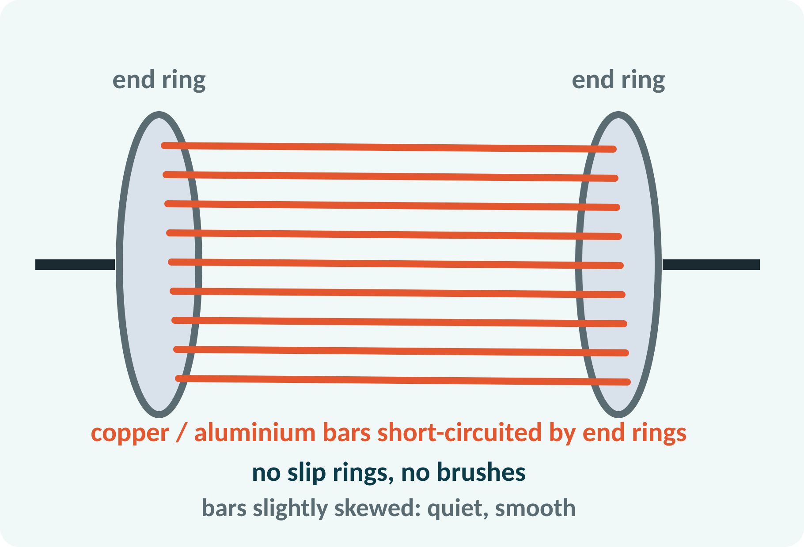
Squirrel-Cage Rotor
Laminated core with slots.
Copper or aluminium bars in the slots.
Bars joined by end rings: a short-circuited cage.
No slip rings or brushes.
Skewed bars reduce noise.
Most common type: simple, rugged and cheap
Notes:
The squirrel-cage rotor has solid bars of aluminium or copper in the slots, welded or cast to end rings at both ends. This forms a permanently short-circuited winding that looks like a cage. There are no brushes or slip rings, so it is robust and almost maintenance free. Its drawback is that its rotor resistance cannot be changed from outside, so the starting torque is moderate.

Slide 12
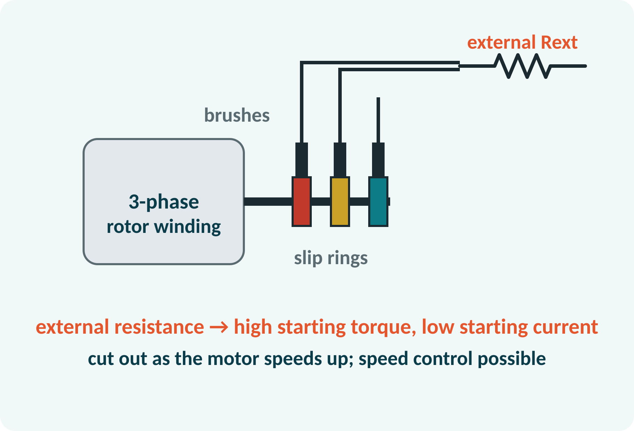
Wound-Rotor (Slip-Ring) Rotor
Rotor carries a three-phase winding.
Winding ends go to three slip rings.
Brushes connect external resistance.
High starting torque, low starting current.
Speed control by rotor resistance.
Rext cut out gradually as the motor accelerates
Notes:
The wound rotor has an insulated three-phase winding, usually star connected, whose three ends are taken to slip rings on the shaft. Carbon brushes connect the rings to an external three-phase rheostat. A large external resistance at start gives a high torque at low starting current, and is cut out as the motor reaches speed. It is used in cranes and hoists, which need high starting torque.

Slide 13
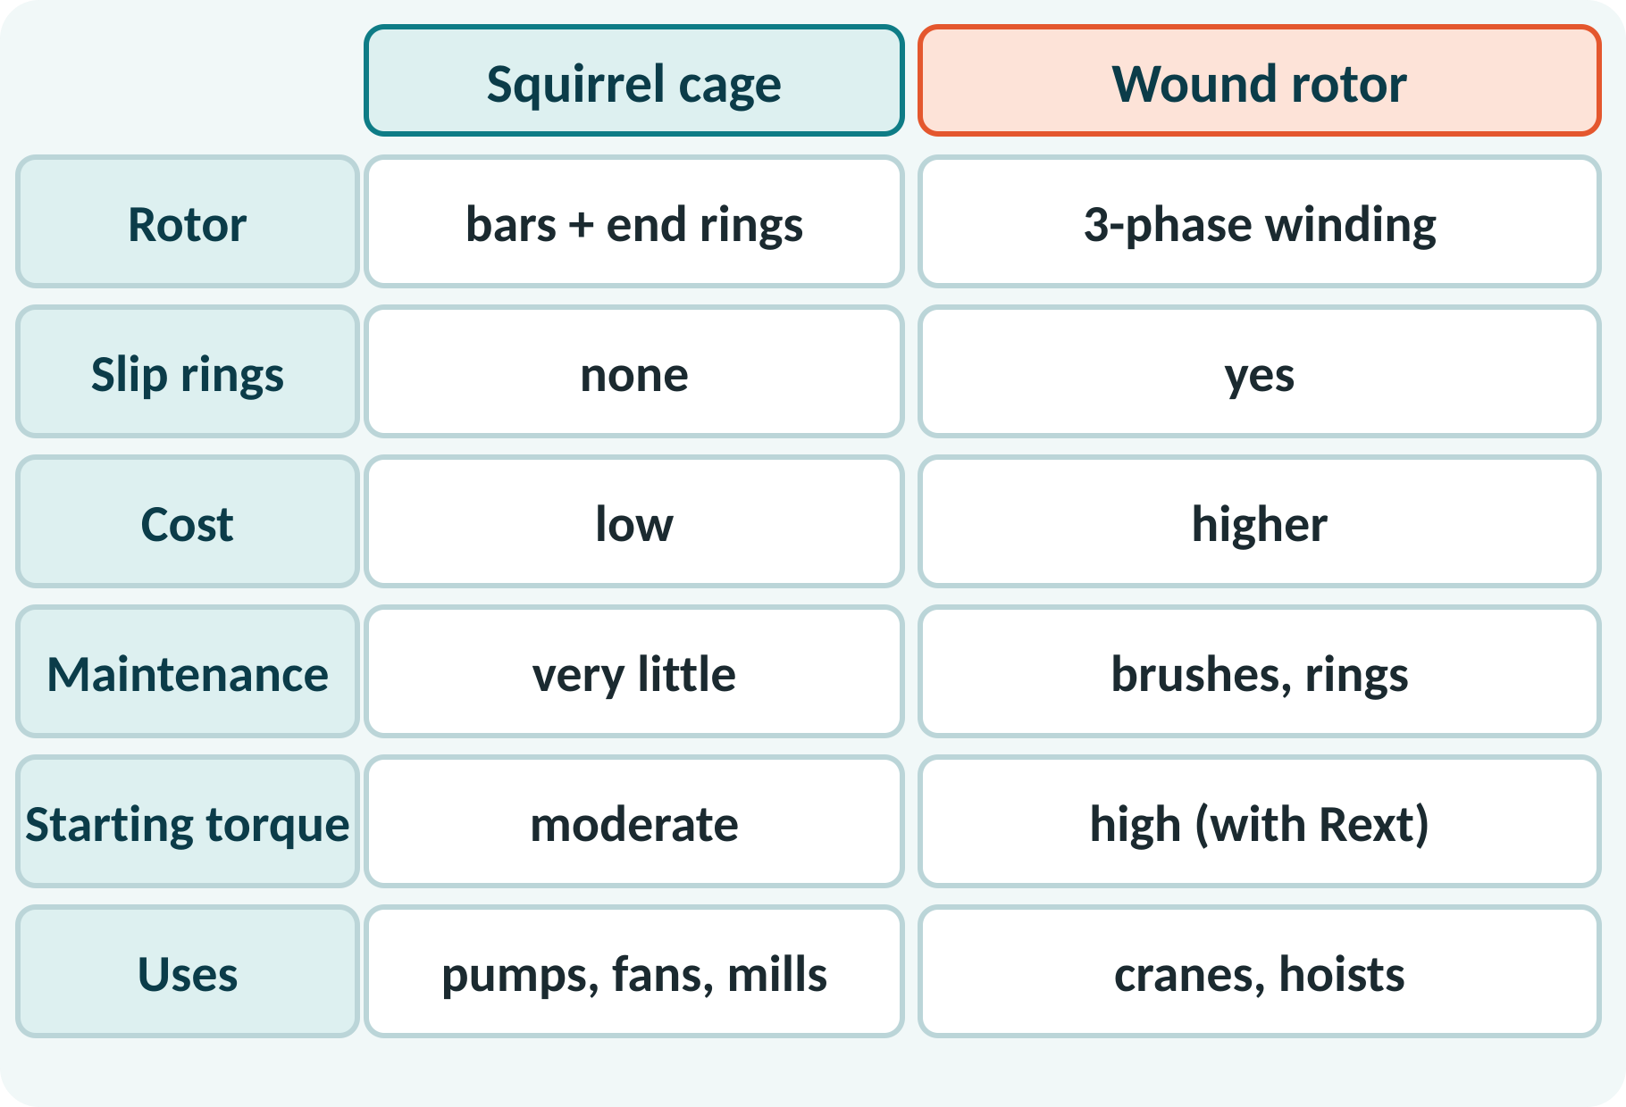
Squirrel Cage vs Wound Rotor
Cage: cheap, rugged, maintenance-free.
Wound: slip rings, brushes, costlier.
Wound rotor gives high starting torque.
Wound rotor allows speed control.
Stator is identical in both.
Both run on the same rotating-field principle
Notes:
The two motors differ only in the rotor. The squirrel-cage motor is cheaper and more reliable, so it is used in most applications. The wound-rotor motor costs more and needs maintenance of brushes and slip rings, but allows external resistance for high starting torque or limited speed control. Stator construction and principle of operation are the same.

Slide 14
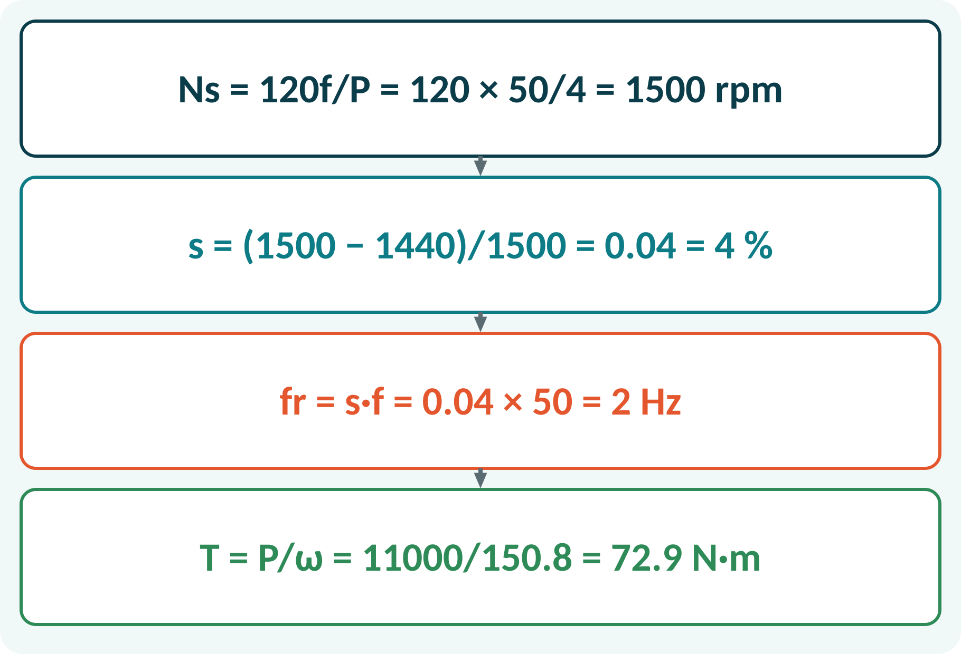
Solved Example 1: Slip and Torque
A 4-pole, 50 Hz induction motor runs at 1440 rpm and delivers 11 kW. Find Ns, slip, rotor frequency and shaft torque.
1. Ns = 120 × 50/4 = 1500 rpm.
2. s = (1500 − 1440)/1500 = 0.04 (4 %).
3. fr = s·f = 2 Hz.
4. ω = 2π × 1440/60 = 150.8 rad/s.
5. T = P/ω = 11000/150.8 = 72.9 N·m.
Answer: Ns = 1500 rpm, slip 4 %, fr = 2 Hz, T = 72.9 N·m
Notes:
Find the synchronous speed from frequency and poles, then the slip from the speed difference. The rotor frequency is slip times supply frequency, only two hertz here. Torque is output power divided by angular speed in radians per second. Remember to convert rpm to rad per second using two pi over sixty.

Slide 15
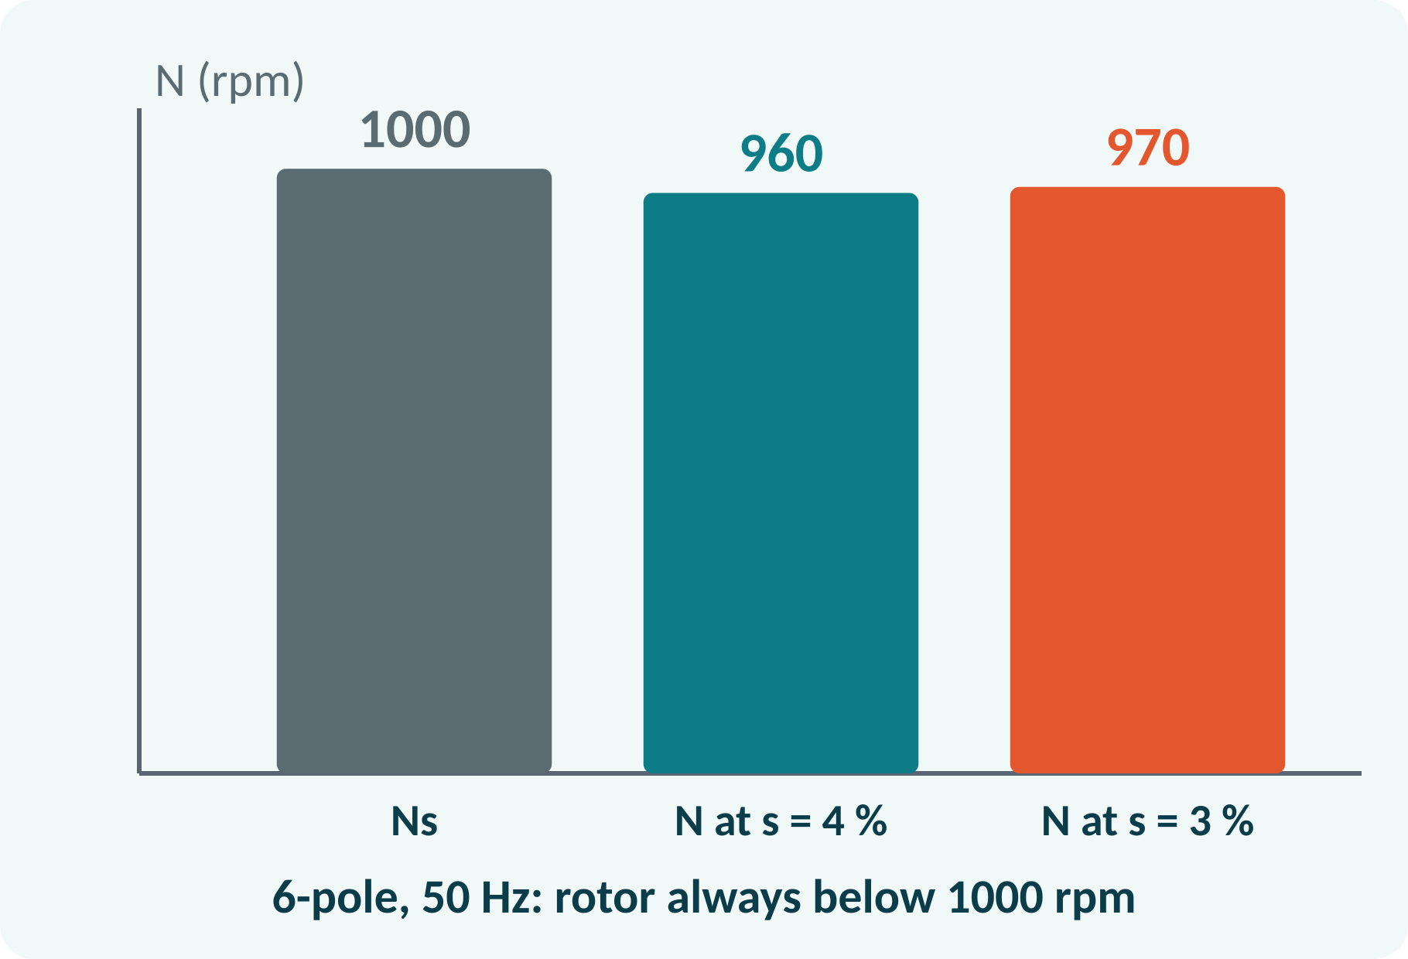
Solved Example 2: Speed from Slip
A 6-pole, 50 Hz induction motor has full-load slip 4 %. Find the speed, and the speed if the load is reduced so that slip is 3 %.
1. Ns = 120 × 50/6 = 1000 rpm.
2. N = Ns(1 − s) = 1000 × 0.96 = 960 rpm.
3. At s = 3 %: N = 1000 × 0.97 = 970 rpm.
4. Rotor frequency at full load = 0.04 × 50 = 2 Hz.
Answer: 960 rpm at full load, 970 rpm at lighter load; Ns = 1000 rpm
Notes:
Compute the synchronous speed first. The rotor speed follows from N equals Ns times one minus s. Lighter load reduces the slip, so the speed rises a little but never reaches 1000 rpm. This shows why the induction motor is a nearly constant-speed machine.

Slide 16
Common Mistakes and Exam Tips
✕
Common mistakes
✓
Exam tips
Using N = Ns (ignoring slip).
Using P as the number of pole pairs in Ns = 120f/P.
Saying the rotor runs at synchronous speed.
Mixing slip as % and as a fraction.
Forgetting to swap two phases to reverse direction.
Ns = 120f/P with P = number of poles.
Slip as a fraction in formulas.
Rotor frequency fr = s·f.
Torque needs ω in rad/s.
Notes:
These are the points where marks are lost most often in induction motors. Give one quick example for each mistake. Remind students that writing the formula, substitution and the unit earns method marks even if the arithmetic slips. Encourage them to check the answer for reasonableness.

Slide 17
Summary
Three-phase currents produce a rotating field of constant magnitude.
Ns = 120f/P.
Rotor follows the field with slip s = (Ns − N)/Ns.
Stator: laminated core with 3-phase winding.
Rotor: squirrel cage (simple) or wound (slip rings).
Ns = 120f/P; N = Ns(1 − s); fr = s·f
Notes:
Recap in one minute. Say each point and ask the class to recall the formula for it. If they remember these ideas, most numerical problems on induction motors are within reach. Next lecture: diodes and rectifiers. Revise the two solved examples tonight.

Slide 18
Quick Quiz
Q1. Synchronous speed for 50 Hz, 6 poles:
(a) 500 (b) 1000 (c) 1500 (d) 3000 rpm
Ans: (b)
Q2. Slip at standstill is:
(a) 0 (b) 0.5 (c) 1 (d) ∞
Ans: (c)
Q3. To reverse the direction of rotation:
(a) swap two supply leads (b) swap all leads (c) change frequency (d) open one phase
Ans: (a)
Q4. The rotor of a squirrel-cage motor has:
(a) slip rings (b) bars and end rings (c) a commutator (d) permanent magnets
Ans: (b)
Q5. N = 1450 rpm, Ns = 1500 rpm gives slip:
(a) 3.3 % (b) 5 % (c) 33 % (d) 0.33 %
Ans: (a)
Notes:
Give about one minute per question and take a show of hands. Discuss why the wrong options are tempting, especially the one that uses a wrong formula. Use the quiz as a quick check on induction motors before leaving.

Slide 19
References
1
Hughes Edward, Electrical Technology
10th Ed., Pearson Education, 2010 (Units 1, 2 textbook)
2
H. Cotton, Electrical Technology
7th Ed., CBS Publishers, 2005 (reference)
Next lecture: Unit 3: semiconductor diode and rectifiers
Notes:
Point students to the textbooks listed in the syllabus for induction motors. Ask them to solve at least three textbook problems on this topic before the next class. Thank the class and preview the next lecture.

