Slide 1
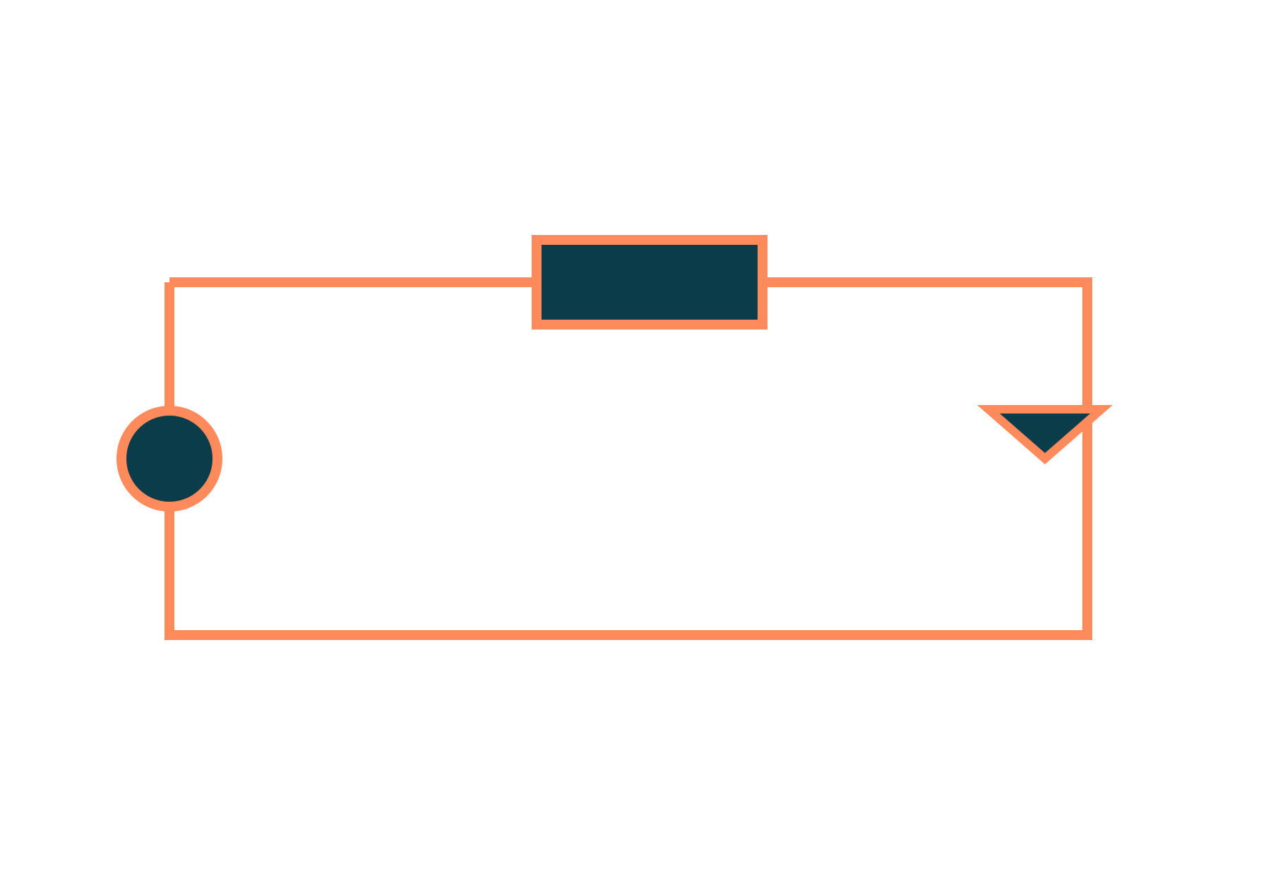
Diode, Equivalent Circuits and Zener Diode
Basic Electrical and Electronics Engineering
Unit 3: Diodes, Transistors and their Applications
Topic: Semiconductor diode, diode equivalent circuits, Zener diode as voltage regulator
Prof. Mitesh Astik
Notes:
Welcome everyone. Today's topic is Semiconductor diode, diode equivalent circuits, Zener diode as voltage regulator. It belongs to Unit 3: Diodes, Transistors and their Applications. By the end of this session you will be able to use it in numerical problems. Keep your notebooks ready because we will solve two examples.

Slide 2

Learning Outcomes
Explain the p-n junction and its biasing.
Read the diode V–I characteristic.
Use ideal and practical diode models.
Design a simple Zener voltage regulator.
Linked to CO3
Analyse characteristics of the p-n junction diode and Zener diode.
Notes:
Read the outcomes aloud. They map to CO3 of the syllabus. Tell students that these are examinable and that the two solved examples follow the same pattern. Ask them to tick off each outcome at the end of the lecture.

Slide 3
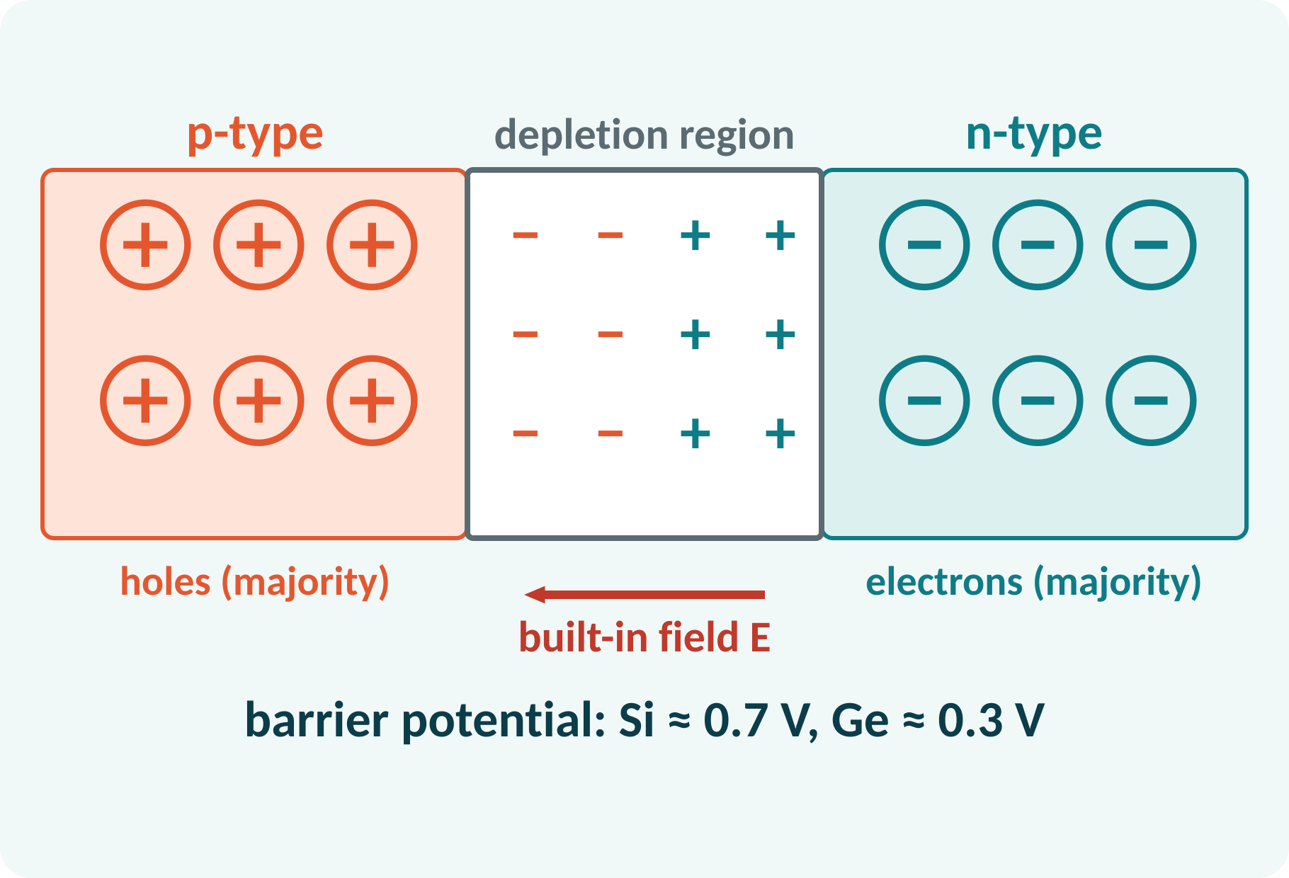
Recap: What You Already Know
Semiconductors: silicon and germanium.
Doping makes p-type (holes) and n-type (electrons).
Majority and minority carriers.
Ohm's law and resistor circuits.
p-type: trivalent dopant (holes); n-type: pentavalent dopant (electrons)
Notes:
Silicon and germanium are semiconductors that can be doped to make p-type material with excess holes and n-type with excess electrons. Joining the two forms a p-n junction, which is the heart of the diode. The resistor circuit analysis we did in Unit 1 will help us solve diode circuits.

Slide 4
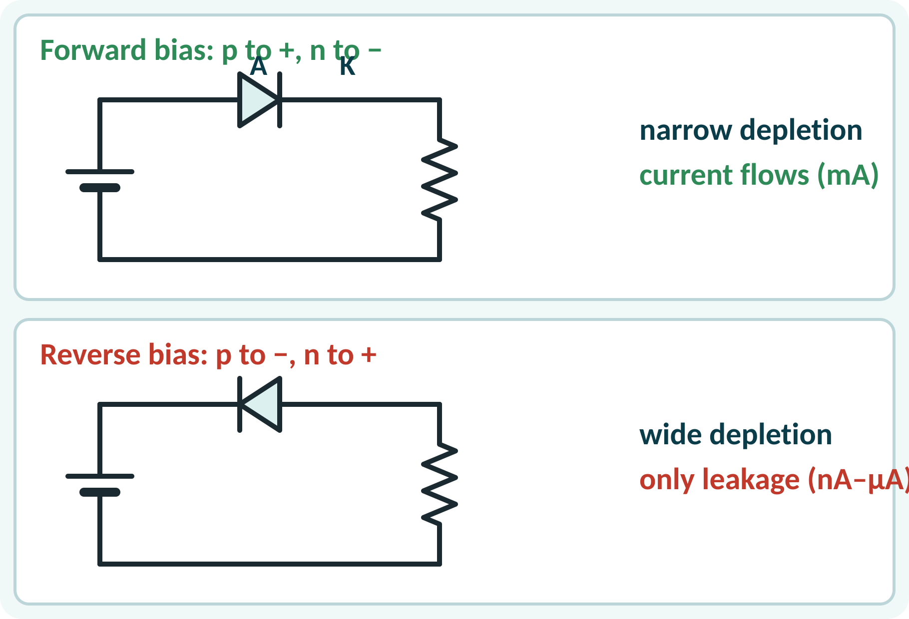
Motivation: A One-Way Valve for Current
Mobile charger converts AC to DC with diodes.
LED lights, radios, solar panels.
Protects circuits from reverse polarity.
Zener diodes give a steady reference voltage.
A diode conducts in one direction and blocks in the other
Notes:
Every power adapter contains diodes to turn the AC mains into DC. A diode acts like a one-way valve for current. This property also protects equipment from a wrongly connected battery. Zener diodes, a special type, give a steady voltage reference, which we study in the second half of the lecture.

Slide 5
The p-n Junction
Holes and electrons diffuse across the junction.
They recombine, leaving fixed ions.
Depletion region forms; a built-in field appears.
Barrier potential opposes further diffusion.
Si ≈ 0.7 V; Ge ≈ 0.3 V.
Barrier potential: Si ≈ 0.7 V, Ge ≈ 0.3 V at room temperature
Notes:
When the p and n materials are joined, holes diffuse into the n side and electrons into the p side. They recombine, leaving a region with no mobile carriers, called the depletion region. The fixed ions create an electric field that opposes further diffusion. The potential across it is the barrier potential, about 0.7 volts in silicon.

Slide 6
Forward and Reverse Bias
Forward: p to +, n to − of the source.
Depletion narrows; current flows above 0.7 V.
Reverse: p to −, n to +.
Depletion widens; only a tiny leakage flows.
Resistor in series limits forward current.
Forward: conducts when V > Vγ; reverse: I ≈ Is (nA–µA) until breakdown
Notes:
In forward bias the external voltage opposes the barrier, the depletion region shrinks and a large current flows once the voltage exceeds about 0.7 volts. In reverse bias the external voltage adds to the barrier, so the region widens and only a very small leakage current of minority carriers flows. Always use a series resistor with a forward-biased diode to limit the current.

Slide 7
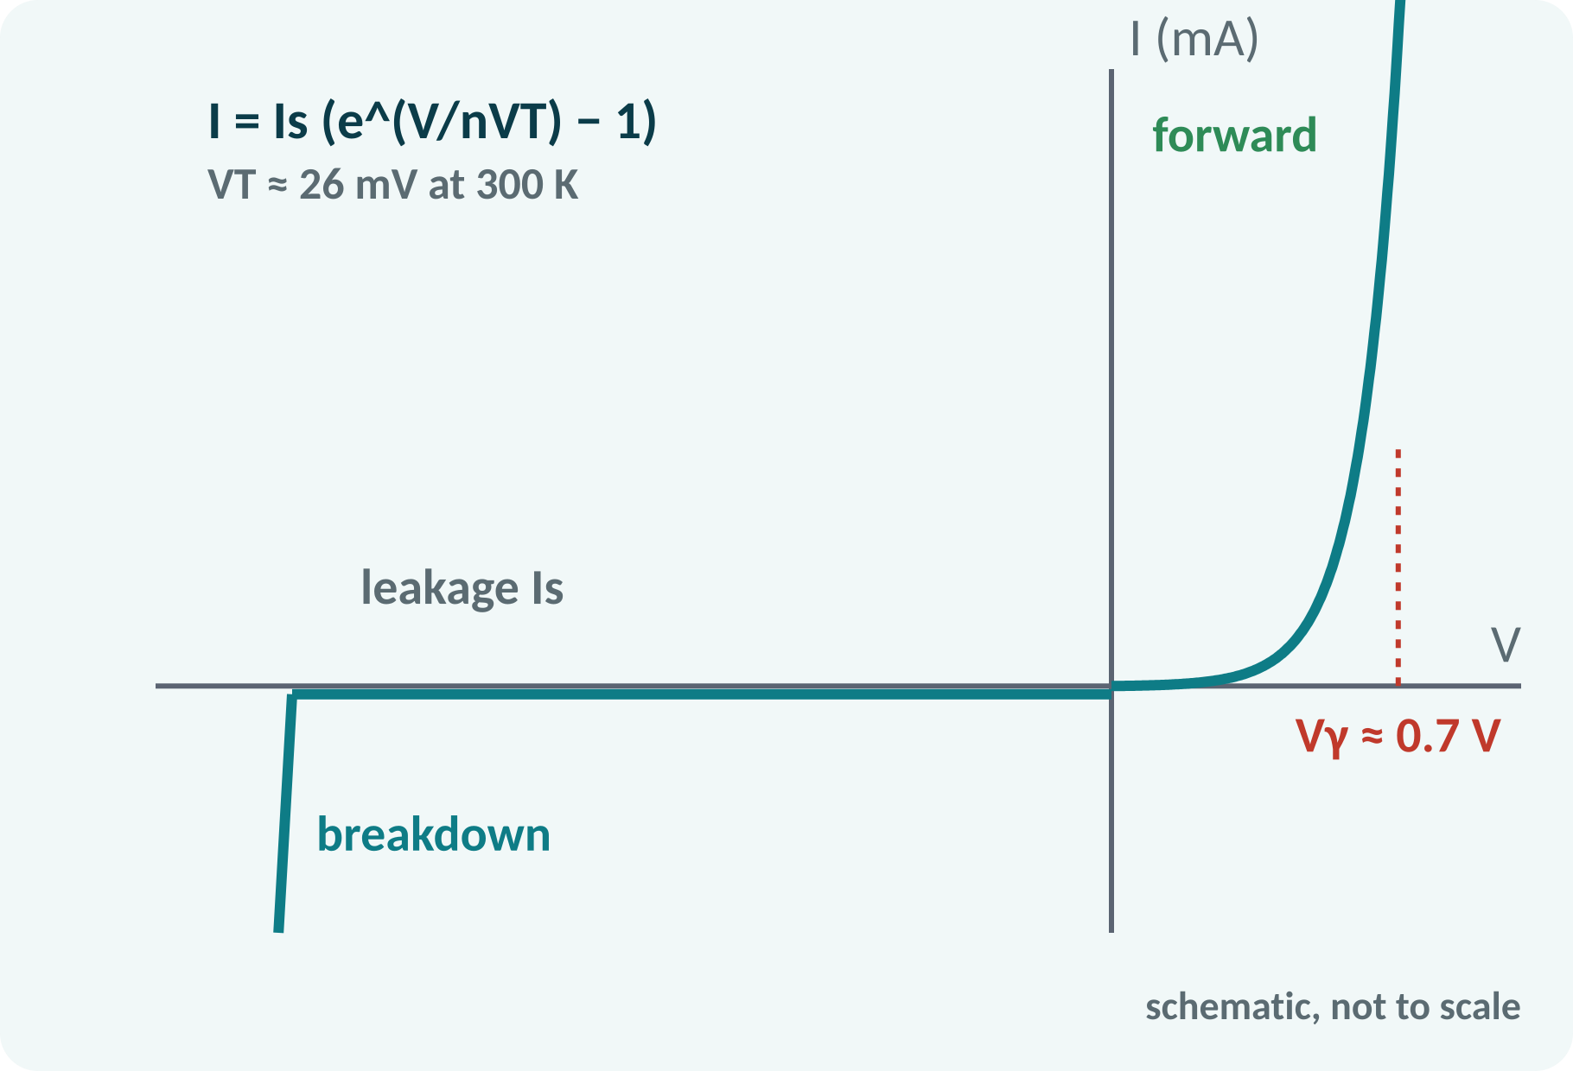
Diode V–I Characteristic
Forward: exponential rise after the knee.
Knee voltage Vγ ≈ 0.7 V (Si).
Reverse: small, nearly constant leakage.
Breakdown at high reverse voltage.
Leakage doubles about every 10 °C.
I = Is·(e^(V/(n·VT)) − 1); VT = kT/q ≈ 26 mV at 300 K
Is reverse saturation current, n ideality factor (1–2)
Notes:
The Shockley equation describes the characteristic. Below the knee, about 0.5 volts for silicon, the current is negligible. Above the knee the current rises very rapidly, so the voltage across a conducting diode stays near 0.7 volts. In reverse the current is a tiny saturation current, until the breakdown voltage is reached. Temperature affects both the knee and the leakage.

Slide 8
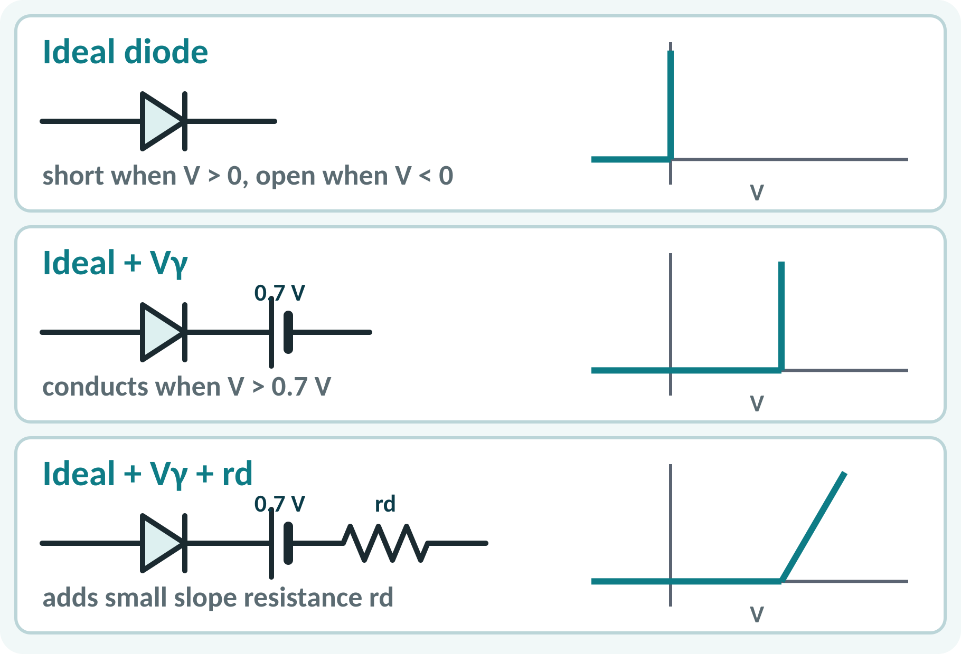
Diode Equivalent Circuits
Ideal: a switch, no drop.
Practical: ideal diode plus 0.7 V battery.
Piecewise linear: add a small resistance rd.
Choose the simplest model that is accurate enough.
Reverse: open circuit in all models.
Ideal: V = 0 if on; Practical: V = Vγ; Linear: V = Vγ + I·rd
Notes:
Solving with the exponential equation is difficult, so we replace the diode by a simple equivalent circuit. The ideal model is a perfect switch. The practical model adds a 0.7 volt battery to represent the knee. The third model adds a small resistance for the slope of the characteristic. For most problems in this course the practical model is enough.

Slide 9
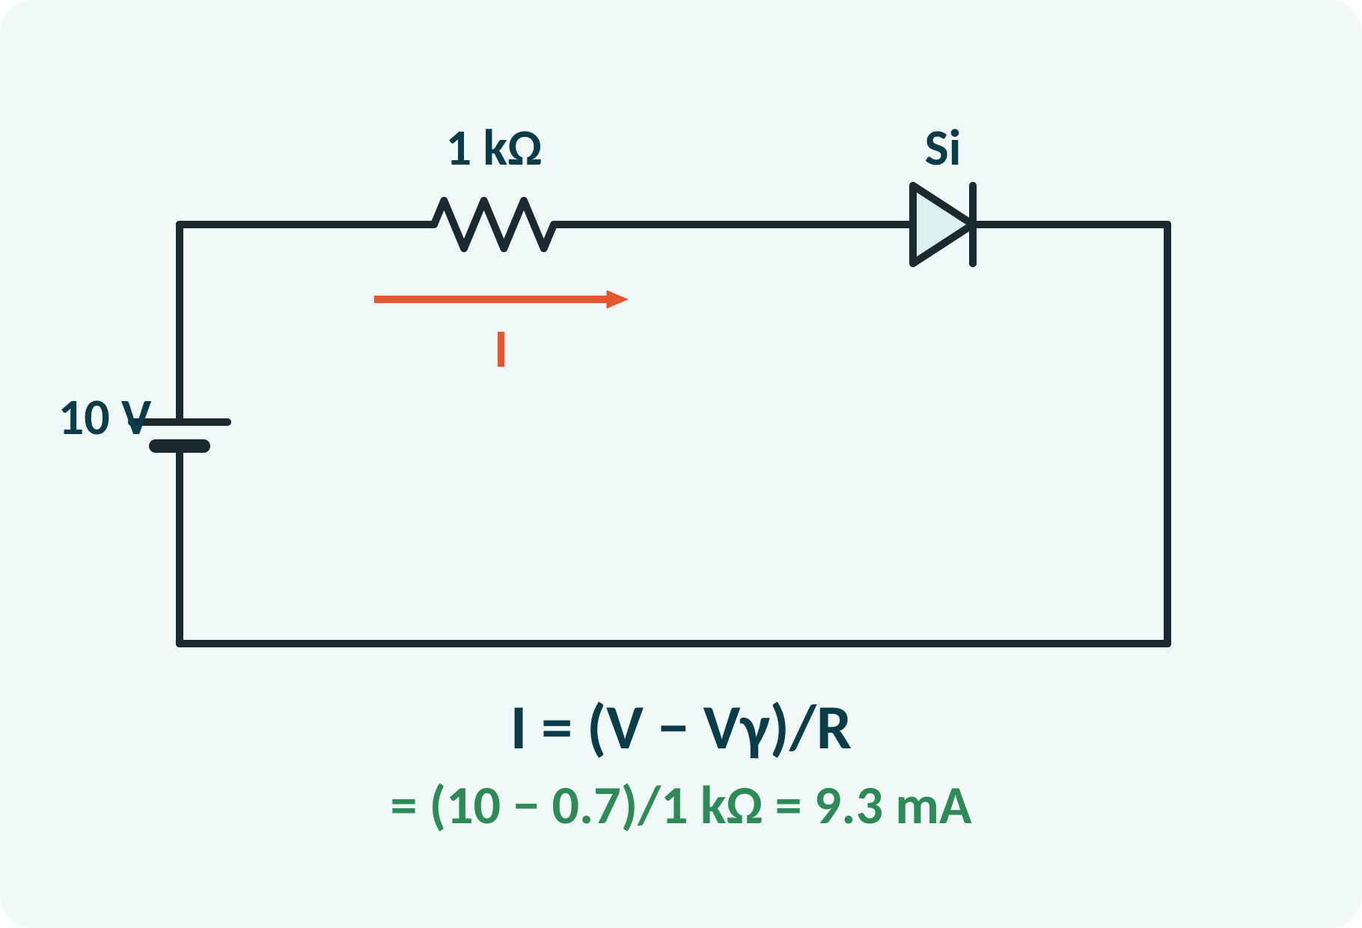
Analysing a Diode Circuit
Decide: forward or reverse biased?
Replace the diode by its equivalent circuit.
Apply KVL around the loop.
Solve for the current.
Check the assumption.
Series diode–resistor: I = (V − Vγ)/R (V > Vγ); I ≈ 0 if reverse biased
Notes:
First guess the state of the diode. If the source drives current from anode to cathode with more than 0.7 volts, assume it conducts. Replace it by a 0.7 volt drop, write Kirchhoff's voltage law and find the current. Then check: the current must be positive, otherwise the diode is off and the current is zero. Here the current is 9.3 milliamperes.

Slide 10
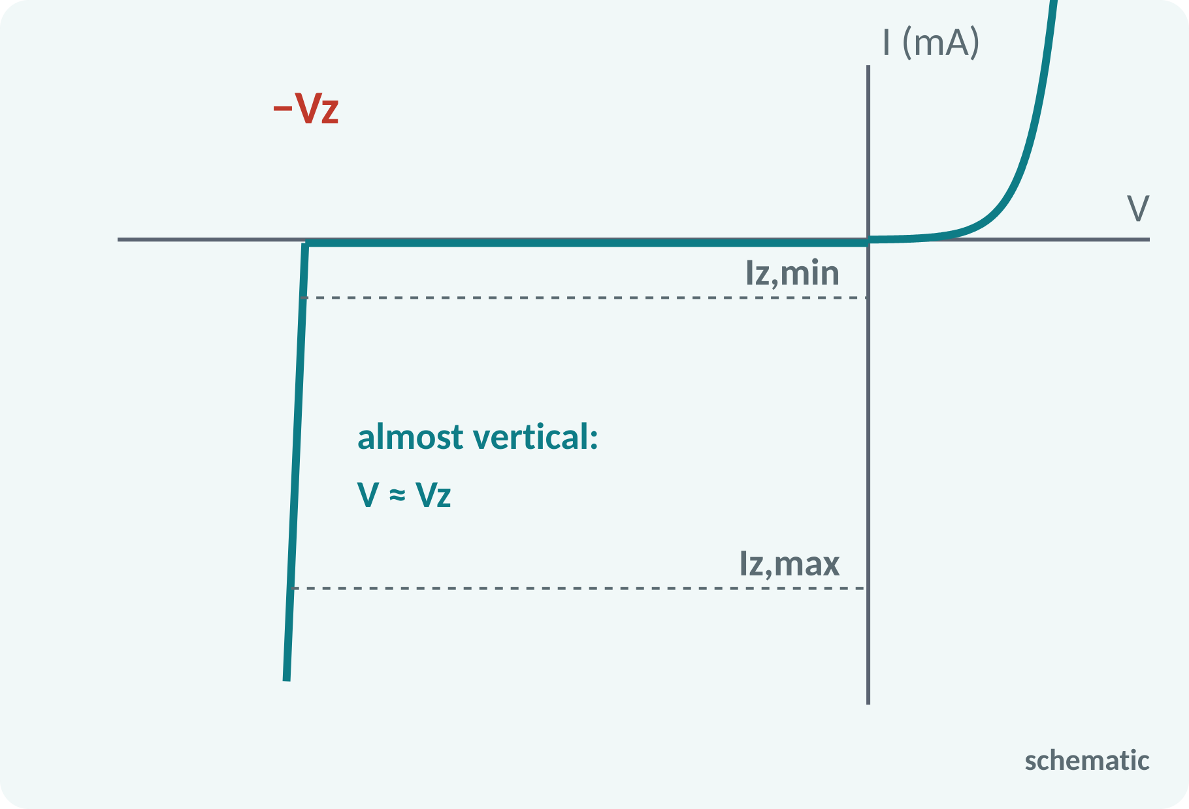
Zener Diode
Heavily doped diode designed to operate in breakdown.
Reverse breakdown voltage Vz is sharp and stable.
Voltage stays near Vz over a wide current range.
Safe current limited by power rating.
Symbol: diode with bent bar.
Operation: reverse biased, Iz,min < Iz < Iz,max; Pz = Vz·Iz ≤ Pz,max
Notes:
A Zener diode is made for operation in the reverse breakdown region. In breakdown the voltage across it stays almost constant at Vz while the current may change widely. This makes it ideal as a reference or a simple voltage regulator. The current must stay above a minimum to remain in breakdown and below a maximum set by the power rating.

Slide 11
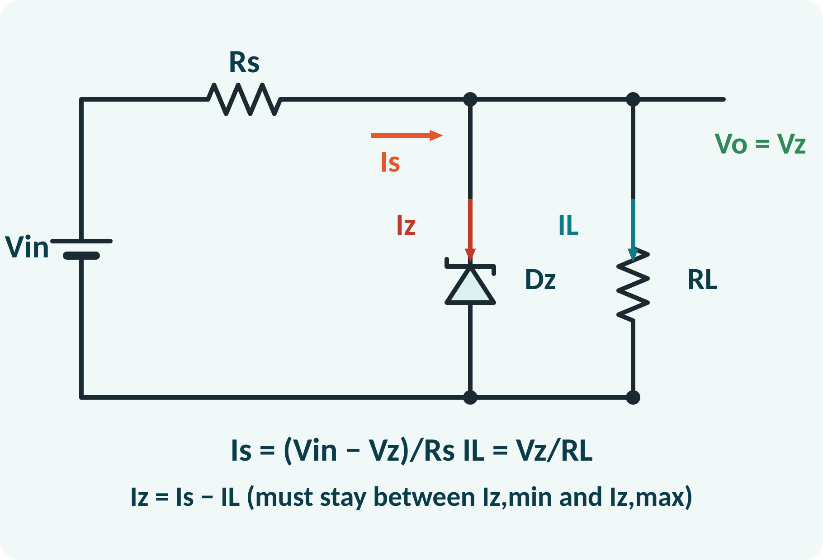
Zener Voltage Regulator
Series resistor Rs, Zener in parallel with load.
Output Vo = Vz while the Zener is in breakdown.
Source current splits: Iz and IL.
Iz absorbs changes in Vin or load.
Need Iz,min ≤ Iz ≤ Iz,max.
Is = (Vin − Vz)/Rs; IL = Vz/RL; Iz = Is − IL
Notes:
The Zener is connected in parallel with the load, in reverse, with a series resistor from the supply. The output voltage is held at Vz. The current through Rs is fixed by the difference between input and Zener voltage. That current divides between the load and the Zener, so if the load current changes, the Zener current changes by the opposite amount and the output stays constant.

Slide 12
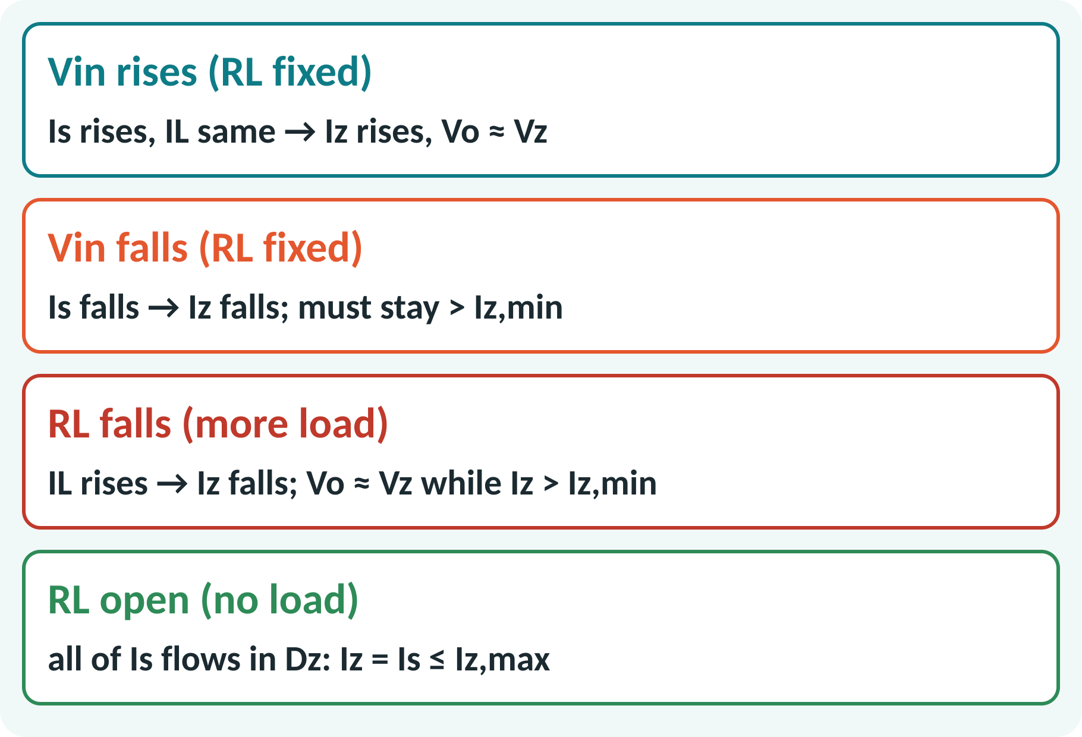
Regulator Behaviour and Limits
Line regulation: Vin changes, Vo steady.
Load regulation: RL changes, Vo steady.
Regulation fails when Iz < Iz,min.
No-load case: Iz = Is must be ≤ Iz,max.
Choose Rs to meet both limits.
Rs,max = (Vin,min − Vz)/(Iz,min + IL,max); Rs,min = (Vin,max − Vz)/(Iz,max + IL,min)
Notes:
As the input voltage rises, the Zener takes more current and the output stays at Vz. As the load draws more current, the Zener current falls. The limit comes when the Zener current drops to its minimum, since then it leaves breakdown and regulation is lost. At no load all the series current flows through the Zener, which must not exceed its power rating. The choice of Rs balances these two limits.

Slide 13
Solved Example 1: Series Diode
10 V source, 1 kΩ resistor, silicon diode. Find the current for (a) forward bias with the practical model, (b) ideal diode, (c) reversed diode.
(a) I = (10 − 0.7)/1 kΩ = 9.3 mA.
(b) Ideal: I = 10/1 kΩ = 10 mA.
(c) Reverse: diode off, I ≈ 0, all 10 V across the diode.
Power in the diode (a): P = 0.7 × 9.3 mA = 6.5 mW.
Answer: 9.3 mA (practical), 10 mA (ideal), ≈ 0 (reversed)
Notes:
Apply Kirchhoff's voltage law using the practical model for part a. The result is 9.3 milliamperes. For the ideal diode there is no 0.7 volt drop, so the current is a little larger: 10 milliamperes. If the diode is reversed it blocks, no current flows and the whole supply voltage appears across the diode. The comparison shows when the ideal model is accurate enough.

Slide 14
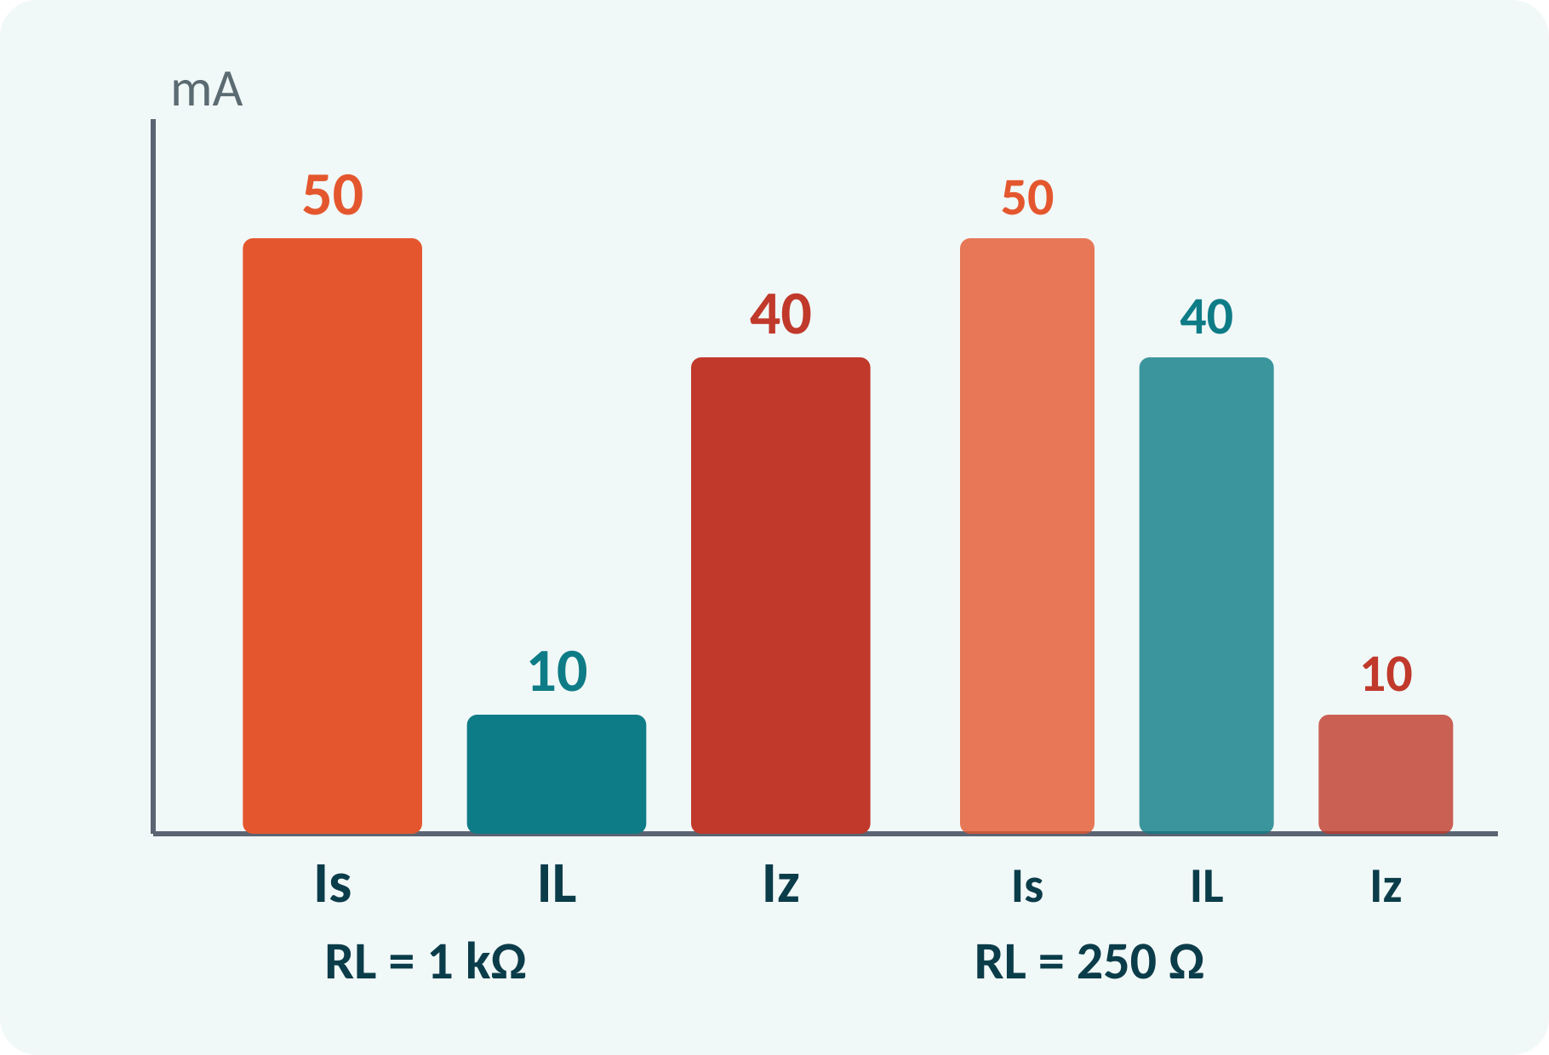
Solved Example 2: Zener Regulator
Vin = 20 V, Rs = 200 Ω, Vz = 10 V. Find Is, IL, Iz for RL = 1 kΩ and for RL = 250 Ω. Find RL,min if Iz,min = 5 mA.
1. Is = (20 − 10)/200 = 50 mA (both cases).
2. RL = 1 kΩ: IL = 10 mA, Iz = 40 mA.
3. RL = 250 Ω: IL = 40 mA, Iz = 10 mA.
4. IL,max = Is − Iz,min = 45 mA → RL,min = 10/0.045 = 222 Ω.
Answer: Iz = 40 mA and 10 mA; regulation holds for RL ≥ 222 Ω
Notes:
The series current depends only on the input voltage, the Zener voltage and Rs, so it is the same in both cases. With a light load the Zener carries most of it. With a heavier load the load current rises and the Zener current drops. The minimum load resistance is found by letting the Zener keep only its minimum current: all the remainder goes to the load.

Slide 15
Common Mistakes and Exam Tips
✕
Common mistakes
✓
Exam tips
Using 0.7 V for a Zener in breakdown.
Connecting the Zener forward-biased.
No series resistor with the Zener or diode.
Ignoring the minimum Zener current.
Assuming the diode is on without checking.
Check forward or reverse bias first.
Always include Rs.
Verify Iz,min ≤ Iz ≤ Iz,max.
Verify the current sign after solving.
Notes:
These are the points where marks are lost most often in diodes and Zener regulation. Give one quick example for each mistake. Remind students that writing the formula, substitution and the unit earns method marks even if the arithmetic slips. Encourage them to check the answer for reasonableness.

Slide 16
Summary
p-n junction: depletion region, barrier 0.7 V (Si).
Forward conducts above Vγ; reverse blocks.
Models: ideal, ideal + Vγ, + rd.
Zener operates in reverse breakdown at Vz.
Regulator: Iz = Is − IL stays within limits.
I = (V − Vγ)/R; Is = (Vin − Vz)/Rs; Iz = Is − IL
Notes:
Recap in one minute. Say each point and ask the class to recall the formula for it. If they remember these ideas, most numerical problems on diodes and Zener regulation are within reach. Next lecture: rectifiers: half-wave and full-wave bridge. Revise the two solved examples tonight.

Slide 17
Quick Quiz
Q1. Barrier potential of silicon is about:
(a) 0.3 V (b) 0.7 V (c) 1.2 V (d) 5 V
Ans: (b)
Q2. A diode is forward biased when:
(a) p to −, n to + (b) p to +, n to − (c) both to + (d) open
Ans: (b)
Q3. 10 V, 1 kΩ, Si diode: I =
(a) 10 mA (b) 9.3 mA (c) 0.7 mA (d) 0
Ans: (b)
Q4. Zener diode works in:
(a) forward region (b) reverse breakdown (c) cut-off only (d) saturation
Ans: (b)
Q5. Zener regulator: Iz equals:
(a) Is + IL (b) Is − IL (c) IL − Is (d) Vz/Rs
Ans: (b)
Notes:
Give about one minute per question and take a show of hands. Discuss why the wrong options are tempting, especially the one that uses a wrong formula. Use the quiz as a quick check on diodes and Zener regulation before leaving.

Slide 18
References
1
Boylestad Robert L. and Nashelsky Louis, Electronic Devices and Circuit Theory
11th Ed., PHI, 2016 (Units 3, 4, 5 textbook)
2
H. Cotton, Electrical Technology
7th Ed., CBS Publishers, 2005 (reference)
Next lecture: rectifiers: half-wave and full-wave bridge
Notes:
Point students to the textbooks listed in the syllabus for diodes and Zener regulation. Ask them to solve at least three textbook problems on this topic before the next class. Thank the class and preview the next lecture.

