Slide 1
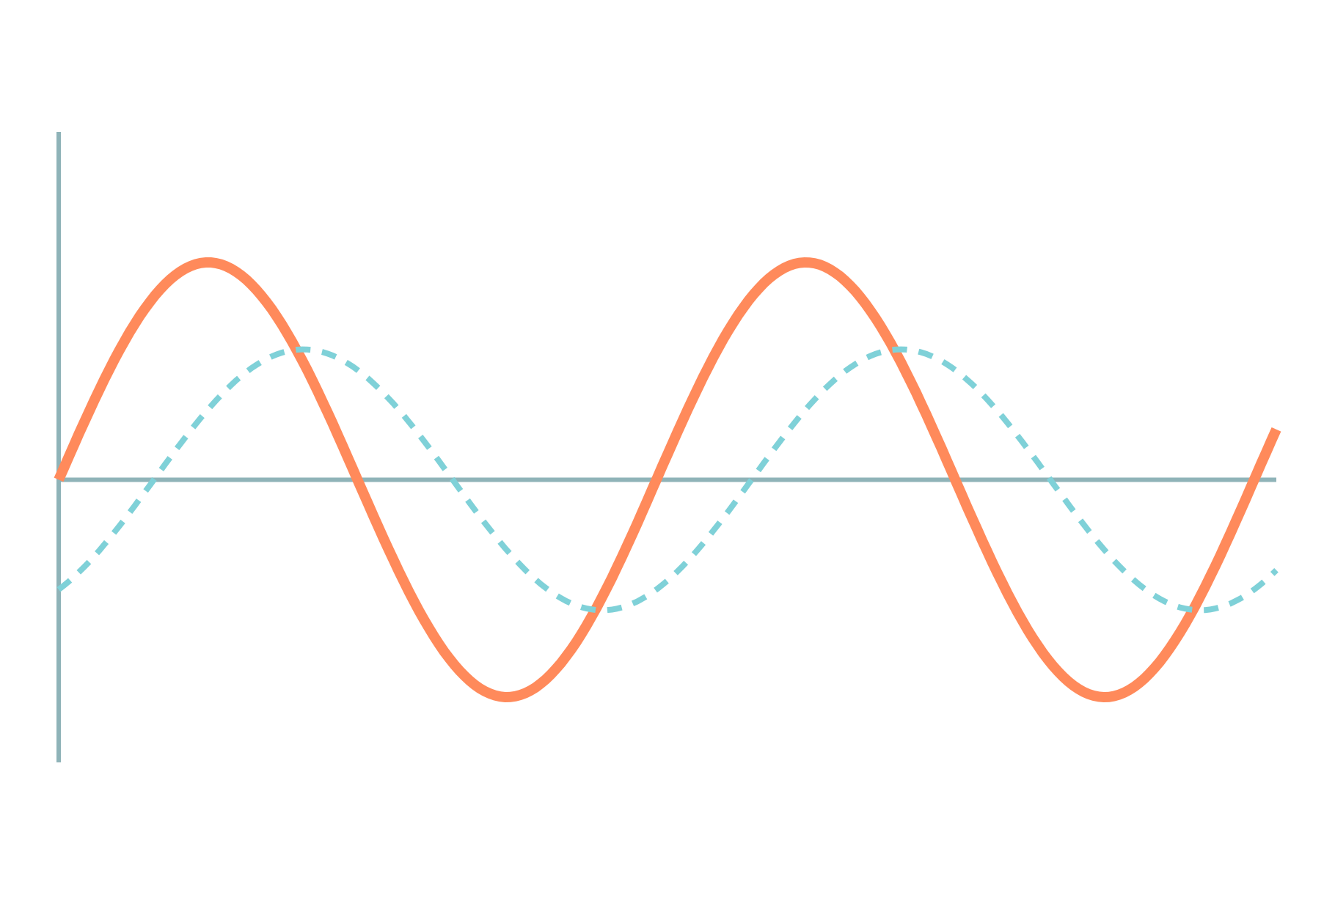
Half-Wave and Bridge Rectifiers
Basic Electrical and Electronics Engineering
Unit 3: Diodes, Transistors and their Applications
Topic: Half-wave rectifier, full-wave bridge rectifier
Prof. Mitesh Astik
Notes:
Welcome everyone. Today's topic is Half-wave rectifier, full-wave bridge rectifier. It belongs to Unit 3: Diodes, Transistors and their Applications. By the end of this session you will be able to use it in numerical problems. Keep your notebooks ready because we will solve two examples.

Slide 2

Learning Outcomes
Draw and explain the half-wave and bridge rectifiers.
Calculate Vdc, Idc, Vrms, ripple factor, efficiency, PIV.
Compare the two rectifiers.
Explain the effect of a capacitor filter.
Linked to CO3
Analyse diode characteristics to understand operation in specific applications.
Notes:
Read the outcomes aloud. They map to CO3 of the syllabus. Tell students that these are examinable and that the two solved examples follow the same pattern. Ask them to tick off each outcome at the end of the lecture.

Slide 3
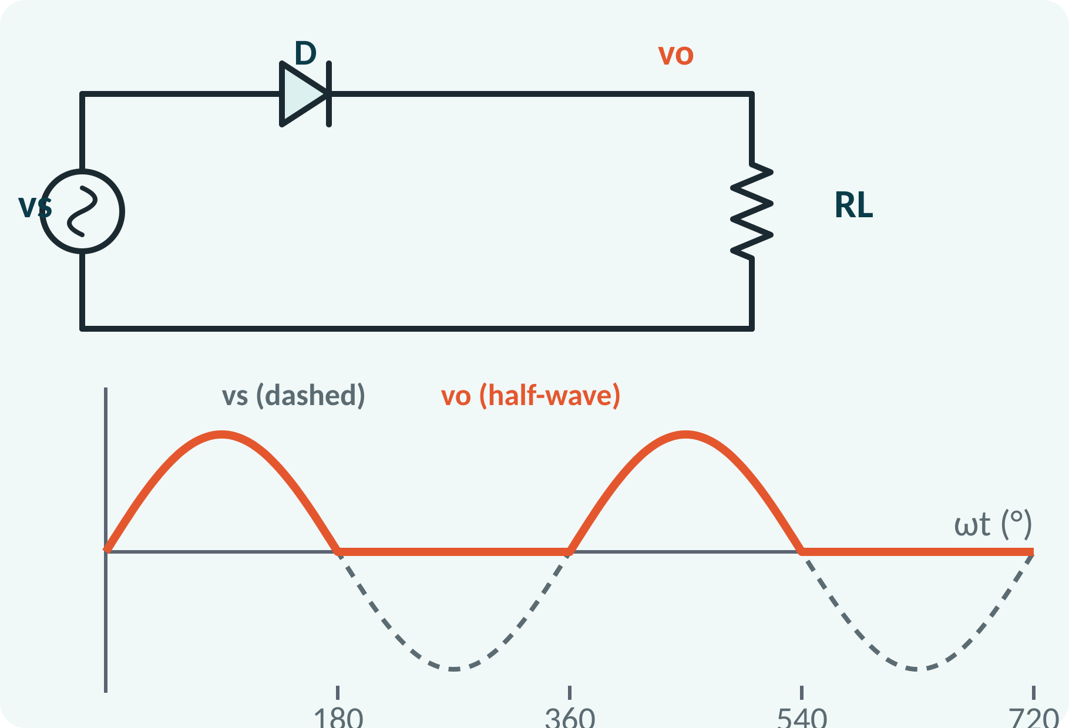
Recap: What You Already Know
A diode conducts when forward biased.
Practical drop Vγ ≈ 0.7 V (Si).
Sine wave: average over a half cycle 0.637 Vm.
RMS value of a sine: Vm/√2.
Average of a half-wave: Vm/π; RMS of a half-wave: Vm/2
Notes:
A diode passes current only when the anode is positive with respect to the cathode. We use the practical model with a 0.7 volt drop. From Unit 1 we know the average and RMS values of waveforms, which we will apply to the rectified output. Keep the RMS and average values of a sine wave in mind.

Slide 4
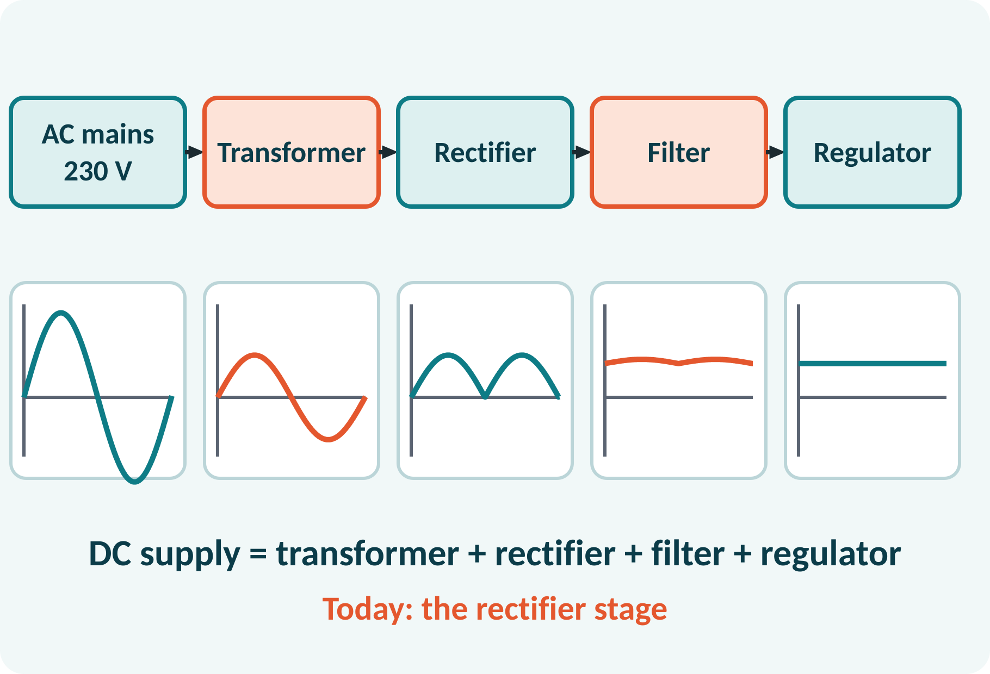
Motivation: AC Mains to DC Supply
Electronics need steady DC.
Mains is 50 Hz AC.
Chargers and adapters contain rectifiers.
Rectifier is the key step.
AC → transformer → rectifier → filter → regulator → DC load
Notes:
Every mobile charger or radio adapter converts AC to DC. The transformer first lowers the voltage, the rectifier converts AC to pulsating DC, the filter smooths it, and a regulator, such as the Zener or a 78xx IC, fixes the voltage. Today we study the rectifier stage.

Slide 5
Half-Wave Rectifier
One diode in series with the load.
Positive half-cycle: diode conducts.
Negative half-cycle: diode blocks.
Output is a series of positive half-sine pulses.
Output has a DC component plus ripple.
vo = Vm sin ωt for 0 ≤ ωt ≤ π; vo = 0 for π ≤ ωt ≤ 2π
Notes:
In the positive half-cycle the diode is forward biased and the load voltage follows the input. In the negative half-cycle the diode is reverse biased and no current flows. So only the positive half-cycles appear across the load. The output is unidirectional, but it is far from steady DC because it is zero for half the time.

Slide 6
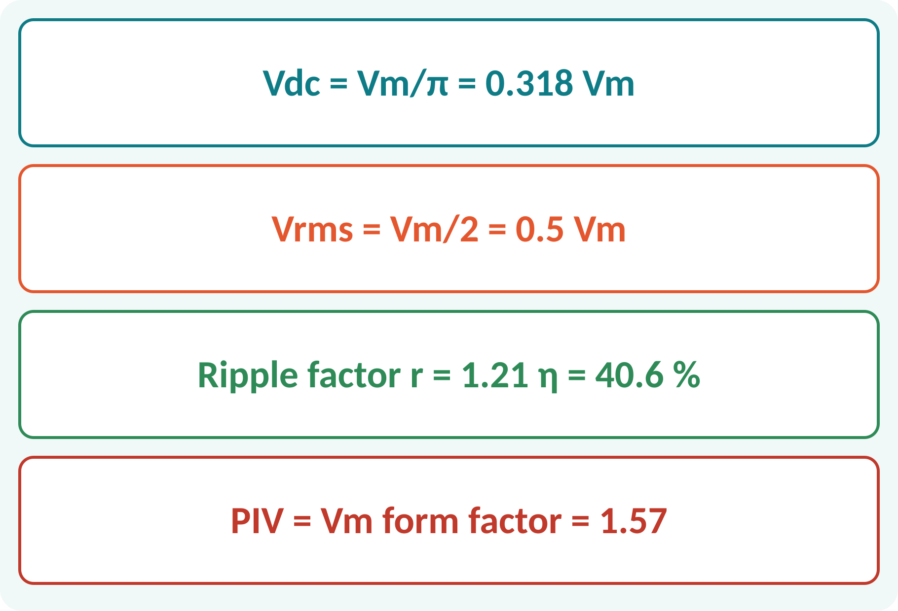
Half-Wave Rectifier: Performance
Average value: Vdc = Vm/π.
RMS value: Vrms = Vm/2.
Ripple factor 1.21: very poor.
Efficiency only 40.6 %.
Diode must withstand Vm in reverse (PIV).
Vdc = Vm/π; Idc = Im/π; Vrms = Vm/2; r = √[(Vrms/Vdc)² − 1] = 1.21; PIV = Vm
η = 0.406 (maximum)
Notes:
The average value of the half-wave output is Vm over pi and the RMS value is Vm over two. The ripple factor is the ratio of the AC to the DC content, which is 1.21: the ripple is bigger than the DC itself. The efficiency is at most 40.6 per cent. The diode must be rated to withstand the peak inverse voltage, which is the full peak of the input.

Slide 7
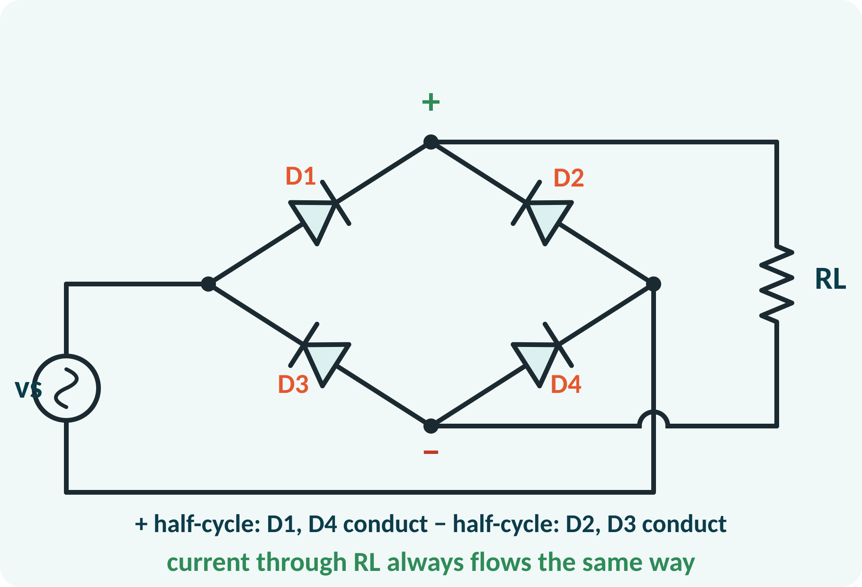
Full-Wave Bridge Rectifier
Four diodes in a bridge.
Positive half-cycle: D1 and D4 conduct.
Negative half-cycle: D2 and D3 conduct.
Current through the load has the same direction.
No centre-tapped transformer needed.
vo = |Vm sin ωt| (minus two diode drops in practice)
Notes:
In the bridge circuit each half-cycle uses a different pair of diodes, but in both the current flows through the load in the same direction. The top terminal of the bridge is always positive. In practice two diodes are in series with the load, so the peak output is Vm minus 1.4 volts. A bridge needs only a simple transformer without a centre tap.

Slide 8
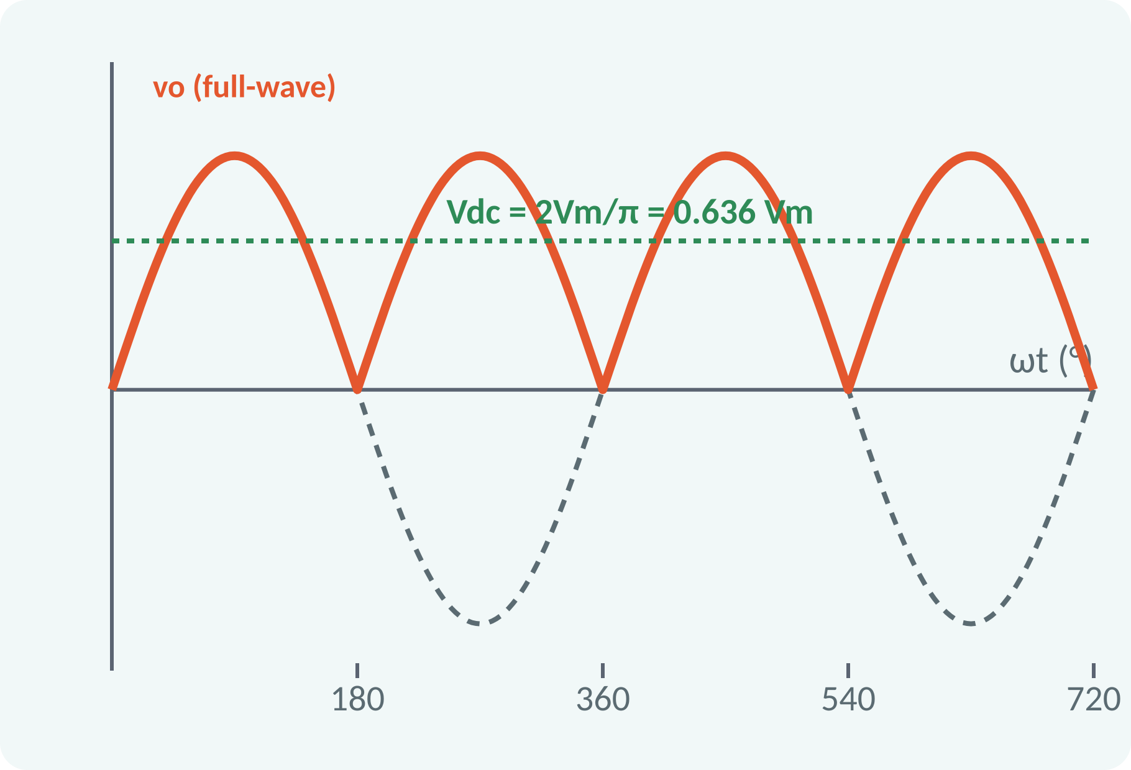
Bridge Rectifier: Performance
Both half-cycles are used.
Vdc doubles: 2Vm/π.
Ripple frequency doubles to 2f.
Efficiency 81.2 %.
PIV per diode is Vm.
Vdc = 2Vm/π = 0.636Vm; Vrms = Vm/√2; r = 0.482; η = 81.2 %; PIV = Vm
Notes:
Because both half-cycles reach the load, the average value doubles compared with the half-wave. The ripple factor falls to 0.48 and the efficiency doubles to 81 per cent. The ripple frequency is twice the supply frequency, which makes filtering easier. Each diode only needs to block Vm when it is off.

Slide 9
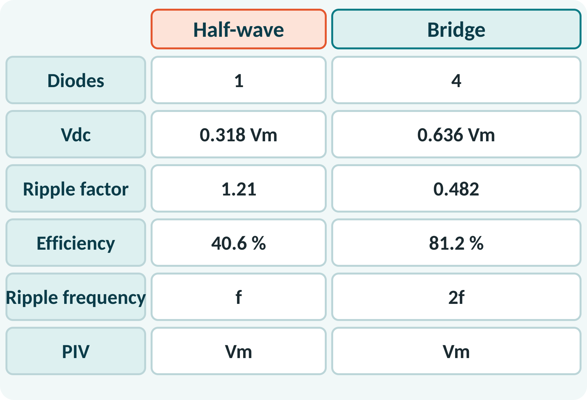
Half-Wave vs Bridge
Bridge: higher Vdc, lower ripple.
Bridge: twice the efficiency.
Half-wave: only one diode, simplest.
Bridge diodes: lower PIV than centre-tap.
Ripple frequency: f against 2f.
Prefer the bridge for power supplies; half-wave for very small loads
Notes:
Compare the two on the table. The bridge needs four diodes but gives a higher average voltage, a smaller ripple and twice the efficiency. The half-wave circuit is cheap and used only for very small loads such as indicator lamps. In both cases the diode must withstand a reverse voltage equal to Vm.

Slide 10
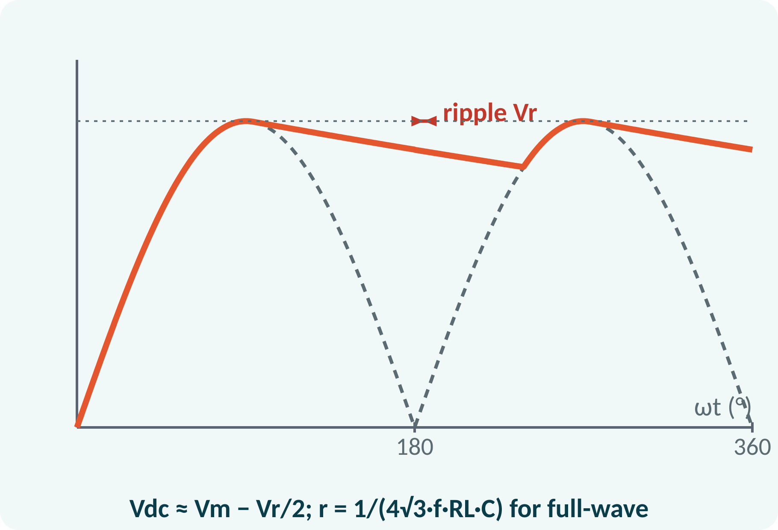
Capacitor Filter
Capacitor charges to the peak.
It discharges slowly through the load.
Output becomes nearly steady.
Larger C or RL: smaller ripple.
Diodes conduct in short pulses.
Vdc ≈ Vm − Vr/2; r = 1/(4√3·f·RL·C) (full-wave); r = 1/(2√3·f·RL·C) (half-wave)
Notes:
A capacitor connected across the load charges to the peak of the rectified voltage and then supplies the load while the rectified voltage falls. The output only drops by the ripple voltage before the next peak recharges it. Bigger capacitance or a larger load resistance gives less ripple. The trade-off is a larger peak current in the diodes.

Slide 11
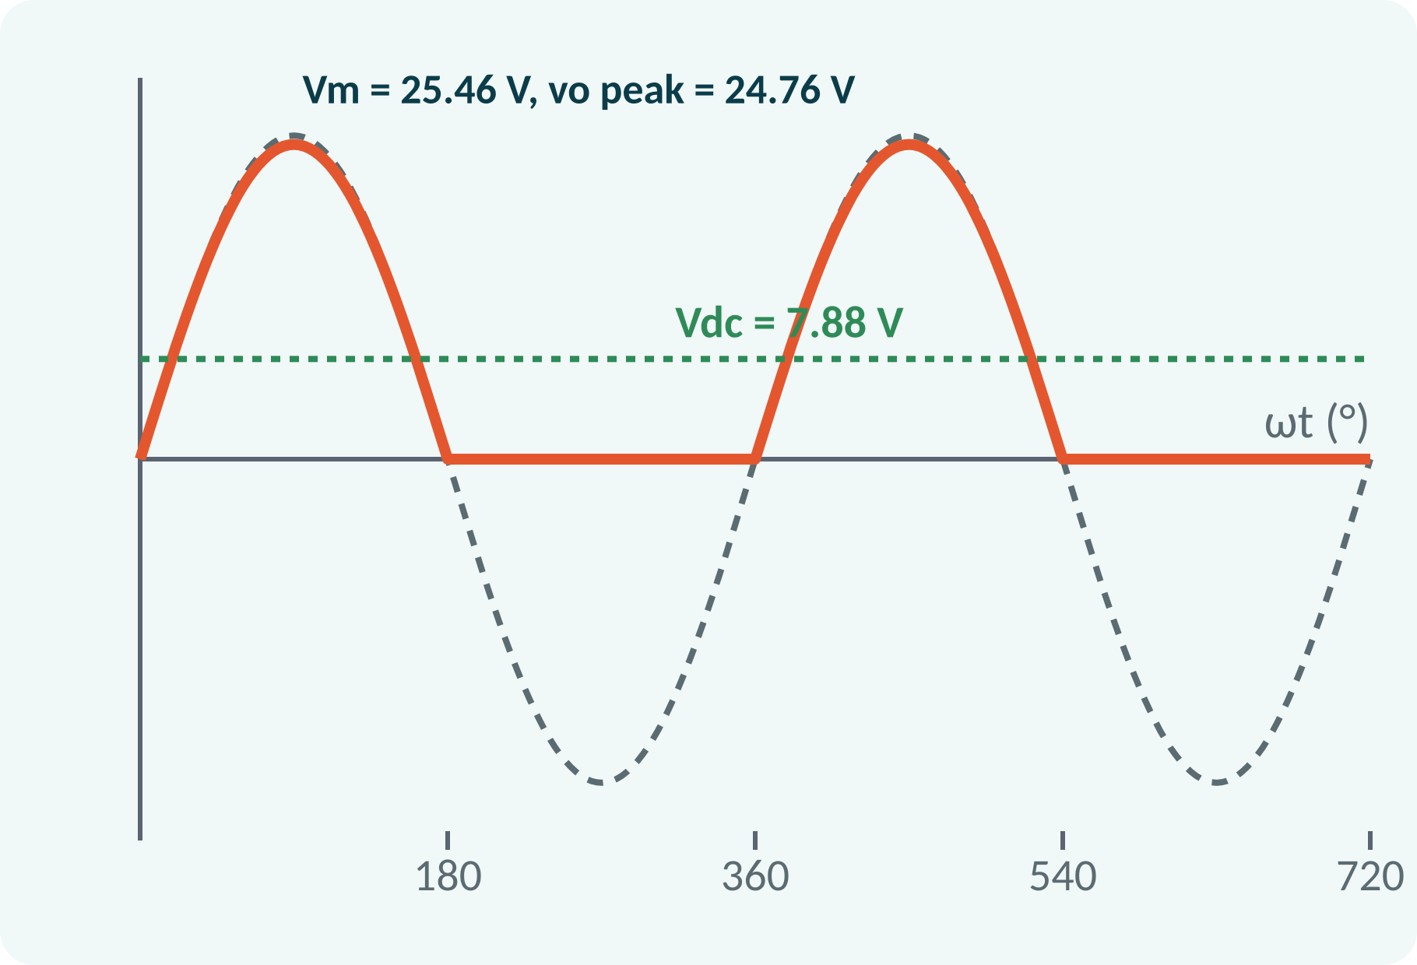
Solved Example 1: Half-Wave
A half-wave rectifier has a transformer secondary of 18 V RMS, RL = 100 Ω, Si diode. Find Vm, Vdc, Idc, Vrms and PIV.
1. Vm = 18√2 = 25.46 V.
2. Load peak = 25.46 − 0.7 = 24.76 V.
3. Vdc = 24.76/π = 7.88 V; Idc = 78.8 mA.
4. Vrms = 24.76/2 = 12.38 V.
5. PIV = Vm = 25.46 V.
Answer: Vdc = 7.88 V, Idc = 78.8 mA, Vrms = 12.4 V, PIV = 25.5 V
Notes:
Convert the RMS secondary voltage to peak. Subtract the diode drop to get the load peak voltage. The average voltage is the load peak over pi and the current follows from Ohm's law. The RMS value of a half-wave is half of the peak. The diode must withstand the full secondary peak when reverse biased, so choose a diode with a PIV rating above 26 volts.

Slide 12
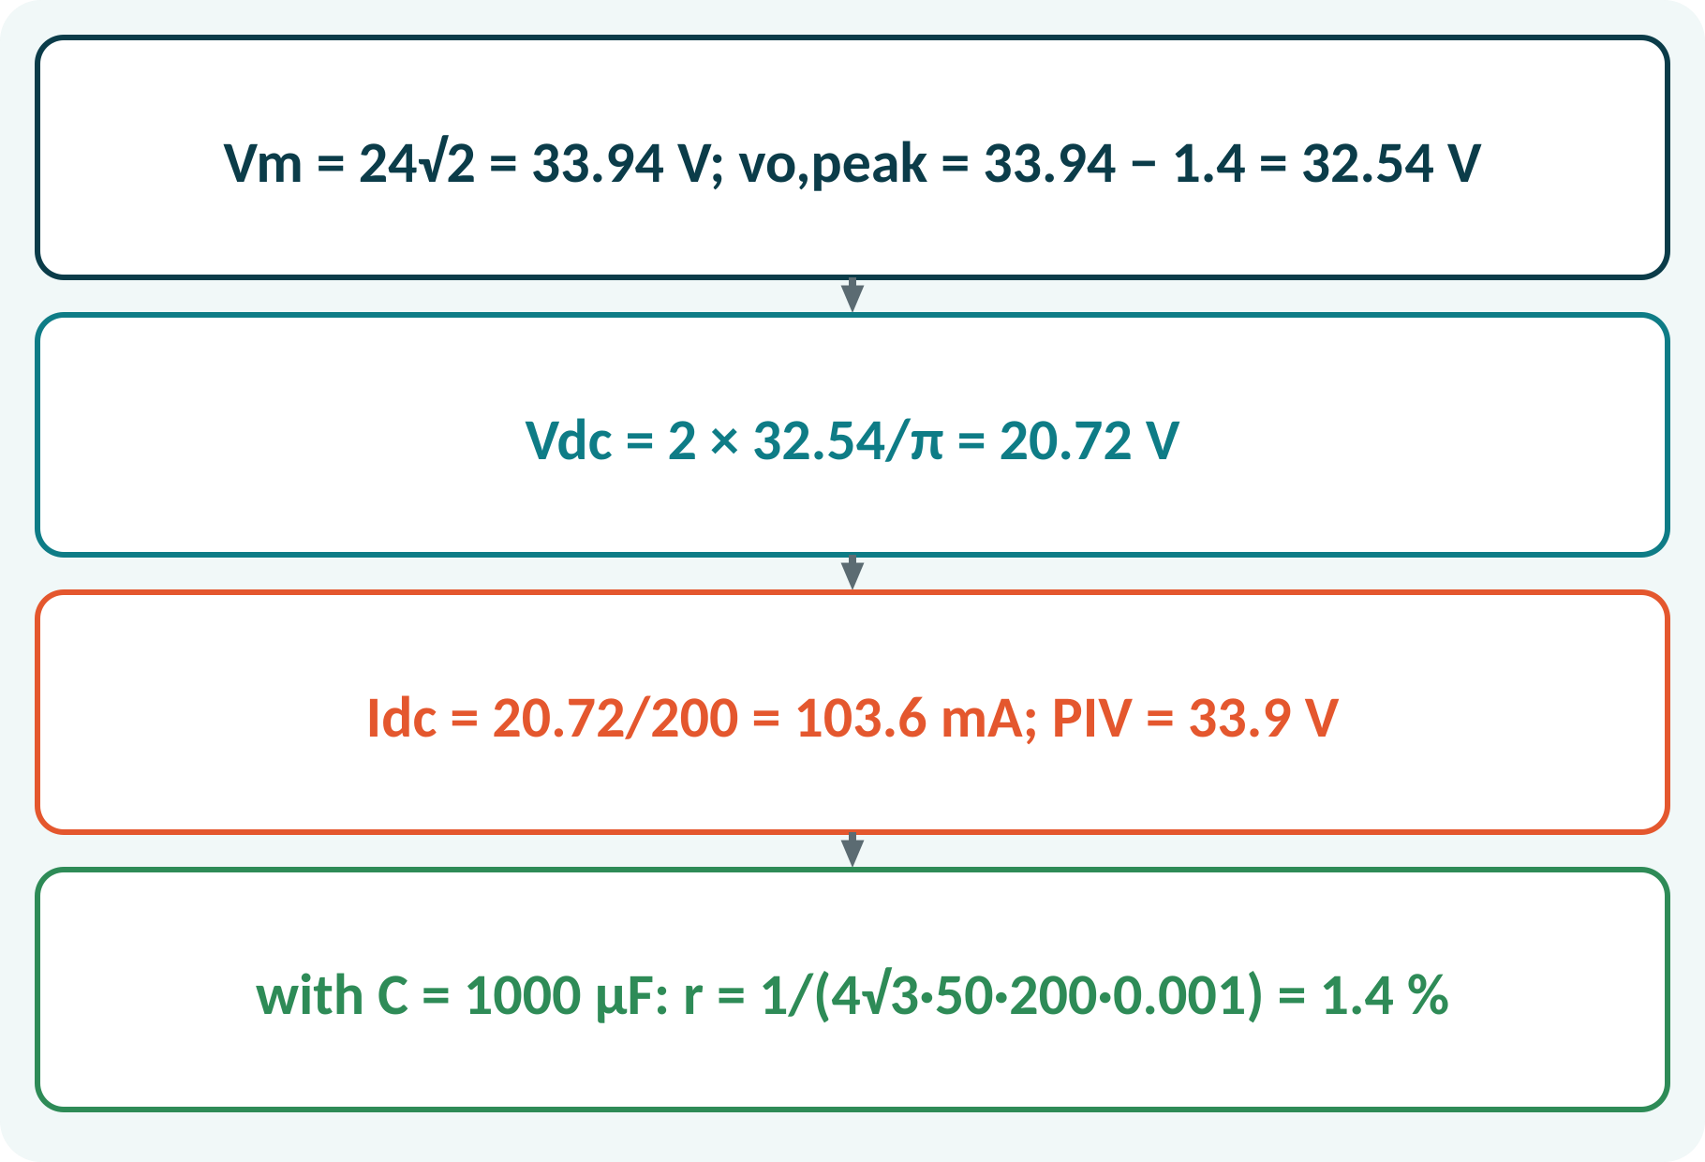
Solved Example 2: Bridge Rectifier
A bridge rectifier is fed from 24 V RMS and has RL = 200 Ω, Si diodes. Find Vdc, Idc, PIV and the ripple factor with a 1000 µF capacitor.
1. Vm = 24√2 = 33.94 V; load peak = 33.94 − 1.4 = 32.54 V.
2. Vdc = 2 × 32.54/π = 20.72 V (without C).
3. Idc = 20.72/200 = 103.6 mA.
4. PIV = Vm ≈ 33.9 V.
5. r = 1/(4√3·50·200·0.001) = 0.0144 (1.4 %).
Answer: Vdc = 20.7 V, Idc = 104 mA, PIV = 33.9 V; r = 1.4 % with 1000 µF
Notes:
Two diodes conduct at a time, so subtract two diode drops, 1.4 volts, from the peak. The average output is twice the peak over pi. A smoothing capacitor raises the DC voltage towards the peak and reduces the ripple factor to about 1.4 per cent for this load. Check that the diode ratings exceed the PIV and the peak current.

Slide 13
Common Mistakes and Exam Tips
✕
Common mistakes
✓
Exam tips
Using Vm/π for a bridge output.
Ignoring diode drops in low-voltage circuits.
Using RMS instead of peak in PIV.
Forgetting that the bridge conducts two diodes in series.
Taking ripple frequency as f for a bridge.
Convert RMS to peak first.
Subtract 0.7 V (or 1.4 V for a bridge).
PIV = Vm for the bridge and half-wave.
State Vdc formulas clearly.
Notes:
These are the points where marks are lost most often in rectifiers. Give one quick example for each mistake. Remind students that writing the formula, substitution and the unit earns method marks even if the arithmetic slips. Encourage them to check the answer for reasonableness.

Slide 14
Summary
Half-wave: one diode, Vdc = Vm/π, ripple 1.21, η = 40.6 %.
Bridge: four diodes, Vdc = 2Vm/π, ripple 0.48, η = 81.2 %.
PIV = Vm for both.
Bridge ripple frequency = 2f.
Capacitor filter lowers ripple.
Vdc(HW) = Vm/π; Vdc(FW) = 2Vm/π; η = Pdc/Pac
Notes:
Recap in one minute. Say each point and ask the class to recall the formula for it. If they remember these ideas, most numerical problems on rectifiers are within reach. Next lecture: BJT and its use as a switch. Revise the two solved examples tonight.

Slide 15
Quick Quiz
Q1. Vdc of a half-wave rectifier with Vm = 10 V:
(a) 3.18 V (b) 6.37 V (c) 5 V (d) 7.07 V
Ans: (a)
Q2. Ripple factor of a full-wave rectifier:
(a) 1.21 (b) 0.48 (c) 0.1 (d) 2
Ans: (b)
Q3. Diodes conducting in a bridge at a time:
(a) 1 (b) 2 (c) 3 (d) 4
Ans: (b)
Q4. Ripple frequency of a bridge on 50 Hz:
(a) 25 Hz (b) 50 Hz (c) 100 Hz (d) 150 Hz
Ans: (c)
Q5. Maximum efficiency of a half-wave rectifier:
(a) 81.2 % (b) 40.6 % (c) 100 % (d) 20 %
Ans: (b)
Notes:
Give about one minute per question and take a show of hands. Discuss why the wrong options are tempting, especially the one that uses a wrong formula. Use the quiz as a quick check on rectifiers before leaving.

Slide 16
References
1
Boylestad Robert L. and Nashelsky Louis, Electronic Devices and Circuit Theory
11th Ed., PHI, 2016 (Units 3, 4, 5 textbook)
2
H. Cotton, Electrical Technology
7th Ed., CBS Publishers, 2005 (reference)
Next lecture: Unit 4: BJT construction, operation and use as a switch
Notes:
Point students to the textbooks listed in the syllabus for rectifiers. Ask them to solve at least three textbook problems on this topic before the next class. Thank the class and preview the next lecture.

