Slide 1
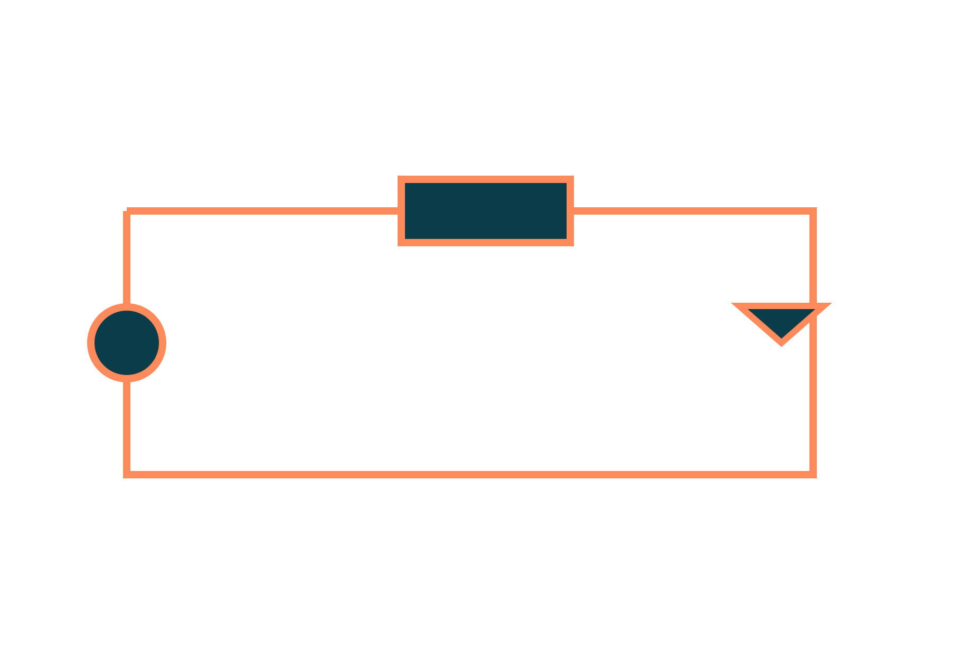
BJT: Operation, Load Line and Switch
Basic Electrical and Electronics Engineering
Unit 4: Transistors
Topic: BJT construction and operation, characteristics, DC load line, BJT as a switch
Prof. Mitesh Astik
Notes:
Welcome everyone. Today's topic is BJT construction and operation, characteristics, DC load line, BJT as a switch. It belongs to Unit 4: Transistors. By the end of this session you will be able to use it in numerical problems. Keep your notebooks ready because we will solve two examples.

Slide 2

Learning Outcomes
Describe BJT construction and operation.
Use IC = βIB and IE = IB + IC.
Read output characteristics and the DC load line.
Design a BJT switch.
Linked to CO4
Describe the construction and operation of BJT to operate as a switch.
Notes:
Read the outcomes aloud. They map to CO4 of the syllabus. Tell students that these are examinable and that the two solved examples follow the same pattern. Ask them to tick off each outcome at the end of the lecture.

Slide 3
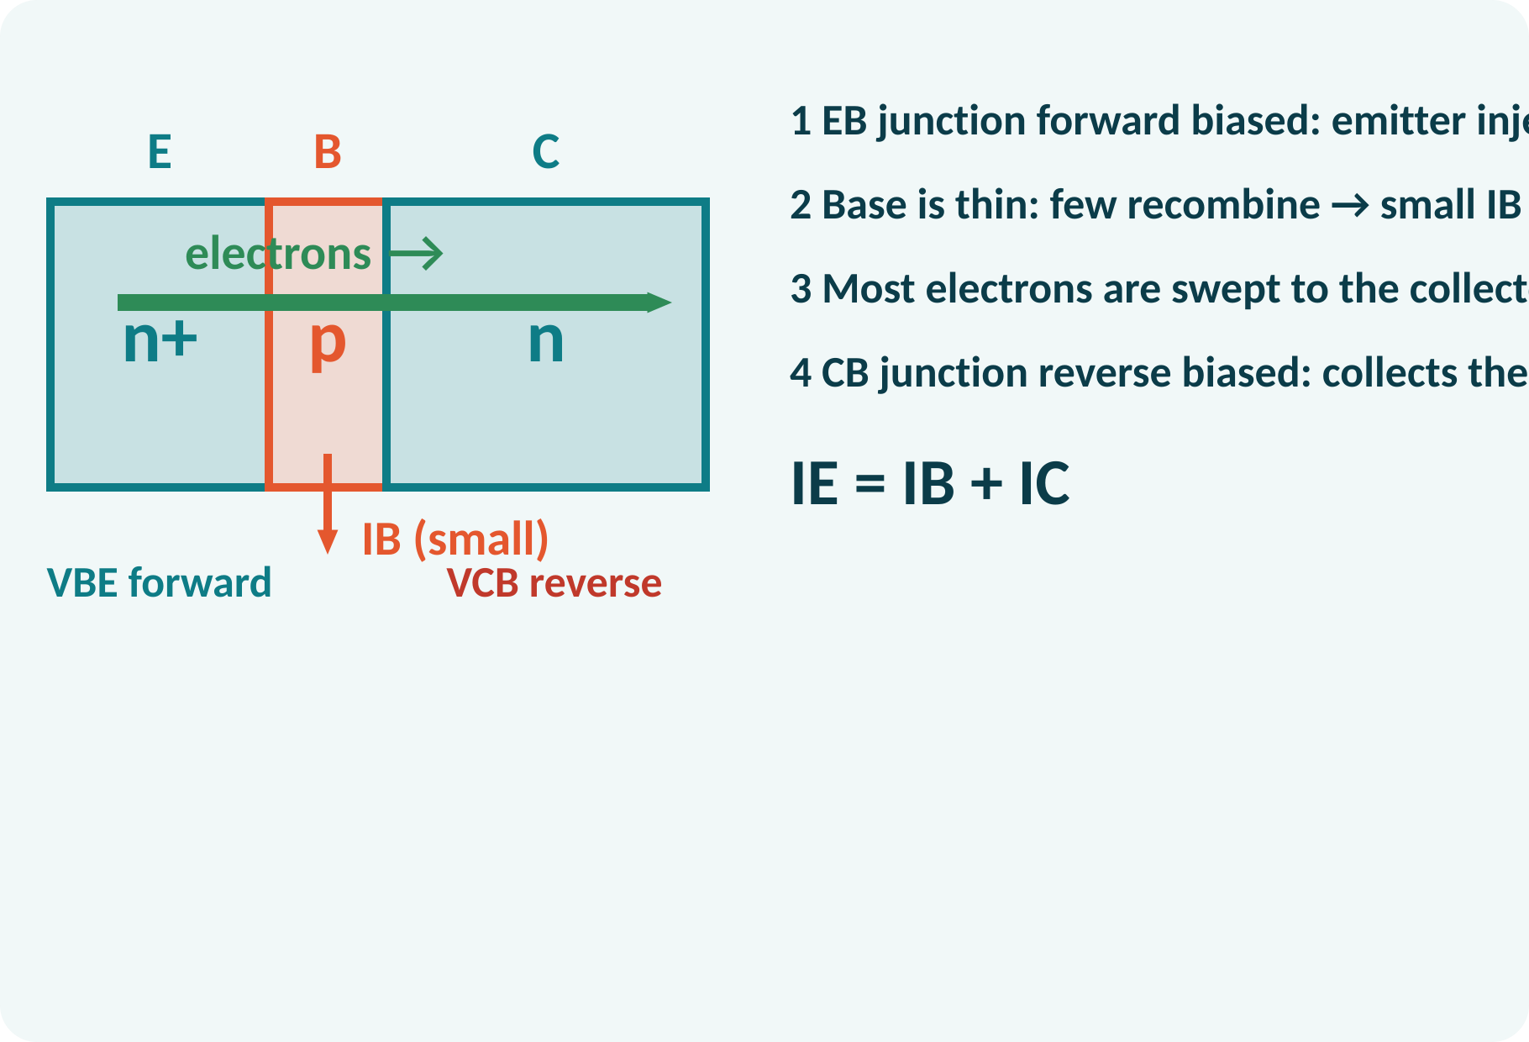
Recap: What You Already Know
p-n junction: forward and reverse bias.
Majority and minority carriers.
Forward bias lowers the barrier.
Kirchhoff's current law at a node.
KCL: IE = IB + IC; Vγ ≈ 0.7 V for a forward-biased silicon junction
Notes:
The BJT is two p-n junctions back to back, so everything we learned about diodes applies: a forward-biased junction conducts above about 0.7 volts and a reverse-biased junction blocks. Kirchhoff's current law applied to the transistor gives the emitter current as the sum of base and collector currents. Keep these two ideas in mind.

Slide 4
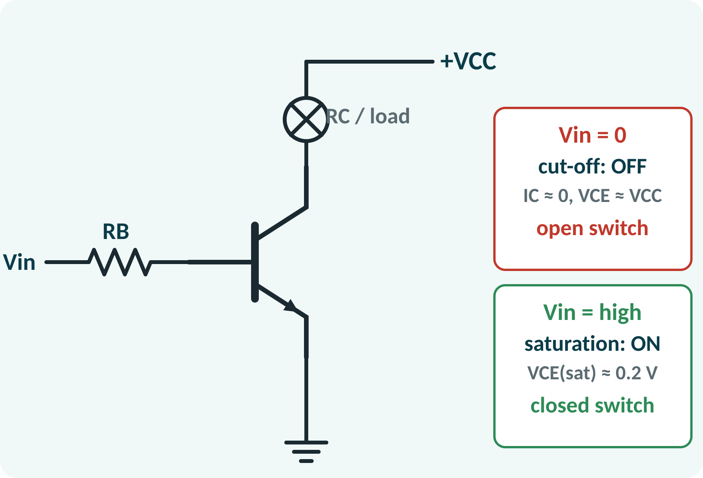
Motivation: One Device, Two Jobs
Amplifier: small signal controls big current.
Switch: turns lamps, relays and motors on and off.
Processors use millions of switches.
Interface between logic and power.
A small base current controls a much larger collector current
Notes:
A transistor can act as an amplifier or as a switch. In both roles a small current at the base controls a larger current in the collector. As a switch it lets a five volt logic signal turn on a lamp, a relay or a motor. Digital circuits use transistors purely as switches, billions of them in a modern processor.

Slide 5
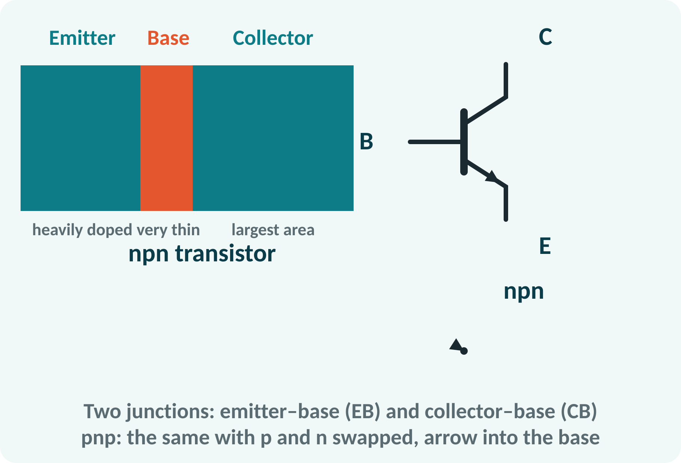
BJT Construction
Three layers: emitter, base, collector.
npn: n–p–n sandwich; pnp: p–n–p.
Emitter: heavily doped, emits carriers.
Base: very thin, lightly doped.
Collector: largest, collects carriers.
Arrow on the emitter shows conventional current direction (out for npn, in for pnp)
Notes:
The bipolar junction transistor has three regions. The emitter is heavily doped so it can inject many carriers. The base is very thin and lightly doped so that almost all of those carriers get through it. The collector is physically the largest because it must dissipate heat. The arrow on the emitter of the symbol shows the direction of conventional current.

Slide 6
Operation of an npn Transistor
Active mode: EB forward, CB reverse.
Emitter injects electrons into the base.
Base is thin: only about 1 % recombine → IB.
Reverse CB field sweeps the rest to the collector.
Small IB controls large IC.
IE = IB + IC; IC ≈ IE (α ≈ 0.99)
Notes:
With the emitter-base junction forward biased and the collector-base junction reverse biased, electrons flow from the emitter into the base. Since the base is very thin, only a few recombine with holes and form the base current. The reverse-biased collector junction pulls the other electrons across into the collector, forming the collector current. A tiny change in the base current changes the collector current by a factor beta.

Slide 7
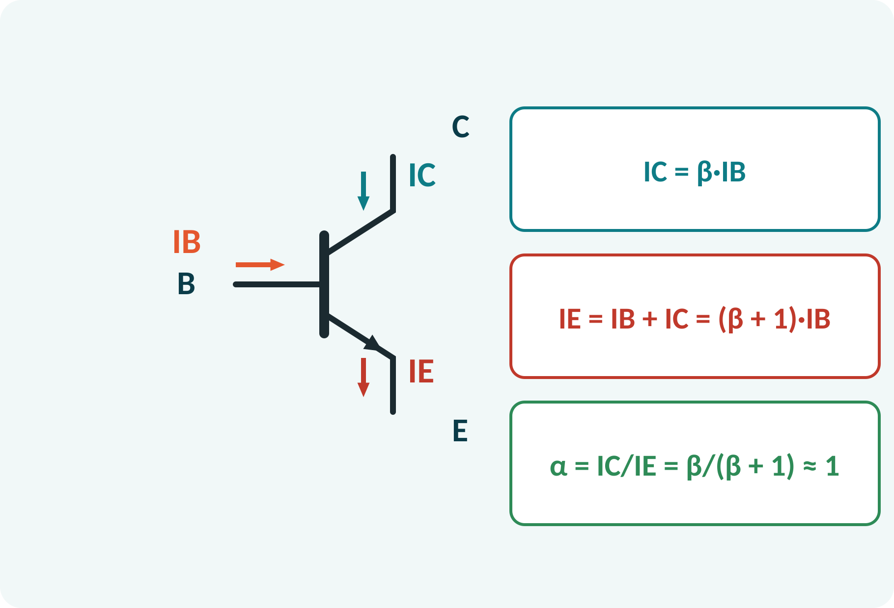
Current Relations
β (hFE): current gain, typically 50–300.
α: fraction of IE reaching the collector.
IC = β·IB in the active region.
Emitter current is the largest.
IC = β·IB; IE = IB + IC = (β + 1)·IB; α = β/(β + 1)
β dimensionless, currents in A or mA
Notes:
Beta is the ratio of collector to base current. It varies from one transistor to another and with temperature, so design should not depend on its exact value. The emitter current is the sum of the base and collector currents, so it is slightly larger than the collector current. Alpha, the ratio IC over IE, is close to one.

Slide 8
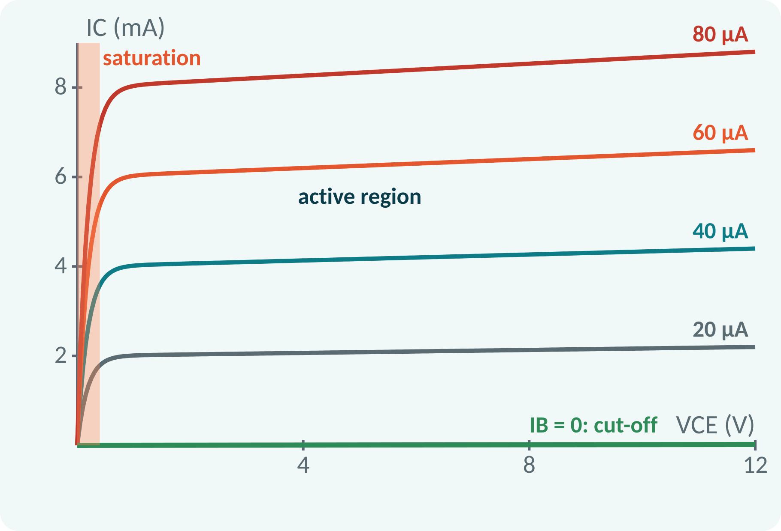
Common-Emitter Output Characteristics
IC against VCE for different base currents.
Active region: curves nearly flat, IC ≈ β·IB.
Saturation: small VCE, IC rises steeply.
Cut-off: IB = 0, IC ≈ 0.
Spacing of curves reflects β.
Active: IC ≈ β·IB; saturation: VCE(sat) ≈ 0.2 V; cut-off: IC ≈ ICEO (tiny)
Notes:
In the common-emitter configuration the base is the input and the collector the output. Each curve is for a fixed base current. For VCE above a few tenths of a volt the curve is nearly flat, so the collector current is set by the base current. At very low VCE the transistor is saturated and the current drops. When the base current is zero only a negligible leakage current flows.

Slide 9
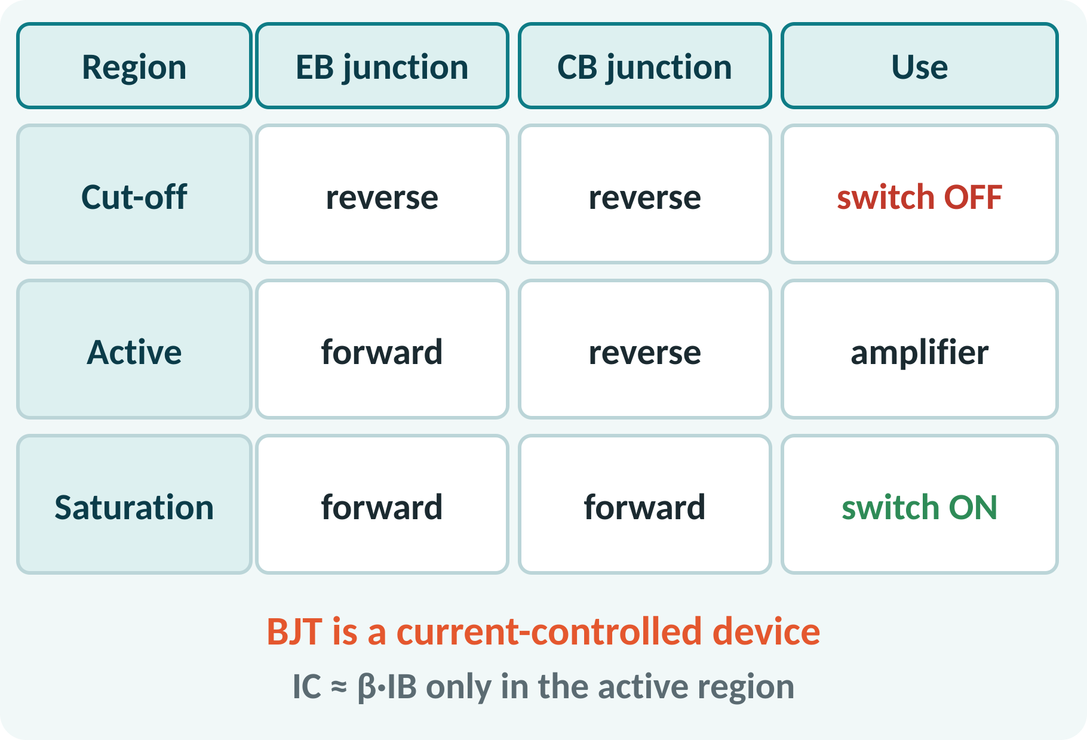
Regions of Operation
Cut-off: both junctions reverse biased.
Active: EB forward, CB reverse.
Saturation: both junctions forward biased.
Amplifier works in the active region.
Switch works between cut-off and saturation.
Cut-off: IB = 0, switch OFF; Saturation: IC = IC(sat), switch ON
Notes:
The state of the two junctions defines the operating region. In cut-off both are reverse biased, so no current flows and the switch is open. In the active region the emitter junction is forward and the collector junction reverse biased, the condition for amplification. In saturation both are forward biased, the collector voltage is only a fraction of a volt, and the switch is closed.

Slide 10
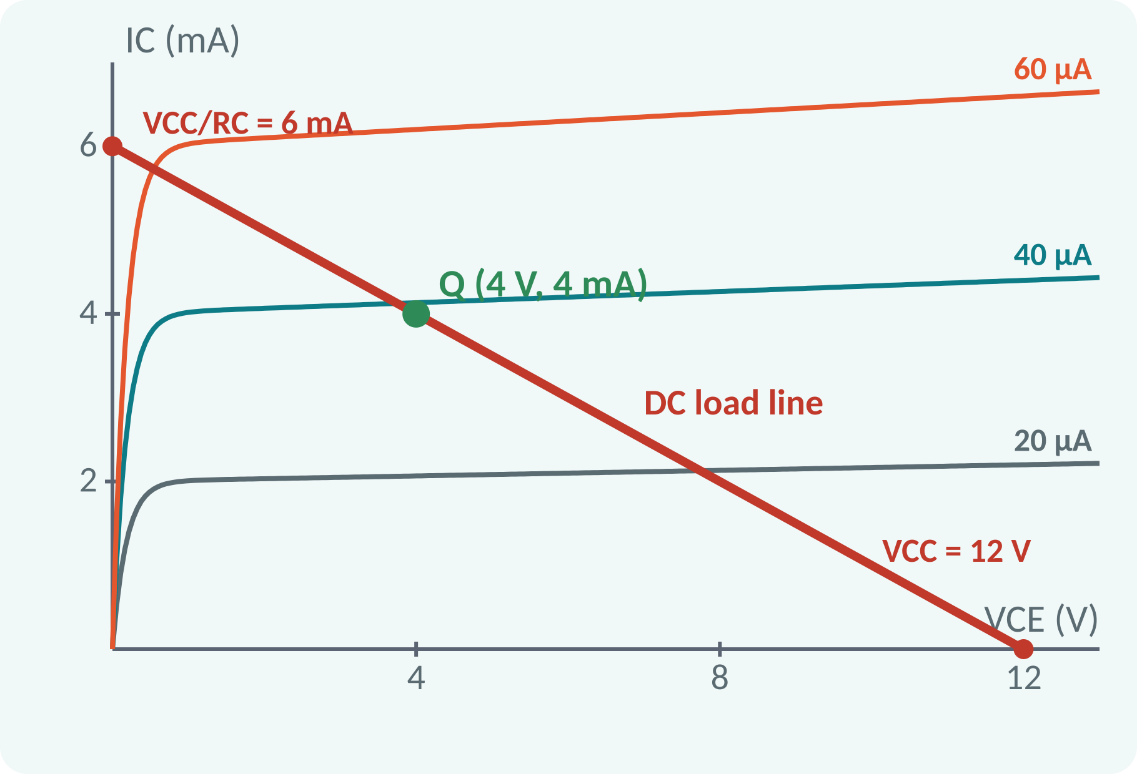
DC Load Line
Collector circuit: VCC = IC·RC + VCE.
Straight line on the output characteristics.
End points: (VCE = VCC, IC = 0) and (0, VCC/RC).
Operating (Q) point lies on the load line.
Q is set by the base current.
IC = (VCC − VCE)/RC; example VCC = 12 V, RC = 2 kΩ: (12 V, 0) and (0, 6 mA)
Q: IB = 40 µA → IC = 4 mA, VCE = 4 V
Notes:
Writing Kirchhoff's voltage law round the collector circuit gives a straight line relation between IC and VCE. Its end points are the cut-off point, where VCE equals VCC, and the saturation point, where IC equals VCC over RC. The transistor must operate on this line, at the point where it crosses the curve of the chosen base current. This is the Q-point and it fixes the DC bias.

Slide 11
BJT as a Switch
Input low: cut-off, transistor OFF.
Input high: saturation, transistor ON.
Load gets full VCC when ON, nothing when OFF.
VCE(sat) ≈ 0.2 V: nearly an ideal closed switch.
Used for LEDs, relays, motors and logic gates.
OFF: IC ≈ 0, VCE ≈ VCC; ON: IC = (VCC − VCE(sat))/RC, VCE ≈ 0.2 V
Notes:
A transistor switch is operated at the two ends of the load line. With zero input voltage the base current is zero and the transistor is cut off: the collector is at VCC and the lamp is off. With a high input voltage a large base current drives the transistor into saturation, the collector voltage falls to about 0.2 volts and the lamp gets nearly the whole supply. The device acts as a fast electronic switch with no moving parts.

Slide 12
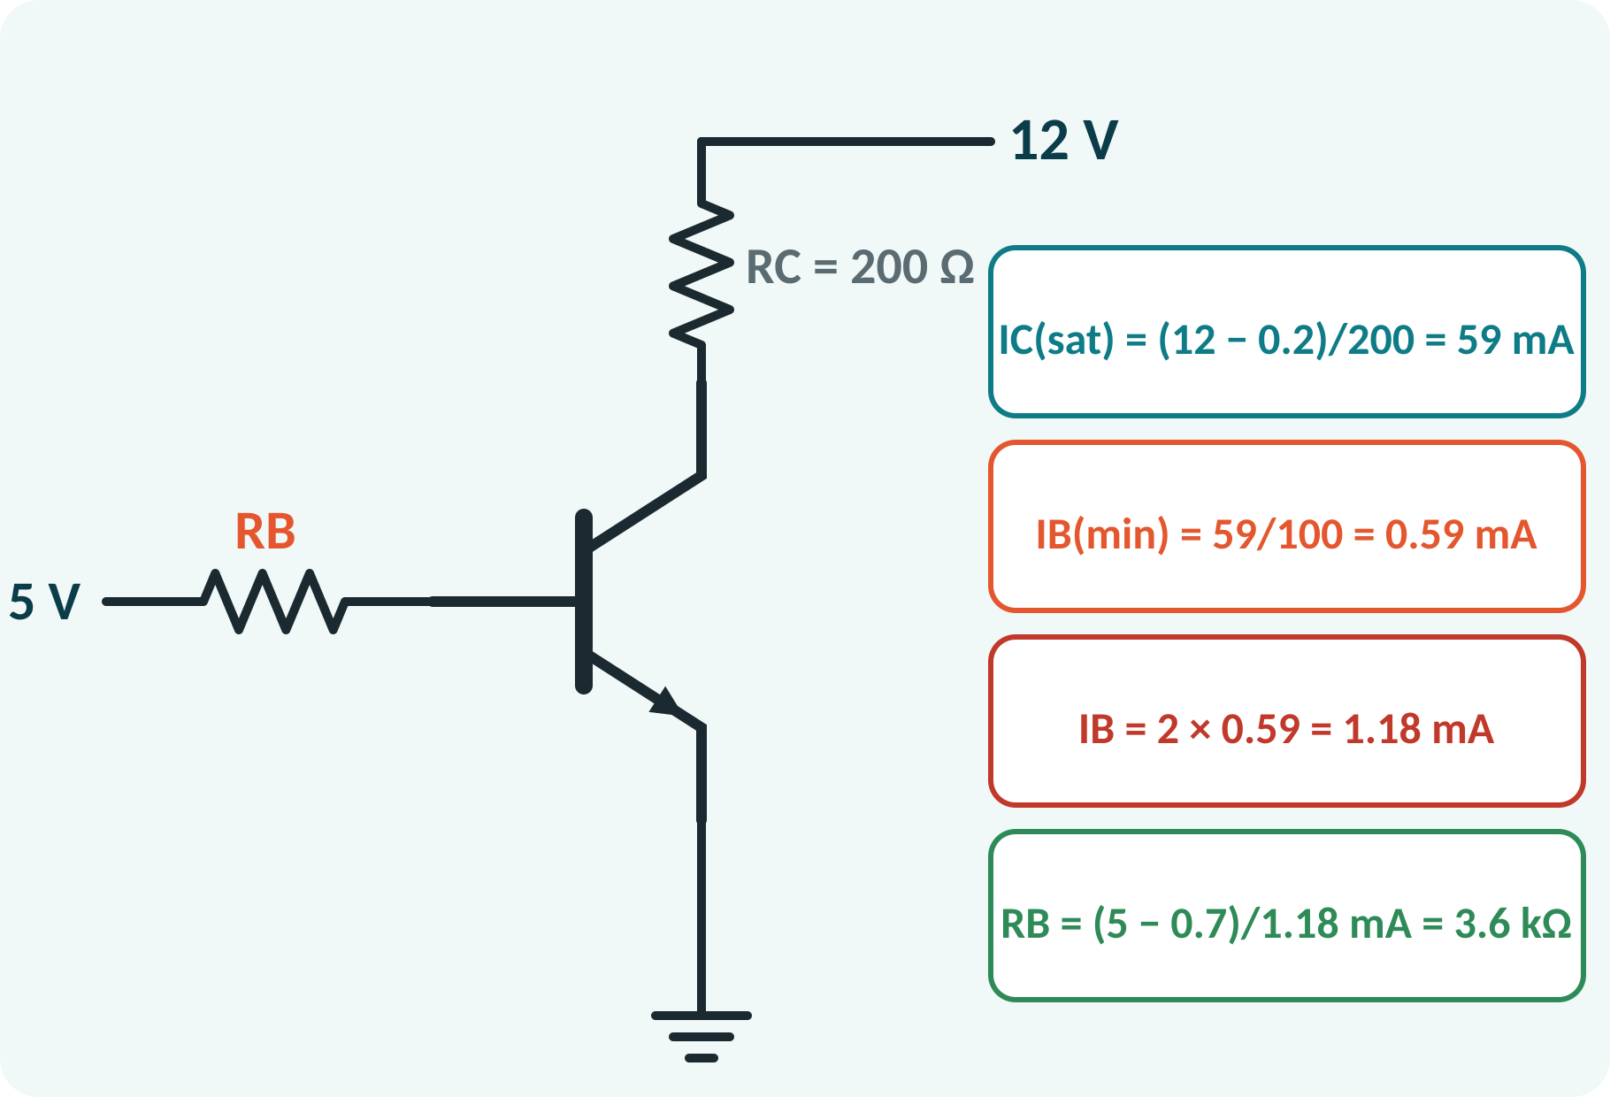
Designing a BJT Switch
Find IC(sat) from the load.
Required IB(min) = IC(sat)/βmin.
Overdrive: use 2–5 × IB(min).
Calculate RB from the input voltage.
Choose the nearest standard value.
IC(sat) = (VCC − VCE(sat))/RC; IB ≥ IC(sat)/β; RB = (Vin − VBE)/IB
Notes:
Start from the load: the collector current in saturation is set by the supply and the load resistor. The base current must be large enough to keep the transistor saturated even for the lowest possible beta, so divide by beta and multiply by an overdrive factor. Then compute the base resistor from the input voltage minus the 0.7 volt base-emitter drop.

Slide 13
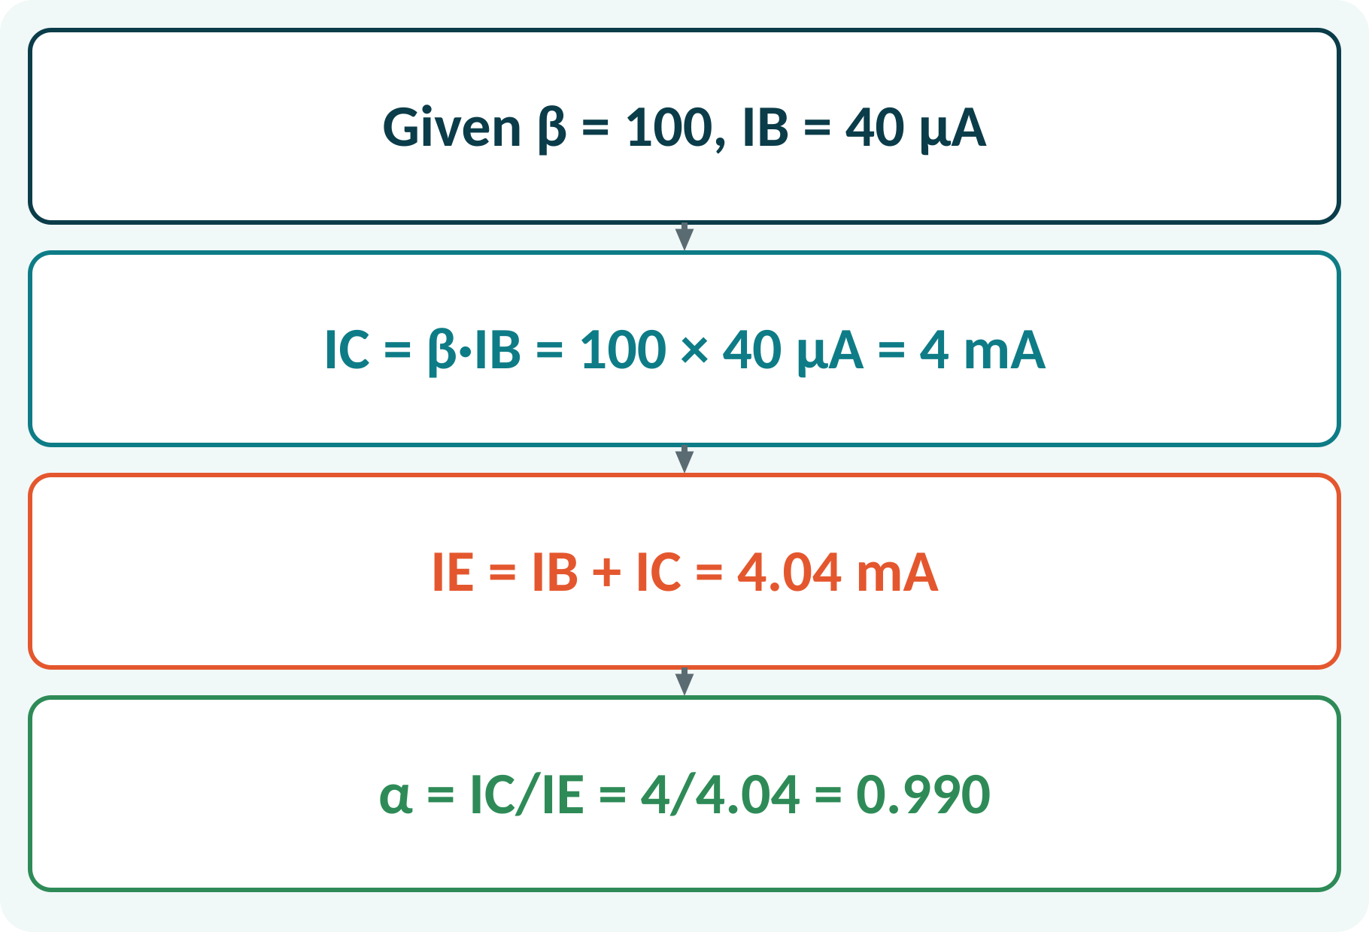
Solved Example 1: BJT Currents
A transistor with β = 100 has IB = 40 µA in the active region. Find IC, IE and α.
1. IC = β·IB = 100 × 40 µA = 4 mA.
2. IE = IB + IC = 0.04 + 4 = 4.04 mA.
3. α = IC/IE = 4/4.04 = 0.990.
4. Check: α = β/(β + 1) = 100/101 = 0.990.
Answer: IC = 4 mA, IE = 4.04 mA, α = 0.990
Notes:
The collector current is beta times the base current. The emitter current is the sum of base and collector currents, which is a little more than the collector current. The ratio of IC to IE is alpha, which agrees with beta over beta plus one. Always keep units consistent: microamperes and milliamperes.

Slide 14
Solved Example 2: Switch Design
Drive a 200 Ω load from 12 V using a 5 V logic signal. βmin = 100, VBE = 0.7 V, VCE(sat) = 0.2 V. Find RB.
1. IC(sat) = (12 − 0.2)/200 = 59 mA.
2. IB(min) = 59 mA/100 = 0.59 mA.
3. Overdrive × 2: IB = 1.18 mA.
4. RB = (5 − 0.7)/1.18 mA = 3.64 kΩ.
5. Choose RB = 3.3 kΩ: IB = 1.30 mA, which saturates the transistor.
Answer: RB ≈ 3.3 kΩ (standard), IC(sat) = 59 mA
Notes:
First find how much collector current the load needs when the transistor is fully on. Divide by the minimum beta to get the minimum base current, then double it to be safe. The base resistor follows from Ohm's law with the 0.7 volt drop. Picking the next lower standard value, 3.3 kilo-ohms, gives slightly more base current, which keeps the transistor firmly in saturation.

Slide 15
Common Mistakes and Exam Tips
✕
Common mistakes
✓
Exam tips
Using IC = β·IB in saturation.
Forgetting VBE = 0.7 V in the RB calculation.
Designing the switch with typical β instead of minimum.
Connecting a pnp with npn polarity.
No base resistor (damages the junction).
Check the region before using IC = βIB.
Overdrive the base for a switch.
Use the minimum β from the data sheet.
Check power rating of the transistor.
Notes:
These are the points where marks are lost most often in BJTs. Give one quick example for each mistake. Remind students that writing the formula, substitution and the unit earns method marks even if the arithmetic slips. Encourage them to check the answer for reasonableness.

Slide 16
Summary
BJT: emitter, base, collector; two junctions.
Active: EB forward, CB reverse.
IC = β·IB; IE = IB + IC.
DC load line joins (VCC, 0) and (0, VCC/RC).
Switch: cut-off = OFF, saturation = ON.
RB = (Vin − VBE)/IB, IB ≥ IC(sat)/β
Notes:
Recap in one minute. Say each point and ask the class to recall the formula for it. If they remember these ideas, most numerical problems on BJTs are within reach. Next lecture: MOSFET, common-source amplifier and MOS inverter. Revise the two solved examples tonight.

Slide 17
Quick Quiz
Q1. In active mode the junctions are:
(a) EB forward, CB reverse (b) both forward (c) both reverse (d) EB reverse, CB forward
Ans: (a)
Q2. β = 100, IB = 20 µA gives IC =
(a) 0.2 mA (b) 2 mA (c) 20 mA (d) 2 µA
Ans: (b)
Q3. BJT switch is ON in:
(a) cut-off (b) active (c) saturation (d) breakdown
Ans: (c)
Q4. Load-line saturation point for VCC = 10 V, RC = 1 kΩ:
(a) 10 mA (b) 1 mA (c) 100 mA (d) 10 V
Ans: (a)
Q5. The base of a BJT is:
(a) thick, heavily doped (b) thin, lightly doped (c) the largest region (d) metal
Ans: (b)
Notes:
Give about one minute per question and take a show of hands. Discuss why the wrong options are tempting, especially the one that uses a wrong formula. Use the quiz as a quick check on BJTs before leaving.

Slide 18
References
1
Boylestad Robert L. and Nashelsky Louis, Electronic Devices and Circuit Theory
11th Ed., PHI, 2016 (Units 3, 4, 5 textbook)
2
H. Cotton, Electrical Technology
7th Ed., CBS Publishers, 2005 (reference)
Next lecture: MOSFET, common-source amplifier and MOS inverter
Notes:
Point students to the textbooks listed in the syllabus for BJTs. Ask them to solve at least three textbook problems on this topic before the next class. Thank the class and preview the next lecture.

