Slide 1
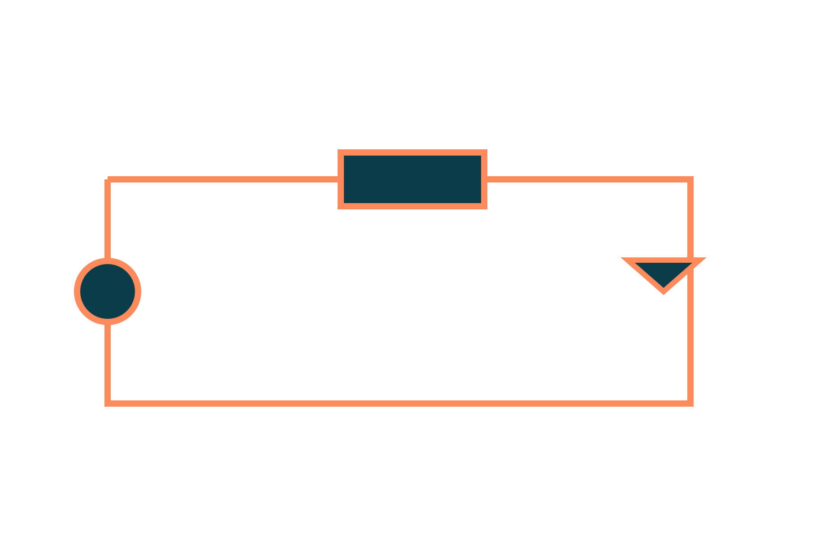
MOSFET, CS Amplifier and MOS Inverter
Basic Electrical and Electronics Engineering
Unit 4: Transistors
Topic: n-channel enhancement MOSFET, characteristics, common-source amplifier, DC load line, MOS inverter
Prof. Mitesh Astik
Notes:
Welcome everyone. Today's topic is n-channel enhancement MOSFET, characteristics, common-source amplifier, DC load line, MOS inverter. It belongs to Unit 4: Transistors. By the end of this session you will be able to use it in numerical problems. Keep your notebooks ready because we will solve two examples.

Slide 2

Learning Outcomes
Describe the structure and working of an n-channel enhancement MOSFET.
Read the output and transfer characteristics.
Find the Q-point using the DC load line.
Explain the common-source amplifier and MOS inverter.
Linked to CO4
Describe the construction and operation of FET to operate as a switch.
Notes:
Read the outcomes aloud. They map to CO4 of the syllabus. Tell students that these are examinable and that the two solved examples follow the same pattern. Ask them to tick off each outcome at the end of the lecture.

Slide 3
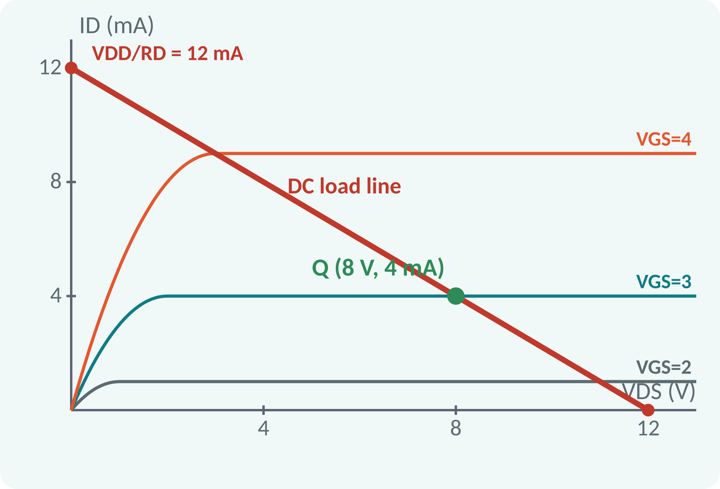
Recap: What You Already Know
BJT: current-controlled (IB controls IC).
Load line: VCC = IC·RC + VCE.
Q-point sets the DC bias.
Switch: cut-off and saturation.
MOSFET: voltage-controlled (VGS controls ID); load line: VDD = ID·RD + VDS
Notes:
In the last lecture we saw that the BJT is controlled by the base current. The MOSFET is controlled by a voltage at the gate, with practically no gate current. The load-line method that we learned for the BJT works in the same way here. We simply replace the collector quantities by the drain quantities.

Slide 4
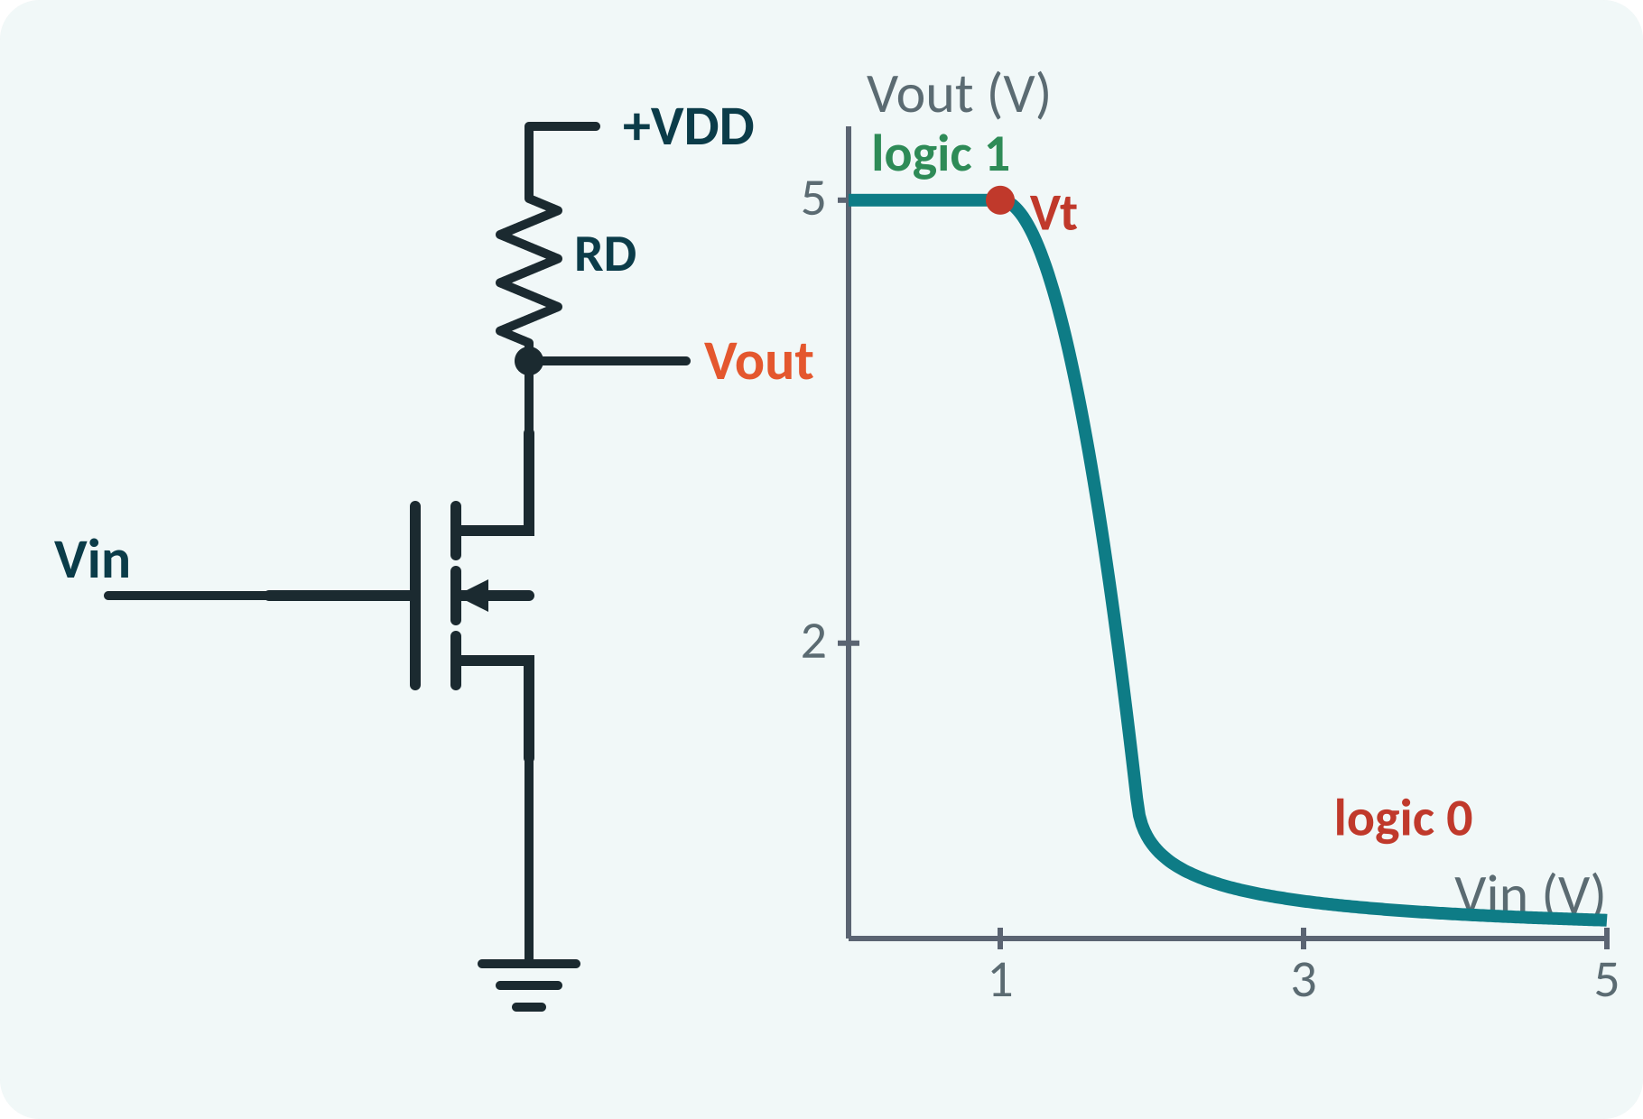
Motivation: The Transistor of Modern Electronics
Billions in a processor or phone.
Very high input resistance; low power.
Small, easy to integrate.
Basic building block of logic gates.
MOSFET dominates ICs: amplifiers, memories, processors, power switches
Notes:
Almost every integrated circuit uses MOSFETs. Because the gate is insulated by an oxide layer, the input resistance is extremely high and the device takes almost no input power. They are small and easy to fabricate in large numbers. In this lecture we learn the n-channel enhancement MOSFET and two key circuits, the common-source amplifier and the inverter.

Slide 5
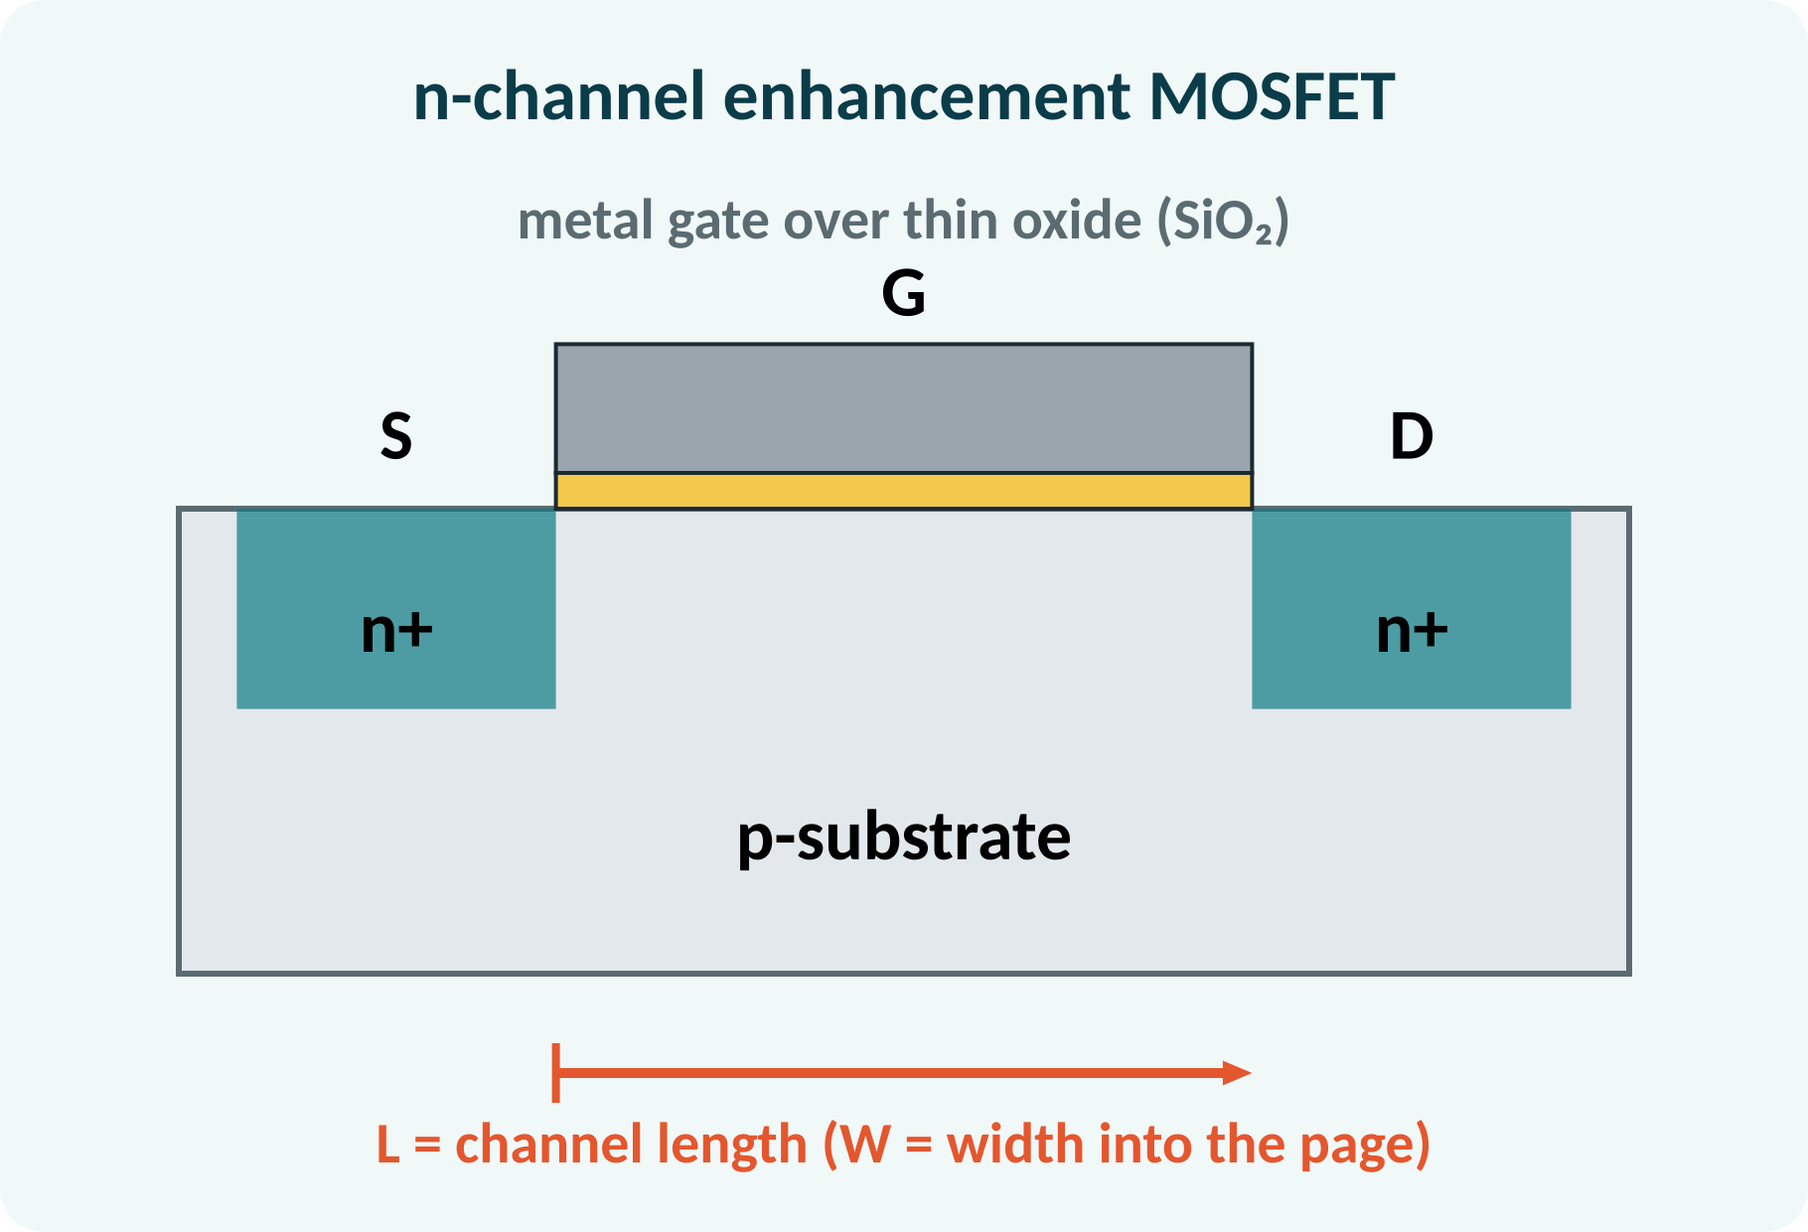
Structure of the n-Channel Enhancement MOSFET
p-type substrate (body).
Two n+ regions: source and drain.
Thin SiO₂ insulating layer over the channel region.
Metal gate on the oxide.
No channel exists at VGS = 0.
Terminals: Gate (G), Drain (D), Source (S), Body (B, tied to S); L channel length, W width
Notes:
The n-channel MOSFET is built on a p-type substrate in which two heavily doped n regions form the source and drain. Between them, a thin insulating layer of silicon dioxide separates the metal gate from the substrate. Since the gate is insulated, no current flows into it. In the enhancement type there is no channel between source and drain until a gate voltage is applied.

Slide 6
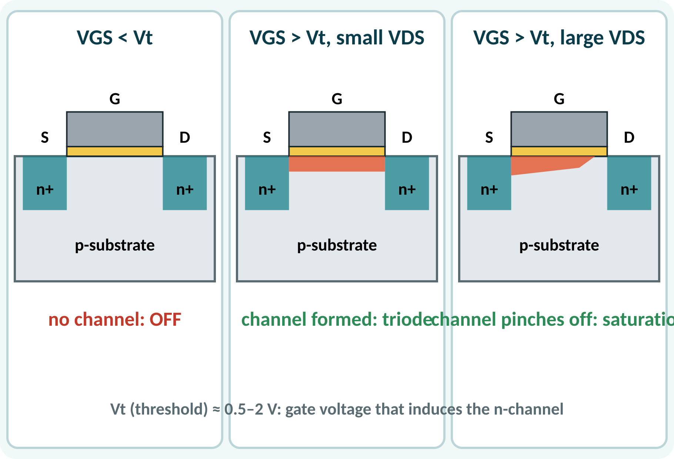
Working of the MOSFET
VGS < Vt: no channel; ID ≈ 0 (OFF).
VGS > Vt: positive gate attracts electrons: n-channel forms.
Small VDS: channel acts as a resistor (triode).
Large VDS: channel pinches off near the drain.
Beyond pinch-off ID is nearly constant (saturation).
Channel induced when VGS > Vt; pinch-off when VDS = VGS − Vt
Notes:
At zero gate voltage the two n regions are separated by the p region, so no current flows. When the gate voltage exceeds the threshold voltage, the positive field attracts electrons to the surface and forms an n-type channel linking source and drain. For small drain voltage the channel behaves as a resistor. At larger drain voltage the channel narrows near the drain and the current levels off.

Slide 7
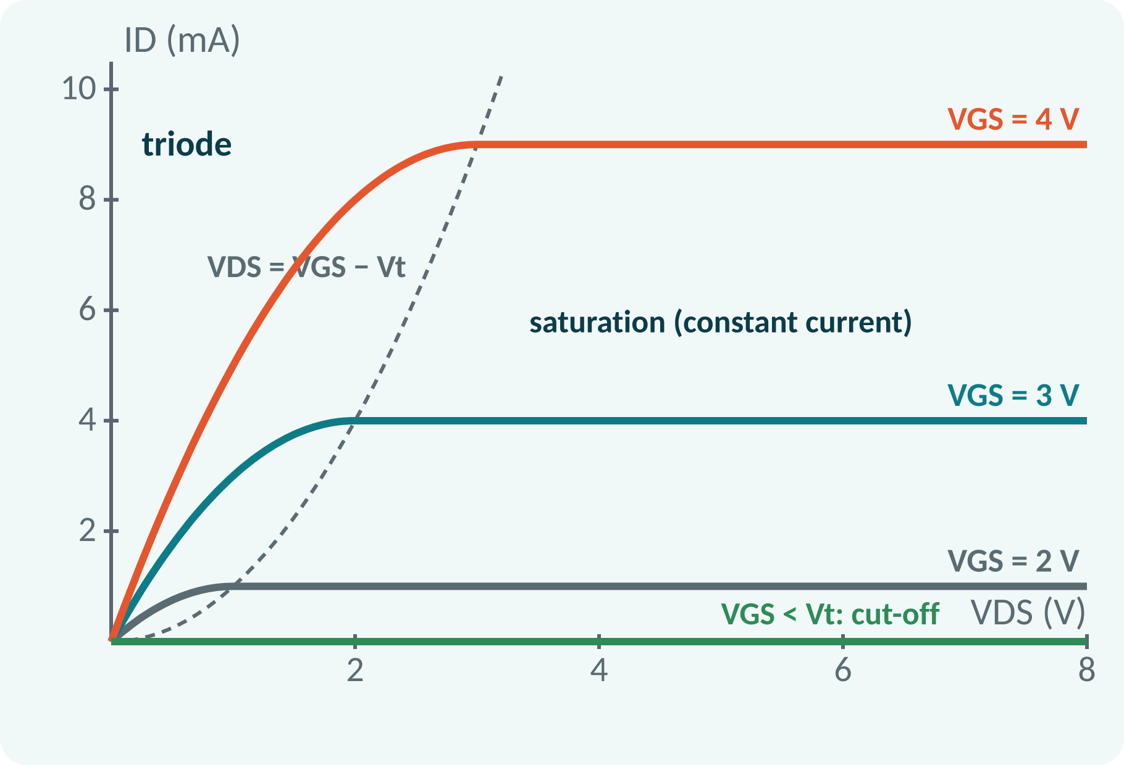
Output Characteristics
ID against VDS for fixed VGS values.
Triode region: ID rises with VDS (resistor-like).
Saturation: ID nearly flat; used for amplification.
Cut-off: VGS < Vt, ID = 0.
Boundary: VDS = VGS − Vt.
Triode: VDS < VGS − Vt; saturation: VDS ≥ VGS − Vt; cut-off: VGS < Vt
Notes:
Each curve is for a fixed gate voltage. In the triode region the current increases roughly linearly at first, then the curve bends. At the boundary VDS equals VGS minus Vt the current reaches its saturation value. The saturation current grows with the square of VGS minus Vt, so the spacing of the curves increases. The MOSFET is OFF when VGS is below the threshold.

Slide 8
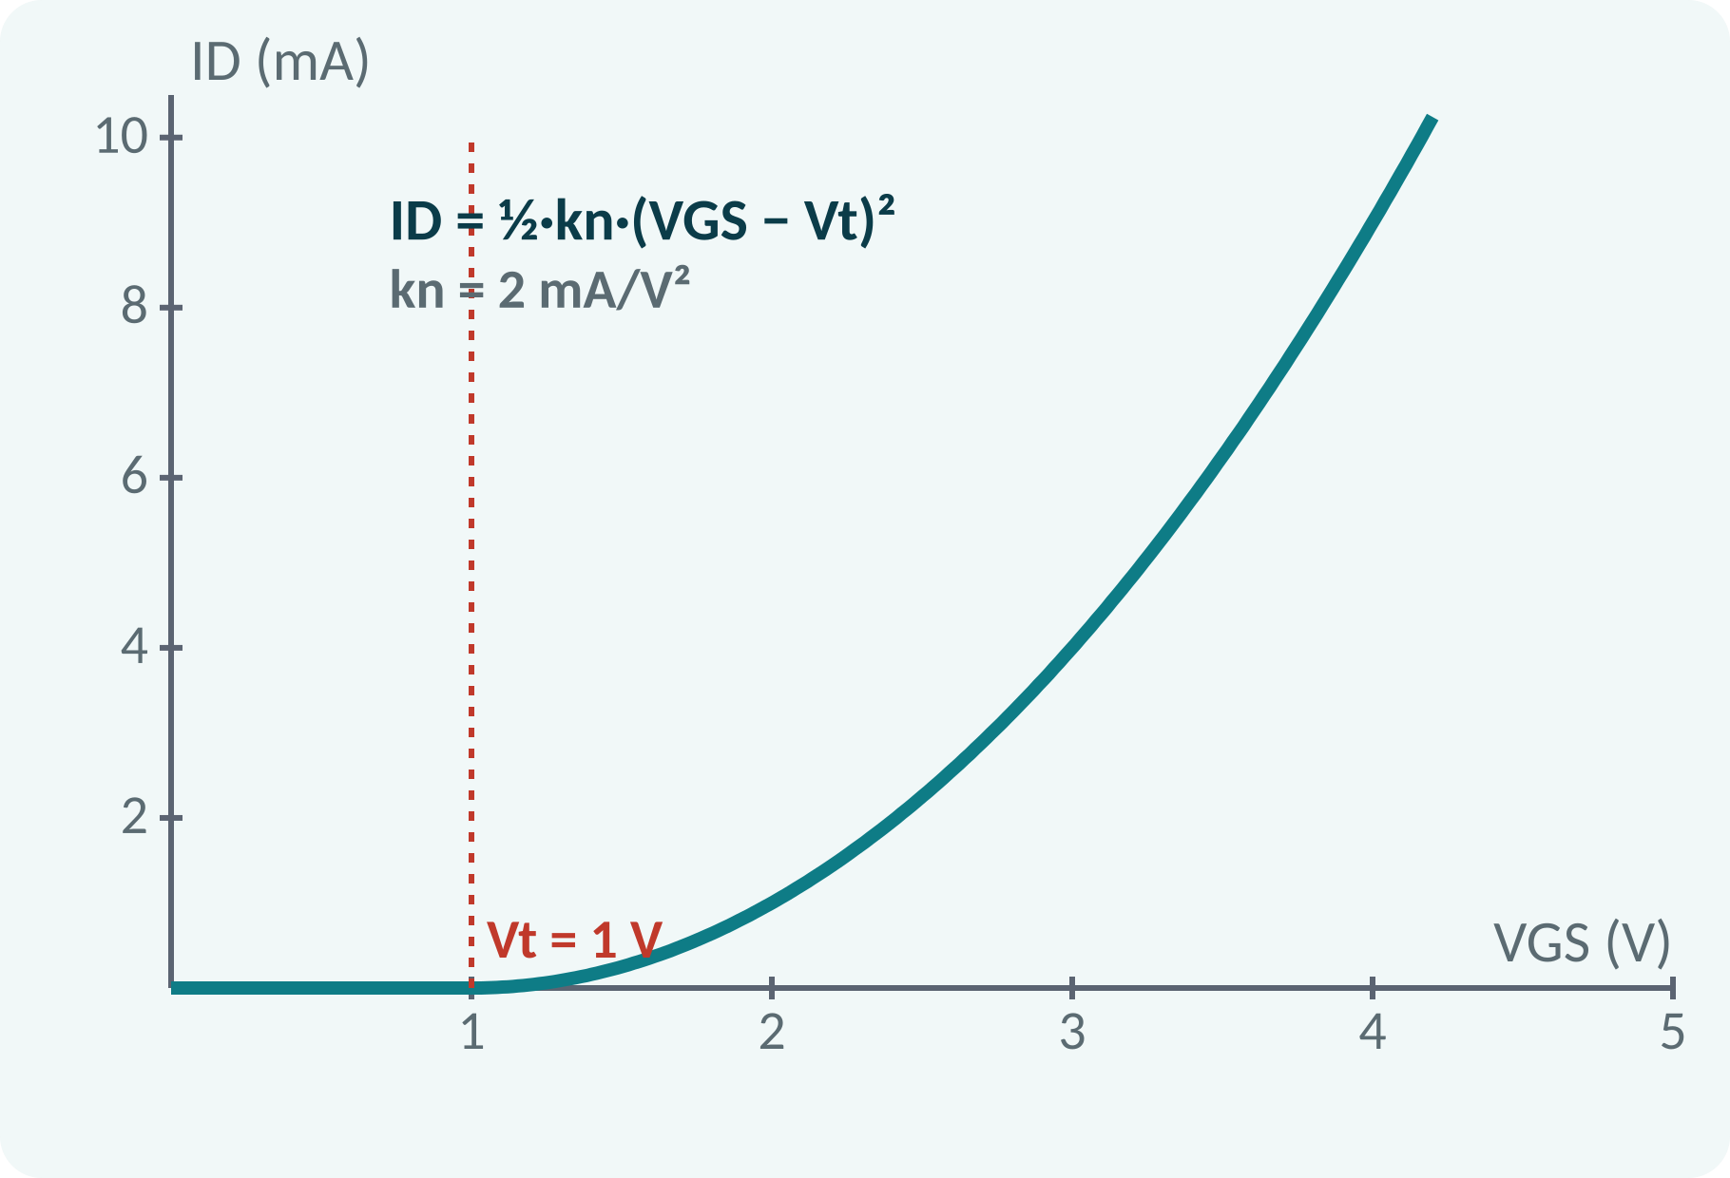
Square-Law Equations and Transfer Curve
Saturation: ID depends only on VGS.
Square-law relation with threshold Vt.
kn depends on W/L and process.
Transfer curve: ID against VGS.
ID = ½·kn·(VGS − Vt)² (saturation); kn = μn·Cox·W/L (mA/V²)
Triode: ID = kn[(VGS − Vt)VDS − VDS²/2]
Notes:
In saturation the drain current is half kn times the square of the gate overdrive voltage. The parameter kn depends on the width to length ratio of the channel, which the designer chooses, and on process constants. The transfer curve starts at the threshold voltage and rises as a parabola. In the triode region the current also depends on the drain voltage.

Slide 9
DC Load Line and Q-Point
Drain circuit: VDD = ID·RD + VDS.
Load line joins (VDD, 0) and (0, VDD/RD).
Q-point: intersection with the VGS curve.
Amplifier: Q in the saturation region.
Switch: operate at the two ends.
VDS = VDD − ID·RD; example VDD = 12 V, RD = 1 kΩ, VGS = 3 V: Q = (8 V, 4 mA)
Notes:
Apply Kirchhoff's voltage law around the drain circuit to get the load line. Its end points are the cut-off point at VDS equal to VDD, and the point where the drain current is VDD over RD. The intersection with the curve for the chosen gate voltage is the quiescent point. For an amplifier we place Q in the middle of the saturation region so the signal swing is symmetric.

Slide 10
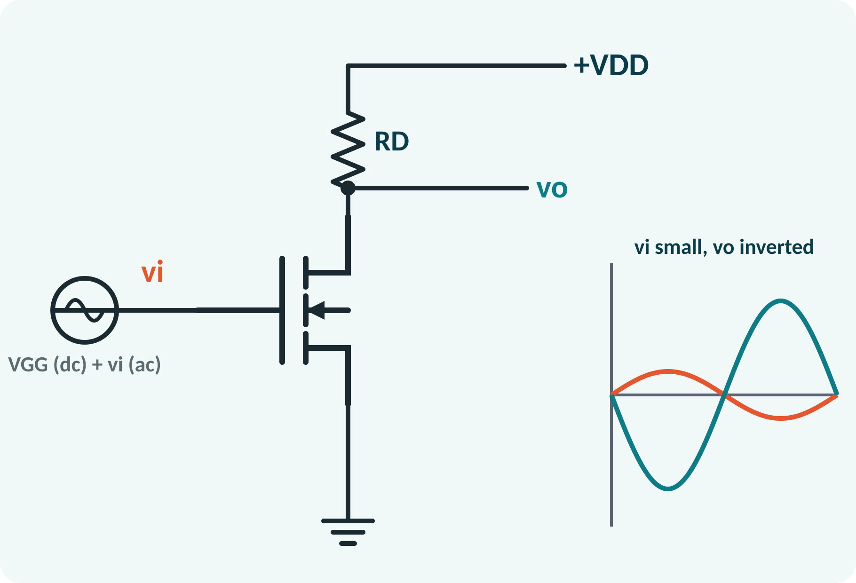
Common-Source Amplifier
Source is the common terminal.
DC bias VGG sets the Q-point.
Small input signal vi rides on VGG.
Drain voltage varies inversely: vo opposite to vi.
Gain larger than 1, phase 180°.
Bias: ID = ½·kn(VGG − Vt)²; VDS = VDD − ID·RD
Notes:
In the common-source amplifier the input goes to the gate and the output is taken from the drain; the source is grounded. The DC bias voltage places the Q-point in saturation, and the small input signal changes the gate voltage a little. The drain current follows and the voltage drop across RD changes, so the drain voltage moves in the opposite direction. The output is an amplified, inverted copy of the input.

Slide 11
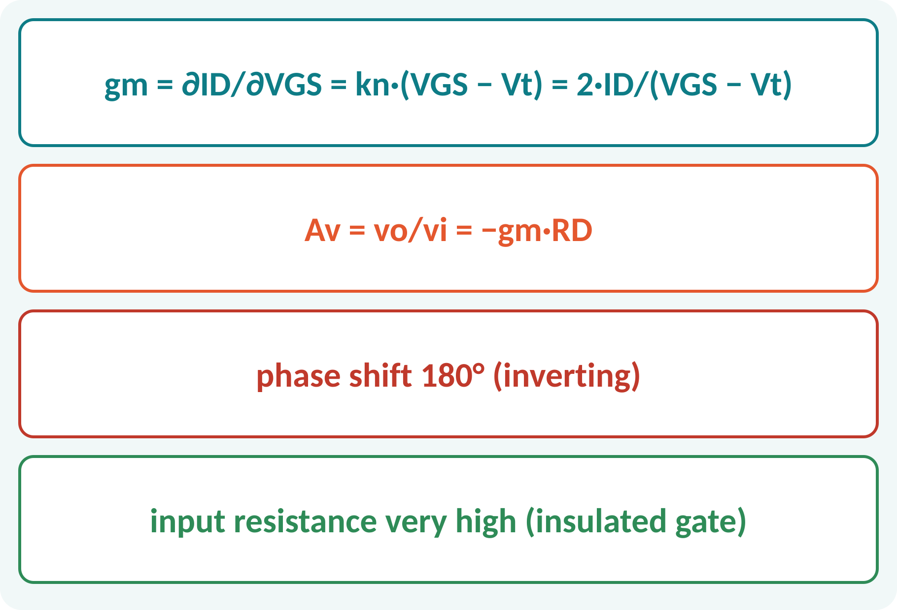
Small-Signal Gain
Transconductance gm: change in ID per VGS.
Output change: −gm·vgs·RD.
Gain magnitude grows with RD and gm.
Input resistance is very high.
Output is 180° out of phase.
gm = kn(VGS − Vt) = 2·ID/(VGS − Vt); Av = −gm·RD
gm in mS (mA/V)
Notes:
The transconductance is the slope of the transfer curve at the Q-point. A small gate voltage change gives a drain current change equal to gm times that voltage. The drain current change flowing through RD produces the output voltage change, so the voltage gain is minus gm times RD. The negative sign means that the output is inverted.

Slide 12
MOS Inverter
NMOS with a drain resistor RD.
Vin low (< Vt): MOSFET OFF → Vout = VDD (logic 1).
Vin high: MOSFET ON, triode → Vout ≈ 0 (logic 0).
Output is the logical NOT of the input.
CMOS version replaces RD by a pMOS: no static power.
Vin < Vt: Vout = VDD; Vin = VDD: Vout = VDD − ID·RD ≈ VOL
Notes:
The simplest inverter is an NMOS transistor with a load resistor. When the input is low the transistor is off, no current flows, so the output is pulled up to VDD. When the input is high the transistor conducts and pulls the output close to ground. So the circuit inverts logic levels. Modern chips use CMOS, where a pMOS transistor replaces the resistor and no static current flows.

Slide 13
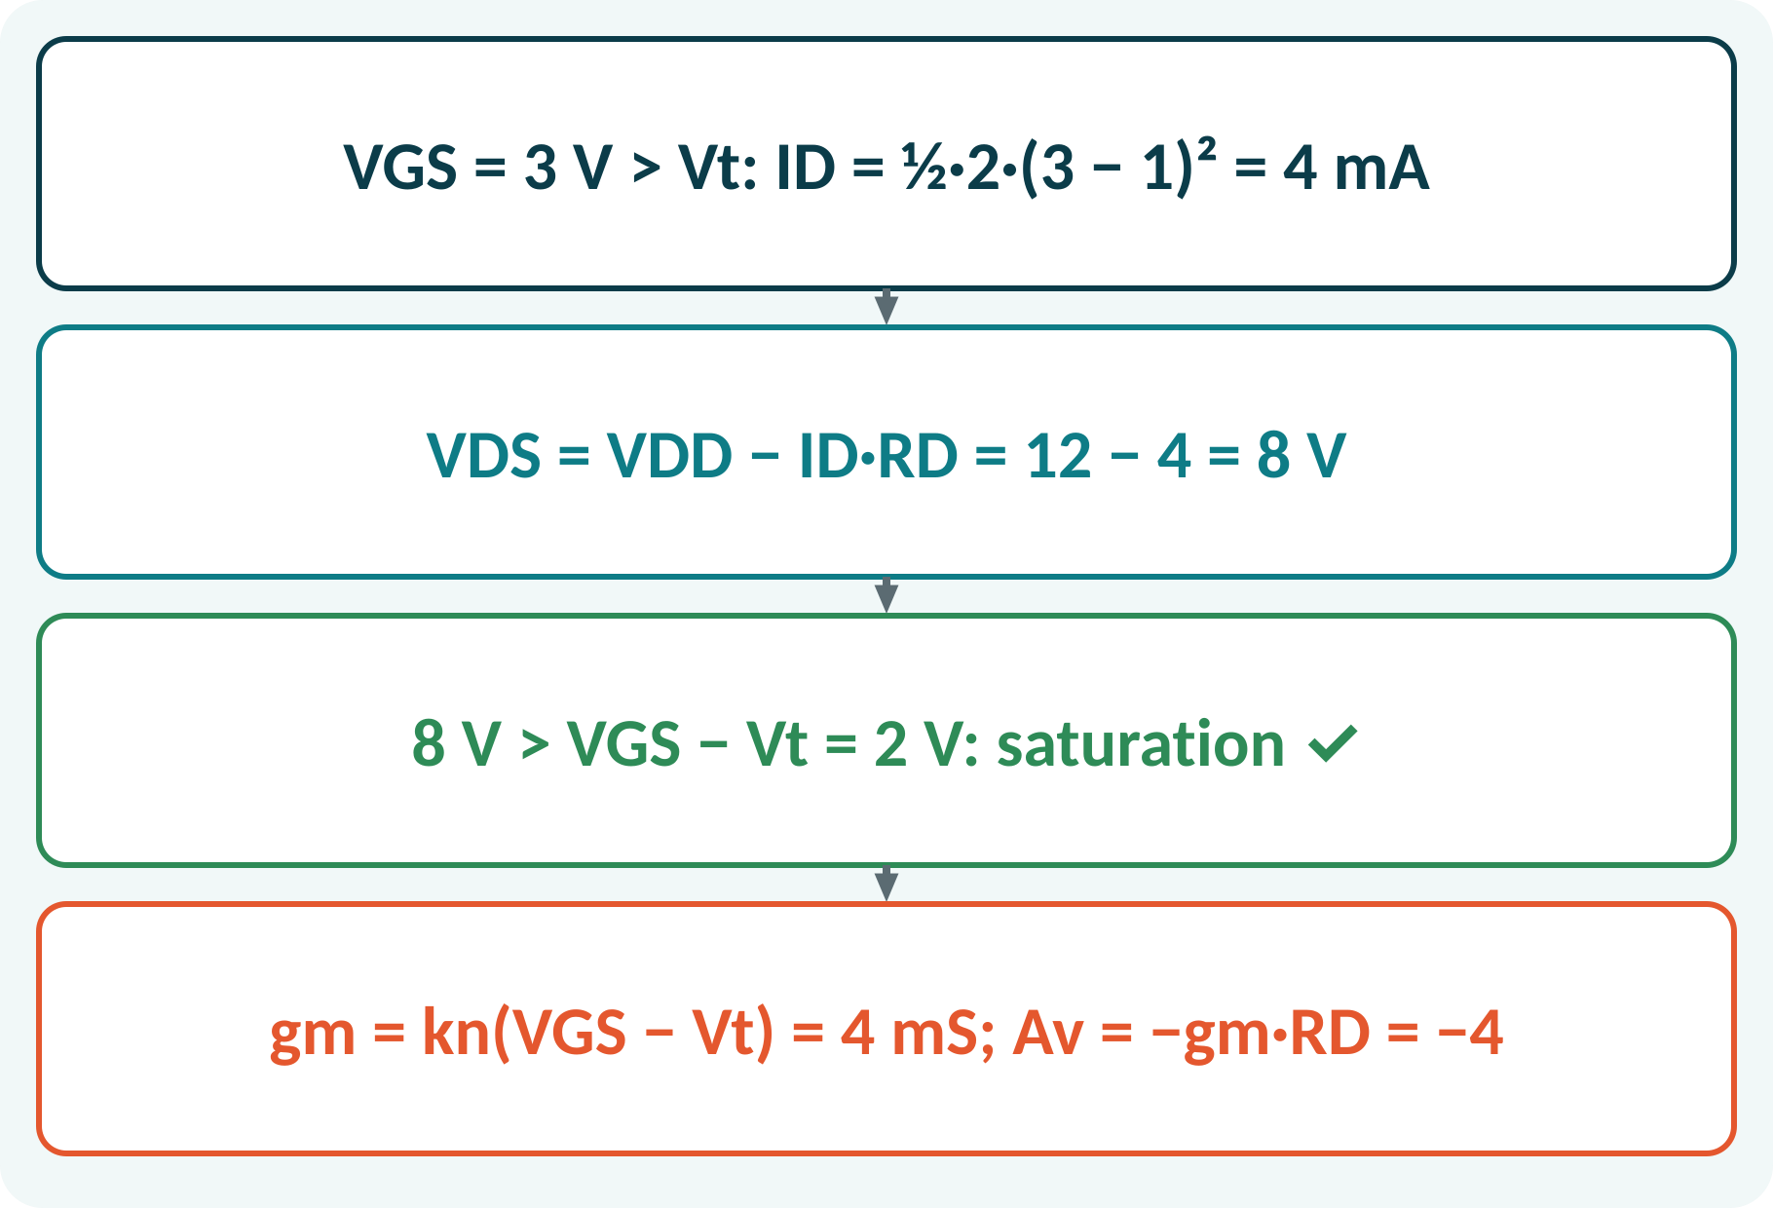
Solved Example 1: Bias and Gain
NMOS: Vt = 1 V, kn = 2 mA/V², VDD = 12 V, RD = 1 kΩ, VGS = 3 V. Find ID, VDS, region, gm and Av.
1. ID = ½ × 2 × (3 − 1)² = 4 mA.
2. VDS = 12 − 4 × 1 = 8 V.
3. VDS (8 V) > VGS − Vt (2 V): saturation, as assumed.
4. gm = kn(VGS − Vt) = 2 × 2 = 4 mS.
5. Av = −gm·RD = −4.
Answer: ID = 4 mA, VDS = 8 V (saturation), gm = 4 mS, Av = −4
Notes:
Assume saturation and apply the square-law formula to find the drain current. Then use the drain loop equation to get VDS. Finally verify that the assumption was right: VDS is greater than the overdrive voltage. If it were not, we would have to redo the calculation with the triode equation. The gain is minus gm times RD, so the stage amplifies four times and inverts.

Slide 14
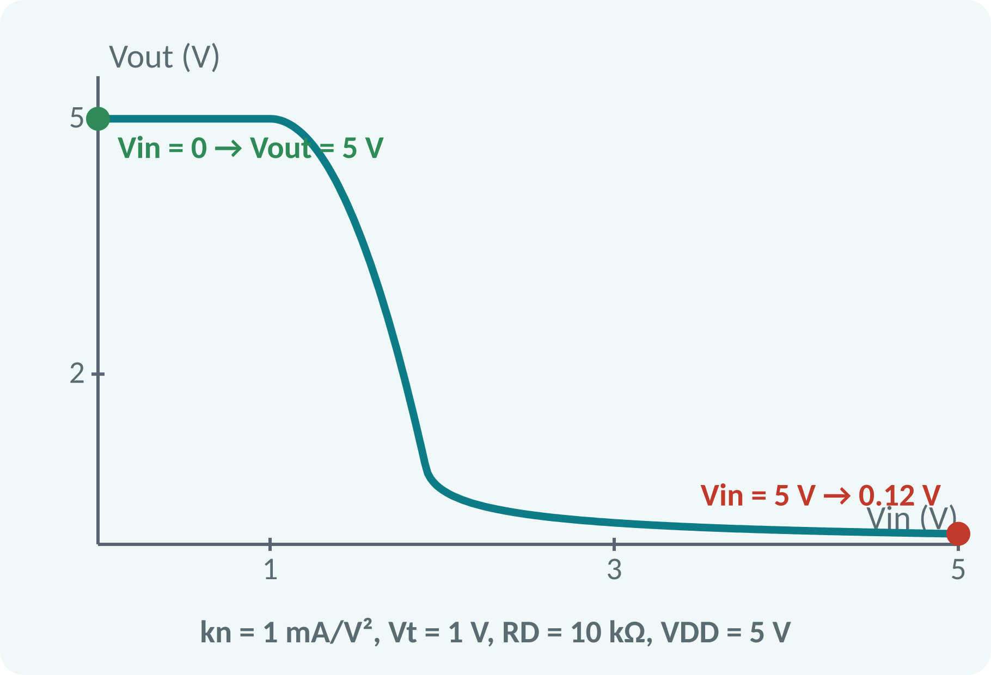
Solved Example 2: MOS Inverter
VDD = 5 V, RD = 10 kΩ, Vt = 1 V, kn = 1 mA/V². Find Vout for Vin = 0 V and for Vin = 5 V.
1. Vin = 0 < Vt: MOSFET off, Vout = 5 V.
2. Vin = 5 V: assume triode: ID = 1·(4Vo − Vo²/2) mA.
3. Vo = 5 − 10·ID → 5Vo² − 41Vo + 5 = 0.
4. Vo = (41 − √1581)/10 = 0.124 V (< 4 V: triode ✓).
Answer: Vout = 5 V for Vin = 0; Vout ≈ 0.12 V for Vin = 5 V
Notes:
With zero input the MOSFET is off and the output rises to VDD. For a high input assume triode operation and write the drain current in terms of the output voltage. Equating it with the current through the load resistor gives a quadratic equation, of which only the small root is valid. The output is about 0.12 volts, a clean logic zero, and the triode assumption is confirmed because 0.12 is much less than 4.

Slide 15
Common Mistakes and Exam Tips
✕
Common mistakes
✓
Exam tips
Using the saturation formula in the triode region.
Forgetting to check VDS ≥ VGS − Vt.
Using VGS < Vt and expecting current.
Treating the gate as drawing current.
Forgetting the minus sign in Av.
State the assumed region, then check it.
ID = ½ kn (VGS − Vt)² only in saturation.
Use ID = VDD-based load line for Q.
Av = −gm·RD (inverting).
Notes:
These are the points where marks are lost most often in MOSFET circuits. Give one quick example for each mistake. Remind students that writing the formula, substitution and the unit earns method marks even if the arithmetic slips. Encourage them to check the answer for reasonableness.

Slide 16
Summary
Enhancement MOSFET: channel induced when VGS > Vt.
Regions: cut-off, triode, saturation.
Saturation: ID = ½·kn·(VGS − Vt)².
CS amplifier: Av = −gm·RD (inverting).
MOS inverter: Vin low → Vout high, Vin high → Vout low.
gm = kn(VGS − Vt); Av = −gm·RD; VDS = VDD − ID·RD
Notes:
Recap in one minute. Say each point and ask the class to recall the formula for it. If they remember these ideas, most numerical problems on MOSFET circuits are within reach. Next lecture: operational amplifiers and linear ICs. Revise the two solved examples tonight.

Slide 17
Quick Quiz
Q1. An n-channel enhancement MOSFET is OFF when:
(a) VGS > Vt (b) VGS < Vt (c) VDS > 0 (d) VDS = 0
Ans: (b)
Q2. Saturation ID for kn = 2 mA/V², VGS − Vt = 2 V:
(a) 2 mA (b) 4 mA (c) 8 mA (d) 1 mA
Ans: (b)
Q3. The common-source amplifier output is:
(a) in phase (b) 180° out of phase (c) 90° shifted (d) zero
Ans: (b)
Q4. gm for kn = 2 mA/V², overdrive 2 V:
(a) 1 mS (b) 2 mS (c) 4 mS (d) 8 mS
Ans: (c)
Q5. In an NMOS inverter, Vin = low gives:
(a) Vout low (b) Vout high (c) Vout = 0 always (d) undefined
Ans: (b)
Notes:
Give about one minute per question and take a show of hands. Discuss why the wrong options are tempting, especially the one that uses a wrong formula. Use the quiz as a quick check on MOSFET circuits before leaving.

Slide 18
References
1
Boylestad Robert L. and Nashelsky Louis, Electronic Devices and Circuit Theory
11th Ed., PHI, 2016 (Units 3, 4, 5 textbook)
2
H. Cotton, Electrical Technology
7th Ed., CBS Publishers, 2005 (reference)
Next lecture: Unit 5: operational amplifiers
Notes:
Point students to the textbooks listed in the syllabus for MOSFET circuits. Ask them to solve at least three textbook problems on this topic before the next class. Thank the class and preview the next lecture.

