Slide 1
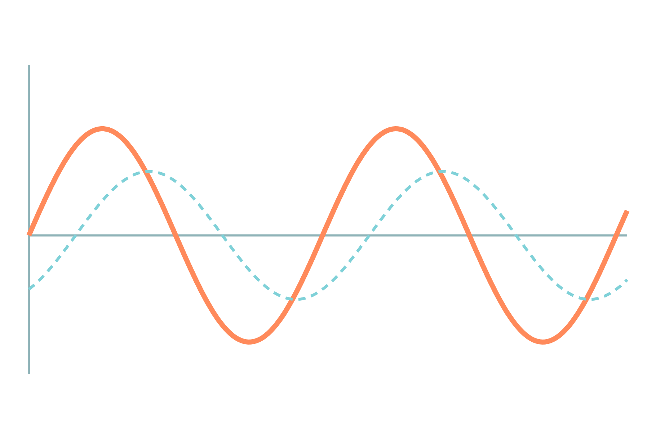
Op-Amp Basics and Amplifier Circuits
Basic Electrical and Electronics Engineering
Unit 5: Op-Amp and Linear IC Applications
Topic: Op-amp specifications, differential and common-mode operation, inverting, non-inverting and summing amplifiers
Prof. Mitesh Astik
Notes:
Welcome everyone. Today's topic is Op-amp specifications, differential and common-mode operation, inverting, non-inverting and summing amplifiers. It belongs to Unit 5: Op-Amp and Linear IC Applications. By the end of this session you will be able to use it in numerical problems. Keep your notebooks ready because we will solve two examples.

Slide 2

Learning Outcomes
State the ideal op-amp characteristics.
Explain differential and common-mode operation and CMRR.
Analyse inverting and non-inverting amplifiers.
Design a summing amplifier.
Linked to CO5
Describe the working principles of op-amp and signal processing circuits.
Notes:
Read the outcomes aloud. They map to CO5 of the syllabus. Tell students that these are examinable and that the two solved examples follow the same pattern. Ask them to tick off each outcome at the end of the lecture.

Slide 3
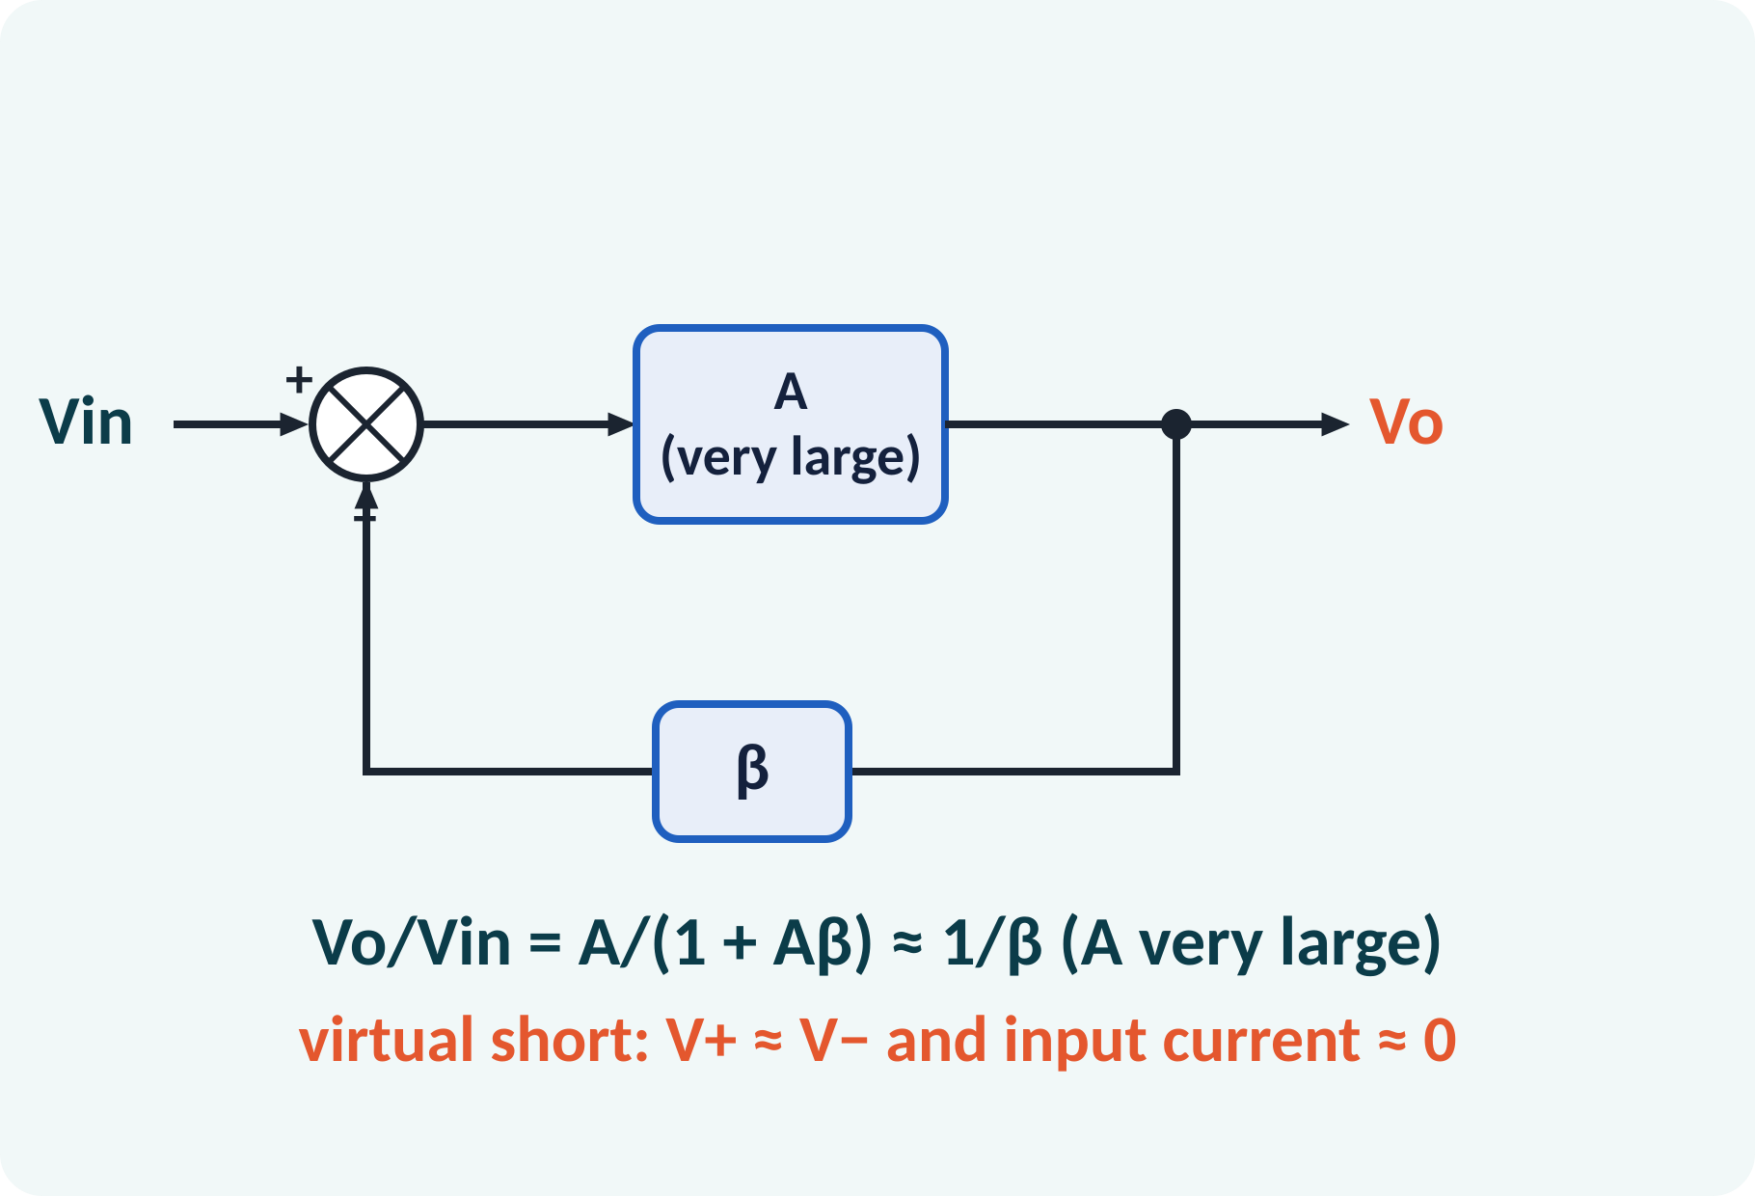
Recap: What You Already Know
Amplifier gain: A = Vo/Vin.
Decibel: dB = 20 log₁₀ A.
Feedback: part of the output returned to the input.
Kirchhoff's laws and Ohm's law.
Gain in dB = 20 log₁₀ |Vo/Vin|; 40 dB = ×100
Notes:
Recall the idea of gain and the decibel scale. Feedback means that a fraction of the output is fed back to the input. We shall see that feedback with a very high gain amplifier makes its overall gain depend only on the external resistors. For the analysis we need only Ohm's law and Kirchhoff's current law.

Slide 4
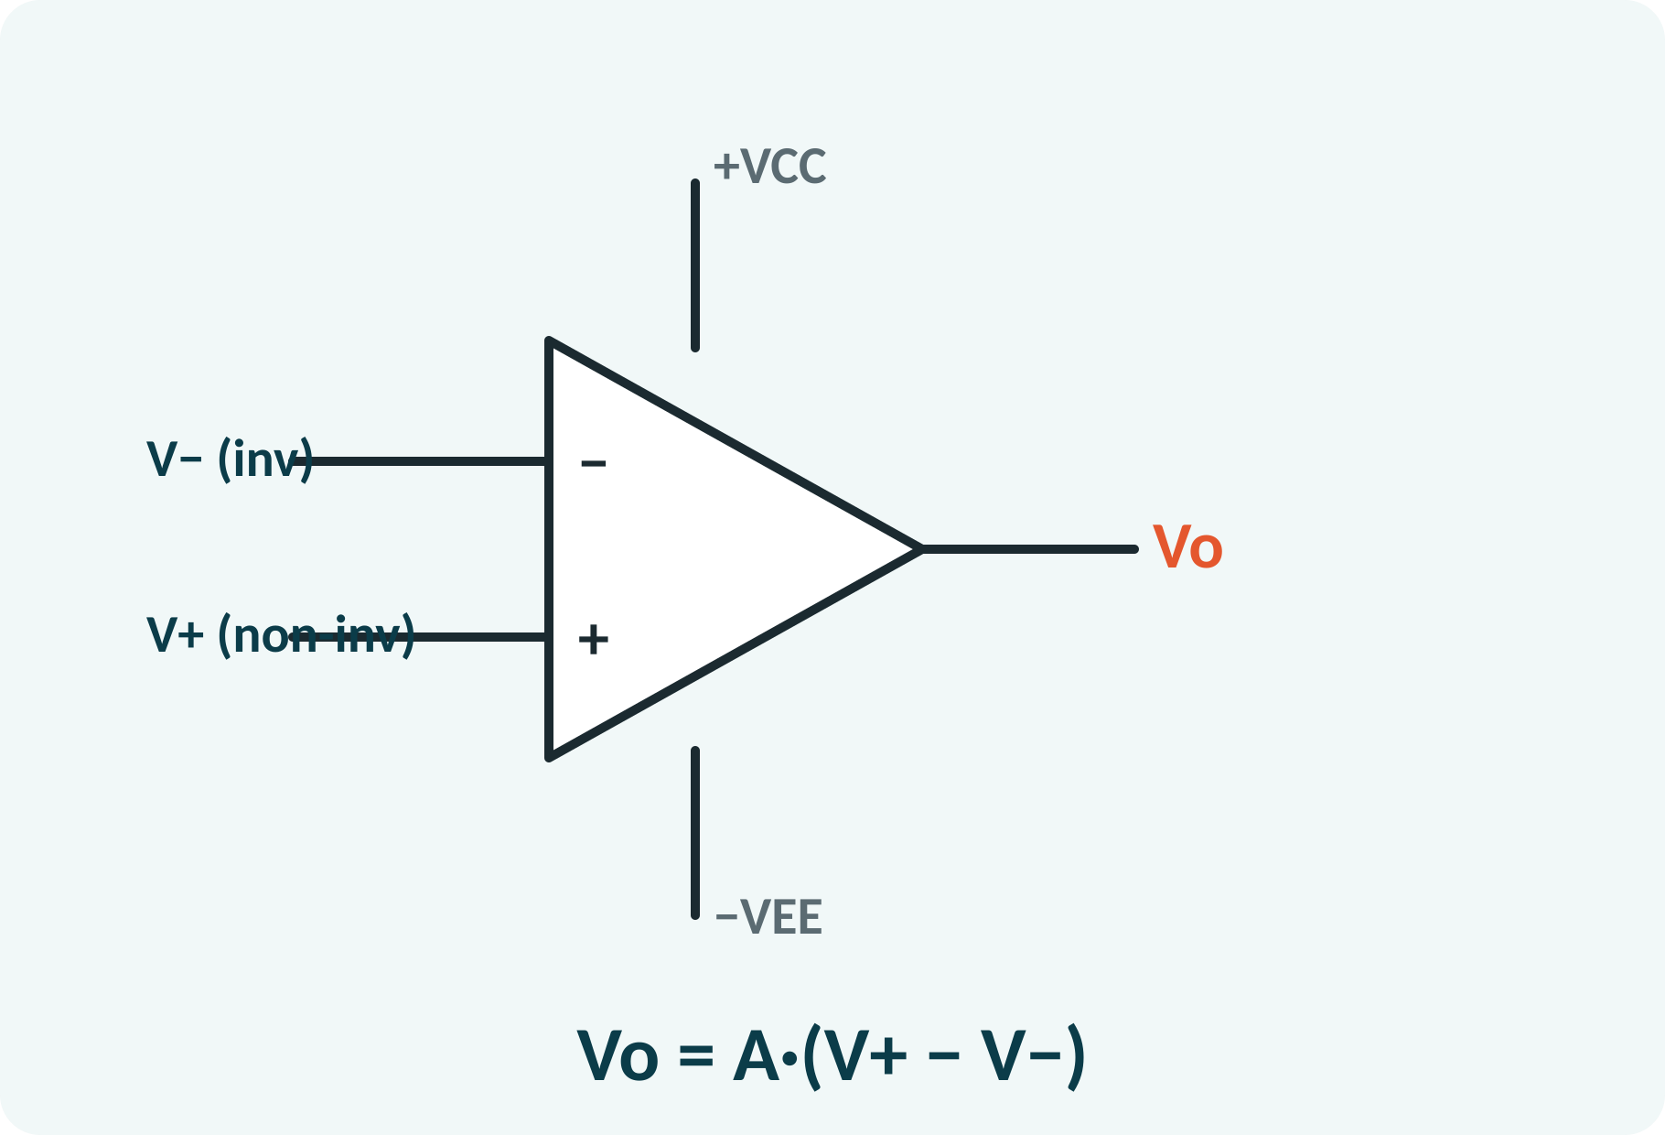
Motivation: The Universal Building Block
Sensor amplifiers and audio equipment.
Filters, oscillators, comparators.
Analog computers: add, integrate, differentiate.
One chip, many functions set by resistors.
Op-amp: a high-gain differential amplifier, usually with two supplies ±VCC
Notes:
The operational amplifier is a small integrated circuit that can be configured with a few external components to perform many functions. It is used in measuring instruments, audio amplifiers, active filters and signal processing. The name comes from analog computers, where it performed mathematical operations such as adding and integrating.

Slide 5
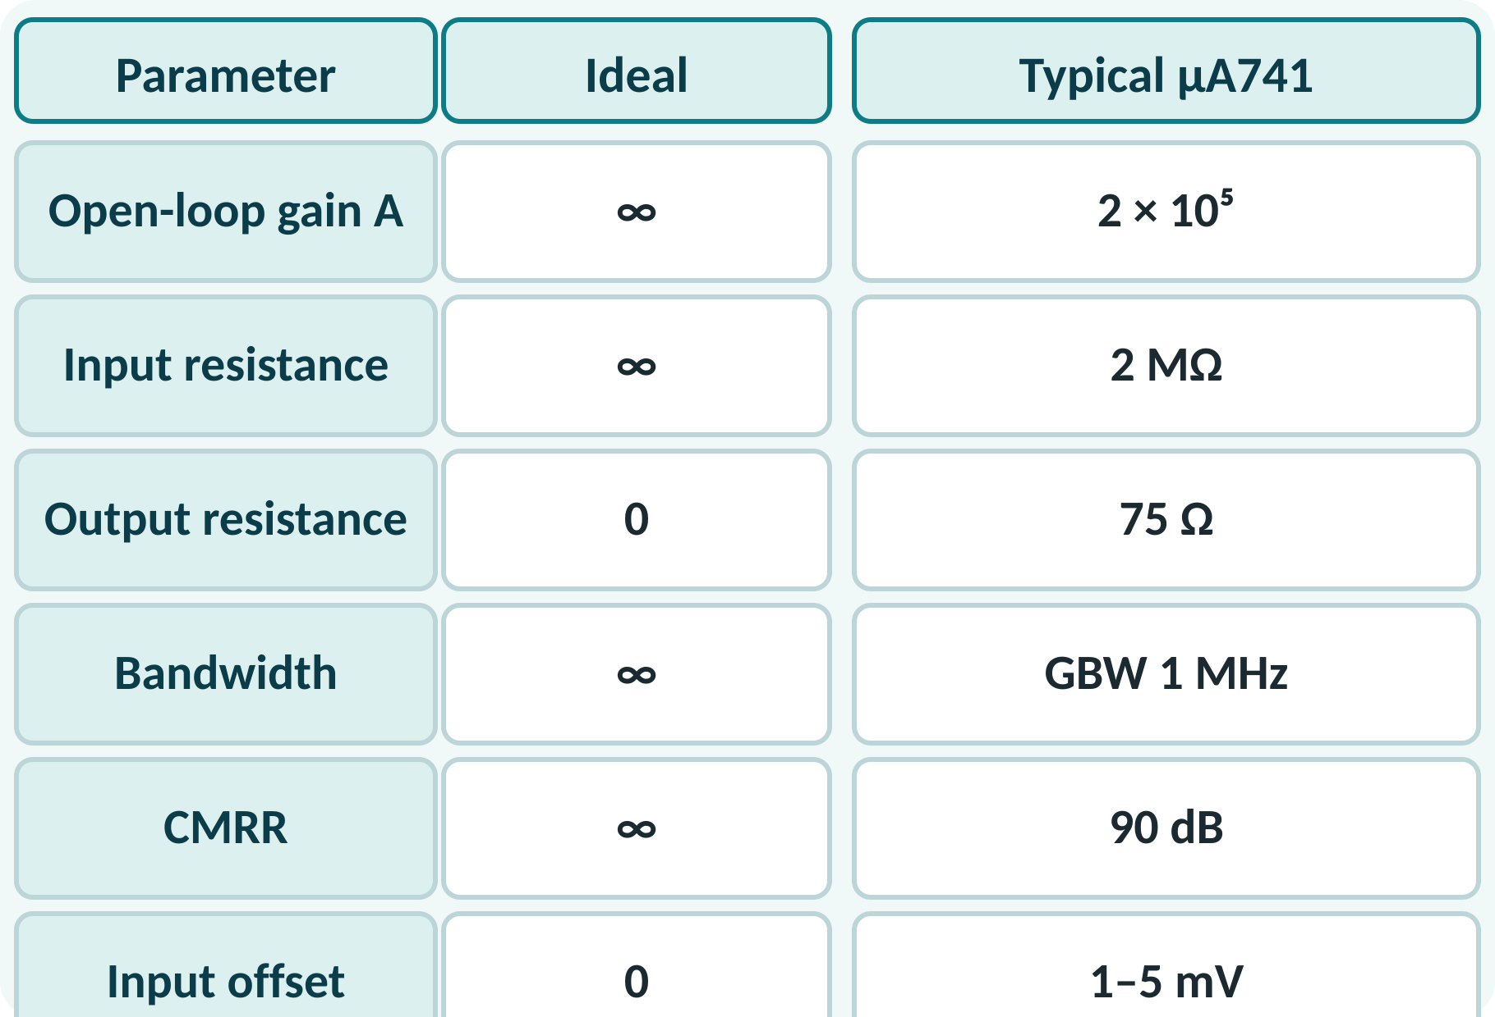
Op-Amp Symbol and Ideal Characteristics
Two inputs: inverting (−) and non-inverting (+).
One output; dual supply ±VCC.
Ideal: infinite gain, infinite input resistance.
Ideal: zero output resistance, infinite bandwidth.
Ideal: infinite CMRR, zero offset.
Vo = A·(V+ − V−); practical µA741: A ≈ 2×10⁵, Rin ≈ 2 MΩ, Ro ≈ 75 Ω
Notes:
The op-amp amplifies the difference between its two inputs. The ideal op-amp has infinite open-loop gain, infinite input resistance, zero output resistance, infinite bandwidth and infinite common-mode rejection. A real device like the 741 is very close in the quantities that matter for our calculations, so the ideal assumptions give very good answers.

Slide 6
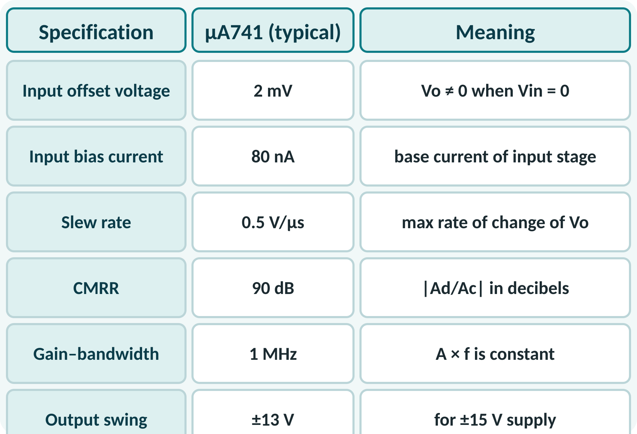
Op-Amp Specifications
Input offset voltage: output error with zero input.
Input bias current: small base currents of input stage.
Slew rate: limits output speed, V/µs.
CMRR: ability to reject common signals.
Gain–bandwidth product: A × f = constant.
Slew rate SR = dVo/dt|max (V/µs); fmax = SR/(2π·Vp) for an undistorted sine of peak Vp
Notes:
The data sheet lists practical limitations. The offset voltage shifts the output away from zero. The bias currents flow into the input terminals. The slew rate is the maximum rate at which the output voltage can change, which limits the frequency of large signals. The gain bandwidth product tells us that if we choose a gain of 10 the bandwidth is one hundred kilohertz for the 741.

Slide 7
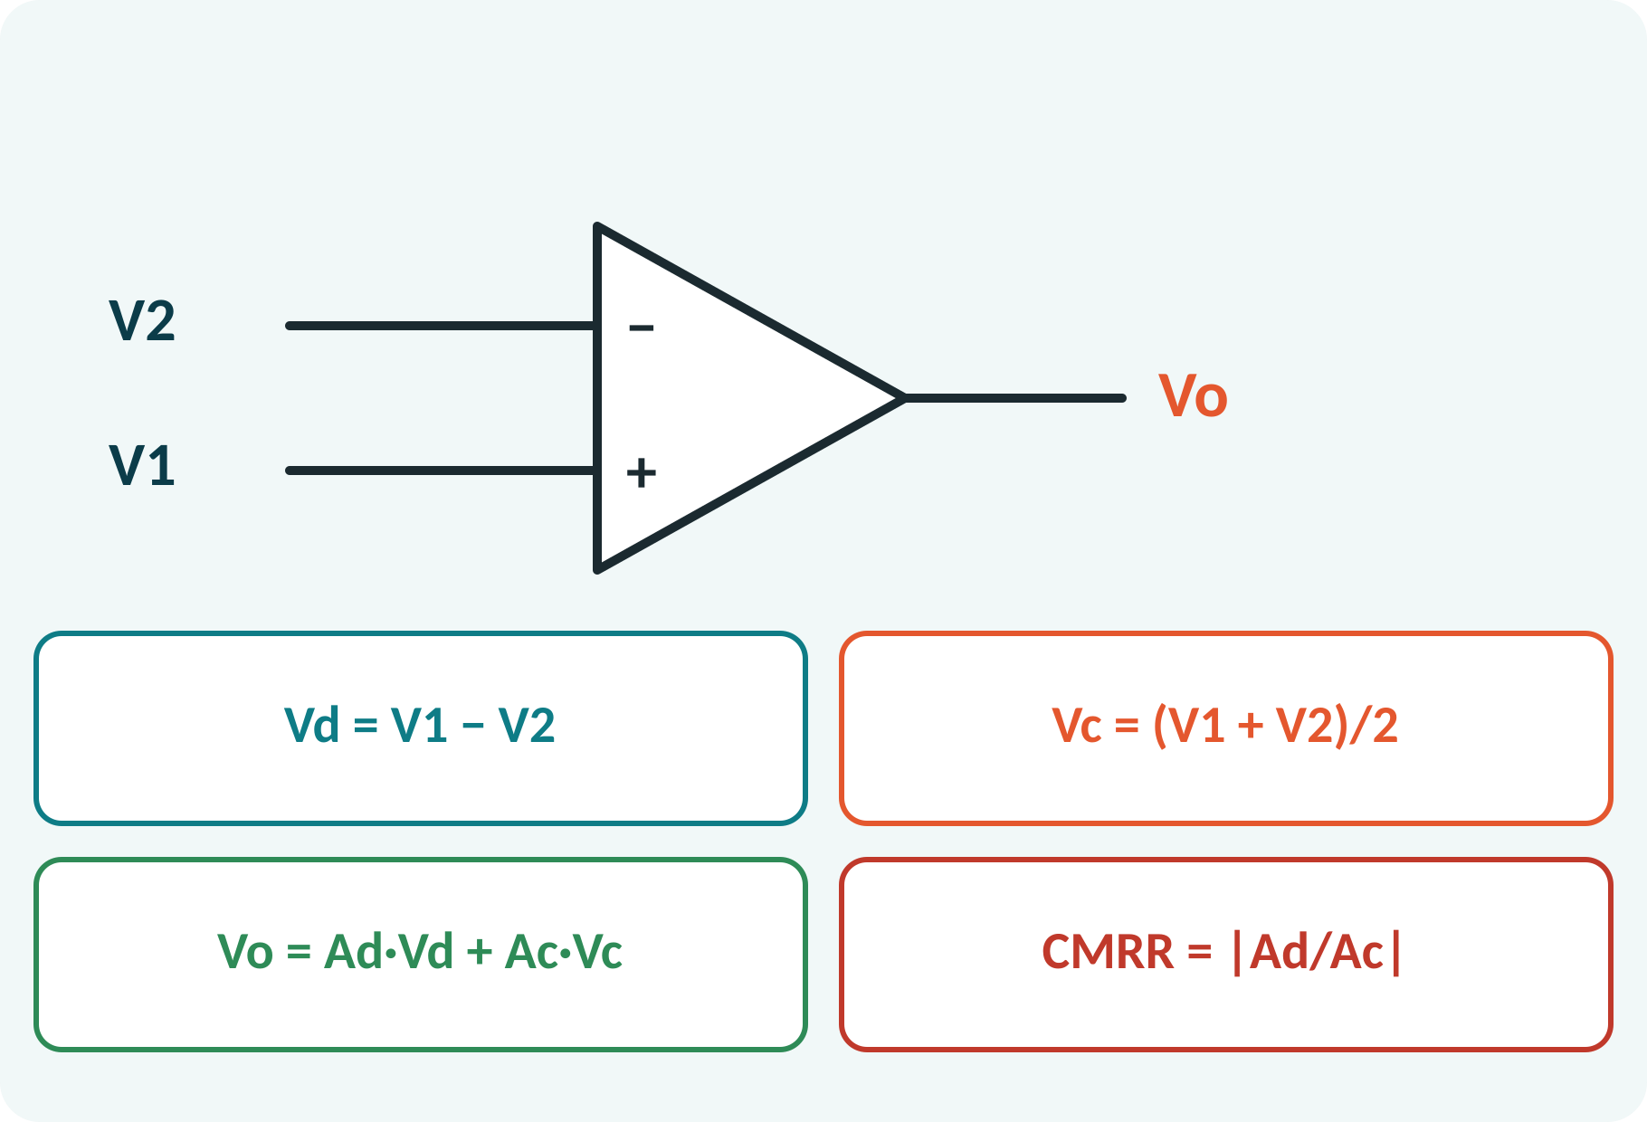
Differential and Common-Mode Operation
Differential signal: Vd = V1 − V2.
Common-mode signal: Vc = (V1 + V2)/2.
Op-amp amplifies Vd by Ad, Vc by Ac (small).
CMRR measures how well Vc is rejected.
High CMRR rejects noise picked up on both inputs.
Vo = Ad·Vd + Ac·Vc; CMRR = |Ad/Ac|; CMRR(dB) = 20 log₁₀|Ad/Ac|
Notes:
Any pair of inputs can be split into a differential part and a common part. A good op-amp amplifies the difference by Ad and nearly ignores the common part, which is amplified by only a tiny gain Ac. The ratio of the two is the common-mode rejection ratio, 90 dB for the 741, meaning the common signal is reduced thirty thousand times relative to the difference. This is what allows small sensor signals to be recovered from noisy lines.

Slide 8
Negative Feedback and the Virtual Short
Output fed back to the inverting input.
Closed-loop gain ≈ 1/β, set by resistors.
Because A is huge, V+ − V− ≈ 0: virtual short.
Input current into the op-amp ≈ 0.
Use these two rules for every circuit.
Vo/Vin = A/(1 + Aβ) ≈ 1/β; rules: V+ = V−, I(in) = 0
Notes:
With negative feedback the closed-loop gain depends only on the feedback network when the open-loop gain is very large. The output tries to keep the difference between the inputs at nearly zero, so the two input voltages are almost equal: this is the virtual short. Since the input resistance is very large, no current flows into the input terminals. With these two rules we can analyse any op-amp circuit with a few lines of algebra.

Slide 9
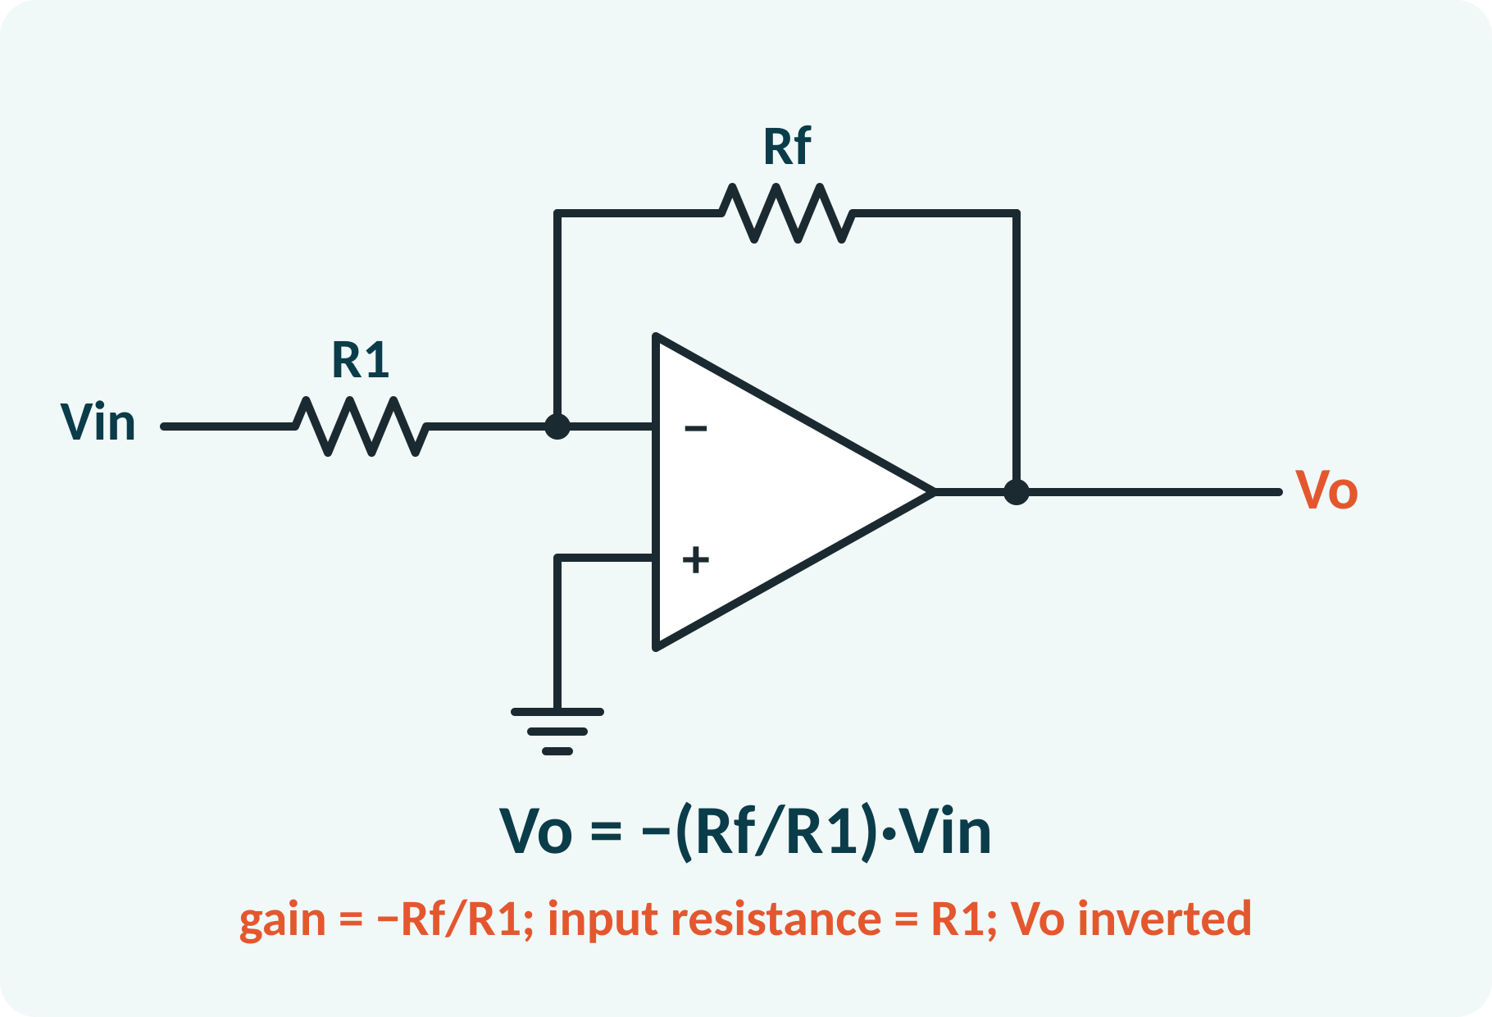
Inverting Amplifier
Input applied through R1 to the (−) input.
Non-inverting input grounded.
Virtual ground at the (−) input.
Current through R1 flows through Rf.
Output is inverted.
Vo = −(Rf/R1)·Vin; Av = −Rf/R1; Rin = R1
Notes:
Because the non-inverting input is at ground, the virtual short makes the inverting input also zero volts: a virtual ground. The input current is Vin over R1 and, since no current enters the op-amp, the same current flows through Rf. The voltage across Rf is then the output voltage with a minus sign. The gain is the ratio Rf over R1 and the output is inverted.

Slide 10
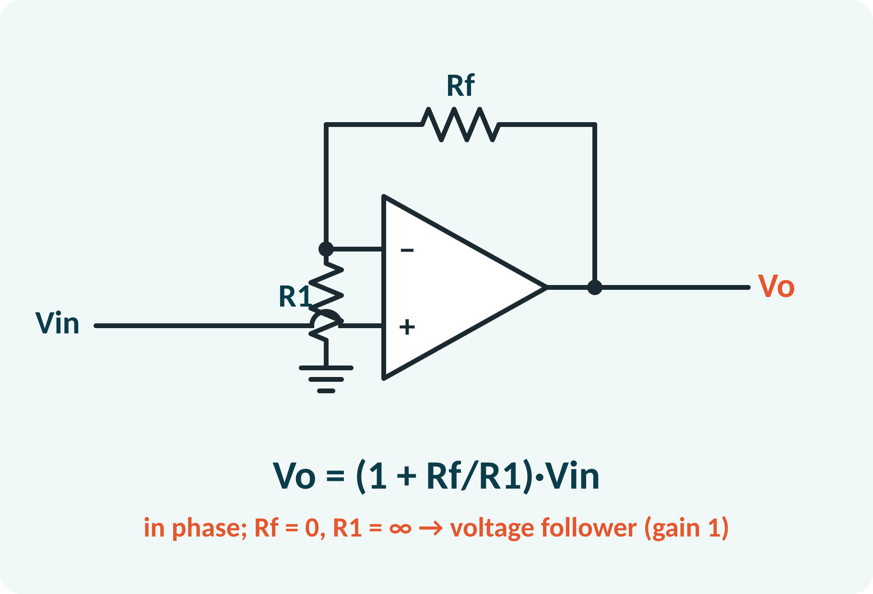
Non-Inverting Amplifier
Input applied directly to the (+) input.
R1 and Rf form a divider from the output.
V− = Vo·R1/(R1 + Rf) = Vin.
Gain is 1 + Rf/R1, at least 1.
Very high input resistance.
Vo = (1 + Rf/R1)·Vin; Av = 1 + Rf/R1
Voltage follower: Rf = 0, Av = 1
Notes:
In the non-inverting amplifier the input signal goes to the non-inverting terminal, so the input resistance is extremely high. The feedback resistors form a voltage divider on the output, and the virtual short forces the divided voltage to equal Vin. Solving gives a gain of one plus Rf over R1. If Rf is zero the circuit becomes a voltage follower, a buffer with gain one.

Slide 11
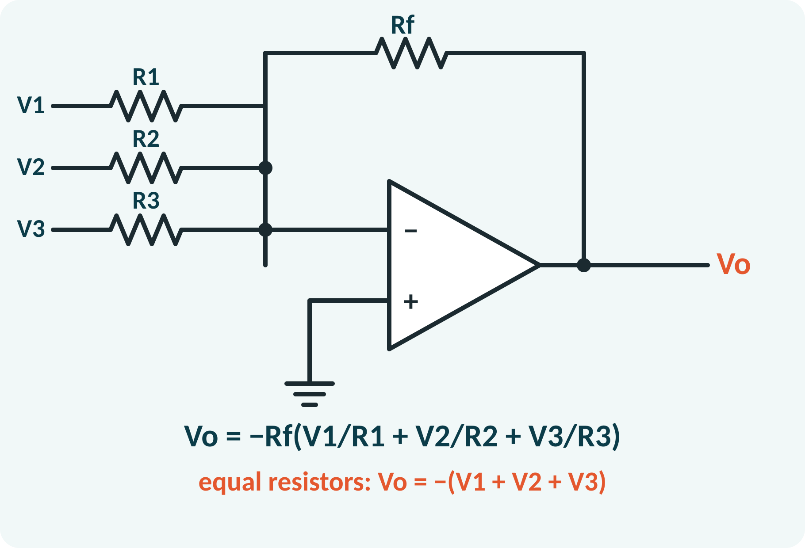
Summing Amplifier
Several inputs, each through its own resistor.
All join at the virtual ground.
Currents add: I = V1/R1 + V2/R2 + V3/R3.
Total current flows through Rf.
Output is the inverted weighted sum.
Vo = −Rf·(V1/R1 + V2/R2 + V3/R3)
R1 = R2 = R3 = Rf: Vo = −(V1 + V2 + V3)
Notes:
Each input drives a current through its own resistor into the virtual ground, and these currents add without interacting. The sum flows through the feedback resistor, producing a voltage with a negative sign. By choosing different resistor values we give each input its own weight. This circuit is used in audio mixers and in digital-to-analog converters.

Slide 12
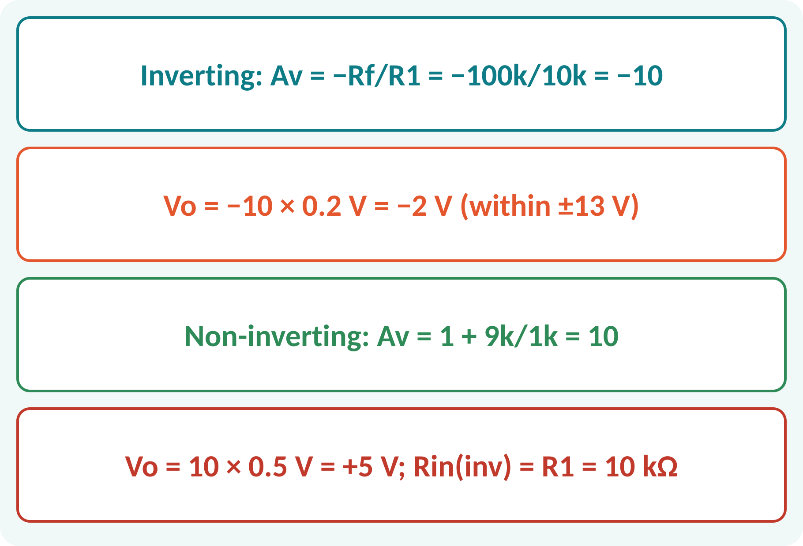
Solved Example 1: Inverting and Non-Inverting
(a) Inverting: R1 = 10 kΩ, Rf = 100 kΩ, Vin = 0.2 V. (b) Non-inverting: R1 = 1 kΩ, Rf = 9 kΩ, Vin = 0.5 V.
1. Inverting gain = −Rf/R1 = −10.
2. Vo = −10 × 0.2 = −2 V; Rin = 10 kΩ.
3. Non-inverting gain = 1 + Rf/R1 = 1 + 9 = 10.
4. Vo = 10 × 0.5 = +5 V.
Answer: (a) Vo = −2 V; (b) Vo = +5 V; both within ±13 V swing
Notes:
For the inverting amplifier the gain is minus Rf over R1, minus ten. For the non-inverting amplifier it is one plus Rf over R1, plus ten. Check that the outputs are within the saturation limits of the op-amp, about 13 volts for a 15 volt supply. Note that the input resistance of the inverting circuit is R1 while that of the non-inverting circuit is very large.

Slide 13
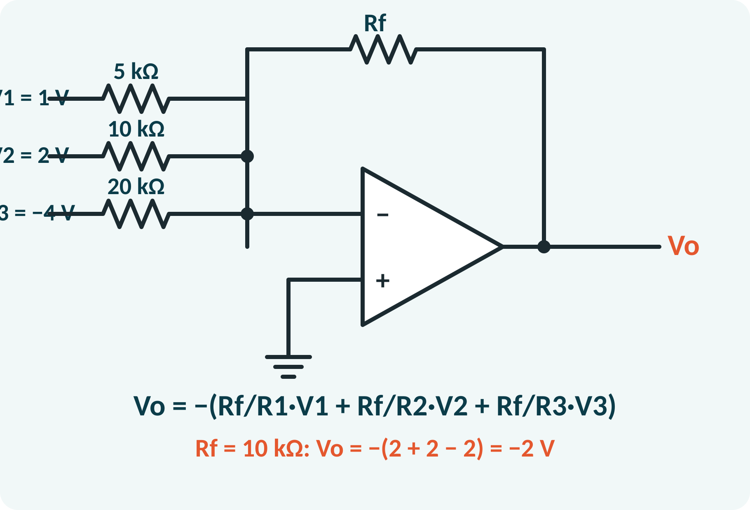
Solved Example 2: Summing Amplifier
Rf = 10 kΩ, R1 = 5 kΩ, R2 = 10 kΩ, R3 = 20 kΩ; V1 = 1 V, V2 = 2 V, V3 = −4 V. Find Vo.
1. Weights: Rf/R1 = 2, Rf/R2 = 1, Rf/R3 = 0.5.
2. Sum = 2 × 1 + 1 × 2 + 0.5 × (−4) = 2 + 2 − 2 = 2.
3. Vo = −2 V.
4. Check: output within ±13 V.
Answer: Vo = −2 V
Notes:
Compute each input's weight as the ratio of the feedback resistor to its input resistor. Multiply by the input voltage and add, remembering the sign of V3. The total is plus two, and the output is its inverse, minus two volts. A final check on the output swing confirms that the op-amp is not saturated.

Slide 14
Common Mistakes and Exam Tips
✕
Common mistakes
✓
Exam tips
Forgetting the sign in the inverting gain.
Using 1 + Rf/R1 for the inverting amplifier.
Ignoring op-amp saturation (±VCC).
Treating Rin of the inverting amplifier as infinite.
Applying virtual ground without negative feedback.
Use V+ = V− and I(in) = 0.
Check that |Vo| < supply voltage.
Inverting: Rin = R1.
Name the configuration before writing the formula.
Notes:
These are the points where marks are lost most often in op-amp amplifiers. Give one quick example for each mistake. Remind students that writing the formula, substitution and the unit earns method marks even if the arithmetic slips. Encourage them to check the answer for reasonableness.

Slide 15
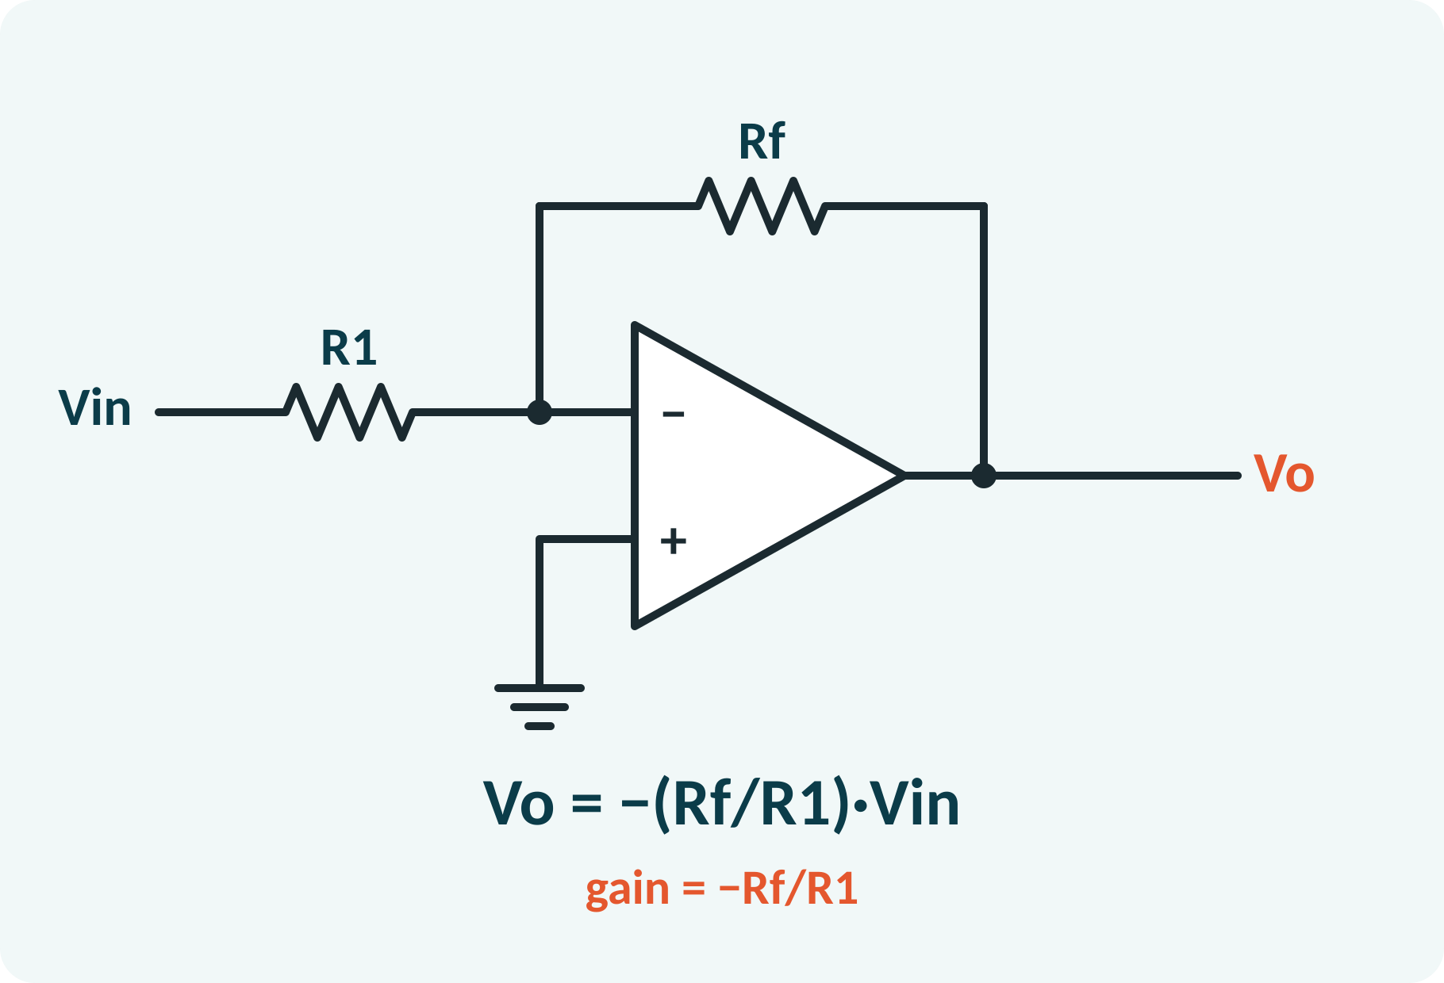
Summary
Ideal op-amp: A = ∞, Rin = ∞, Ro = 0, infinite CMRR.
Differential gain Ad, common-mode gain Ac, CMRR = Ad/Ac.
Negative feedback gives the virtual short.
Inverting: −Rf/R1; non-inverting: 1 + Rf/R1.
Summing: Vo = −Rf ΣVi/Ri.
Rules: V+ = V−, no input current
Notes:
Recap in one minute. Say each point and ask the class to recall the formula for it. If they remember these ideas, most numerical problems on op-amp amplifiers are within reach. Next lecture: integrator, differentiator and comparator. Revise the two solved examples tonight.

Slide 16
Quick Quiz
Q1. Voltage gain of an inverting amplifier with R1 = 2 kΩ, Rf = 20 kΩ:
(a) 10 (b) −10 (c) 11 (d) −0.1
Ans: (b)
Q2. Non-inverting gain with Rf = 9 kΩ, R1 = 1 kΩ:
(a) 9 (b) 10 (c) −9 (d) 1
Ans: (b)
Q3. CMRR of 100 dB means |Ad/Ac| =
(a) 100 (b) 10⁵ (c) 10² (d) 1000
Ans: (b)
Q4. Voltage follower has gain:
(a) 0 (b) 1 (c) 10 (d) ∞
Ans: (b)
Q5. At the inverting input of an inverting amplifier the voltage is:
(a) Vin (b) Vo (c) ≈ 0 (virtual ground) (d) VCC
Ans: (c)
Notes:
Give about one minute per question and take a show of hands. Discuss why the wrong options are tempting, especially the one that uses a wrong formula. Use the quiz as a quick check on op-amp amplifiers before leaving.

Slide 17
References
1
Boylestad Robert L. and Nashelsky Louis, Electronic Devices and Circuit Theory
11th Ed., PHI, 2016 (Units 3, 4, 5 textbook)
2
David A. Bell, Operational Amplifier and Linear ICs
3rd Ed., Oxford University Press, 2011 (reference, Unit 5)
Next lecture: integrator, differentiator and comparator
Notes:
Point students to the textbooks listed in the syllabus for op-amp amplifiers. Ask them to solve at least three textbook problems on this topic before the next class. Thank the class and preview the next lecture.

