Slide 1
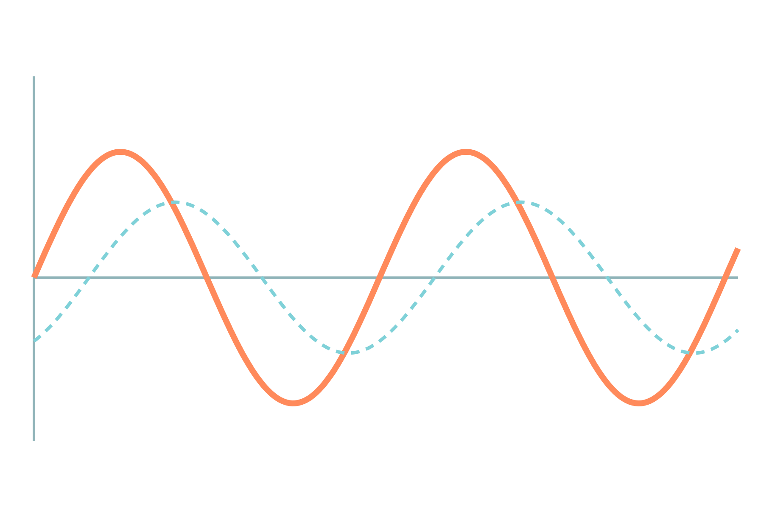
Integrator, Differentiator and Comparator
Basic Electrical and Electronics Engineering
Unit 5: Op-Amp and Linear IC Applications
Topic: Op-amp integrator, differentiator and comparator
Prof. Mitesh Astik
Notes:
Welcome everyone. Today's topic is Op-amp integrator, differentiator and comparator. It belongs to Unit 5: Op-Amp and Linear IC Applications. By the end of this session you will be able to use it in numerical problems. Keep your notebooks ready because we will solve two examples.

Slide 2

Learning Outcomes
Derive the output of the integrator and differentiator.
Predict output waveforms for square and sine inputs.
Explain the comparator and level detection.
Calculate output voltages and timing.
Linked to CO5
Describe the working principles of op-amp and signal-processing circuits.
Notes:
Read the outcomes aloud. They map to CO5 of the syllabus. Tell students that these are examinable and that the two solved examples follow the same pattern. Ask them to tick off each outcome at the end of the lecture.

Slide 3
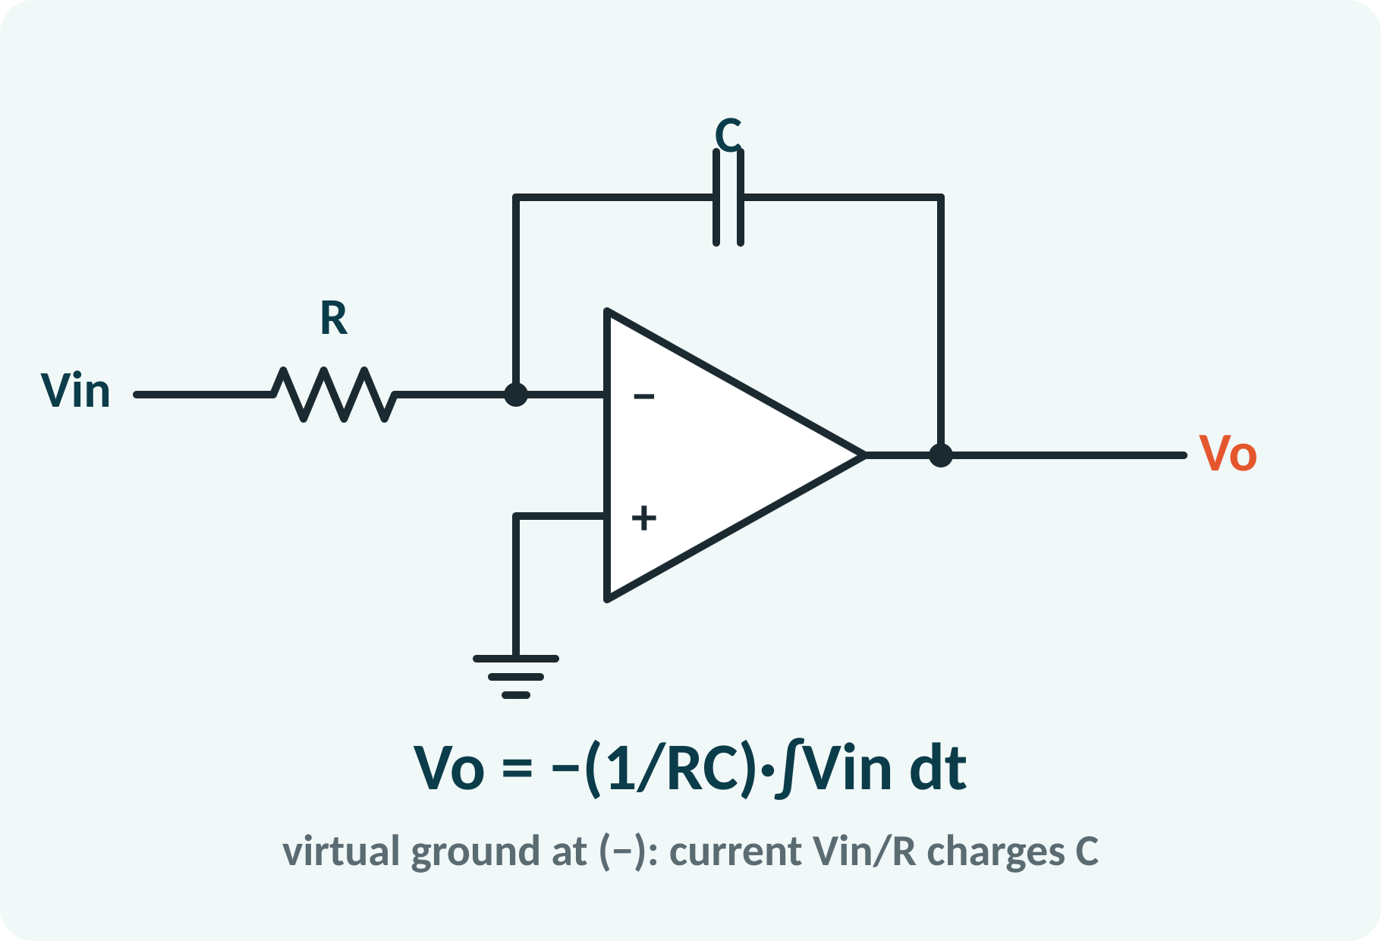
Recap: What You Already Know
Virtual ground at the inverting input.
No current enters the op-amp.
Capacitor: i = C·dv/dt; v = (1/C)∫i dt.
Inverting amplifier: Vo = −(Zf/Z1)·Vin.
Generalised inverting amplifier: Vo = −(Zf/Z1)·Vin; capacitor impedance 1/(sC)
Notes:
The rules for an ideal op-amp with negative feedback, namely the virtual short and zero input current, still apply. The inverting amplifier formula holds with impedances in place of resistances. If we replace one resistor by a capacitor, the circuit performs calculus. Recall that the current through a capacitor is C times the derivative of its voltage.

Slide 4
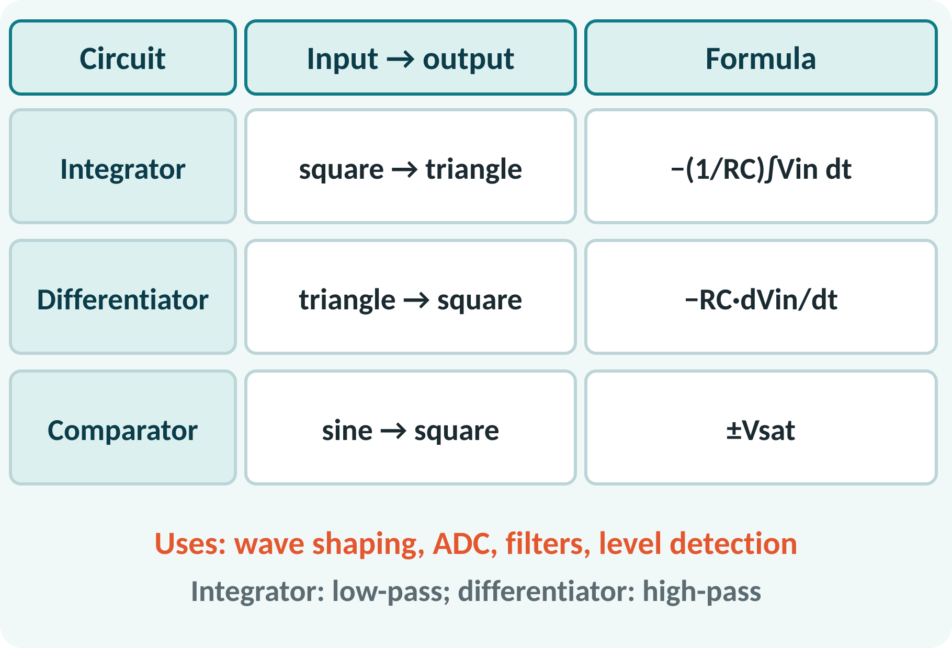
Motivation: Calculus with Circuits
Analog computers solve differential equations.
Integrators in ADCs and PID controllers.
Differentiators detect edges and rate of change.
Comparators turn analog levels into logic.
Three basic functions: ∫, d/dt and decision (comparison)
Notes:
An op-amp with a capacitor can integrate or differentiate a signal. These circuits were used in analog computers and are still used in controllers, wave shapers and data converters. The comparator on the other hand converts an analog signal into a digital decision. Together they form the basis for oscillators and analog-to-digital converters.

Slide 5
Op-Amp Integrator
Resistor R at the input; capacitor C in feedback.
Input current Vin/R charges the capacitor.
Capacitor voltage is the integral of that current.
Output is minus the integral of the input.
Gain falls with frequency: low-pass.
Vo(t) = −(1/RC)·∫Vin dt + Vo(0); RC time constant (s)
In s-domain: Vo/Vin = −1/(sRC)
Notes:
The input current is Vin divided by R because the inverting input is at virtual ground. All of it flows into the feedback capacitor, so the voltage on the capacitor is the time integral of the current divided by C. The output equals minus that voltage. For a constant input the output is therefore a ramp, whose slope is minus Vin over RC.

Slide 6
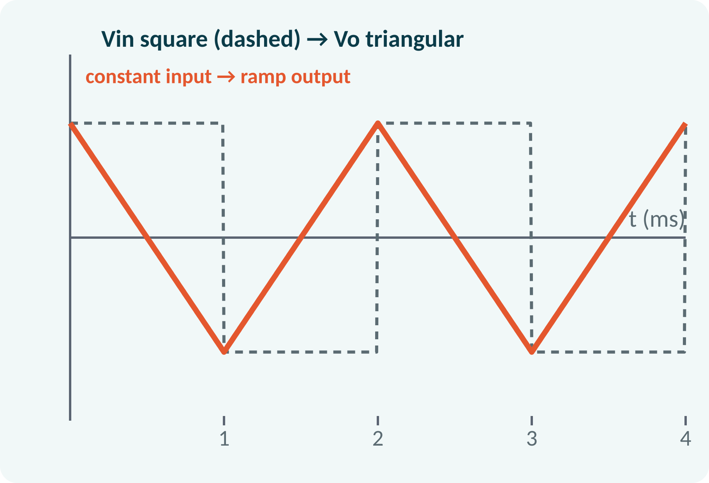
Integrator: Waveforms and Limitations
DC input → linear ramp.
Square-wave input → triangular output.
Sine input → cosine (90° shifted).
Offset causes drift until saturation.
Fix: resistor Rf across C limits DC gain.
Square ±V, half-period T/2: output swing = V·T/(2RC) (peak-to-peak)
Practical integrator: Rf ≈ 10 R in parallel with C
Notes:
A constant input produces a straight-line output, and a square wave therefore gives a triangular wave. The slope of each segment is minus the input amplitude over RC. A practical integrator has a problem with small DC offsets, which are integrated until the output saturates. A resistor across the capacitor limits the DC gain and avoids this drift, at the cost of a lower accuracy at very low frequencies.

Slide 7
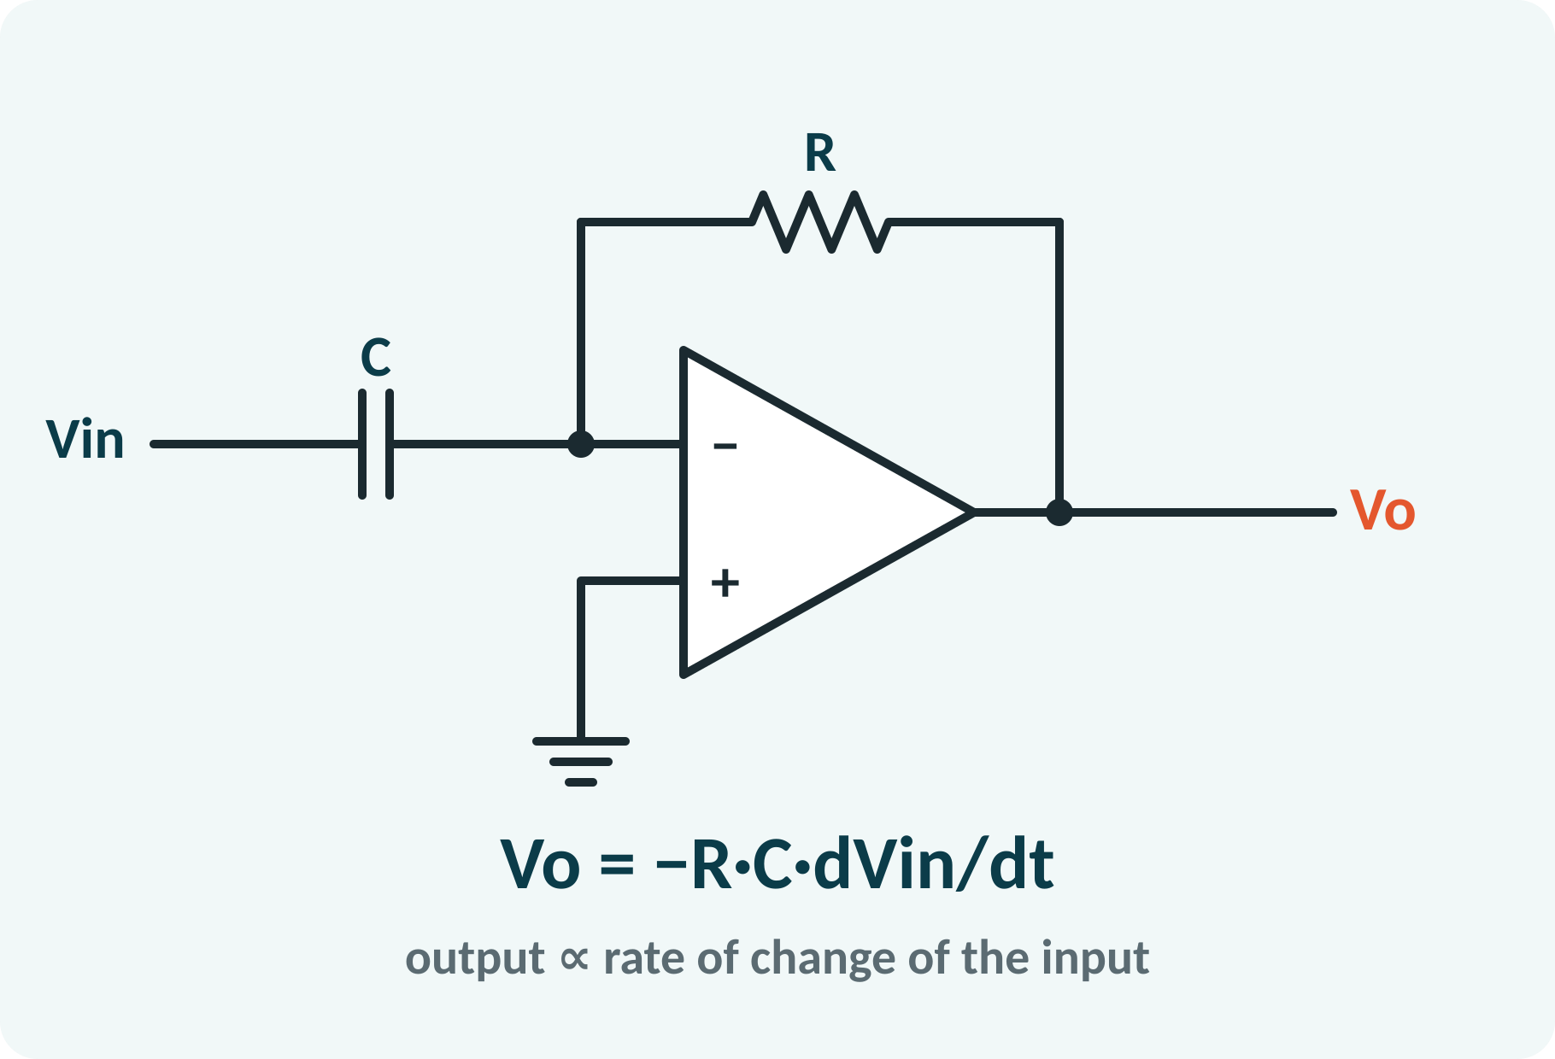
Op-Amp Differentiator
Capacitor C at the input; resistor R in feedback.
Capacitor current = C·dVin/dt.
That current flows through R.
Output is minus RC times the rate of change.
Gain rises with frequency: high-pass.
Vo(t) = −R·C·dVin/dt; in s-domain: Vo/Vin = −sRC
Notes:
In the differentiator the positions of R and C are swapped. The current through the input capacitor is C times the rate of change of the input voltage, and since there is virtual ground the same current flows through the feedback resistor. The output is therefore minus RC times the derivative of the input. A rising input produces a negative output and a falling input produces a positive output.

Slide 8
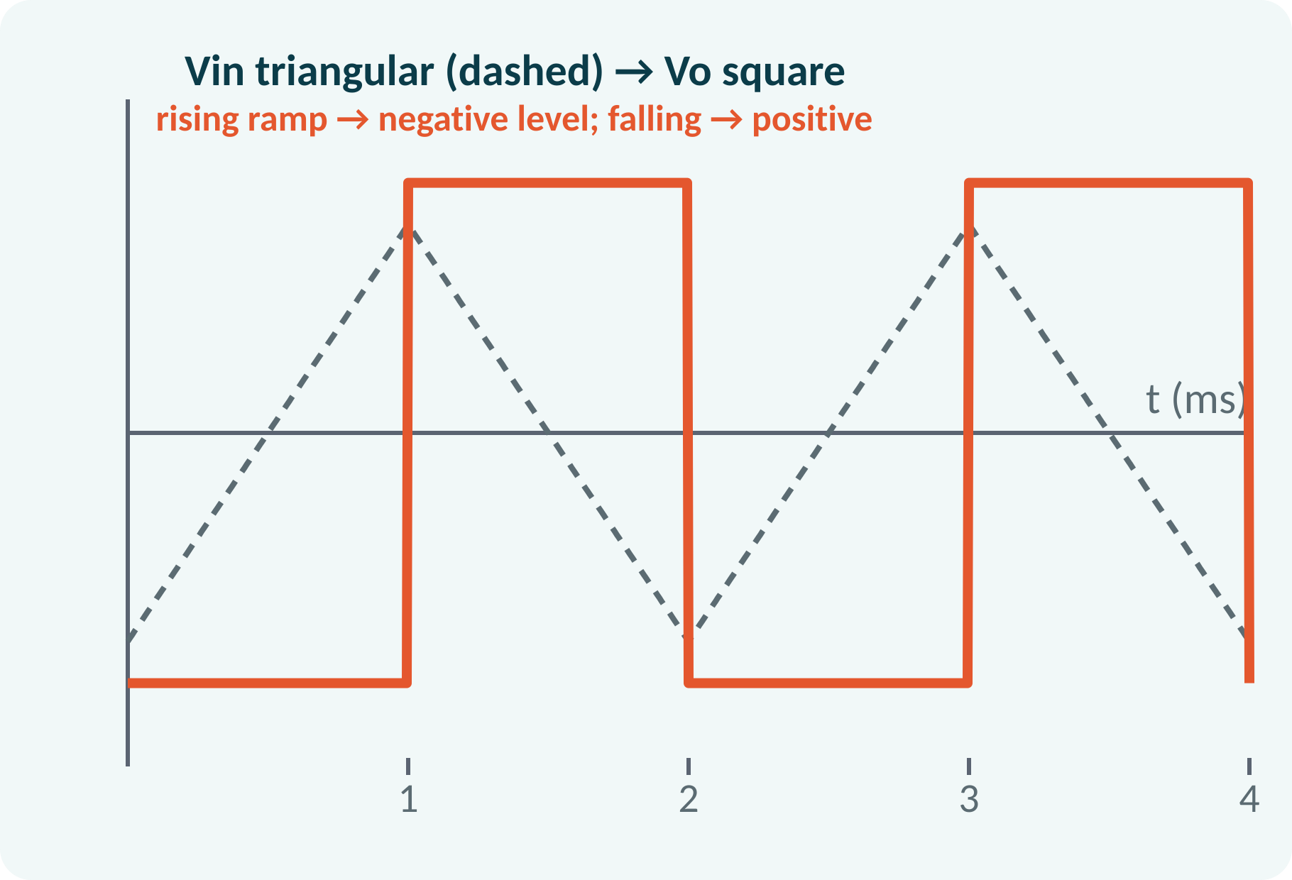
Differentiator: Waveforms and Limitations
Triangular input → square output.
Sine input → cosine output (amplitude × RCω).
Amplifies high-frequency noise strongly.
Can become unstable.
Practical: series Rs with C and Cf across R.
Vin = Vm sin ωt → Vo = −RC·ωVm cos ωt
Practical differentiator: add Rs (series with C) and Cf (across Rf)
Notes:
Differentiating a triangular wave gives a square wave, because the slope is constant on each segment. For a sine input the output amplitude is RC omega times the input amplitude, so high frequencies are amplified more, including noise. To make the circuit practical we add a small resistor in series with the input capacitor and a small capacitor across the feedback resistor to limit the high-frequency gain.

Slide 9
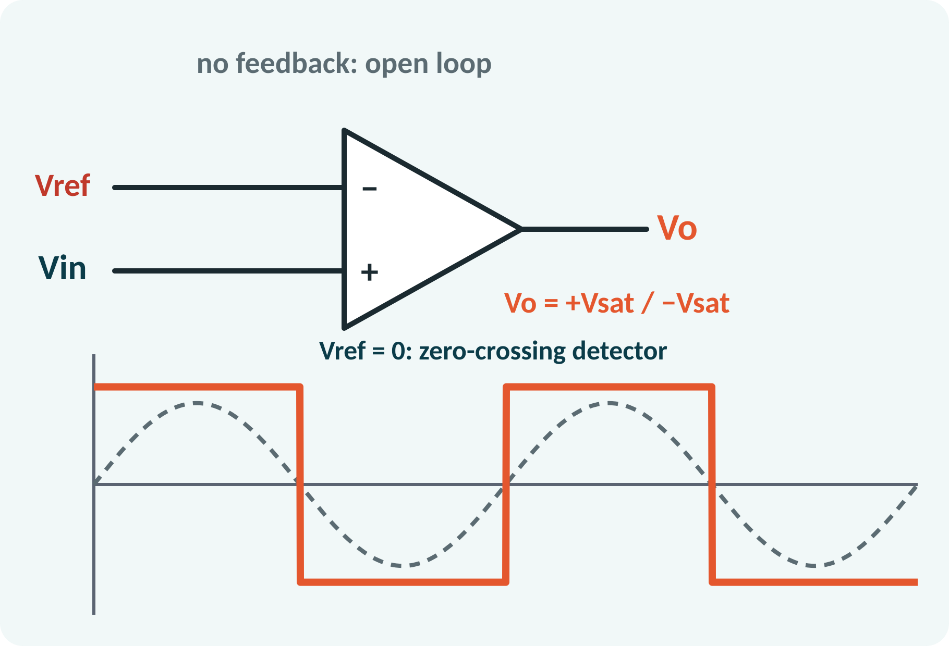
Op-Amp Comparator
Op-amp used without feedback (open loop).
Compares Vin with a reference Vref.
Vin > Vref: output +Vsat.
Vin < Vref: output −Vsat.
Zero-crossing detector: Vref = 0.
Vo = +Vsat if V+ > V−; Vo = −Vsat if V+ < V−; Vsat ≈ VCC − 1.5 V
Notes:
In the comparator there is no feedback, so the huge open-loop gain drives the output to a saturation level for even a tiny difference between inputs. If the signal is at the non-inverting input and the reference at the inverting input, the output is high when the signal exceeds the reference and low otherwise. With zero reference the circuit detects zero crossings and converts a sine wave to a square wave.

Slide 10
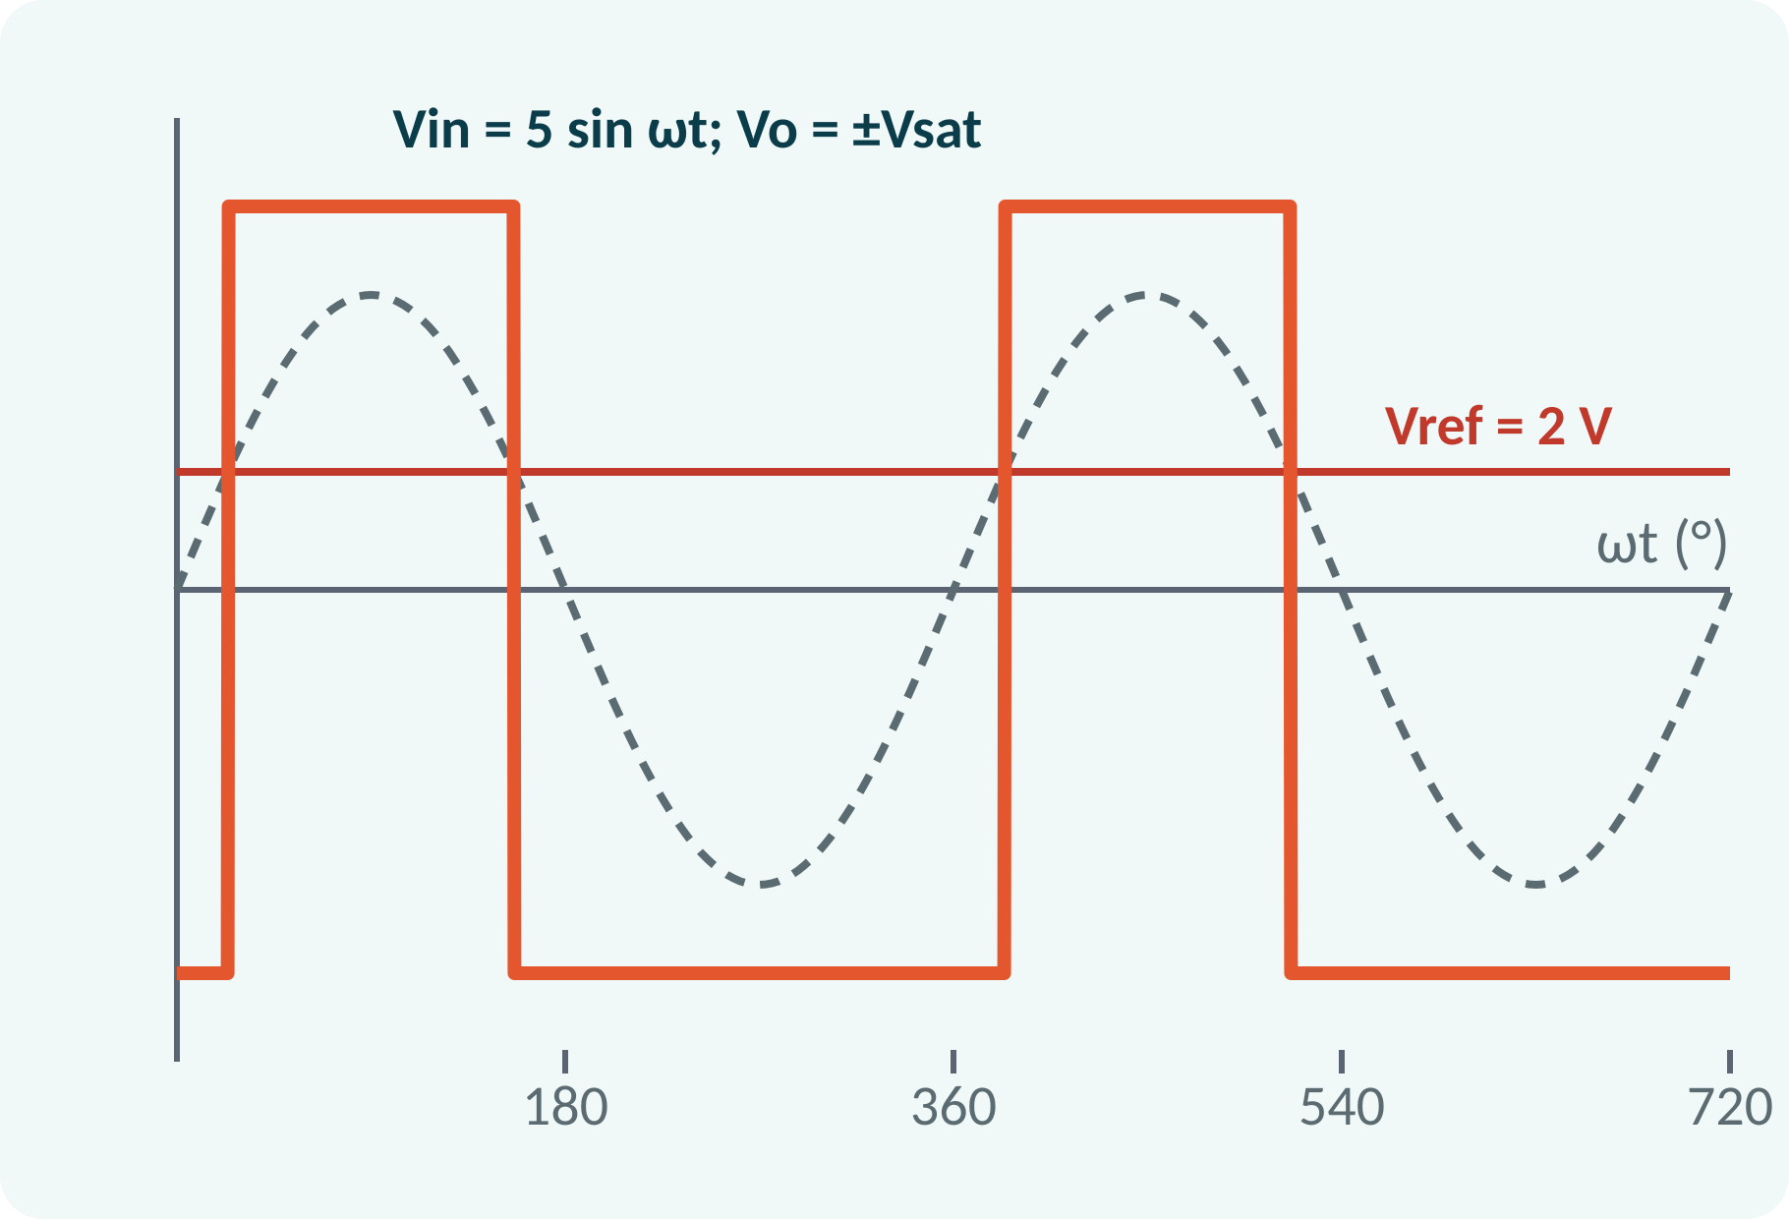
Level Detector and Hysteresis
Non-zero Vref sets the trigger level.
Output is high only while Vin > Vref.
Pulse width depends on Vref.
Noise near the threshold causes chatter.
Positive feedback (Schmitt trigger) adds hysteresis.
Switching angle: θ = sin⁻¹(Vref/Vm); high for 180° − 2θ each cycle
Notes:
A reference voltage other than zero shifts the switching instants. The output goes high when the sine passes the reference on the rising side and low when it falls below. The width of the output pulse therefore depends on the reference level, which is the basis of pulse-width control. In noisy environments a Schmitt trigger, which uses positive feedback to create two thresholds, avoids false switching.

Slide 11
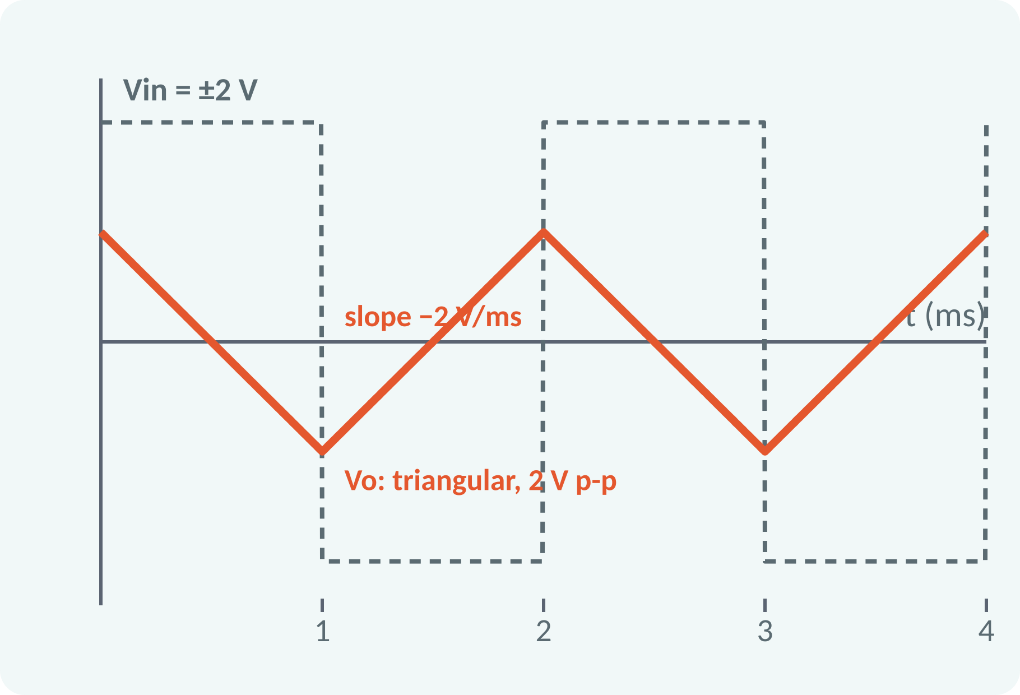
Solved Example 1: Integrator
R = 10 kΩ, C = 0.1 µF. Input: ±2 V square wave, frequency 500 Hz (half-period 1 ms). Find the output.
1. RC = 10 kΩ × 0.1 µF = 1 ms.
2. Slope = −Vin/RC = −2 V/1 ms = −2 V/ms (for +2 V).
3. In 1 ms the output falls by 2 V; with −2 V it rises by 2 V.
4. Output: triangular wave, 2 V peak-to-peak.
Answer: triangular output, slope ∓2 V/ms, 2 V peak-to-peak (±1 V)
Notes:
First compute the time constant, 1 millisecond. For a constant input of 2 volts the output slope is minus two volts per millisecond. Since each half-period lasts one millisecond, the output changes by two volts, giving a triangular wave of two volts peak to peak centred on zero. Check that this does not exceed the saturation limit.

Slide 12
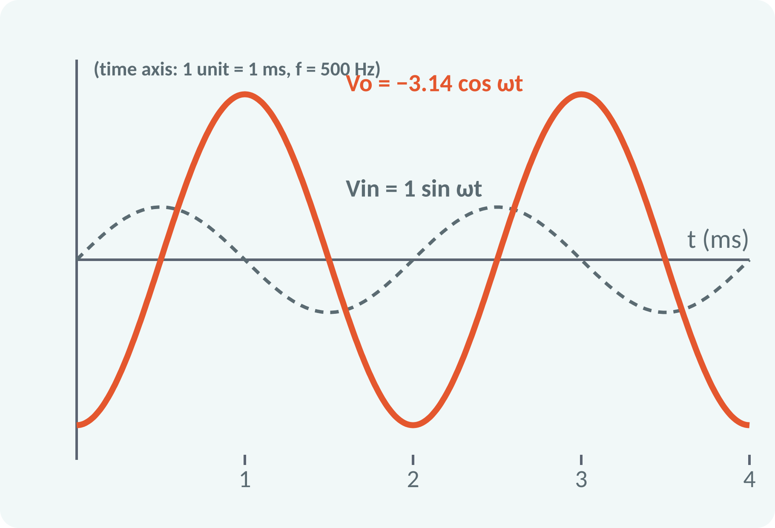
Solved Example 2: Differentiator
R = 10 kΩ, C = 0.1 µF, Vin = 1·sin(2π × 500t) V. Find Vo.
1. RC = 1 ms; ω = 2π × 500 = 3142 rad/s.
2. dVin/dt = 1 × ω·cos ωt = 3142 cos ωt V/s.
3. Vo = −RC·dVin/dt = −10⁻³ × 3142 cos ωt.
4. Vo = −3.14 cos(2π × 500t) V.
Answer: Vo = −3.14 cos ωt V (amplitude 3.14 V, 90° shifted, inverted)
Notes:
Differentiate the sine to get omega times cosine and multiply by minus RC. The output amplitude is 3.14 volts, more than three times the input, because the frequency is high enough that omega times RC is about three. At lower frequencies the gain would be smaller. The output is a cosine, so it is shifted by 90 degrees, and inverted.

Slide 13
Solved Example 3: Level Detector
Vin = 5 sin ωt at the (+) input, Vref = +2 V at the (−) input, Vsat = ±13 V. Find the switching angles and the duty cycle.
1. Output high when 5 sin ωt > 2.
2. sin θ = 2/5 = 0.4 → θ1 = 23.6°.
3. θ2 = 180° − 23.6° = 156.4°.
4. High for 156.4° − 23.6° = 132.8° per cycle.
5. Duty = 132.8/360 = 36.9 %.
Answer: Vo = +13 V for 23.6° < ωt < 156.4°, else −13 V; duty 36.9 %
Notes:
The output switches at the points where the input equals the reference. For a 5 volt sine and a 2 volt reference, the sine of the switching angle is 0.4, which is 23.6 degrees. By symmetry the falling crossing is at 156.4 degrees. The output is high between those two angles, so the positive pulse is about 133 degrees long in each cycle, a duty cycle of 36.9 per cent.

Slide 14
Common Mistakes and Exam Tips
✕
Common mistakes
✓
Exam tips
Forgetting the minus sign in the integrator and differentiator.
Using RC in the wrong units (µF, kΩ).
Expecting a stable differentiator at high frequency.
Ignoring op-amp saturation in the integrator.
Using feedback in a comparator.
Vo = −(1/RC)∫Vin dt; Vo = −RC·dVin/dt.
Write RC in seconds first.
Check that |Vo| < Vsat.
Comparator: no feedback; output ±Vsat.
Notes:
These are the points where marks are lost most often in op-amp applications. Give one quick example for each mistake. Remind students that writing the formula, substitution and the unit earns method marks even if the arithmetic slips. Encourage them to check the answer for reasonableness.

Slide 15
Summary
Integrator: Vo = −(1/RC)∫Vin dt (low-pass).
Differentiator: Vo = −RC dVin/dt (high-pass).
Square → triangle (integrator); triangle → square (differentiator).
Comparator: Vo = ±Vsat depending on Vin ≷ Vref.
Practical versions need Rf / Rs and Cf.
∫: slope = −Vin/RC; d/dt: amplitude = RC·ω·Vm
Notes:
Recap in one minute. Say each point and ask the class to recall the formula for it. If they remember these ideas, most numerical problems on op-amp applications are within reach. Next lecture: 555 timer and 78xx voltage regulators. Revise the two solved examples tonight.

Slide 16
Quick Quiz
Q1. Integrator with square-wave input gives:
(a) square (b) triangular (c) sine (d) DC
Ans: (b)
Q2. In a differentiator the capacitor is:
(a) in feedback (b) at the input (c) to ground (d) absent
Ans: (b)
Q3. RC = 1 ms, Vin = 5 V DC: integrator slope =
(a) −5 V/ms (b) +5 V/ms (c) −5 mV/ms (d) 0
Ans: (a)
Q4. A comparator with Vin > Vref (Vin at +) gives:
(a) 0 V (b) −Vsat (c) +Vsat (d) Vref
Ans: (c)
Q5. Differentiator output for sin input is:
(a) sine (b) cosine (c) DC (d) triangular
Ans: (b)
Notes:
Give about one minute per question and take a show of hands. Discuss why the wrong options are tempting, especially the one that uses a wrong formula. Use the quiz as a quick check on op-amp applications before leaving.

Slide 17
References
1
Boylestad Robert L. and Nashelsky Louis, Electronic Devices and Circuit Theory
11th Ed., PHI, 2016 (Units 3, 4, 5 textbook)
2
David A. Bell, Operational Amplifier and Linear ICs
3rd Ed., Oxford University Press, 2011 (reference, Unit 5)
Next lecture: 555 timer and 78xx voltage regulators
Notes:
Point students to the textbooks listed in the syllabus for op-amp applications. Ask them to solve at least three textbook problems on this topic before the next class. Thank the class and preview the next lecture.

