Slide 1
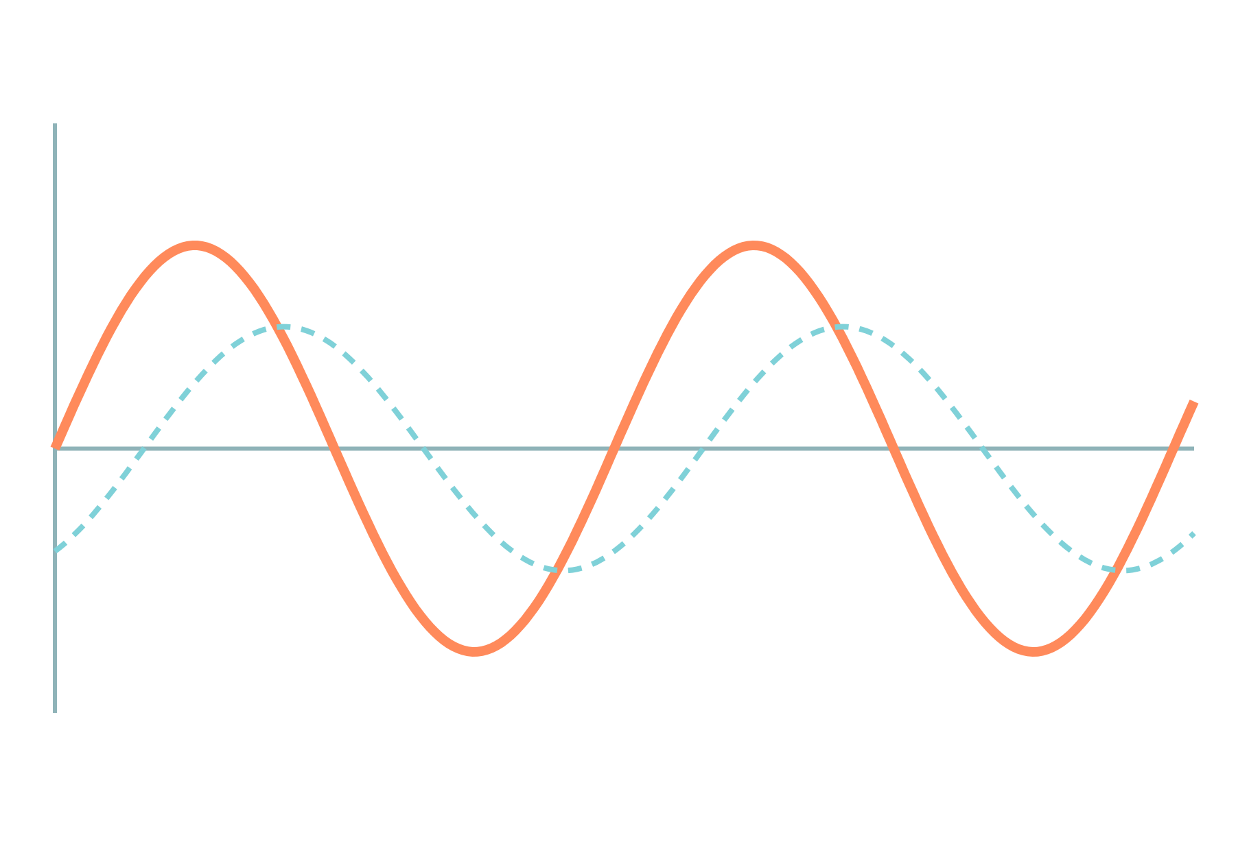
555 Timer and 78XX Regulators
Basic Electrical and Electronics Engineering
Unit 5: Op-Amp and Linear IC Applications
Topic: 555 timer IC in astable mode; 78XX series IC voltage regulators
Prof. Mitesh Astik
Notes:
Welcome everyone. Today's topic is 555 timer IC in astable mode; 78XX series IC voltage regulators. It belongs to Unit 5: Op-Amp and Linear IC Applications. By the end of this session you will be able to use it in numerical problems. Keep your notebooks ready because we will solve two examples.

Slide 2

Learning Outcomes
Describe the internal blocks and pins of the 555.
Explain astable operation with RA, RB and C.
Calculate frequency and duty cycle.
Use 78XX regulators in a power supply.
Linked to CO5
Describe the working principles of op-amp and signal-processing circuits.
Notes:
Read the outcomes aloud. They map to CO5 of the syllabus. Tell students that these are examinable and that the two solved examples follow the same pattern. Ask them to tick off each outcome at the end of the lecture.

Slide 3
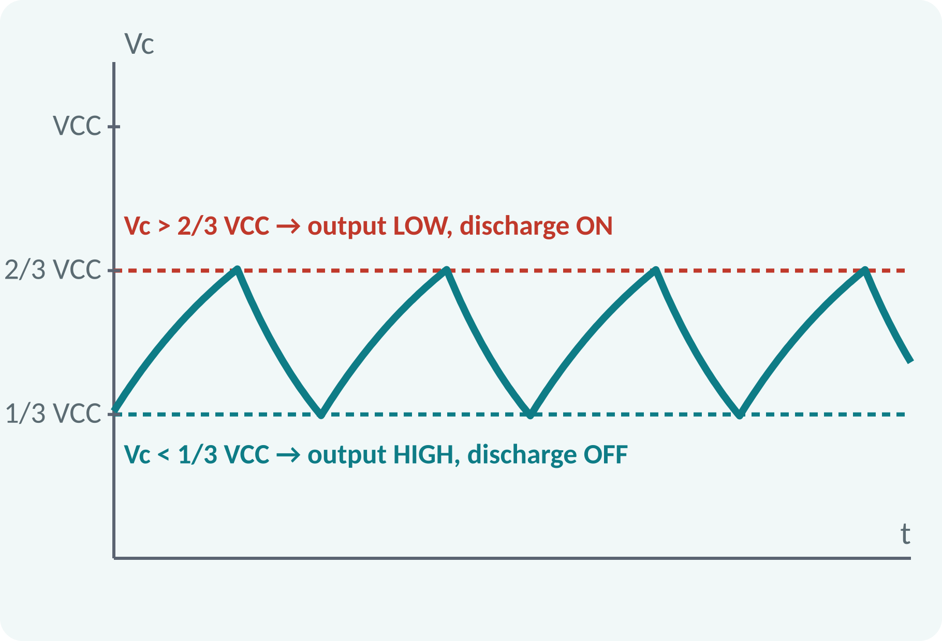
Recap: What You Already Know
Capacitor charges as v = V(1 − e^(−t/RC)).
Time constant τ = RC.
Comparator output ±Vsat.
Voltage divider: Vout = Vin·R2/(R1 + R2).
Capacitor charging between two levels takes t = RC·ln[(Vf − V1)/(Vf − V2)]
Notes:
A capacitor charged through a resistor rises exponentially with time constant RC. Comparators switch their output when one input crosses the other. A voltage divider produces a fraction of the supply. The 555 timer combines these three ideas inside a single eight-pin package, and with two resistors and a capacitor it becomes an oscillator.

Slide 4
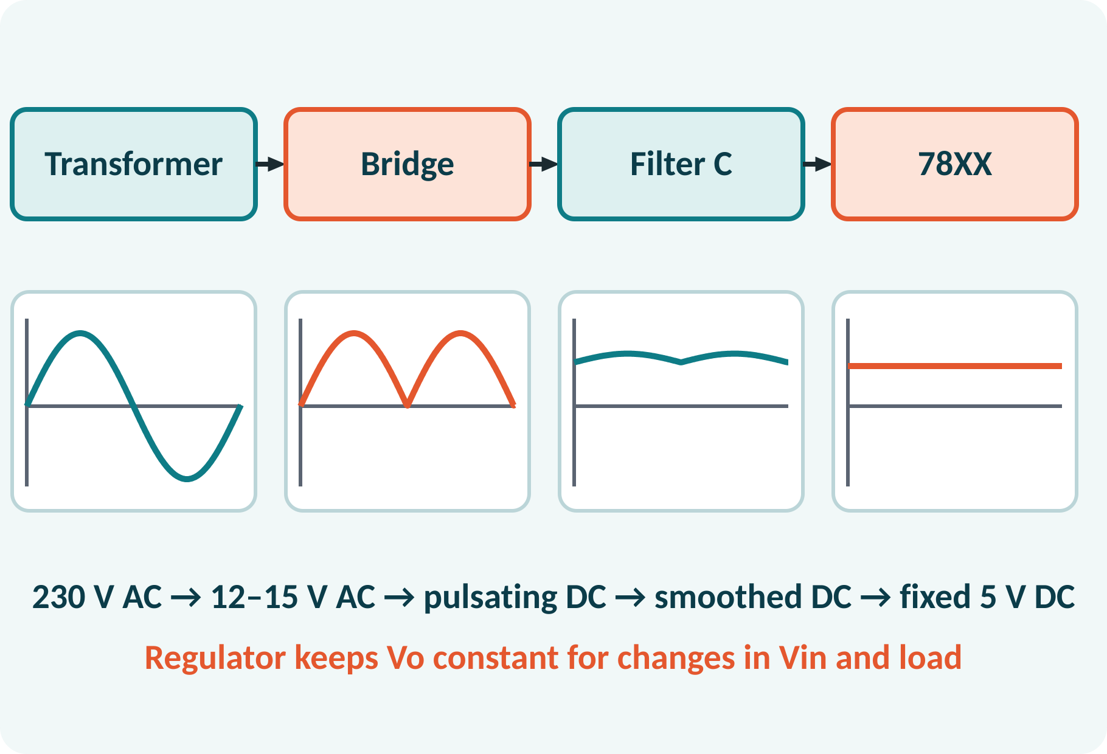
Motivation: Timers, Flashers and Regulators
Flashing lights, buzzers, clock pulses.
Pulse generation for digital circuits.
Every power supply needs a regulator.
Both are cheap, popular ICs.
555: pulse generator; 78XX: steady DC supply
Notes:
The 555 timer is one of the most widely used ICs ever made. It produces timing pulses for flashers, alarms and clocks. The 78XX series is equally popular as the last stage of a DC power supply and gives a fixed voltage such as 5 volts for digital circuits. Both are examples of linear ICs designed to be used with a handful of external components.

Slide 5
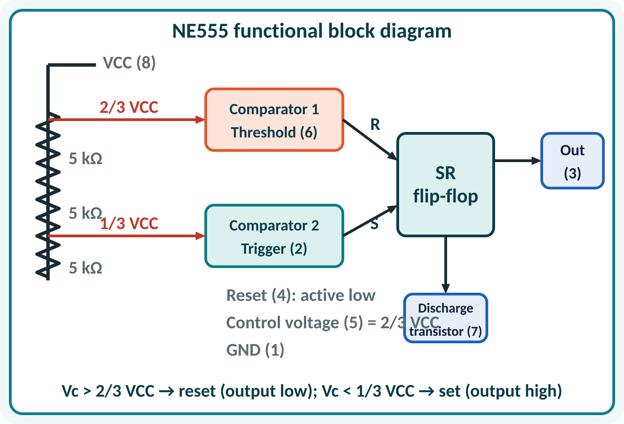
555 Timer: Internal Structure
Voltage divider of three 5 kΩ resistors.
Comparator 1 (threshold) compares with 2/3 VCC.
Comparator 2 (trigger) compares with 1/3 VCC.
SR flip-flop stores the state.
Output stage and discharge transistor.
Thresholds: upper = 2/3 VCC, lower = 1/3 VCC
Notes:
Inside the 555 three equal resistors form a voltage divider that defines two thresholds at two thirds and one third of the supply. Two comparators check the external capacitor voltage against these thresholds and set or reset a flip-flop. The flip-flop controls the output pin and a transistor that discharges the timing capacitor.

Slide 6
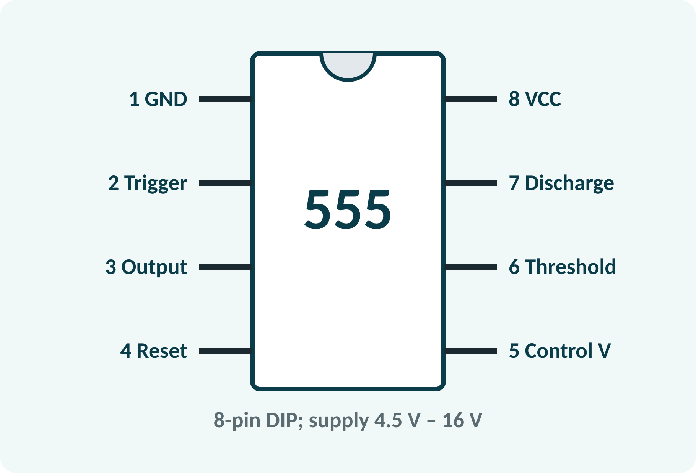
555 Pin Configuration
Pin 1: ground; pin 8: VCC.
Pin 2: trigger (set at 1/3 VCC).
Pin 6: threshold (reset at 2/3 VCC).
Pin 3: output; pin 4: reset (tie to VCC).
Pin 7: discharge; pin 5: control voltage (0.01 µF to ground).
Supply 4.5–16 V; output current up to 200 mA
Notes:
Learn the eight pins: one is ground, eight is the supply. Two is the trigger input and six the threshold input, which are the two comparator inputs. Pin three is the output and pin seven discharges the capacitor. Pin four resets the timer when pulled low, so we normally tie it to the supply. Pin five sets the threshold voltage and is bypassed with a small capacitor.

Slide 7
Operation: Set and Reset
Vc < 1/3 VCC: trigger comparator sets the flip-flop.
Output HIGH; discharge transistor OFF; C charges.
Vc > 2/3 VCC: threshold comparator resets it.
Output LOW; discharge transistor ON; C discharges.
Cycle repeats in astable mode.
Set at 1/3 VCC; reset at 2/3 VCC; Vc swings between the two
Notes:
When the capacitor voltage is below one third of the supply the trigger comparator sets the flip-flop, the output goes high, and the discharge transistor turns off so the capacitor charges. When the voltage reaches two thirds of the supply the threshold comparator resets the flip-flop, the output goes low and the capacitor is discharged. In astable mode these two events alternate forever.

Slide 8
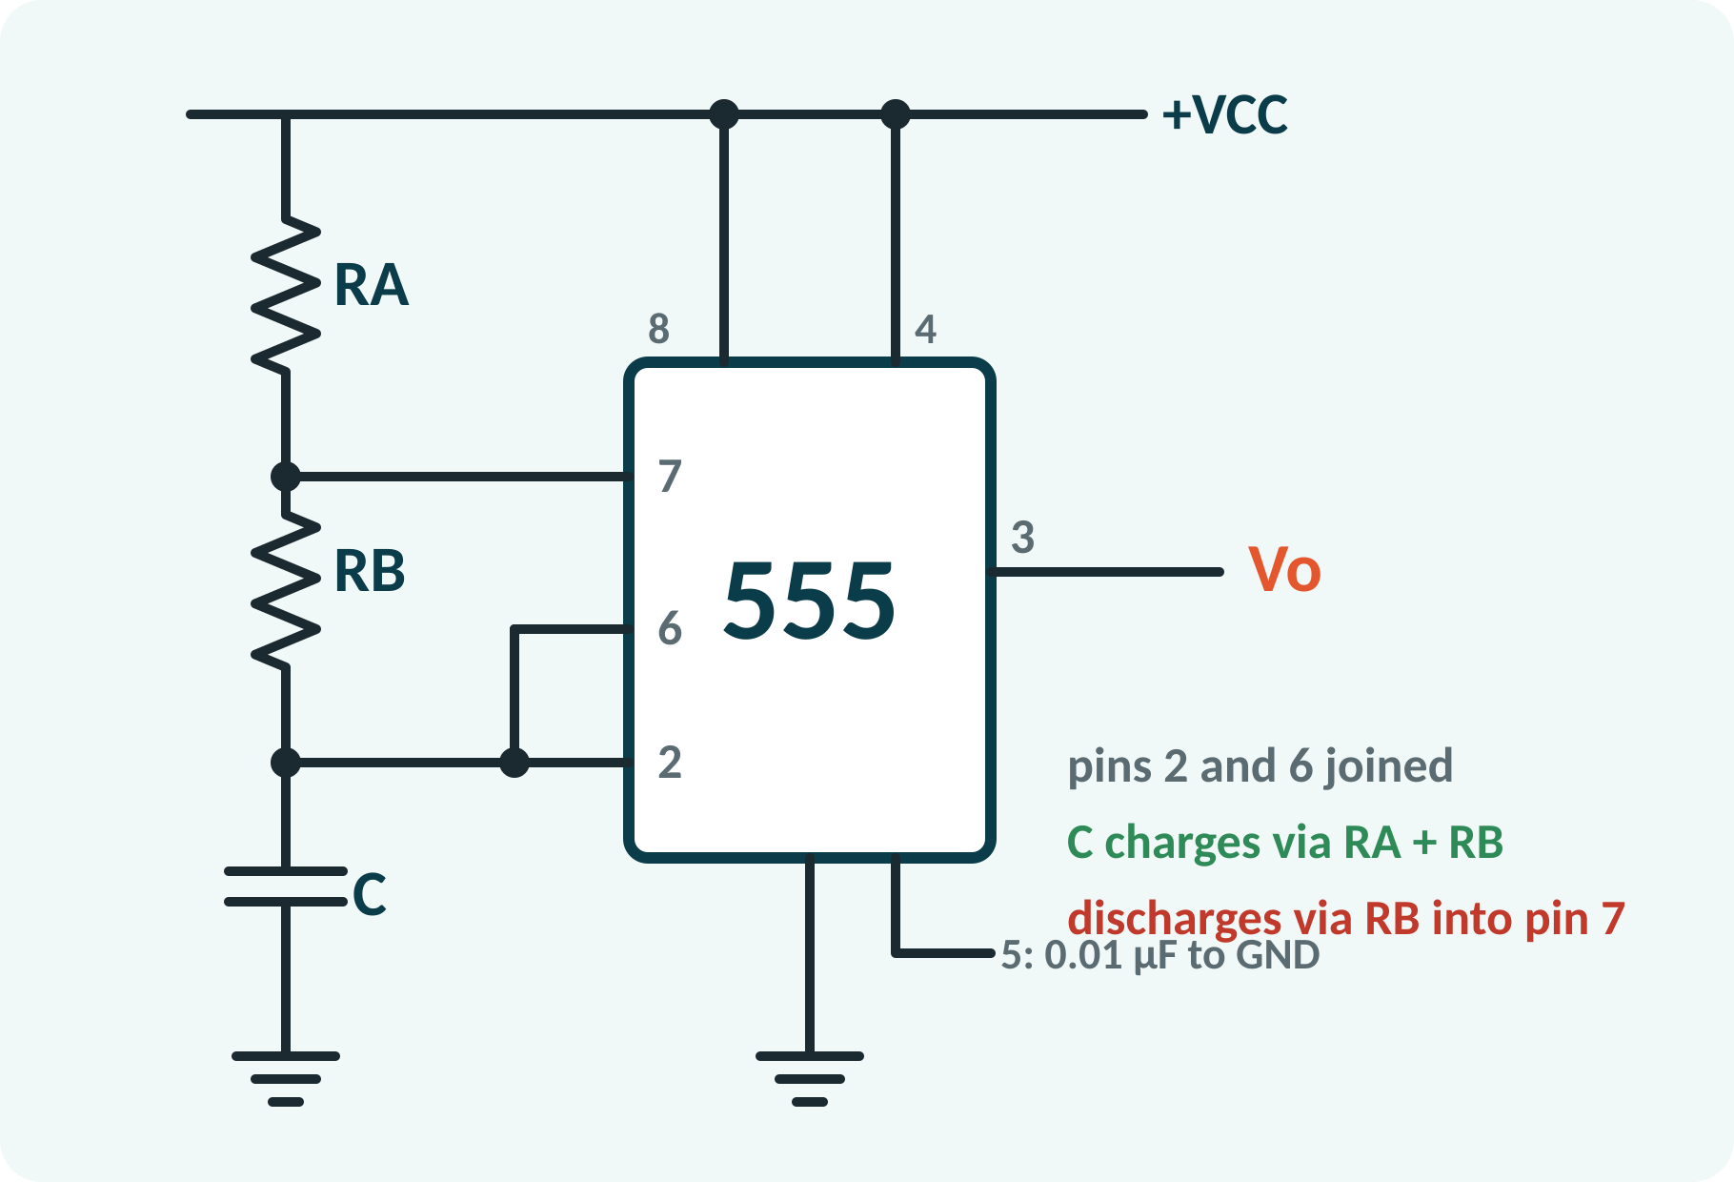
Astable Multivibrator Circuit
External RA, RB and C set the timing.
Pins 2 and 6 tied together to the capacitor.
Pin 7 connects between RA and RB.
No stable state: output toggles continuously.
Also called a free-running oscillator.
Charging path: VCC → RA → RB → C; discharge path: C → RB → pin 7
Notes:
In the astable circuit the timing capacitor is charged through both resistors RA and RB from the supply. The discharge pin, connected between RA and RB, grounds that point through the internal transistor when the output is low, so the capacitor then discharges through RB alone. Because pins two and six are joined, the capacitor voltage triggers both comparators, and the circuit oscillates on its own.

Slide 9
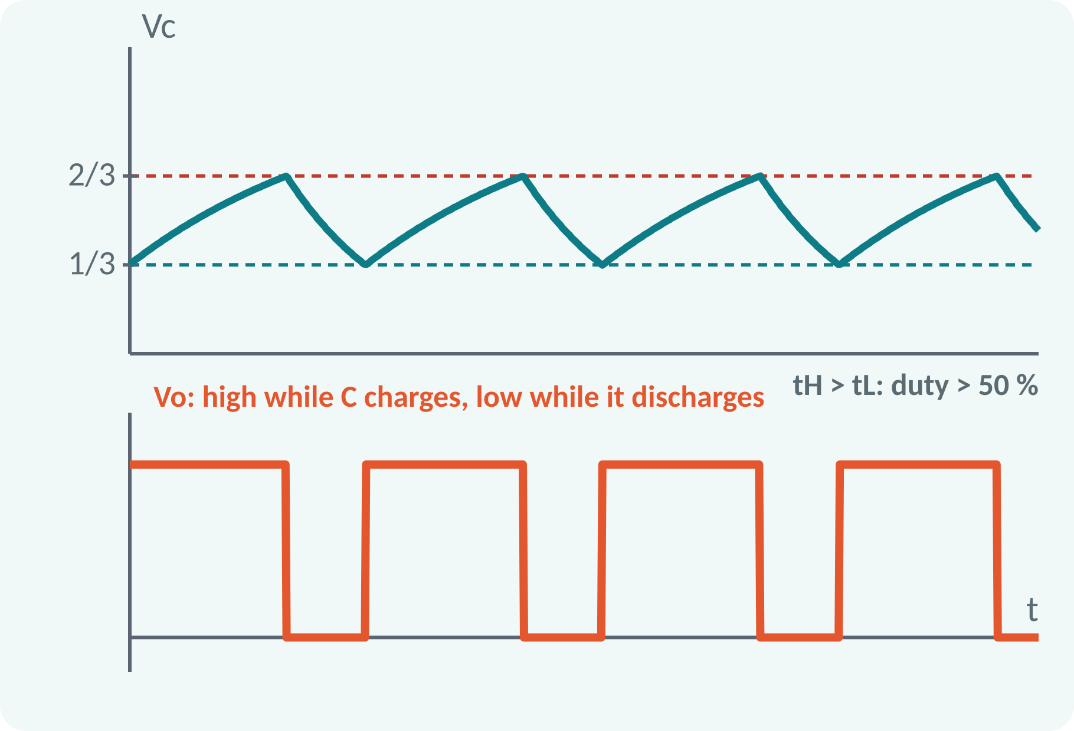
Astable Waveforms
C charges from 1/3 to 2/3 VCC through RA + RB.
Output is HIGH during charging.
C discharges from 2/3 to 1/3 VCC through RB.
Output is LOW during discharging.
Rectangular wave; duty cycle above 50 %.
Charging τ = (RA + RB)C; discharging τ = RB·C; interval = τ·ln 2 = 0.693τ
Notes:
The capacitor voltage rises and falls between one third and two thirds of VCC. The time to charge from one third to two thirds is the time constant times natural log of two, which is 0.693 times the time constant. The charging time constant includes RA and RB, the discharge time constant only RB. So the output is high for longer than it is low.

Slide 10
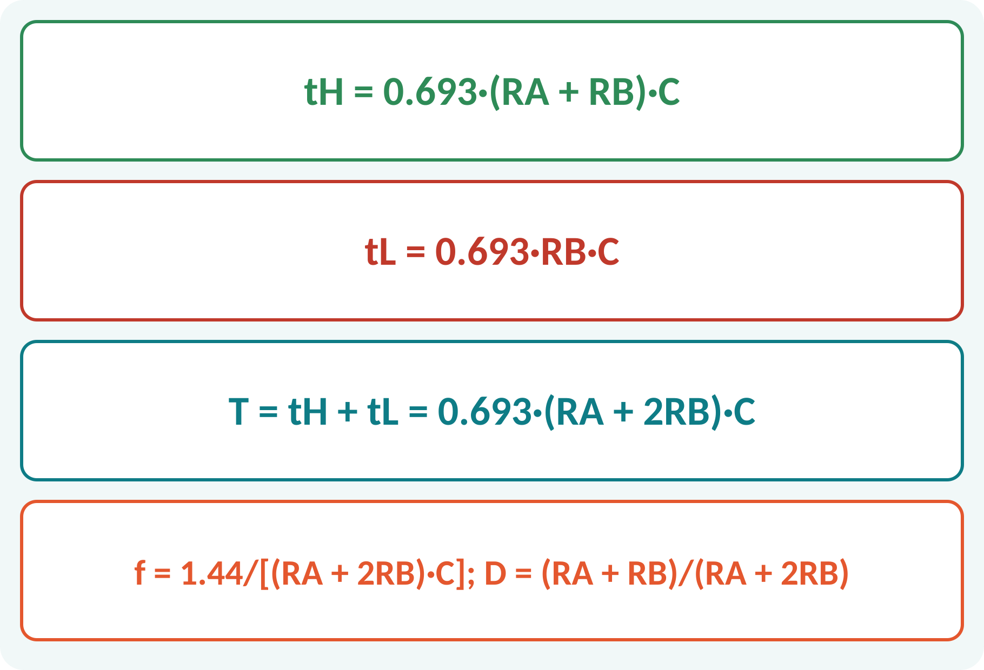
Timing Equations
High time depends on RA + RB.
Low time depends only on RB.
Frequency from the total period.
Duty cycle always above 50 %.
Use RA ≪ RB for a near-50 % duty cycle.
tH = 0.693(RA + RB)C; tL = 0.693RB·C; f = 1.44/[(RA + 2RB)C]; D = (RA + RB)/(RA + 2RB)
Notes:
Using the constants from the previous slide we get the high time as 0.693 times RA plus RB times C and the low time as 0.693 times RB times C. The period is their sum and the frequency is 1.44 divided by RA plus two RB times C. The duty cycle is the high time over the period, and since RA is positive it is always greater than fifty per cent.

Slide 11
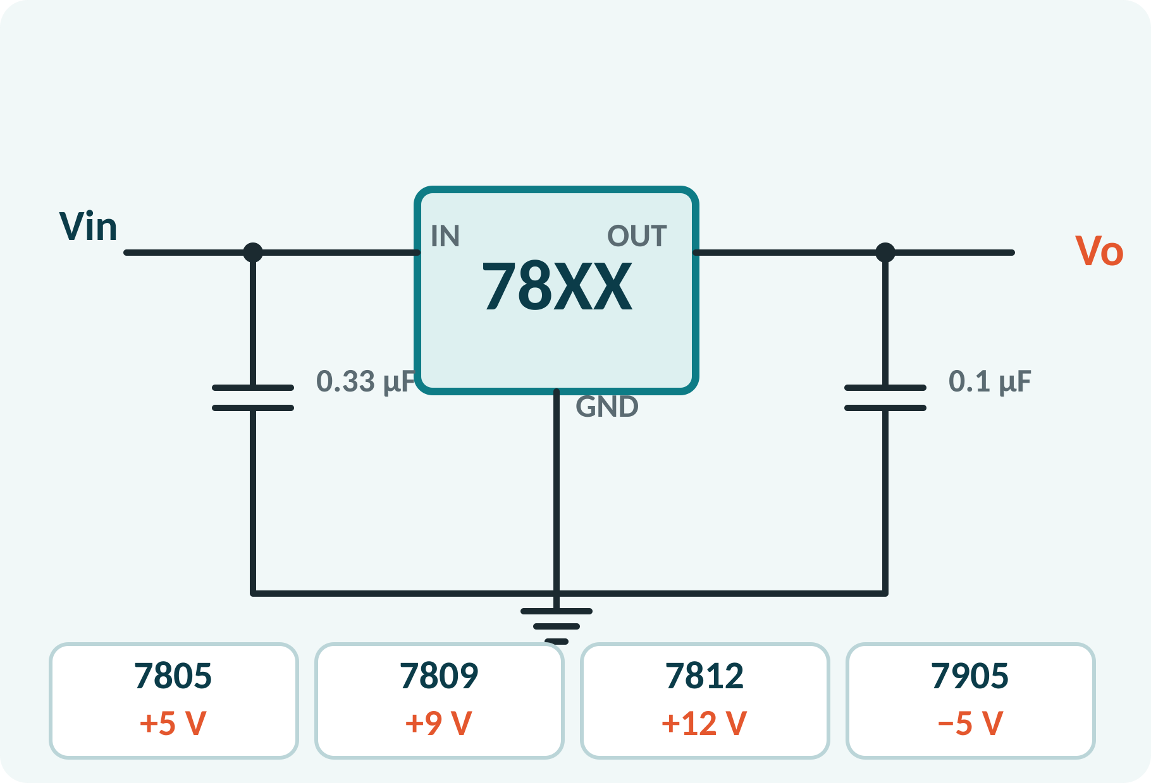
78XX Series Voltage Regulators
Three-terminal fixed positive regulators.
Last two digits give the output: 7805 = 5 V.
Input must exceed output by about 2 V.
Up to 1 A output with a heat sink.
Built-in current limit and thermal shutdown.
Vo = fixed (5, 6, 8, 9, 12, 15, 18, 24 V); Vin(min) ≈ Vo + 2 V; 79XX: negative series
Notes:
The 78XX is a family of fixed-voltage regulators with only three pins: input, ground and output. The last two digits are the output voltage, so the 7805 gives 5 volts and the 7812 gives 12 volts. The input must be at least 2 volts above the output, otherwise regulation is lost. Small capacitors at the input and output improve stability, and the matching 79XX series gives negative voltages.

Slide 12
Regulator in a DC Power Supply
Transformer lowers the mains voltage.
Bridge rectifier gives pulsating DC.
Capacitor filter smooths it.
78XX regulator gives fixed, ripple-free output.
Regulator dissipates (Vin − Vo)·IL as heat.
Preg = (Vin − Vo)·IL; efficiency = Vo/Vin (linear regulator)
Notes:
A complete DC supply is the chain we have built over the last lectures: transformer, rectifier, filter, and regulator. The regulator keeps the output constant even when the mains voltage or the load changes. A linear regulator throws away the voltage difference as heat, so for large drops a heat sink is needed and the efficiency is the ratio of output to input voltage.

Slide 13
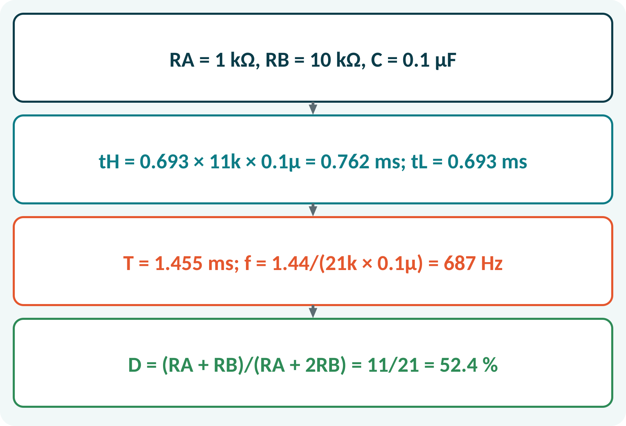
Solved Example 1: Astable Frequency
A 555 astable has RA = 1 kΩ, RB = 10 kΩ, C = 0.1 µF. Find tH, tL, T, f and duty cycle.
1. tH = 0.693 × (1k + 10k) × 0.1 µF = 0.762 ms.
2. tL = 0.693 × 10k × 0.1 µF = 0.693 ms.
3. T = 1.455 ms; f = 1/T = 687 Hz.
4. D = tH/T = 0.762/1.455 = 52.4 %.
Answer: tH = 0.762 ms, tL = 0.693 ms, f = 687 Hz, duty = 52.4 %
Notes:
Substitute the component values into the timing equations. Be careful with units: kilo-ohm times microfarad gives milliseconds. The two times add up to a period of 1.455 milliseconds, which is a frequency of 687 hertz. Because RA is much smaller than RB, the duty cycle is close to fifty per cent.

Slide 14
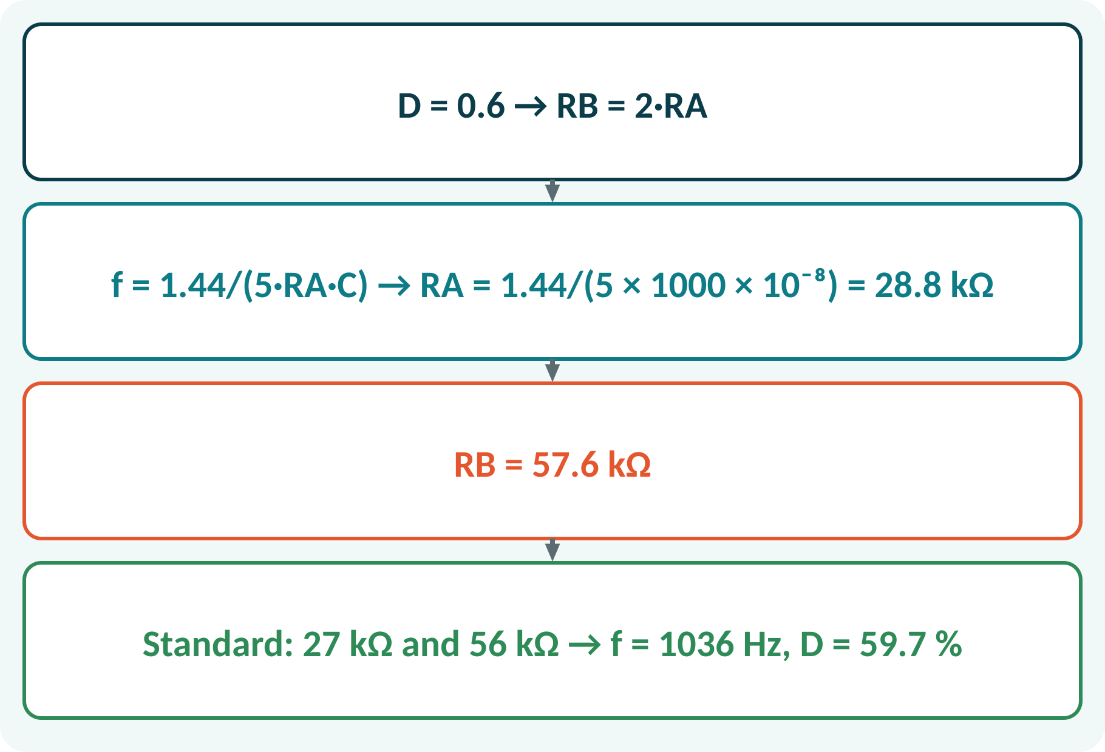
Solved Example 2: Design for 1 kHz
Design an astable 555 for f = 1 kHz, duty cycle 60 %, C = 0.01 µF.
1. D = (RA + RB)/(RA + 2RB) = 0.6 → RB = 2RA.
2. f = 1.44/(RA + 2RB)C = 1.44/(5RA·C).
3. RA = 1.44/(5 × 1000 × 10⁻⁸) = 28.8 kΩ; RB = 57.6 kΩ.
4. Standard values RA = 27 kΩ, RB = 56 kΩ: f = 1.44/(139k × 0.01 µF) = 1036 Hz; D = 59.7 %.
Answer: RA ≈ 28.8 kΩ, RB ≈ 57.6 kΩ (use 27 kΩ and 56 kΩ)
Notes:
Use the duty-cycle equation to find the ratio of RB to RA, which is two. Substitute it into the frequency formula and solve for RA, then for RB. Finally choose the nearest standard resistor values and recompute the frequency and duty cycle to check that they are close to the specification. Real components have tolerances, so small differences are normal.

Slide 15
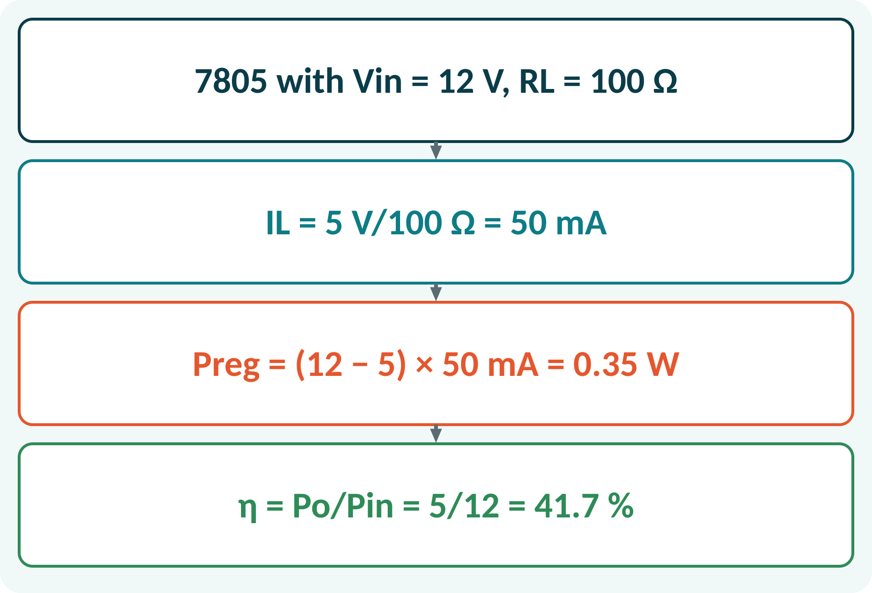
Solved Example 3: 7805 Regulator
A 7805 is supplied from 12 V DC and feeds a 100 Ω load. Find IL, power dissipated in the regulator and efficiency. Is the input voltage adequate?
1. Vin(min) ≈ 5 + 2 = 7 V < 12 V: adequate.
2. IL = Vo/RL = 5/100 = 50 mA.
3. Preg = (Vin − Vo)·IL = 7 × 0.05 = 0.35 W.
4. η = Po/Pin = 5/12 = 41.7 %.
Answer: IL = 50 mA, Preg = 0.35 W, η ≈ 41.7 %
Notes:
First check that the input voltage is high enough, at least two volts above the output. The load current follows from Ohm's law. The regulator dissipates the voltage drop times the load current, which is 0.35 watts here, so a small heat sink may be needed. The efficiency of a linear regulator is simply the ratio of output to input voltage.

Slide 16
Common Mistakes and Exam Tips
✕
Common mistakes
✓
Exam tips
Using tL with RA included.
Mixing kΩ, µF and ms units.
Forgetting to connect pin 4 to VCC.
Expecting 50 % duty with RA = RB.
Input too low for the 78XX (dropout).
Joined pins 2 and 6 for astable operation.
tH uses RA + RB; tL uses RB only.
Vin ≥ Vo + 2 V for 78XX.
Add input and output capacitors.
Notes:
These are the points where marks are lost most often in 555 timer and regulators. Give one quick example for each mistake. Remind students that writing the formula, substitution and the unit earns method marks even if the arithmetic slips. Encourage them to check the answer for reasonableness.

Slide 17
Summary
555: thresholds 2/3 VCC and 1/3 VCC; flip-flop and discharge transistor.
Astable: C charges via RA + RB and discharges via RB.
f = 1.44/[(RA + 2RB)C]; D = (RA + RB)/(RA + 2RB).
78XX: fixed output, three terminals, Vin ≥ Vo + 2 V.
Linear regulator efficiency = Vo/Vin.
T = 0.693(RA + 2RB)C; Preg = (Vin − Vo)·IL
Notes:
Recap in one minute. Say each point and ask the class to recall the formula for it. If they remember these ideas, most numerical problems on 555 timer and regulators are within reach. Next lecture: course revision. Revise the two solved examples tonight.

Slide 18
Quick Quiz
Q1. 555 comparator thresholds are:
(a) 1/2 and 1/4 VCC (b) 2/3 and 1/3 VCC (c) VCC and 0 (d) 3/4 and 1/4 VCC
Ans: (b)
Q2. In astable mode, C discharges through:
(a) RA (b) RA + RB (c) RB (d) none
Ans: (c)
Q3. RA = RB = 10 kΩ, C = 0.1 µF: f ≈
(a) 480 Hz (b) 1.44 kHz (c) 48 Hz (d) 4.8 kHz
Ans: (a)
Q4. 7812 output voltage is:
(a) 7 V (b) 12 V (c) 78 V (d) 1.2 V
Ans: (b)
Q5. Duty cycle of the standard astable circuit is always:
(a) below 50 % (b) exactly 50 % (c) above 50 % (d) 100 %
Ans: (c)
Notes:
Give about one minute per question and take a show of hands. Discuss why the wrong options are tempting, especially the one that uses a wrong formula. Use the quiz as a quick check on 555 timer and regulators before leaving.

Slide 19
References
1
Boylestad Robert L. and Nashelsky Louis, Electronic Devices and Circuit Theory
11th Ed., PHI, 2016 (Units 3, 4, 5 textbook)
2
David A. Bell, Operational Amplifier and Linear ICs
3rd Ed., Oxford University Press, 2011 (reference, Unit 5)
Next lecture: course revision
Notes:
Point students to the textbooks listed in the syllabus for 555 timer and regulators. Ask them to solve at least three textbook problems on this topic before the next class. Thank the class and preview the next lecture.

