Slide 1
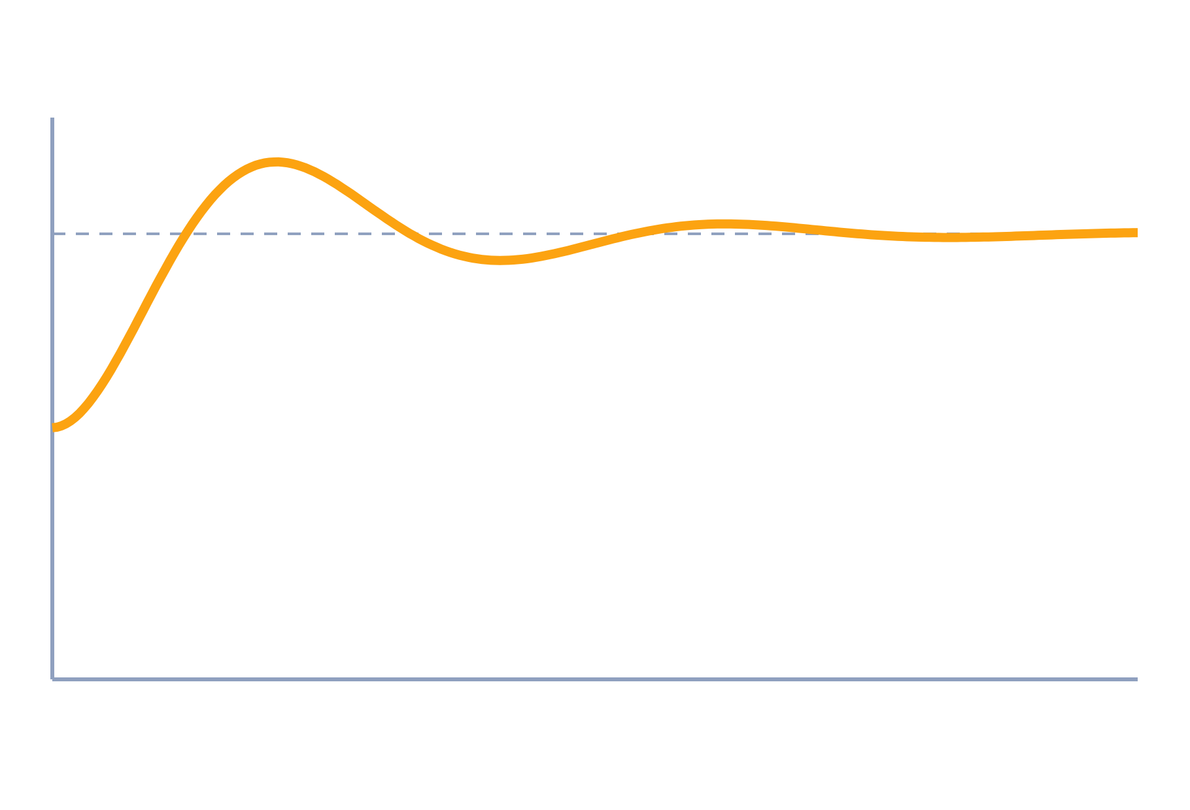
Block Diagrams and Signal Flow Graphs
Control Systems (22EEG53)
Unit 1: Mathematical Modelling of Physical Systems
Topic: Block diagram reduction, signal flow graphs, Mason's gain formula
Prof. Mitesh Astik
Notes:
Welcome everyone. Today's topic is Block diagram reduction, signal flow graphs, Mason's gain formula. It belongs to Unit 1: Mathematical Modelling of Physical Systems. By the end of this session you will be able to use it in numerical problems. Keep your notebooks ready because we will solve two examples.

Slide 2

Learning Outcomes
Reduce block diagrams using standard rules.
Draw a signal flow graph and identify paths and loops.
Apply Mason's gain formula to find C/R.
Compare block reduction with Mason's method.
Linked to CO1
Model dynamical systems by transfer functions.
Notes:
Read the outcomes aloud. They map to CO1 of the syllabus. Tell students that these are examinable and that the two solved examples follow the same pattern. Ask them to tick off each outcome at the end of the lecture.

Slide 3
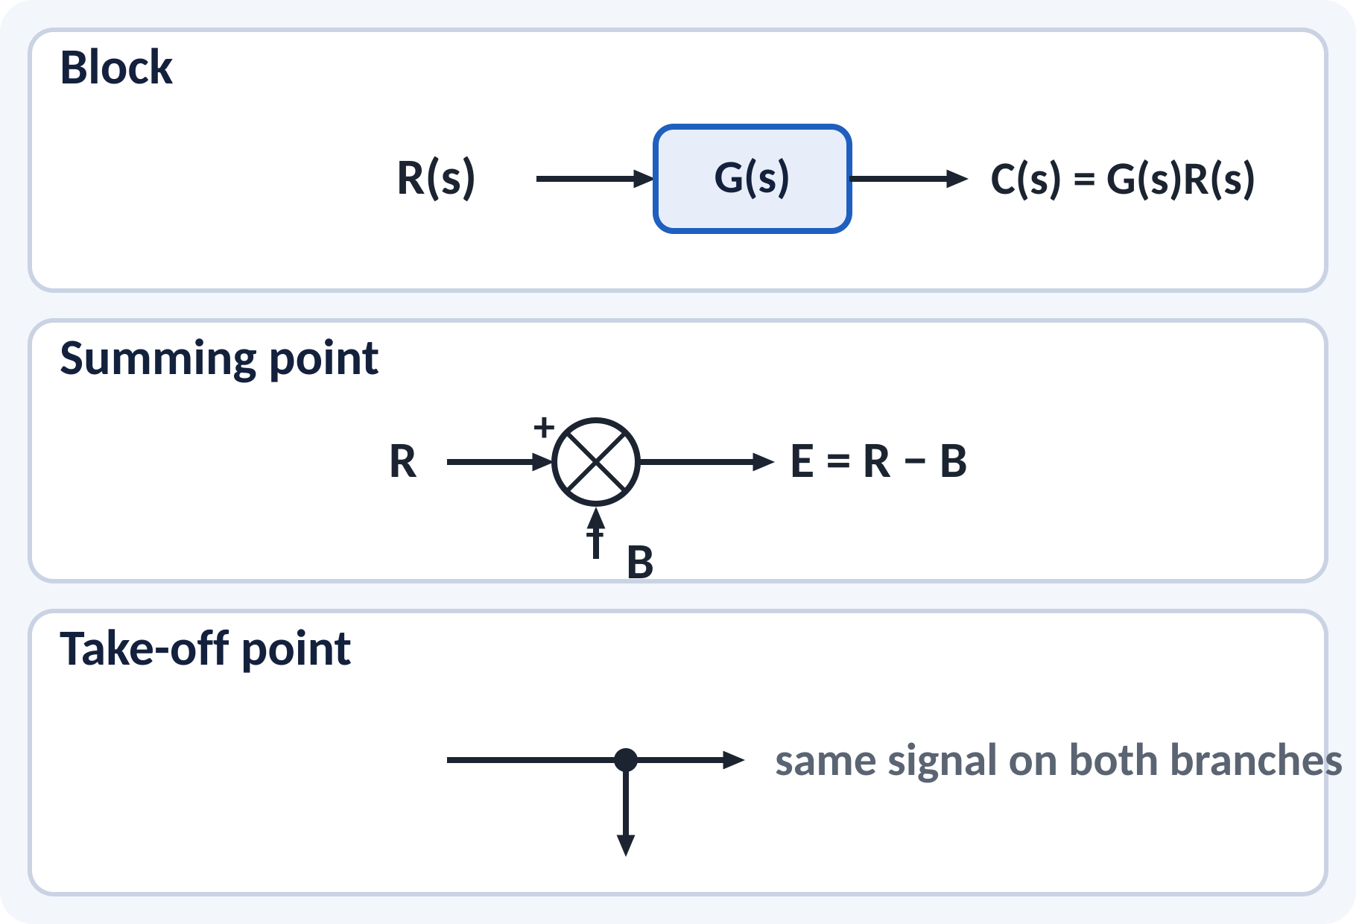
Recap: What You Already Know
Transfer function G(s) = C(s)/R(s).
A block multiplies its input by G(s).
A summing point adds or subtracts signals.
A take-off point copies a signal.
C(s) = G(s)·R(s); E(s) = R(s) − B(s)
G(s) transfer function, E error, B feedback signal
Notes:
Recall that a block is just a transfer function and the signal on the output side is the input multiplied by G(s). The summing point adds signals with the sign marked next to the arrow. The take-off point sends the same signal in two directions without loading it. These three symbols are enough to draw any linear control system.

Slide 4
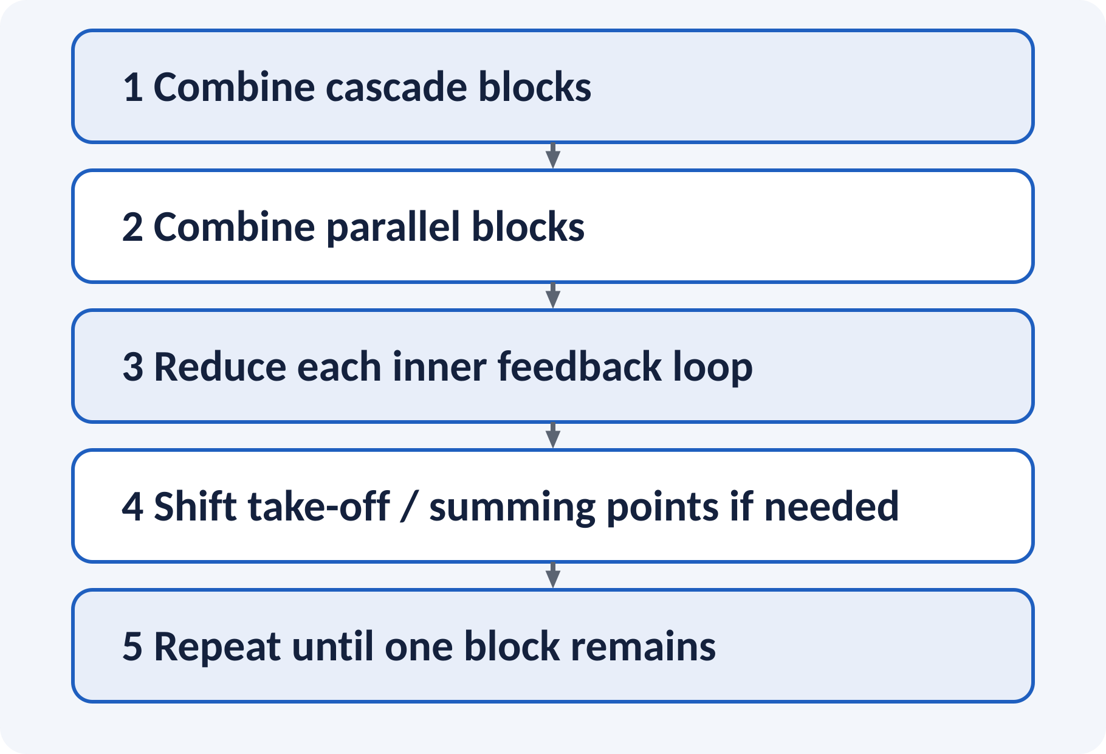
Motivation: Many Loops, One Answer
Real plants have several loops and branches.
We need one overall transfer function C(s)/R(s).
Reduction rules simplify step by step.
Mason's formula gives the answer in one pass.
Goal: replace a complex diagram by a single block T(s) = C(s)/R(s)
Notes:
A motor speed controller has a current loop inside a speed loop inside a position loop. We cannot write one differential equation easily, but we can reduce the diagram. The rules we learn today are used in every later unit. Signal flow graphs are an alternative that avoids drawing the same blocks again and again.

Slide 5
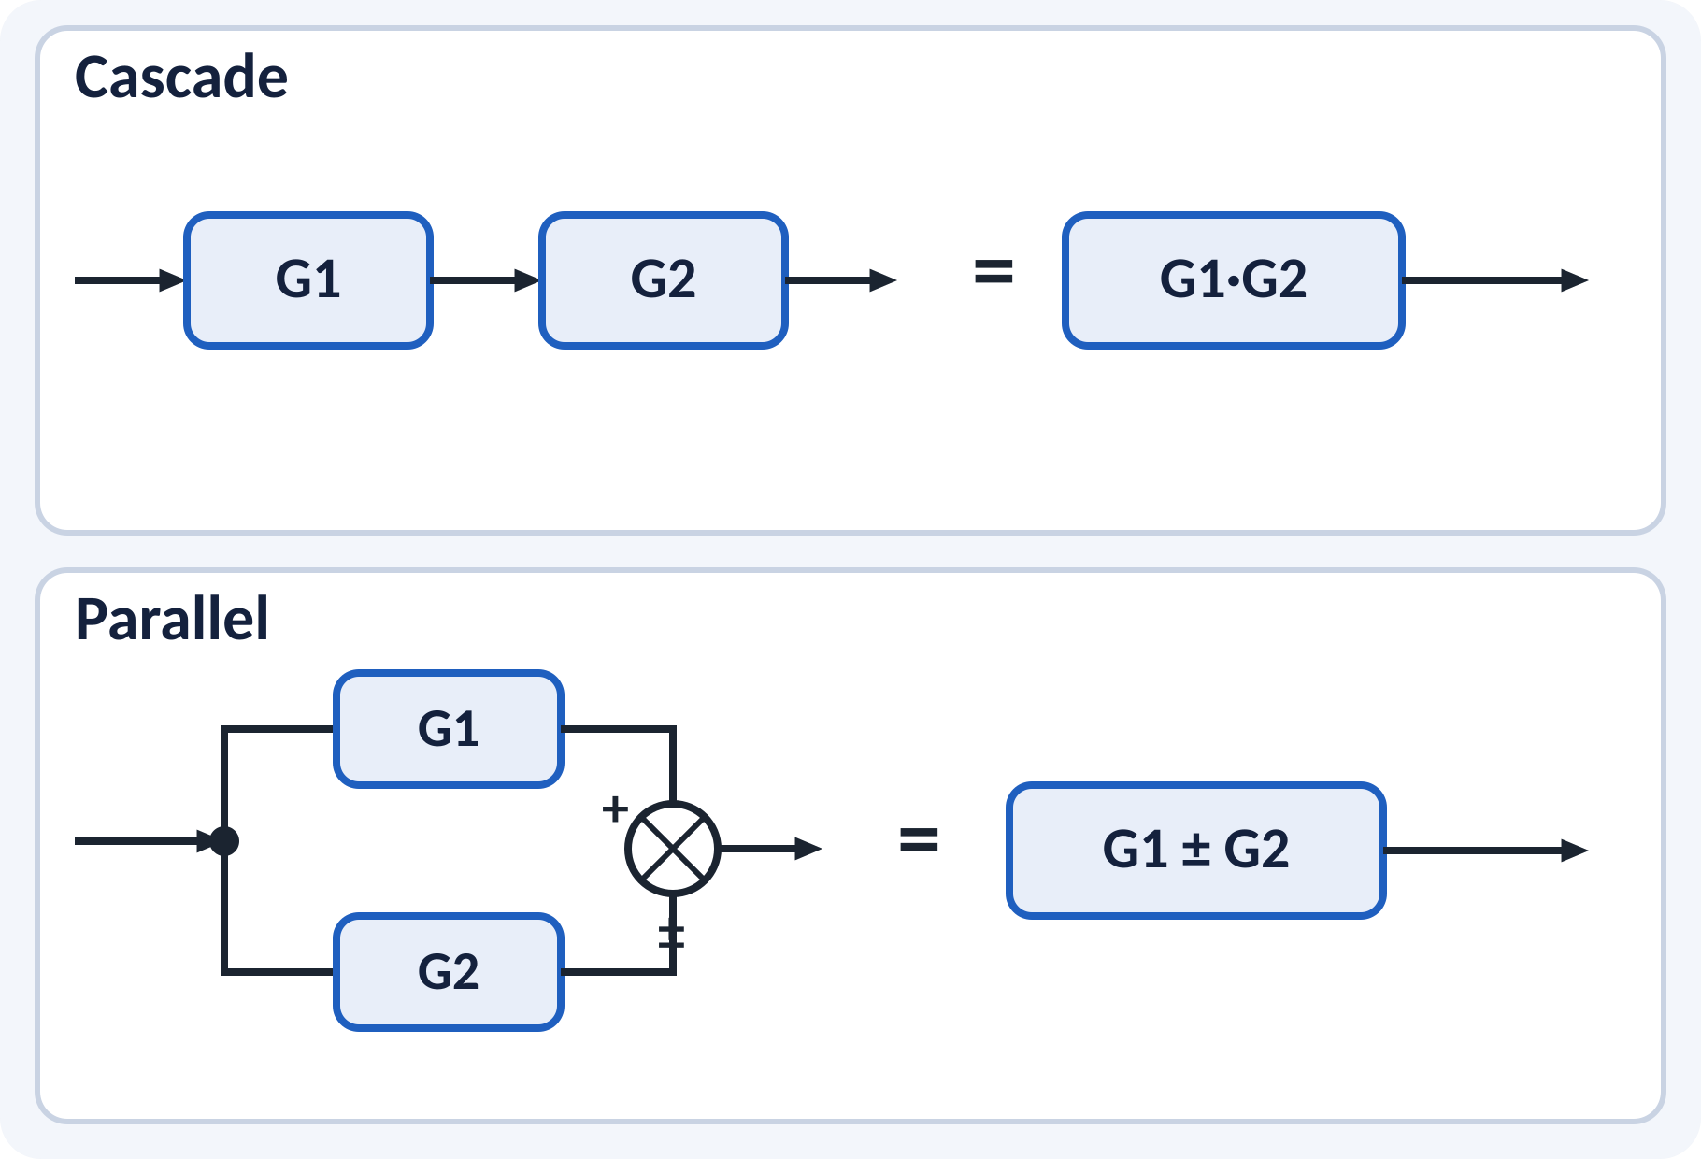
Blocks in Cascade and in Parallel
Cascade blocks multiply: G1·G2.
Parallel blocks add or subtract: G1 ± G2.
The sign follows the summing point.
Order of cascade blocks does not matter (LTI).
Cascade: G = G1 G2; Parallel: G = G1 ± G2
Notes:
When two blocks are in series, the output of the first is the input of the second, so the transfer functions multiply. When two blocks share the same input and their outputs are added, the transfer functions add. Pay attention to the sign at the summing point for the parallel case. These two rules solve many simple problems.

Slide 6
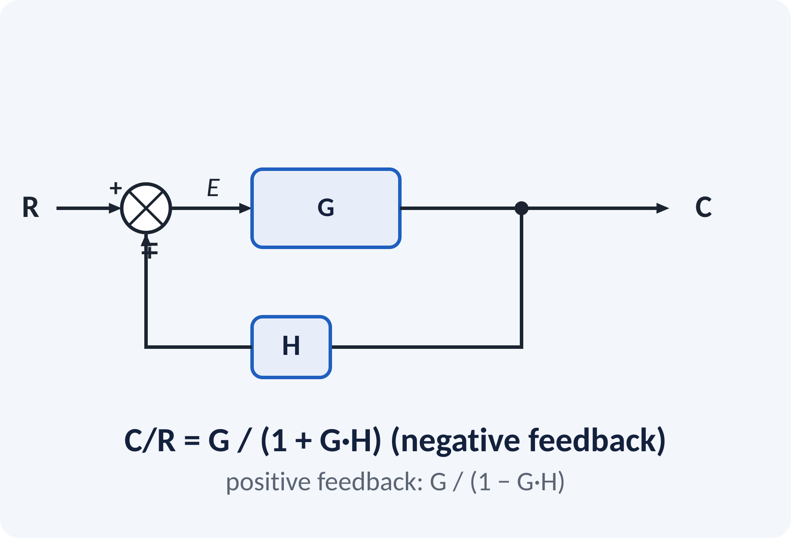
Feedback Loop Reduction
Forward path G, feedback path H.
Negative feedback subtracts at the summing point.
Derive: C = G·E, E = R − H·C.
Eliminate E to get the closed-loop transfer function.
Unity feedback means H = 1.
C/R = G/(1 + G·H) (negative); C/R = G/(1 − G·H) (positive)
G forward gain, H feedback gain, GH open-loop gain
Notes:
From the diagram, C equals G times E and E equals R minus H times C. Substitute and collect the C terms to get C over R equals G over one plus G H. The product G H is the open-loop transfer function and appears everywhere in stability analysis. For positive feedback the sign in the denominator changes.

Slide 7
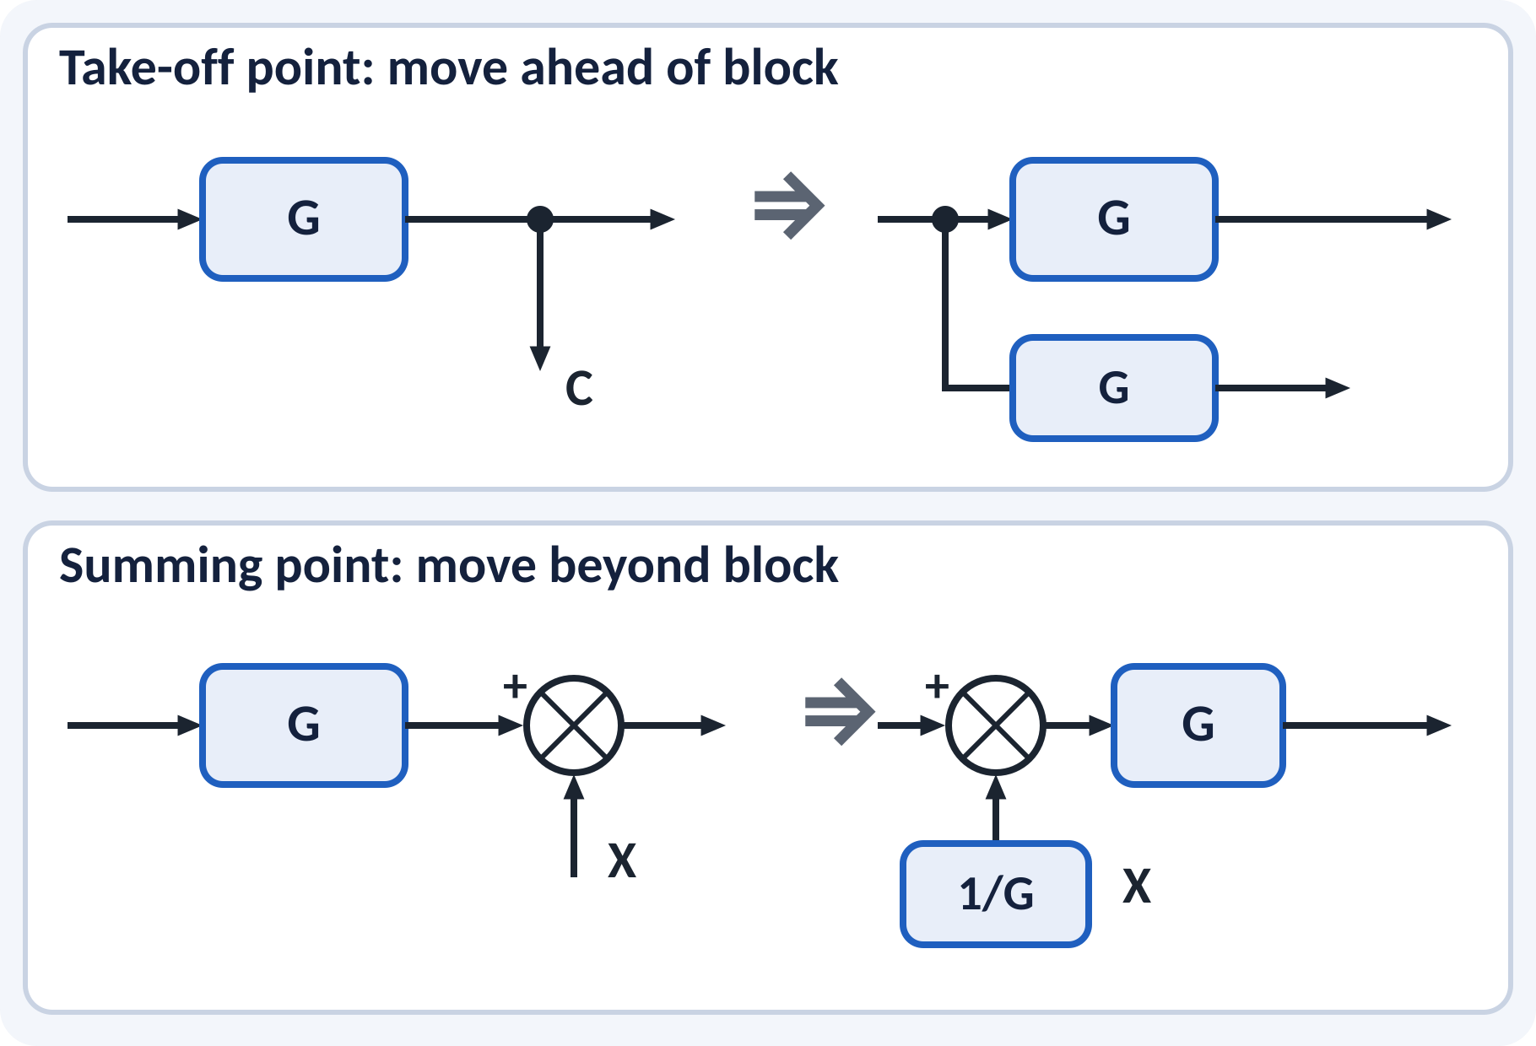
Moving Take-off and Summing Points
Shifting is needed when loops overlap.
Take-off ahead of G: put G in the branch.
Summing point beyond G: put 1/G in the branch.
The signals at the outputs must stay unchanged.
Rule: whatever you move across a block G, multiply by G (forward) or 1/G (backward)
Notes:
Sometimes loops cannot be reduced because their take-off or summing points interleave. We move a point across a block and compensate in the branch so that every signal stays the same. Check each output signal after the move to make sure it is unchanged. Practise with two or three diagrams because this is the part that confuses students.

Slide 8
Block Diagram Reduction Procedure
Combine cascade blocks.
Combine parallel blocks.
Reduce inner feedback loops first.
Shift points to untangle overlapping loops.
Repeat; finish with the outer loop.
Work from the inside to the outside, one change at a time
Notes:
The order matters. Always look for cascade and parallel blocks first, then close the innermost feedback loop. Redraw the diagram after each step so that you do not lose a signal. If the diagram is stuck, shift a take-off or summing point. At the end you should have a single block with the overall transfer function.

Slide 9
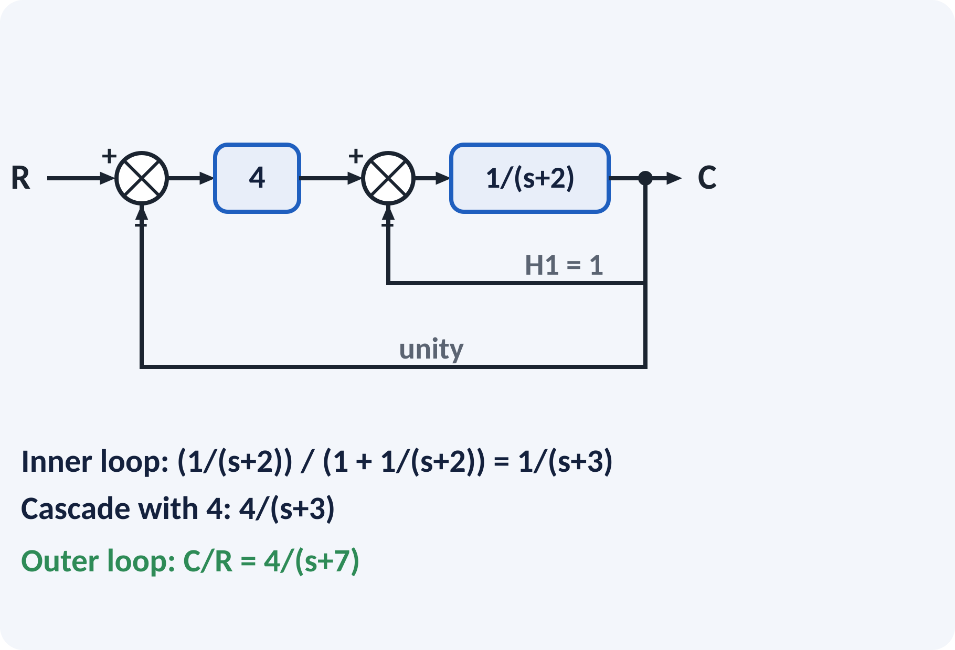
Solved Example 1: Block Reduction
Given the diagram: gain 4, then 1/(s+2) with inner feedback H1 = 1, and outer unity feedback. Find C/R.
1. Inner loop: G2/(1 + G2H1) = [1/(s+2)]/[1 + 1/(s+2)] = 1/(s+3).
2. Cascade with gain 4: 4/(s+3).
3. Outer unity loop: [4/(s+3)]/[1 + 4/(s+3)] = 4/(s+7).
Answer: C(s)/R(s) = 4/(s + 7), a first-order system with pole at s = −7
Notes:
Identify the innermost loop first, which is around the 1 over s plus 2 block. Close it using G over one plus G H. Multiply by the gain 4 in cascade and then close the outer unity feedback loop. Check the result at s equal to zero: the DC gain is 4 over 7, which matches the diagram, and the single pole at minus 7 tells us the system is stable.

Slide 10
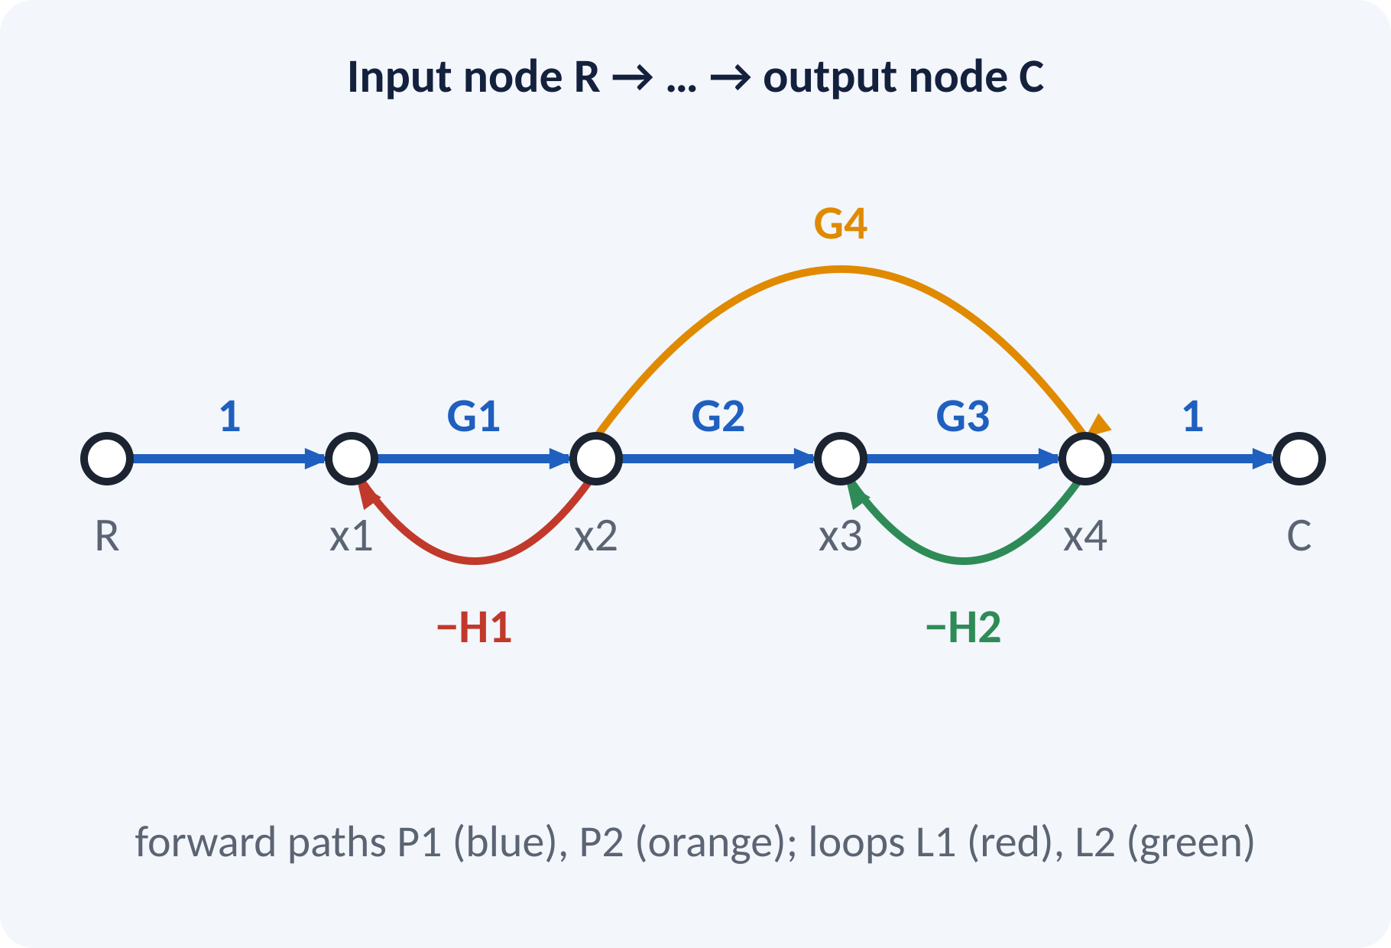
Signal Flow Graph: Terminology
Node: a variable; branch: a directed gain.
Forward path: input to output, no node repeated.
Loop: closed path, no node repeated.
Non-touching loops share no node.
Loop gain: product of branch gains in the loop.
Source node: only outgoing branches; sink node: only incoming branches
Notes:
A signal flow graph is a compact form of the block diagram. Variables become nodes and transfer functions become branches with arrows. A forward path runs from the input node to the output node without visiting a node twice. A loop starts and ends at the same node. Two loops are non-touching if they have no node in common.

Slide 11
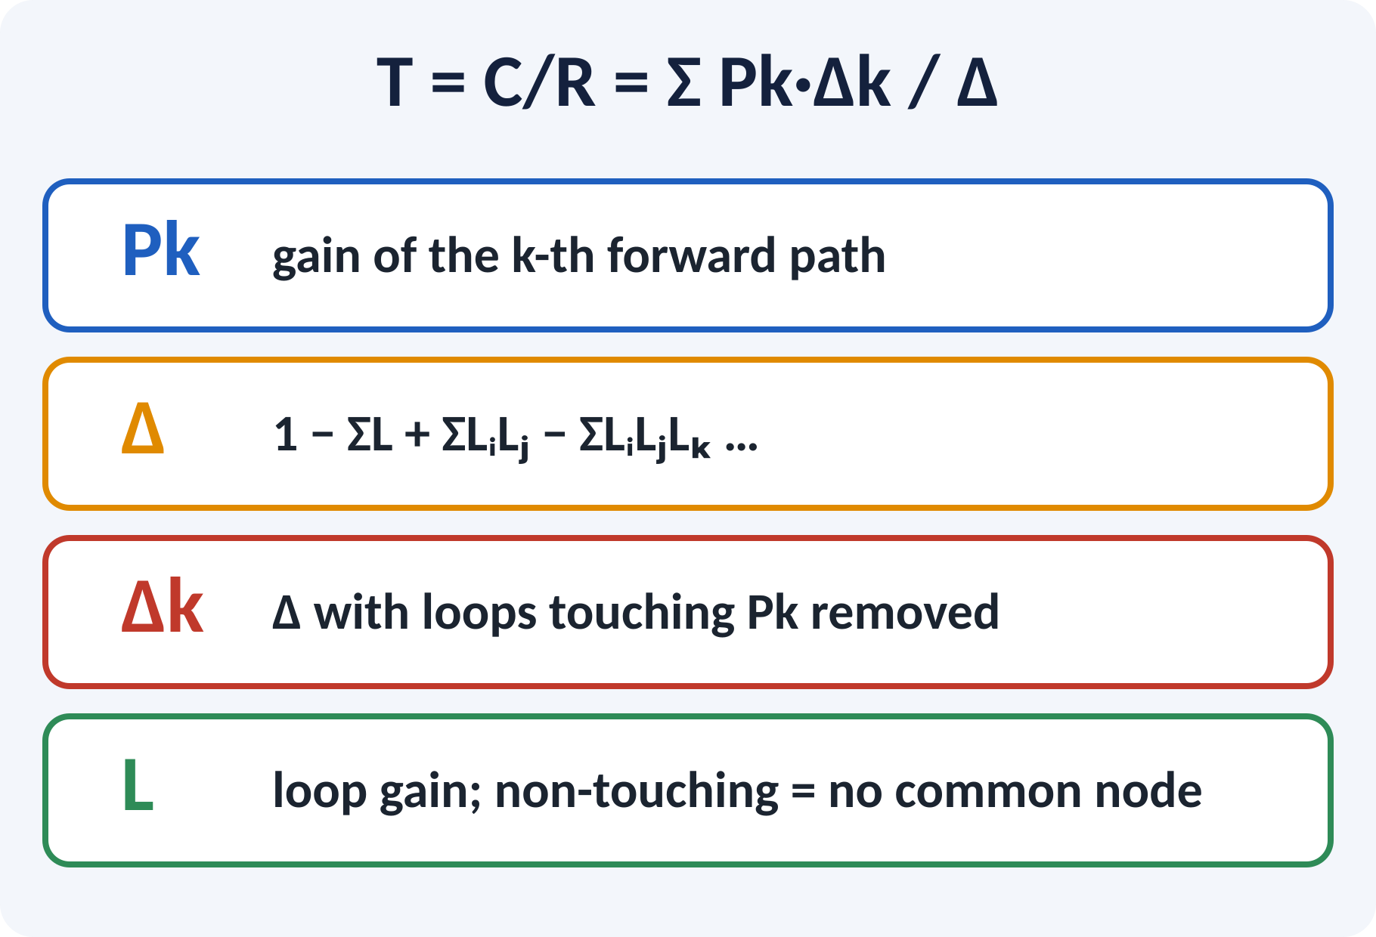
Mason's Gain Formula
One formula gives C/R directly from the graph.
Δ uses single loops, then pairs of non-touching loops.
Δk is Δ with loops that touch path k removed.
Add the contribution of every forward path.
T = Σ Pk·Δk / Δ; Δ = 1 − ΣL₁ + ΣL₂ − ΣL₃ + …
Pk path gain, L₁ single loops, L₂ pairs of non-touching loops
Notes:
List all forward paths and all loops first. Then build Δ by subtracting the single loop gains and adding products of non-touching pairs. For each path find Δk by deleting loops that touch it. Finally divide the sum of Pk times Δk by Δ. Take care with signs: a negative feedback branch gives a negative loop gain.

Slide 12
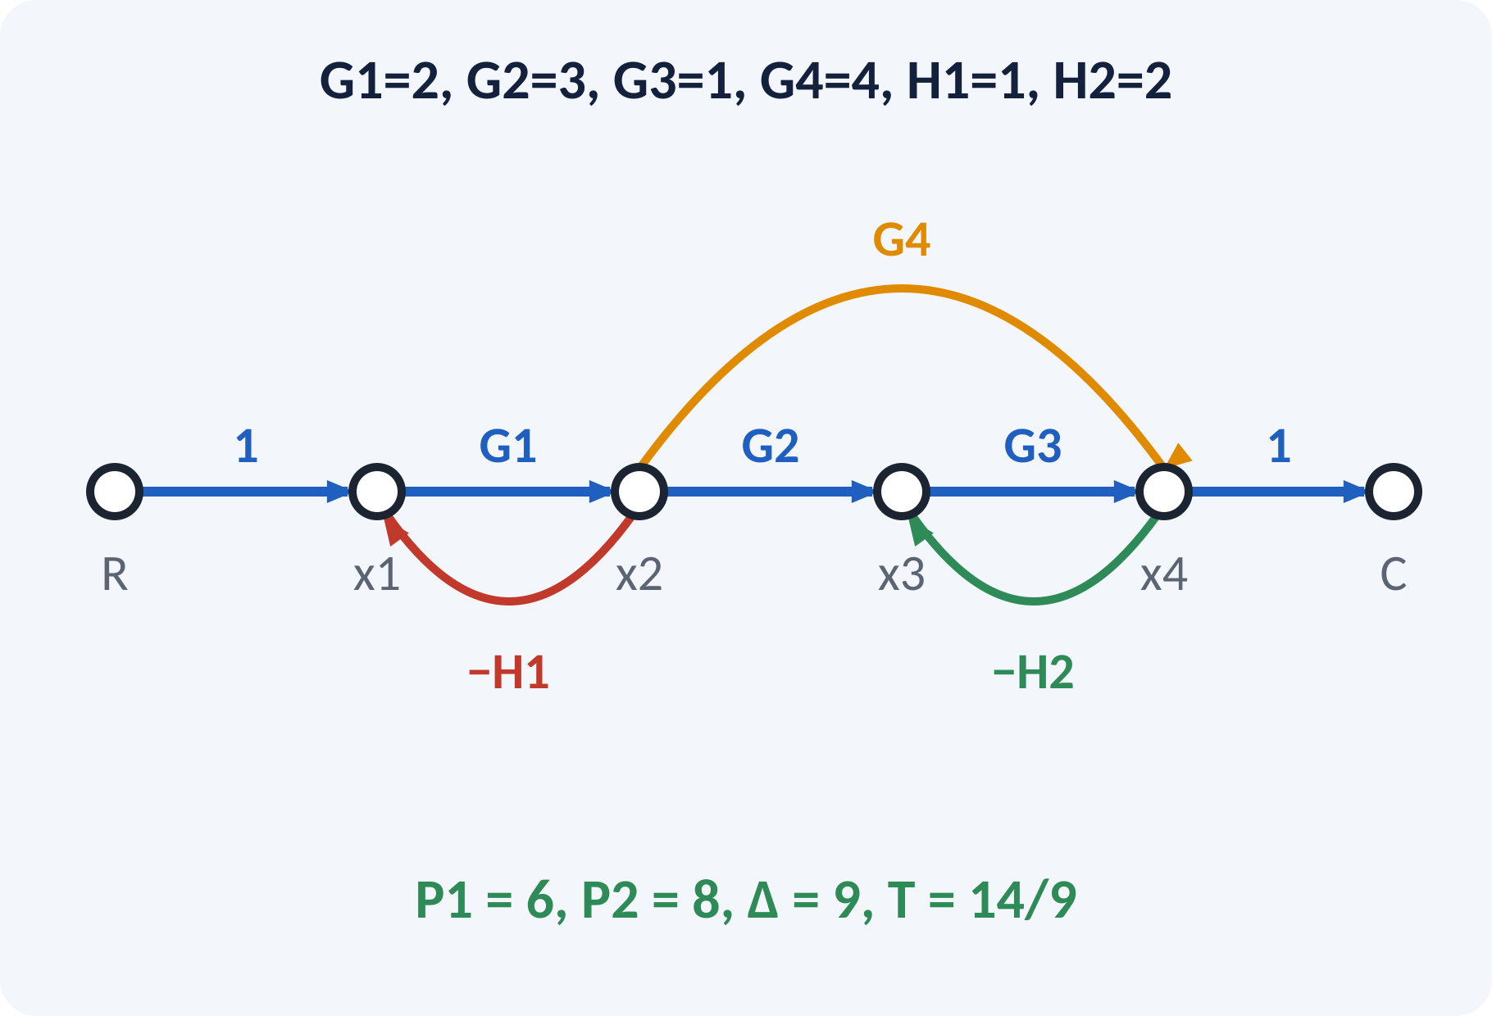
Solved Example 2: Mason's Formula
Graph with G1 = 2, G2 = 3, G3 = 1, G4 = 4, H1 = 1, H2 = 2 (as drawn). Find C/R.
1. Paths: P1 = G1G2G3 = 6; P2 = G1G4 = 8.
2. Loops: L1 = −G1H1 = −2; L2 = −G3H2 = −2.
3. L1 and L2 are non-touching: L1L2 = 4.
4. Δ = 1 − (−2 − 2) + 4 = 9.
5. Both paths touch both loops: Δ1 = Δ2 = 1.
6. T = (6 + 8)/9 = 14/9.
Answer: C/R = 14/9 ≈ 1.56
Notes:
List the forward paths and the loops in a table so that you do not miss any. The two loops share no node, so they are non-touching and their product is added in Δ. Each forward path passes through at least one node of each loop, so both Δk are one. The final answer is 14 over 9. Ask students to verify by block reduction if time permits.

Slide 13
Common Mistakes and Exam Tips
✕
Common mistakes
✓
Exam tips
Missing a forward path or a loop.
Wrong sign: using plus for negative feedback.
Calling loops non-touching when they share a node.
Forgetting to compute Δk for each path.
Moving a take-off point without compensating.
Make a table of paths and loops first.
Write the sign on every loop gain.
Check DC gain of the answer.
Redraw after every reduction step.
Notes:
These are the points where marks are lost most often in block diagrams and Mason's formula. Give one quick example for each mistake. Remind students that writing the formula, substitution and the unit earns method marks even if the arithmetic slips. Encourage them to check the answer for reasonableness.

Slide 14
Summary
Cascade: G1G2; parallel: G1 ± G2.
Negative feedback loop: G/(1 + GH).
Move points across blocks with G or 1/G compensation.
SFG: nodes, branches, forward paths, loops.
Mason: T = ΣPkΔk/Δ.
T = ΣPkΔk/Δ, Δ = 1 − ΣL₁ + ΣL₂ − …
Notes:
Recap in one minute. Say each point and ask the class to recall the formula for it. If they remember these ideas, most numerical problems on block diagrams are within reach. Next lecture: time response: standard test signals and first-order systems. Revise the two solved examples tonight.

Slide 15
Quick Quiz
Q1. Two blocks G1 and G2 in cascade give:
(a) G1+G2 (b) G1G2 (c) G1/G2 (d) G1−G2
Ans: (b)
Q2. Negative feedback loop with forward G, feedback H:
(a) G/(1−GH) (b) G/(1+GH) (c) GH/(1+G) (d) 1/(1+GH)
Ans: (b)
Q3. Moving a summing point beyond a block G needs a block:
(a) G (b) 1/G (c) −G (d) none
Ans: (b)
Q4. Non-touching loops have:
(a) same gain (b) a common node (c) no common node (d) opposite signs
Ans: (c)
Q5. With ΣPkΔk = 14 and Δ = 9, C/R =
(a) 9/14 (b) 1.56 (c) 23 (d) 5
Ans: (b)
Notes:
Give about one minute per question and take a show of hands. Discuss why the wrong options are tempting, especially the one that uses a wrong formula. Use the quiz as a quick check on block diagrams before leaving.

Slide 16
References
1
I. J. Nagrath and M. Gopal, Control Systems Engineering
5th Ed., New Age International (P) Ltd., 2008 (Units 1, 2 textbook)
2
K. Ogata, Modern Control Engineering
5th Ed., Pearson Education Asia / PHI, 2009 (reference)
3
P. S. Satyanarayana, Concepts of Control Systems
2nd Ed., Dynaram Publishers, Bangalore, 2001 (reference)
Next lecture: Unit 2: standard test signals and time response of zero and first-order systems
Notes:
Point students to the textbooks listed in the syllabus for block diagrams. Ask them to solve at least three textbook problems on this topic before the next class. Thank the class and preview the next lecture.

