Slide 1
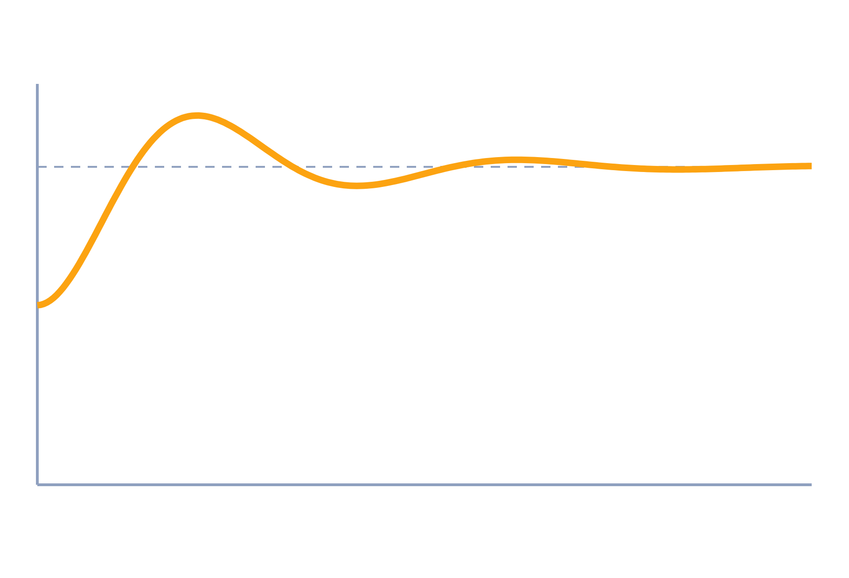
Test Signals and First-Order Response
Control Systems (22EEG53)
Unit 2: Time Domain Analysis of Control Systems
Topic: Standard test signals; response of zero-order and first-order systems
Prof. Mitesh Astik
Notes:
Welcome everyone. Today's topic is Standard test signals; response of zero-order and first-order systems. It belongs to Unit 2: Time Domain Analysis of Control Systems. By the end of this session you will be able to use it in numerical problems. Keep your notebooks ready because we will solve two examples.

Slide 2

Learning Outcomes
Name the standard test signals and their Laplace transforms.
Separate transient and steady-state response.
Find the response of zero- and first-order systems.
Use the time constant τ to get specifications.
Linked to CO2
Analyse response of systems to standard test signals.
Notes:
Read the outcomes aloud. They map to CO2 of the syllabus. Tell students that these are examinable and that the two solved examples follow the same pattern. Ask them to tick off each outcome at the end of the lecture.

Slide 3
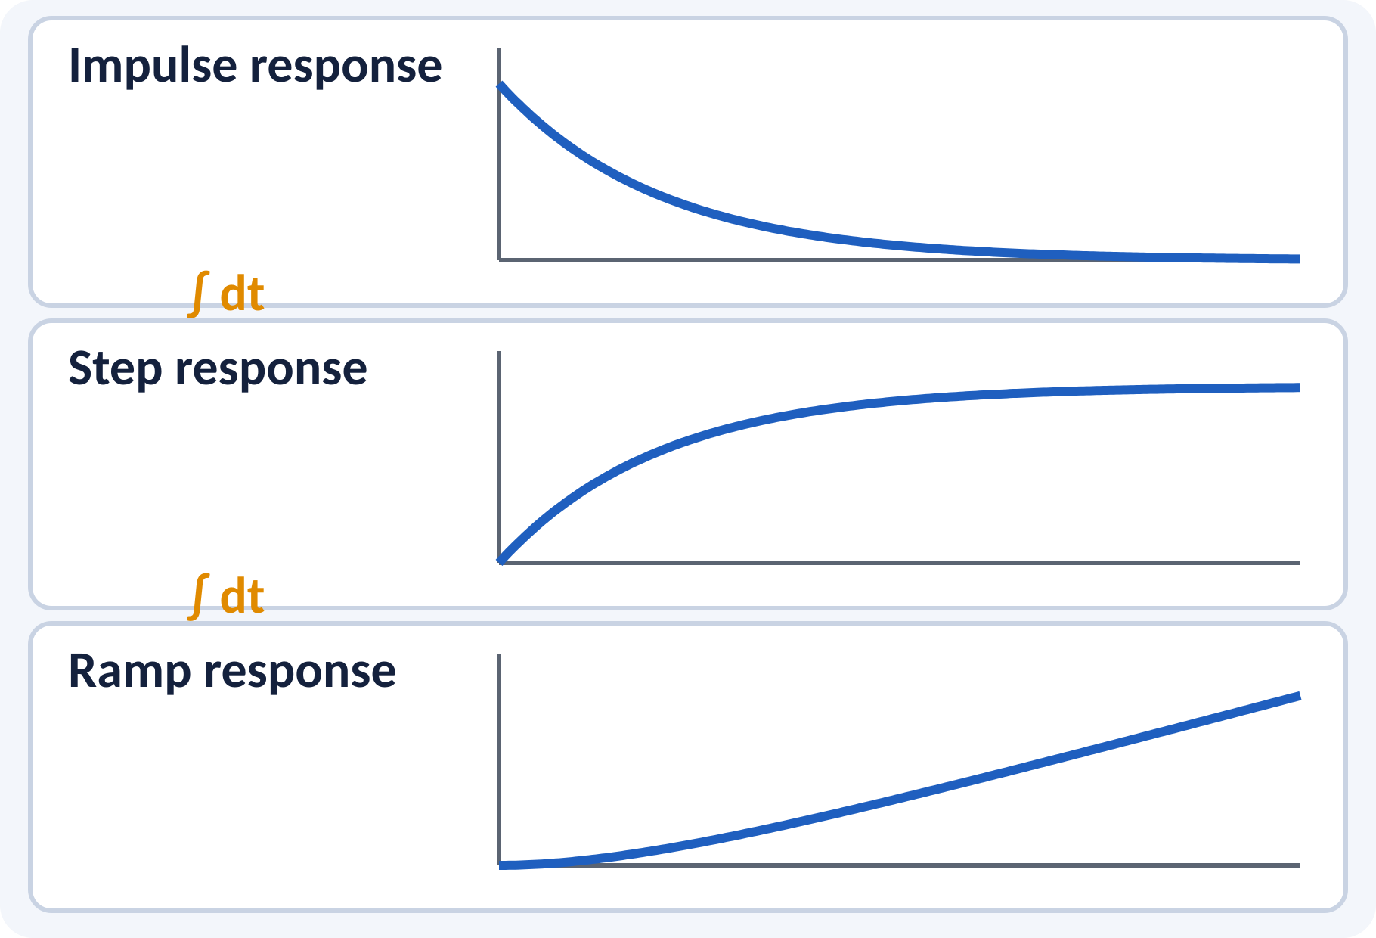
Recap: What You Already Know
Laplace transform of unit step is 1/s.
Inverse transform by partial fractions.
Poles decide the form of the response.
Transfer function G(s) = C(s)/R(s).
C(s) = G(s)·R(s); c(t) = L⁻¹{C(s)}
L{e^(−at)} = 1/(s + a)
Notes:
Recall how to invert a Laplace transform using partial fractions. A pole at minus a gives an exponential e to the minus a t in time. The unit step has transform 1 over s. We will apply these three facts to first-order systems today.

Slide 4
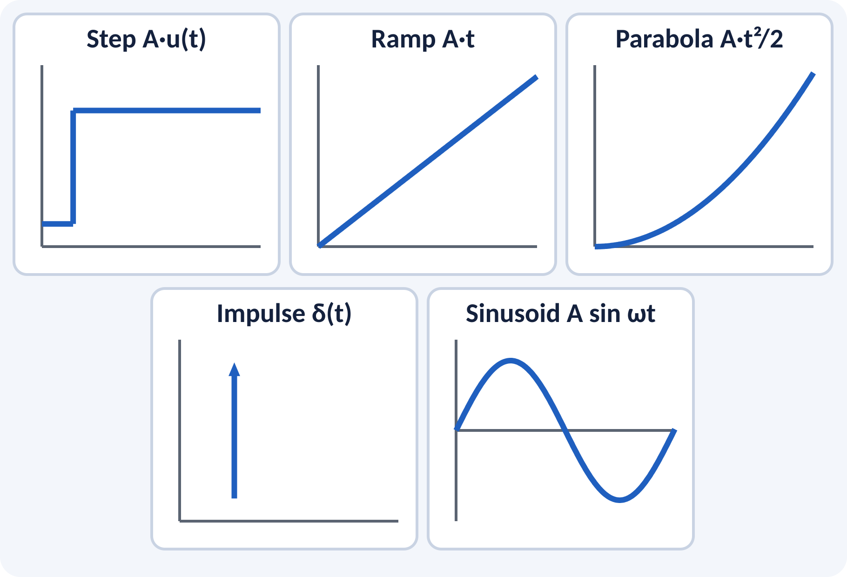
Motivation: Why Standard Test Signals?
Real inputs are random and unknown.
Test signals give a fair comparison of systems.
Step tests sudden changes; ramp tests tracking.
Response to one signal predicts the others.
Compare systems with the same input: step, ramp, parabola, impulse, sinusoid
Notes:
A designer does not know the exact signal the system will see, so we choose simple signals as benchmarks. A step represents a sudden command change, a ramp represents a moving target such as a tracking antenna. If a system behaves well for these, we trust it in real use. Keep this picture in mind for the whole unit.

Slide 5
Standard Test Signals
Step: sudden change of constant size.
Ramp: constant velocity input.
Parabola: constant acceleration input.
Impulse: very short, unit-area pulse.
Sinusoid: used for frequency response.
r = A u(t) → A/s; A t → A/s²; A t²/2 → A/s³; δ(t) → 1
A amplitude; unit signals use A = 1
Notes:
Each signal is the integral of the previous one: impulse to step to ramp to parabola. This is why the Laplace transforms are one, one over s, one over s squared and one over s cubed. The sinusoid is the test signal for frequency-domain analysis in Unit 3. In time domain we mostly use the step.

Slide 6
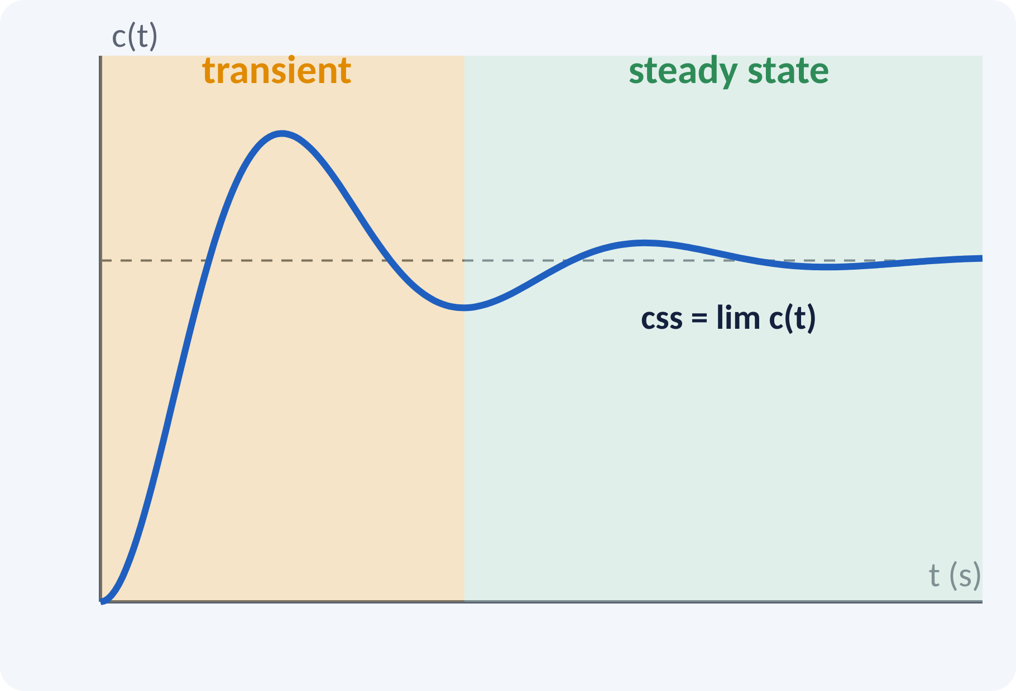
Transient and Steady-State Response
Total response = transient + steady state.
Transient dies out with time.
Steady state is the final behaviour.
Specifications describe both parts.
c(t) = ctr(t) + css(t), ctr → 0 as t → ∞
css = lim c(t) as t → ∞ (stable systems)
Notes:
After applying a step, the output first shows a transient and finally settles to a constant value. For a stable system the transient term vanishes. Transient specifications are rise time, peak overshoot and settling time. The steady-state specification is the final error, which we study later in this unit.

Slide 7
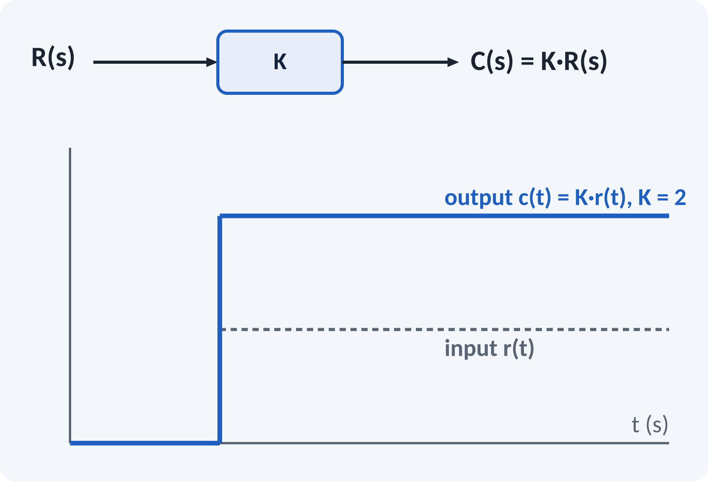
Zero-Order System
Transfer function is a pure gain K.
Output follows input instantly, scaled by K.
No energy storage, no dynamics.
Example: potentiometer, ideal amplifier.
G(s) = K → c(t) = K·r(t)
K gain (output unit per input unit)
Notes:
A zero-order system has no poles, so there is no transient at all. The output copies the input multiplied by the gain. Real devices approximate this when their dynamics are much faster than the signal. A potentiometer used as a position sensor is the classic example.

Slide 8
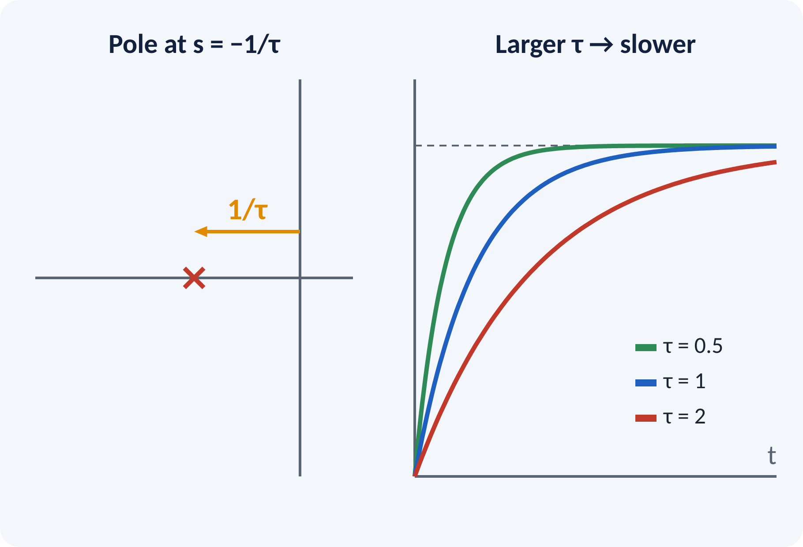
First-Order System
Contains one energy-storage element.
Standard form has a time constant τ.
Single pole on the negative real axis.
Examples: RC circuit, thermometer, tank filling.
G(s) = K/(τ s + 1); pole at s = −1/τ
τ time constant (s), K DC gain
Notes:
A first-order system has one pole at minus one over tau. The farther the pole is from the origin, the faster the response. The time constant tau has a physical meaning: it is R C for an RC circuit and thermal capacity times resistance for a thermometer. Larger tau means a slower system.

Slide 9
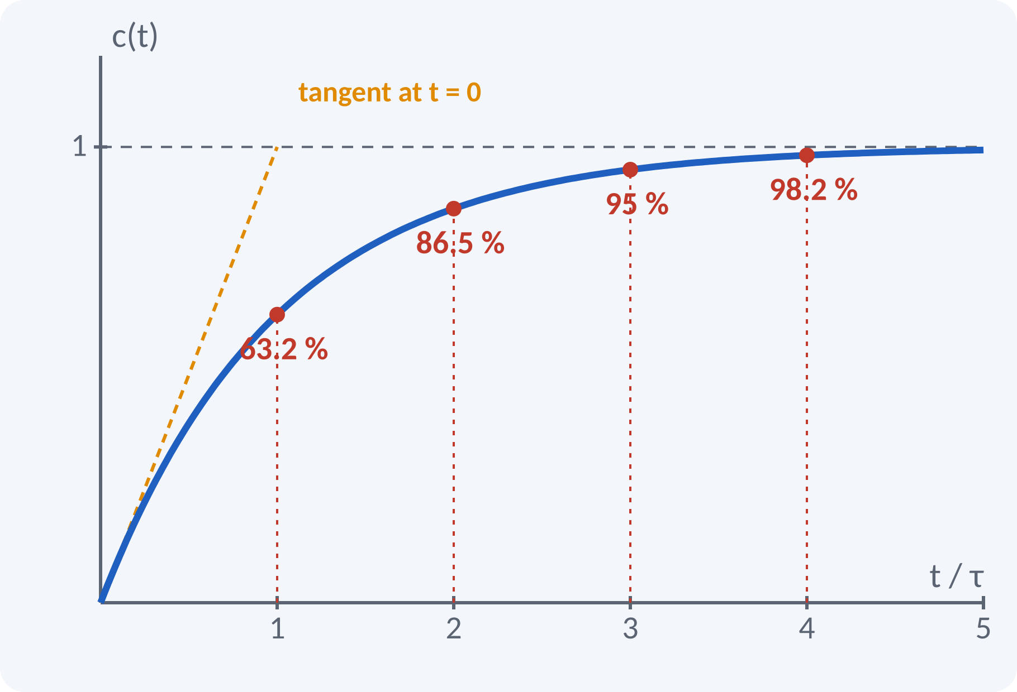
Unit Step Response of First Order
C(s) = K/[s(τs + 1)]; take K = 1.
Output rises exponentially to the final value.
At t = τ it reaches 63.2 % of final value.
Initial slope is 1/τ.
Settling: 4τ for 2 %, 3τ for 5 %.
c(t) = 1 − e^(−t/τ); ts(2 %) = 4τ, ts(5 %) = 3τ, tr(10–90 %) = 2.2τ
td = 0.69 τ (time to reach 50 %)
Notes:
Partial fractions give c of t equals one minus e to the minus t over tau. After one time constant the output is 63.2 per cent of the final value, after four it is 98 per cent. The tangent at the origin hits the final value at t equal to tau. A first-order system has no overshoot, so its specifications are only rise, delay and settling time.

Slide 10
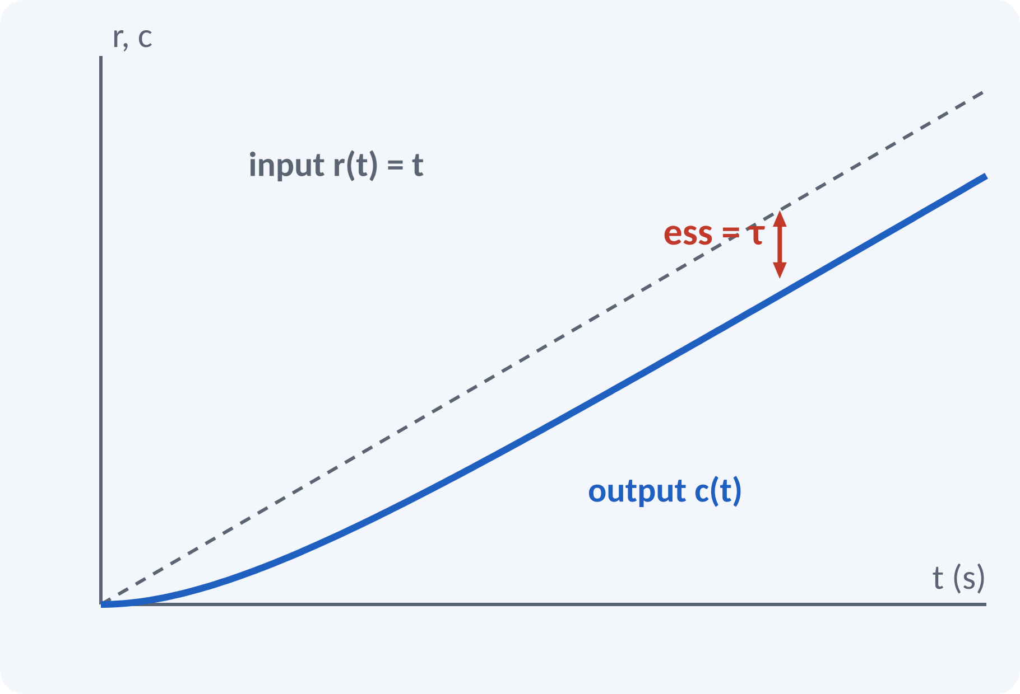
Unit Ramp Response of First Order
Input r(t) = t, so R(s) = 1/s².
Output follows the ramp with a lag.
Steady-state error equals τ.
Smaller τ gives smaller tracking error.
c(t) = t − τ + τ e^(−t/τ); ess = τ
ess steady-state error (same unit as the input)
Notes:
For the ramp the output eventually runs parallel to the input, shifted by the time constant. The gap is the steady-state error and is equal to tau. So a faster system follows a ramp more accurately. This idea leads to the velocity error constant, which we meet in the third lecture of this unit.

Slide 11
Impulse Response and Relationships
Impulse: R(s) = 1, so C(s) = 1/(τs + 1).
Output decays exponentially from 1/τ.
Step response is the integral of impulse response.
Ramp response is the integral of step response.
c(t) = (1/τ) e^(−t/τ) (impulse); d/dt(ramp response) = step response
For an LTI system: derivative of input gives derivative of output
Notes:
The impulse response is the derivative of the step response and the step response is the derivative of the ramp response. This follows from linearity and is very useful: if you know one response you can obtain the others. The impulse response is also the inverse transform of G of s itself.

Slide 12
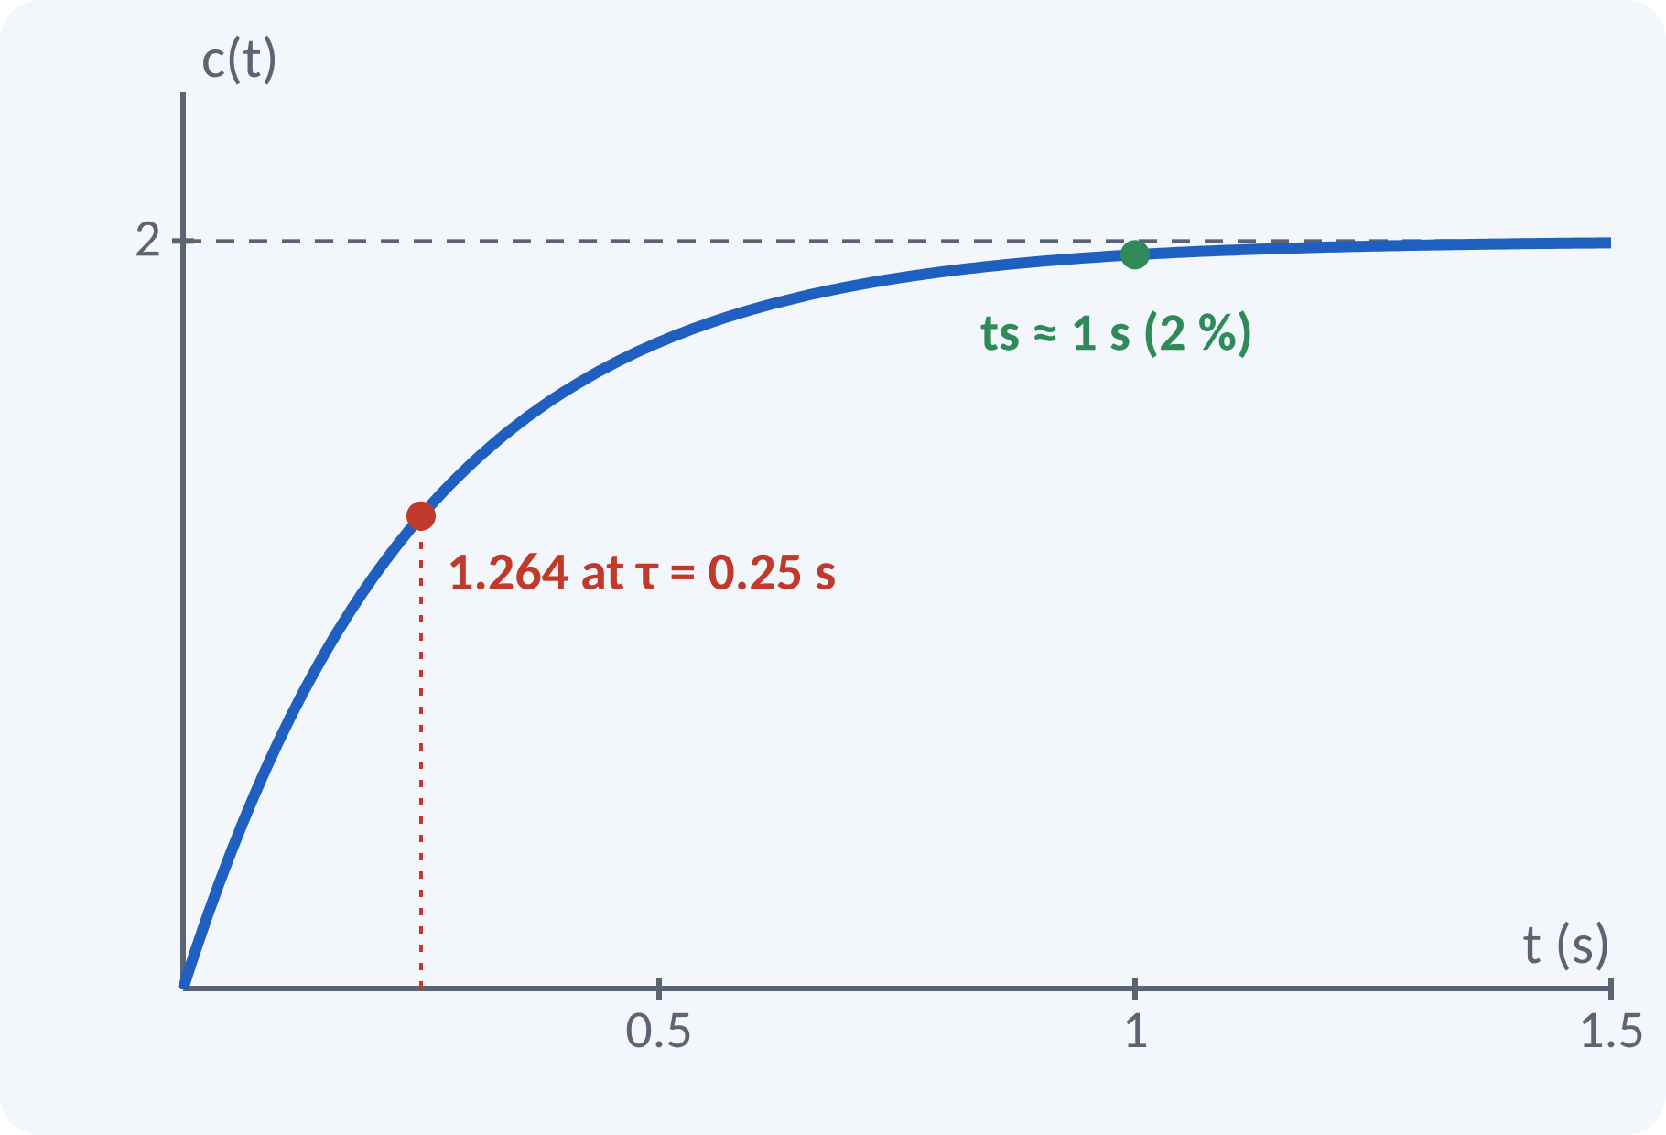
Solved Example 1: First-Order Step
Given C/R = 4/(0.5s + 2). Find K, τ, c(t) for a unit step, tr and ts.
1. Standard form: 4/(0.5s + 2) = 2/(0.25s + 1).
2. K = 2, τ = 0.25 s.
3. c(t) = 2(1 − e^(−4t)).
4. At t = τ: c = 2 × 0.632 = 1.264.
5. tr = 2.2τ = 0.55 s.
6. ts(2 %) = 4τ = 1.0 s; ts(5 %) = 0.75 s.
Answer: K = 2, τ = 0.25 s, ts = 1.0 s (2 %), c(∞) = 2
Notes:
Divide numerator and denominator by two to reach the standard form with unit coefficient of s in the denominator constant term. Read K and tau directly. The final value is K, so the output ends at 2 for a unit step. The settling time for 2 per cent is four time constants, which is one second.

Slide 13
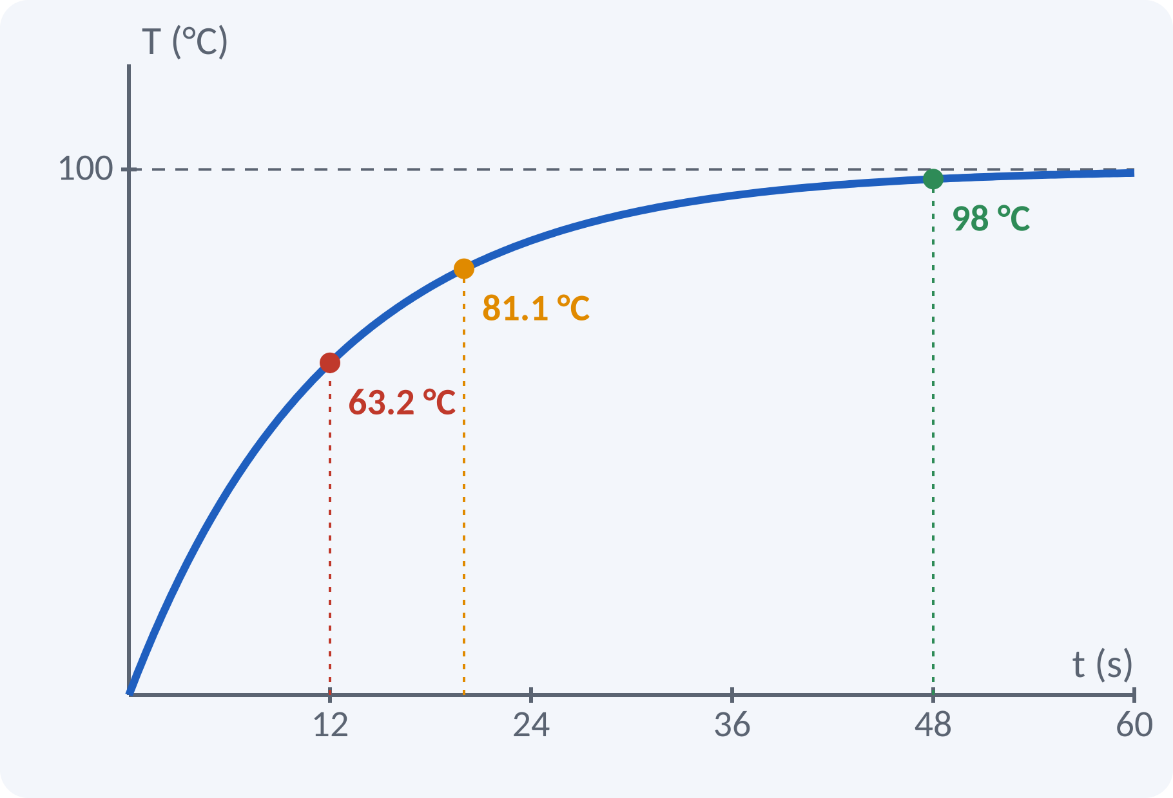
Solved Example 2: Thermometer Test
A thermometer is dipped in 100 °C water. It reads 63.2 °C after 12 s. Find τ, G(s), reading at 20 s, and ts.
1. 63.2 % of final value occurs at t = τ, so τ = 12 s.
2. K = 1 (reads 100 °C finally): G(s) = 1/(12s + 1).
3. T(20) = 100(1 − e^(−20/12)) = 100(1 − 0.189) = 81.1 °C.
4. ts(2 %) = 4τ = 48 s.
Answer: τ = 12 s, G(s) = 1/(12s + 1), T(20 s) = 81.1 °C, ts = 48 s
Notes:
This is a practical identification problem. The time at which the response reaches 63.2 per cent of its final value is the time constant, so we read tau straight from the data. The gain is one because the reading ends at the true temperature. Then every other quantity follows from the first-order formulas.

Slide 14
Common Mistakes and Exam Tips
✕
Common mistakes
✓
Exam tips
Using 63.2 % of the input instead of the final output.
Taking ts = 4τ for a 5 % band.
Forgetting the DC gain K in c(∞).
Mixing τ with the pole value 1/τ.
Expecting overshoot in a first-order system.
Convert to the form K/(τs + 1) first.
Read K and τ, then use the formulas.
Check units of τ (seconds).
Remember ess(ramp) = τ for unity-gain first order.
Notes:
These are the points where marks are lost most often in first-order systems. Give one quick example for each mistake. Remind students that writing the formula, substitution and the unit earns method marks even if the arithmetic slips. Encourage them to check the answer for reasonableness.

Slide 15
Summary
Test signals: step, ramp, parabola, impulse, sinusoid.
Response = transient + steady state.
Zero order: c(t) = K·r(t).
First order: c(t) = 1 − e^(−t/τ); ts = 4τ (2 %).
Ramp error = τ; impulse is derivative of step response.
G(s) = K/(τs + 1); c(t) = K(1 − e^(−t/τ))
Notes:
Recap in one minute. Say each point and ask the class to recall the formula for it. If they remember these ideas, most numerical problems on first-order systems are within reach. Next lecture: second-order systems and time-domain specifications. Revise the two solved examples tonight.

Slide 16
Quick Quiz
Q1. Laplace transform of the unit ramp is:
(a) 1 (b) 1/s (c) 1/s² (d) 1/s³
Ans: (c)
Q2. At t = τ a first-order step response reaches:
(a) 50 % (b) 63.2 % (c) 86.5 % (d) 98 %
Ans: (b)
Q3. ts (2 %) of a first-order system with τ = 3 s is:
(a) 3 s (b) 9 s (c) 12 s (d) 6 s
Ans: (c)
Q4. Steady-state error of 1/(τs+1) for a unit ramp is:
(a) 0 (b) τ (c) 1/τ (d) ∞
Ans: (b)
Q5. A zero-order system has:
(a) one pole (b) two poles (c) no poles (d) a pole at origin
Ans: (c)
Notes:
Give about one minute per question and take a show of hands. Discuss why the wrong options are tempting, especially the one that uses a wrong formula. Use the quiz as a quick check on first-order systems before leaving.

Slide 17
References
1
I. J. Nagrath and M. Gopal, Control Systems Engineering
5th Ed., New Age International (P) Ltd., 2008 (Units 1, 2 textbook)
2
K. Ogata, Modern Control Engineering
5th Ed., Pearson Education Asia / PHI, 2009 (reference)
3
P. S. Satyanarayana, Concepts of Control Systems
2nd Ed., Dynaram Publishers, Bangalore, 2001 (reference)
Next lecture: second-order response (done) and then static error constants
Notes:
Point students to the textbooks listed in the syllabus for first-order systems. Ask them to solve at least three textbook problems on this topic before the next class. Thank the class and preview the next lecture.

