Slide 1
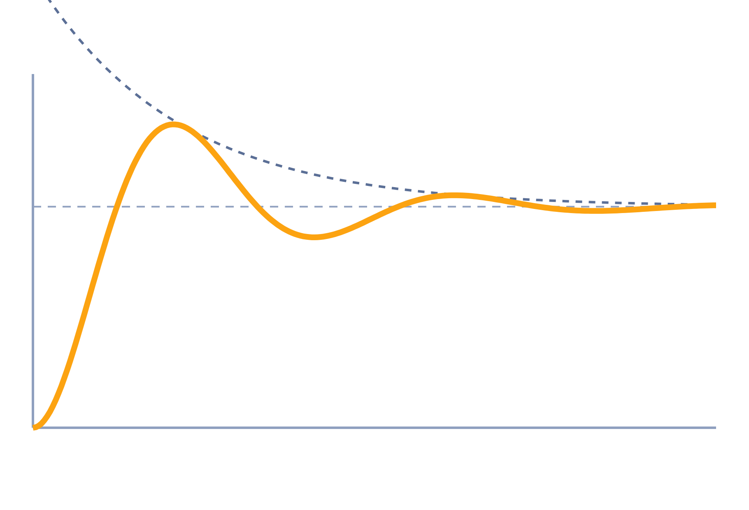
Time Response of Second-Order Systems
Control Systems (22EEG53)
Unit 2: Time Domain Analysis of Control Systems
Topic: Second-order response and time-domain specifications
Prof. Mitesh Astik
Notes:
Welcome everyone. Today we study how a second-order system reacts when we apply a step input. This is the most important system in Unit 2, because almost every real system is approximated by it for design. By the end, you will predict overshoot and settling time from just two numbers, ζ and ωn.

Slide 2
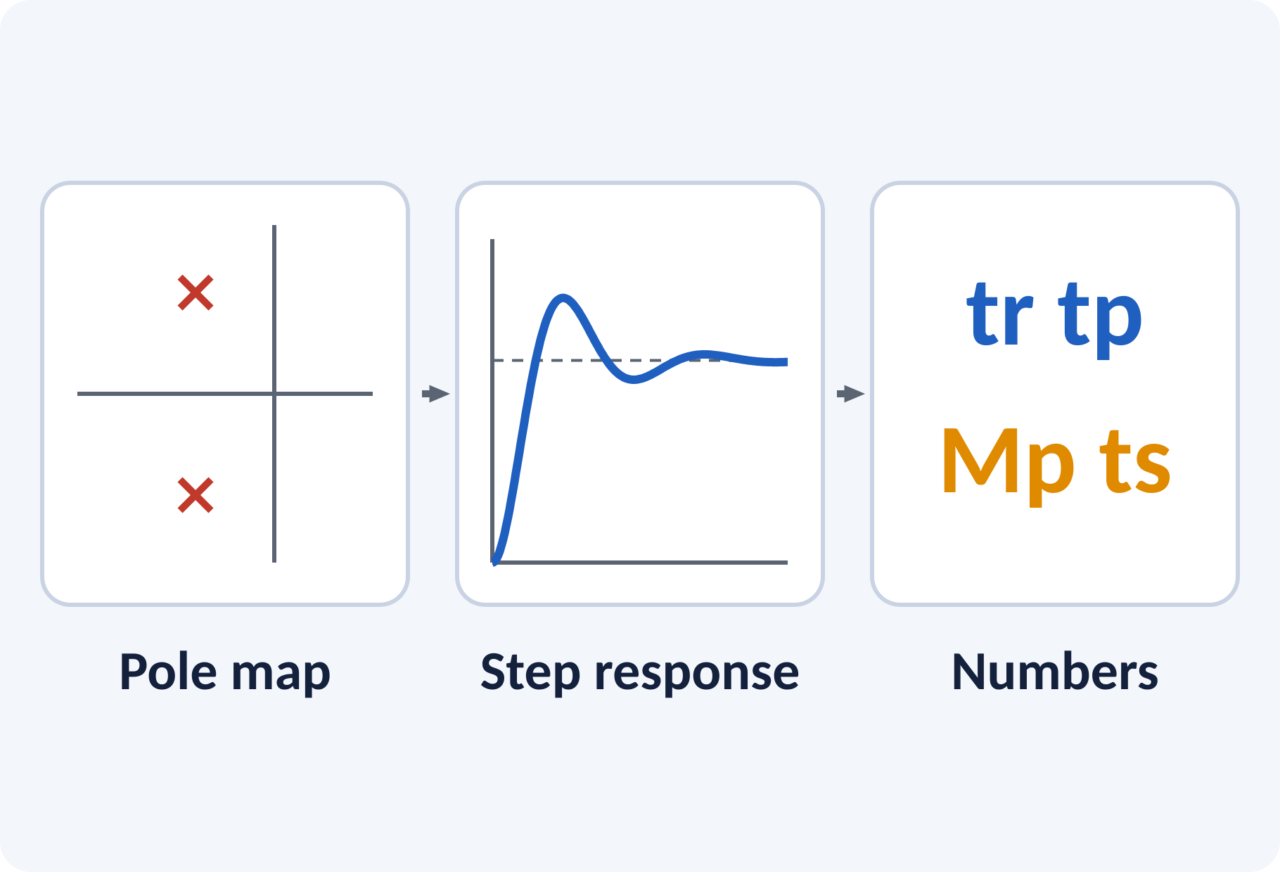
Learning Outcomes
Write the standard second-order transfer function; locate its poles.
Classify damping and sketch the unit-step response.
Calculate tr, tp, Mp, ts from ζ and ωn.
Find ζ and ωn from given specifications.
Linked to CO2
Analyse first- and second-order systems' response to standard test signals.
Notes:
Read the outcomes aloud and tell students that all four are examinable. They map directly to Course Outcome 2 in the syllabus. Point out the picture: the pole location gives the curve, and the curve gives the numbers.

Slide 3
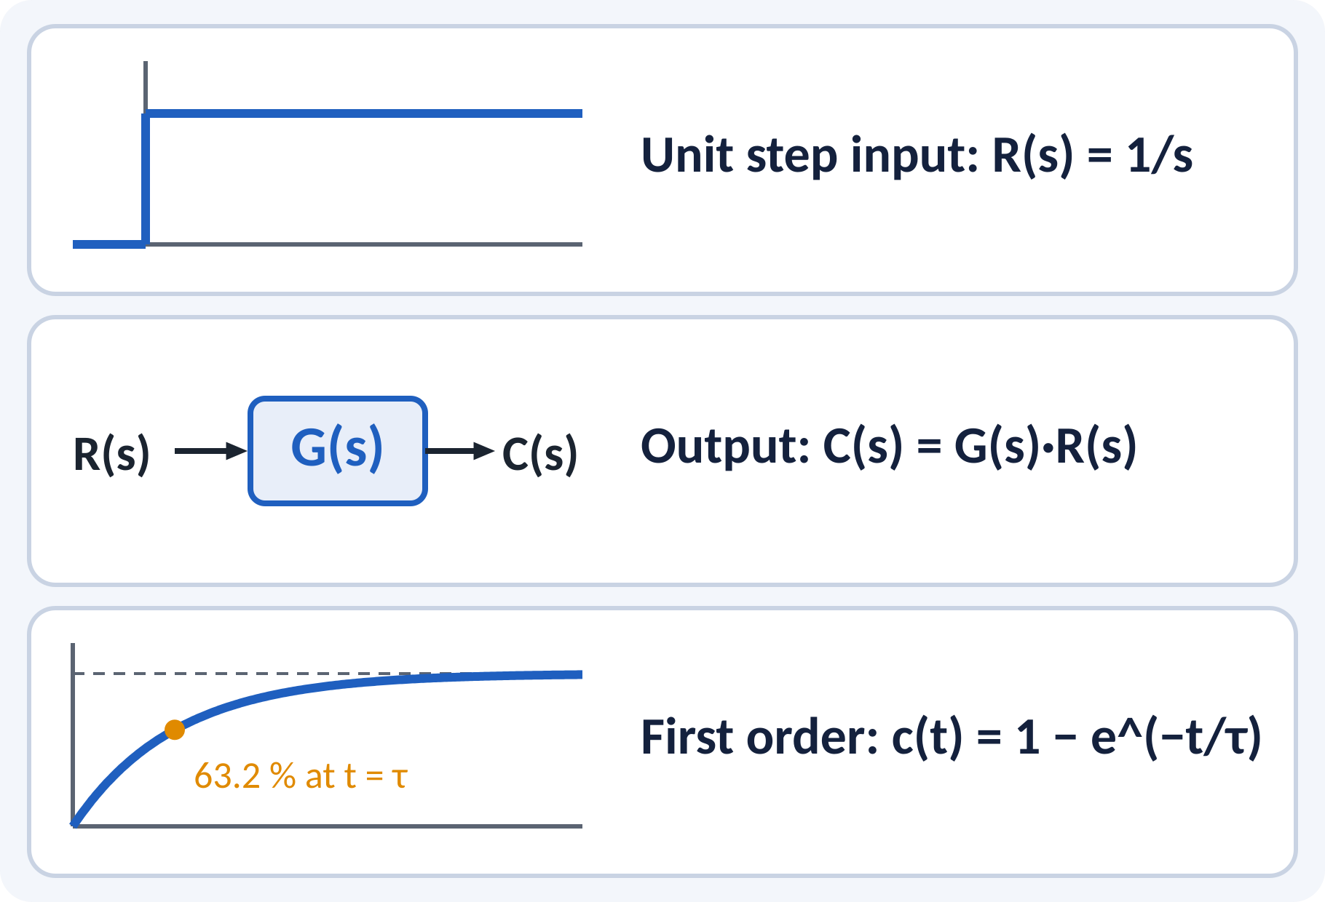
Recap: What You Already Know
Laplace transform of unit step is 1/s.
Poles are roots of the denominator.
Partial fractions give the time response.
First-order step: c(t) = 1 − e^(−t/τ).
C(s) = G(s)·R(s)
C(s) output, G(s) transfer function, R(s) input
Notes:
Ask who remembers the first-order step response and let two students answer. Remind them that C(s) equals G(s) times R(s) is the whole game. We will use partial fractions, but I give the final results to save time. First order had one pole; second order has two, and that changes everything.

Slide 4
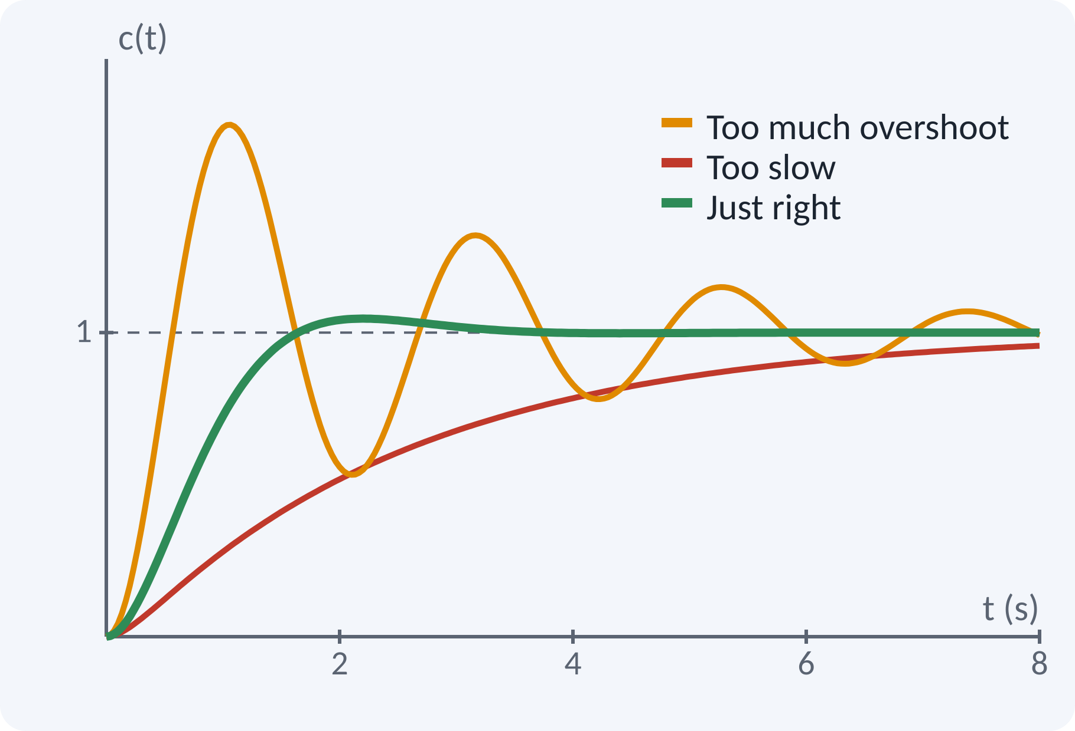
Motivation: Why Overshoot Matters
A lift must stop at the floor without bouncing.
A disk-drive head must settle in milliseconds.
Antenna and robot arm: fast but not shaky.
Lab link: DC position control (Experiment 8).
Specs: how fast, how much overshoot, how long to settle.
Design goal: fast rise, small overshoot, short settling time
Notes:
A lift that overshoots the floor level is uncomfortable and unsafe. A disk head that rings for too long wastes read time. All of these are second-order position servos. Our job today is to turn words like fast and smooth into numbers, which you will check in Experiment 8 using MATLAB.

Slide 5
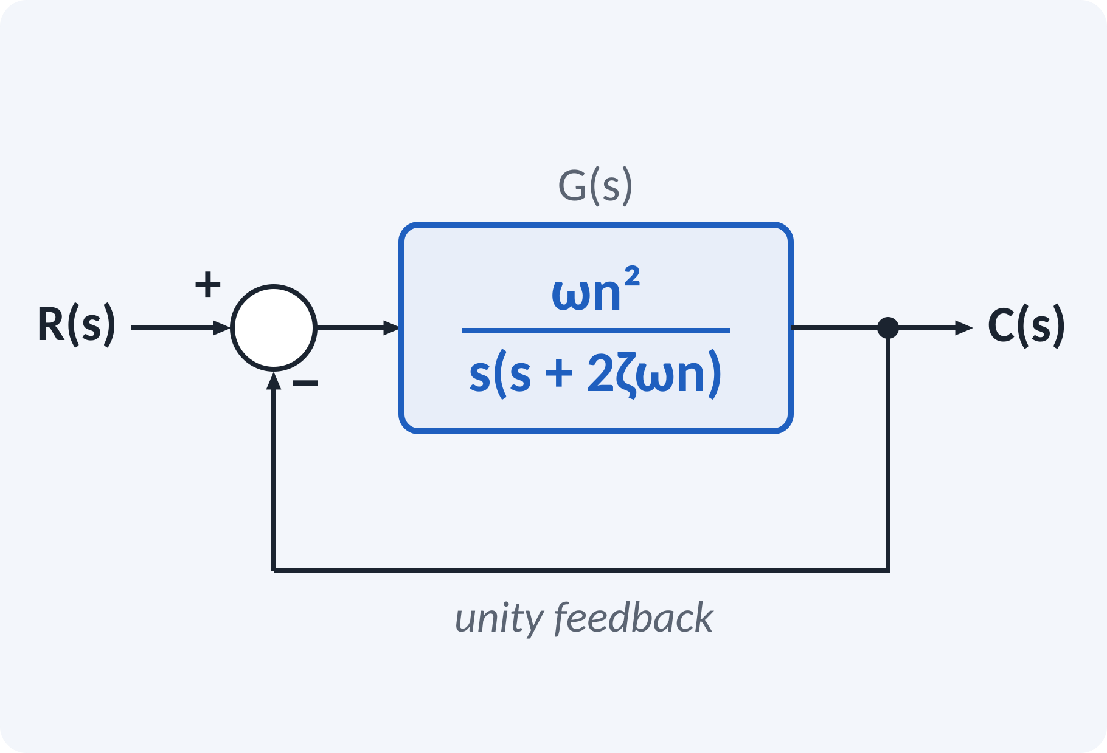
Standard Second-Order Model
A servo with unity feedback gives this form.
Two parameters decide the whole response.
ωn: how fast the system oscillates.
ζ: how quickly oscillations die out.
C(s)/R(s) = ωn² / (s² + 2ζωn·s + ωn²) G(s) = ωn² / [s(s + 2ζωn)]
ωn natural frequency (rad/s), ζ damping ratio (no unit)
Notes:
Here is our standard form. Every second-order problem in the exam is first rewritten into this form. Compare coefficients: the s term gives 2ζωn and the constant gives ωn squared. Remember the open-loop form as well, because a servo gives it directly. Keep this on the board all lecture.

Slide 6
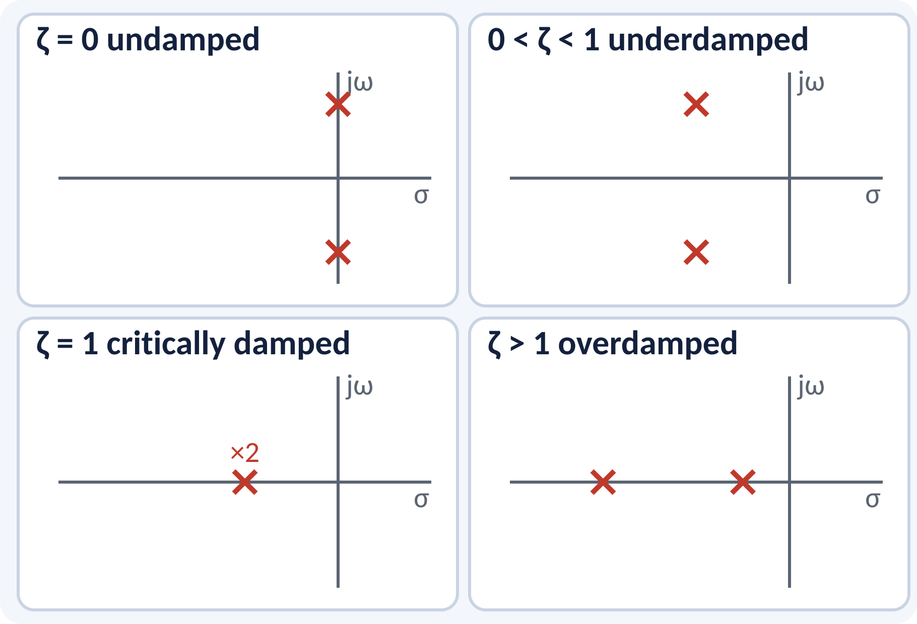
Poles and Damping Cases
ζ = 0: poles on the imaginary axis.
0 < ζ < 1: complex-conjugate pair.
ζ = 1: repeated real pole.
ζ > 1: two distinct real poles.
s1,2 = −ζωn ± jωd, ωd = ωn√(1 − ζ²)
ωd damped natural frequency (rad/s)
Notes:
The roots of the denominator decide everything. When ζ is zero the poles sit on the imaginary axis and the output never dies out. As ζ increases the poles move into the left half-plane and the oscillation decays. At ζ equal to one they meet on the real axis, and beyond that they split apart and there is no oscillation at all.

Slide 7
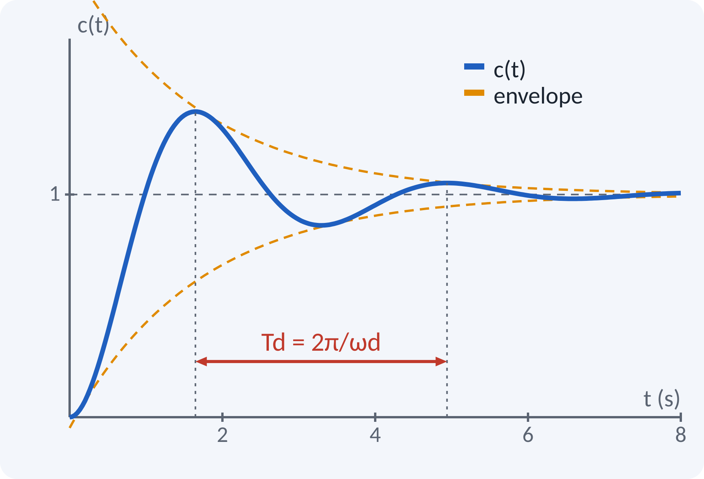
Underdamped Step Response
Most useful case for design and exams.
Response oscillates and settles at 1.
Envelope decays as e^(−ζωn·t).
Damped frequency ωd is below ωn.
c(t) = 1 − [e^(−ζωn·t)/√(1 − ζ²)]·sin(ωd·t + φ)
φ = cos⁻¹ζ (rad), ωd = ωn√(1 − ζ²) (rad/s)
Notes:
This comes from the inverse Laplace transform of C(s) equal to ωn squared over s times the denominator. The sine term gives the oscillation and the exponential term gives the decay. The dashed envelope shows how fast the swings shrink. Remember the structure for the exam; the specification formulas come from this equation.

Slide 8
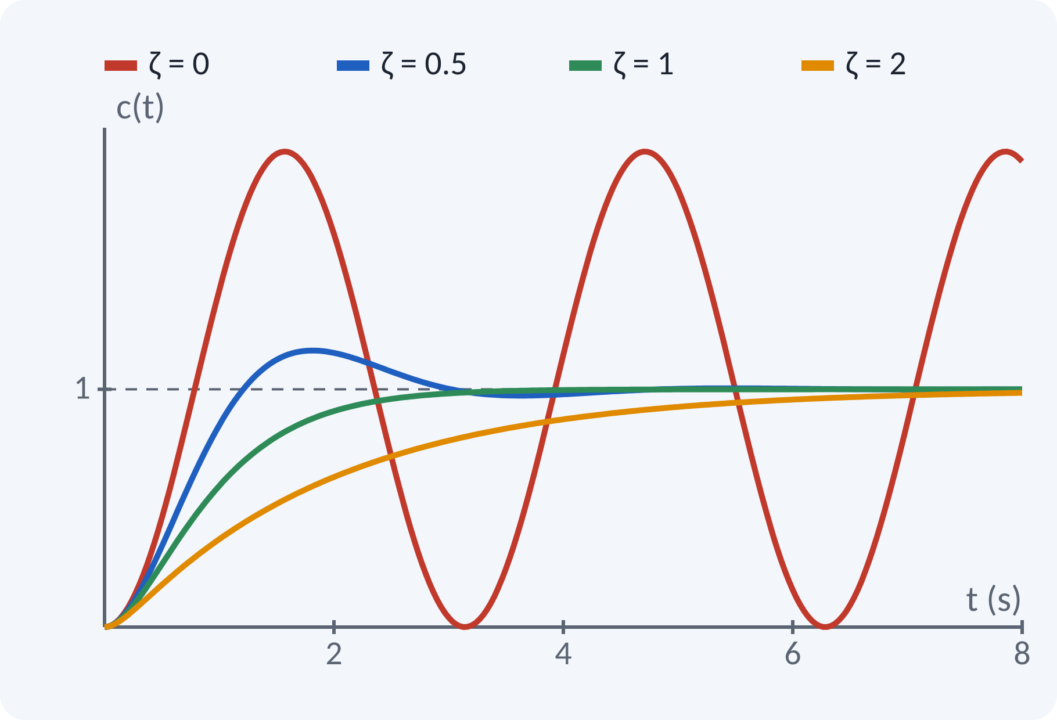
Other Damping Cases
ζ = 0: c(t) = 1 − cos ωn·t, sustained oscillation.
ζ = 1: c(t) = 1 − (1 + ωn·t)e^(−ωn·t).
ζ > 1: slow, no overshoot.
Critical damping: fastest without overshoot.
Poles for ζ > 1: s = −ζωn ± ωn√(ζ² − 1)
Notes:
Compare the four curves on one graph. Undamped never settles, like a frictionless swing. Critical damping reaches the final value fastest without crossing it. Overdamped is safe but slow. In practice we choose slightly underdamped, because a small overshoot buys us speed.

Slide 9
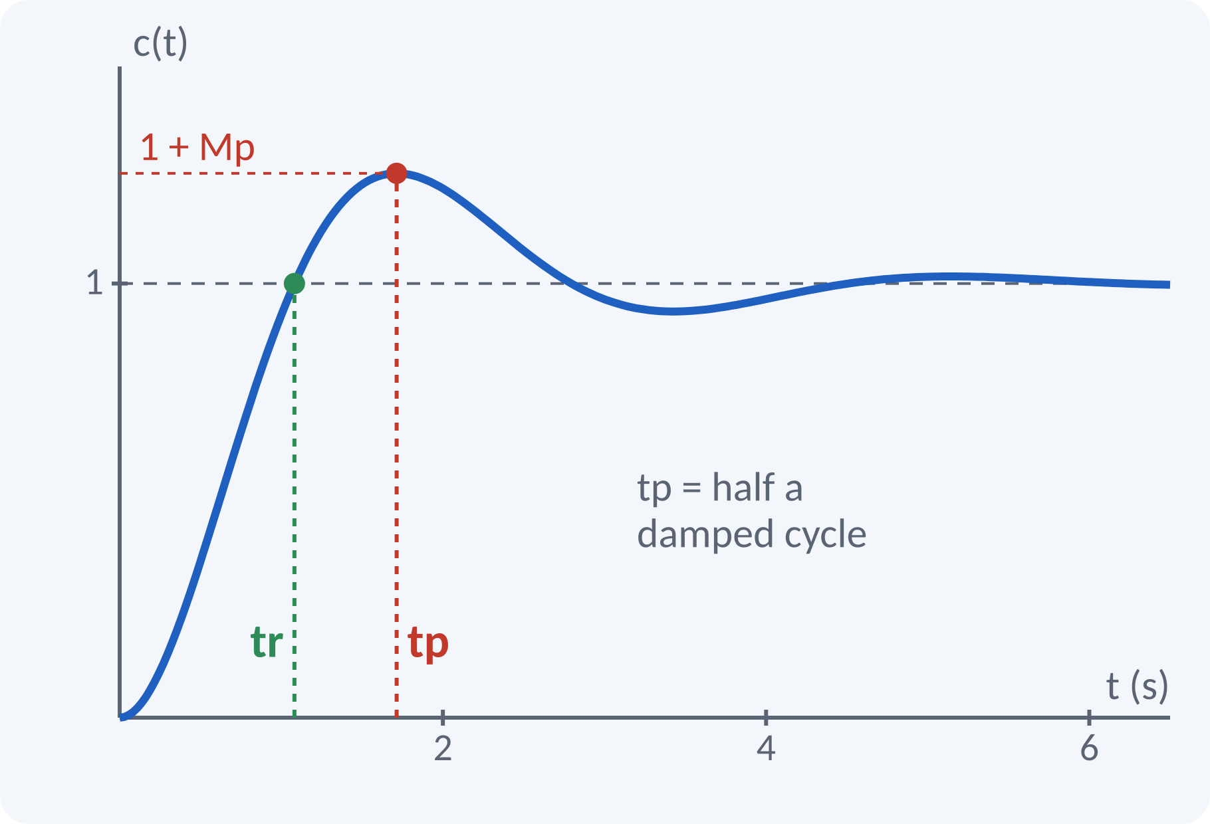
Rise Time and Peak Time
tr: time to go from 0 to 100 % of final value.
tp: time to reach the first peak.
Both depend on ωd; larger ωd is faster.
tr = (π − φ)/ωd, φ = cos⁻¹ζ in rad tp = π/ωd
tr, tp in s; ωd in rad/s
Notes:
We get rise time by setting c(t) equal to 1, which gives sine of ωd·tr plus φ equal to zero. For peak time we set dc/dt to zero, and the first solution is ωd·tp equal to π. So the peak is exactly half a damped cycle. Be careful: use ωd, not ωn.

Slide 10
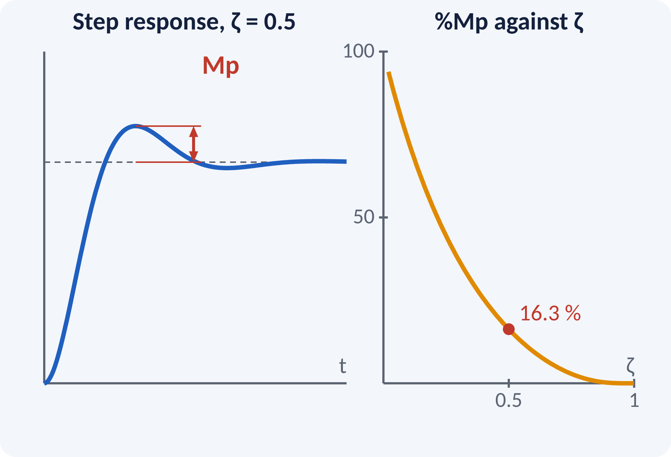
Peak Overshoot
Mp: how far the peak rises above the final value.
Depends only on ζ, not on ωn.
Smaller ζ gives larger overshoot.
Typical: ζ 0.5→16.3 %, 0.6→9.5 %, 0.7→4.6 %.
Mp = e^(−πζ/√(1 − ζ²)), %Mp = 100·Mp
ζ = ln(1/Mp) / √(π² + ln²(1/Mp))
Notes:
Substitute tp into the response and you get this neat formula. Notice ωn has disappeared, so overshoot is fixed by the damping ratio alone. In design questions we are given Mp and must find ζ, so remember the inverse formula as well. For example, ζ of 0.5 gives about 16 per cent overshoot.

Slide 11
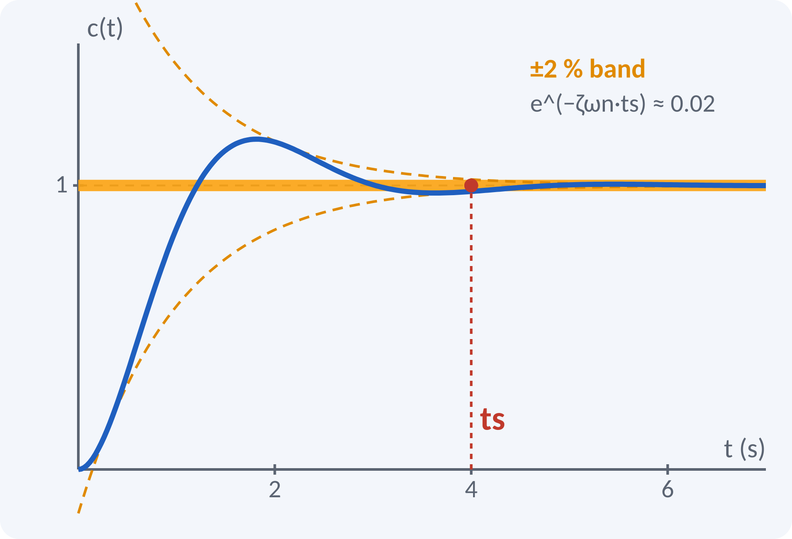
Settling Time and Delay Time
ts: time after which response stays in a band.
Band: ±2 % (or ±5 %) of final value.
Set by the real part of the poles, σ = ζωn.
td: time to reach 50 % of final value.
ts ≈ 4/(ζωn) for 2 % band; ts ≈ 3/(ζωn) for 5 % band
td ≈ (1 + 0.7ζ)/ωn
Notes:
The envelope decays as e to the minus ζωn t. We ask when it falls to 2 per cent, and that gives ζωn·ts about 4. The 5 per cent band gives 3. Always say which criterion you use in the exam. Delay time is the time to reach half the final value and is only a rough guide.

Slide 12
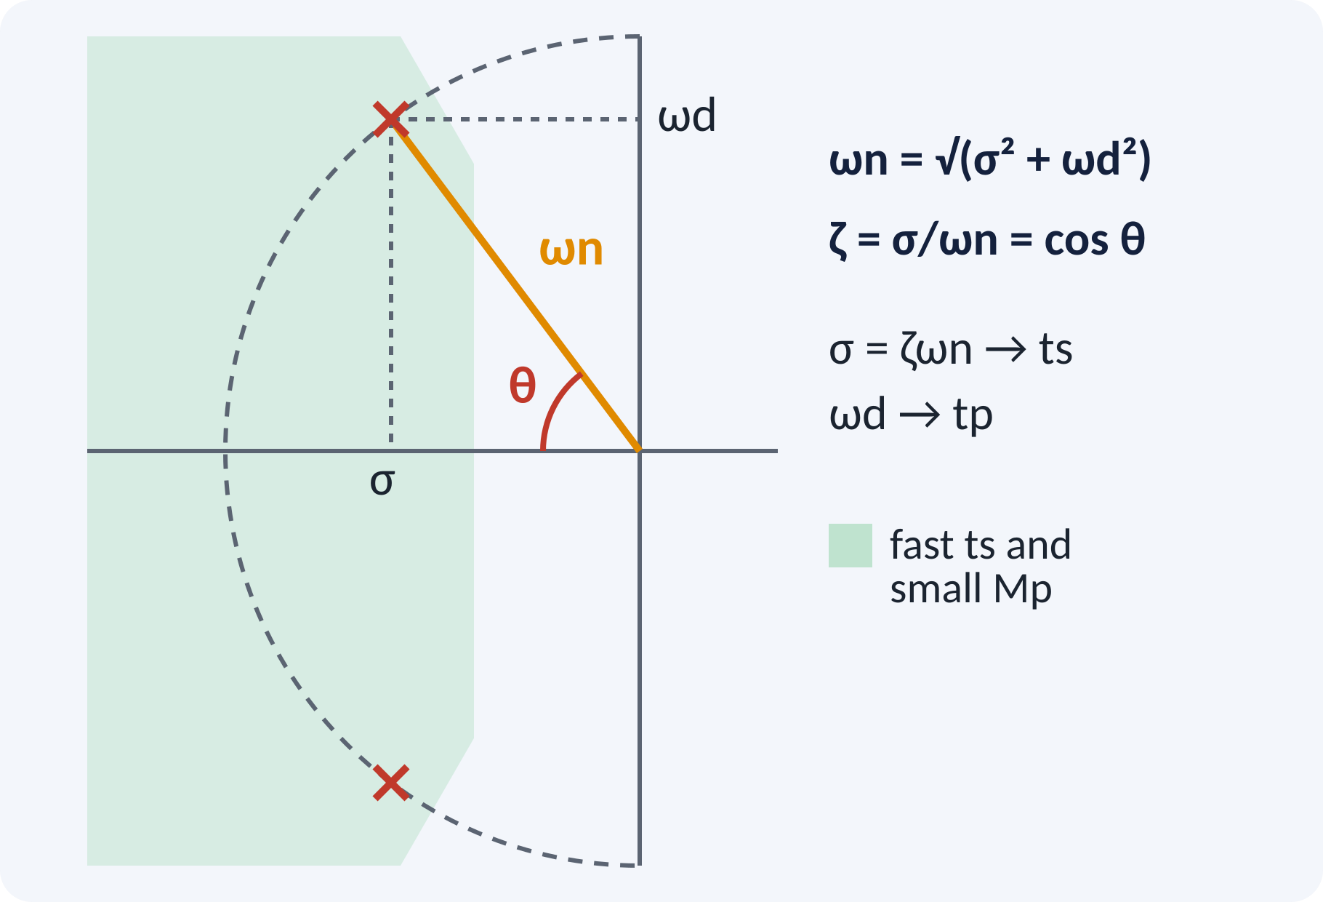
Pole Location and Specifications
ωn = distance of the pole from the origin.
ζ = cos θ, θ measured from negative real axis.
Real part σ sets settling time.
Imaginary part ωd sets peak time.
ωn = √(σ² + ωd²); ζ = σ/ωn = cos θ
Notes:
This slide ties everything together. Any pole pair on the s-plane tells you the specifications at a glance. Poles further left settle faster. Poles with a steeper angle from the real axis oscillate more and overshoot more. We shall use exactly this picture again in root locus in Unit 4.

Slide 13
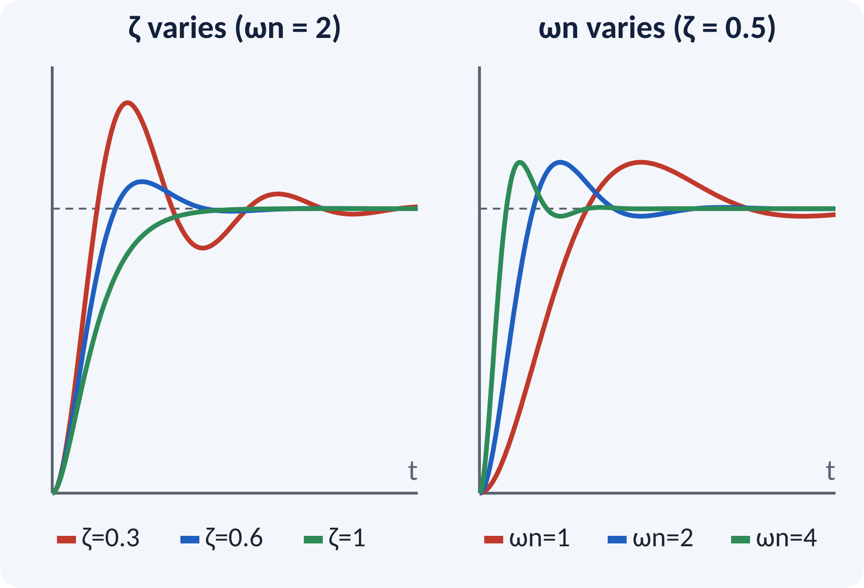
Effect of ζ and ωn
Increase ζ: overshoot falls, peak comes later.
Increase ωn: all times shrink; overshoot unchanged.
Typical design choice: 0.4 ≤ ζ ≤ 0.8.
Trade-off: speed against smoothness.
ζ changes the shape of the response; ωn changes its speed
Notes:
Keep this picture in your head. Damping ratio changes the shape of the curve, and natural frequency only stretches it in time. If a designer wants a faster response without more overshoot, raise ωn and keep ζ fixed. In practice that costs more control effort, so there is always a trade-off.

Slide 14
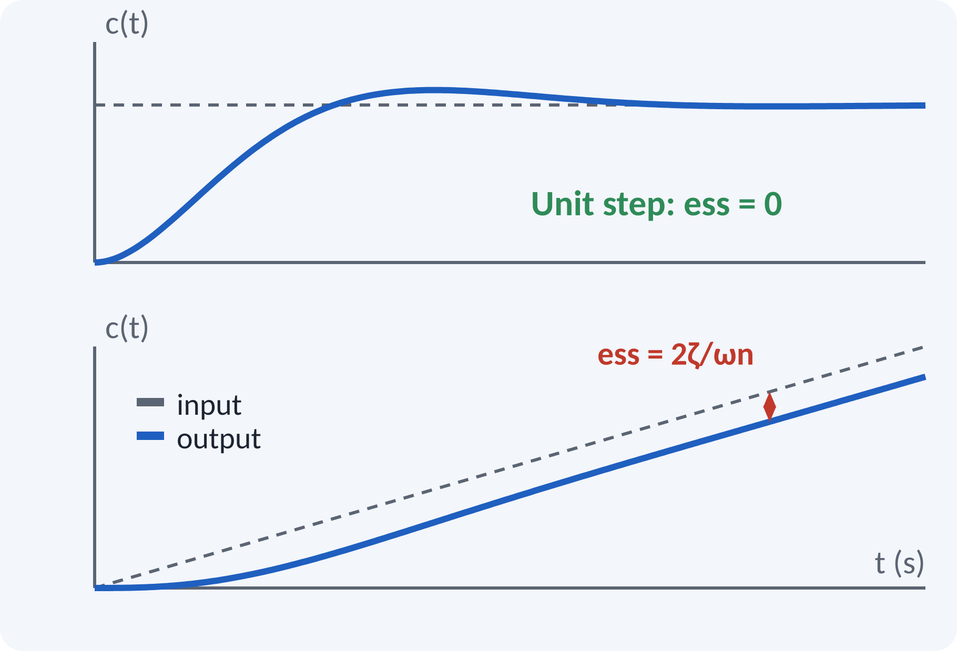
Steady-State Link (Type 1)
G(s) = ωn²/[s(s + 2ζωn)] is Type 1.
Unit step input: ess = 0.
Unit ramp input: finite error ess = 1/Kv.
Raising ζ increases the ramp error.
Kv = lim s→0 s·G(s) = ωn/(2ζ); ess(ramp) = 2ζ/ωn
Kv velocity error constant (1/s), ess steady-state error
Notes:
This slide connects the transient part to the steady-state part of Unit 2. Our servo has one integrator, so it follows a step exactly. For a ramp it follows with a constant lag of 2ζ over ωn. Notice the tension: raising ζ reduces overshoot but increases ramp error. We will meet static error constants in the next lecture.

Slide 15
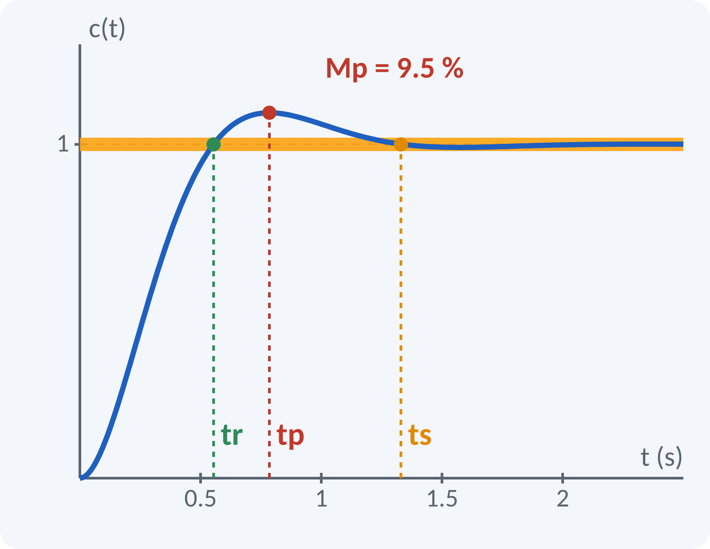
Solved Example 1: Find the Specs
Given G(s) = 25/[s(s + 6)], unity feedback, unit step.
1. T(s) = 25/(s² + 6s + 25), so ωn = 5 rad/s.
2. 2ζωn = 6, so ζ = 0.6; ωd = 5√0.64 = 4 rad/s.
3. φ = cos⁻¹0.6 = 0.927 rad; tr = (π − 0.927)/4 = 0.554 s.
4. tp = π/4 = 0.785 s.
5. Mp = e^(−π·0.6/0.8) = 0.0948, i.e. 9.5 %.
6. ts = 4/3 = 1.33 s (2 %); 3/3 = 1.0 s (5 %).
7. Kv = 25/6; ess(ramp) = 2ζ/ωn = 0.24.
Answer: ωn = 5, ζ = 0.6, tr = 0.554 s, tp = 0.785 s, Mp = 9.5 %, ts = 1.33 s
Notes:
Walk through slowly. Step one: close the loop and compare with the standard form. Steps two and three give ωn and ζ directly, and after that every specification is a single formula. Ask the class to compute tp themselves before showing it. Finally, verify with MATLAB in the lab.

Slide 16
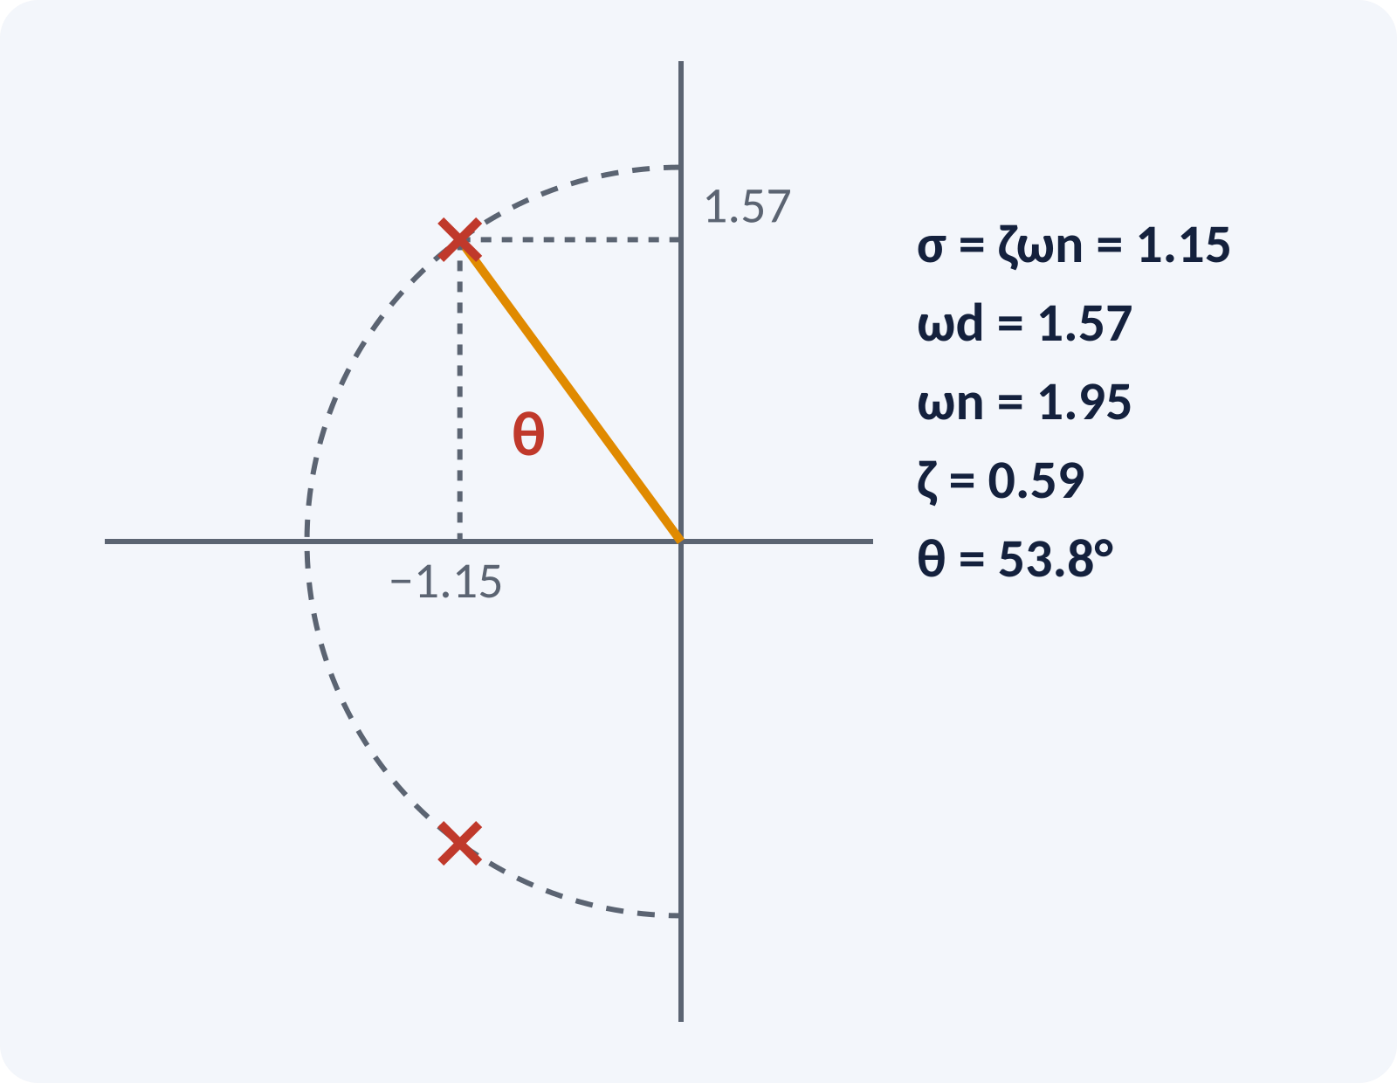
Solved Example 2: Design from Specs
Given G(s) = K/[s(s + a)], unity feedback. Need Mp = 10 %, tp = 2 s. Find K, a, ts.
1. ζ = ln10/√(π² + ln²10) = 2.303/3.895 = 0.591.
2. ωd = π/tp = 1.571 rad/s.
3. ωn = ωd/√(1 − ζ²) = 1.571/0.807 = 1.947 rad/s.
4. K = ωn² = 3.79.
5. a = 2ζωn = 2.30.
6. ts = 4/(ζωn) = 4/1.151 = 3.47 s (2 %).
Answer: K = 3.79, a = 2.30, ts = 3.47 s; poles at −1.15 ± j1.57
Notes:
This is the reverse problem and examiners love it. Overshoot gives the damping ratio. Peak time and ζ together give ωn. Then match the closed-loop denominator s squared plus a·s plus K with the standard form. Notice the poles sit at minus 1.15 plus or minus j1.57, which we can plot. Always check by computing ts.

Slide 17
Common Mistakes and Exam Tips
✕
Common mistakes
✓
Exam tips
Using ωn instead of ωd in tr and tp.
Mixing degrees and radians for φ.
Writing Mp as a fraction but quoting it as %.
Quoting ts without stating the 2 % or 5 % band.
Using the overshoot formula outside 0 < ζ < 1.
Rewrite into standard form first.
Compare coefficients to get ωn and ζ.
Check that ζ lies between 0 and 1.
Set the calculator to radians for φ.
Show formula, substitution, answer with unit.
Notes:
These are the most common marks lost in the exam. Setting the calculator to radians for φ is a classic one. Also remember that the closed-loop standard form needs the constant term to match ωn squared, so check the gain. Writing units and the formula earns method marks even if the arithmetic slips.

Slide 18
Summary
Standard form: ωn²/(s² + 2ζωn·s + ωn²).
ζ decides response type; poles −ζωn ± jωd.
tp = π/ωd; tr = (π − φ)/ωd.
Mp = e^(−πζ/√(1 − ζ²)); depends on ζ only.
ts ≈ 4/(ζωn) for a 2 % band.
Pole position gives the specs; the specs give the pole position
Notes:
Recap in one minute. Reduce to standard form, read ζ and ωn, and then every specification follows from the formulas. Pole position tells you the specification, and the specification tells you the pole position. Next class: static error constants and the generalized error series. Revise the two examples tonight.

Slide 19
Quick Quiz
Q1. A system with ζ = 0.4 is:
(a) undamped (b) underdamped (c) critically damped (d) overdamped
Ans: (b)
Q2. Peak overshoot depends only on:
(a) ωn (b) ζ (c) K only (d) ts
Ans: (b)
Q3. ζ = 0.5, ωn = 4 rad/s: ts (2 % band) =
(a) 0.5 s (b) 1 s (c) 2 s (d) 4 s
Ans: (c)
Q4. ωn = 10 rad/s, ζ = 0.6: peak time tp =
(a) 0.314 s (b) 0.393 s (c) 0.524 s (d) 0.785 s
Ans: (b)
Q5. Peak overshoot for ζ = 0.5 is about:
(a) 5 % (b) 16.3 % (c) 25 % (d) 50 %
Ans: (b)
Notes:
Give about one minute per question and ask for a show of hands. Question 4 is the trap: people divide by ωn and choose option (a). Discuss why the wrong options are attractive. Use the quiz as a quick check of understanding before leaving.

Slide 20
References
1
I. J. Nagrath and M. Gopal, Control Systems Engineering
5th Ed., New Age International (P) Ltd., 2008 (Unit 2 textbook)
2
Benjamin C. Kuo, Automatic Control Systems
7th Ed., PHI, 2007 (Units 3–5 textbook)
3
K. Ogata, Modern Control Engineering
5th Ed., Pearson Education Asia / PHI, 2009 (reference)
4
P. S. Satyanarayana, Concepts of Control Systems
2nd Ed., Dynaram Publishers, Bangalore, 2001 (reference)
5
Lab: MATLAB / Simulink
Experiments 1, 3 and 8: step response, time-domain specifications, DC position control
Next lecture: static error constants and generalized error series
Notes:
Point students to the chapters on second-order time response in the Unit 2 textbook. Encourage solving the textbook problems on time-domain specifications. Remind them to use MATLAB to check their answers. Thank the class.

