Slide 1
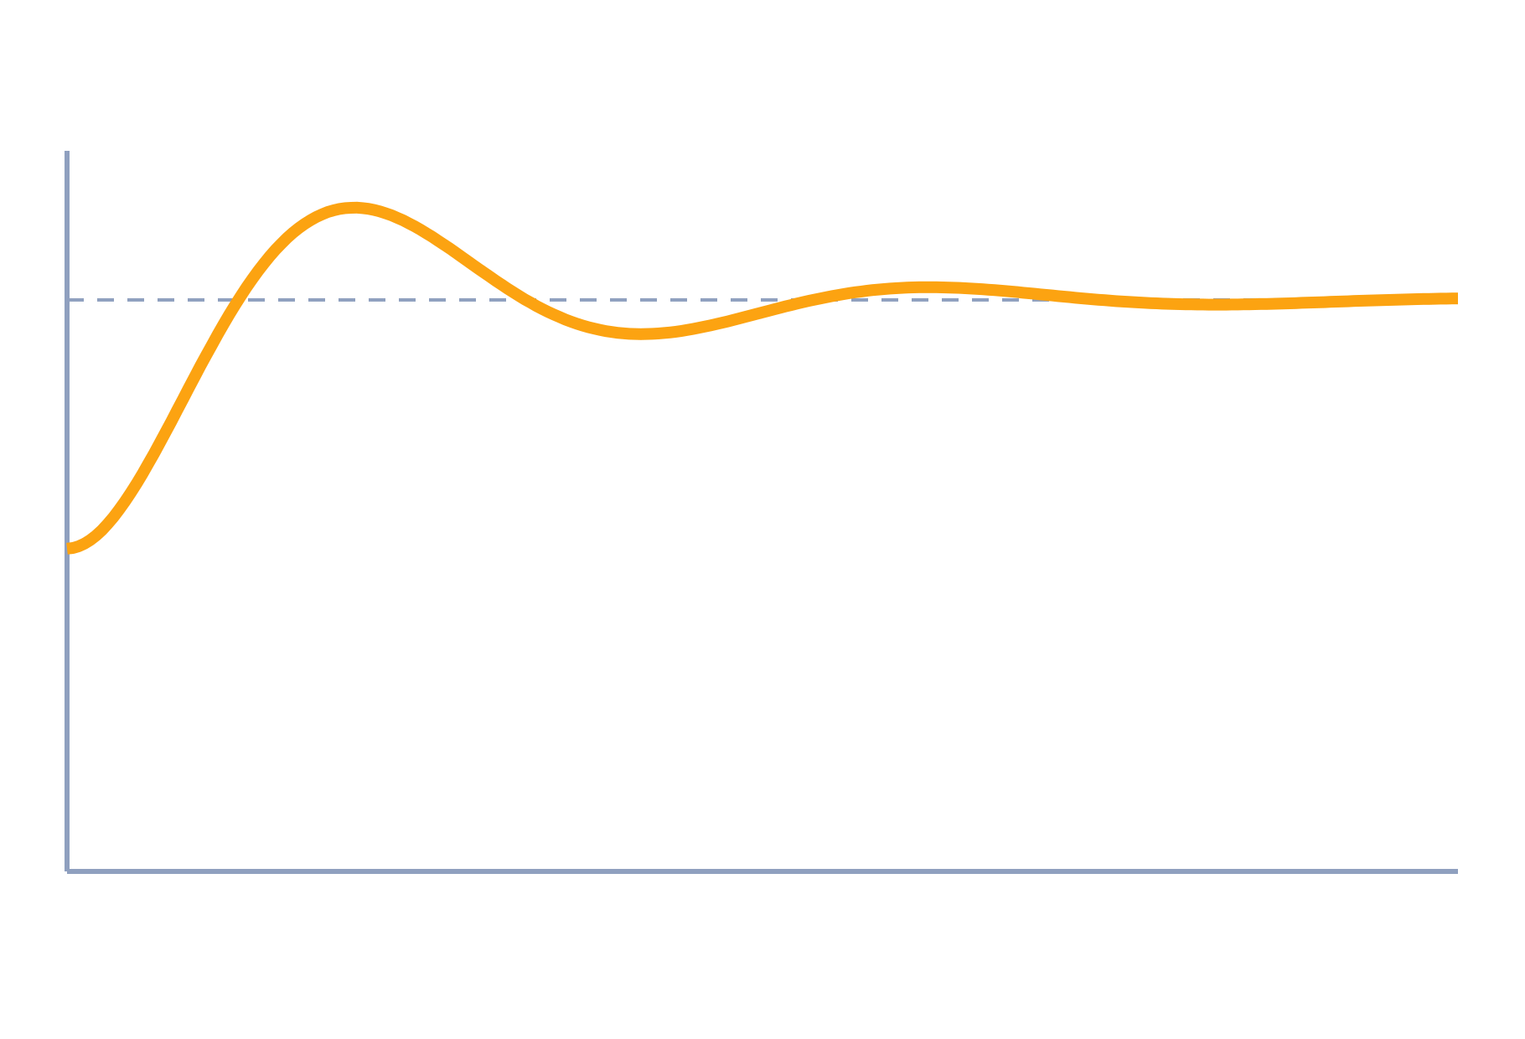
Steady-State Error and Error Constants
Control Systems (22EEG53)
Unit 2: Time Domain Analysis of Control Systems
Topic: Type of systems, static error constants, steady-state error, generalized error series
Prof. Mitesh Astik
Notes:
Welcome everyone. Today's topic is Type of systems, static error constants, steady-state error, generalized error series. It belongs to Unit 2: Time Domain Analysis of Control Systems. By the end of this session you will be able to use it in numerical problems. Keep your notebooks ready because we will solve two examples.

Slide 2

Learning Outcomes
Find the type of a system from G(s).
Calculate Kp, Kv, Ka and the steady-state error.
Predict error for step, ramp and parabolic inputs.
Use the generalized error series for general inputs.
Linked to CO2
Analyse response during transient and steady-state conditions.
Notes:
Read the outcomes aloud. They map to CO2 of the syllabus. Tell students that these are examinable and that the two solved examples follow the same pattern. Ask them to tick off each outcome at the end of the lecture.

Slide 3
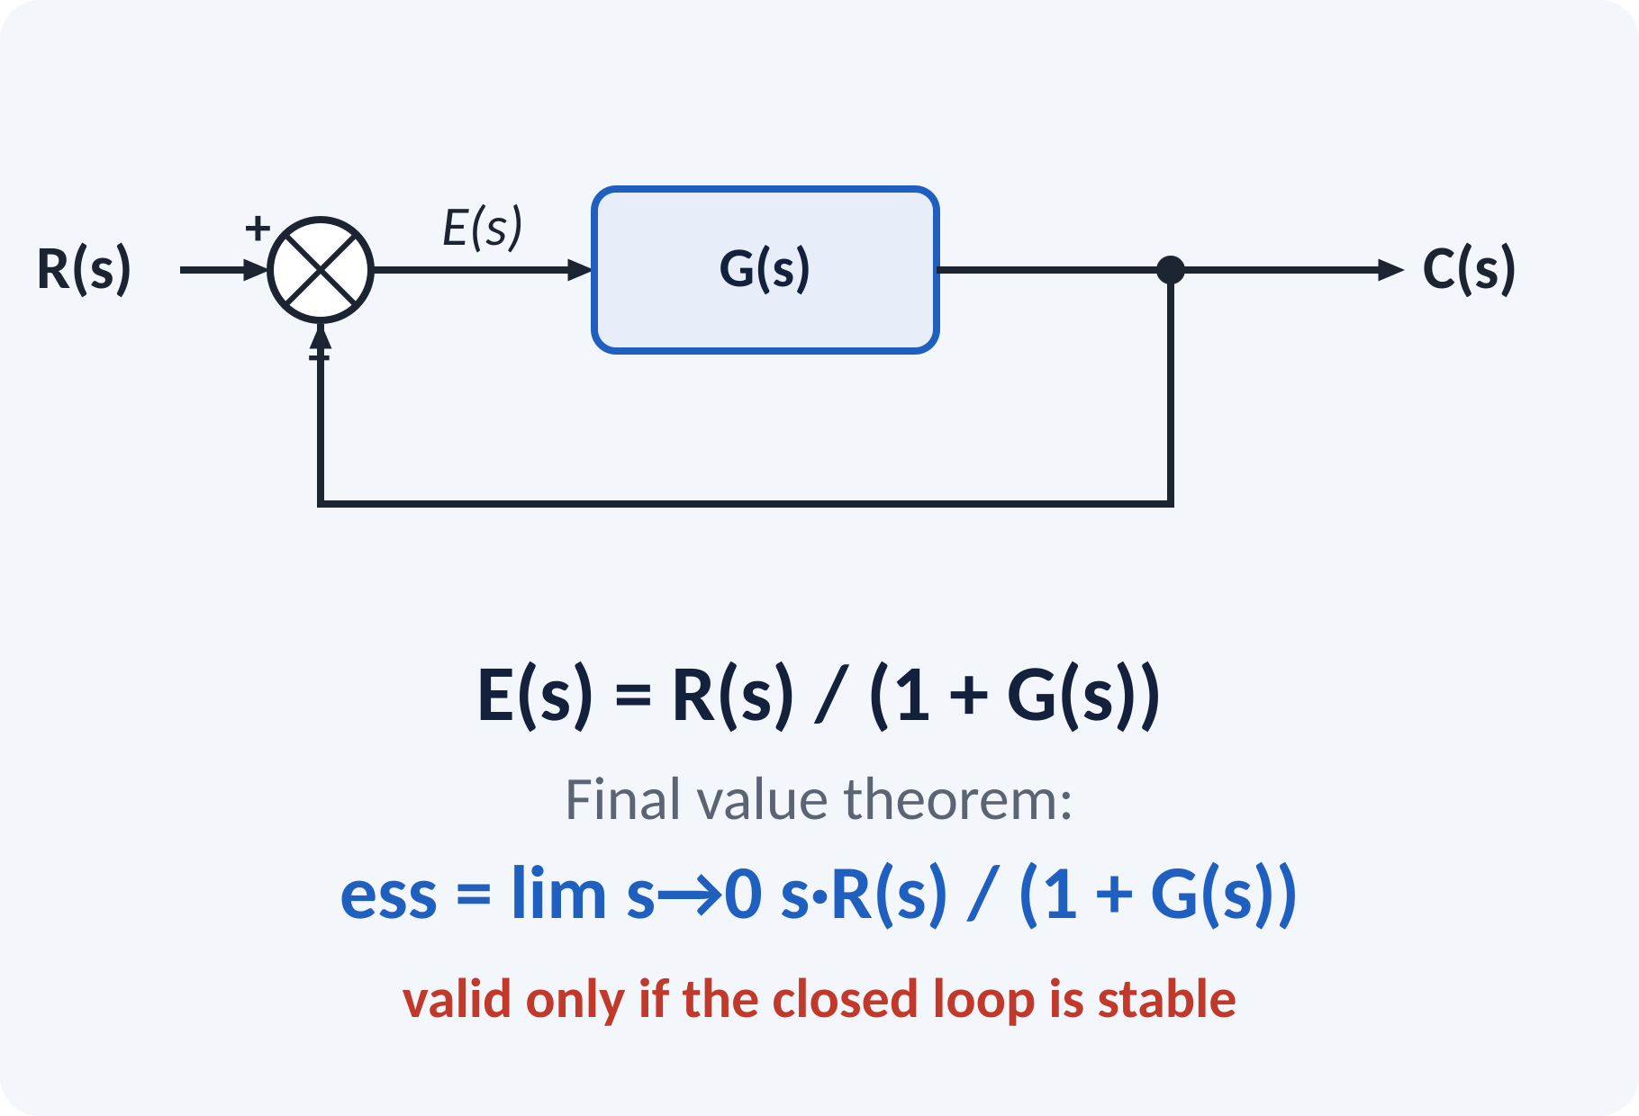
Recap: What You Already Know
Unity feedback: error e = r − c.
Closed-loop stable systems have a final value.
Final value theorem: lim s·F(s) as s → 0.
Test signals: 1/s, 1/s², 1/s³.
lim t→∞ f(t) = lim s→0 s·F(s) (poles in left half-plane only)
Notes:
Recall the final value theorem: the steady value of a time function is the limit of s times its transform as s goes to zero. It is valid only if all poles of s F of s are in the left half-plane. We apply it to the error signal of a unity-feedback system. The result depends on the open-loop transfer function and on the input signal.

Slide 4
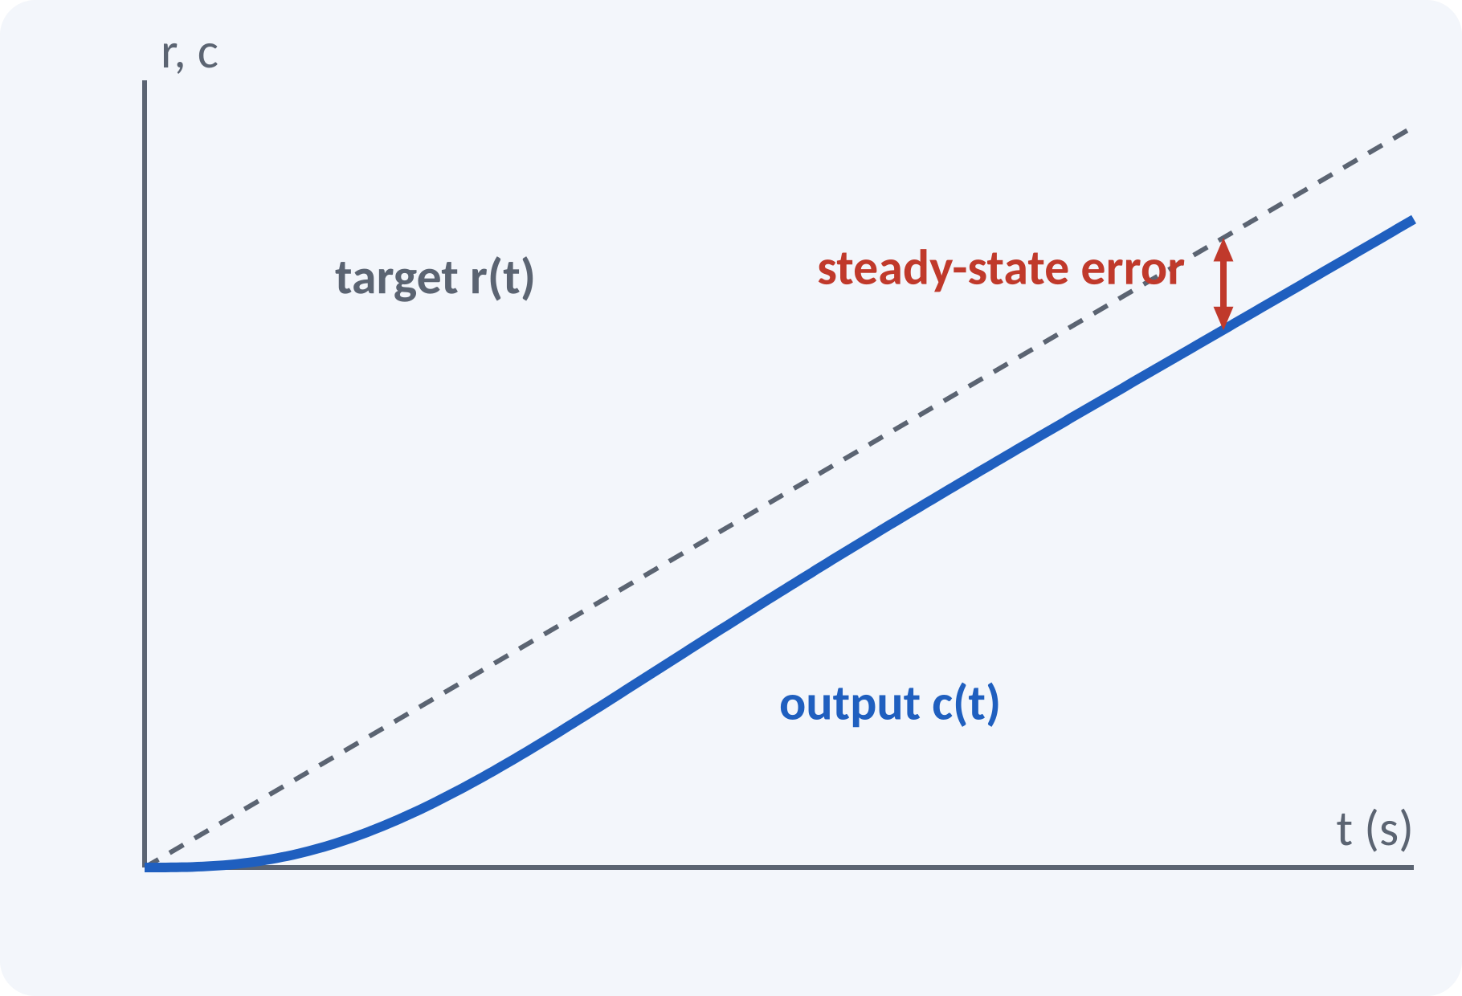
Motivation: Tracking Accuracy
A radar must follow a moving aircraft.
A robot must follow a path precisely.
Transient dies out but a constant gap may remain.
Steady-state error measures that final gap.
Design aim: keep ess within the allowed limit for the expected input
Notes:
A tracking antenna follows a satellite moving at constant angular speed, which is a ramp input. Even after the transient has died out, the antenna points slightly behind the satellite. That constant gap is the steady-state error. Today we learn how to predict it from the open-loop transfer function.

Slide 5
Steady-State Error
Error: e(t) = r(t) − c(t) (unity feedback).
E(s) = R(s)/(1 + G(s)).
Apply the final value theorem to E(s).
The result depends on G(s) at s → 0.
Valid only for a stable closed loop.
ess = lim s→0 s·R(s)/(1 + G(s))
G(s) open-loop transfer function, R(s) input
Notes:
From the block diagram E equals R minus C and C equals G times E, so E equals R over one plus G. Multiply by s and take the limit. Always check the stability of the closed loop first, otherwise the error does not settle. For non-unity feedback, first convert the system to an equivalent unity-feedback form.

Slide 6
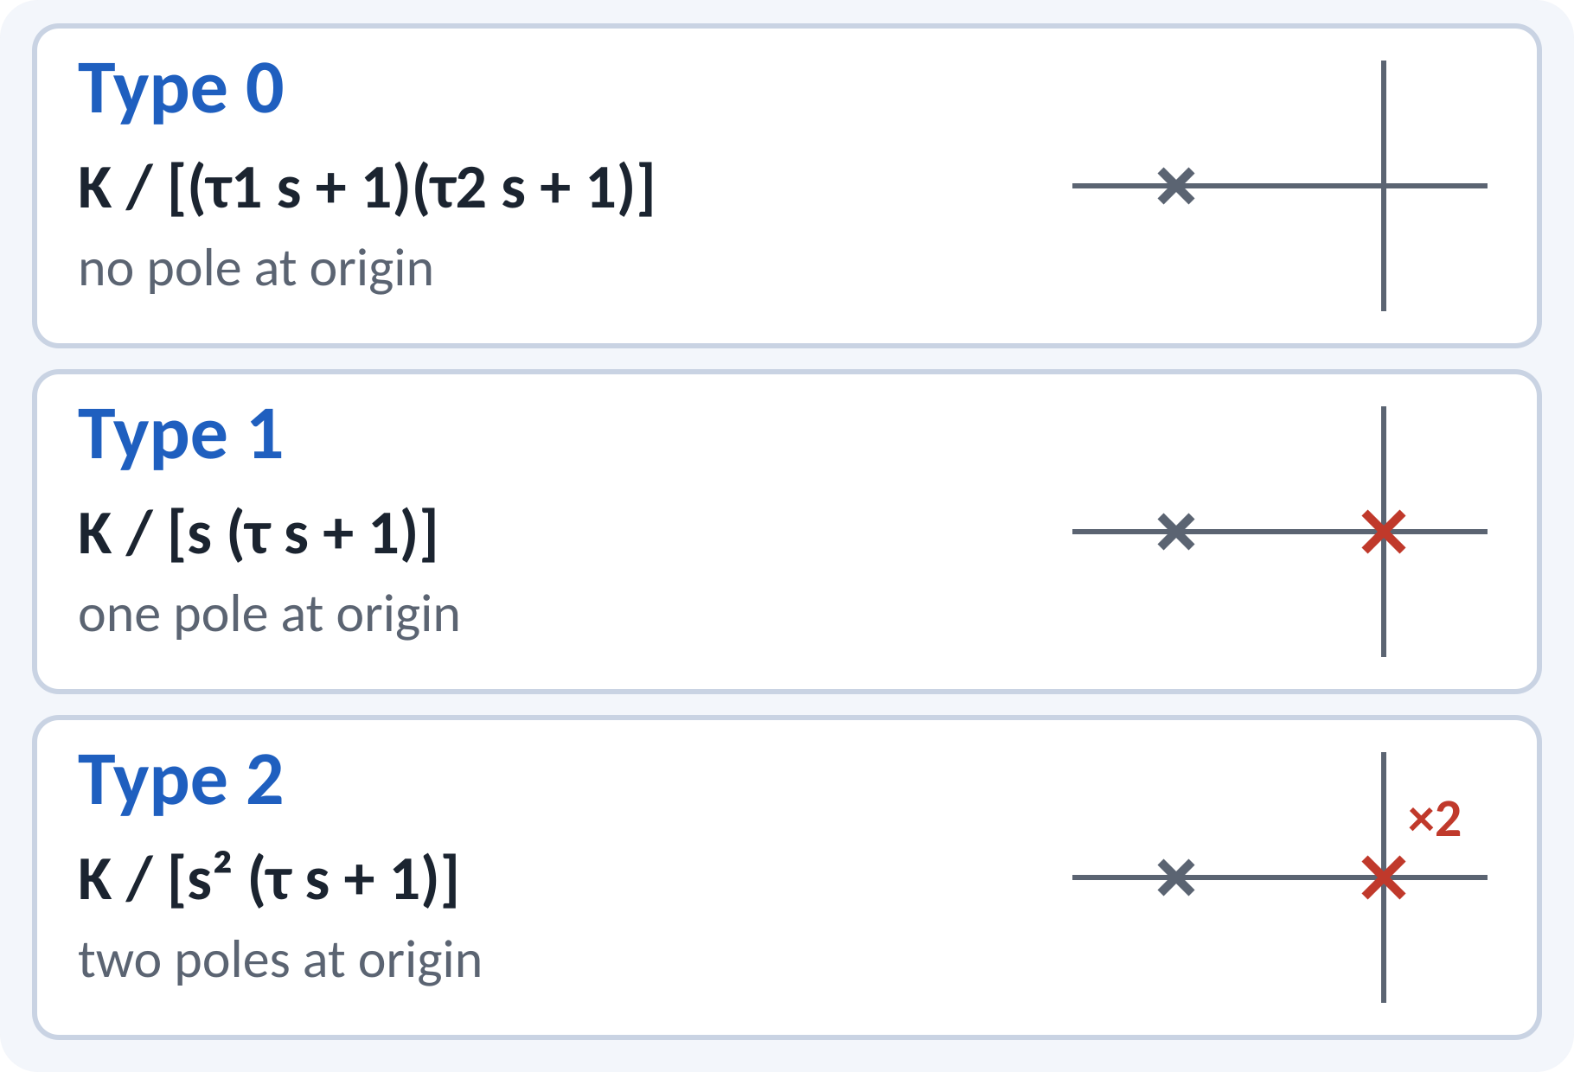
Type of a System
Type = number of poles of G(s) at s = 0.
Type 0: no integrator.
Type 1: one integrator.
Type 2: two integrators.
Type tells which inputs are tracked with zero error.
G(s) = K ∏(τᵢ s + 1) / [sᴺ ∏(τⱼ s + 1)]; type = N
Notes:
The type of the system is the power of s in the denominator when G of s is written in the time-constant form. Each integrator at the origin improves the tracking ability by one step. Note that type is a property of the open-loop transfer function, not the closed loop. Count the poles at the origin carefully before using the error constants.

Slide 7
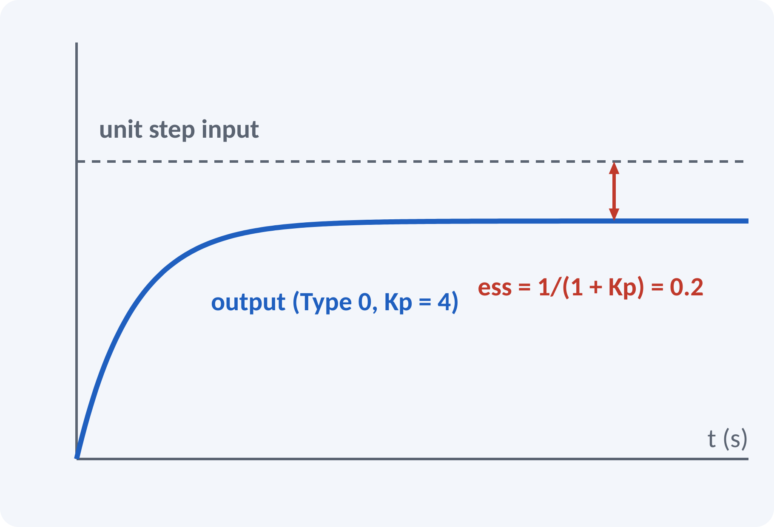
Static Position Error Constant Kp
Input: unit step, R(s) = 1/s.
Kp = lim G(s) as s → 0.
Type 0: Kp = K, finite error.
Type 1 or higher: Kp = ∞, zero error.
ess = 1/(1 + Kp) for a unit step; A/(1 + Kp) for amplitude A
Kp = lim s→0 G(s)
Notes:
For a step input, R of s is A over s, and the error reduces to A over one plus G of zero. G of zero is the position error constant Kp. A type 0 system has a finite Kp, so it leaves a constant error. A type 1 system has an integrator, Kp is infinite and the step error is zero.

Slide 8
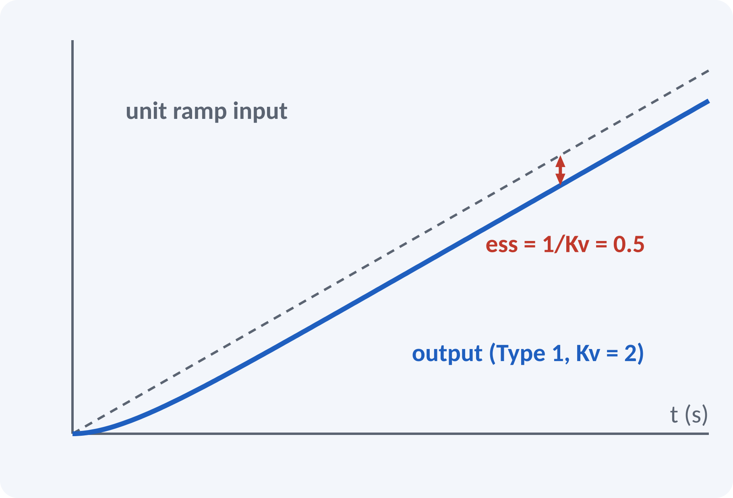
Static Velocity Error Constant Kv
Input: unit ramp, R(s) = 1/s².
Kv = lim s·G(s) as s → 0.
Type 0: ess = ∞.
Type 1: finite error 1/Kv.
Type 2 or higher: zero error.
ess = A/Kv for a ramp of slope A
Kv = lim s→0 s·G(s)
Notes:
For the ramp, E of s becomes A over s squared times one plus G, and the limit gives A over the limit of s G of s. That limit is Kv. A type 1 system tracks a ramp with a constant lag of A over Kv. Increasing the gain raises Kv and reduces the error, but it also affects stability, which is the central trade-off in design.

Slide 9
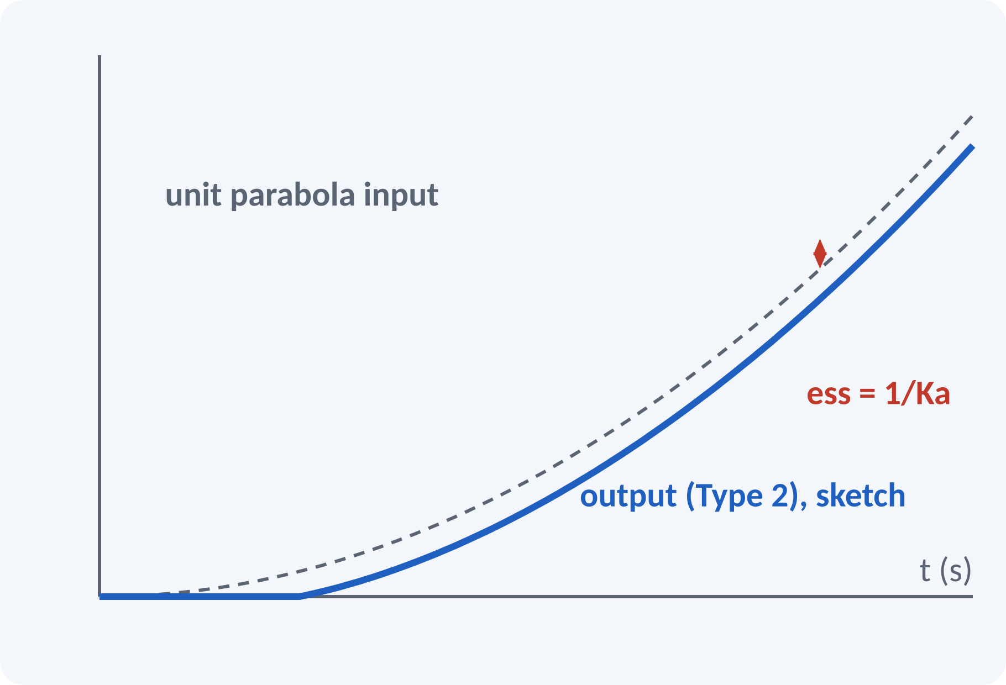
Static Acceleration Error Constant Ka
Input: parabola A·t²/2, R(s) = A/s³.
Ka = lim s²·G(s) as s → 0.
Types 0 and 1: infinite error.
Type 2: finite error A/Ka.
Type 3 or higher: zero error.
ess = A/Ka; Ka = lim s→0 s²·G(s)
Notes:
The parabola represents constant acceleration. Only a type 2 or higher system can follow it with a finite error. The acceleration error constant is the limit of s squared times G of s. This is important for satellite tracking systems where the target accelerates. Remember that the size of A is the coefficient of t squared over two.

Slide 10
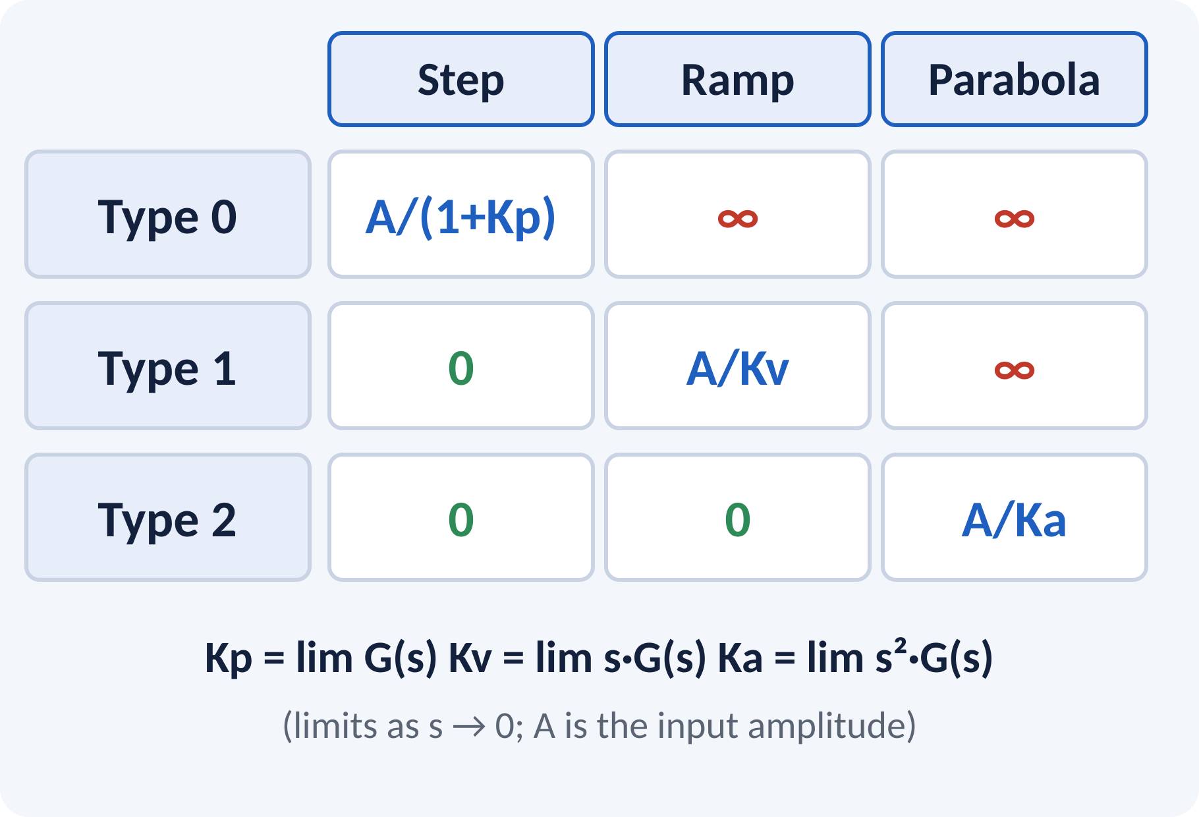
Error Table: Type vs Input
Higher type → better tracking, but harder stability.
Zero error needs enough integrators.
Finite errors use Kp, Kv or Ka.
Superposition applies for combined inputs.
r = A·u(t) + B·t + (C/2)·t² → ess = A/(1+Kp) + B/Kv + C/Ka
Notes:
This table is the most important result of the lecture. Memorise the pattern: the diagonal gives finite errors, above the diagonal gives zero and below it gives infinite error. For a mixed input, apply superposition and add the individual errors. An infinite term in the sum makes the total error infinite.

Slide 11
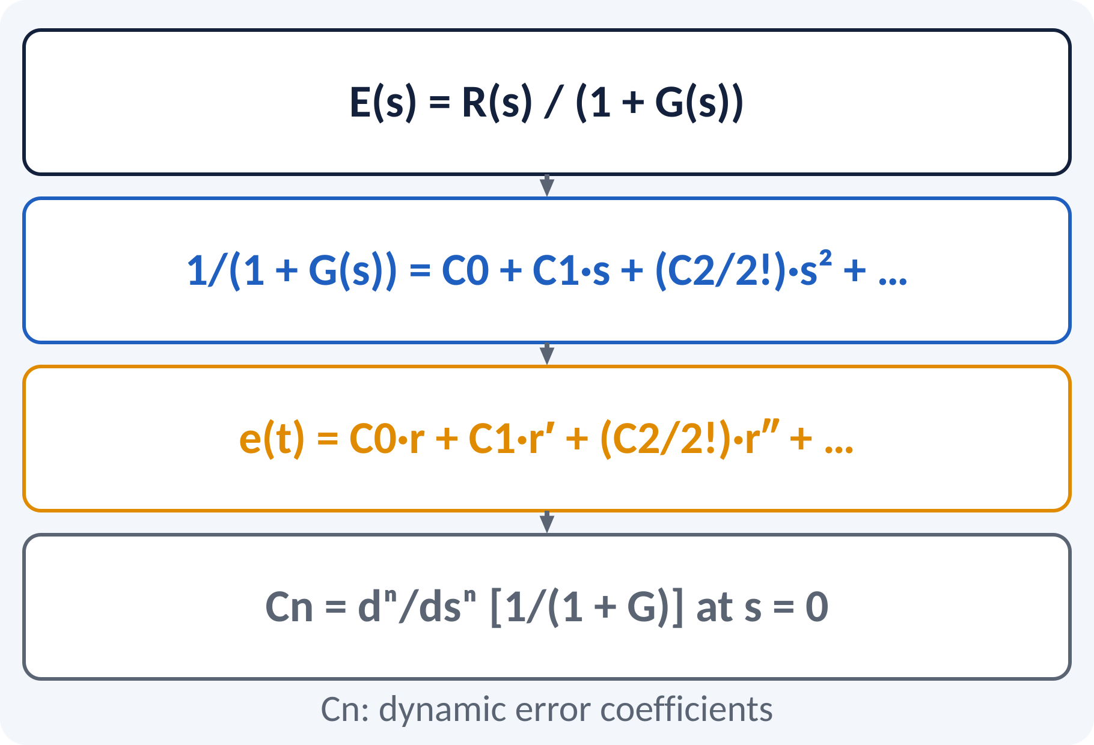
Generalized Error Series
Static constants cover only step, ramp, parabola.
Series handles any smooth input r(t).
Expand 1/(1 + G(s)) in powers of s.
Coefficients Cn are dynamic error coefficients.
Error follows from the derivatives of r(t).
e(t) = C0·r(t) + C1·r′(t) + (C2/2!)·r″(t) + …
Cn = dⁿ/dsⁿ [1/(1 + G(s))] at s = 0
Notes:
Write E of s as one over one plus G times R of s and expand one over one plus G in a power series in s. Each power of s corresponds to a derivative in time. The coefficients are found by long division in ascending powers of s. The series is useful for a time-varying error, and the first non-zero term dominates the steady state.

Slide 12
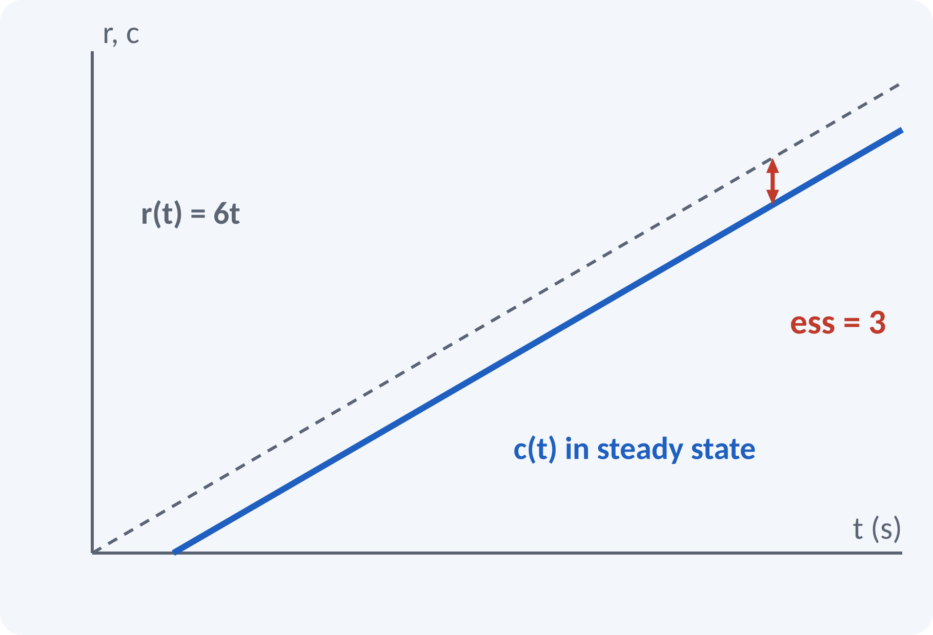
Solved Example 1: Static Constants
Unity feedback, G(s) = 20(s + 2)/[s(s + 4)(s + 5)]. Input r = 6t. Find type, Kp, Kv, Ka, ess.
1. Stability: s³ + 9s² + 40s + 40 → all Routh entries positive: stable.
2. One pole at origin: Type 1.
3. Kp = ∞.
4. Kv = lim sG = 20×2/(4×5) = 2.
5. Ka = lim s²G = 0.
6. Ramp slope A = 6: ess = A/Kv = 3.
Answer: Type 1, Kp = ∞, Kv = 2, Ka = 0, ess = 3 for r = 6t
Notes:
First confirm stability with the characteristic equation, otherwise the final value theorem cannot be used. The system has one pole at the origin, so it is type 1. The limit of s G of s is twenty times two over four times five, which is 2. The input is 6 t so the slope is 6 and the error is 6 over 2, equal to 3.

Slide 13
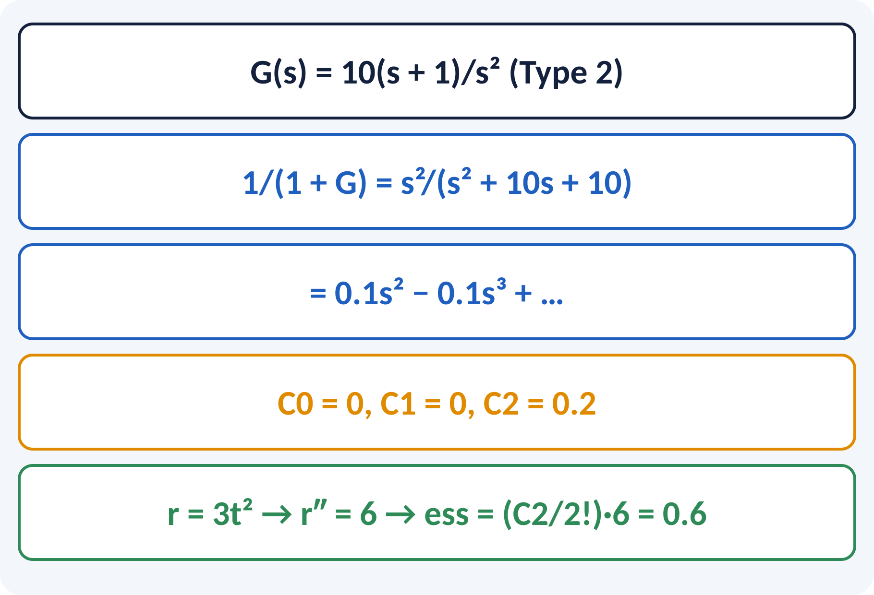
Solved Example 2: Error Series
Unity feedback, G(s) = 10(s + 1)/s². Input r(t) = 3t². Find ess by Ka and by the error series.
1. Type 2: Ka = lim s²G = 10(0 + 1) = 10.
2. r = 3t² = 6·t²/2, so A = 6: ess = 6/10 = 0.6.
3. Series: 1/(1+G) = s²/(s² + 10s + 10) = 0.1s² − 0.1s³ + …
4. C0 = C1 = 0, C2/2! = 0.1.
5. e = 0.1·r″ = 0.1 × 6 = 0.6.
Answer: ess = 0.6 by both methods
Notes:
The first method uses the acceleration constant, which is ten. The second method expands the error transfer function in a power series. The first two coefficients vanish because the system is type 2, and the s squared coefficient gives the same answer, 0.6. Having two methods agree is a good way to check your work in the exam.

Slide 14
Common Mistakes and Exam Tips
✕
Common mistakes
✓
Exam tips
Applying the theorem to an unstable closed loop.
Counting type from the closed-loop transfer function.
Forgetting to write G(s) in time-constant form for K.
Using the amplitude of r(t) wrongly (A for t²/2).
Using static constants for non-unity feedback directly.
Check stability first (Routh).
Count poles of G(s) at s = 0 only.
Write K as the gain in time-constant form.
Convert to unity feedback if H(s) ≠ 1.
Notes:
These are the points where marks are lost most often in steady-state error. Give one quick example for each mistake. Remind students that writing the formula, substitution and the unit earns method marks even if the arithmetic slips. Encourage them to check the answer for reasonableness.

Slide 15
Summary
ess = lim s·R(s)/(1 + G(s)) for stable unity feedback.
Type = number of integrators in G(s).
Kp = lim G, Kv = lim sG, Ka = lim s²G.
Errors: A/(1+Kp), A/Kv, A/Ka for step, ramp, parabola.
Error series: e(t) = ΣCn r⁽ⁿ⁾/n!.
Zero / finite / infinite error follows the type–input table
Notes:
Recap in one minute. Say each point and ask the class to recall the formula for it. If they remember these ideas, most numerical problems on steady-state error are within reach. Next lecture: frequency-domain specifications. Revise the two solved examples tonight.

Slide 16
Quick Quiz
Q1. G(s) = 10/[s(s+2)] is of type:
(a) 0 (b) 1 (c) 2 (d) 3
Ans: (b)
Q2. Kv of G(s) = 10/[s(s+2)] is:
(a) 0 (b) 2 (c) 5 (d) ∞
Ans: (c)
Q3. Ramp error of a Type 0 system is:
(a) 0 (b) finite (c) 1/Kp (d) infinite
Ans: (d)
Q4. Unit step error of Type 0 with Kp = 4 is:
(a) 0.2 (b) 0.25 (c) 4 (d) 0
Ans: (a)
Q5. Ka = lim of:
(a) G(s) (b) sG(s) (c) s²G(s) (d) G(s)/s
Ans: (c)
Notes:
Give about one minute per question and take a show of hands. Discuss why the wrong options are tempting, especially the one that uses a wrong formula. Use the quiz as a quick check on steady-state error before leaving.

Slide 17
References
1
I. J. Nagrath and M. Gopal, Control Systems Engineering
5th Ed., New Age International (P) Ltd., 2008 (Units 1, 2 textbook)
2
K. Ogata, Modern Control Engineering
5th Ed., Pearson Education Asia / PHI, 2009 (reference)
3
P. S. Satyanarayana, Concepts of Control Systems
2nd Ed., Dynaram Publishers, Bangalore, 2001 (reference)
Next lecture: Unit 3: frequency-domain specifications and Bode plots
Notes:
Point students to the textbooks listed in the syllabus for steady-state error. Ask them to solve at least three textbook problems on this topic before the next class. Thank the class and preview the next lecture.

