Slide 1
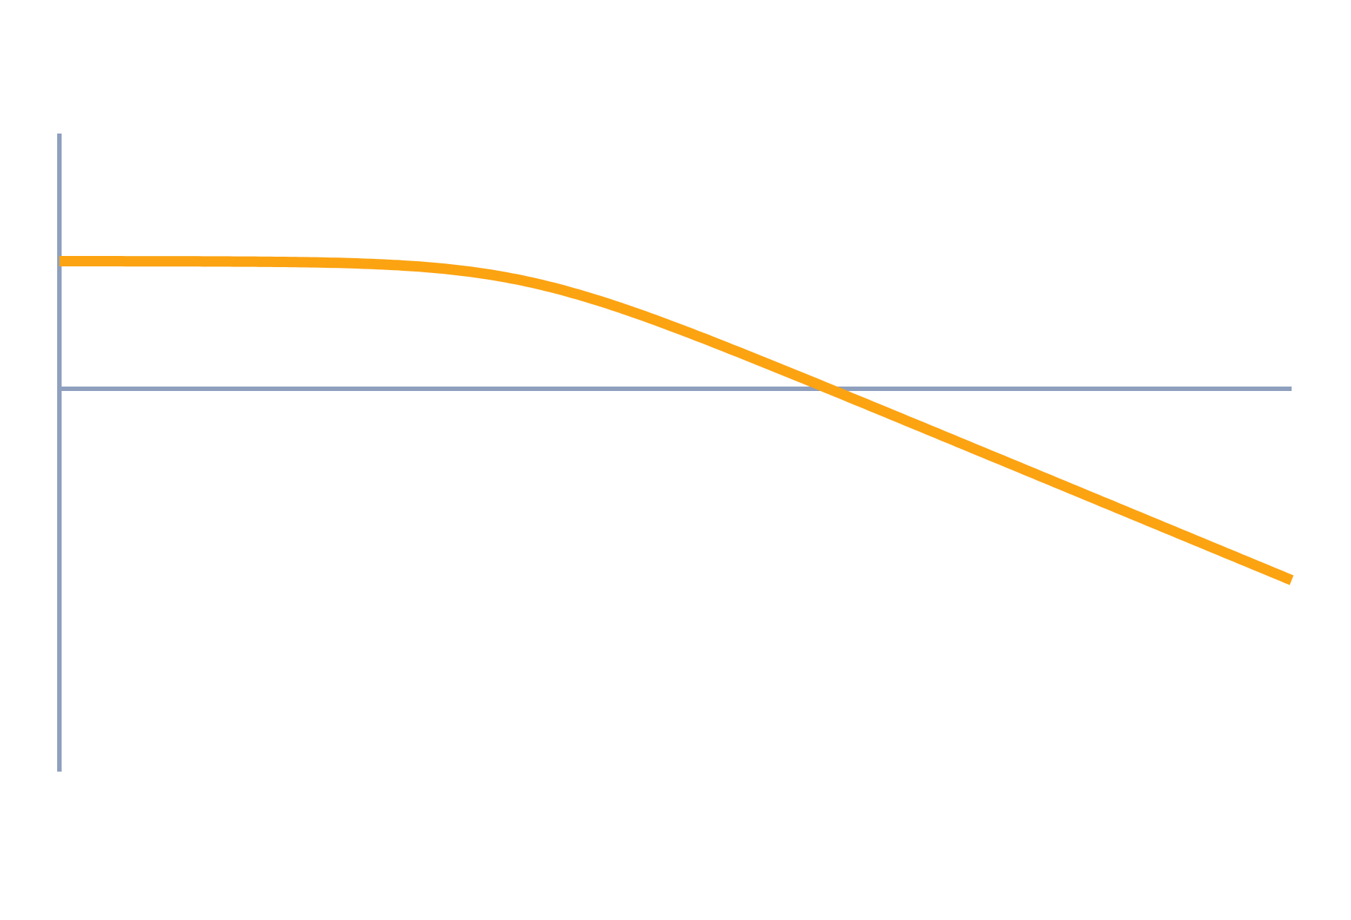
Lag, Lead and Lag-Lead Compensators
Control Systems (22EEG53)
Unit 5: Compensators and Controllers
Topic: Introduction to compensators — lag, lead and lag-lead
Prof. Mitesh Astik
Notes:
Welcome everyone. Today's topic is Introduction to compensators — lag, lead and lag-lead. It belongs to Unit 5: Compensators and Controllers. By the end of this session you will be able to use it in numerical problems. Keep your notebooks ready because we will solve two examples.

Slide 2

Learning Outcomes
Explain why compensation is needed.
Write lag and lead transfer functions and their Bode features.
Design a lead network for a phase-margin target.
Select RC values for lag and lead networks.
Linked to CO5
Design the appropriate compensator and controller for given specifications.
Notes:
Read the outcomes aloud. They map to CO5 of the syllabus. Tell students that these are examinable and that the two solved examples follow the same pattern. Ask them to tick off each outcome at the end of the lecture.

Slide 3
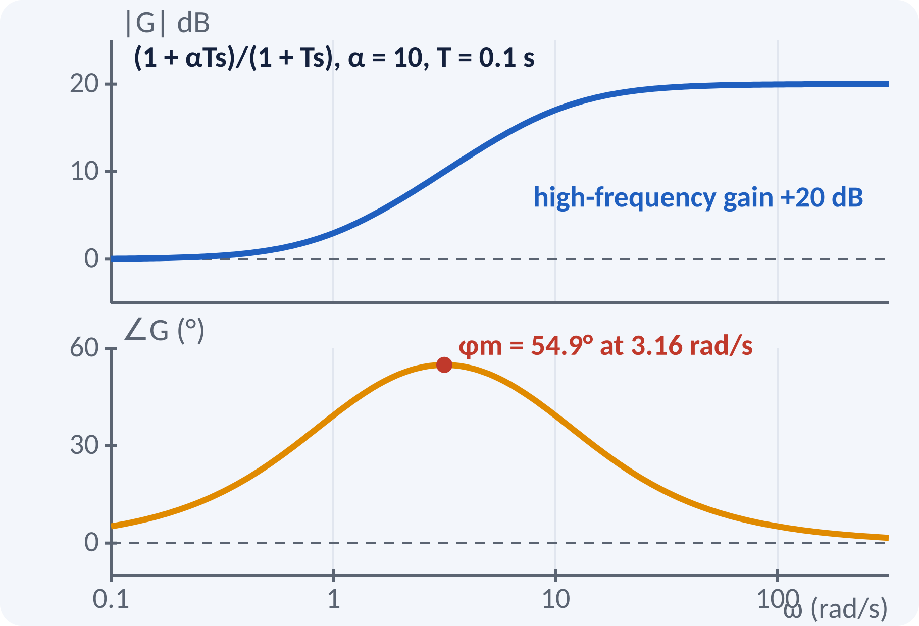
Recap: What You Already Know
Phase margin relates to damping (PM ≈ 100ζ).
Gain K sets Kv and steady-state error.
Bandwidth sets speed of response.
Bode plot: pole −20 dB/dec, zero +20 dB/dec.
PM = 180° + ∠L(jωgc); Kv = lim s·L(s)
L(s) open-loop transfer function
Notes:
Recall that phase margin tells us about damping and the velocity error constant tells us about tracking accuracy. A pole adds phase lag and slopes the magnitude down, while a zero adds phase lead. A compensator is simply a deliberately chosen pole and zero pair that reshapes the open-loop frequency response.

Slide 4
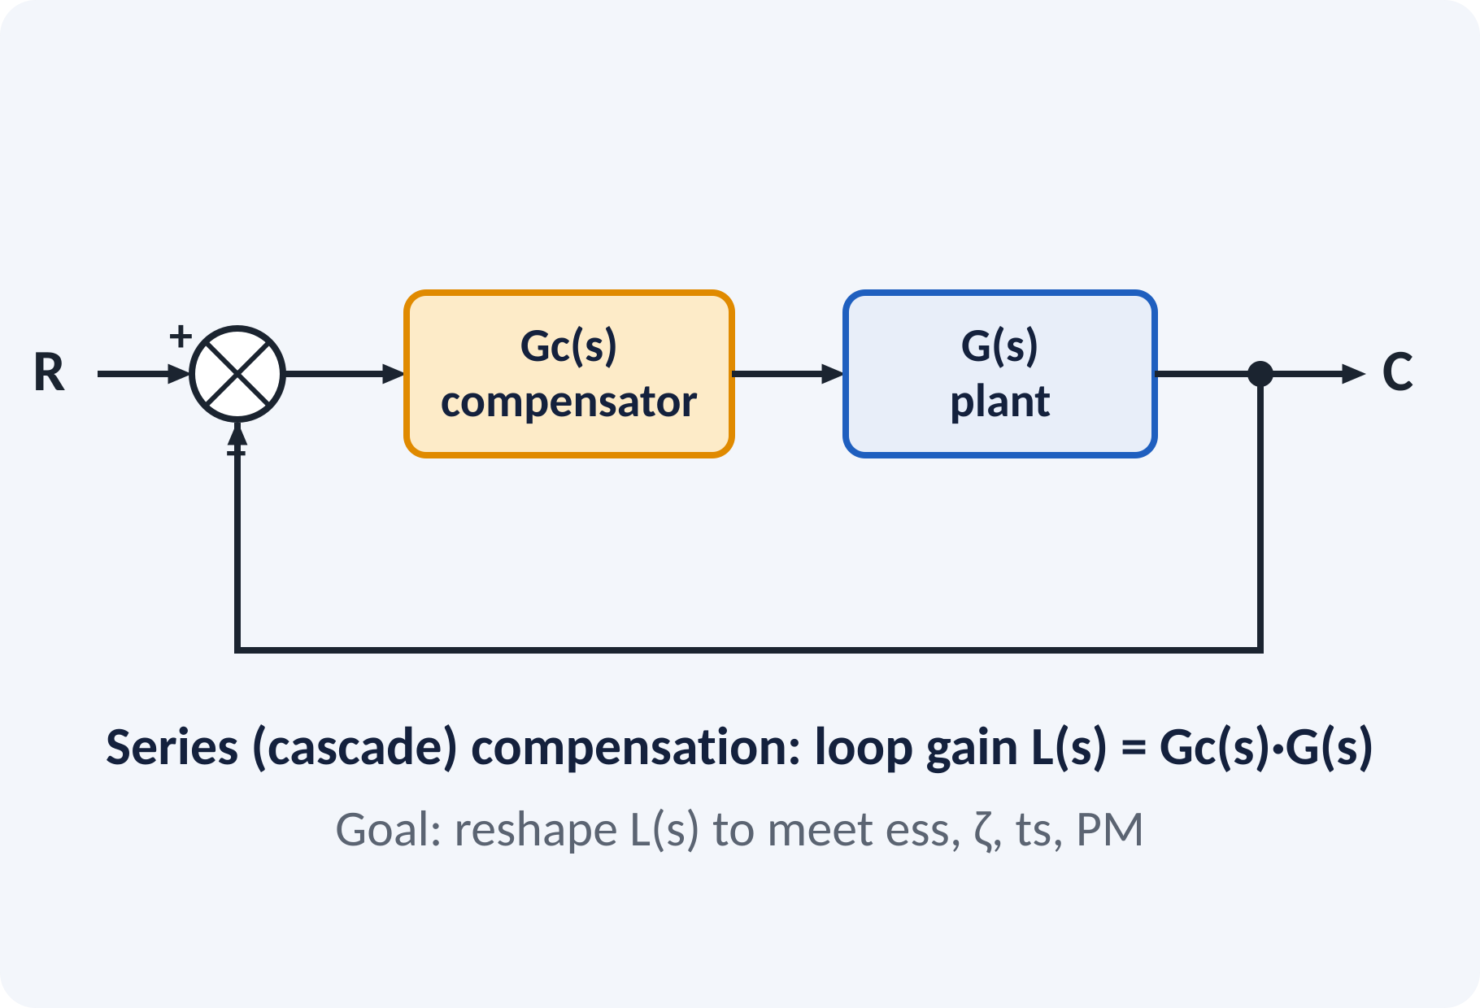
Motivation: Gain Alone Is Not Enough
Raise K: error falls but PM falls too.
Specifications often conflict.
Compensator adds phase or gain where needed.
Simple, cheap, passive RC networks.
Need: ess small and PM large and bandwidth high, at the same time
Notes:
If we only change the gain, we trade accuracy against stability. A servo that meets the error requirement may oscillate. Adding a compensator changes the shape of the open-loop response so that both requirements can be met. Lab experiments nine and ten implement exactly these RC networks.

Slide 5
Series Compensation
Compensator Gc(s) placed in the forward path.
Open-loop becomes Gc(s)·G(s).
Alternatives: feedback or feed-forward compensation.
Lead, lag and lag-lead are the standard types.
L(s) = Gc(s)·G(s); Gc(s) = Kc·(s + z)/(s + p)
Notes:
In series compensation the compensator is placed ahead of the plant, so the loop gain becomes the product of the two transfer functions. The compensator contains one pole and one zero whose positions determine its type. It is the most common configuration in the exam and in practice, since it is easy to realise with RC networks and operational amplifiers.

Slide 6
Lead Compensator
Zero closer to the origin than the pole.
Adds positive phase near ωm.
Raises gain at high frequency.
Widens bandwidth; faster, better damping.
Noise at high frequency increases.
Gc(s) = (1 + αTs)/(1 + Ts), α > 1; φm = sin⁻¹[(α − 1)/(α + 1)] at ωm = 1/(T√α)
α lead ratio, T time constant (s)
Notes:
The lead network has its zero at one over alpha T and its pole at one over T, so the zero is nearer the origin. The phase rises to a maximum of arcsine of alpha minus one over alpha plus one at the geometric mean of the corner frequencies. The magnitude rises by twenty log alpha at high frequency. We use it to improve phase margin and speed.

Slide 7
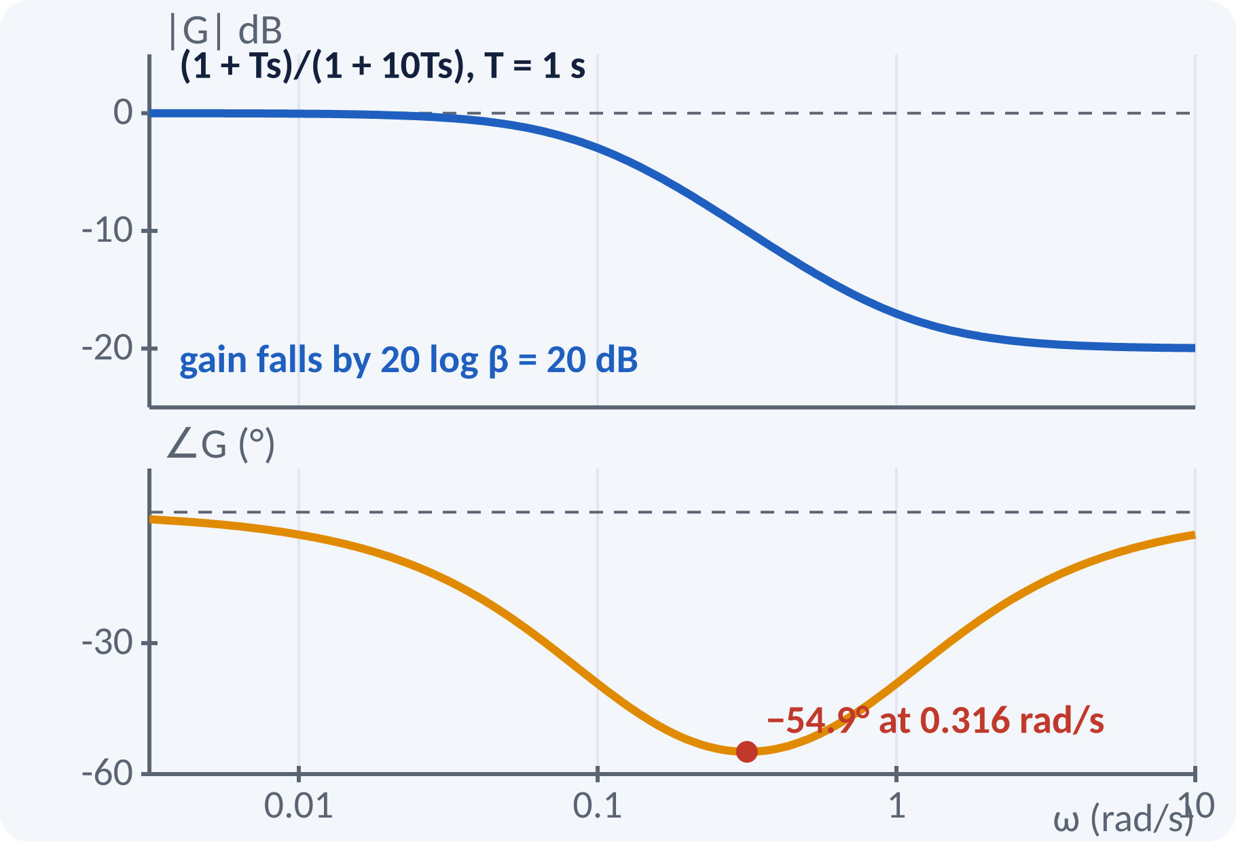
Lag Compensator
Pole closer to the origin than the zero.
Reduces gain at high frequency by 20 log β.
Adds phase lag; place it well below ωgc.
Allows a larger low-frequency gain.
Reduces bandwidth; slower response.
Gc(s) = (1 + Ts)/(1 + βTs), β > 1; max lag = sin⁻¹[(β − 1)/(β + 1)] at ω = 1/(T√β)
β lag ratio, T (s)
Notes:
The lag network has its pole nearer to the origin than its zero. It attenuates the high-frequency gain by twenty log beta decibels, so we can raise K to improve the steady-state error without moving the crossover frequency. The price is some phase lag, so we place the corner frequencies well below the gain crossover. Bandwidth falls, so the response becomes slower.

Slide 8
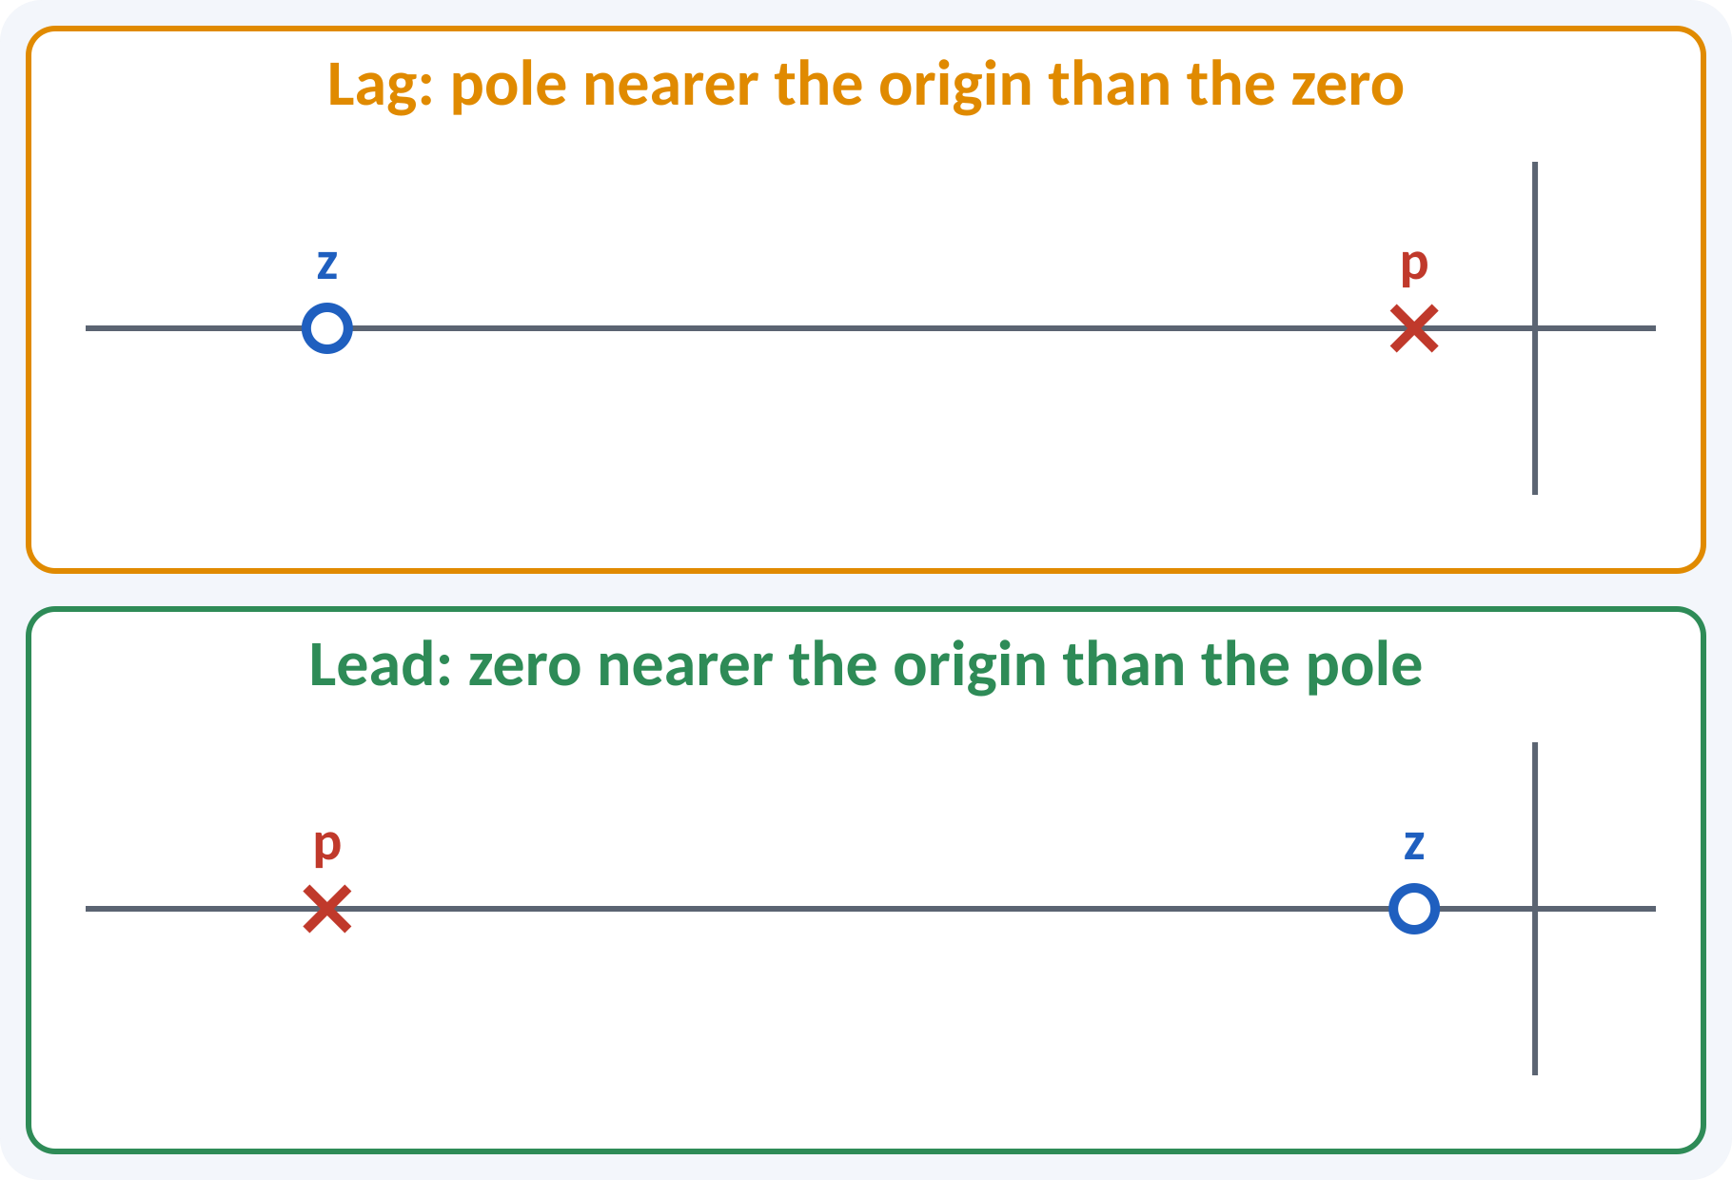
Pole–Zero Pattern: Lag vs Lead
Lead: zero at −1/(αT), pole at −1/T.
Lag: zero at −1/T, pole at −1/(βT).
Lag pole–zero pair sits close to the origin.
Lead pair sits near the dominant poles.
Lead: |z| < |p|; Lag: |z| > |p|
Notes:
On the s-plane the only difference between lead and lag is the order of the pole and zero. For the lead network the zero is closer to the origin. For the lag network the pole is closer to the origin and the pair is placed near the origin so as not to disturb the transient response. This view is used in root-locus design.

Slide 9
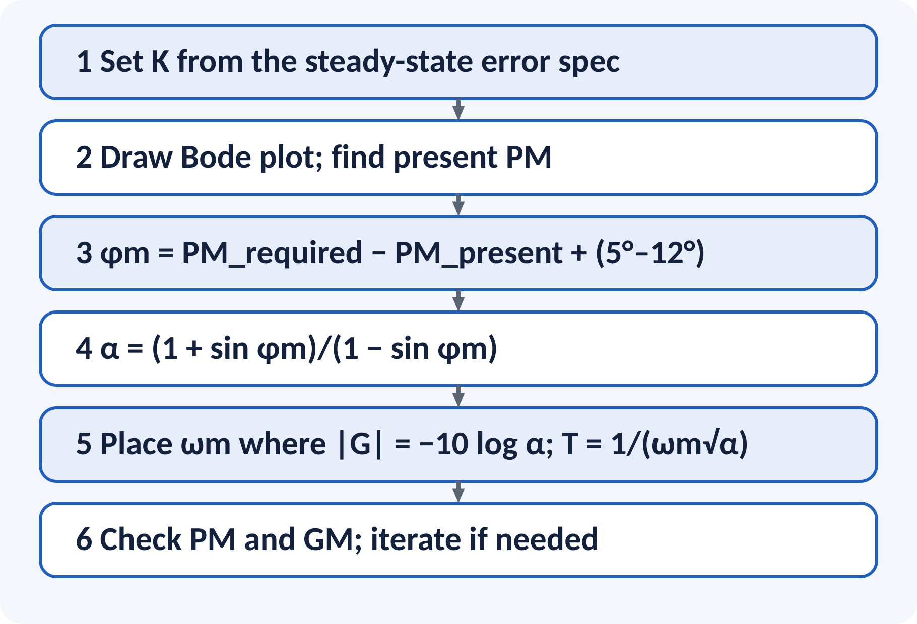
Lead Design Procedure (Bode)
Fix K for the steady-state specification.
Compute the phase lead needed.
Add 5°–12° to cover the gain shift.
Compute α and place ωm.
Verify margins and iterate.
α = (1 + sin φm)/(1 − sin φm); T = 1/(ωm√α); gain at ωm = +10 log α dB
Notes:
Follow the steps in order. The needed lead is the difference between the required and the present phase margin plus a safety margin. Alpha follows from the maximum phase formula. Place the maximum lead at the new gain crossover, which is where the plant gain is minus 10 log alpha decibels. Always recheck because adding the lead shifts the crossover frequency.

Slide 10
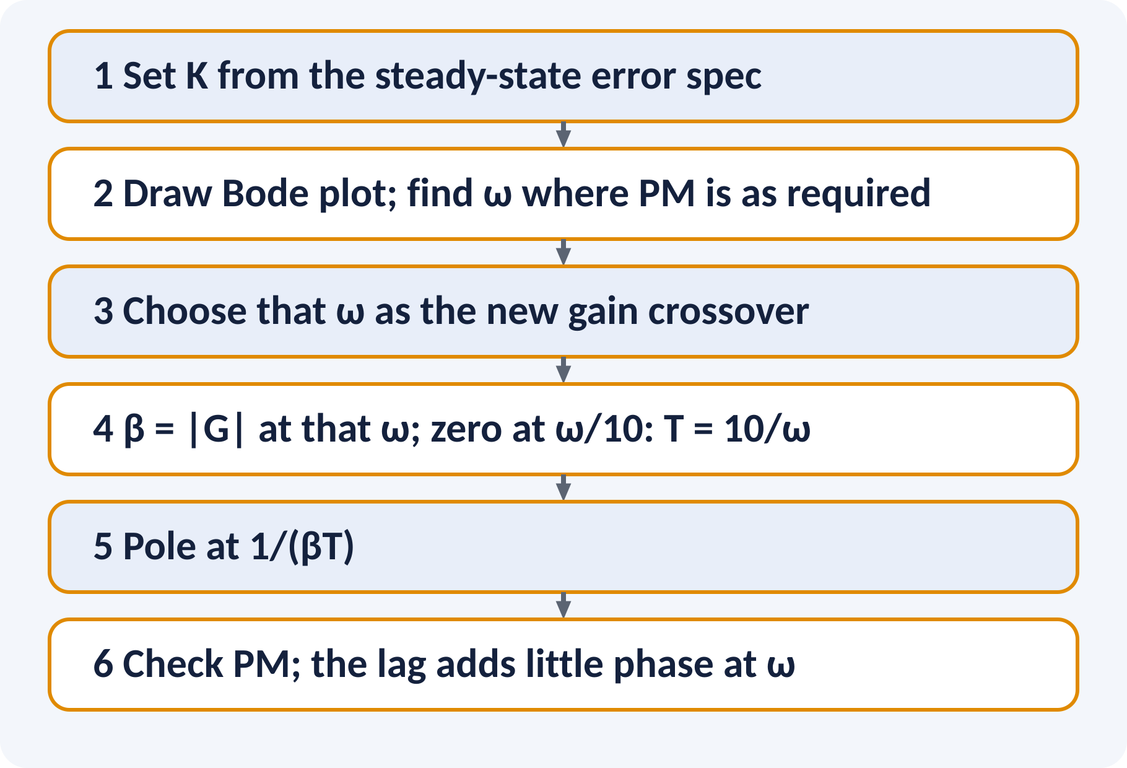
Lag Design Procedure (Bode)
Fix K for the steady-state specification.
Find where the plant phase gives the required PM.
Make that frequency the new crossover.
β from the plant gain there; zero a decade below.
Check the final margins.
β = |G(jω′gc)|; 1/T = ω′gc/10; pole at 1/(βT)
Notes:
For lag design we look for the frequency where the plant already has the required phase margin plus a few degrees. The lag network must bring the magnitude to zero dB at that frequency, which fixes beta. The zero is placed about a decade below the new crossover so that the lag network adds only a few degrees of phase lag there. The pole follows from beta.

Slide 11
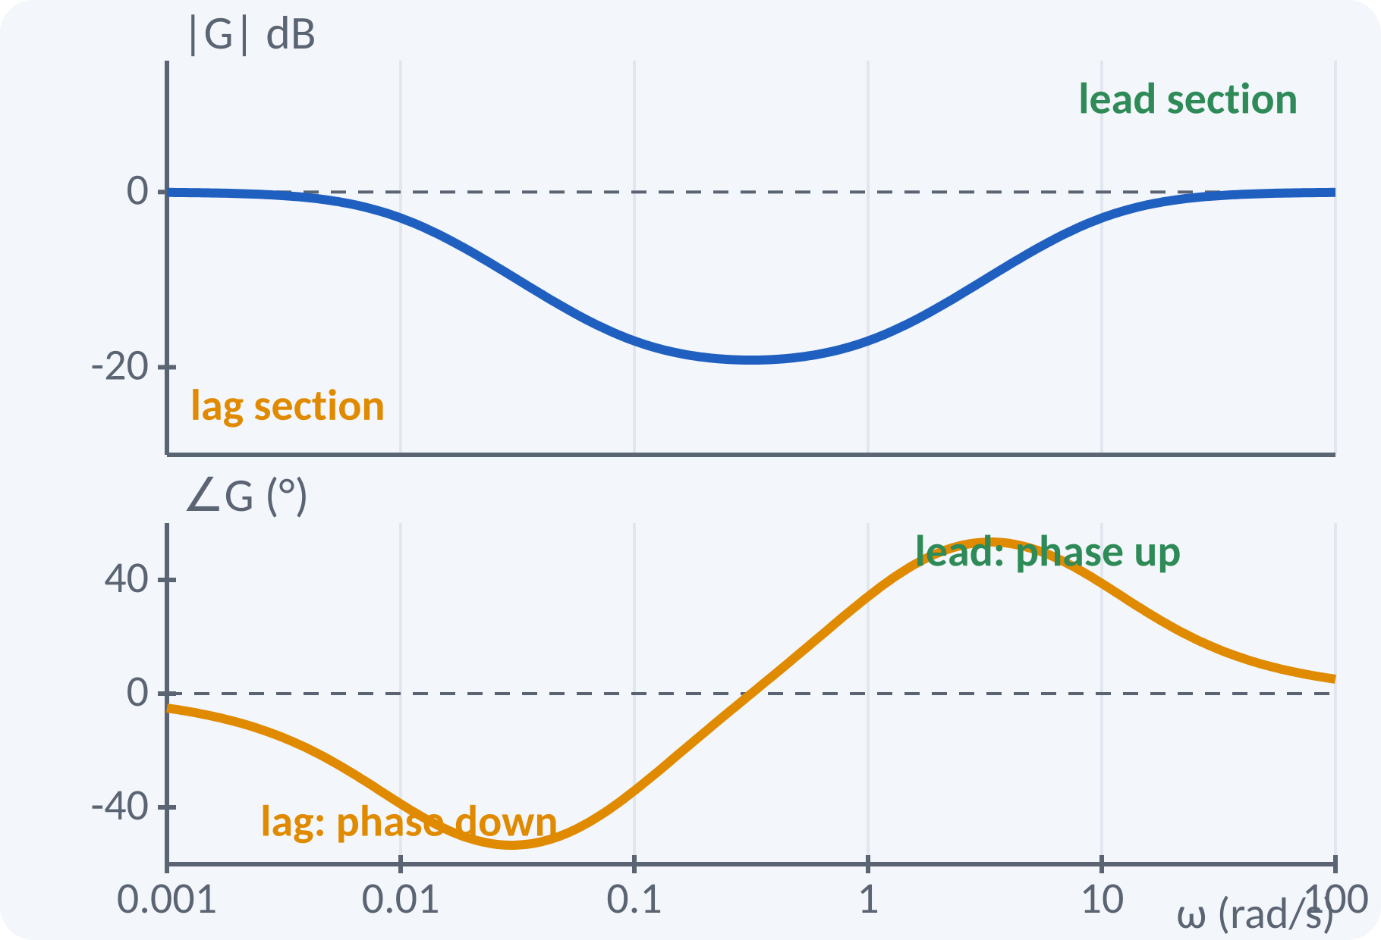
Lag–Lead Compensator
Combines a lag section and a lead section.
Lag improves steady-state accuracy.
Lead improves speed and damping.
Used when both are needed.
Lag corners lie below, lead corners above.
Gc(s) = [(1 + T1 s)/(1 + βT1 s)]·[(1 + T2 s)/(1 + T2 s/β)]
Notes:
When a system needs both better accuracy and better transient response, we use a lag-lead network. The lag section is placed at low frequencies and raises the low-frequency gain relative to the high-frequency gain. The lead section gives phase advance near the gain crossover. The design is done in two steps, one for each section.

Slide 12
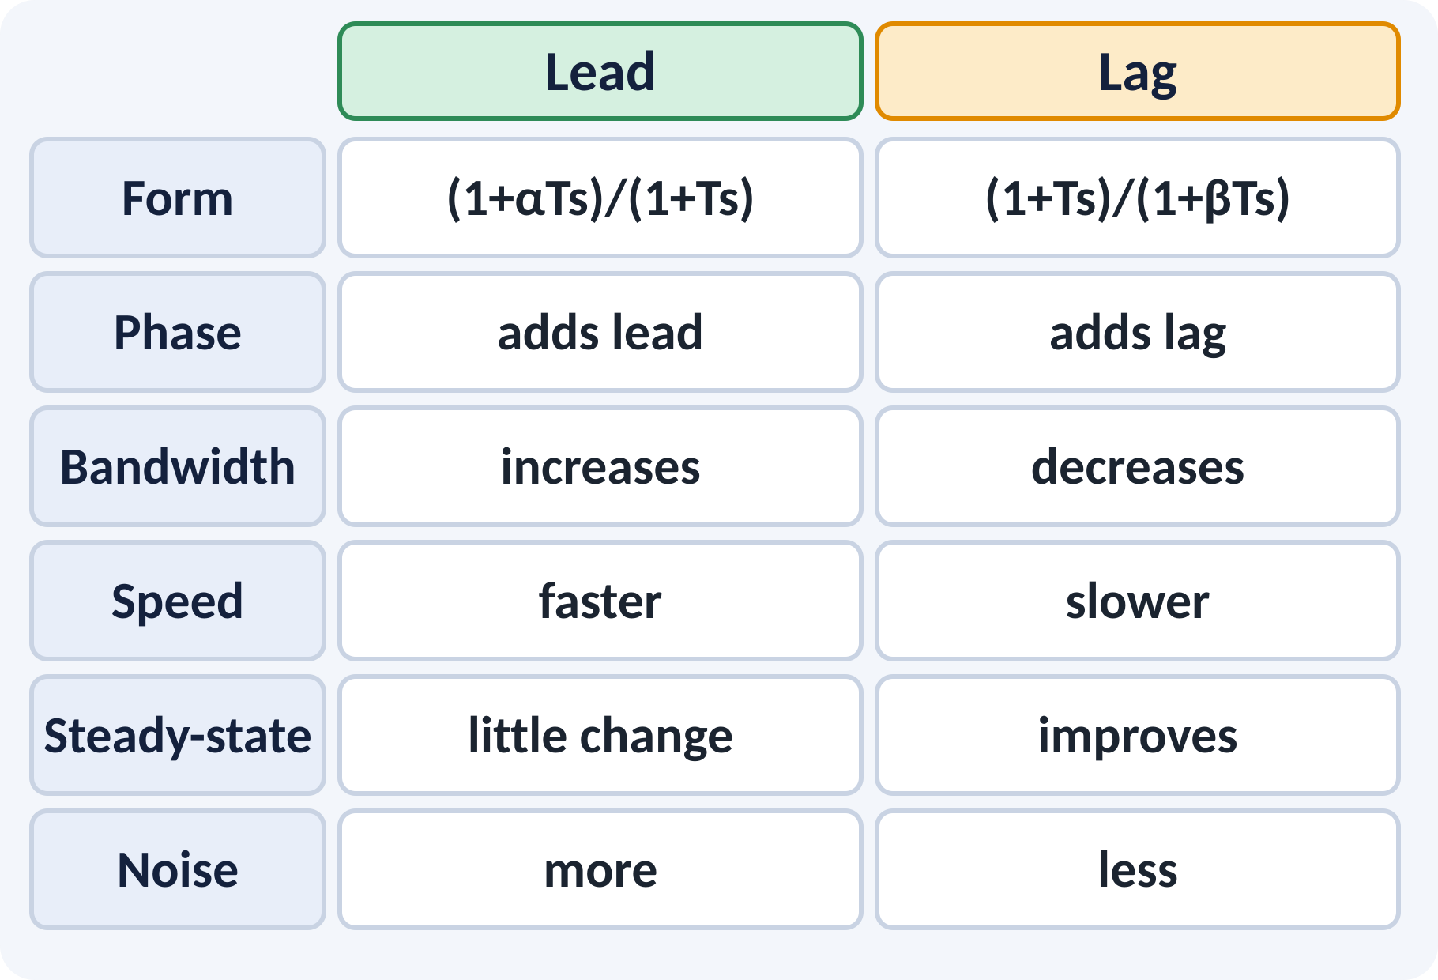
RC Realisations and Comparison
Lag network: R1 in series, R2–C to ground.
Lead network: R1∥C in series, R2 to ground.
Lead network loses gain 1/α; use an amplifier.
Lab: build and test both networks.
Lag: β = (R1 + R2)/R2, T = R2C; Lead: α = (R1 + R2)/R2, αT = R1C
Notes:
The table summarises when to use each network. Use lead when the response is too slow or too oscillatory, and use lag when the accuracy is not enough but the speed is fine. The passive RC lag network is built from two resistors and one capacitor, and so is the lead network. The lead network attenuates the DC gain by one over alpha, which must be compensated by an amplifier.

Slide 13
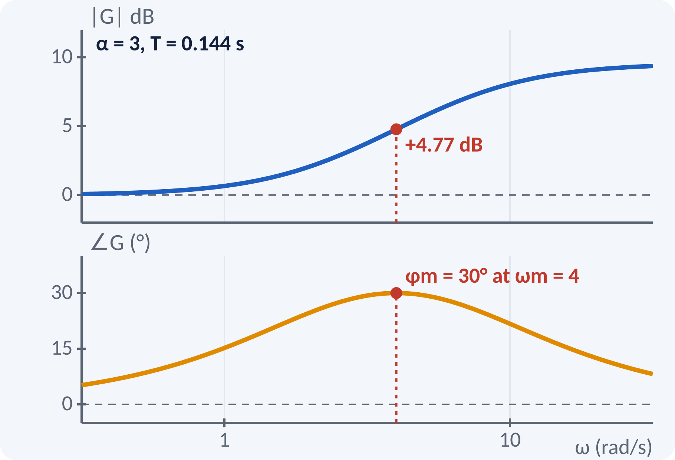
Solved Example 1: Lead Network
A loop has PM = 20°. Required PM = 45°; use 5° margin. Find α and T for ωm = 4 rad/s.
1. φm = 45° − 20° + 5° = 30°.
2. α = (1 + sin 30°)/(1 − sin 30°) = 1.5/0.5 = 3.
3. T = 1/(ωm√α) = 1/(4 × 1.732) = 0.144 s.
4. Zero at 1/(αT) = 2.31, pole at 1/T = 6.93 rad/s.
5. Gain at ωm = 10 log 3 = 4.77 dB.
Answer: Gc(s) = (1 + 0.433s)/(1 + 0.144s); zero 2.31, pole 6.93 rad/s
Notes:
Compute the phase lead required including a safety margin of five degrees. Alpha follows from the maximum-phase formula and equals three. The geometric mean of the corner frequencies must be four rad/s, which gives the time constant. Check that the zero and pole frequencies multiply to sixteen, the square of ωm. Verify the design by recalculating the margins.

Slide 14
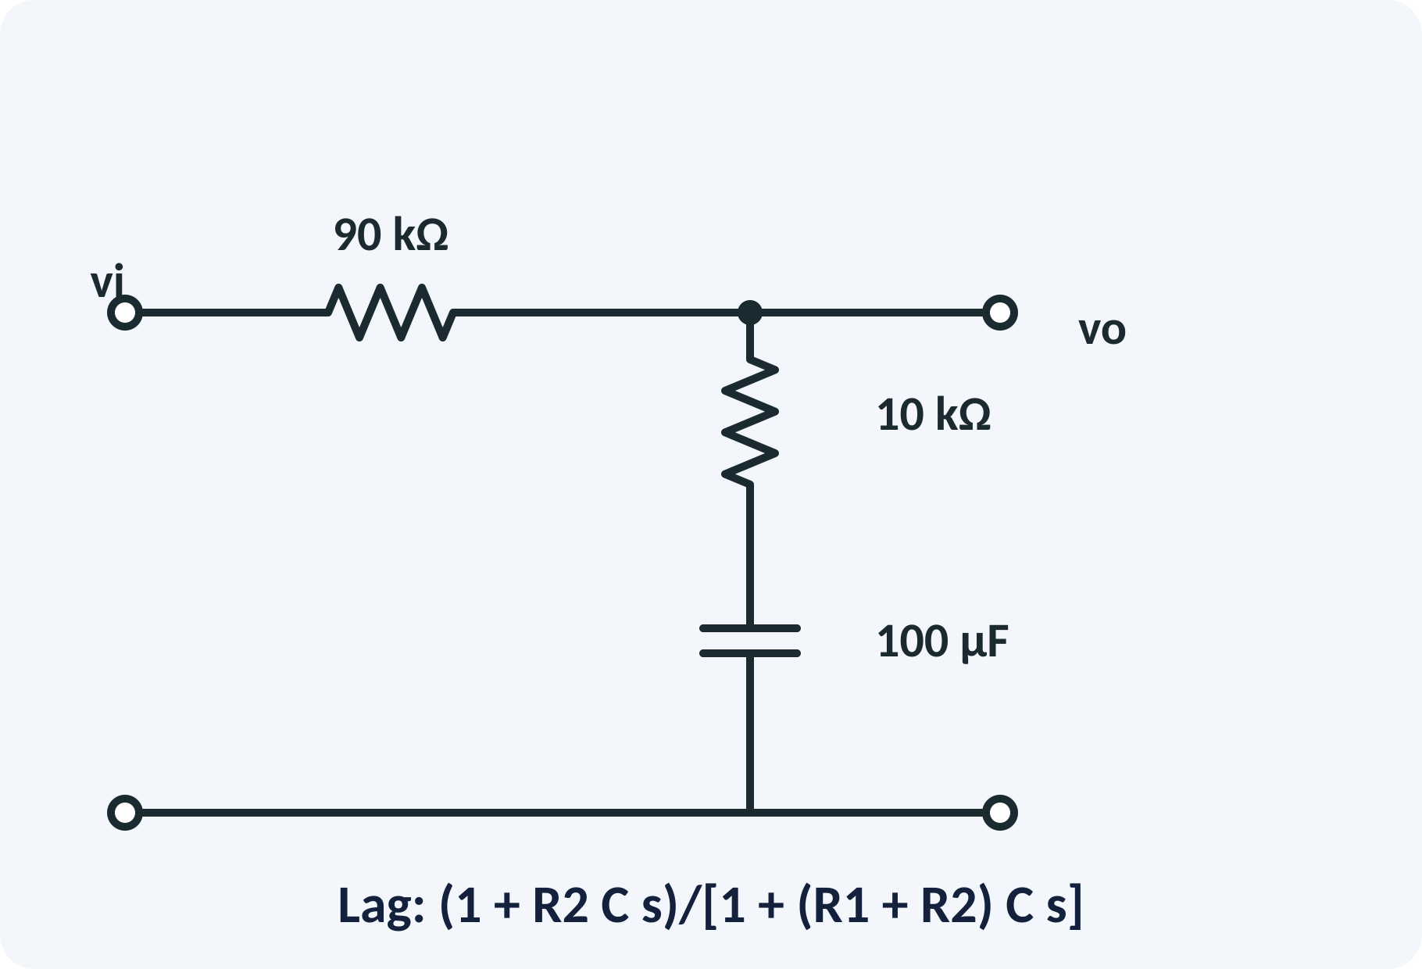
Solved Example 2: RC Lag Network
Design an RC lag with β = 10 and T = 1 s. Find R1, R2, C and the corner frequencies.
1. T = R2C = 1 s: choose R2 = 10 kΩ, C = 100 µF.
2. β = (R1 + R2)/R2 = 10 → R1 = 9R2 = 90 kΩ.
3. Zero at 1/T = 1 rad/s; pole at 1/(βT) = 0.1 rad/s.
4. High-frequency attenuation = 20 log 10 = 20 dB.
5. Maximum lag: sin⁻¹(9/11) = 54.9° at 1/(T√β) = 0.316 rad/s.
Answer: R1 = 90 kΩ, R2 = 10 kΩ, C = 100 µF; Gc(s) = (1 + s)/(1 + 10s)
Notes:
Choose convenient values for R2 and C to give the time constant of one second. Then beta fixes R1. The zero and pole frequencies follow directly, and the maximum lag occurs at the geometric mean of the corner frequencies. This is exactly what you will build in the laboratory for experiment nine and verify with MATLAB.

Slide 15
Common Mistakes and Exam Tips
✕
Common mistakes
✓
Exam tips
Using lag when more phase lead is needed.
Placing the lag corner close to ωgc.
Forgetting the 1/α loss in a passive lead network.
No safety margin in φm.
Not rechecking margins after the shift in crossover.
State the problem first: speed or accuracy?
Lead for speed/damping, lag for accuracy.
Add 5°–12° to φm for the lead.
Verify with the Bode plot or MATLAB.
Notes:
These are the points where marks are lost most often in compensators. Give one quick example for each mistake. Remind students that writing the formula, substitution and the unit earns method marks even if the arithmetic slips. Encourage them to check the answer for reasonableness.

Slide 16
Summary
Compensator = pole–zero pair in series with the plant.
Lead: adds phase, raises bandwidth, speeds up.
Lag: cuts high-frequency gain, improves accuracy.
Lag–lead gives both effects.
α = (1 + sin φm)/(1 − sin φm); ωm = 1/(T√α).
Lead: zero before pole; Lag: pole before zero
Notes:
Recap in one minute. Say each point and ask the class to recall the formula for it. If they remember these ideas, most numerical problems on compensators are within reach. Next lecture: P, PI and PID controllers. Revise the two solved examples tonight.

Slide 17
Quick Quiz
Q1. A lead compensator mainly improves:
(a) steady-state error (b) phase margin and speed (c) noise (d) gain margin only
Ans: (b)
Q2. Maximum lead for α = 3 is:
(a) 19.5° (b) 30° (c) 45° (d) 60°
Ans: (b)
Q3. A lag network reduces high-frequency gain by:
(a) 20 log α (b) 20 log β (c) 10 log β (d) zero
Ans: (b)
Q4. In a lag network the pole is:
(a) nearer to origin than zero (b) farther (c) at origin (d) at infinity
Ans: (a)
Q5. For lead with α = 10, ωm occurs at:
(a) 1/T (b) 1/(T√α) (c) α/T (d) 1/(αT)
Ans: (b)
Notes:
Give about one minute per question and take a show of hands. Discuss why the wrong options are tempting, especially the one that uses a wrong formula. Use the quiz as a quick check on compensators before leaving.

Slide 18
References
1
Benjamin C. Kuo, Automatic Control Systems
7th Ed., PHI, 2007 (Units 3, 4, 5 textbook)
2
J. J. D'Azzo and C. H. Houpis, Feedback Control System Analysis and Synthesis
4th Ed., McGraw Hill International, 1999 (reference, Unit 5)
3
M. Gopal, Control Systems Principles and Design
4th Ed., TMH, 1999 (reference, Units 4, 5)
Next lecture: P, PI and PID controllers
Notes:
Point students to the textbooks listed in the syllabus for compensators. Ask them to solve at least three textbook problems on this topic before the next class. Thank the class and preview the next lecture.

