Slide 1
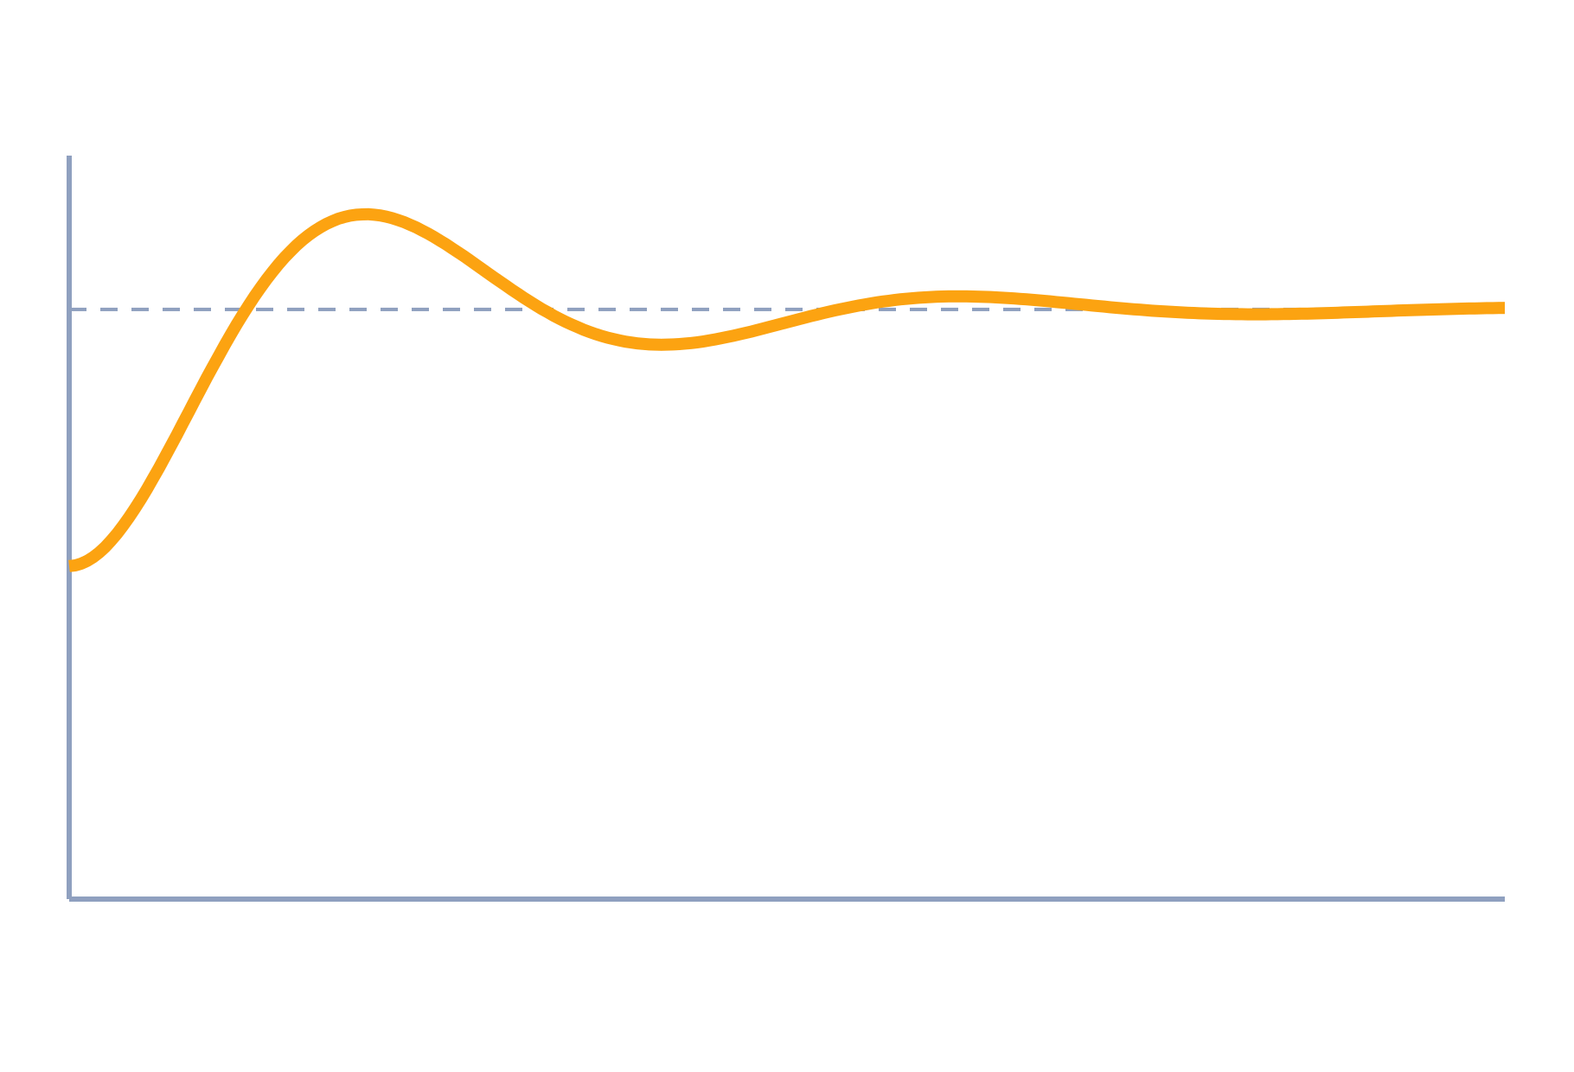
P, PI and PID Controllers
Control Systems (22EEG53)
Unit 5: Compensators and Controllers
Topic: Proportional, integral and derivative control
Prof. Mitesh Astik
Notes:
Welcome everyone. Today's topic is Proportional, integral and derivative control. It belongs to Unit 5: Compensators and Controllers. By the end of this session you will be able to use it in numerical problems. Keep your notebooks ready because we will solve two examples.

Slide 2

Learning Outcomes
Write P, PI, PD and PID control laws.
Explain what each term does to the response.
Tune a PID controller by Ziegler–Nichols.
Compute Kp, Ki and Kd for a given plant test.
Linked to CO5
Design the appropriate compensator and controller for given specifications.
Notes:
Read the outcomes aloud. They map to CO5 of the syllabus. Tell students that these are examinable and that the two solved examples follow the same pattern. Ask them to tick off each outcome at the end of the lecture.

Slide 3
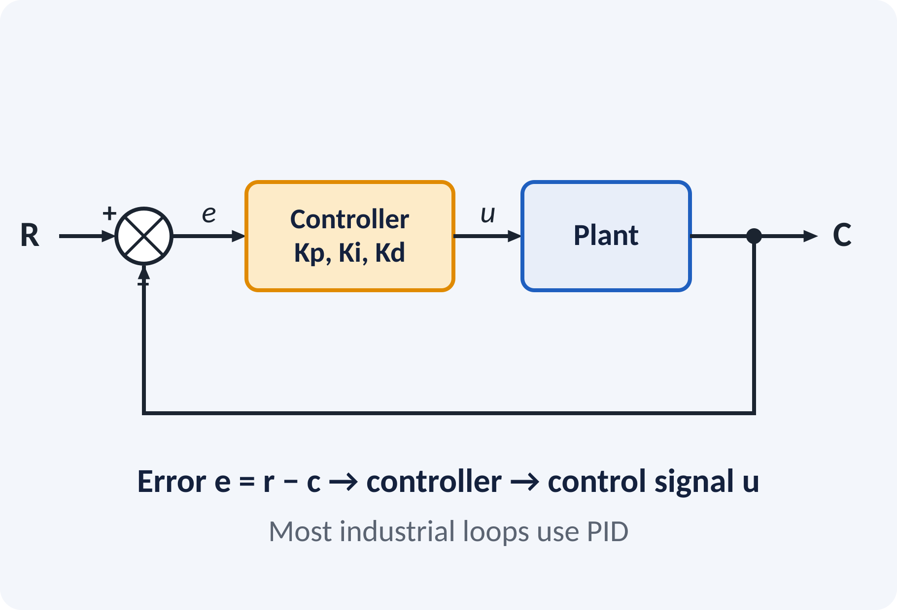
Recap: What You Already Know
Error e = r − c drives the controller.
Steady-state error depends on system type.
Integrator adds a pole at the origin.
Derivative responds to rate of change.
Laplace: ∫e dt → E/s; de/dt → sE; Type N = number of integrators
Notes:
The controller acts on the error signal and produces the control input to the plant. From Unit 2 we know that an integrator in the loop raises the type of the system and removes the steady-state error. A derivative responds to how fast the error is changing, so it can anticipate where the output is heading.

Slide 4
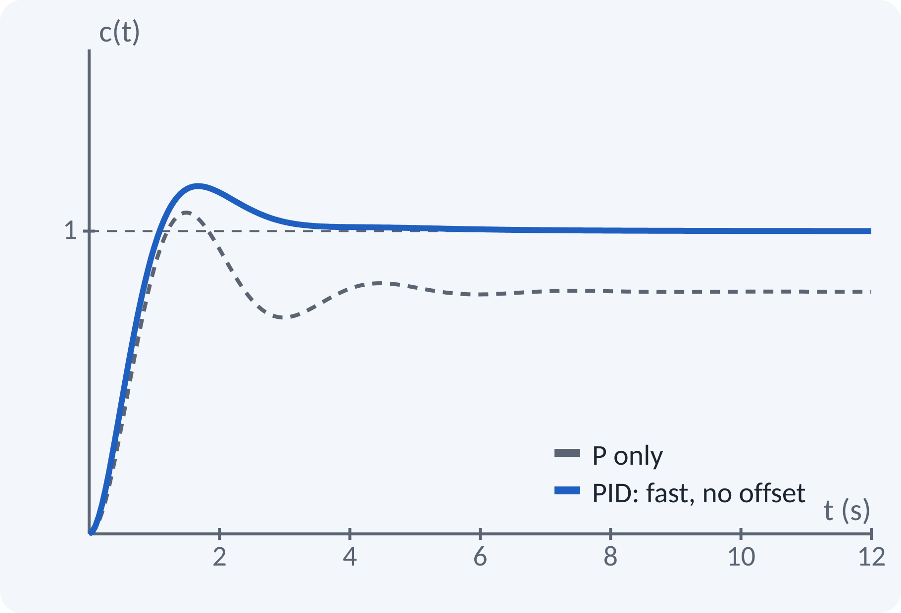
Motivation: The Workhorse of Industry
Over 90 % of industrial loops use PID.
Temperature, speed, level, pressure control.
Three tuning knobs: Kp, Ki, Kd.
Lab: PID design and DC position control.
PID gives fast response and zero steady-state error with little overshoot
Notes:
From the cruise control in a car to the temperature of a furnace, most control loops in industry are PID. It is popular because it is simple, robust and has only three parameters. Look at the picture: the dashed curve is proportional control and leaves a permanent error, while the PID curve reaches the set value quickly.

Slide 5
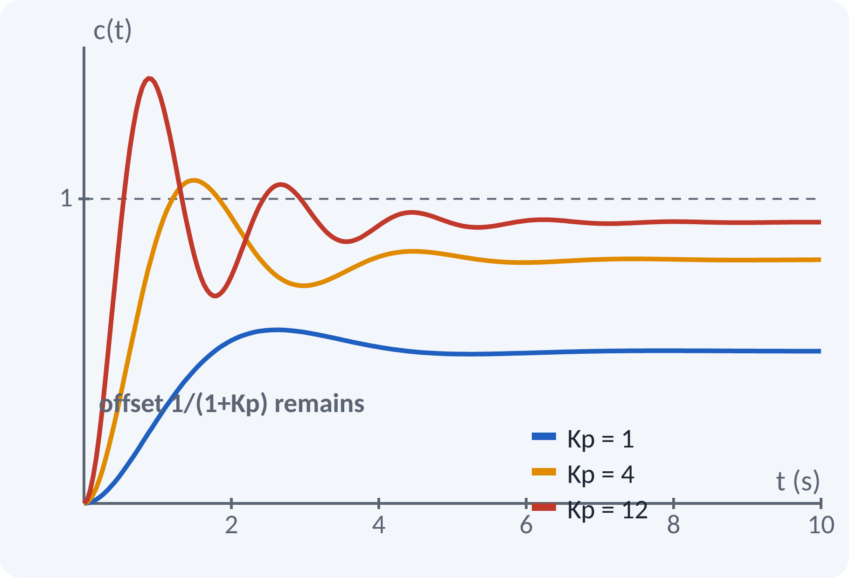
Proportional (P) Controller
Output proportional to the error.
Raising Kp speeds up the response.
Too large Kp gives overshoot and oscillation.
A steady-state offset remains for Type 0 plants.
u(t) = Kp·e(t); Gc(s) = Kp
ess(step) = 1/(1 + Kp·G(0)) for a Type 0 plant
Notes:
The proportional controller multiplies the error by a constant. A larger gain reduces the offset and speeds up the response, but never removes the offset for a Type 0 plant. If the gain is too large the response oscillates and may become unstable. That is why we need the integral and derivative terms.

Slide 6
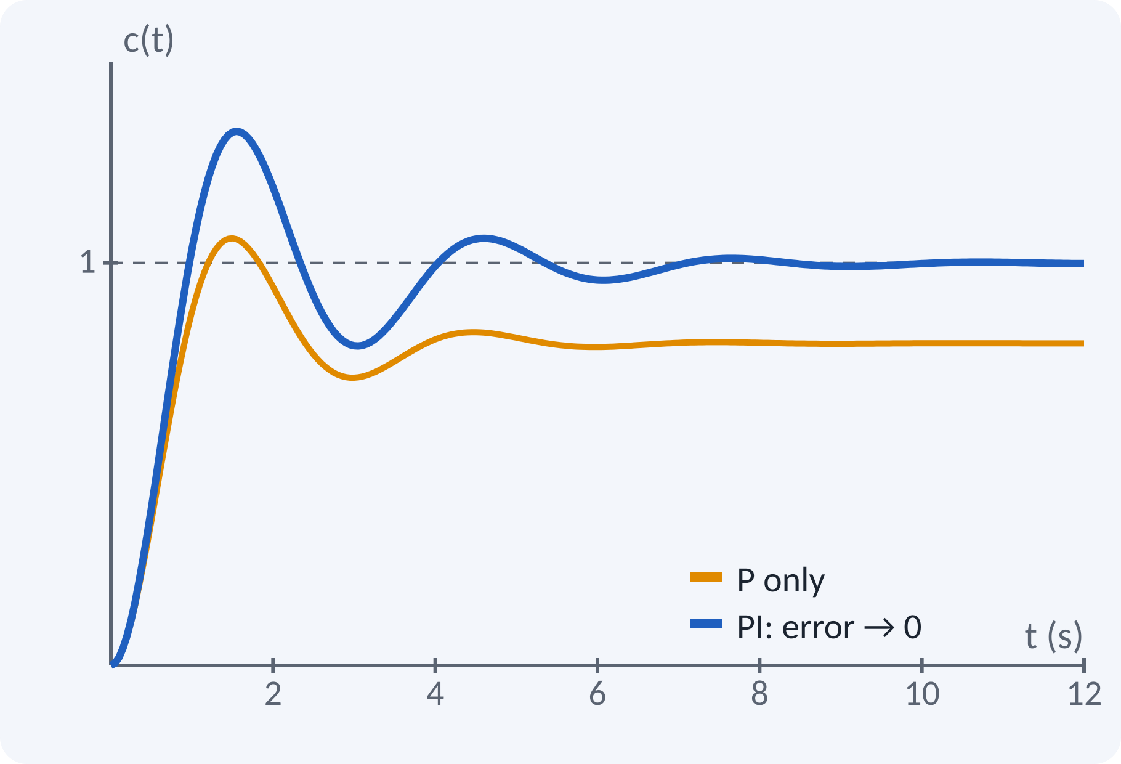
Proportional–Integral (PI) Controller
Integral term accumulates the error.
Output keeps changing until the error is zero.
Eliminates the steady-state error.
Adds lag: may increase overshoot and slow down.
Pole at origin raises system type by one.
u = Kp·e + Ki∫e dt; Gc(s) = Kp + Ki/s = Kp(1 + 1/(Ti s)), Ti = Kp/Ki
Notes:
The integral action sums the error over time. As long as any error remains, the control signal continues to change. So the final error must be zero for a step input. The cost is extra phase lag that reduces damping. In practice PI is the standard choice for slow processes such as temperature or level.

Slide 7
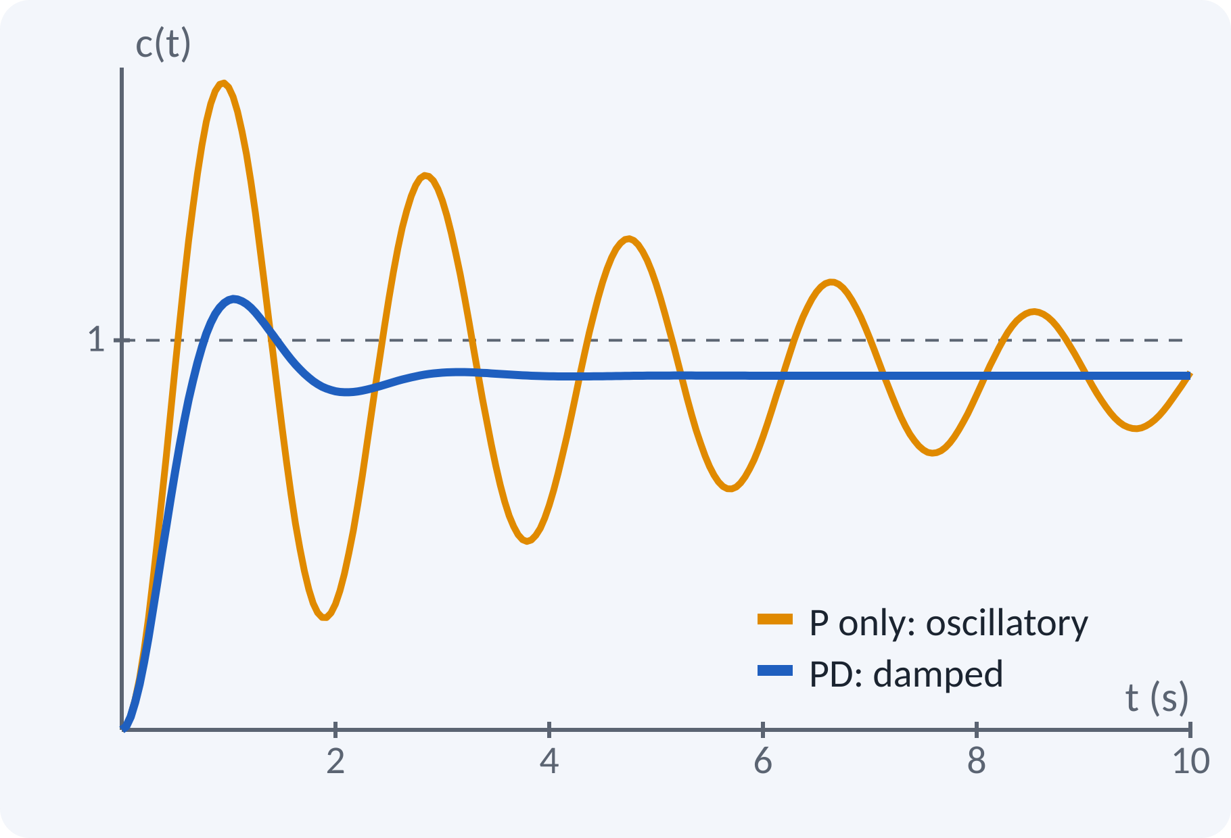
Proportional–Derivative (PD) Controller
Derivative term reacts to the rate of change of error.
Adds damping: reduces overshoot.
Acts like a lead compensator.
Amplifies high-frequency noise.
No effect on steady-state error.
u = Kp·e + Kd·de/dt; Gc(s) = Kp + Kd·s = Kp(1 + Td s), Td = Kd/Kp
Notes:
The derivative term is a prediction: if the error is falling fast, the controller reduces the drive early so as to avoid overshoot. It behaves like a lead network by adding phase lead. But differentiation amplifies noise, so in real controllers the derivative is filtered. It does nothing for a constant error, so it never fixes the steady-state offset.

Slide 8
PID Controller
Combines proportional, integral and derivative actions.
P gives speed; I removes offset; D adds damping.
Standard form uses Ti and Td.
Equivalent to a lag–lead compensator.
u = Kp[e + (1/Ti)∫e dt + Td·de/dt]; Gc(s) = Kp + Ki/s + Kd·s
Ki = Kp/Ti, Kd = Kp·Td
Notes:
The PID controller combines the three actions. The integral action takes care of the steady-state error, the derivative action improves damping and the proportional action provides the main drive. In the standard form the integral and derivative parameters are written as time constants Ti and Td. In the s-domain it is a lag-lead compensator with a pole at the origin.

Slide 9
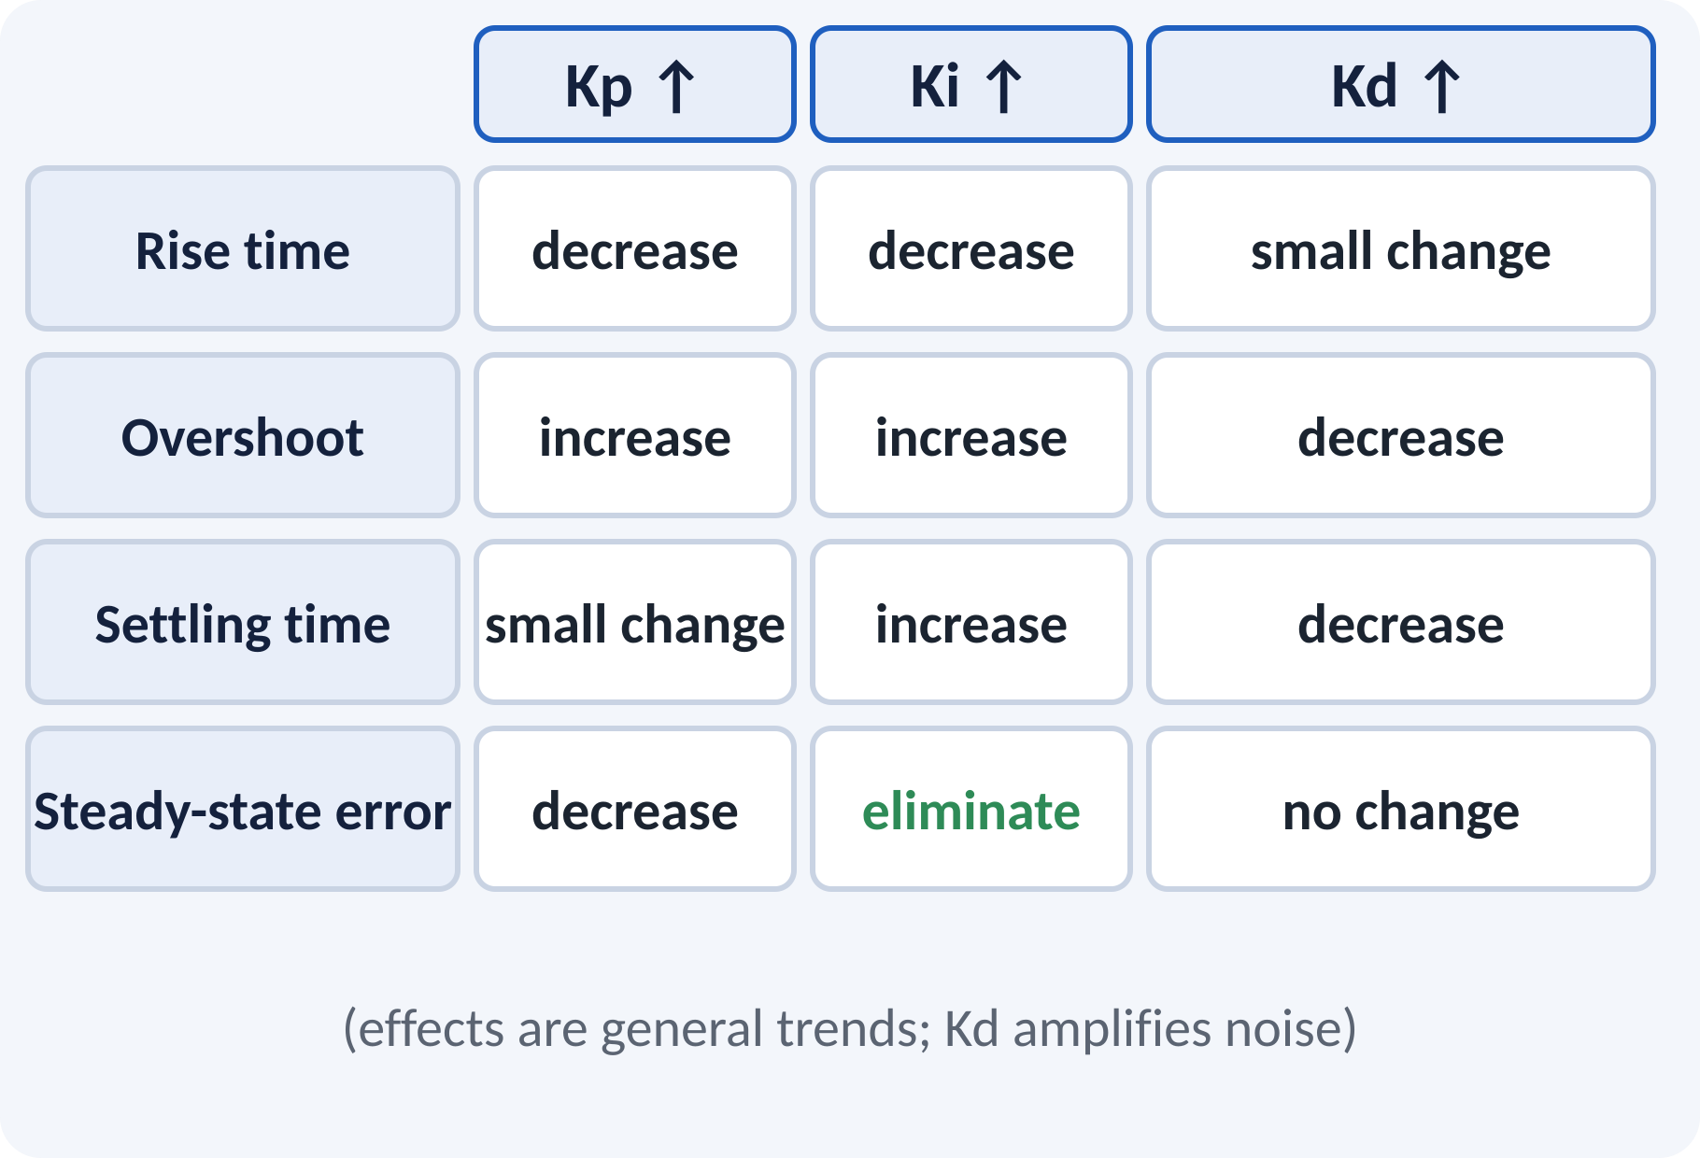
Effect of Each Gain
Each term changes the response differently.
Tune one gain at a time, small steps.
Large Ki causes oscillation.
Large Kd amplifies noise.
Kp ↓ error, ↑ speed; Ki → zero error; Kd ↑ damping
Notes:
This table is a quick guide when tuning by hand. Increasing Kp makes the system faster but less damped. Increasing Ki removes the steady-state error but can cause oscillation. Increasing Kd gives more damping but also amplifies noise. These are trends, not exact rules, so always confirm by simulation or experiment.

Slide 10
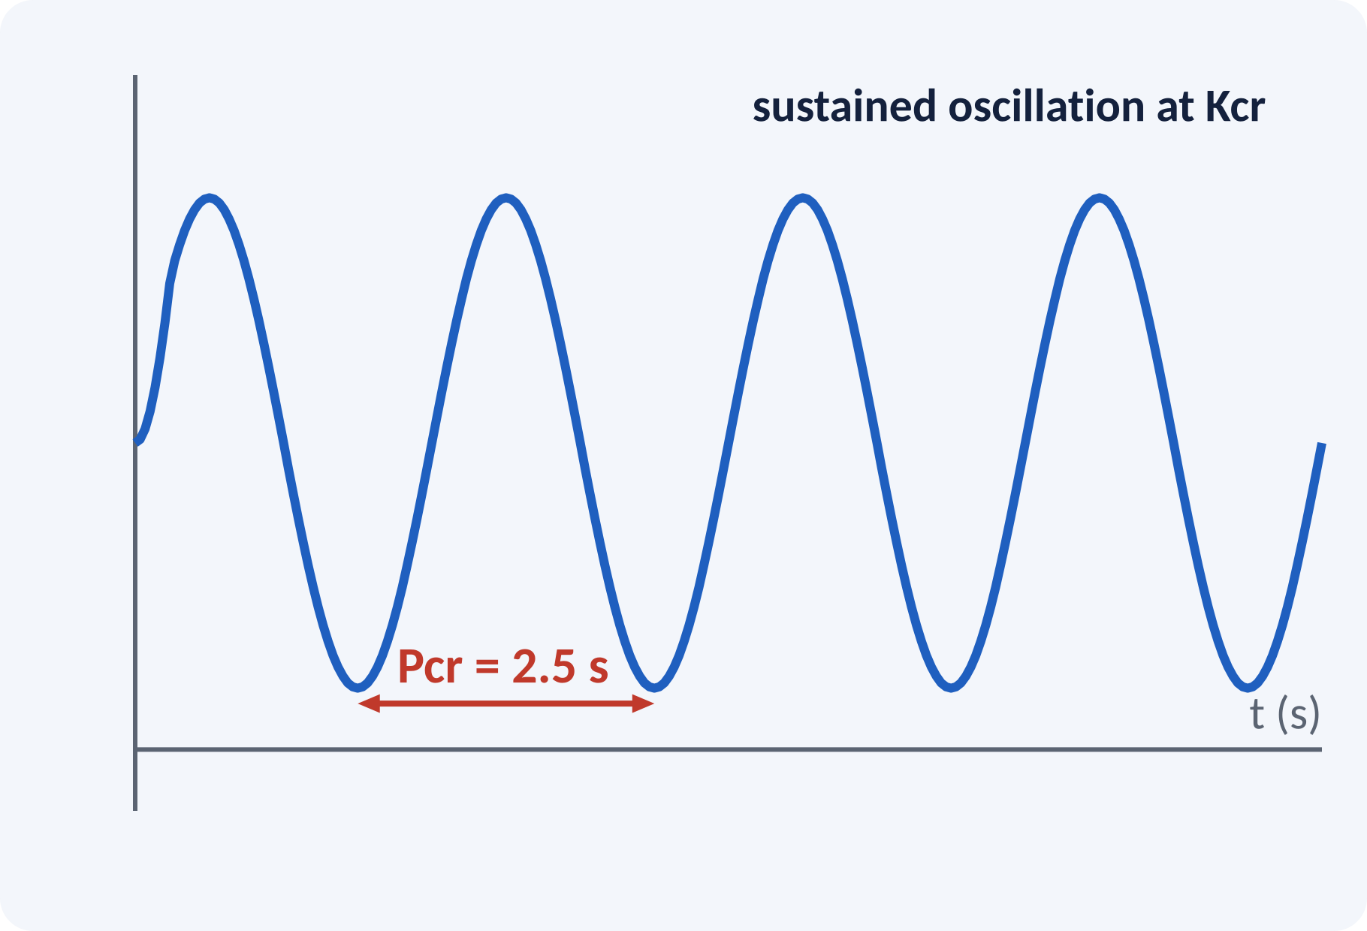
Ziegler–Nichols Tuning
Set Ki = Kd = 0; raise Kp until steady oscillation.
Record the critical gain Kcr and period Pcr.
Use the table to set Kp, Ti and Td.
Gives a quick, reasonable first tuning.
Fine-tune afterwards.
P: Kp = 0.5Kcr; PI: Kp = 0.45Kcr, Ti = Pcr/1.2
PID: Kp = 0.6Kcr, Ti = 0.5Pcr, Td = 0.125Pcr
Notes:
The ultimate-gain method of Ziegler and Nichols needs only one experiment. Use proportional control and increase the gain until the output oscillates steadily. The gain at that point is the critical gain and the period of oscillation is the critical period. Simple formulas then give the PID settings. The result is a good starting point, often with about twenty-five per cent overshoot.

Slide 11
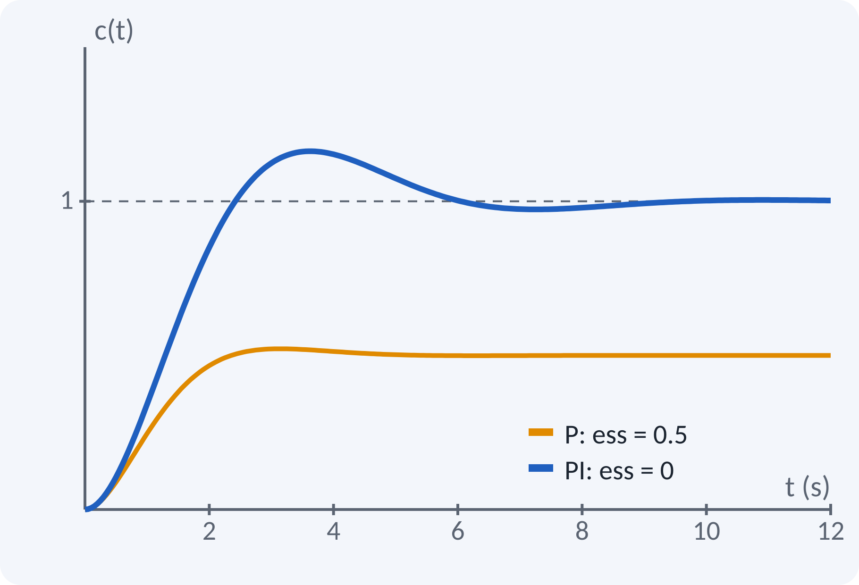
Solved Example 1: P vs PI
Plant G(s) = 1/(s² + 2s + 1), unity feedback. Compare steady-state error for a unit step with P (Kp = 1) and PI (Kp = 1, Ki = 1).
1. P: ess = 1/(1 + Kp·G(0)) = 1/(1 + 1) = 0.5.
2. PI: Gc·G has a pole at the origin → Type 1.
3. Kp(PI) = ∞ so ess = 0.
4. Check stability: s³ + 2s² + 2s + 1 = 0 → Routh: 2·2 > 1 → stable.
Answer: P gives ess = 0.5; PI gives ess = 0 (stable)
Notes:
For the proportional controller the loop gain at zero frequency is one, so the error is one over one plus one, equal to 0.5. With PI the open loop contains the integrator, so the system is type one and the step error is zero. Always check stability after adding the integrator: the Routh test on the characteristic polynomial confirms stability. The plot confirms both results.

Slide 12
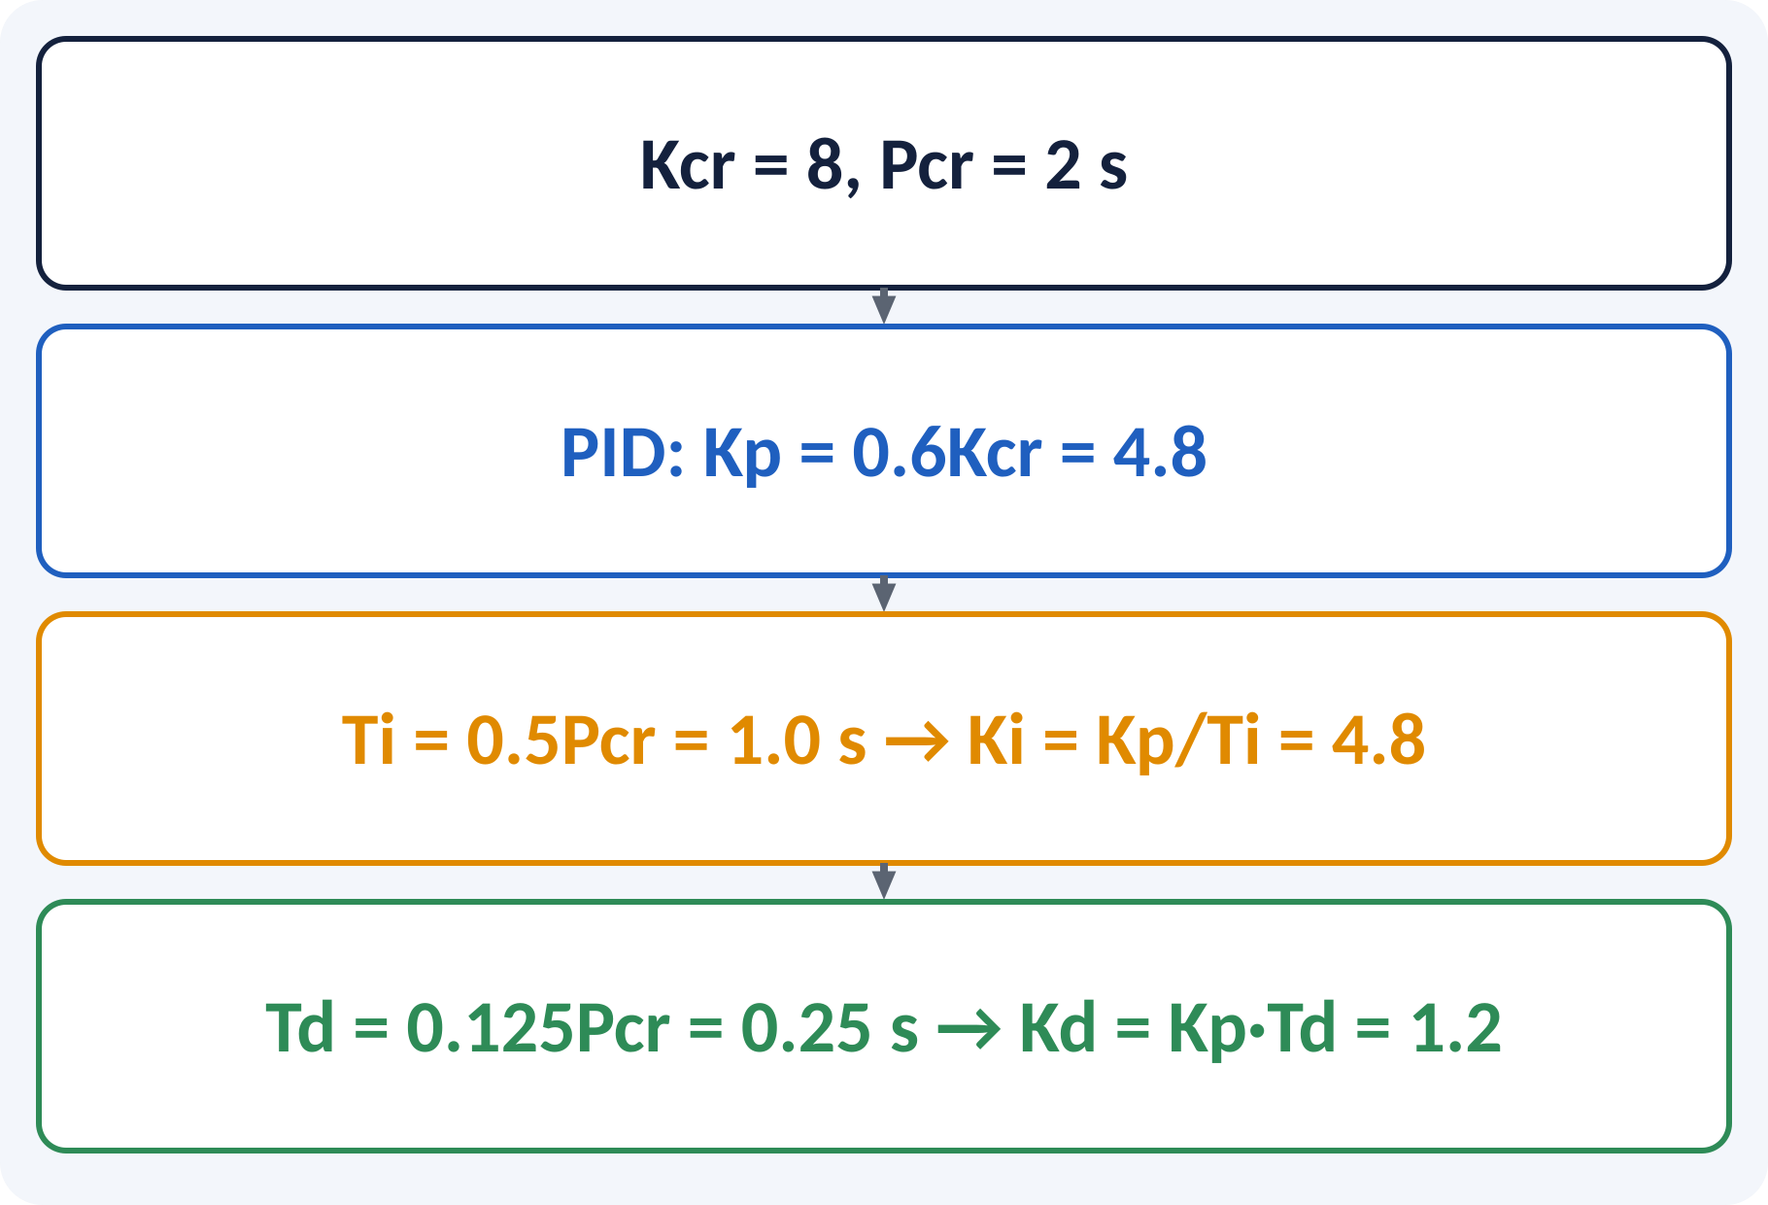
Solved Example 2: Ziegler–Nichols PID
A P-only test gives sustained oscillation at Kcr = 8 with period Pcr = 2 s. Tune a PID.
1. Kp = 0.6Kcr = 4.8.
2. Ti = 0.5Pcr = 1.0 s → Ki = Kp/Ti = 4.8 s⁻¹.
3. Td = 0.125Pcr = 0.25 s → Kd = Kp·Td = 1.2 s.
4. Gc(s) = 4.8 + 4.8/s + 1.2s = 1.2(s² + 4s + 4)/s = 1.2(s + 2)²/s.
Answer: Kp = 4.8, Ki = 4.8, Kd = 1.2; Gc(s) = 1.2(s + 2)²/s
Notes:
Apply the Ziegler Nichols formulas directly to the measured critical gain and period. Kp is 0.6 times Kcr. The integral time is half the period and the derivative time is one eighth of the period. Convert to Ki and Kd by the standard relations. The resulting controller has a double zero at minus two and a pole at the origin, a neat form.

Slide 13
Common Mistakes and Exam Tips
✕
Common mistakes
✓
Exam tips
Using the derivative term on a noisy signal without a filter.
Expecting P control to remove steady-state error.
Increasing Ki too much (oscillation).
Mixing Ti with Ki (Ki = Kp/Ti).
Applying Ziegler–Nichols to an unstable plant.
Start with P, then add I, then D.
Tune in small steps, one gain at a time.
Remember: I removes offset, D adds damping.
Check stability after every change.
Notes:
These are the points where marks are lost most often in PID control. Give one quick example for each mistake. Remind students that writing the formula, substitution and the unit earns method marks even if the arithmetic slips. Encourage them to check the answer for reasonableness.

Slide 14
Summary
P: u = Kp·e — fast, leaves an offset.
PI: removes steady-state error, adds lag.
PD: adds damping, noisy.
PID: Gc = Kp + Ki/s + Kd·s combines all.
Z–N: Kp = 0.6Kcr, Ti = 0.5Pcr, Td = 0.125Pcr.
Gc(s) = Kp + Ki/s + Kd s = Kp(1 + 1/(Ti s) + Td s)
Notes:
Recap in one minute. Say each point and ask the class to recall the formula for it. If they remember these ideas, most numerical problems on PID control are within reach. Next lecture: state-variable analysis. Revise the two solved examples tonight.

Slide 15
Quick Quiz
Q1. Which action removes steady-state error to a step?
(a) P (b) D (c) I (d) none
Ans: (c)
Q2. Derivative control mainly improves:
(a) accuracy (b) damping (c) type (d) gain
Ans: (b)
Q3. Ki in terms of Kp and Ti:
(a) Kp·Ti (b) Kp/Ti (c) Ti/Kp (d) Kp + Ti
Ans: (b)
Q4. Z–N PID gain Kp equals:
(a) 0.5Kcr (b) 0.45Kcr (c) 0.6Kcr (d) Kcr
Ans: (c)
Q5. A PI controller makes a Type 0 system:
(a) Type 0 (b) Type 1 (c) Type 2 (d) unstable always
Ans: (b)
Notes:
Give about one minute per question and take a show of hands. Discuss why the wrong options are tempting, especially the one that uses a wrong formula. Use the quiz as a quick check on PID control before leaving.

Slide 16
References
1
Benjamin C. Kuo, Automatic Control Systems
7th Ed., PHI, 2007 (Units 3, 4, 5 textbook)
2
K. Ogata, Modern Control Engineering
5th Ed., Pearson Education Asia / PHI, 2009 (reference)
3
J. J. D'Azzo and C. H. Houpis, Feedback Control System Analysis and Synthesis
4th Ed., McGraw Hill International, 1999 (reference, Unit 5)
Next lecture: state-variable analysis of physical systems
Notes:
Point students to the textbooks listed in the syllabus for PID control. Ask them to solve at least three textbook problems on this topic before the next class. Thank the class and preview the next lecture.

