Slide 1
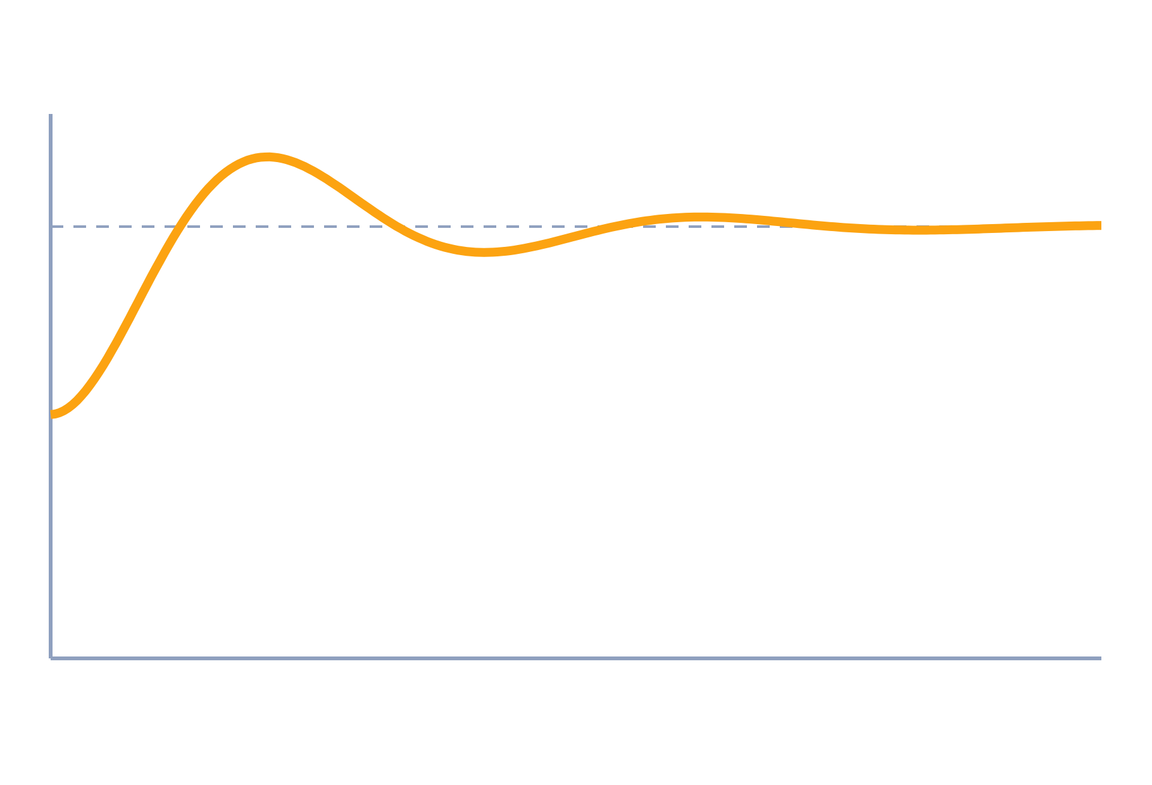
State-Variable Analysis
Control Systems (22EEG53)
Unit 5: Compensators and Controllers
Topic: Introduction to state-variable analysis; state-space model of physical systems (SISO)
Prof. Mitesh Astik
Notes:
Welcome everyone. Today's topic is Introduction to state-variable analysis; state-space model of physical systems (SISO). It belongs to Unit 5: Compensators and Controllers. By the end of this session you will be able to use it in numerical problems. Keep your notebooks ready because we will solve two examples.

Slide 2

Learning Outcomes
Define state, state variable and state space.
Write ẋ = Ax + Bu, y = Cx + Du.
Model RLC and mass–spring–damper systems in state space.
State the advantages over the transfer function.
Linked to CO5
Analyse the system using state-space techniques.
Notes:
Read the outcomes aloud. They map to CO5 of the syllabus. Tell students that these are examinable and that the two solved examples follow the same pattern. Ask them to tick off each outcome at the end of the lecture.

Slide 3
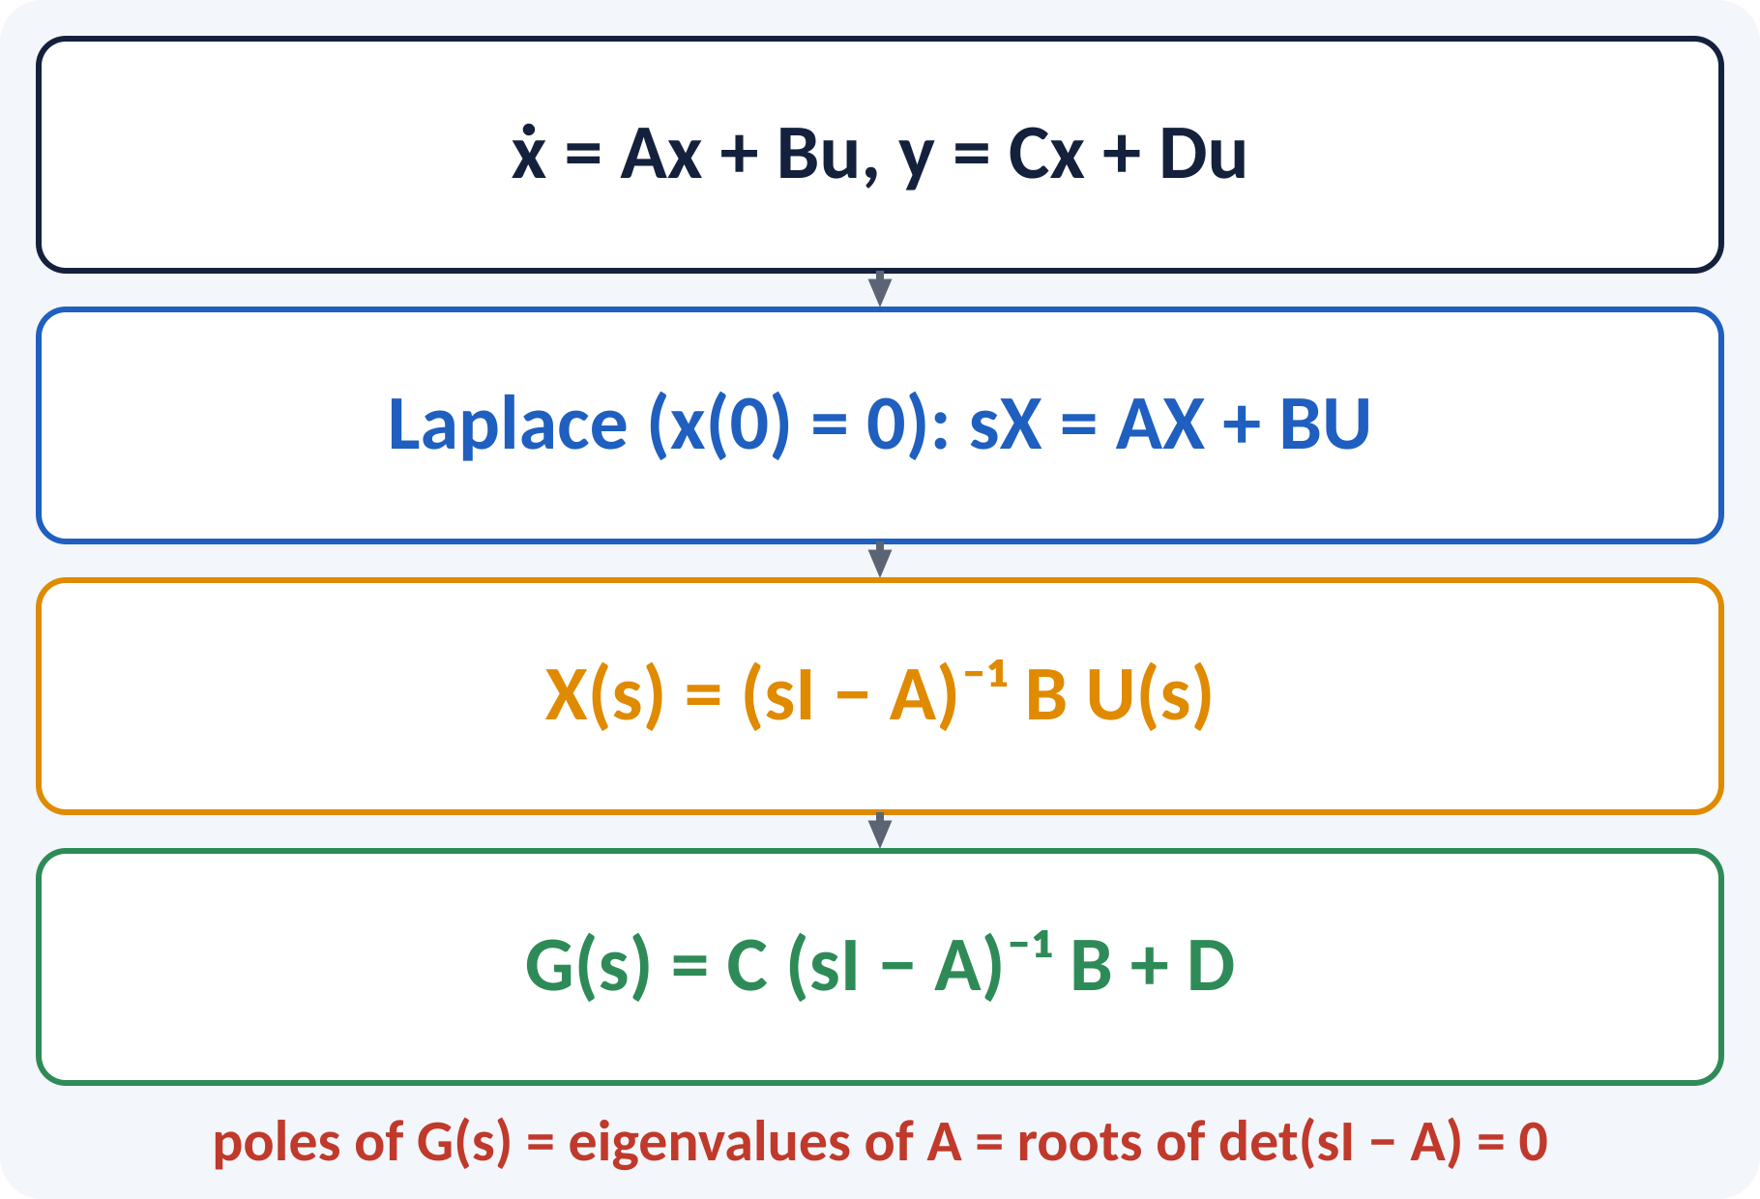
Recap: What You Already Know
An nth-order ODE needs n initial conditions.
Transfer function: input–output only.
Matrix multiplication and inverse.
Poles = roots of the characteristic equation.
Series RLC: L q″ + R q′ + q/C = v; M x″ + B x′ + K x = f
Notes:
We already know how to write the differential equation of an RLC circuit or a mass spring damper and convert it to a transfer function. The transfer function only describes the input-output behaviour with zero initial conditions. Today we keep the internal variables and write the same system as a set of first-order equations. Brush up matrix multiplication and the inverse of a two by two matrix.

Slide 4
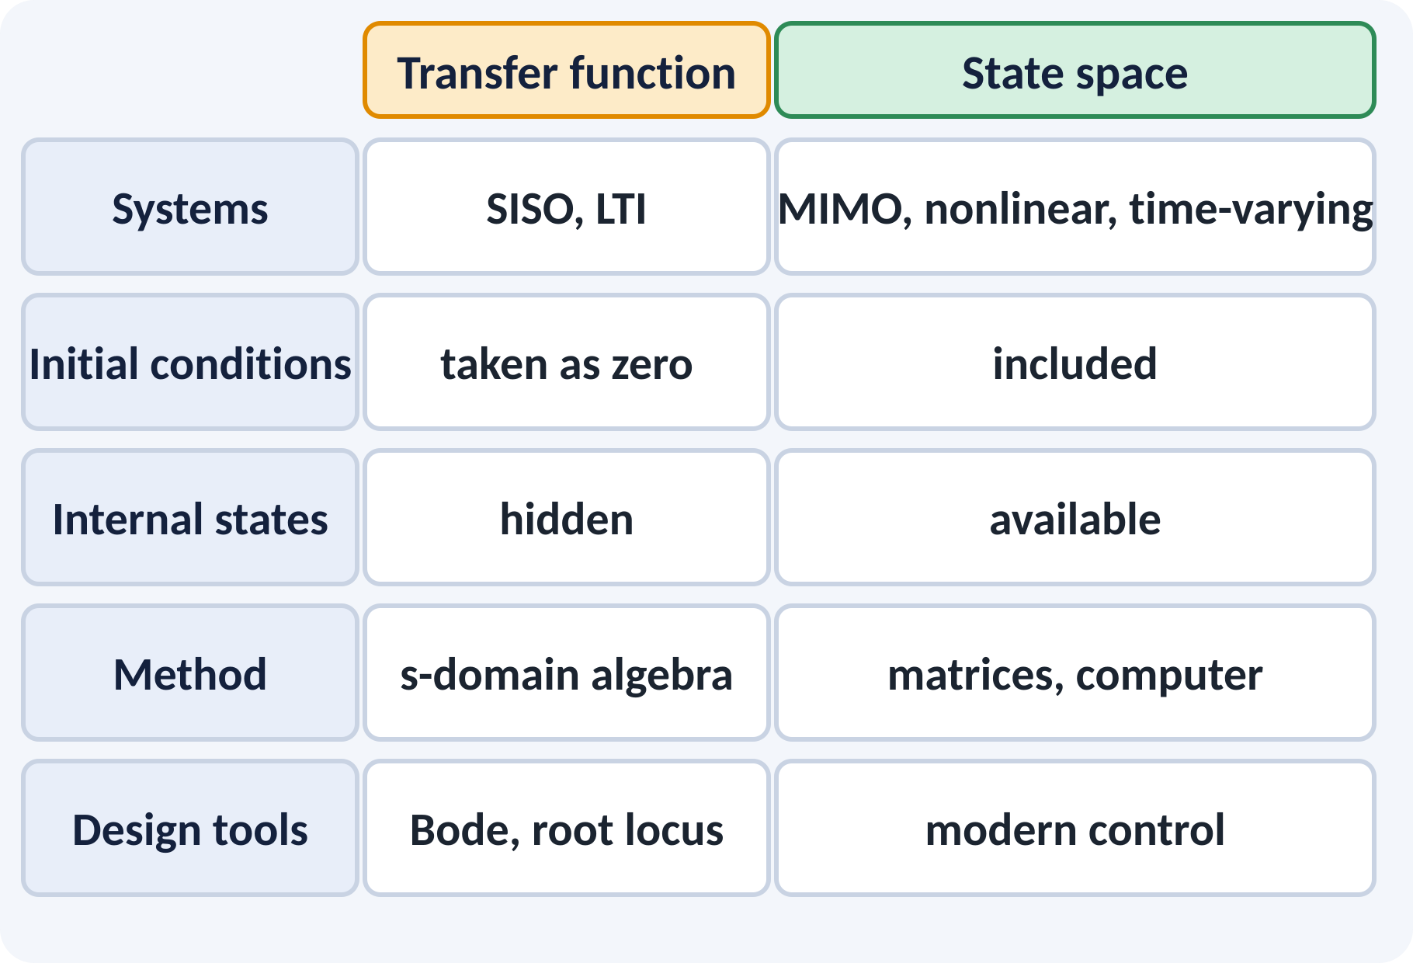
Motivation: Beyond the Transfer Function
Robots and aircraft have many inputs and outputs.
Nonlinear and time-varying systems.
Need to know internal quantities, e.g. current.
Computers solve first-order matrix equations easily.
State space = the language of modern control, simulation and estimation
Notes:
A quadcopter has four motors and many outputs, so a single transfer function is not enough. In state space we can also see what happens inside the system, such as the current in an inductor. Simulation software such as MATLAB and Simulink works on state equations. That is why modern control is built on this model.

Slide 5
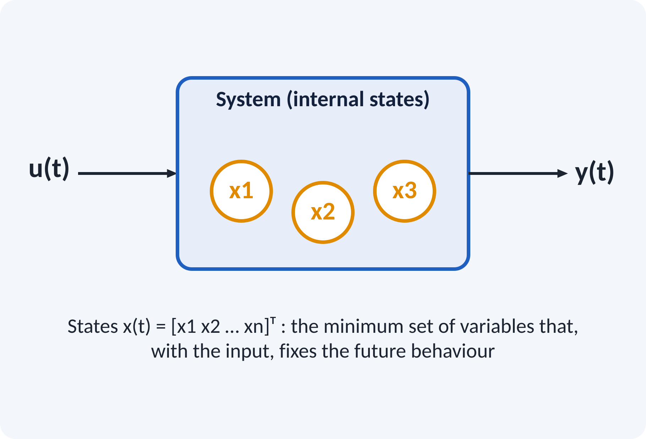
State, State Variables, State Space
State: the smallest set of variables describing the system.
State variables: x1, x2, …, xn.
State vector x(t): the column of states.
State space: the n-dimensional space of x.
Number of states = order of the system.
x(t) = [x1 x2 … xn]ᵀ, n = number of energy-storage elements
Notes:
The state of a system at any time is the minimum information needed to predict its future when the input is known. For physical systems the natural choices are the quantities that store energy, such as capacitor voltage, inductor current, position and velocity. The number of independent states equals the order of the differential equation.

Slide 6
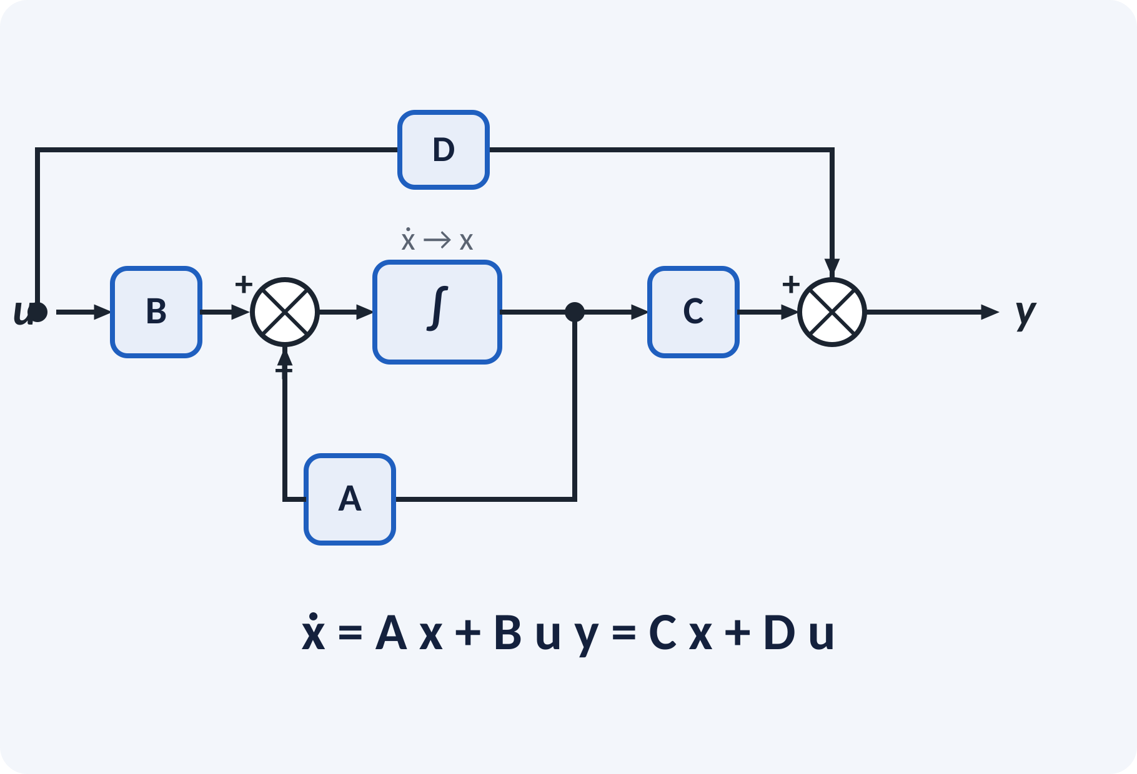
State Equations
State equation: ẋ = A x + B u.
Output equation: y = C x + D u.
A: system matrix (n × n).
B: input matrix; C: output matrix; D: feedthrough.
SISO: u and y are scalars.
ẋ = A x + B u; y = C x + D u
A n×n, B n×1, C 1×n, D 1×1 for a SISO system
Notes:
The state equation gives the derivative of every state as a combination of the states and the input. The output equation picks the output from the states. The block diagram shows an integrator per state, a feedback through A, and the paths B, C and D. For most physical systems D is zero.

Slide 7
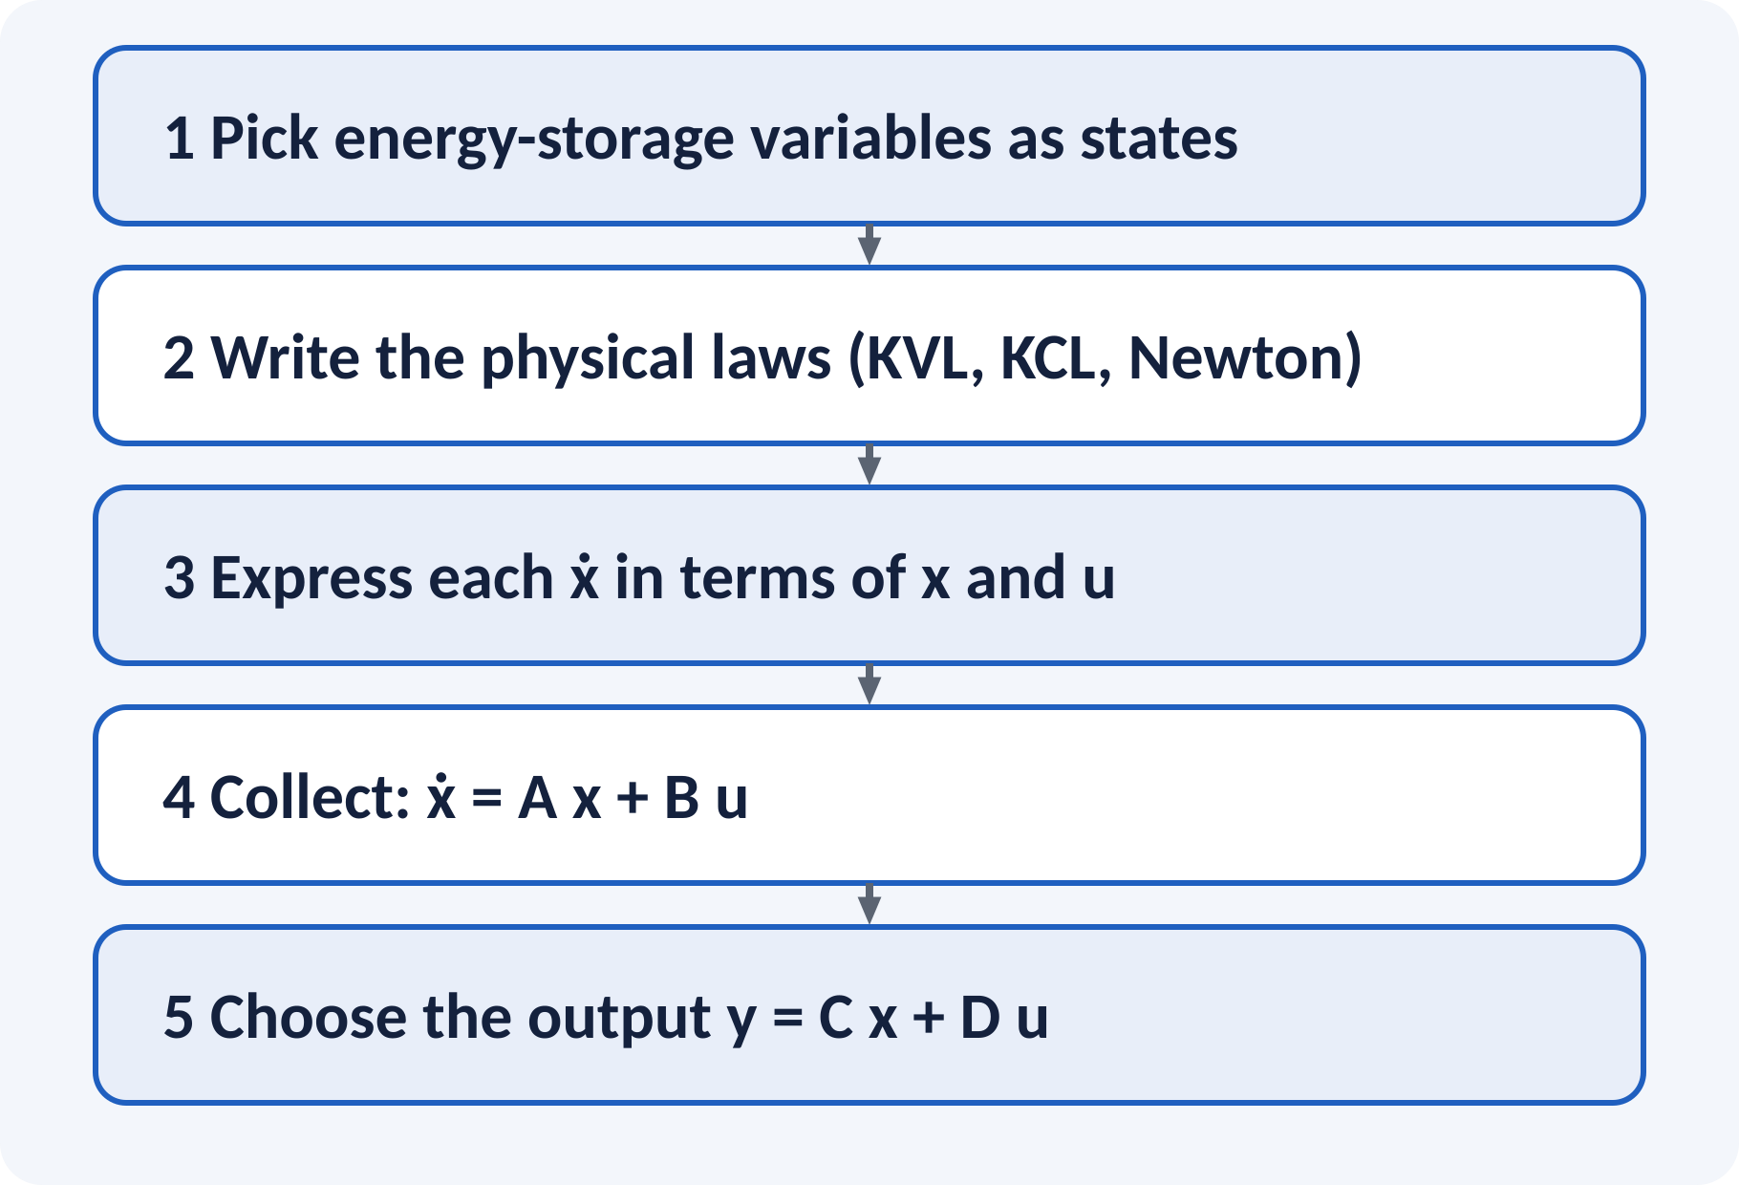
Physical Variable Approach
Choose physically meaningful states.
Energy-storage elements give the states.
Write the governing physical laws.
Rearrange into first-order form.
Read off the matrices.
Electrical: x = vC, iL; mechanical: x = position, velocity
Notes:
In the physical variable approach we pick states with a physical meaning. For a circuit these are capacitor voltages and inductor currents, for a mechanical system they are the position and velocity of each mass. Write the physical laws, solve each equation for the derivative of a state, and then arrange the coefficients into the matrices.

Slide 8
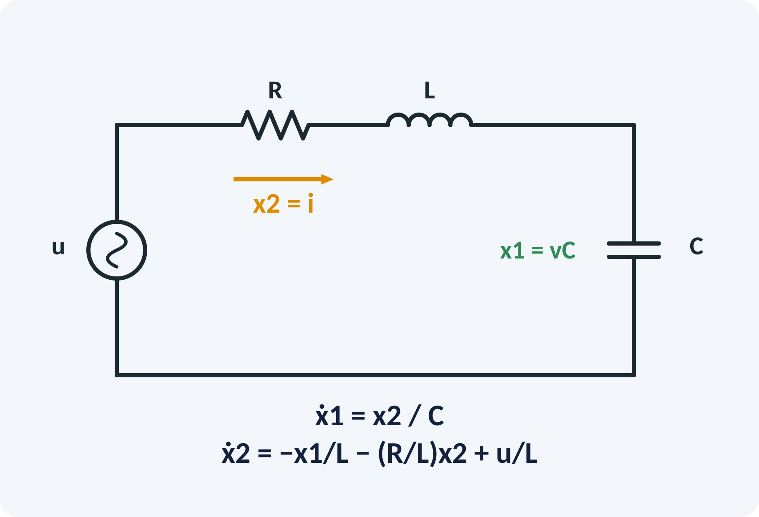
State Model of a Series RLC Circuit
States: x1 = vC, x2 = iL = i.
Capacitor: i = C·dvC/dt → ẋ1 = x2/C.
KVL: u = R i + L di/dt + vC.
Solve: ẋ2 = −x1/L − (R/L)x2 + u/L.
Output: y = vC = x1.
A = [[0, 1/C], [−1/L, −R/L]], B = [0, 1/L]ᵀ, C = [1 0]
Notes:
Choose capacitor voltage and inductor current as states. The capacitor equation gives the derivative of x1 directly. Kirchhoff's voltage law around the loop gives the derivative of the current. Writing the two equations in matrix form gives A, B and C. Notice that A has the circuit elements as entries.

Slide 9
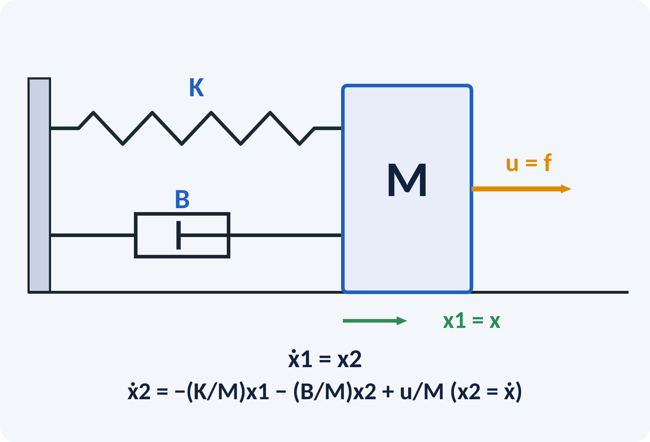
State Model of Mass–Spring–Damper
States: x1 = x (position), x2 = ẋ (velocity).
ẋ1 = x2 by definition.
Newton: M ẍ = u − B ẋ − K x.
Solve for ẋ2.
Output: y = x = x1.
A = [[0, 1], [−K/M, −B/M]], B = [0, 1/M]ᵀ, C = [1 0]
Notes:
For a mass spring damper the natural states are the position and the velocity. The first state equation is just the definition of velocity. Newton's second law gives the second one. The resulting A matrix has the same form as the RLC case: compare K over M with one over L C and B over M with R over L, which is the analogy again.

Slide 10
Advantages of State Space
Handles MIMO systems naturally.
Works for nonlinear and time-varying systems.
Includes initial conditions.
Gives access to every internal state.
Easy to simulate and design by computer.
Transfer function: external description; state space: internal description
Notes:
The transfer function describes only the relation between input and output. The state model includes initial conditions and gives all internal variables, which is needed for state feedback and observers. It also extends to multi-input multi-output, nonlinear and time-varying systems. The price is that we deal with matrices, so we usually use a computer.

Slide 11
From State Model to Transfer Function
Take the Laplace transform with x(0) = 0.
Solve for X(s).
Substitute into the output equation.
Poles of G(s) are the eigenvalues of A.
G(s) = C (sI − A)⁻¹ B + D; characteristic equation: det(sI − A) = 0
Notes:
Transform the state equation with zero initial state and solve for X of s using the inverse of s I minus A. Substitute into the output equation to get G of s. The denominator of G is the determinant of s I minus A, so the closed-form poles are the eigenvalues of A. This provides the link between the two descriptions.

Slide 12
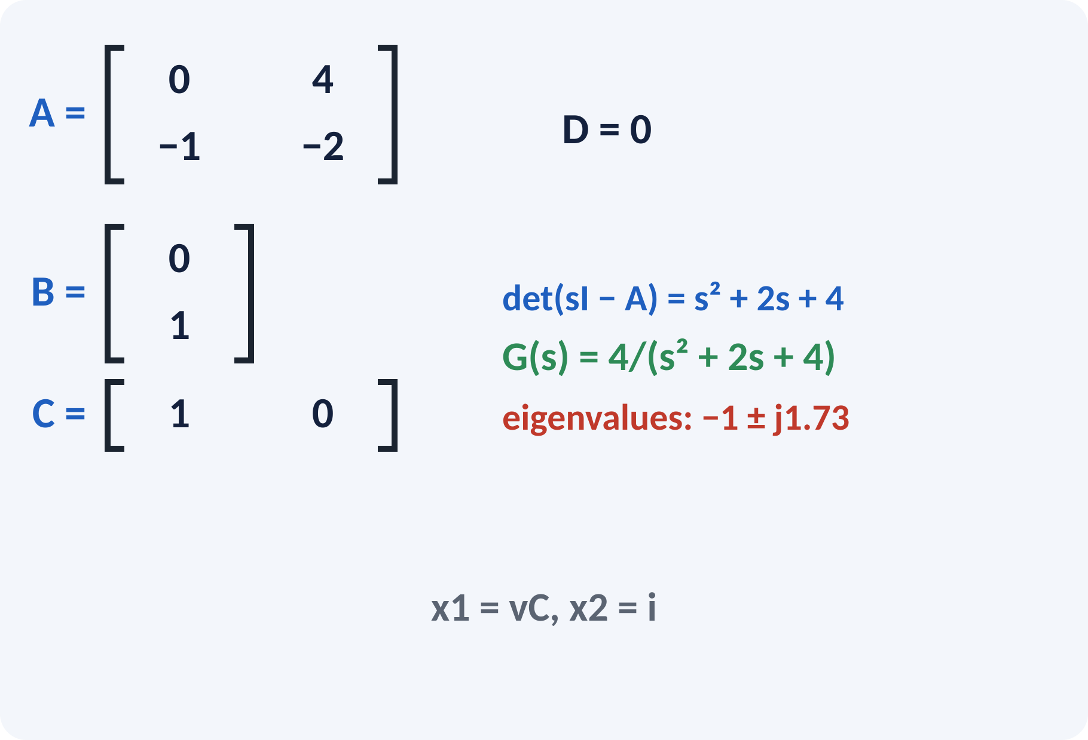
Solved Example 1: RLC State Model
R = 2 Ω, L = 1 H, C = 0.25 F; output vC. Find A, B, C and G(s).
1. x1 = vC, x2 = i: ẋ1 = 4x2, ẋ2 = −x1 − 2x2 + u.
2. A = [[0, 4], [−1, −2]], B = [0, 1]ᵀ, C = [1 0], D = 0.
3. sI − A = [[s, −4], [1, s + 2]], det = s² + 2s + 4.
4. (sI − A)⁻¹B = [4, s]ᵀ/det.
5. G(s) = C(sI − A)⁻¹B = 4/(s² + 2s + 4).
Answer: G(s) = 4/(s² + 2s + 4); eigenvalues −1 ± j1.73
Notes:
Substitute the component values into the general model. Then compute the determinant of s I minus A and the product with B. The first element of the result is the transfer function. It matches the transfer function derived in the first lecture of Unit 1, which confirms that the two descriptions agree. The eigenvalues are the poles.

Slide 13
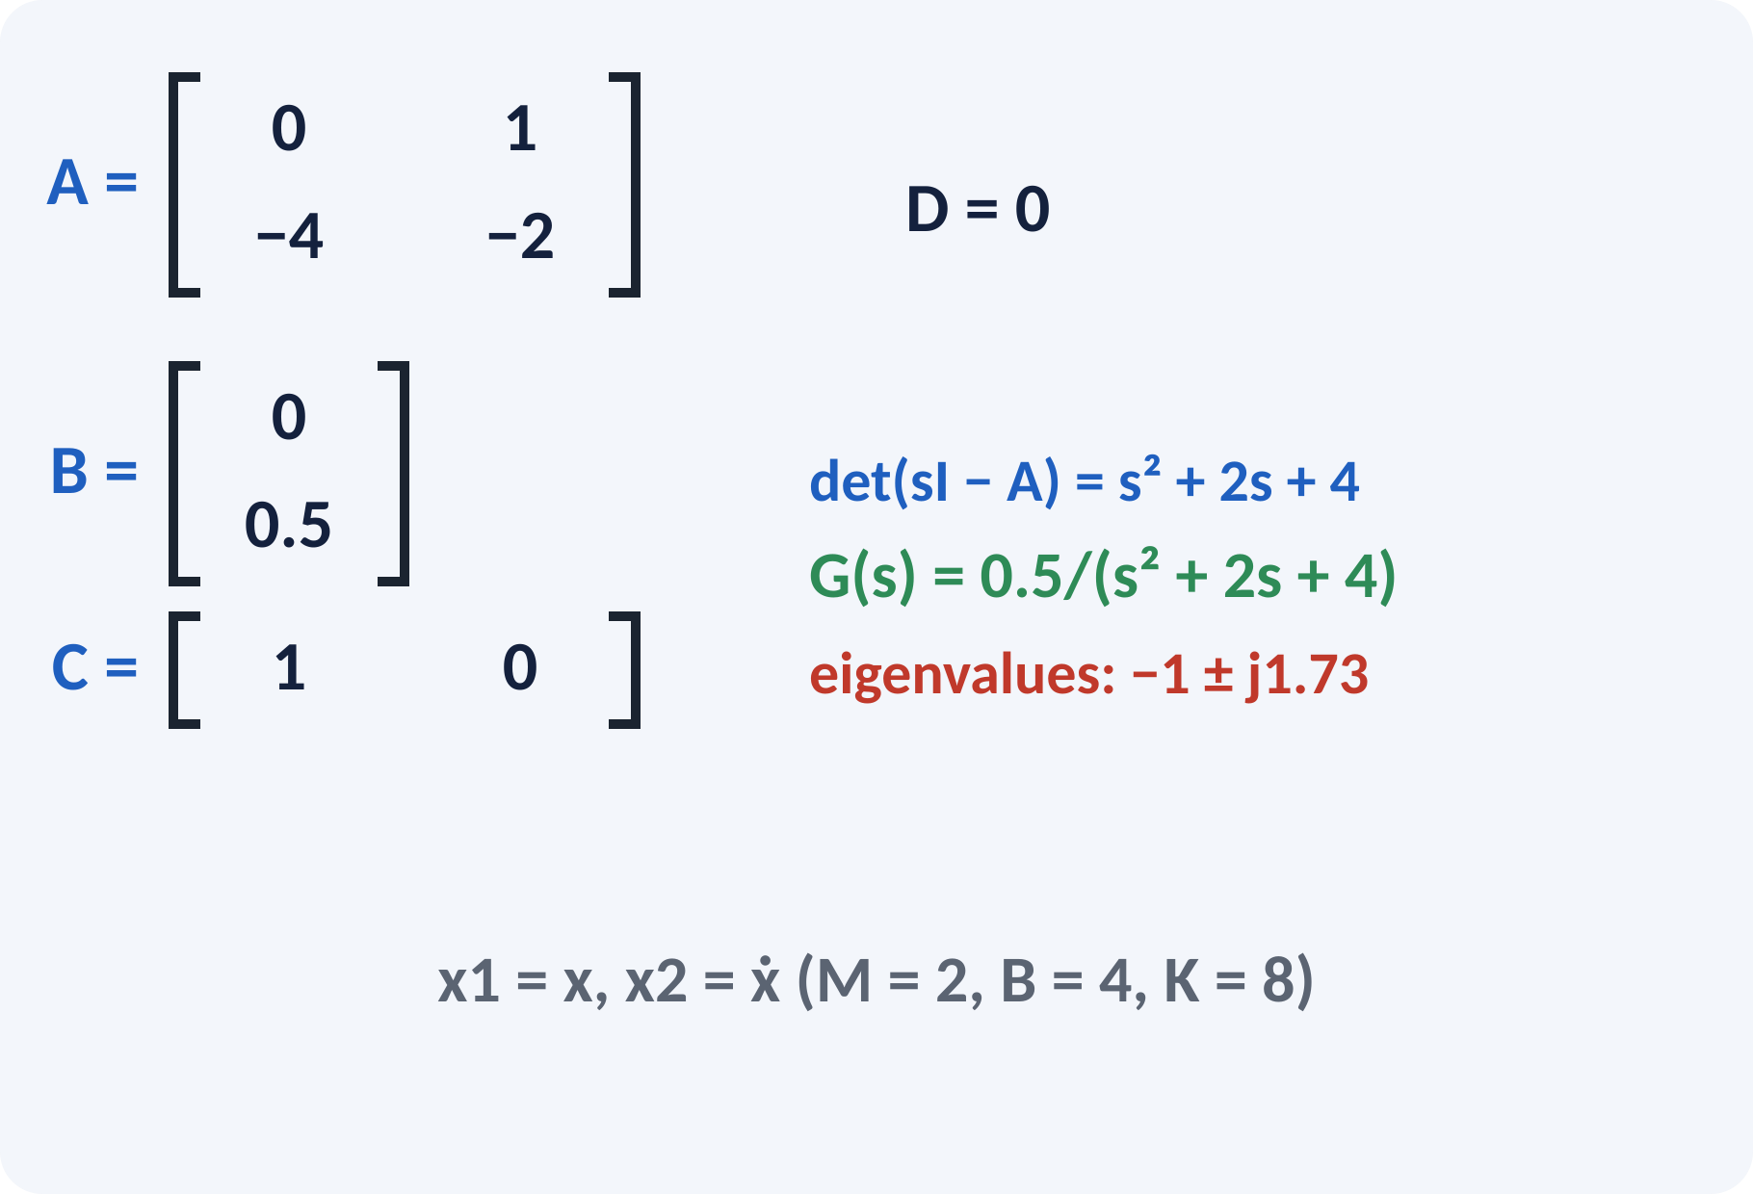
Solved Example 2: Mass–Spring–Damper
M = 2 kg, B = 4 N·s/m, K = 8 N/m; output x. Find the state model and G(s).
1. x1 = x, x2 = ẋ: ẋ1 = x2, ẋ2 = −4x1 − 2x2 + 0.5u.
2. A = [[0, 1], [−4, −2]], B = [0, 0.5]ᵀ, C = [1 0].
3. det(sI − A) = s² + 2s + 4.
4. G(s) = 0.5/(s² + 2s + 4) = 1/(2s² + 4s + 8).
5. Eigenvalues −1 ± j1.73 → ζ = 0.5, ωn = 2 rad/s.
Answer: G(s) = 1/(2s² + 4s + 8); same poles as the RLC system (analogy)
Notes:
Divide the force balance by M to get the second state equation. The transfer function agrees with the one from Unit 1: one over two s squared plus four s plus eight. The eigenvalues of A are the same as those of the RLC circuit in the previous example, because the two systems are analogues. This is a good check on your calculation.

Slide 14
Common Mistakes and Exam Tips
✕
Common mistakes
✓
Exam tips
Choosing too many or too few states.
Mixing up the order of rows in A.
Using initial conditions when finding G(s).
Forgetting the 1/M factor in B.
Confusing A (system matrix) with the open-loop transfer function.
Count the energy-storage elements.
Write ẋ1 = x2 first, then the second law.
Check G(s) against the transfer function method.
Check eigenvalues of A = poles of G(s).
Notes:
These are the points where marks are lost most often in state-space models. Give one quick example for each mistake. Remind students that writing the formula, substitution and the unit earns method marks even if the arithmetic slips. Encourage them to check the answer for reasonableness.

Slide 15
Summary
State vector x = minimum set describing the system.
ẋ = Ax + Bu; y = Cx + Du.
Physical approach: use energy-storage variables.
G(s) = C(sI − A)⁻¹B + D; poles = eigenvalues of A.
State space handles MIMO and nonlinear systems.
Number of states = order of the system = number of storage elements
Notes:
Recap in one minute. Say each point and ask the class to recall the formula for it. If they remember these ideas, most numerical problems on state-space models are within reach. Next lecture: revision of Unit 5 and course. Revise the two solved examples tonight.

Slide 16
Quick Quiz
Q1. Number of state variables of a series RLC circuit:
(a) 1 (b) 2 (c) 3 (d) 4
Ans: (b)
Q2. In ẋ = Ax + Bu, matrix A is:
(a) input matrix (b) output matrix (c) system matrix (d) feedthrough
Ans: (c)
Q3. Poles of G(s) equal:
(a) eigenvalues of A (b) elements of B (c) rows of C (d) D
Ans: (a)
Q4. States chosen for a mass–spring–damper:
(a) force and mass (b) position and velocity (c) K and B (d) energy only
Ans: (b)
Q5. A main advantage of state space:
(a) only SISO (b) handles MIMO and initial conditions (c) needs no matrices (d) only linear
Ans: (b)
Notes:
Give about one minute per question and take a show of hands. Discuss why the wrong options are tempting, especially the one that uses a wrong formula. Use the quiz as a quick check on state-space models before leaving.

Slide 17
References
1
Benjamin C. Kuo, Automatic Control Systems
7th Ed., PHI, 2007 (Units 3, 4, 5 textbook)
2
J. J. D'Azzo and C. H. Houpis, Feedback Control System Analysis and Synthesis
4th Ed., McGraw Hill International, 1999 (reference, Unit 5)
3
M. Gopal, Control Systems Principles and Design
4th Ed., TMH, 1999 (reference, Units 4, 5)
Next lecture: course revision
Notes:
Point students to the textbooks listed in the syllabus for state-space models. Ask them to solve at least three textbook problems on this topic before the next class. Thank the class and preview the next lecture.

